Slide 1
News from the ISOLDE group and
Collaboration Matters
7th of November, 2017
Gerda Neyens

Slide 2

Associates & Corresponding Associates & staff
Associates
  Andrei Andreyev (April 2017 – March 2018)
  Joachim Cederkall (October 2017 – September 2018)
  No new request on this call
Corresponding Associates
  Excellent candidate for next year (May – September)
Staff members:
  Magda Kowlaska (Oct 2015 – Sep 2018) ERC betaDropNMR
  Stephan Malbrunot-Ettenbauer (Feb 2017-Jan2021) ERC MIRACLS
ISOLDE User Support:
  Jennifer Weterings (2002 - )

Slide 3
Fellows
Research Fellows:
    Liam Gaffney (Oct 2016 – Sep 2019 - COFUND) Miniball
    Vladimir Manea (Jan2016 – April 2018) ISOLTRAP
    Hanne Heylen (Oct 2017 – sept 2020 – COFUND) COLLAPS-VITO
    Outstanding candidates for this round – 3 recommended
Applied Fellows:
    Andree Welker (August 2017 – July 2019, CERN applied Fellow)
    HIFI spectrometer / WIZARD
    Lina Pallada (April 2017 – May 2019, ERC Magda, BetaDROPNMR)
    Frank Wienholtz (Jan2016 – Dec 2017, ENSAR2) MR-TOF-MS for ISOLDE
      Requested 1 year extension
    excellent candidate for ERC-MIRACLS
    And many others paid by their home institution.

Slide 4
Doctoral Students
      CERN Doctoral Student – open position starting February 2018 !
        Financed by CERN
        Needs a University Doctoral School registration
        Good candidates are welcome !
      Rob Harding (September 2015 – December 2018 )
      CERN Doctoral student + York University (50/50 ERC Betadrop) VITO
      Fredrik Pantefjord Gustafson (July 2017 – October 2020) VITO/CRIS
      CERN doctoral student + Leuven University (50/50 ERC Betadrop)
      Jonas Karthein (November 2017 – October 2020) ISOLTRAP
      CERN doc. stud. via Gentner Doctoral Program (Germany) - MPIK Heidelberg
      And many others paid by their home institution (+ eventual subsistence from the collaboration).

Slide 5
AGATA at ISOLDE
The AGATA collaboration requested bits for AGATA to the different large scale facilities for the period 2021-2030. Deadline September 30, 2017.
The idea of AGATA@ISOLDE had been presented to the miniball collaboration in May this year. After discussions with the Miniball spokesperson, some AGATA members and ISOLDE members, a conditional bit has been submitted.
Conditions:
  The ISCC should be informed. Peter Reiter will present the motivation for bringing AGATA to ISOLDE in ISCC meeting of February 2018.
  The physics case and added value to the ISOLDE physics program has to be clarified (what can AGATA do more/better than Miniball)
  The necessary fundings to install and run the machine during the foreseen period of 3-4 years will have to be secured (shared by ISOLDE and AGATA collaborations).
  Little to no funding for investment in ‘logistics’ is available till 2023 at ISOLDE
  A solution has to be found for the more than 400 shifts of baglog on HIE-ISOLDE (mostly Miniball).
  Two periods were proposed: 2021-2023 or after LS3 (~2026 onwards).

Slide 6
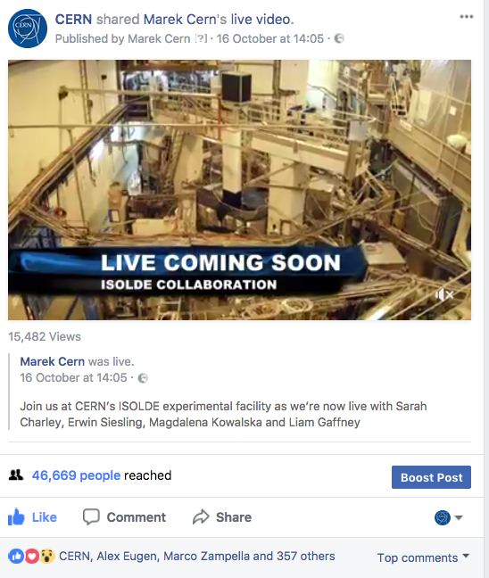
50 years of radioactive beams at ISOLDE
Meet ISOLDE Facebook Live
Some technical issue → the video was streamed from a colleague’s personal account instead of through CERN. This meant people didn’t receive the notification CERN was going live and significantly reduced our viewing numbers.
Despite this, we had a fantastic rate of engagement.
The video itself reached 46,669 people.
The shared video in the CERN post was watched 12,191 times (for at least three seconds). In total, the video was watched 15,482 times.
The number of unique users (distinct people who viewed the shared video in CERN post at least once) reached 11,868 people.

Slide 7
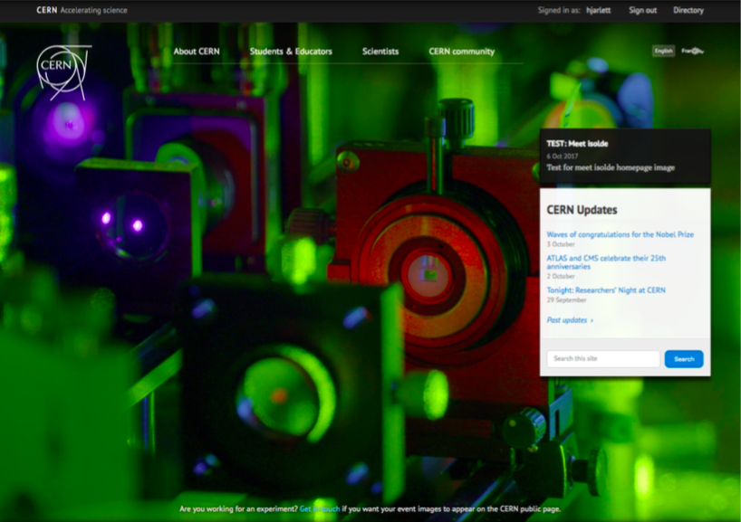
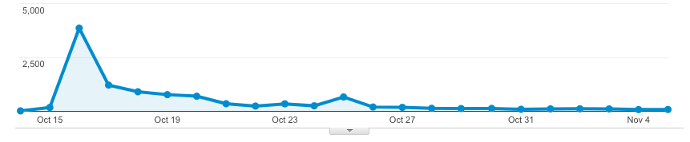
50 years of radioactive beams at ISOLDE
Meet ISOLDE Articles and Video’s
On CERN front page on October 16, 2017
Promote one video per week on main page in next weeks
  Gives a peak-view after week 2
  Now week 3 announcement
More than 12000 views of the video’s
Almost 10.000 views of the articles series
Articles with over 2000 views are considered a success – History article is now at > 2000, others are still below.
Peoples stayed more than 5 min. (typically it is 3 min.)

Slide 8
EMIS 2018
Chair: Richard Catherall, co-chair G. Neyens
AT CERN – September 16 – 21, 2018
Invited speakers have been selected – to be invited this week
150 rooms have been blocked in the hostel
Main auditorium has been booked
Globe is booked for welcome reception on Sunday and for public lecture on Tuesday
Excursions are decided (Annecy with guided tour + Olympic Museum at Lauzanne – both followed by wine tasting in Geneva area).
Dinner on the boat
Website on-line January 2018

Slide 9
ENSAR 2
MANAGEMENT GROUP
Coordinator: Muhsin N. Harakeh
Deputy Coordinator: Marek Lewitowicz
Manager: Ketel Turzó
Financial Officer: Veronique Vandevoorde
Administrative Officer: Sandrine Dubromel
First reporting period: March 2016 – August 2017
Meetings in GANIL 10-12 October:
  FCG (Facility Coordination Group) – representatives/directors of TA laboratories and their PAC chair (10+10)
  PCC (Project Coordination Committee) – work package leaders of TA’s, NA’s and JRA’s (representing the coordinators of each of those)
    TA: G. Neyens – A. Jokinen
    NA: A. Gadea – O. Tengblad
    JRA: S. Lenzi – C. Scheidenberger
  GA (General Assembly) – all – APPROVAL OF FINANCIAL AND SCIENTIFIC REPORTS

Slide 10
ENSAR 2
TA funding FOR USERS FROM OUTSIDE EUROPE based on ‘EXCHANGE AGREEMENT’
up to 20% of the total ENSAR2 for transnational access (TA)
cover local expenses only and to work BI-directionally (EU researcher going abroad, NON-EU researchers coming to EU).
ONLY for members of non-European institutes/facilities that signed the exchange agreement
JAPAN: o RCNP Osaka;
o RIKEN Tokyo;
o KEK@RIKEN;
o CNS@RIKEN;
Please note that in the case of Experiments with facilities of KEK@RIKEN and CNS@RIKEN, RIKEN will not pay local costs and this is the reason that separate MoUs are needed.
CHINA: o IMP-CAS Lanzhou;
SOUTH AFRICA: o iThemba Cape Town
RUSSIA: o JINR Dubna
UNITED STATES: o NSCL East Lansing
No interest: TRIUMF Vancouver; No response: ANL and Indian laboratories.

Slide 11
Cern OPEN ACCESS PUBLICATION
Ongoing discussion: how make sure all ISOLDE publications are published with open access (cost)
Step 1: put preprints on the Cern Document Server (CDS) with info on the journal (and reprint if permitted)
(Cern inventory of all publications – compare output from SME experiments ! – future …)
Also PhD theses related to ISOLDE experiments on CDS

Slide 12
Feedback from EP-retrait
LONG-TERM FUTURE OF NON-LHC EXPERIMENTS:
  ISOLDE WILL CONTINUE WITH +/- SIMILAR SUPPORT
  SYNERGIES BETWEEN AD AND ISOLDE COULD BE IDENTIFIED

