Slide 1
YETS 2017-18 AD RING
AD Technical Coordination Meeting #2
2017-11-09
Aymeric BOUVARD
EN-EA-EC

Slide 2
YETS 2017-2018
From 18 dec 2017 to 30 march 2018
The access point will be in "general" mode during the entire shutdown with free access by the emergency exits.
An exception will be made at dangerous interventions requiring limited access to persons qualified for this work. During these periods, access control through impact will be awarded based.
All material out of the Ring will be stored in Buffer Zone and a TREC Request will be done for control by the owner.
Each owner of equipment will be in charge of performing the EDH transport and handling referring to their equipment.
The visits will be subject to restrictions under the current work.

Slide 3
YETS AD Ring
Work Request
MSC
  Refurbishment of 3 Magnets: BHS52, QDN55, QFN56.
  Storage of the shielding blocs in AD Hall.
    BHS52:
      18 blocks 24168
      2 ventilation modules
      Removal of the quadrupole QFW52 Not necessary
      Cutting of the vacuum chamber in AD Hall before transfer to the b.867. This intervention will be supervised by RP and EN-EA.
    QDN55
      4 shielding blocks 24168
    QFN56
      6 concrete beams
    The exposed magnets, near ELENA should be removed in another place in the AD Hall. Probably on the shielding in front of ASCUSA and ALPHA experimental areas.
TE/ABT
  Replacement of the Septum SME5305/07. Postponed
  BCCC
  Installation of new controlled flow valve and insulation vacuum valve

Slide 4
YETS AD Ring
Work Request
BI
  General maintenance of the E.Cooler.
  General maintenance BTV
  Kickers:
  General maintenance + Test
CV:
  Removal of ventilation modules (BHS52)
  Maintenance of demineralized water
  Water maintenance
  RP:
  Source Test:
    PMIA604
    PAXA604
    PAXT113
  EL:
  AUG Test
VSC
  Disconnection and reconnection: BHS52, QDN55, QFN56, SME5305/07
  Works and Maintenance:
    Sector 1A
    Sector 1B
    Sector 2A
    Sector 2B
    Sector 3
    Sector 4
    DE Experimental Lines
  Bakeout Sector 1 (BHS52, QDN55, QFN56, SME5305/07)
  Bakeout Sector 2A (SHV1305)
  SU
  Alignment: BHS52, QDN55, QFN56, SME5305/07
  STI
  Replacement of the scraper SHV1305 (sector2)
  RF
    Maintenance + Test ADC02 and ADC10

Slide 5
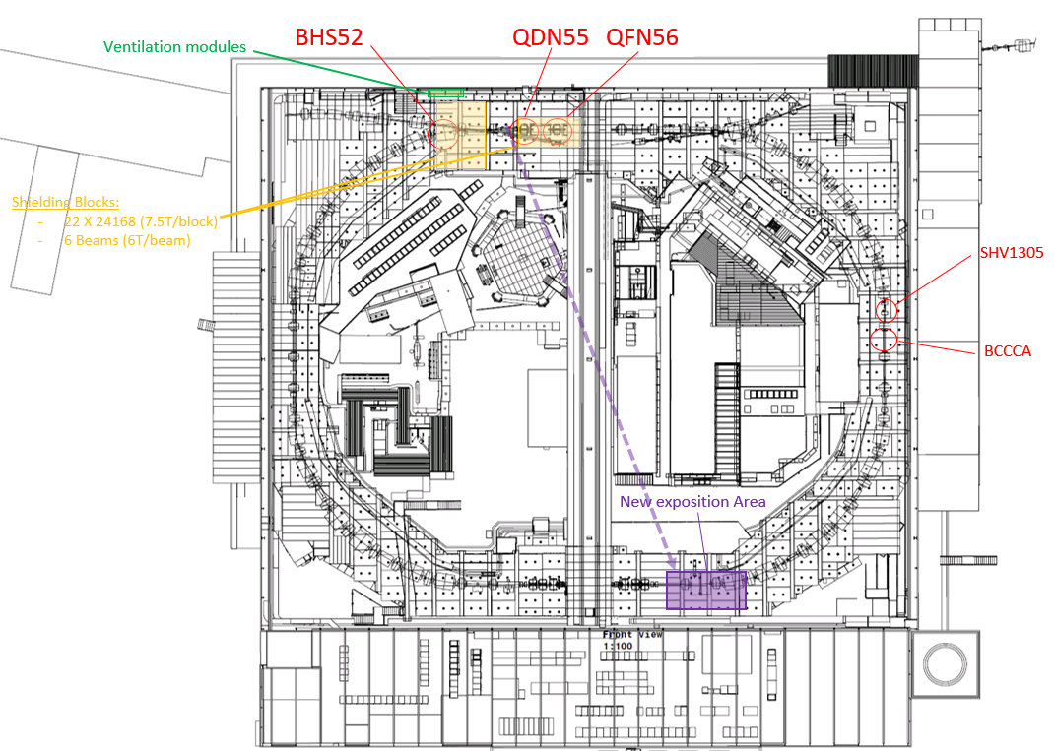

Slide 6
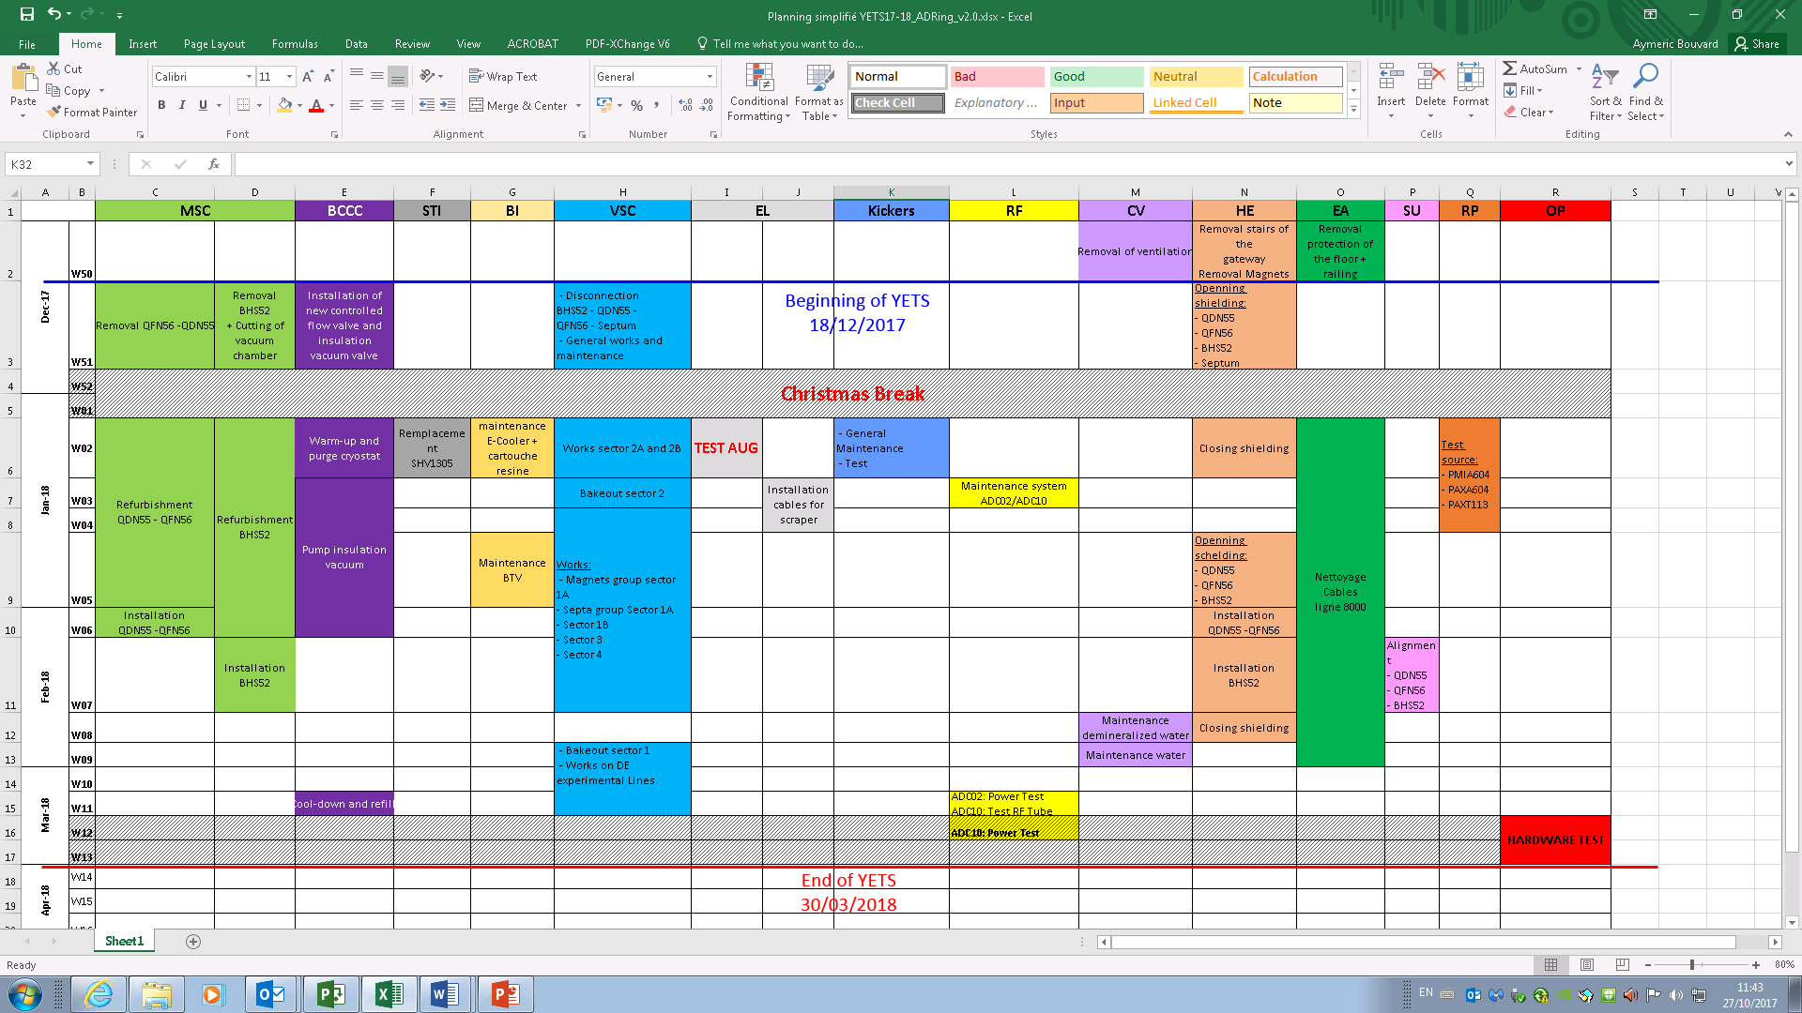
Planning
The end of the YETS has been moved at the 30 March 2018.
Maintenance of the demineralized water and all bakeout will be able done before the Hardware test.

Slide 7
Planning
ADC10 Test will be done during the Hardware test

Slide 8
Thank You

