Slide 1
AD Target YETS and LS2 Works
E. Grenier-Boley
M. Calviani, C. Torregrosa, S. de Man, R. Franqueira Ximenes
9th November 2017

Slide 2
YETS 2017-2018 Period
February 6th
Survey RP
Access
Area closing March 16th

Slide 3
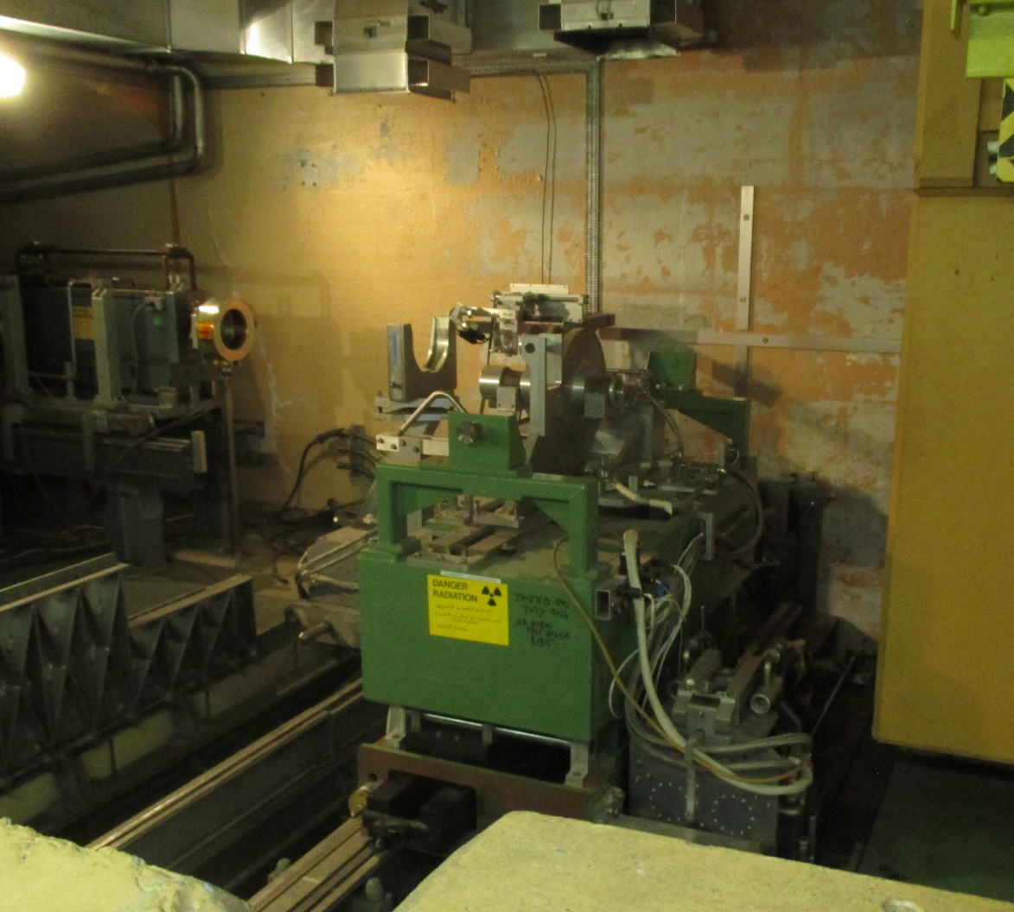
YETS & need
Consignation de la Corne TE-ABT – Gregor Grawer
Survey RP (HSE-RP-AS) -> 6 Février -> Gerald Dumont
Maintenance Mécanique zone cible (EN-STI-TCD) – AD coordination
TETRA Level measurements (IT-CS-TR) – Katarzyna Maria Dyga
RIA à contrôler : Patrick Berlinguy 163699
Telecom Visit (IT-CS-TR) -> Giosue Zambon
Cable Obsolet (EN-STI) -> Jerome Lendaro
DogLeg stripline inspection (EN-STI) -> Aurelio de Macedo
Maintenance PR-207 bat 232 (EN-HE-HM) -> Gilles Roche
Maintenance Evacuation (BE-ICS-AS) -> Pierre Durand
Maintenance Détection Incendie (BE-ICS-AS) -> Pierre Durand
Measure for new design (EN-STI for MME) – AD coordination
AD Target - Closed - Test Access Safety February 28th – Didier Chapuis.
TT6 Inspection – changement filtre 196 et station hors gel – EN-CV Nicolas Roget
Need during YETS
  RP Technician for operation on target area
  Survey – Horn movement
  Horn and magnet consignation and restart.

Slide 4
LS2 Works
09th November 2017

Slide 5
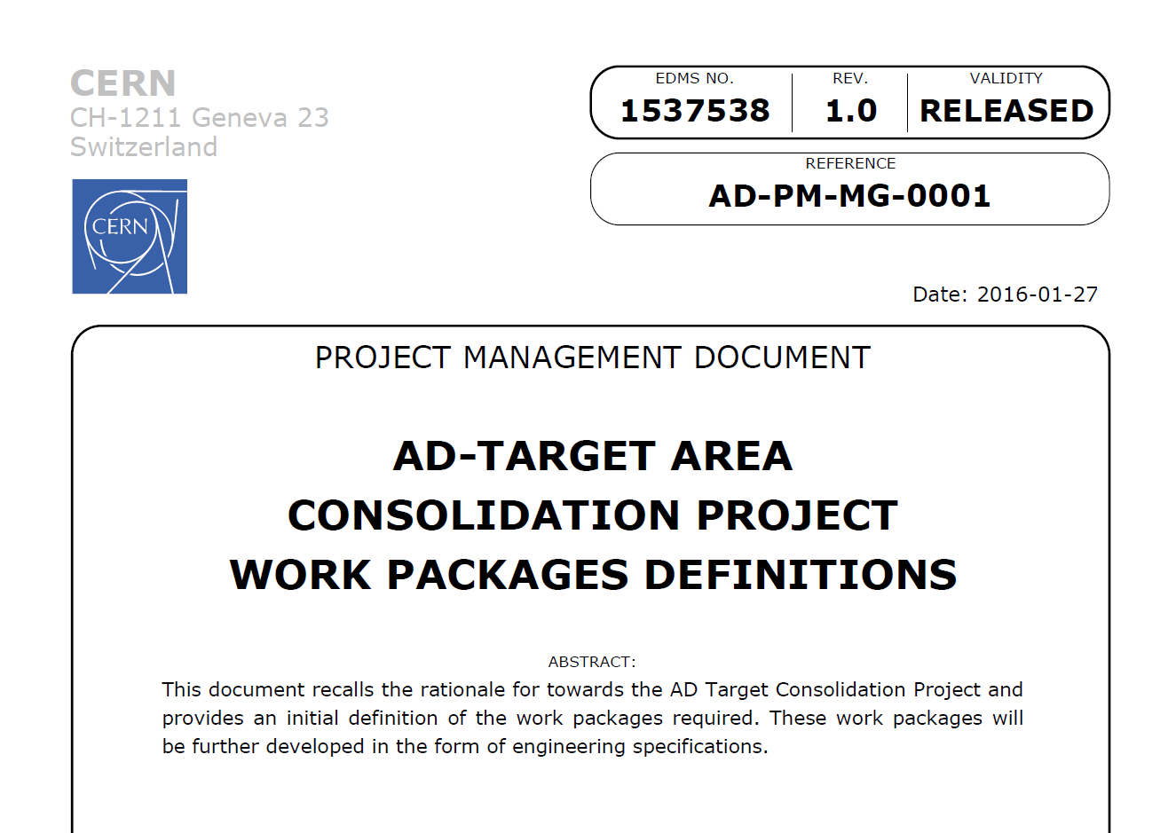
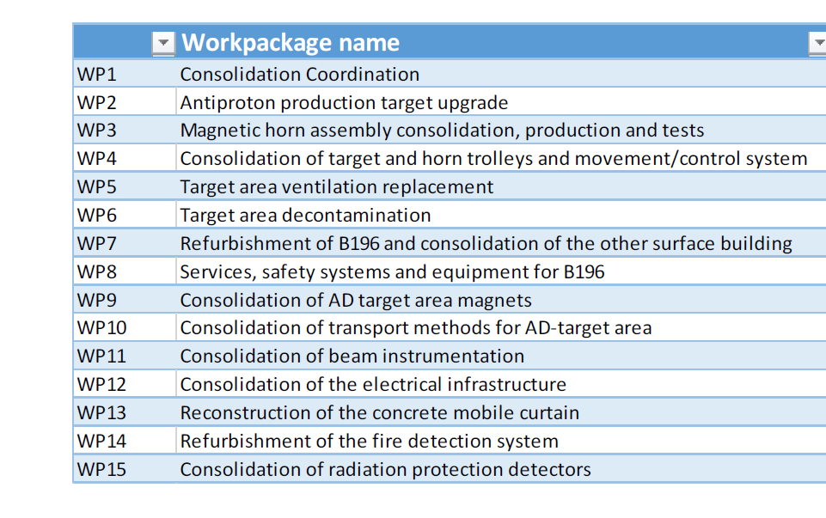
Activities
Initially defined within 15 work packages in the document:
“AD-TARGET AREA CONSOLIDATION PROJECT WORK PACKAGES DEFINITIONS”
https://edms.cern.ch/document/1537538/1.0
Now it has bit a re-arranged…

Slide 6
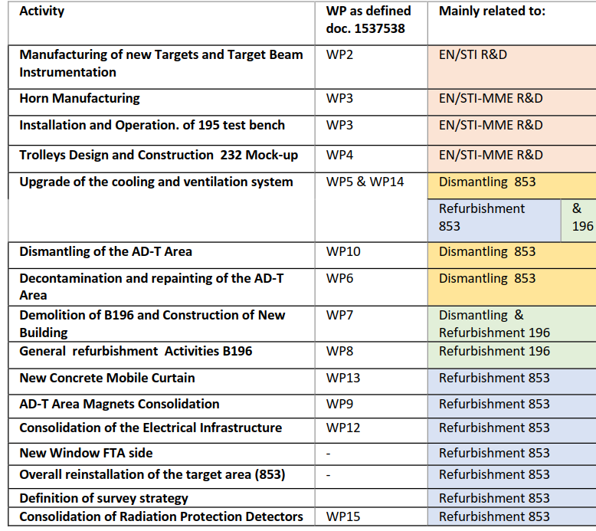
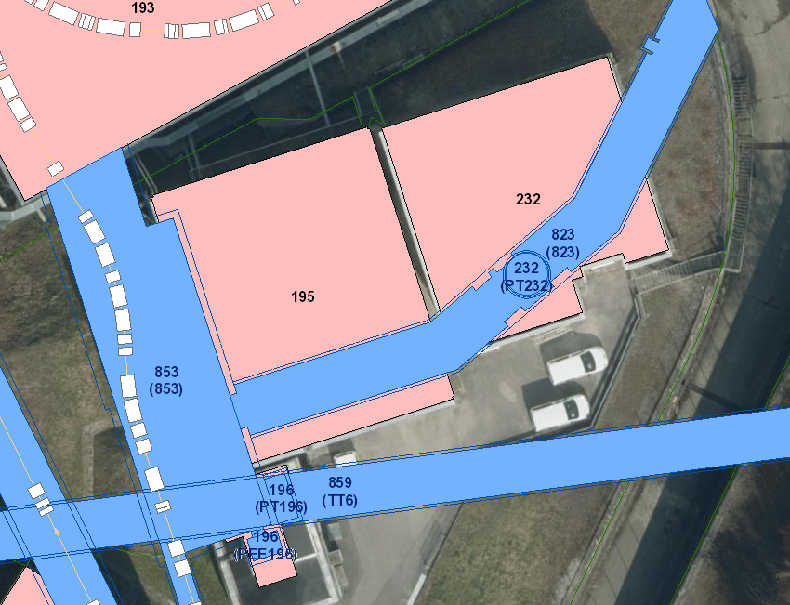
1)
https://edms.cern.ch/panoramas#id=36410861&lon=0.00&lat=0.00&fov=90.00
2)
3)
4)
5)
6)
7)
8)
9)
10)
11)
12)
13)
14)
15)
16)

Slide 7
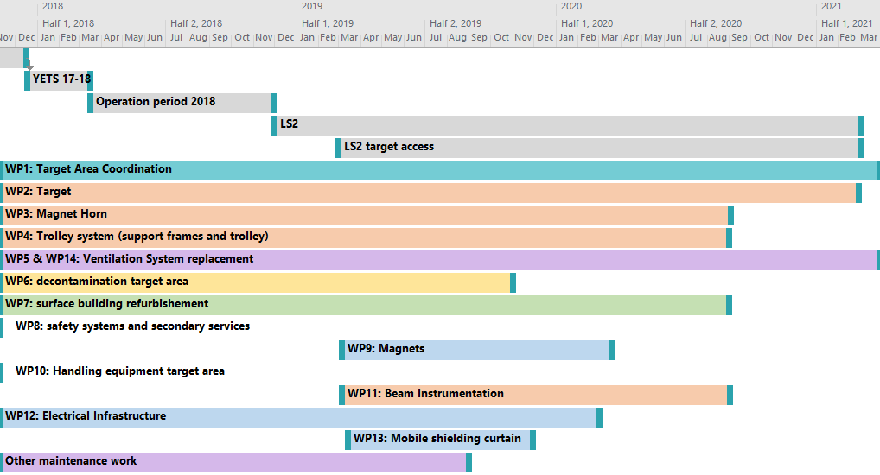
Main Schedule
Status STI side
  Horn test bench complete for end of November
  AD target trolley under study (EN-MME)

Slide 8
People Involved
EN-CV: A. Broche, H. Sabre, M. Battistin
SMB-SE: E. Perez Dueñas, R. Fernandez Ortega, F. Magnin
EN-HE: J.L Grenard, C. Bertone
EN-EA: A. Bouvard, V. Clerc
EN-EL: M. Szewczyk
TE-VSC: A. Sinturel, J. Somoza
HSE-RP: C. Theis, J.F. Gruber
EN-ACE-SU: T. Dobers
TE-MSC: A. Newborough, Thonet
TE-ABT: G. Grawer, E. Carlier
HSE-SEE: A. Henriques
BE-ICS: D. Chapuis, D. Raffourt
BE-BI: T. Lefevre, S. Burger
BE-OP: B. Lefort, T. Eriksson
EN-MEE: M. Timmins, R. Ferriere
EN-STI: M. Calviani, E. Grenier-Boley, S. de Man, M. Butcher, T. Feniet, J. Lendaro, A. De Macedo, K. Kershaw, C. Torregrosa

Slide 9
Need during LS2 (AD target area)
During dismantling and decontamination phase. Big work, lot of waste
  HSE-RP – Support in area, Waste, temporary storage
  EN-HE – Handling & transport
  EN-ACE – Survey reference
  TE-MSC – Magnets dog leg and permanents magnets in FTA
  TE-VSC – Demontage Chambre à vide
  EN-EA – Decontamination package
Moke-up test in bulding 232.
  EN-HE – Handling & transport (removal of hold one and installation)
  EN-ACE – Survey
New Area.
  EN-HE – Handling transport & renovation mobile shielding
  EN-ACE – Survey reference
  HSE-RP – Support
  TE-VSC – Change of the new FTA windows
  TE-MSC – Magnets dog leg and permanents magnets in FTA
  TE-VSC – Remontage Chambre à vide

Slide 10
Thanks for your attention

