Slide 1

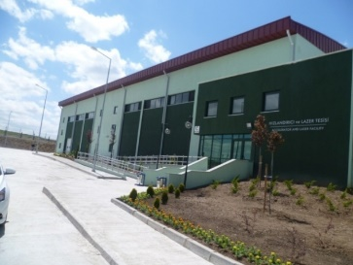
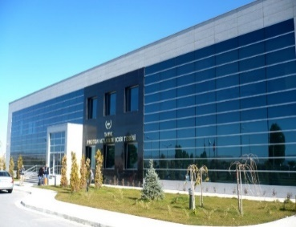
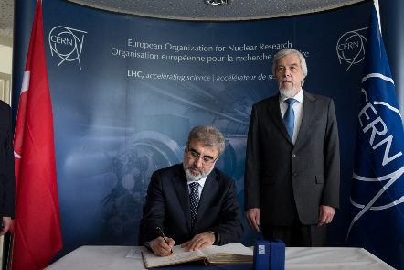
October 6-7, 2017
Boğaziçi & Bilgi Universities
ISTANBUL
Restricted ECFA Meeting
Accelerator R&D in Turkey
National Projects & International Collaborations
Prof. Dr. Ömer Yavaş
Ankara University
Dept. of Eng. Physics & Institute of Accelerator Technologies yavas@ankara.edu.tr

Slide 2
Outline
A summary on the status of accelerator R&D in Turkey
National Accelerator Projects & Facilities
  Turkish Accelerator Center (TAC) Project & TARLA Facility
  Turkish Atomic Energy Authority’s (TAEK) Facilities and Projects
  Ongoing Accelerator R&D Projects in Universities
International Memberships and Collaborations
  International memberships
  International collaborations
Conclusions
2

Slide 3
A summary on the status of accelerator R&D in Turkey
Turkish Accelerator Center (TAC) Project and TARLA Facility
TAEK Proton Accelerator Facility & SPP Project
Accelerator related R&D projects in universities
Medical linacs for therapy (>225)
Baby Cyclotrons for medical pharmaceuticals (>10)
Industrial Accelerators (>5)
Membership of SESAME (since 2000)
Associate membership of CERN (since 2015)
3

Slide 4
Turkish Acccelerator Center (TAC) Project
http://thm.ankara.edu.tr (TR) http://tac.ankara.edu.tr (EN)
Today’s Turkey, at the threshold of the European Union membership, is committed to have world-class research facilities, and Turkish Accelerator Center (TAC) is going on to be yet another example of this commitment.
Mission of TAC Collaboration:
To design, construct and use of high energy particle accelerators for scientific research and technological development in basic and applied sciences in Turkey and the region.
To form a national accelerator community and a national industrial production base in accelerator technologies.
To collaborate with international accelerator community.
4

Slide 5
Phases of the TAC Project
First Phase:
Feasibility Study (1997-2001) by support of State Planing Organization (SPO)
Outcome: Turkish Accelerator Center (TAC) is proposed and main road map is defined.
  Report:
  http://www.tarla.org.tr/thm/tac/YUUP/TacFizibilite.pdf
  Second Phase:
  General Desing Study (2002-2005) by support of SPO (Ministry of Development since 2011)
Outcome : General/Conceptual Design Report published and main parameters, types, and research potentials of proposed TAC facilities are explained.
Reports:
http://www.tarla.org.tr/thm/tac/YUUP/TAC_Tasarim.pdf
http://www.tarla.org.tr/thm/tac/YUUP/TacIsinimKaynaklariCDR.pdf
5

Slide 6
Phases of the TAC Project
  Third Phase:
Technical Design Study and First Facility by support of Ministry of Development (2006-2016)
TAC collaboration is established as an inter-university (14 Universities) collaboration under the coordination of Ankara University
Outcome :
  - Institute: Institute of Accelerator Technologies (IAT) is established in 2010
  - First Facility: TARLA Facility (IR FEL & Bremsstrahlung) is fully funded and under construction
  - Technical Design Reports for Proposed Facilities:
  - Synchrotron Radiation Facility (TURKAY)
  - Proton Accelerator Facility (TURKPRO)
  - SASE FEL Facility (TURKSEL)
  - Particle Factory (TURKFAB)
6

Slide 7
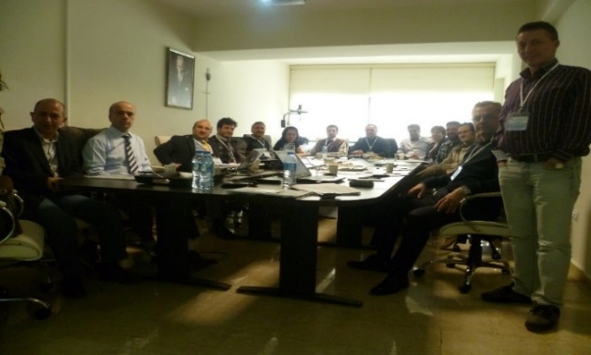
Funding Agency, Coordination, Collaboration and Facilities
Government of Turkey
International Machine
Advisory Committee (IMAC)
Ministry of Development
International Scientific
Advisory Committee (ISAC)
Ankara University (Coordinator)
Turkish Accelerator Center Collaboration
Ankara, Gazi, Istanbul, Boğaziçi, Doğuş, Gebze Teknik, Uludağ, Dumlupınar,
Osmangazi, Erciyes, Niğde, S. Demirel, Gaziosmanpaşa and Adıyaman Universities
TAC Board (17 members)
Director: Prof. Dr. Omer Yavas (Ankara Univ.)
Accelerator Facilities (Sub-Projects)
Board of TAC Collaboration
TARLA
IRFEL & Brems. Facility
15-40 MeV Sc e- Linac
TURKAY
Synchrotron Radiation
Facility
3 GeV e- Synchrotron
TURKSEL
SASE FEL Facility
1-6 GeV Sc e- Linac
TURKPRO
Proton & Neutron Facility
3-2000 MeV p Linac
TURKFAB
Particle (Charm) Factory
1 x 3.56 GeV
e-e+ Collider
Under construction
Designed
Designed
Designed
Designed
7

Slide 8












TAC Collaboration
Project Team: 78 staff with PhD + 78 graduate students and engineers
Ankara University (Coordinator)
Boğaziçi University
Gazi University
Doğuş University
İstanbul University
Erciyes University
Uludağ University
Süleyman Demirel University
Dumlupınar University
Niğde University
Osmangazi University
Gebze Institute of
Advanced Technologies
In April 2013, Gaziosmanpasa and Adıyaman groups are joined to the collaboration
8

Slide 9

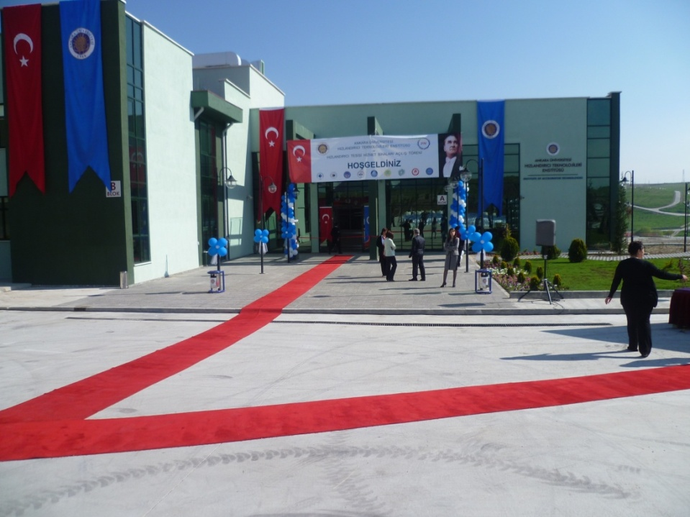
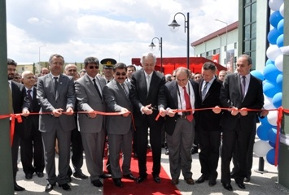
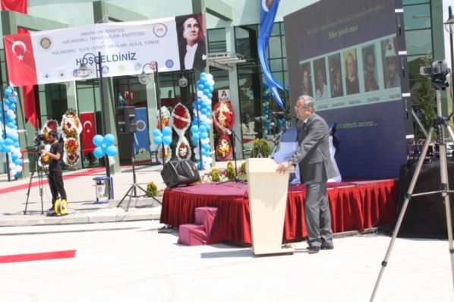
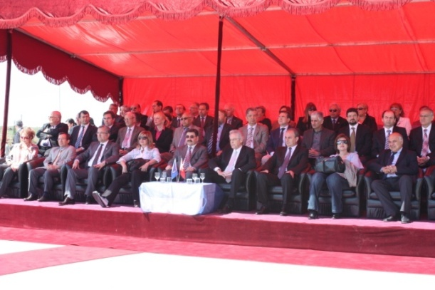
TARLA Facility & Institute of Accelerator Technologies
Opening Ceremony (May 9, 2011)
TARLA Facility
Institute of Accelerator Technologies (IAT)
9

Slide 10

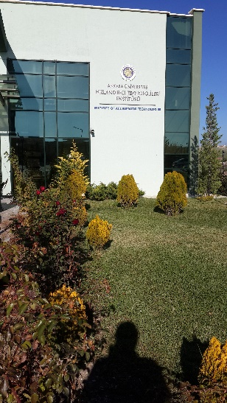
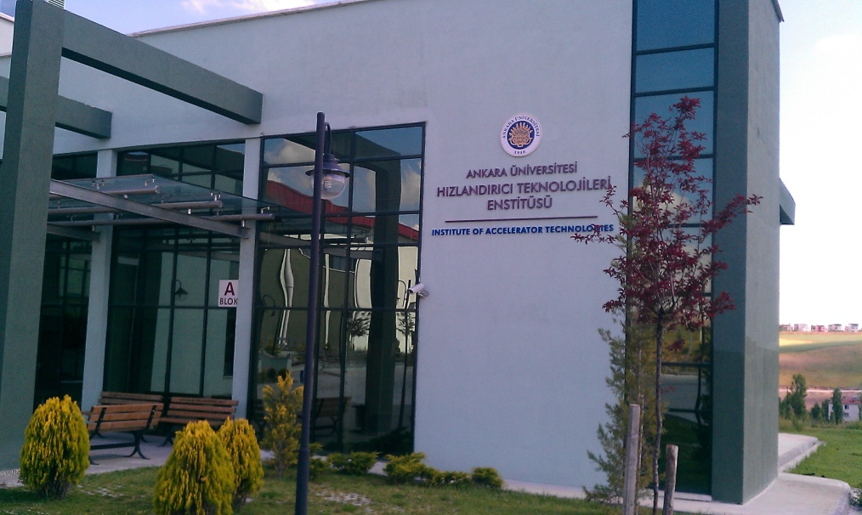
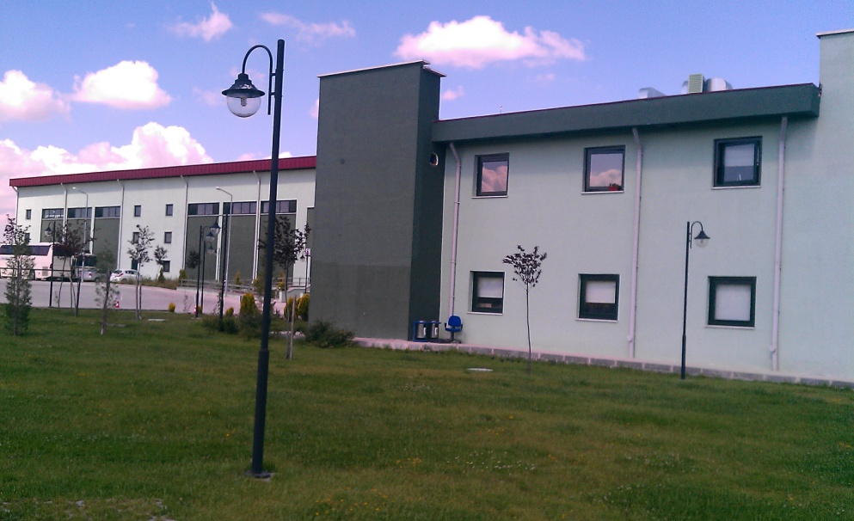
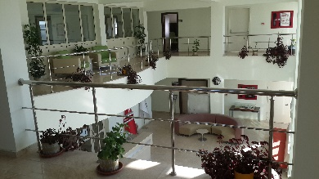
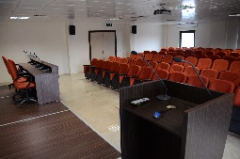
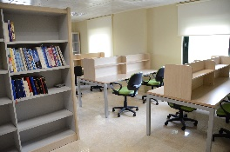
Institute of Accelerator Technologies (IAT)
http://hte.ankara.edu.tr
Established in February 26, 2010 in Ankara University
and unique in Turkey
Institute has 18 full time personal (12 technical)
Main role of the institute is the coordination of TARLA IR FEL facility
Recently, a common graduate programme on accelerator and detector technologies is developed together with Institute of Nuclear Sciences
and the programme is started in January 2016.
10

Slide 11

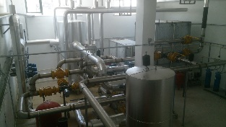
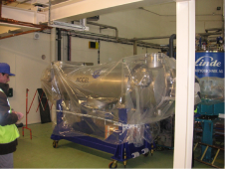
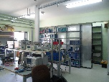
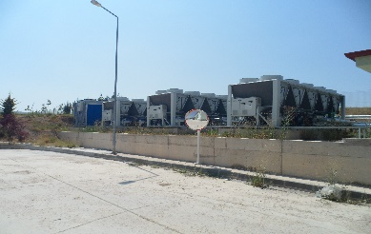
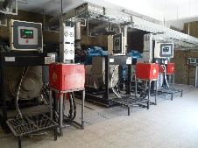
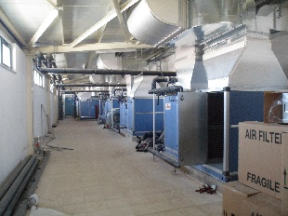
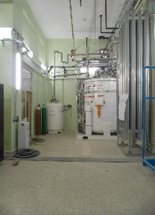
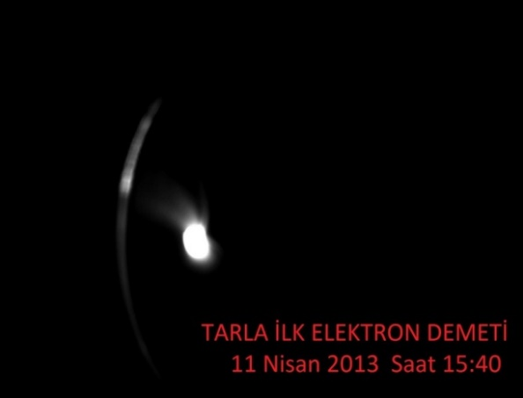
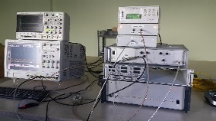
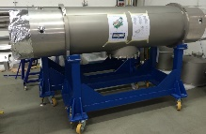
Infrared FEL & Brems. Facility (TARLA)
http://tarla.org.tr
e-beam energy : up to max. 40 MeV
IR FEL wavelength : 3-250 microns
Energy of Brems. : up to 30 MeV
First beam from DC e-Gun!
April 11, 2013
TARLA building was completed in 2011
E-Gun installed in 2013
He and water cooling systems were installed in 2015-2016
SRF modules will be installed in 2017-2018
IR FEL & Bremsstrahlung beams will be obtained in 2019-2020
TARLA will be ready for research in 2020
11

Slide 12
Research Potential of TARLA
Free Electron Laser
Coherent IR Radiation (3-250 µm)
Material, (bio)physics, (bio)chemistry, medical..
Polarized Bremmstrahlung (0-30 MeV)
Nuclear Physics, Astrophysics, Radiation hardness
Gamma induced positron spectroscopy
Radiator Foil (Al,Nb)
Superconducting accelerator based electron beam
0 - 40 MeV ,
0-1 (1.5) mA
40 (60) kW
cw / pulsed
Electron Beam (0-40 MeV)
Radyobiolgy, Detector study, Thomson scattering
Electron difraction, plasma studies
Direct Use
W Moderator
Mono Chromatic Positron (10-300 keV)
Semiconductors, material, …
Crystal Channeling & Compton Back Scat.
Quasi Monochromatic X-ray (10-100 keV)
Radiation physics, Radiobiology..
Neutron Source (0-30 MeV)
Fission, material, nuclear physics
Lead Target
THz Radiation (0.1-3 THz)
Material research, detector study…
Bending Magnet
12

Slide 13
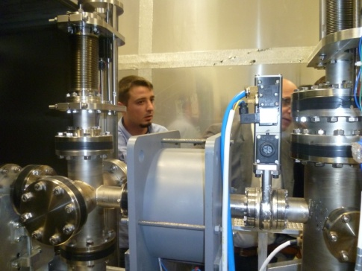
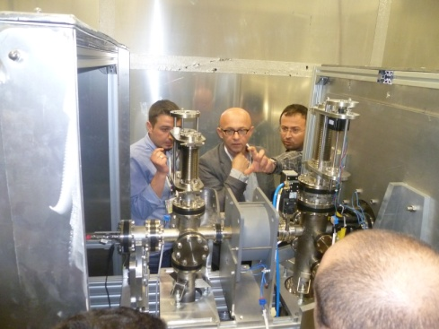
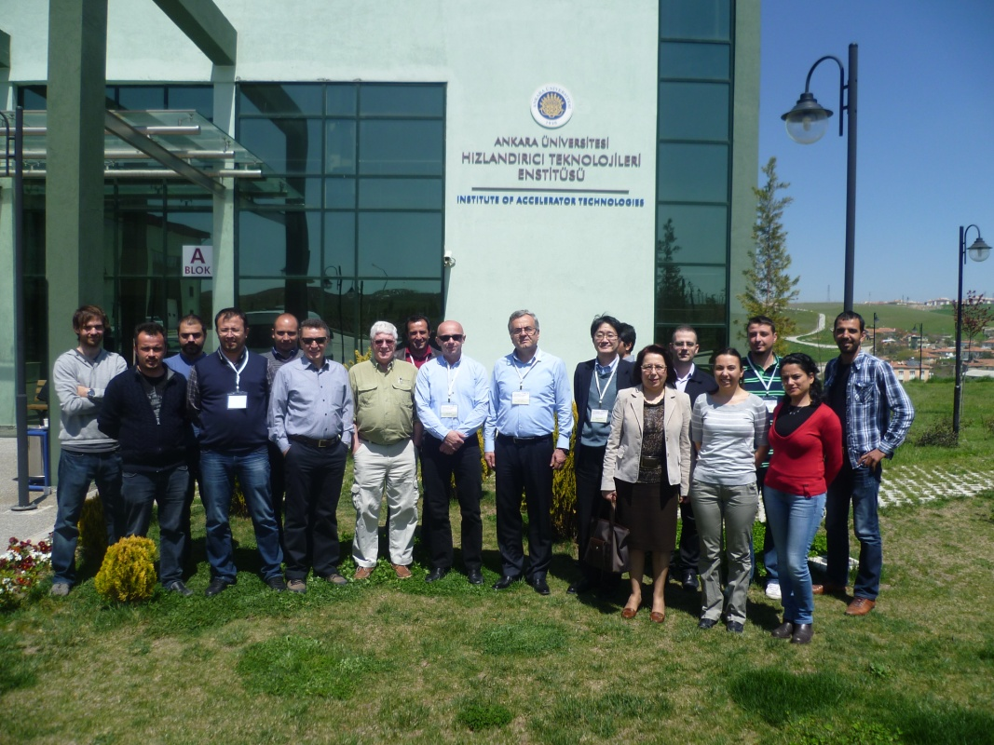
International Machine Advisory Committee (IMAC)
Peter MICHEL (HZDR-ELBE, Germany) (Head)
Ernst WEIHRETER (HZB-BESSY, Germany)
Hideaki OHGAKI (Kyoto University, Japan)
Jean R. DELAYEN (JLab, USA)
Susan SMITH (ASTeC, UK)
1st Meeting:
December 4-5, 2009
Ankara University
2nd Meeting:
September 2-3, 2010
Bodrum, Mugla
3rd Meeting:
May 12-13, 2011
IAT, Ankara University
4th Meeting:
March 8-9, 2012
IAT, Ankara University
5th Meeting:
April 22-23, 2013
IAT, Ankara University
6th Meeting:
October 20,21, 2014 IAT, Ankara University
7th Meeting:
September 7-8, 2015 IAT, Ankara University
13

Slide 14
Proposed TAC Facilities
TAC Synchrotron Radiaton Facility (SR)
A third generation light source based on dedicated 3 GeV electron synchrotron
TAC SASE FEL Facility (SASE FEL)
A fourth generation light source based on 1-6 GeV electron linac
TAC Proton Accelerator Facility (PAF)
Low and middle energy: 3 - 65 - 250 MeV, high energy: up to 2 GeV
TAC Particle Factory (PF)
Electron-positron collider as a charm factory (Ec.m.= 3.8 GeV)
http://tac.en.ankara.edu.tr/sr
http://tac.en.ankara.edu.tr/sase-fel
http://tac.en.ankara.edu.tr/paf
http://tac.en.ankara.edu.tr/pf
14

Slide 15
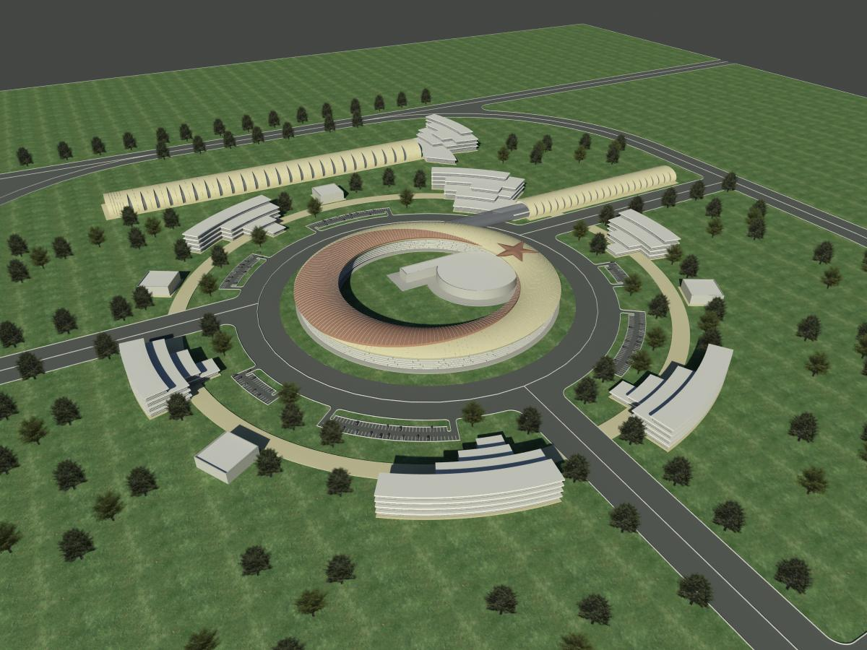
TAC PAF Facility
TAC SASE FEL Facility
Linac on Ring PF (optional)
TAC SR Facility
Other Buildings:
Institutes, User offices,
Workshops, Library,
Guesthouse etc.
“Green field” campus view of TAC
15

Slide 16
International Scientific Advisory Committe (ISAC)
Ercan ALP (Argonne National Laboratory, USA) (Head)
Behçet ALPAT (INFN Perugia, Italy)
David M. ASNER (PNL, USA)
Swapan CHATTOPADHYAY (Cockroft Institute, UK)
Eugene LEVICHEV (BINP, Russia)
Yasar ONEL (Univ. of Iowa, USA)
Luigi PALUMBO (INFN Frascati, Italy)
Ken PEACH (Oxford University, UK)
Roland SAUERBREY (FZD, Germany)
Zehra SAYERS (Sabancı University, Turkey)
Saleh SULTANSOY (TOBB ETU, Turkey)
Ali TANRIKUT (TAEK, Turkey)
Gökhan UNEL (UCI & CERN)
Helmut WIEDEMANN (Stanford University, USA)
Frank ZIMMERMANN (CERN)
1st Meeting:
October 8-9, 2009
Ankara University
Ankara, Turkey
2nd Meeting:
June 21-22, 2010
Boğaziçi University Istanbul, Turkey
3rd Meeting:
May 9-10, 2011
Ankara University
Ankara, Turkey
4th Meeting:
June 11-12, 2012
Istanbul University
Istanbul, Turkey
5th Meeting:
June 24-25, 2013
Ankara University
Ankara, Turkey
6th Meeting:
July 7-8, 2014
Istanbul University
Istanbul, Turkey
16

Slide 17
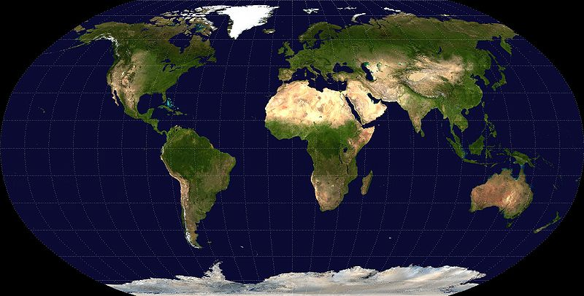
International MoUs in Frame of TAC
GERMANY
DESY, FZB-BESSY, FZDR, European XFEL
USA
ANL, JLab
ENGLAND
Cockcroft Inst.
RUSSIA
BINP
SWITZERLAND
CERN
CHINA
IHEP, BESIII
TURKEY
TAC
ITALY
INFN
JORDAN SESAME
SWEDEN
ESS
JAPAN
iFEL, JAERI, KEK
Memorandum of Understandings between TAC (Turkey) and
DESY, Germany (1996) IHEP-BEPC, China (2011)
CERN CLIC CTF3, Switzerland (2004) European XFEL, Germany (2012)
BESSY-II, Germany (2007) ESS, Sweden (2013)
HZDR, Germany (2007) INFN, Italy (2013)
The Cockcroft Institute, UK (2011)
> 300 scientific visits to these centers
17

Slide 18


International Collaborations on Light Sources
ESUO: European Synchrotron User Organization
CALIPSOPlus: Coordinated Access to LIght sources to Promote Standards and Optimization (EU H2020 Project)
The 20 consortium members of CALIPSOPlus
ALBA, AU (ISA), CLIO(CNRS), DESY, Diamond, Elettra, EMBL, ESRF, BESSY(HZB), FELBE(HZDR), ANKA(KIT), INFN, MAXIV, PSI-SLS, FELIX(RU), SOLARIS, SOLEIL, STFC, TAC-TARLA, European XFEL
18

Slide 19

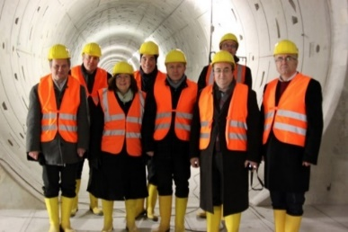
International Collaborations on Light Sources
FELS OF EUROPE Collaboration
http://www.fels-of-europe.eu
Partners: European XFEL (Germany, Coordinator), DESY (Germany), ELETTRA (Italy),
HZB-BESSY (Germany), HZSDR (Germany), IFN (Italy), MAX-IV (Sweden), NCNR
(Poland), CNRS (France), PSI (Switzerland), Radbout University (Nederlands), STFC
(UK), SOLEIL (France), Institute of Accelerator Technologies (Turkey)
X-Band XFEL Collaboration (COMPACTLIGHT)
Partners: CERN CLIC- Switzerland, Elettra - Italy, Jagiellonian University - Poland,
Daresbury Laboratory- UK, Shangai Institute of Applied Physics – China, VDL ETG T&D
B.V., Eindhoven – Netherlands, University of Oslo - Norway, National Technical
University of Athens – Greece, Uppsala University, Uppsala – Sweden, Australian
Synchrotron, Clayton – Australia, Lancaster University, Lancaster- UK,
Institute of Accelerator Technologies, Ankara-Turkey (EU H2020 Project)
- J. Pfingster et al., The X-Band FEL Collaboration, FEL2015, S. Korea.
- G. D’Auria, Compactlight Proposal, CLIC Workshop 2017, CERN
Euro XFEL visit, 2014
19

Slide 20
From 2006 to date
  Inter-University TAC Collaboration was established (2006)
  TAC-ISAC and TAC-IMAC were established (2009)
  User Committee on TARLA was established (2009)
  The Institute of Accelerator Technologies was established (IAT) (2010)
  Buildings and IAT and TARLA were opened to the service (2011)
  User Committee on TAC SR was established (2011)
  TARLA facility is the first facility of TAC (under construction)
  The first beam from TARLA DC e-Gun was obtained (2013)
  Design of TAC Synchrotron Radiation Facility is developed
  Design of TAC Proton Accelerator Facility is developed
  Design of TAC SASE FEL Facility is developed
  Design of TAC Particle Factory is developed
  Many MoUs are signed with well known Accelerator Centers
  More than 350 scientific visit to abroad
  Around 200 Msc - PhD thesis on accelerators and light sources
  6 National Accelerator Congress (UPHUK) are organized
  11 National Accelerator Summer Schools (UPHDYO) are organized
20

Slide 21
Conclusion on TAC & TARLA
TAC is planned as a world-class R&D and technology center in basic and applied sciences for Turkey and our region.
TARLA facility is under construction as the first facility of TAC. It is planned that TARLA will be ready to operate for R&D studies as a national and regional “user facility” in 2020.
Technical Design Reports of proposed TAC facilities are completed and presented to the Ministry of Development (MD) in February 2016.
At the begining of 2016, a new period for three years is defined by MD to complete TARLA and in this frame the title of project revised as «Electron Accelerator and Laser Facility TARLA» and project team is revised, also.
Turkish Parlament (TBMM) is approved a new law (Law No: 6550) to re-organize of existing and developing reserach centers. It is expected that TAC will get a new statute as a National Research Center due to this law. This law will regulate a new management, personnel and financial support and review mechanism.
21

Slide 22

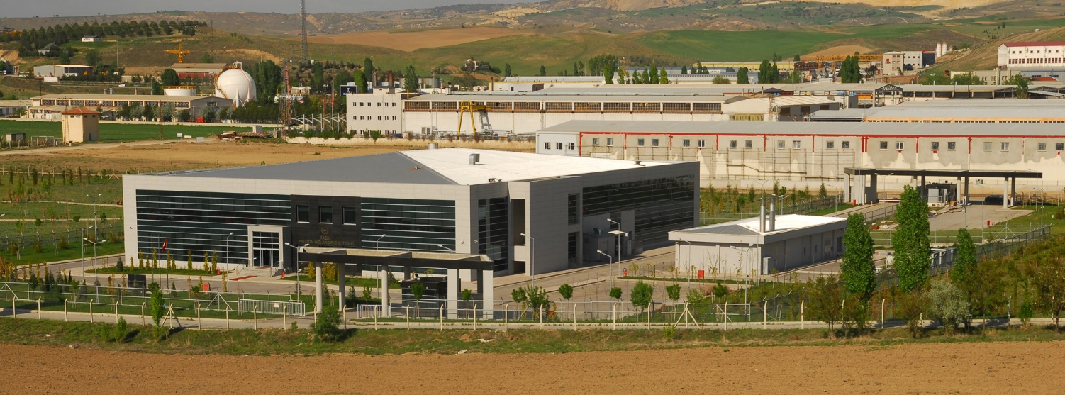
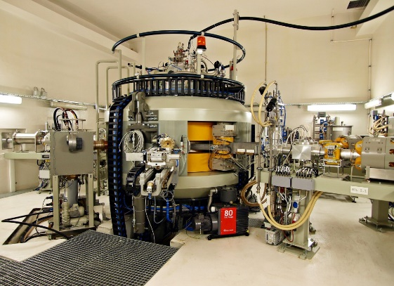
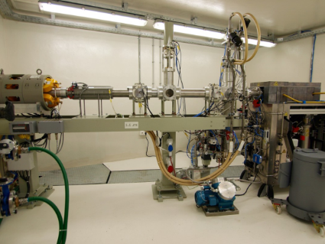
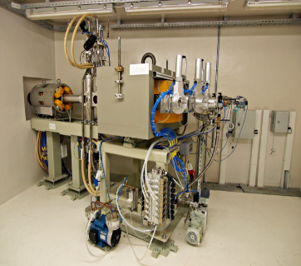
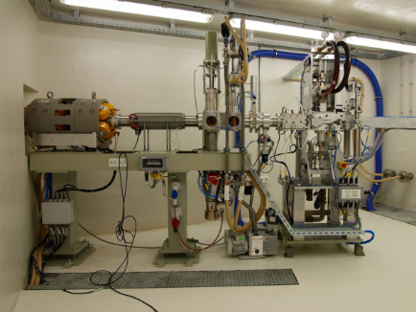
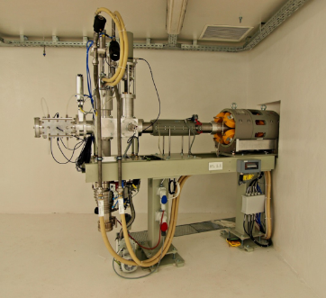
TAEK Proton Accelerator Facility
Accelerator
R&D in
Opening ceremony: May 29, 2012
The machine
  - 15-30 MeV proton cyclotron
    (Cyclon 30, IBA)
Purpose
  - Radioisotope production
  - R&D with proton beam
Facility Location:
  Sarayköy Nuclear Research and
  Training Center (SANAEM), Ankara
22

Slide 23
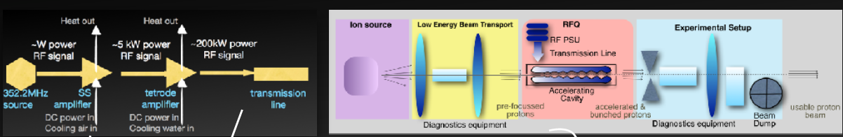
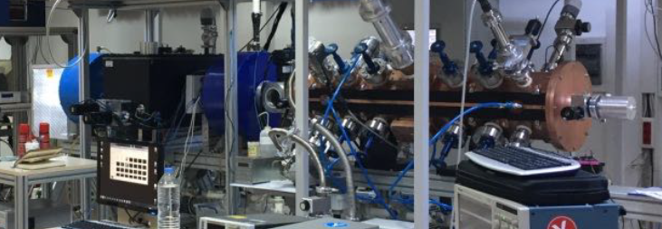
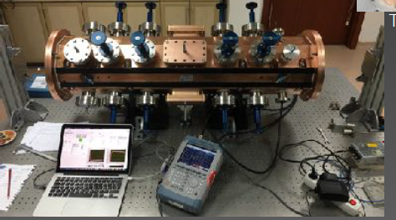
Accelerator
R&D in
TAEK’s SANAEM Prometheus Project (SPP)
Main parameters of p-RFQ Linac:
E > 1 MeV and I > 1 mA, pulsed, H+, RF = 352.21 MHz, d.f. > 0.01
Main goal of project: All components to be designed and built in Turkey!
Run by SANAEM, TAEK’s Sarayköy Research and Training Center since 2012
Participation of scientists and engineers from several universities
Current status of p-RFQ linac facility
RFQ magnet is produced in Turkey
All components produced and installed
First protons out of LEBT seen in December 2015
Protons at the end of RFQ seen in Winter 2016 vanes’ shadow can be seen
RF training & power coupling tests ongoing …
23

Slide 24
Accelerator-Related Ongoing Projects
Accelerator
R&D in
Ankara University
  Design and manufacture of 1.3 GHz RF pulse compressor
  Design, production and tests of high gradient quadrupole magnets
  Development of 3D e-beam printer for industrial use
  Radio frequency quadrupole (RFQ) design and simulation software
  Demirci-Pro: Design & simulation of a radiofrequency quadrupole (RFQ) based linear accelerator for light ions
Middle East Technical University
  Design and contruction of a p-beam line in TAEK’s p-Cyclotron Facility for radiation hardness tests of space equipments
Boğaziçi University
  High-power 800MHz RF circulator and transmission line project
  Building a trial low-energy electron gun for industrial applications
Akdeniz University
  Modifications of a clinical linac (30 µA, 18 MeV) for use in nuclear physics research
TOBB ETU
  Development of an e-gun for electron beam welding; design and handling MeV energy e-beam using klystrons donated by CERN
24

Slide 25
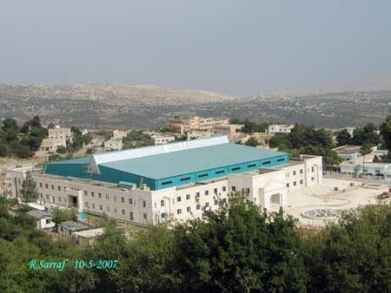
Membership to SESAME
Accelerator
R&D in
Synchrotron-light Experimental Science and Applications
in Middle East
Turkey is member of SESAME Project since 2002
  - Members: Bahrain, Cyprus, Egypt, Iran, Israel, Jordan, Pakistan
  Palestine Authority
  - Council member of Turkey:
  Z. Demircan
  - Head of SAC : Z. Sayers
  - Head of User Com.: Ö. K. Öztürk
Contributions
- Design of beam lines and exp.
  stations, user & financial support
25

Slide 26

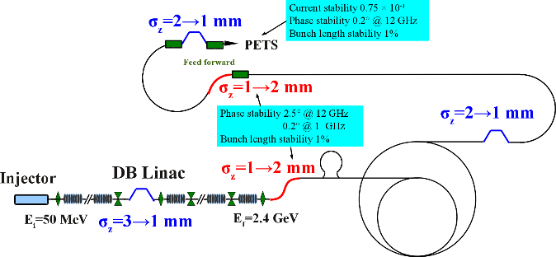
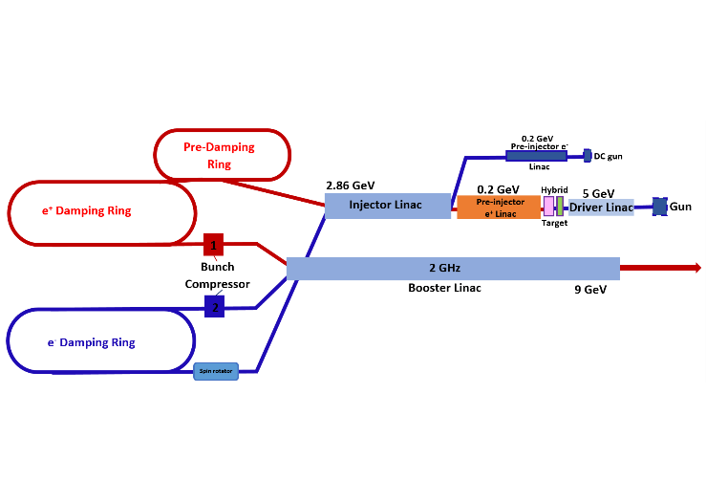
TR Participation to CERN CLIC Collaboration
Accelerator
R&D in
Turkish contribution:
7 research projects are completed on CLIC accelerator, detector
and physics studies by support of TAEK between 2004-2012
Accelerator related contributions:
- CLIC-LHC based ep, eA, 𝛾p, 𝛾A and FEL𝛾A colliders
Drive beam injector, beam dynamics & optics
The beam dynamics of CLIC drive beam studies has been completed as a PhD thesis
Many contributions for bunch compressors for individual sections of Drive Beam has been
done such as injector desing and bunch compressors-decompressors
Ongoing project on ‘CLIC Beam Dynamics and Beam-Beam Interactions’ since 2013 by support of TAEK.
Project Team: 17 members from 7 Turkish Universities (Ankara, Istanbul, ITU, AIBU, Giresun, Nigde, Uludag)
Studies are going on*:
Drive beam dynamics
Injector options & bunch compressor senarios
X-Band X-FEL magnetic lattice and undulator magnet optimizations
X-Band klystron amplifiers
CLIC main beam injector (5 GeV linac) parameter optimization
- Effects of beam-beam interactions on detector design
and physics research
* M.J. Boland et al. Updated Baseline for a Staged Compact Linear Collider, CERN-2016-004, arXiv: 1608.07537
26

Slide 27
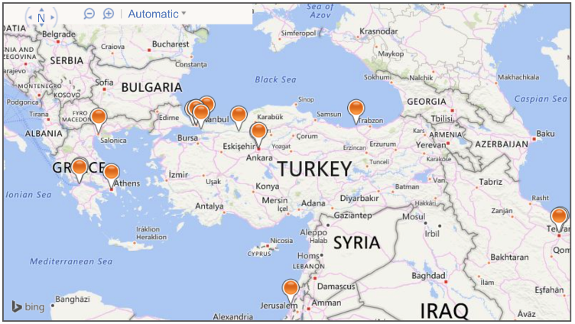
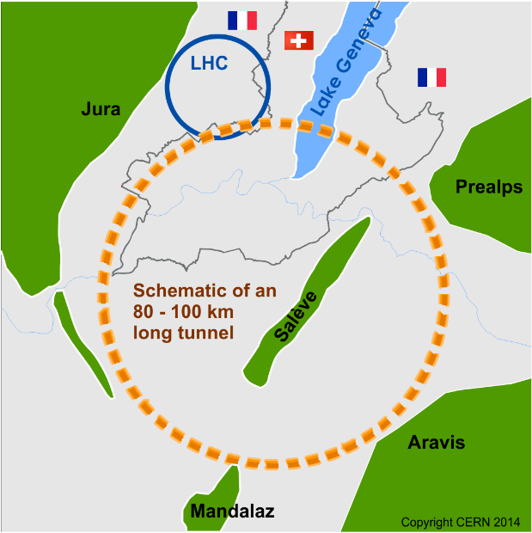
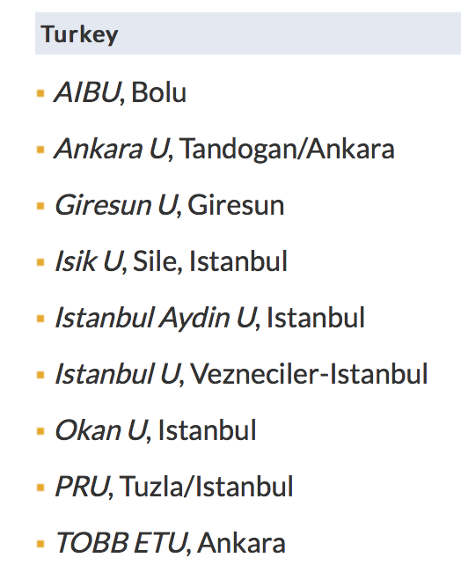
TR Participation to CERN FCC Collaboration
Accelerator
R&D in TR
FCC-hh: 100 TeV pp collider as long-term goal → defines infrastructure needs
FCC-ee: e⁺e⁻ collider, potential intermediate step
FCC-eh: LC-FCC based ep, eA, 𝛾p,
𝛾A and FEL𝛾A colliders
FCC
Collaborating Universities
9 Turkish Universities are signed MoU and three of them (Ankara, AIBU and Giresun) signed an
Addendum with CERN-FCC to give contributions on accelerator, detector and physics studies.
Main goal of FCC collaboration is to
complete CDR of FCC at the end of 2018
Accelerator related presentations
of Turkish scientists in FCC Week 2017
(29 May-02 June 2017, Berlin, Germany)
Linac and damping ring
Prebooster ring
27

Slide 28

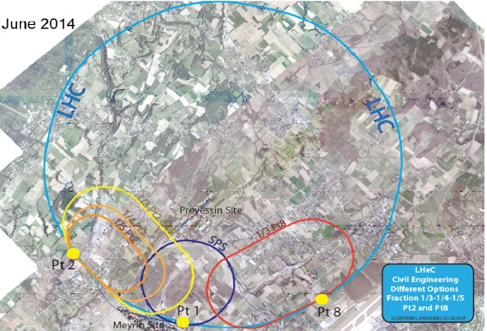
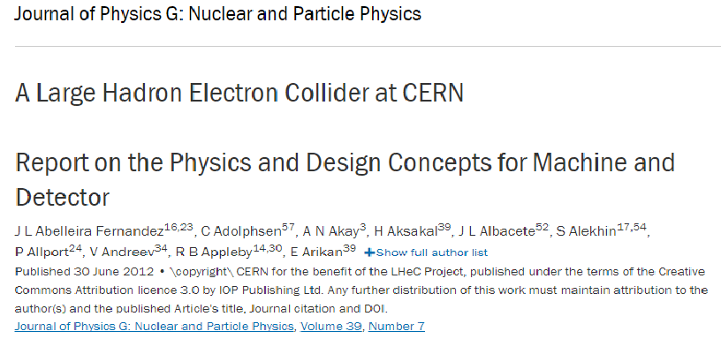
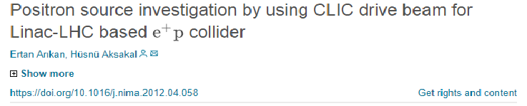
TR Participation to CERN LHeC Collaboration
Accelerator
R&D in TR
http://lhec.web.cern.ch
CDR of LHeC is published in 2012
13 scientists from
7 Turkish Universities
(Ankara, TOBB, Nigde,
Uludag, Giresun, AIBU
and Kastamonu) are
collaborating with
CERN LHeC Project to give
contributions on parameter
optimisation of LHeC based
ep, eA, 𝛾p, 𝛾A, FEL𝛾A and 𝛾𝛾 colliders, positron production, detector design and invetsigation of new physics processes
A paper on LHeC e+p collider by Turkish scientists in NIM-A: (2012)
28

Slide 29
Conclusion
Accelerator
R&D in
The accelerator technologies and applications are very important for national
and regional development.
Realization of the Turkish Accelerator Center (TAC) will boost the development
in almost all fields of science and technology in our country.
It is clear that, we need more closer collaborations with international accelerator
community to realize TAC and other accelerator related projects.
TR industry has good potential to develope and production of acceletor
hardware for national and international projects.
TR accelerator and particle physics community is ready to give contributions
for 2019 update of the European Strategy (ES).
29

Slide 30
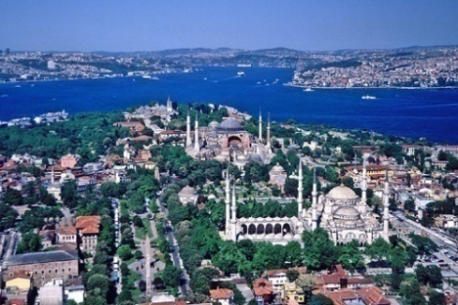
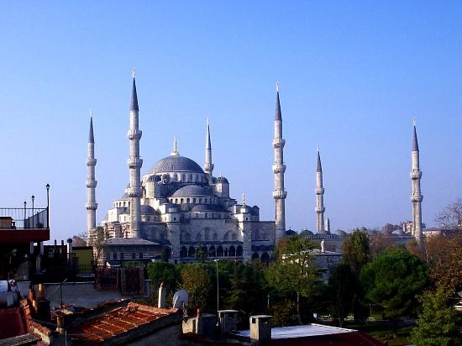


Many thanks for your attention…
ISTANBUL

Slide 31
BACKUP SLIDES

Slide 32




Main Parameters of TARLA Facility
Parameter | Unit | Base | Upgrade
Beam Energy | MeV | 10-40 | 10-40
Max average beam current | mA | 1 | 1.5
Max bunch charge (@ 13 MHz) | pC | 77 | 115
Horizontal emittance | mm.mrad | < 15 | < 16
Vertical emittance | mm.mrad | < 12 | <13
Longitudinal emittance | keV.ps | < 85 | <100
Bunch lenght | Ps | 0.4-6 | 0.4-6
Bunch repetition | MHz | 13 | 13-26
Macropulse duration | μs | 50→ CW | 50→CW
Macropulse repetition | Hz | 1 → CW | 1 → CW
32

Slide 33
Main Parameters of TARLA Facility
 | Parameter | Unit | U25 | U90
Resonator Parameters | Period Length | mm | 25 | 90
 | Number of Poles | # | 60 | 40
 | Type | # | Planar | Planar
 | Pole Material | # | NdFeB | NdFeB
 | Undulator Strength | # | 0.25-0.7 | 0.8-2.4
 | Minimum gap | mm | 15 | 30
 | Resonator Length | m | 11.53 | 11.53
 | Curveture of mirrors (R₁=R₂) | m | 5.86 | 6.32
 | Outcoupling hole radius | mm | TBD | TBD
Laser Parameters | Wavelength | µm | 3-19 | 18-250
 | Micropulse repetition | MHz | 13 | 13
 | Micropulse Length | ps | 0.5-10 | 0.5-10
 | Maximum Peak Power | MW | ~5 | 2.5
 | Maximum Average Power | W | 100 | 50
 | Max Pulse energy | µJ | ~10 | ~8
 | Macropulse duration | µm | 40-CW | 40-CW
 | Macropulse Repetition | Hz | 10-CW | 10-CW
33

Slide 34




Proposed TAC Facilities
TAC-Synchrotron Radiation Facility (TURKAY)
TAC-SASE FEL Facility (TURKSEL)
TAC-Proton Accelerator Facility (TURKPRO)
TAC- Particle Factory Facility (TURKFAB)
34

Slide 35




TAC Synchrotron Radiation Facility (TURKAY)
http://tac.en.ankara.edu.tr/sr
Parameters of main ring
Parameter | Value
Energy (GeV) | 3
Circumference (m) | 477
Beam current (mA) | 500
Horizontal emittance (nmrad) | 0.51
RF frequency (MHz) | 500
RMS bunch length (mm) | 2.1
Big Booster option
Small Booster option
Lattice and Magnet Structure
Big Booster Ring:
C = 445.6 m
Supe period: 8
A super period constits of 6 FODO cell
Main Ring:
C = 477 m
Main cells: 20
A main cell constits of 4 BM + 16 QM
BM: 1.5 m, 0.52 T
QF: 0.30 m, 23.8 T/m
Some of Planned IDs, Expected SR Spectrum
35

Slide 36


Research and User Potential of TURKAY
Research Potential: to produce and use of
synchrotron radiation in scientific research
and technology development studies in basic
and applied sciences
Turkey
185 Universities in 81 cities
National Institutes on:
Biotechnology, Nanotechnology, Accelerator,
Mining, Medicine, Pharmachology, Ceramics,
Metrology, Superconductivity, Space etc.
National Authorities: TUBİTAK , TAEK, MAM
Industry, Technocities, Technoparks …
Our region:
Turkic States, West South Asia, Balkan Countries, Middle East, North Africa
36

Slide 37





TAC Light Sources User Committies and Meetings
IR FEL Experimental Stations and User Committee is established in 2008 (Head: Dr. P. Arikan)
SR User Committee is established in 2011 (Head: Dr. Ö. Kurtuluş Öztürk)
37

Slide 38

TAC-SASE FEL Facility (TURKSEL)
http://tac.en.ankara.edu.tr/sase-fel
TAC SASE FEL facility is developed as 3 GeV (taking into consideration 1-6 GeV region) superconducting electron linac based SASE FEL facility to cover VUV and soft X-ray region.
TAC SASE FEL facility aims to use beams in many fields as material science, biotechnology, nanotechnology, chemistry, space, environment etc. with its unique properties.
(tr)
Parameter | Unit | Value
Beam energy | GeV | 3
RF frequency | GHz | 1.3
Number of Sc Nb cavities | - | 12 x 9 cell cavity
Accelarating gradient | MV/m | <40.7
Cell to cell coupling, k | - | 1.8
Quality factor, Q₀ | - | >10⁹
Peak current | kA | 2
Parameter | Unit | U15
Period length | mm | 15
Magnetic gap | mm | 12
Central magnetic field | T | 0.48
Undulator material | - | NdFeB
Wavelength | nm | 1-100
Saturation FEL power | GW | 1.4
Saturation length | m | 28
Peak brilliance (photons/s/mrad²/mm²/0.1%bw) |  | 10²⁹
Ömer Yavaş | Ankara University

Slide 39
TAC-Proton Accelerator Facility (TURKPRO)
http://tac.en.ankara.edu.tr/paf
http://tac.en.ankara.edu.tr/paf
TAC Proton Accelerator is proposed as a multipurpose, multi GeV energy and multi MW power machine
The project will progress in three stages:
Stage 1: an ion-source, Low Energy Beam Transport (LEBT) and a Radio-Frequency Quadrupole (RFQ) (up to 3 MeV);
Stage 2: a 250 MeV linear accelerator, which could be built in two phases – phase 1 is a 3-65 MeV Drift Tube Linac (DTL) and phase 2 is a MEBT and 65-250 MeV SC-spoke cavity and SC-elliptical cavity
Stage 3: a 1 MW proton facility up to 2 GeV – probably a SC-Elliptical cavity
(Low enery PAF: 3-65 MeV & 65-250 MeV, High energy PAF: up to 2 GeV)
39

Slide 40

TAC Proton Accelerator Facility (TURKPRO)
This proton accelerator facility could serve as a neutron spallation source, a radioactive ion beam facility, a prototype facility to conduct research into accelerator-driven sub-critical reactors, as well as a number of lower energy facilities for use in nuclear, material, biological, and medical sciences.
40

Slide 41
TAC Particle Factory (TURKFAB)
http://tac.en.ankara.edu.tr/pf
Turkish Accelerator Center (TAC) Particle Factory is a super charm factory with the asymmetric beam energy setup consisting of an electron beam with 1 GeV from a linac and a positron beam with 3.56 GeV from a ring, proposed to be designed as a linac-ring type collider at the center of mass energy of 3.77 GeV. A super charm factory with luminosity L=10^35 cm^(-2) s^(-1) will give opportunity to investigate charm physics well further than B factories, benefiting from a boost parameter (bg=0.68) for some processes.
Main parameters of TAC Particle Factory
Parameter | Positron beam | Electron beam
Beam energy (GeV) | 3.56 | 1
Number of particles per bunch (10¹¹) | 2 | 0.2
Beta functions at IP β_{x}/β_{y} (mm) | 80/5 | 80/5
Normalized emittance ε_{x}^{N}/ε_{y}^{N} (µm rad) | 111/0.36 | 31/0.1
σ_{x}/σ_{y} (µm) | 36/0.5 | 36/0.5
σ_{z} (mm) | 5 | 5
Number of bunches | 300
Circumference (m) | 600
Luminosity (cm⁻²s⁻¹) | 1.4x10³⁵
General Layout of Super Charm Factory
TAC PF
41

Slide 42

TR Participation to CERN Projects
Accelerator
R&D in
CERN PROJECTS
http://www.taek.gov.tr/egitim-arastirma/cern-tr.html
42

Slide 43






TAC-ISAC Meetings
Ankara University (2009)
Boğaziçi University (2010)
Ankara University (2011)
Istanbul University (2012)
Ankara University (2013)
Istanbul University (2014)
43

