Slide 1
2017 LIU ions MDs - status
H. Bartosik and Giovanni Rumolo
for the Linac3 and LEIR study team
(contributors on next slide)
October 13, 2017

Slide 2
Contributors
S. Albright, M.E. Angoletta, H. Bartosik, G. Baud, G. Bellodi, S. Benedetti,
N. Biancacci, M. Bozzolan, S. Hirlaender, A. Huschauer, A. Latina,
D. Moreno, V. Kain, D. Kuchler, A. Saa Hernandez, R. Scrivens,
L. Soby, F. Wenander, R. Alemany Fernandez
+
LINAC3 / LEIR machine supervisors

Slide 3
Outline
Introduction and main challenges in view of LIU
Overview of 2017 MDs (plans)
Status of 2017 MDs with Xe
Summary and conclusions

Slide 4
Outline
Introduction and main challenges in view of LIU
Overview of 2017 MDs (plans)
Status of 2017 MDs with Xe
Summary and conclusions

Slide 5
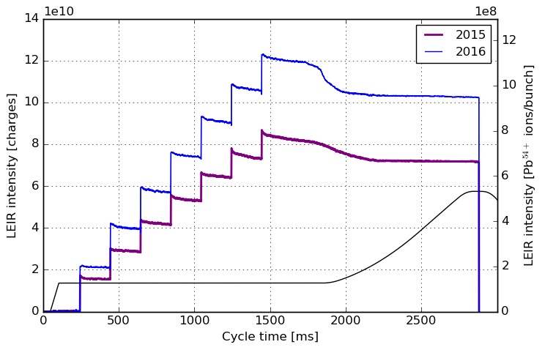
Introduction – main results from 2016
 | Accumulated ions | Ions / bunch at extraction
Achieved 2015 | 15.5 x 10⁸ | 6.0 x 10⁸
Achieved 2016 | 19.1 x 10⁸ | 8.1 x 10⁸
Intensity record 2016 | 22.8 x 10⁸ | 9.5 x 10⁸
LIU/HL-LHC baseline | 19.1 x 10⁸ | 8.1 x 10⁸

Slide 6
Main remaining challenges in view of LIU
Regularly deliver the required high beam intensity
  Improve understanding of source behavior and easier source tuning (automatic source control?)
  Improve monitoring of beam parameters from Linac3 (e.g. transfer line BPMs, stripper foil characterization)
  Make LEIR performance less sensitive to optimal machine settings/beam parameters (e.g. due to exchange or degradation of stripper foil)
Gain intensity margin in LEIR to avoid operating at performance limit
  Further understanding and characterization of loss mechanism at RF capture
  Optimization of working point and sextupole settings
  Further optimization of RF capture process
  Reduced injection spacing (100 or 150 ms) in combination with increased e-current in cooler
  Confirm that coherent instabilities will not become performance limitation
Only selected machine studies in 2017 (operation with Xe-ions) …

Slide 7
Outline
Introduction and main challenges in view of LIU
Overview of 2017 MDs (plans)
Status of 2017 MDs with Xe
Summary and conclusions

Slide 8
Xe MDs with low intensity / “EARLY”
Studies in view of improving reproducibility of machine performance
  Stripper foil tests, charge state distribution
Characterization of beam parameters at LEIR injection
  Different settings of ramping and debunching cavities (joint Linac3/LEIR MDs)
  Measurements with the Schottky (longitudinal and transverse) and IPMs
  Studies on injection efficiency
Beam instrumentation commissioning
  BPMs in ITE (characterization, calibration, YASP, …)
  New electronics for TBT measurements
Optics studies
  K-modulation
  TBT measurements (when new BPM electronics available)
Preparation of 100/150 ms injection
  Tests of source pulsing

Slide 9
Xe MDs with low intensity / “EARLY”
Studies in view of improving reproducibility of machine performance
  Stripper foil tests, charge state distribution
Characterization of beam parameters at LEIR injection
  Different settings of ramping and debunching cavities (joint Linac3/LEIR MDs)
  Measurements with the Schottky (longitudinal and transverse) and IPMs
  Studies on injection efficiency
Beam instrumentation commissioning
  BPMs in ITE (characterization, calibration, YASP, …)
  New electronics for TBT measurements
Optics studies
  K-modulation
  TBT measurements (when new BPM electronics available)
Preparation of 100/150 ms injection
  Tests of source pulsing
-- ongoing
-- to be started

Slide 10
Xe MDs with high intensity / “NOMINAL”
Cooling
  Benchmark of cooling efficiency with simulation tools
  Maximize accumulated intensity with 100 ms injection spacing
RF
  RF voltage calibration with Tomoscope
  Setting up and tests of h3+6 (and also h2+4+6?)
Impedance
  Comparison of coasting beam instability with results from Pb54+
  Impedance, instability rise time after capture
  BTF measurements
Space charge and resonance studies
  Beam response close to resonances and benchmarking with simulations
  Resonance compensation
  Check harmonic sextupoles
  New tune knobs to access larger range of working points
  New optics (only if time permits)

Slide 11
Xe MDs with high intensity / “NOMINAL”
Cooling
  Benchmark of cooling efficiency with simulation tools
  Maximize accumulated intensity with 100 ms injection spacing
RF
  RF voltage calibration with Tomoscope
  Setting up and tests of h3+6 (and also h2+4+6?)
Impedance
  Comparison of coasting beam instability with results from Pb54+
  Impedance, instability rise time after capture
  BTF measurements
Space charge and resonance studies
  Beam response close to resonances and benchmarking with simulations
  Resonance compensation
  Check harmonic sextupoles
  New tune knobs to access larger range of working points
  New optics (only if time permits)
-- ongoing
-- to be started

Slide 12
Outline
Introduction and main challenges in view of LIU
Overview of 2017 MDs (plans)
Status of 2017 MDs with Xe
Summary and conclusions

Slide 13
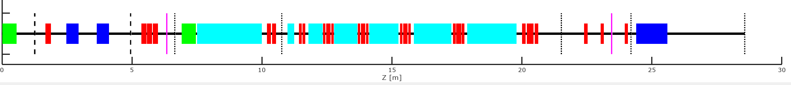
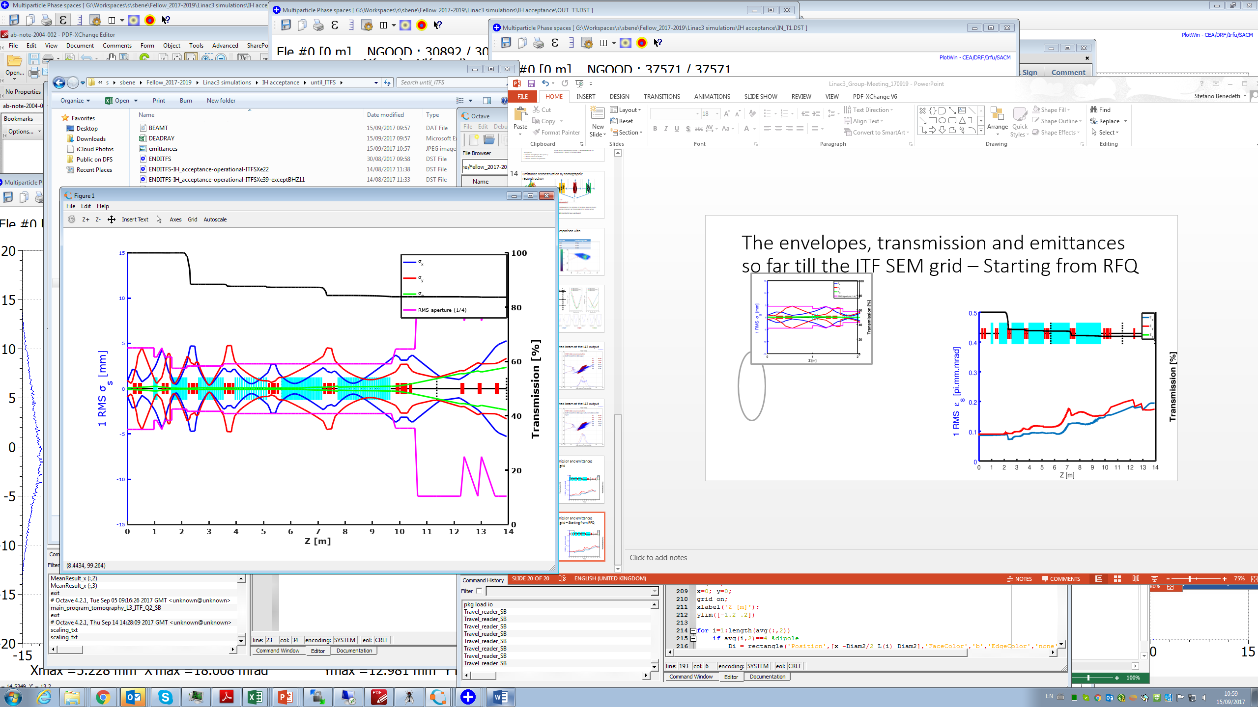
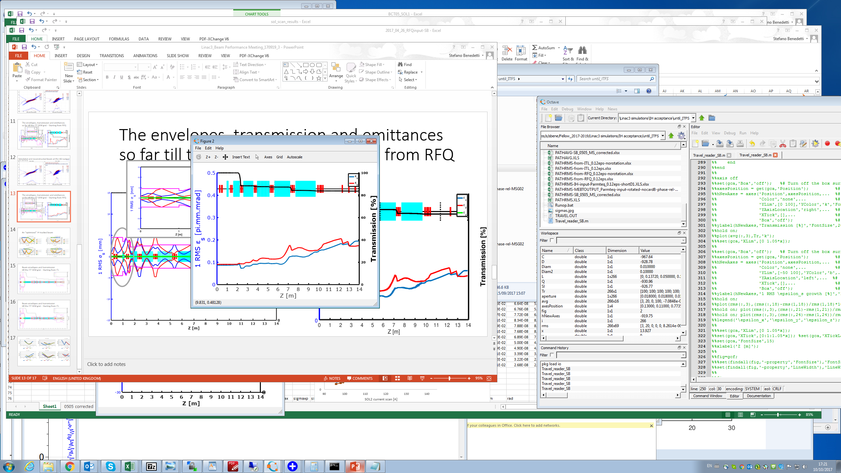
Linac3 and source studies
Tracking the beam reconstructed from quad scan measurements in the LEBT reproduces the measured transmission values through Linac3
All ion species
BCT05~ 170uA
ITM.FC~115uA
BCT15~170uA
ITL.FC
Stripper 22 -> 39
Xe22
SEM
SEM
SEM
SEM
ITL
RFQ
ITM
IH LINAC
ITF/ITFS
~70% RFQ transmission
(measured & simulated)
~ 80% IH linac transmission
(measured & simulated)
G. Bellodi et al.

Slide 14
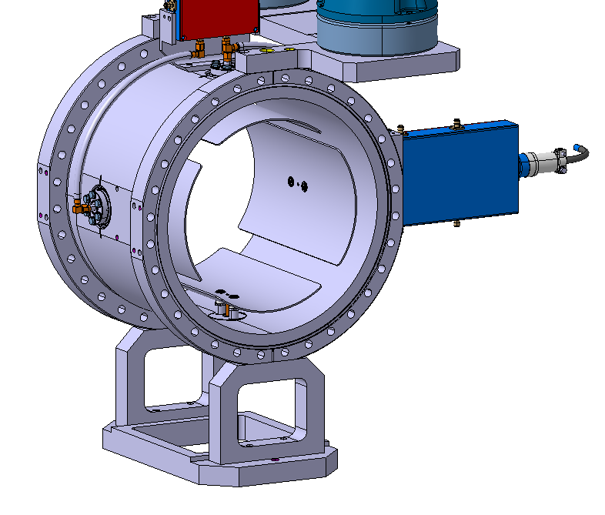
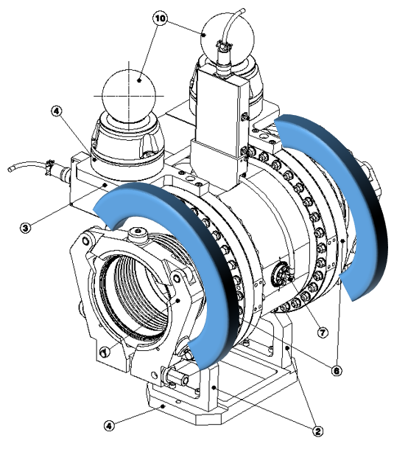
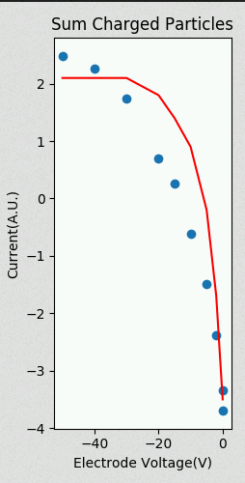
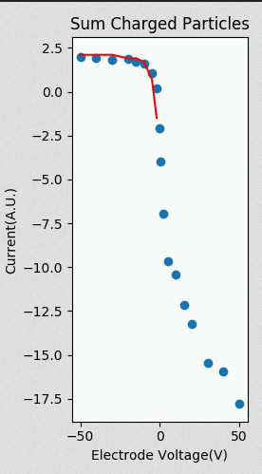
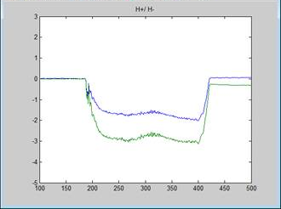
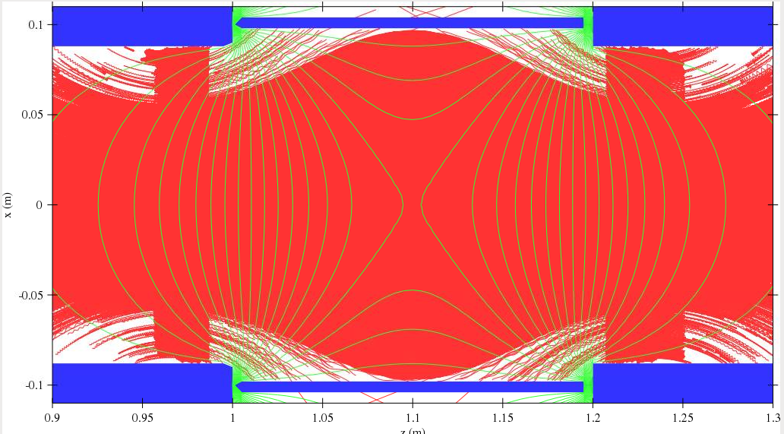
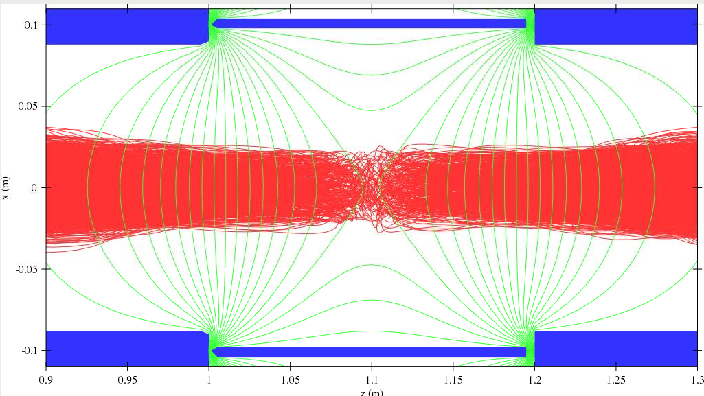
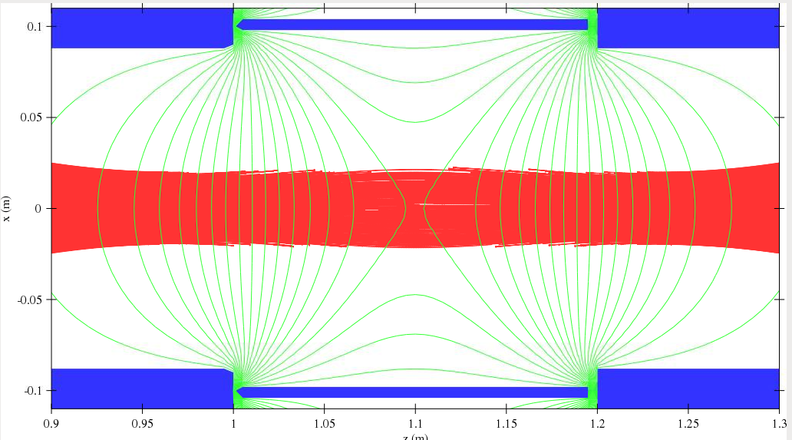
Commissioning of new transfer line BPMs
BPM signals affected by secondary electrons generated during beam passage
  Strong signal offsets caused by charges collected on electrodes, not possible to calculate position
  Addition of magnetic field and electrode bias significantly improved signal quality
  Work in progress (possibility of exploiting 100 MHz beam structure under study)
ITE BPMs
Solenoids installed
With/Without Solenoid field
ΔV/V ~ 5%
Wall Electrons
Beam-Gas ions
Beam-Gas electrons
M. Bozzolan, R. Scrivens et al.

Slide 15
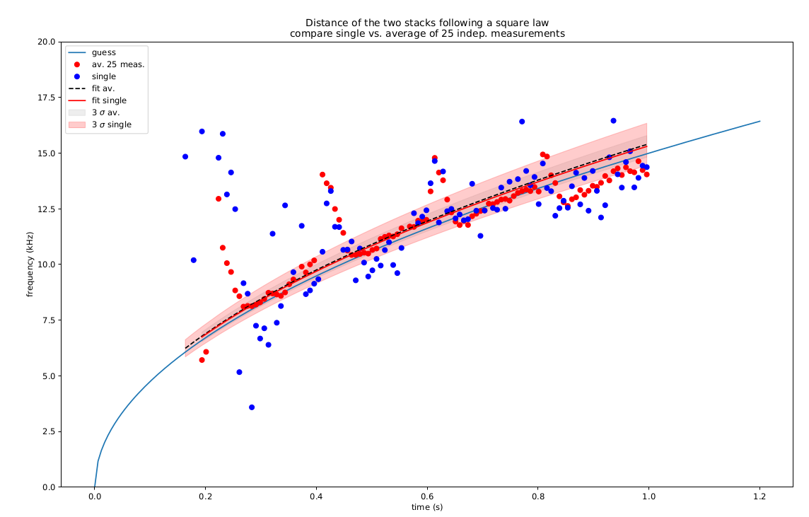
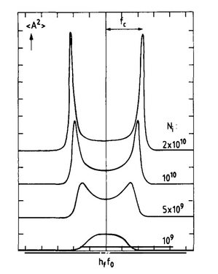
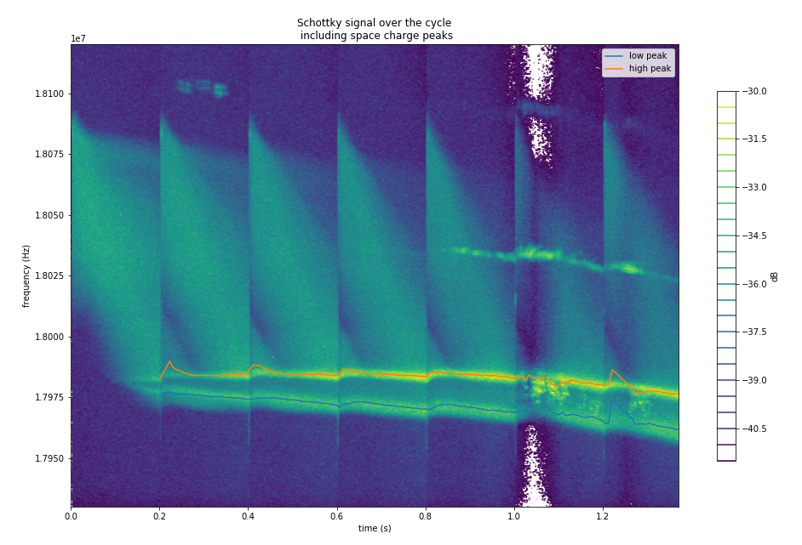
Longitudinal Schottky acquisitions
Improvement of signal quality of existing system
  improved signal quality and resolution compared to previous years
  Improvement of analysis quality by a new ansatz and techniques
  Improvement of software (iPhyton) to analyze the data directly → parameter scans
Injection efficiency:
Cooling efficiency
Dragging
Measure cooling time
LINAC3:
Initial beam characterization
Influence of ramping cavity parameters
Space charge:
Double peak effect
S. Hirlaender

Slide 16
Beam parameters at LEIR injection
Characterize beam parameters at LEIR injection by scanning the phase of ramping and debuncher cavity
  modifies mean energy and energy spread
  compared Linac3 profiles taken in LBS spectrometer line with Schottky measurements of the injected beam in LEIR
phases – deg
Series # | RC | DB
1 | 96 | 45
2 | 102 | 51
3 | 112 | 60
4 | 127 | 77
5 | 142 | 93
6 | 152 | 103
7 | 158 | 110
Linac3 team & S. Hirlaender et al.

Slide 17
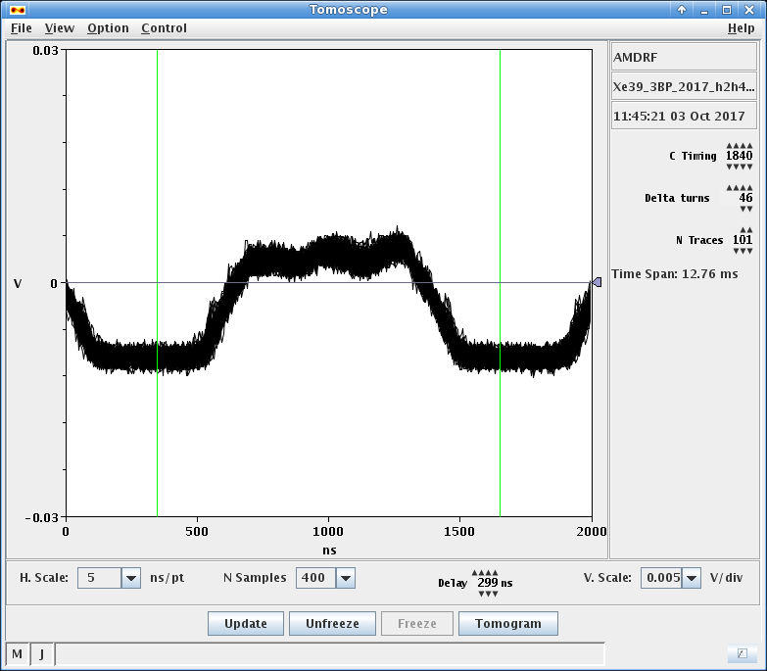
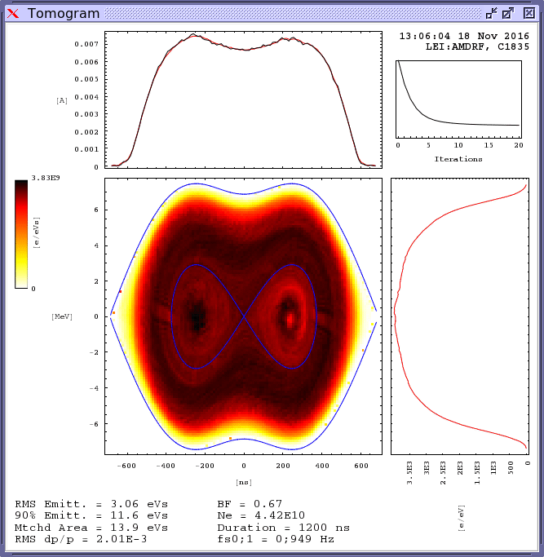
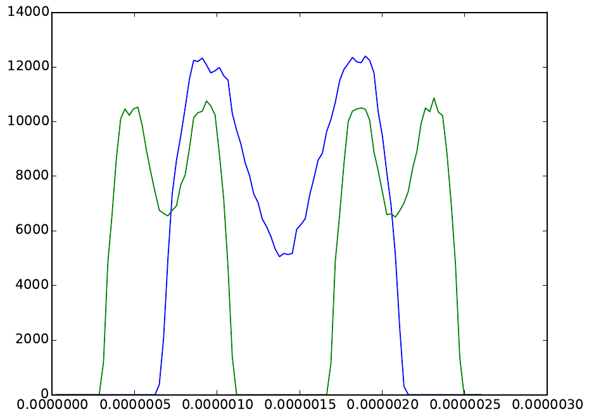
RF studies and commissioning
New LLRF features for studies and future beams
  Operation at h=3+6 (including extraction synchro): deployed and validated with beam
  Operation at triple harmonics (ex: h=2+4+6) with 2 cavities: deployed and validated with beam (proof of principle)
  Interfacing with new White Rabbit-based distribution of Btrain: deployed, to be validated soon.
Frequency modulation to be implemented with h=2+4+6
h=1+2 to be tested for high intensity beams
h=2+4+6 proof of principle
h=2+4
h=1+2
S. Albright, M.E. Angoletta

Slide 18
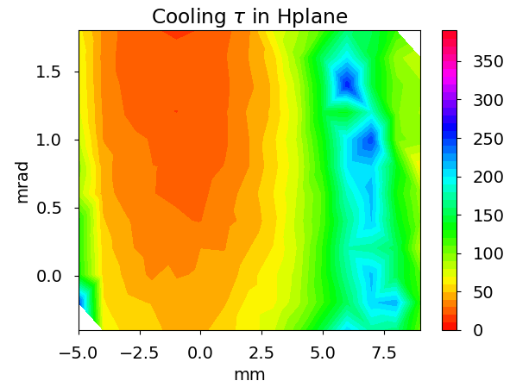
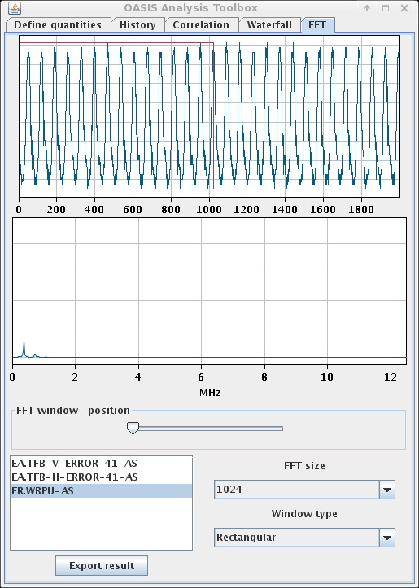
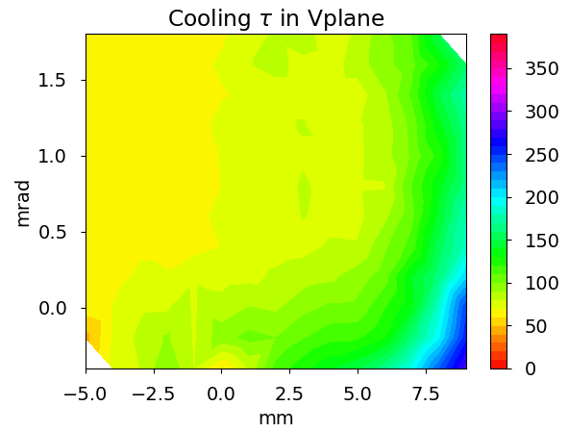
E-cooler studies
Measured cooling efficiency as function of closed orbit in cooler
  Clear optimum in H plane, indications of optimum also in V but losses already after injection
  Self-bunching observed in strongly cooled beams
Strong H cooling
frev
self bunching!
A. Latina, N. Biancacci

Slide 19
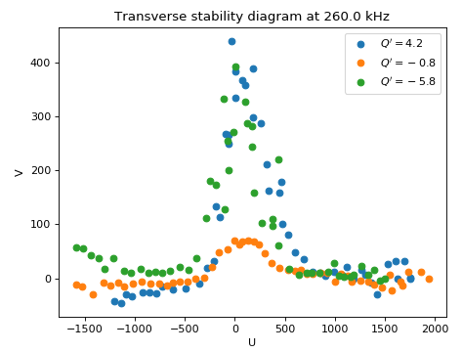
Impedance and instability studies
Transverse impedance:
  Tune shift vs intensity in both coasting
  and bunched beam (on going)
Stability:
  Beam transfer function (BTF) scans with/without cooler and as function of Q’
  Effect of Q’ on the transverse beam stability.
  Threshold of stability vs damper gain: 20% of the max gain enough to stabilize 8e10 accumulated charges.
BTF
BTF gives access to:
  Transverse stability diagram.
  Transverse impedance of the machine.
→ Beam SD increased for |Q’|>0
N. Biancacci et al.

Slide 20
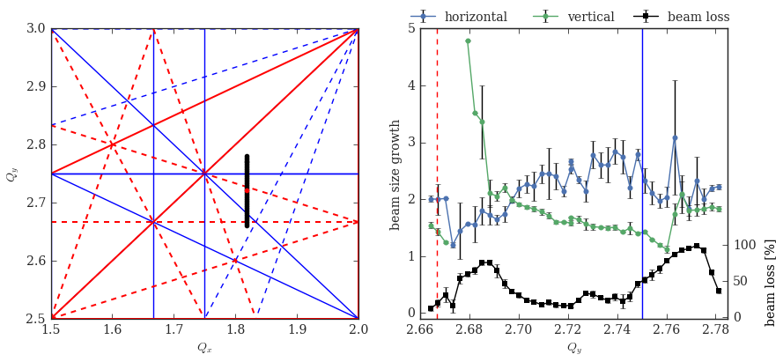
Space charge studies with Xe beams
Emittance growth and losses as function of working point
  In the region around operational working point (1.82, 2.72)
  Many resonances observed (as with Pb beams)
  Studies with different intensities ongoing to check if resonances excited by space charge itself
  Will be used for comparing with space charge simulations
A. Saa Hernandez, D. Moreno, et al.

Slide 21
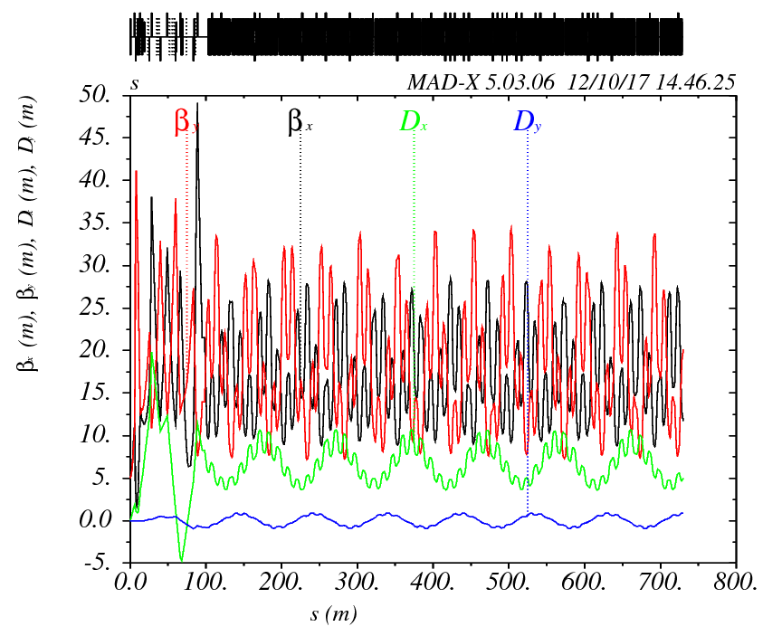
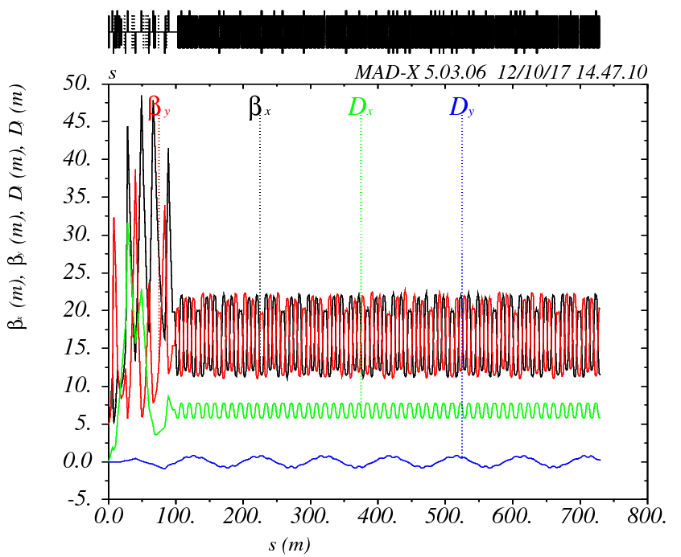
New LEIR to PS transfer line optics
Current TL optics is not matched to the PS periodic solution
  not possible to steer the line in a deterministic way, it is trial and error
  However, a VERY GOOD transmission efficiency can be reached ~ 100%
Effect of the main PS bend #25 taken into account for calculating new optics
  Stray fields give important deflection of incoming beam
  Was taken into account in original optics designed by C. Carli and M. Martini
  Included for calculating new matched optics
Current existing optics
new TL optics
TL
PS
LEIR extraction septum
R. Alemany Fernandez

Slide 22
Outline
Introduction and main challenges in view of LIU
Overview of 2017 MDs (plans)
Status of 2017 MDs with Xe
Summary and conclusions

Slide 23
Summary and conclusions
Main remaining challenges for PS-ion injectors
  Regularly deliver the required high beam intensity
  Gain intensity margin in LEIR to avoid operating at performance limit
Only selected machine studies in 2017 (operation with Xe-ions)
  Most of the MD subjects defined at the beginning of the year are being worked on / almost completed
  Motivated and enthusiastic team working on Linac3 and LEIR is gaining experience for next years production run

Slide 24
Thank you for your attention!

