Slide 2
High-frequency impedance measurements of coated waveguides
A.Passarelli, A. Andreone, H. Bartosik, O. Boine-Frankenheim
M.R. Masullo, G.Papari, G. Rumolo, V.G. Vaccaro

Slide 3
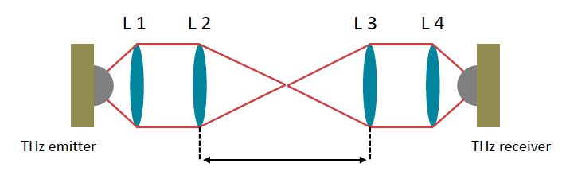
Goal
Study the electromagnetic properties of Amorphous Carbon coating in Sub-THz range.
DUT

Slide 4
CLIC Damping Rings
Parameters | CLIC @3 TeV
Energy [GeV] | 2.86
Circumference [m] | 427.5
RF voltage [MV] | 5.1
Damping time x/s [ms] | 2/1
Bunch population [10⁹] | 4.1
Hor. norm. emit. [nm.rad] | 500
Ver. norm. emit. [nm.rad] | 5
Bunch length [mm] | 1.8
Number of trains | 2
Bunches per train | 156
Bunch spacing [ns] | 1
Two DRs, one for
each species
The short rms σ_{z}=1.8 mm translates into
hundreds of GHz in the frequency domain.

Slide 5
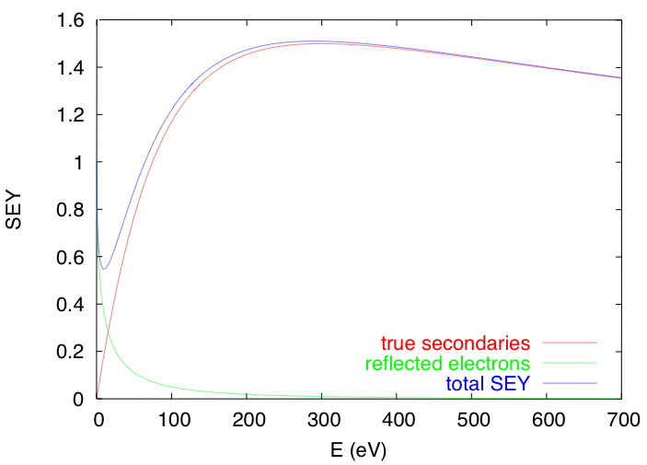
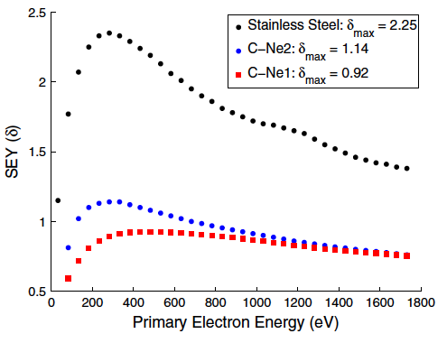
Electron Cloud
G. Rumolo, H. Bartosik and K. Li
USPAS Lectures
When electrons hit the pipe wall, they do not just disappear…..
  High energy electrons easily survive and actually multiply through secondary electron emission
  Low energy electrons tend to survive long because they are likely to be elastically reflected.
Secondary electron emission is governed by the curve below
θ
E_{p}
secondaries
elastically reflected
The electroectromagnetic (EM) characterization of a-C properties up to is required for the impedance modelling of the CLIC DR components.

Slide 6
Outline
Analytical evaluations
Measurement setup
Measurement results
Coatings
Conclusions
Next steps

Slide 7
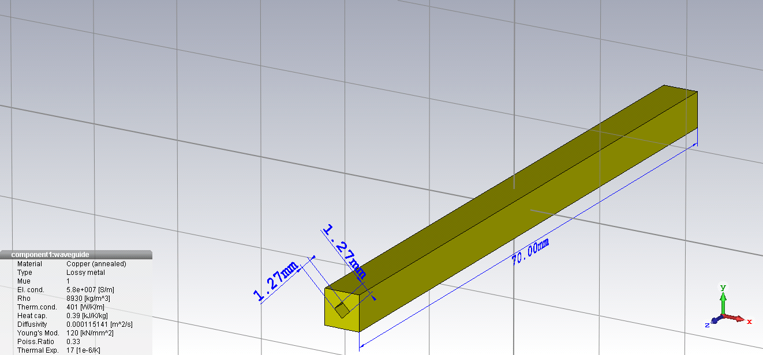
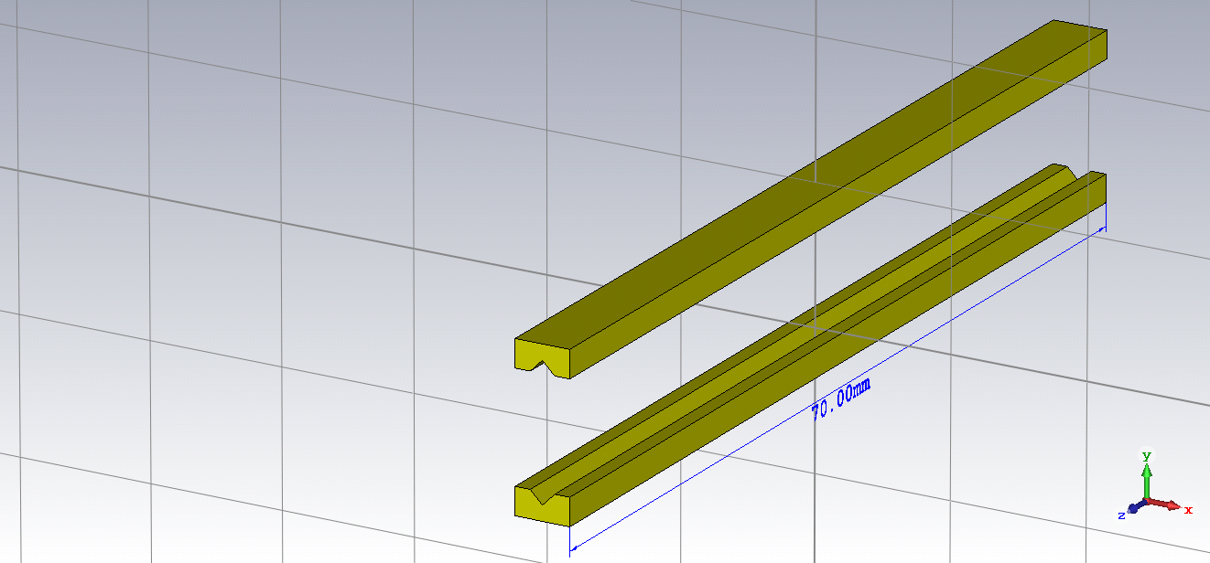
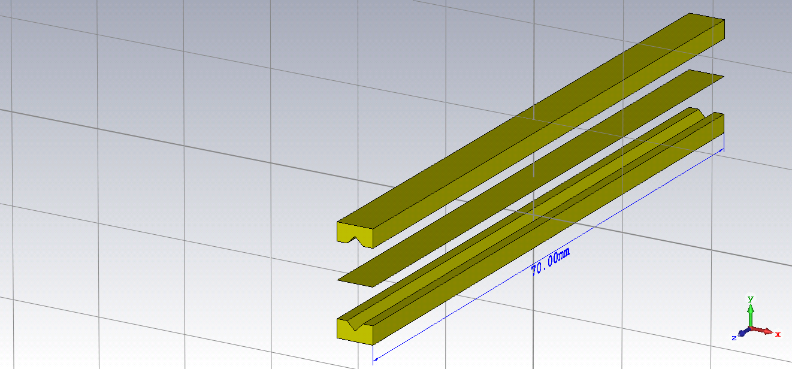
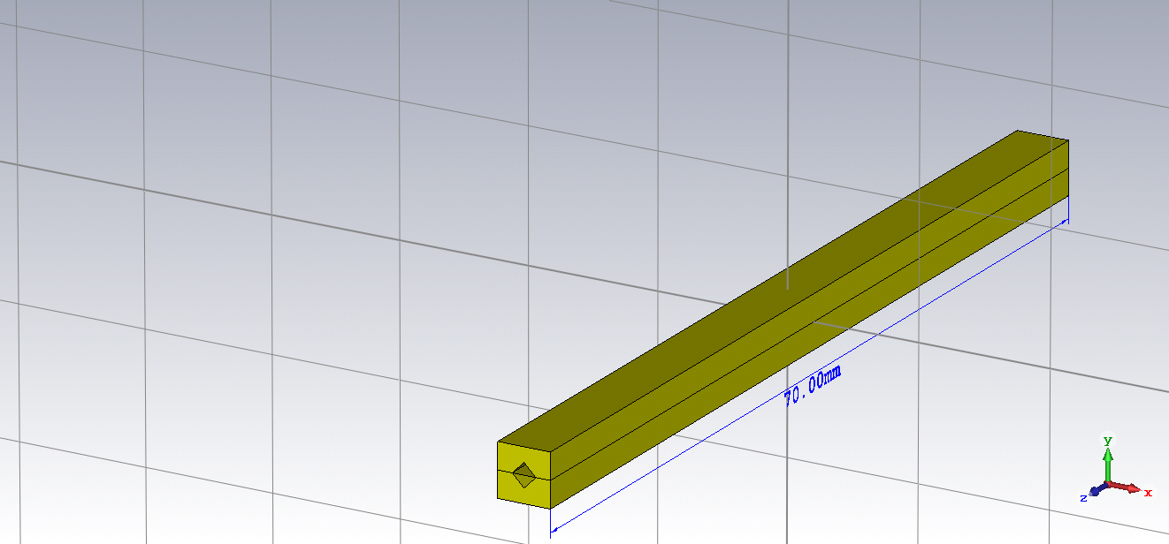

Waveguide
Square waveguide
copper conductivity: σ_{cu} = 6∙10⁷ S/m
waveguide length: 7cm
waveguide side: 1.27mm

Slide 8
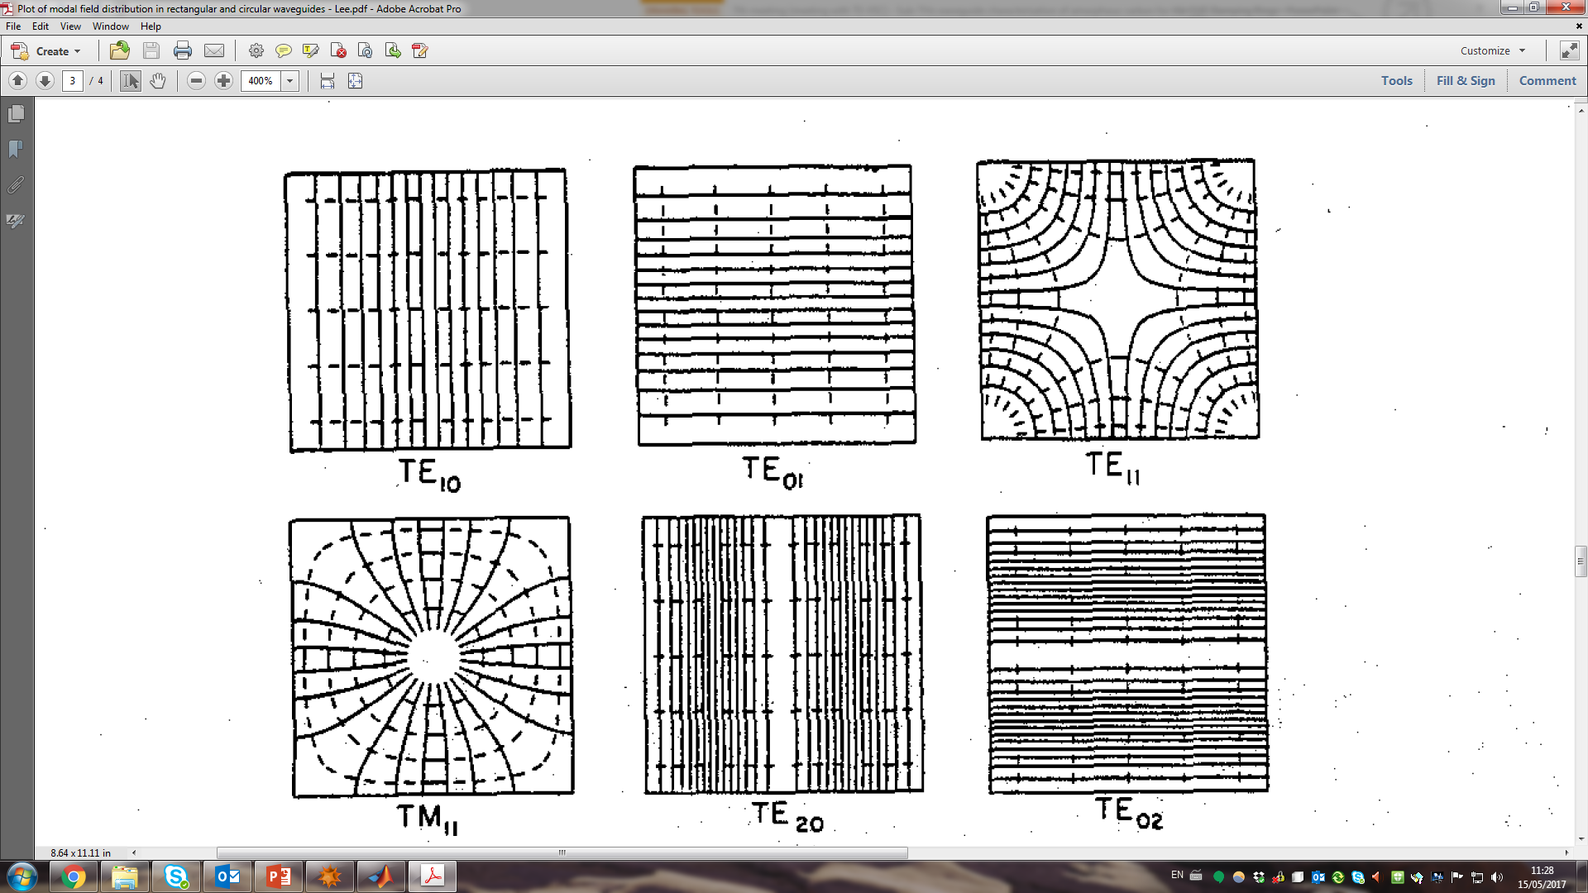
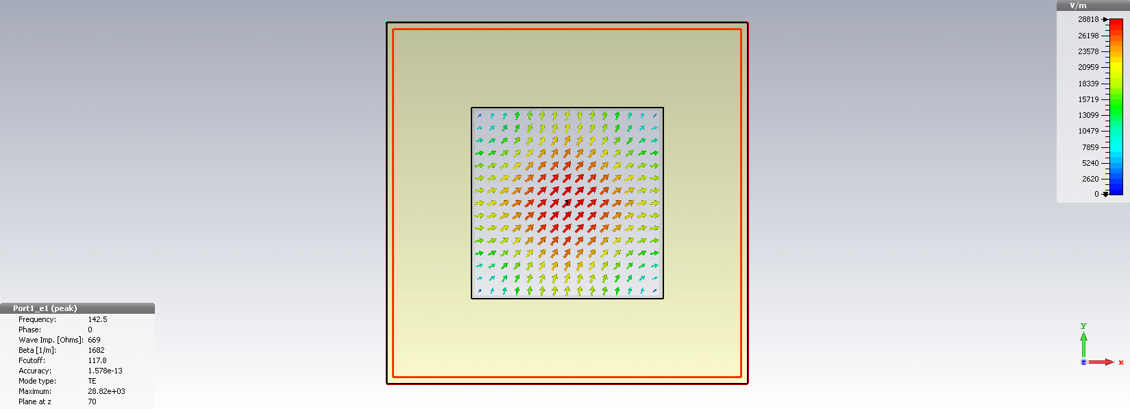
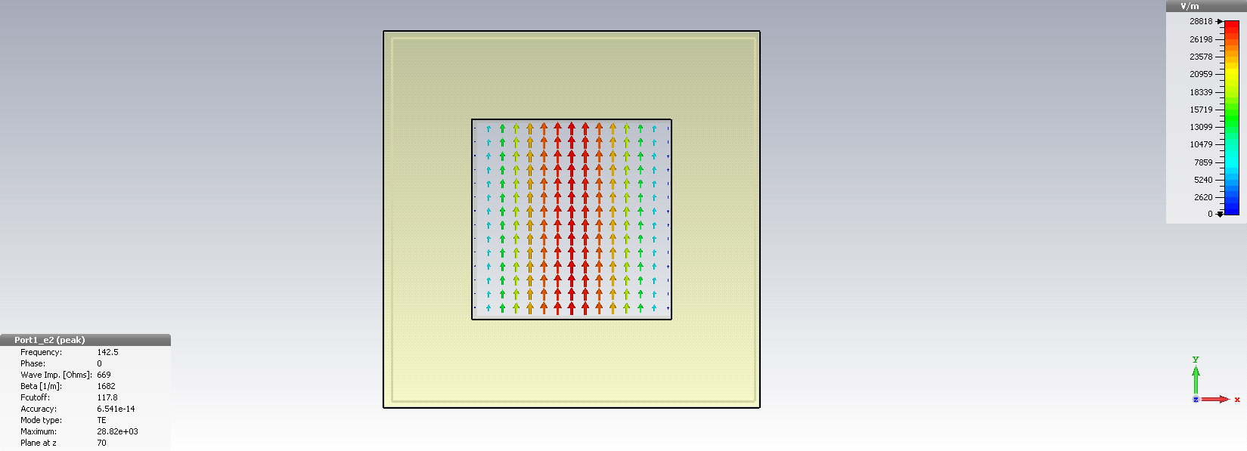
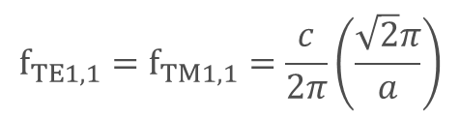

Analytical evaluations
$$f_{TE1,0}=f_{TE0,1}=\frac{ c }{2π}\left(\frac{π}{a}\right)$$
$${f_{TE1,1}=f}_{TM1,1}=\frac{ c }{2π}\left(\frac{\sqrt{2}π}{a}\right)$$
a
Waveguide side a [mm] | Frequency range [GHz]
1.27 | 120-170
The frequency range goes from f_{TE1,0}= f_{TE1,0} to f_{TE1,1}

Slide 9
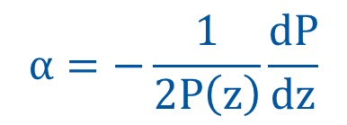
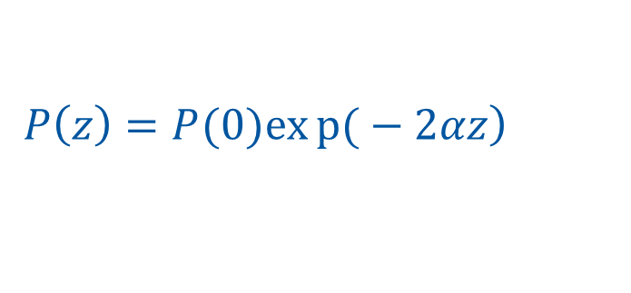
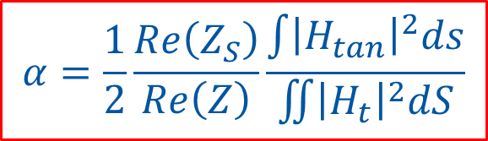
Analytical evaluations
Power attenuation per length unit α is defined by:
$$α=−\frac{1}{2P\left(z\right)}\frac{dP}{dz}$$
$$\left.P\left(z\right)=P(0)exp{(}−2αz\right)$$
The attenuation α due to the losses in the walls is:
$$α=\frac{1}{2}\frac{Re\left(Z_{S}\right)}{Re\left(Z\right)}\frac{\int{{\left|H_{tan}\right|}^{2}ds}}{\iint{{\left|H_{t}\right|}^{2}dS}}$$
N.Markuvitz – Waveguide Handbook
Z_{s} : surf. char.imp.
Z : mode char.imp.
H_{tan} : tang. mag. field
H_{t} : trans. mag. field

Slide 10
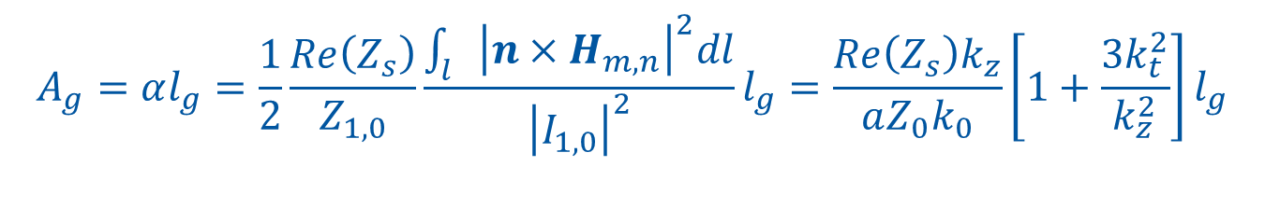
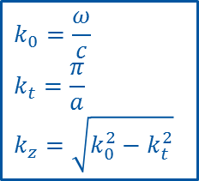
Analytical evaluations
The attenuation for TE_{1,0} mode:
Along the waveguide walls of length $l$:
$$A_{g}=αl_{g}=\frac{1}{2}\frac{Re\left(Z_{s}\right)}{Z_{1,0}}\frac{\int_{l}{{\left|n×H_{m,n}\right|}^{2}dl}}{{\left|I_{1,0}\right|}^{2}}l_{g}=\frac{Re\left(Z_{s}\right)k_{z}}{aZ_{0}k_{0}}\left[1+\frac{3k_{t}^{2}}{k_{z}^{2}}\right]l_{g}$$
$$k_{0}=\frac{ω}{c}$$
$$k_{t}=\frac{π}{a}$$
$$k_{z}=\sqrt{k_{0}^{2}−k_{t}^{2}}$$

Slide 11

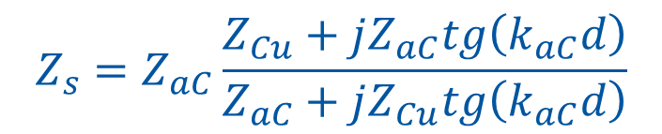


Analytical evaluations
Cu
aC
$$Z_{s}$$
$$Z_{s}$$
d
$$Z_{s}=Z_{aC}\frac{Z_{Cu}+jZ_{aC}tg\left(k_{aC}d\right)}{Z_{aC}+jZ_{Cu}tg\left(k_{aC}d\right)}$$
$$Z_{s}=Z_{Cu}$$

Slide 12
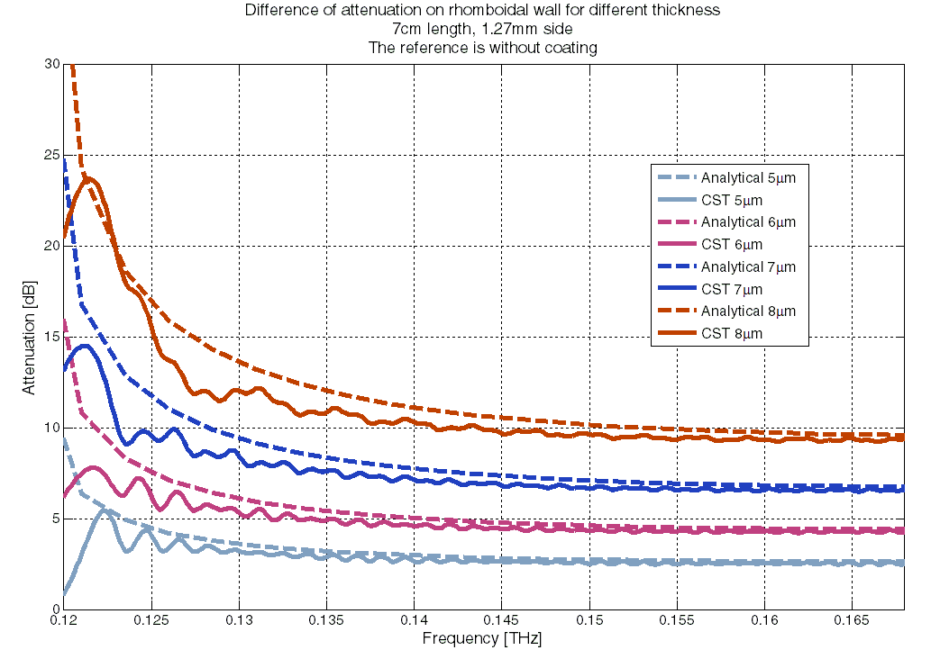
Analytical results
copper conductivity: σ_{cu} = 6∙10⁷ S/m aC conductivity:
waveguide length: 7cm
waveguide side: 1.27mm
σ_{ac} = 10⁴ S/m
Good agreement between TD CST simulations and analytical evaluations.
What happens with two modes?

Slide 13
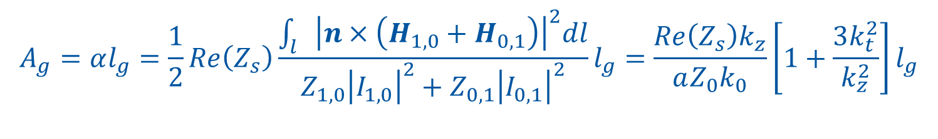
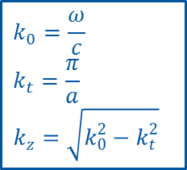
Analytical evaluations
The attenuation for both TE_{1,0} and TE _{0,1} mode:
Along the waveguide walls of length $l$:
$$A_{g}=αl_{g}=\frac{1}{2}Re\left(Z_{s}\right)\frac{\int_{l}{{\left|n×\left(H_{1,0}+H_{0,1}\right)\right|}^{2}dl}}{Z_{1,0}{\left|I_{1,0}\right|}^{2}+Z_{0,1}{\left|I_{0,1}\right|}^{2}}l_{g}=\frac{Re\left(Z_{s}\right)k_{z}}{aZ_{0}k_{0}}\left[1+\frac{3k_{t}^{2}}{k_{z}^{2}}\right]l_{g}$$
The attenuation is the same as the single mode case.
The losses on the walls for the two modes are just double of those of one mode alone as well as the flowing power.
$$k_{0}=\frac{ω}{c}$$
$$k_{t}=\frac{π}{a}$$
$$k_{z}=\sqrt{k_{0}^{2}−k_{t}^{2}}$$

Slide 14
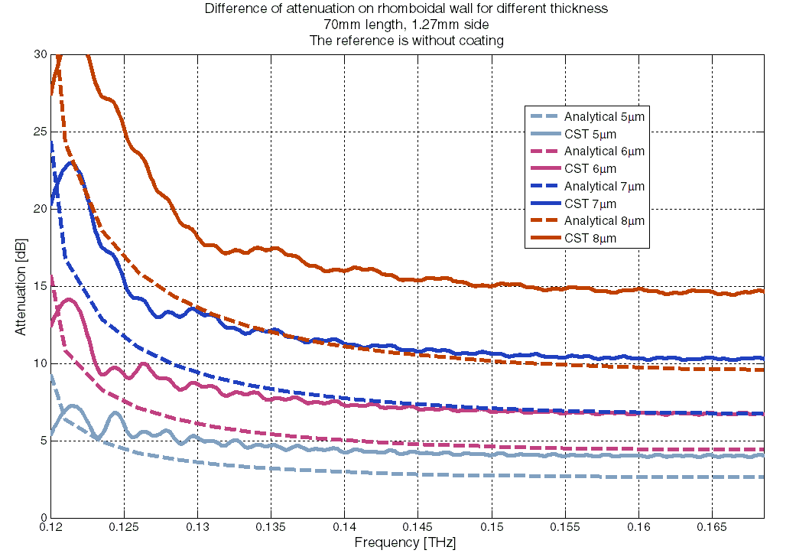
Analytical results
copper conductivity: σ_{cu} = 6∙10⁷ S/m aC conductivity: σ_{ac} = 10⁴ S/m
waveguide length: 7cm
waveguide side: 1.27mm
Bad agreement between TD CST simulations and analytical evaluations.
If we rotate the structure and polarization?

Slide 15
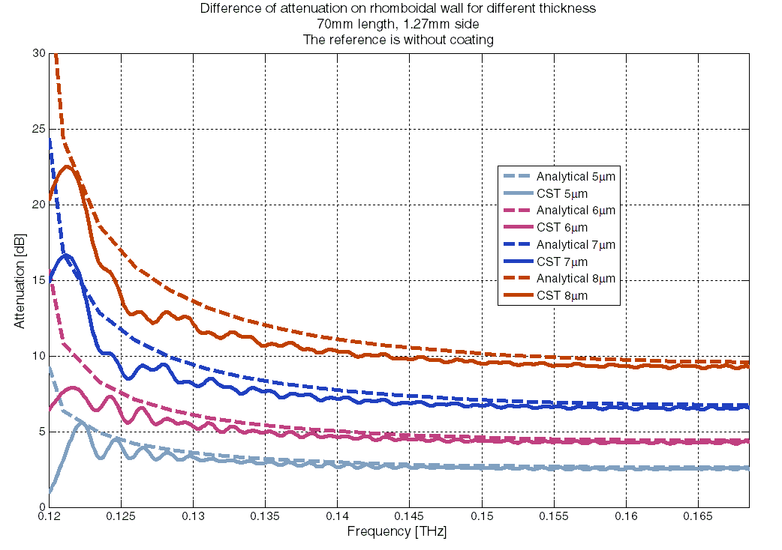
Analytical results
copper conductivity: σ_{cu} = 6∙10⁷ S/m aC conductivity: σ_{ac} = 10⁴ S/m
waveguide length: 7cm
waveguide side: 1.27mm
Good agreement between TD CST simulations and analytical evaluations
if we coherently rotate the structure and the polarization.

Slide 16
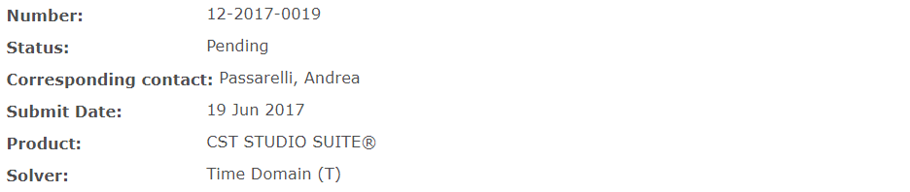
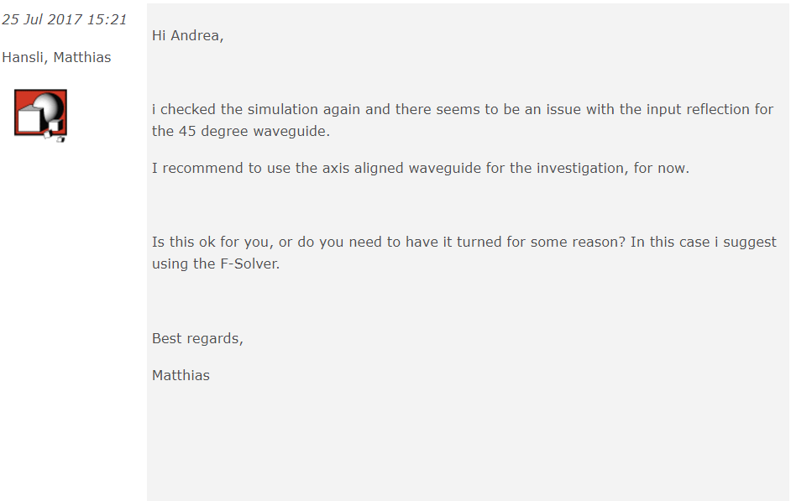
It is time to contact CST support

Slide 17
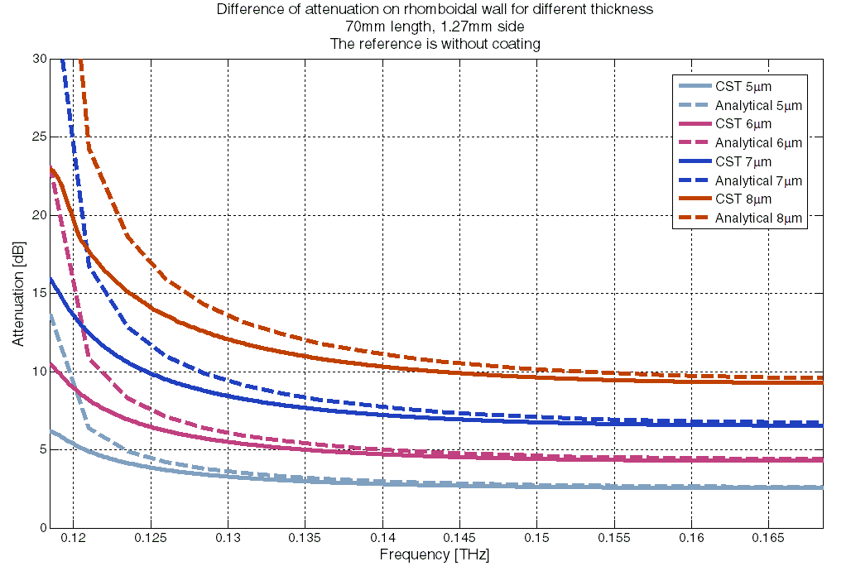
Analytical results
copper conductivity: σ_{cu} = 6∙10⁷ S/m aC conductivity: σ_{ac} = 10⁴ S/m
waveguide length: 7cm
waveguide side: 1.27mm
Good agreement between FD CST simulations and analytical evaluations.
If we coat a central foil?

Slide 18
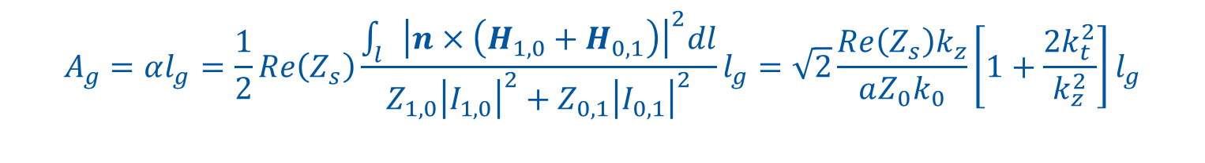
Analytical evaluations
The attenuation for both TE_{1,0} and TE _{0,1} mode:
Along the foil of length l:
$$A_{g}=αl_{g}=\frac{1}{2}Re\left(Z_{s}\right)\frac{\int_{l}{{\left|n×\left(H_{1,0}+H_{0,1}\right)\right|}^{2}dl}}{Z_{1,0}{\left|I_{1,0}\right|}^{2}+Z_{0,1}{\left|I_{0,1}\right|}^{2}}l_{g}=\sqrt{2}\frac{Re\left(Z_{s}\right)k_{z}}{aZ_{0}k_{0}}\left[1+\frac{2k_{t}^{2}}{k_{z}^{2}}\right]l_{g}$$

Slide 19
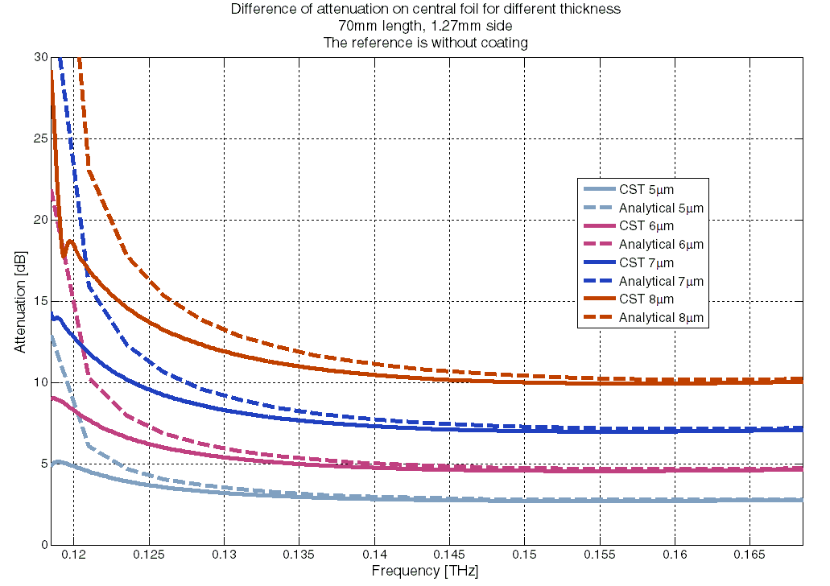
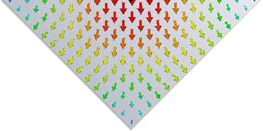
Analytical results
copper conductivity: σ_{cu} = 6∙10⁷ S/m aC conductivity: σ_{ac} = 10⁴ S/m
waveguide length: 7cm
waveguide side: 1.27mm
Good agreement between FD CST simulations and analytical evaluations.
We need two pyramidal transitions…

Slide 20
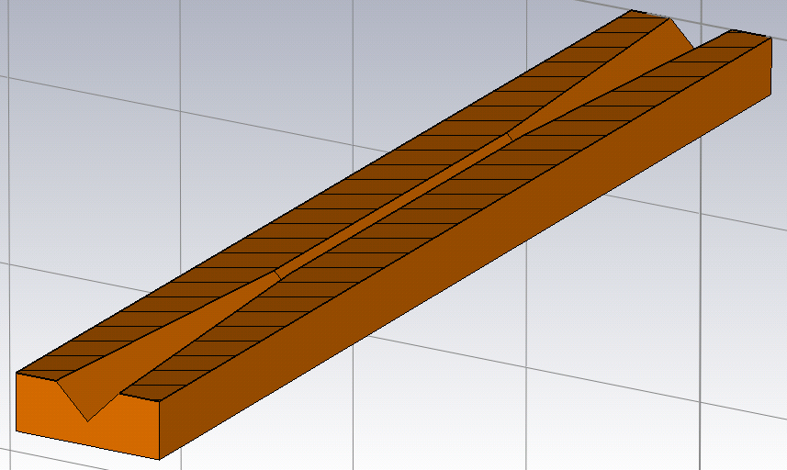
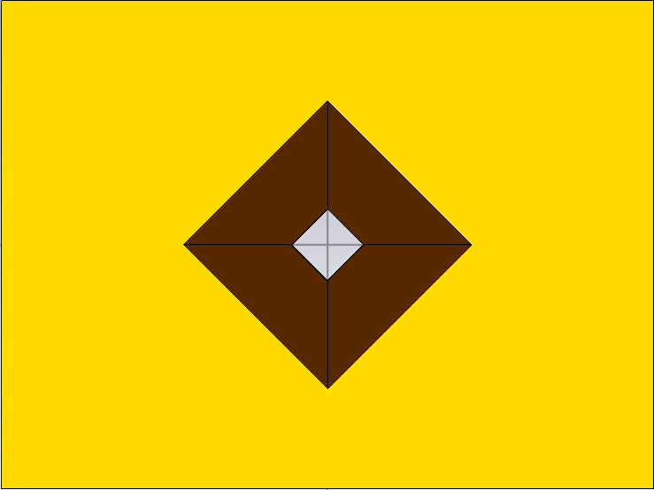

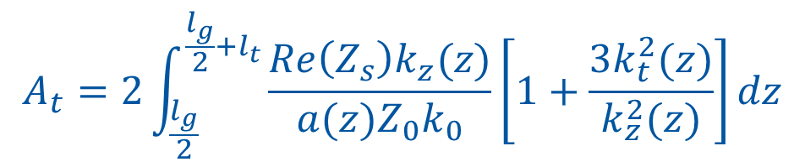
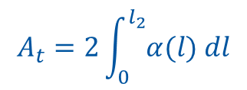
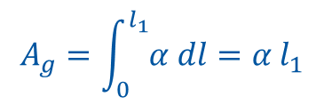
Analytical evaluations
Pyramidal transitions to enhance the signal collection.
$$A_{g}=\int_{0}^{l_{1}}{α dl=α l_{1}}$$
$$A_{t}=2\int_{0}^{l_{2}}{α(l) dl}$$
The attenuation for both TE_{1,0} and TE _{0,1} mode:
Along the waveguide walls of length $l$:
$$A_{t}=2\int_{\frac{l_{g}}{2}}^{\frac{l_{g}}{2}+l_{t}}{\frac{Re\left(Z_{s}\right)k_{z}(z)}{{a(z)Z}_{0}k_{0}}\left[1+\frac{3k_{t}^{2}(z)}{k_{z}^{2}(z)}\right]dz}$$
$$k_{0}=\frac{ω}{c}$$
$$k_{t}=\frac{π}{a}$$
$$k_{z}=\sqrt{k_{0}^{2}−k_{t}^{2}}$$

Slide 21
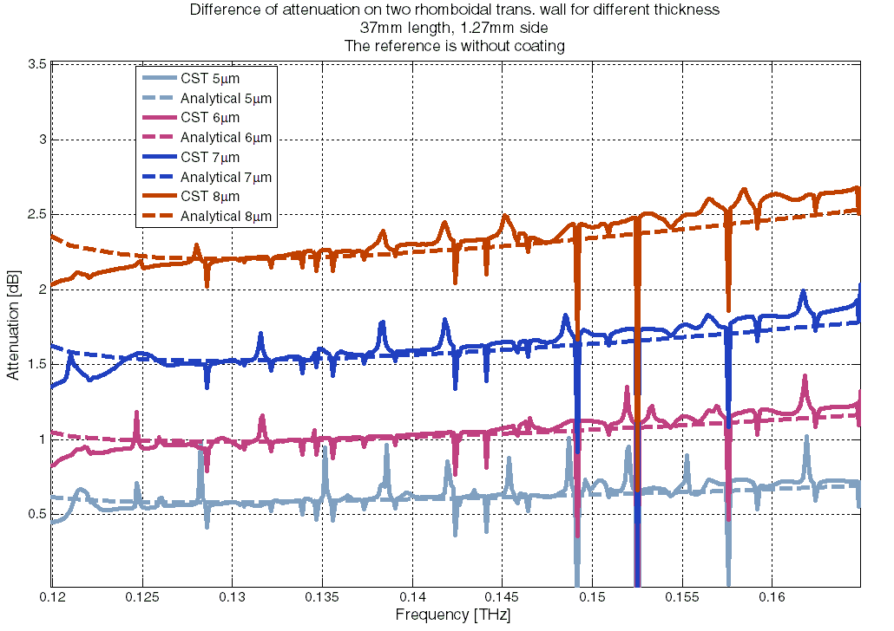
Analytical results
copper conductivity: σ_{cu} = 6∙10⁷ S/m aC conductivity: σ_{ac} = 10⁴ S/m
transition length: 3.7cm
transition side: 5mm → 1.27mm
Good agreement between FD CST simulations and analytical evaluations.
If we coat a central foil?

Slide 22
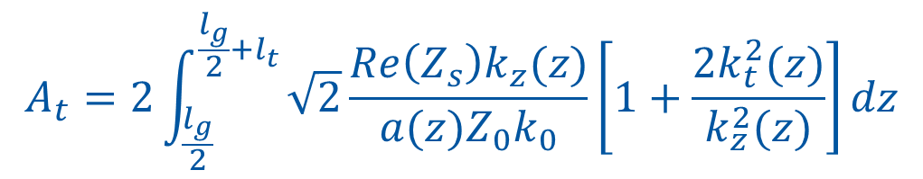
Analytical evaluations
The attenuation for both TE_{1,0} and TE _{0,1} mode:
Along the foil of length l:
$$A_{t}=2\int_{\frac{l_{g}}{2}}^{\frac{l_{g}}{2}+l_{t}}{\sqrt{2}\frac{Re\left(Z_{s}\right)k_{z}(z)}{a(z)Z_{0}k_{0}}\left[1+\frac{2k_{t}^{2}(z)}{k_{z}^{2}(z)}\right]dz}$$

Slide 23
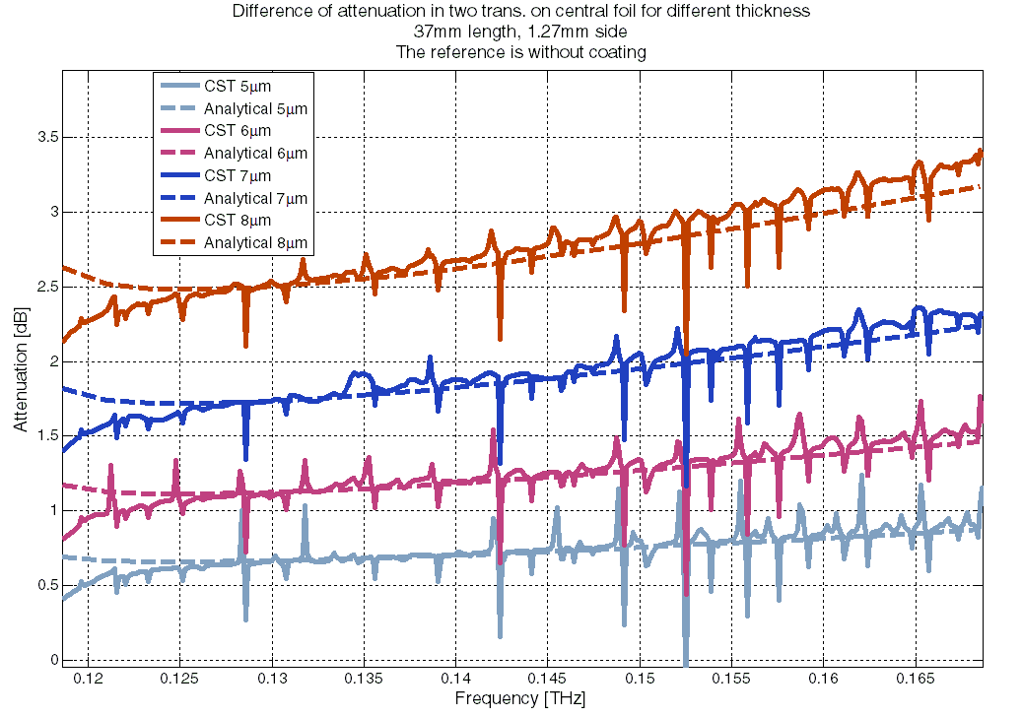
Analytical results
copper conductivity: σ_{cu} = 6∙10⁷ S/m aC conductivity: σ_{ac} = 10⁴ S/m
transition length: 3.7cm
transition side: 5mm → 1.27mm
Good agreement between FD CST simulations and analytical evaluations.

Slide 24
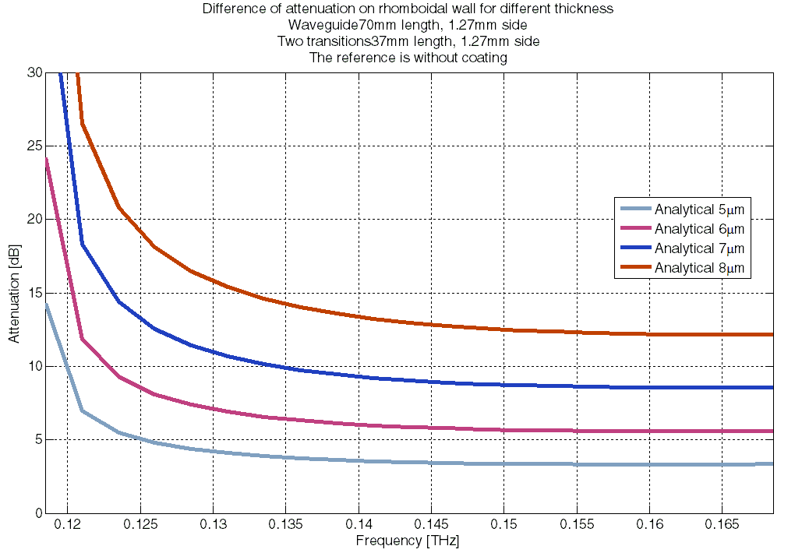
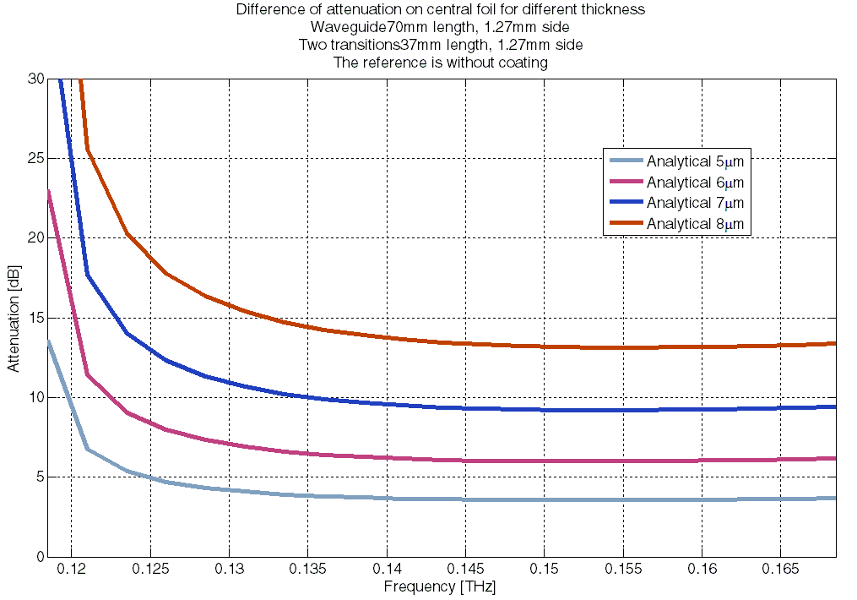
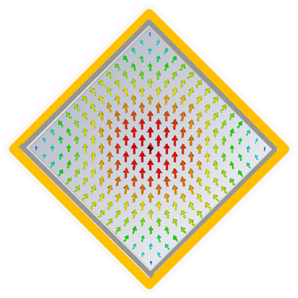
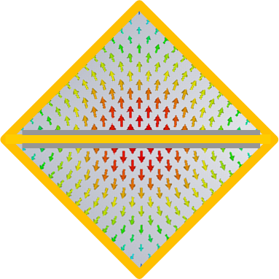
Analytical results
Comparison between attenuation on walls and on foil for different thickness
The signal attenuation along a central coated slab is equal to the one on coated walls.
The advantages of the setup with the central coated slab are:
  intrinsic simplification of the manipulation of all the setup.
  possibility to have a uniform deposition on the slab.

Slide 25
Outline
Analytical evaluations
Measurement setup
Measurement results
Coatings
Conclusions
Next steps

Slide 26
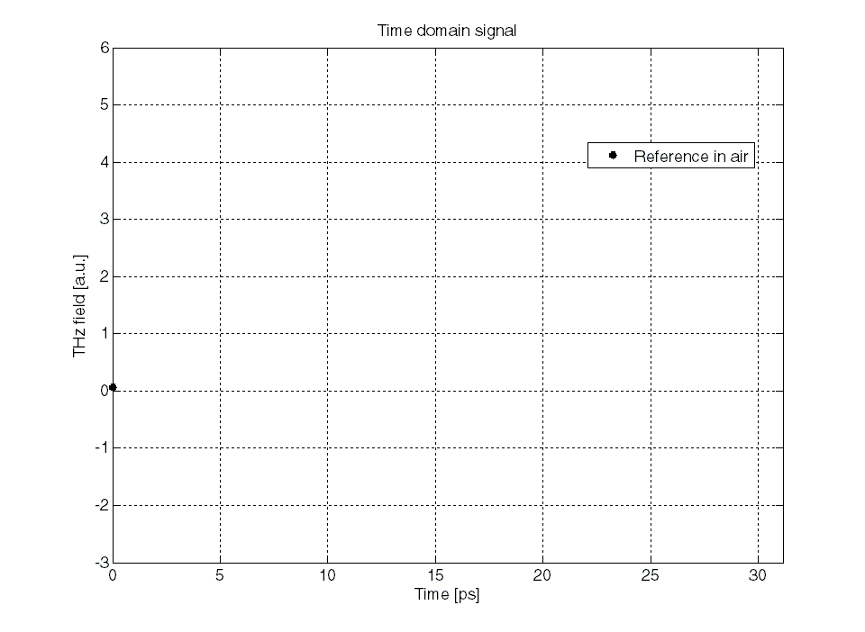
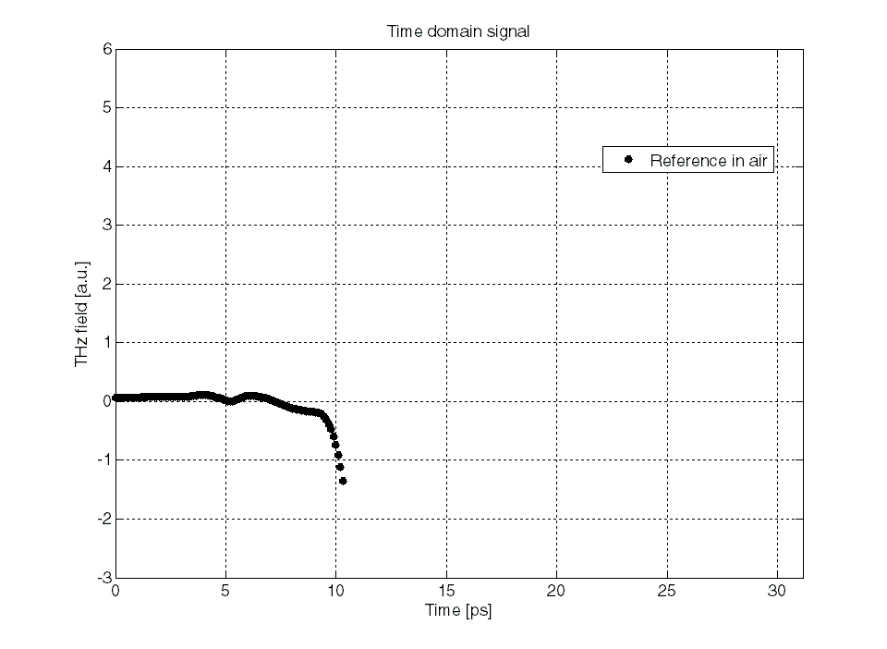
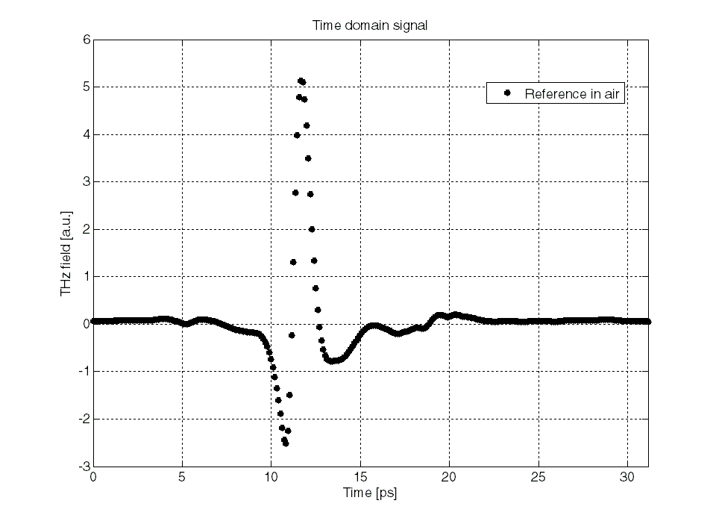

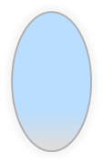
Measurement system
System specifications:
Spectral Range: > 3 THz
Dynamic Range > 70 dB
Scanning Range ~400ps
Spectral Resolution < 3GHz
±15V
Supply
Vin
Out
PA310
T-Light/
FS-Laser
PortA
2F
Tx
Tera15-SL25-FC
Rx
Tera15-DP25-FC
PortB
Attenuator
1
0
Input fiber port
100
ODU
N
DDS Out1
Output fiber port
Lens1
Lens2
Lens3
Lens4

Slide 27
Outline
Analytical evaluations
Measurement setup
Measurement results
Coatings
Conclusions
Next steps

Slide 28
Two different configurations
Adapted “confocal” geometry
152mm
120mm
Lens1
Lens2
spot diameter 2.4 mm
< 5 mm aperture!
Lens3
Lens4
Collimated geometry
8 mm
120mm
Lens1
5 mm aperture!
Lens4

Slide 29
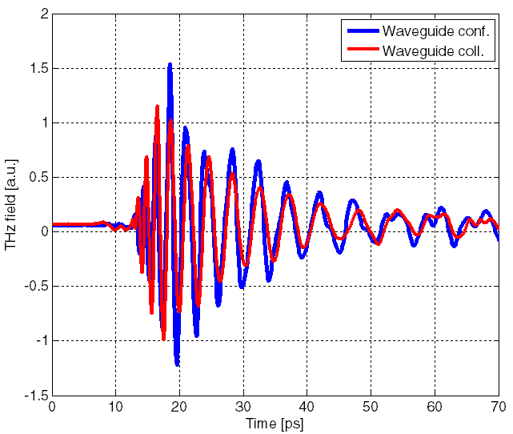
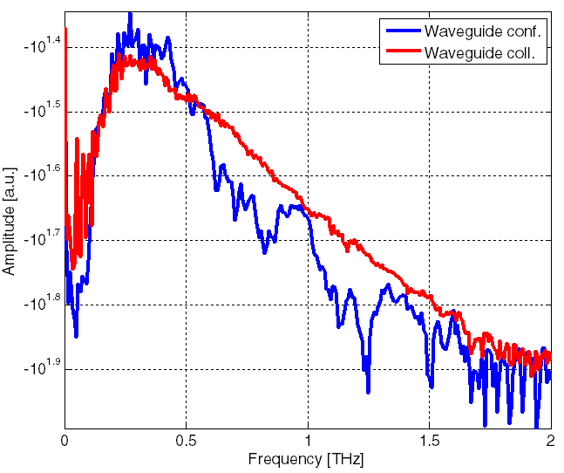
Comparison
Two geometries show similar results.
The collimated geometry is preferred for the planar wave similarity.

Slide 30
Outline
Analytical evaluations
Measurement setup
Measurement results
Coatings (in collaboration with TE-VSC-SCC)
Conclusions
Next steps

Slide 31
Coatings
C. Yin Vallgren
CERN-THESIS-2011-063
DC magnetron sputtering system

Slide 32
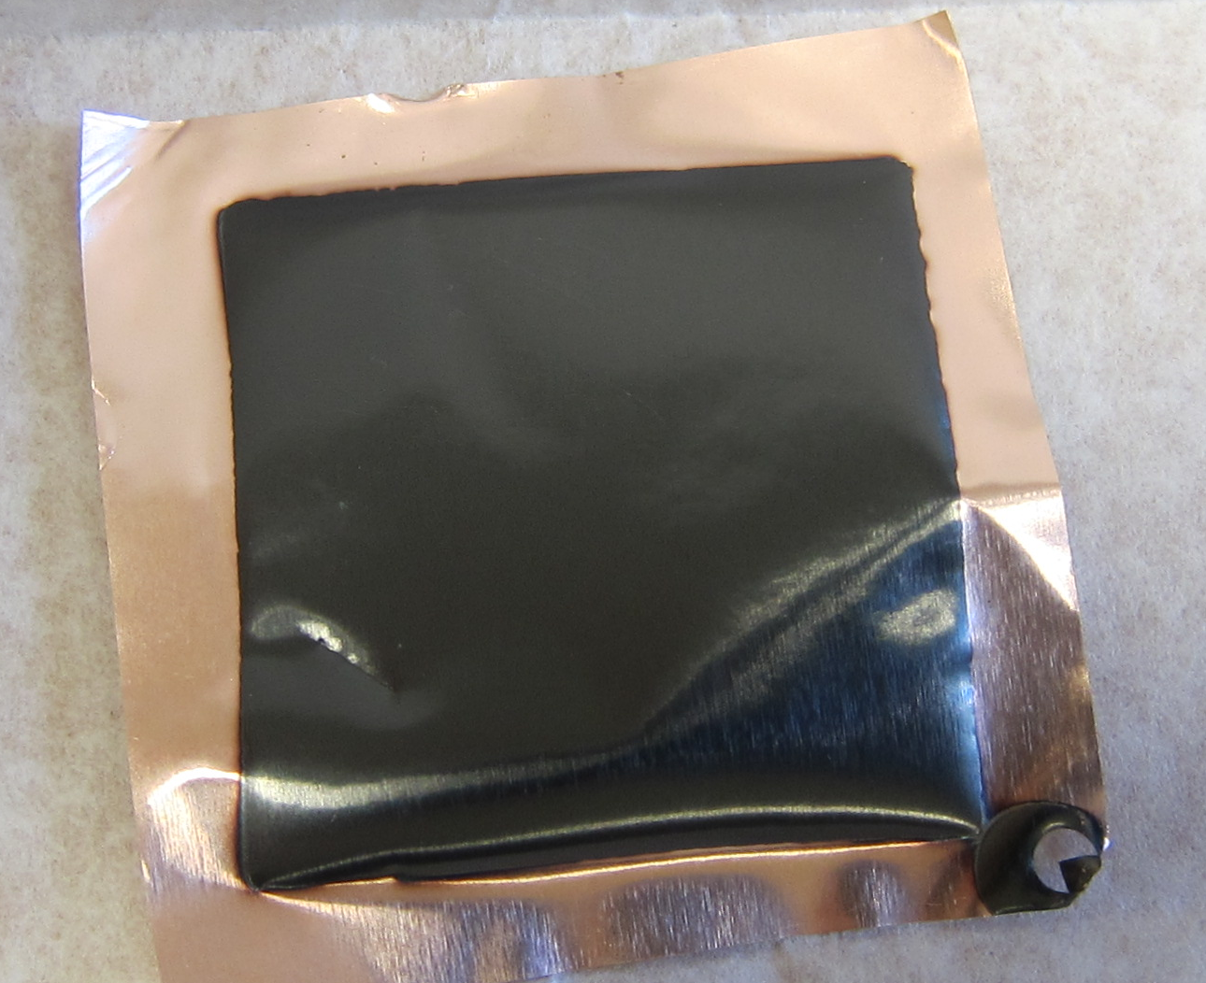
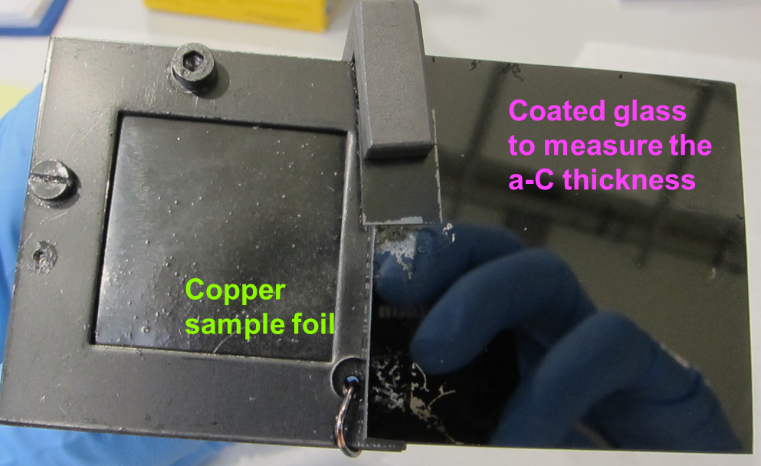
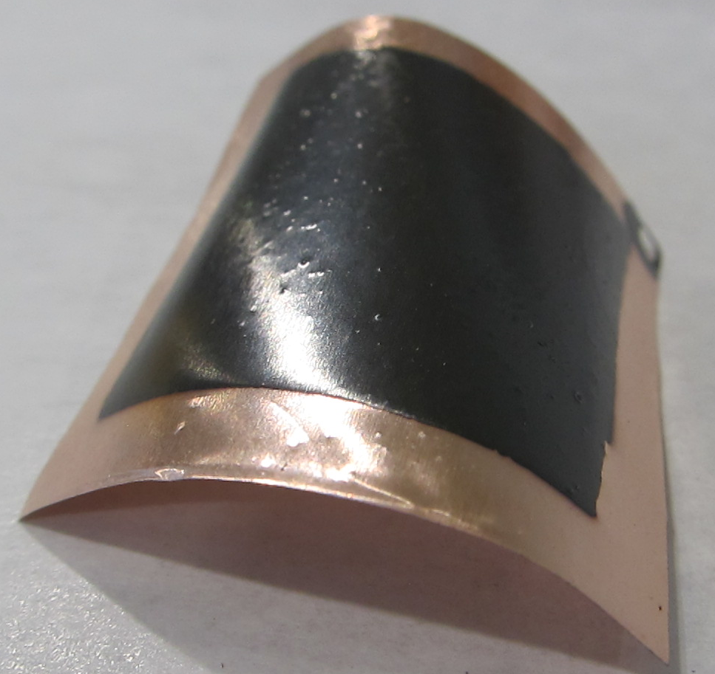
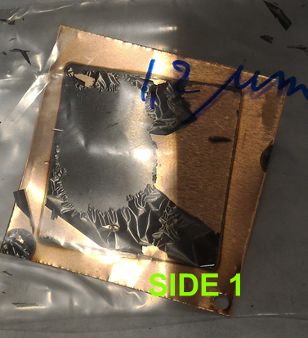




Coatings
One side coating
Good thickness 5μm No Peel off
Sample under stress.
Two sides coating
Good thickness ~5μm
Peel off
No stress on foil

Slide 33
Backup solution
E. Koukovini Platia
CERN-THESIS-2015-152
Use the NEG Coatings as Eirini K.P. did in her thesis to validate our measurement method

Slide 34

Backup solution
We need from 4 to 5 μm of NEG coating thickness on copper foil

Slide 35
Outline
Analytical evaluations
Measurement setup
Measurement results
Coatings
Conclusions
Next steps

Slide 36
Conclusions
Good agreement between Analytical evaluation and CST FD solver.
The rhomboidal waveguides is used to have a smoother transition with pyramidal horns.
The collimated geometry is preferred for the planar wave similarity.
We will use a foil as long as the entire length of the guide + transitions.
Problems in the a-C coating process.
Evaluate NEG conductivity to validate measurement method.

Slide 37




Next steps
Have 5 μm of NEG coatings on copper foil
Evaluate NEG conductivity

Slide 38
Thank you!

Slide 39
Backup slides

Slide 40

CST support reply
Simulation considering the coating thickness of 1um.
The attenuation is similar for all the simulation in frequency domain and in the time domain with the waveguide aligned to the axis.
The simulation with the “rotated” waveguide show different results also increasing the number of meshes.

Slide 41

Skin depth

Slide 42

Analytical results
copper conductivity: σ_{cu} = 6∙10⁷ S/m aC conductivity: σ_{ac} = 10⁴ S/m
waveguide length: 7cm
waveguide radius: 0.9mm
6/7 μm of aC coating thickness is needed to appreciate a signal attenuation.

Slide 43

Analytical results
copper conductivity: σ_{cu} = 6∙10⁷ S/m aC conductivity: σ_{ac} = 10⁴ S/m
waveguide length: 7cm
waveguide radius: 0.9mm
6/7 μm of aC coating thickness is needed to appreciate a signal attenuation.

