Slide 1

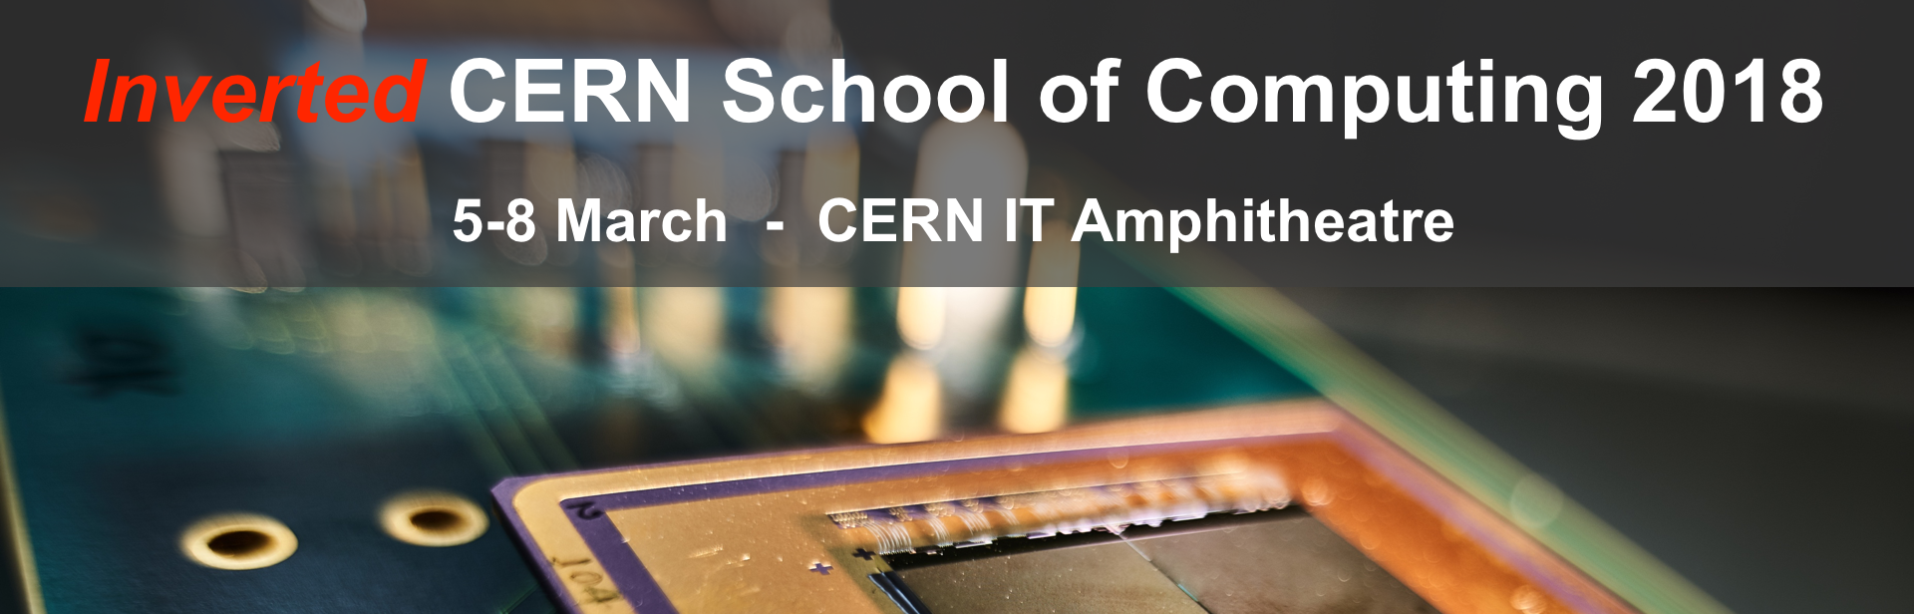
Welcome to
http://indico.cern.ch/e/iCSC-2018
Sebastian Lopienski
CERN School of Computing director
Notes:
I warmly welcome you all, lecturers and attendees alike, to this Inverted CERN School of Computing (iCSC) 2018. There are three reasons why I feel particularly happy and privileged to be writing these words.
First, this year we have a very rich program, based on proposals received from students of the main CSC 2017 (Madrid, Spain) and the Thematic CSC 2017 (Split, Croatia). It consists of a record 13 hours of lectures and 7 hours of hands-on exercises (a novelty!). Topics include Blockchain and Decentralized Consensus, Backend Systems, Complexity and Data Structures, Data Analysis, Identity Federation, Medical Imaging and Parallel Programming, and more. I’m sure you will find them both relevant and interesting!
Secondly, this is already the 11th edition of the Inverted CSC. It was founded by one of my predecessors, François Fluckiger, in 2005 (initially, the Inverted School did not take place every year). His idea was give the floor to former students of the main CERN School of Computing, so that they could share their knowledge and expertise with their colleagues. The fact that we've reached the 11th edition this year, and that we actually received more proposals for lectures than we were able to accommodate, proves that this idea is still valid.
And finally, on a more personal note, the Inverted CSC remains close to my heart. I was one of the lecturers of its first edition back in 2005, giving a lecture about software security - even though I worked on something else at that time. I still remember how this experience had pushed me to develop further my knowledge and passion in security, and - consequently - heavily influenced my professional life. I hope this year’s iCSC will have a similar positive impact on the careers of the lecturers!
I wish to thank the lecturers for their significant work put in preparing the lectures; the mentors for their invaluable input and feedback; Joelma Tolomeo (the School’s Administrative Manager) and Nikos Kasioumis (the Technical Manager) for the work behind the scenes; and finally, you - the attendees - for your interest.
Please join me in enjoying this great learning and knowledge-sharing experience!
* Just like the main CSC, iCSC is not a conference (where people present what they’ve done) but a “real” school (where selected speakers give series of lectures)
* Just like the main CSC, Inverted CSC is not a conference (where people present what they’ve done) but a “real” school (where selected speakers, past CSC students, have put significant efforts to prepare high quality lectures and exercises)
* Lectures will provide state-of-the-art knowledge on important, very relevant and trending topics that are likely to have impact on many aspects of computing in the coming years. These topics include: Parallel Programming, Algorithm Complexity and Data Structures, Backend Systems, Blockchain and Decentralized Consensus, Identity Federation, Medical Imaging, etc.
* A novelty this year is 7 hours of hands-on, practical exercises - which complement the theory lectures.
* More generally: computer science is (obviously) a constantly evolving domain; new techniques, paradigms or approaches can revolutionise how we (computer engineers, physicists) work; and Inverted CSC helps sharing knowledge and learning early the details of such trends.
* Other CSC: Thematic CSC applications close in a week (March 11); main CSC applications will open very soon (mid-March); so interested people should apply!

Slide 2
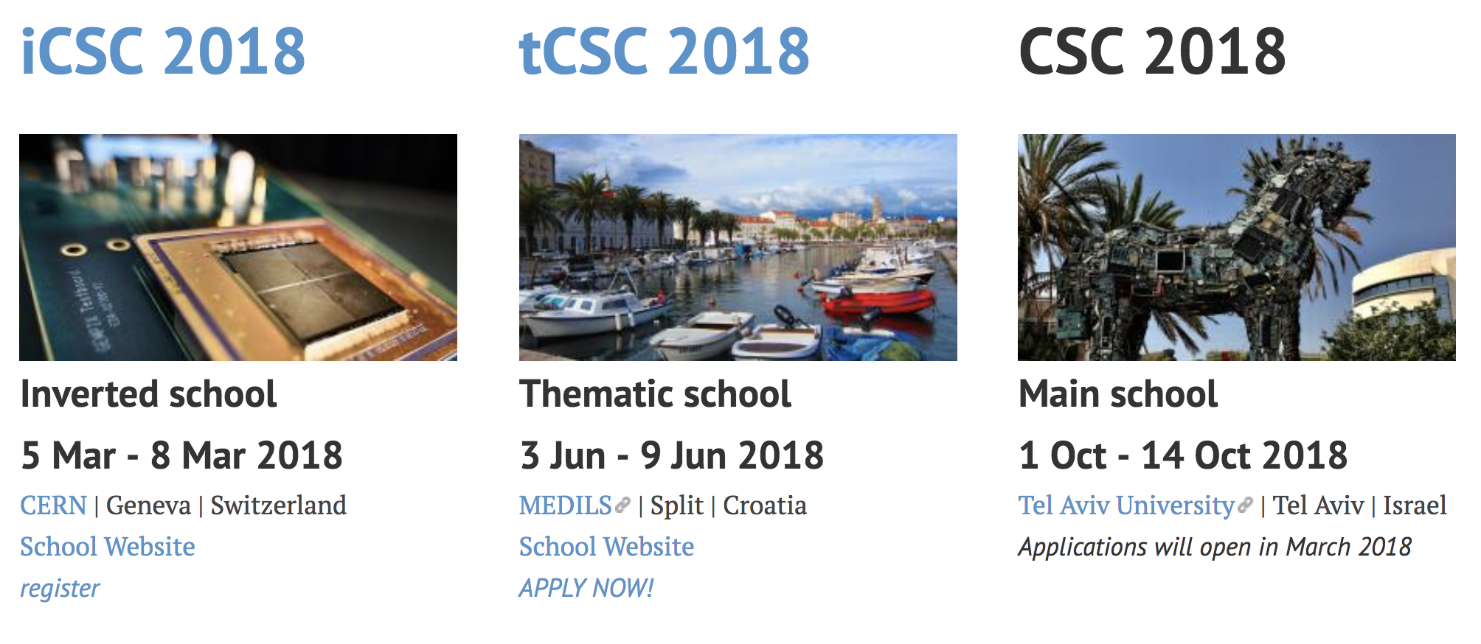
Three CERN Schools of Computing

Slide 3
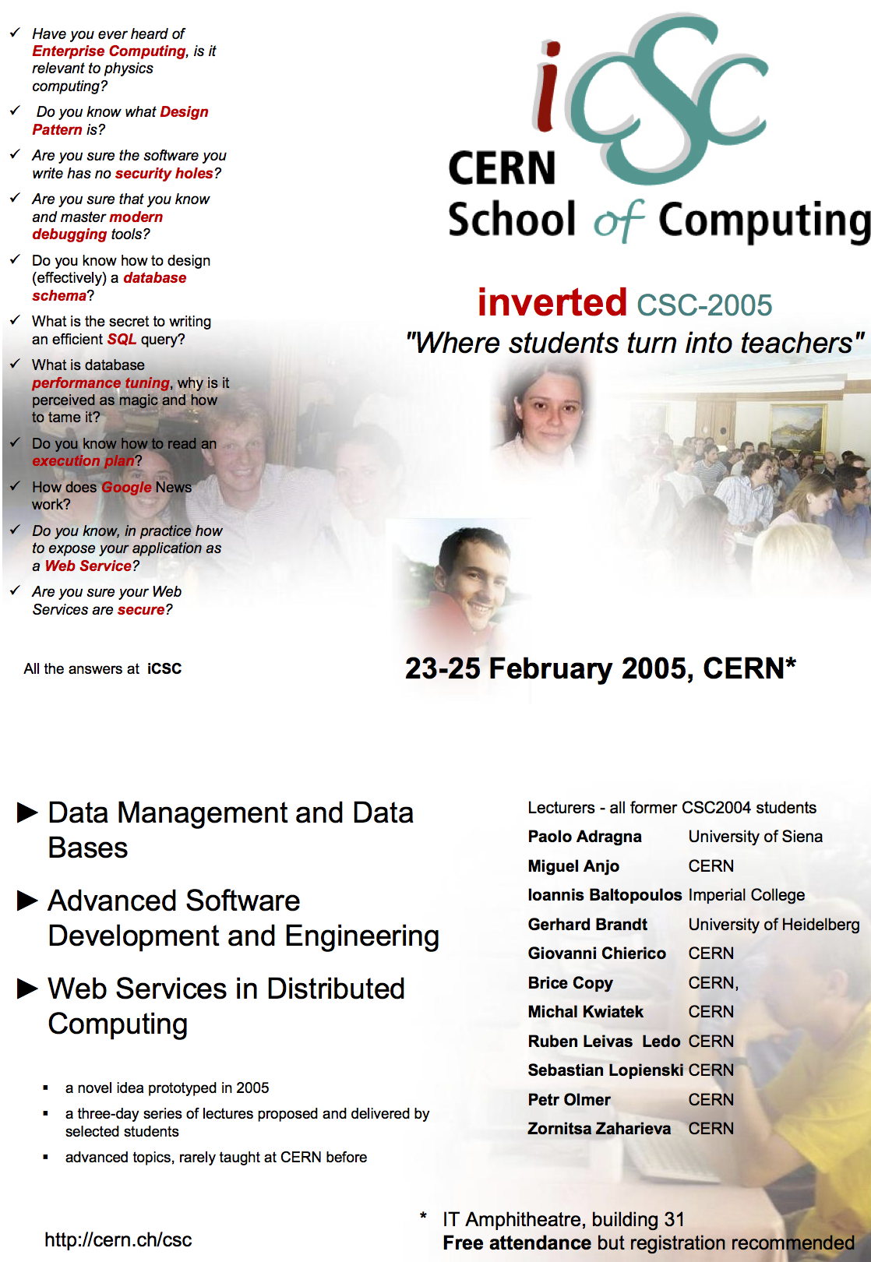
Back in
2005…
“Where students turn into teachers”

Slide 4
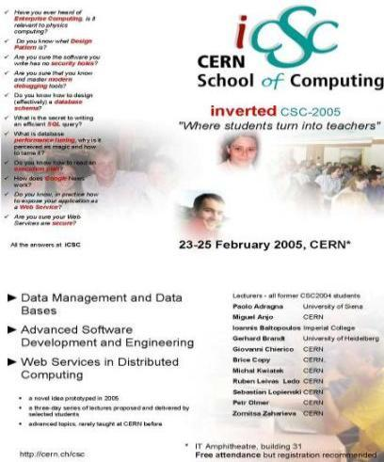
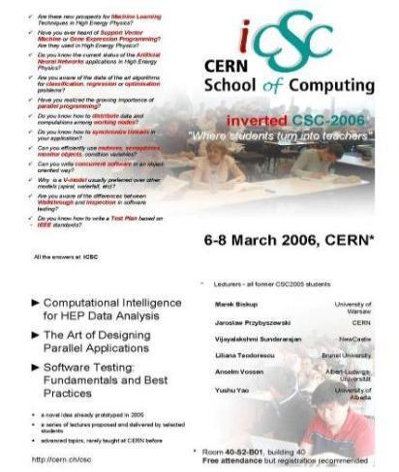
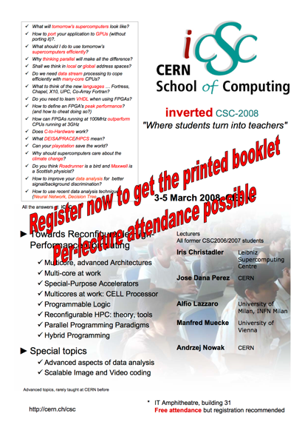
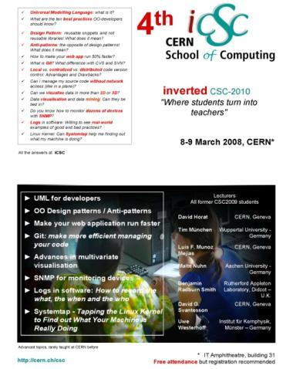
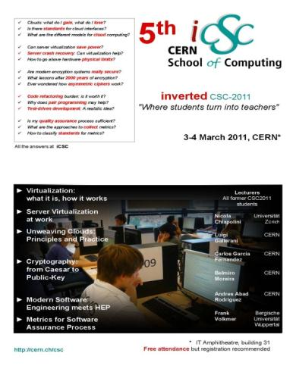
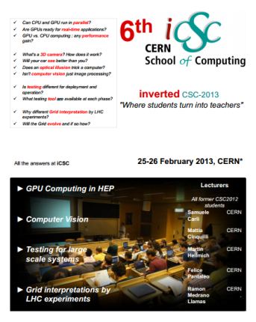
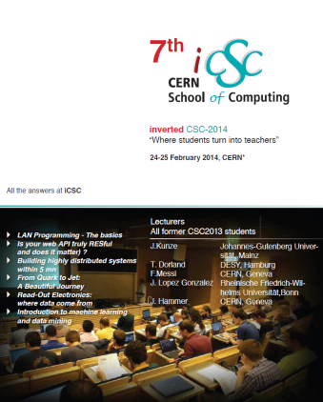
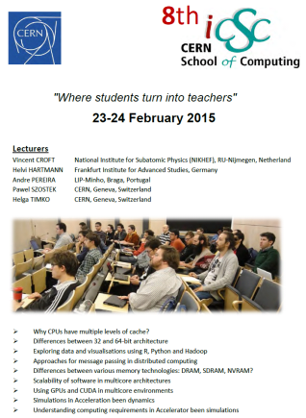
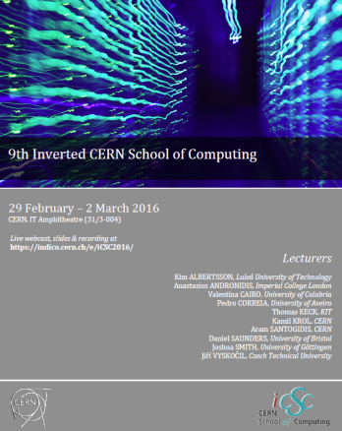
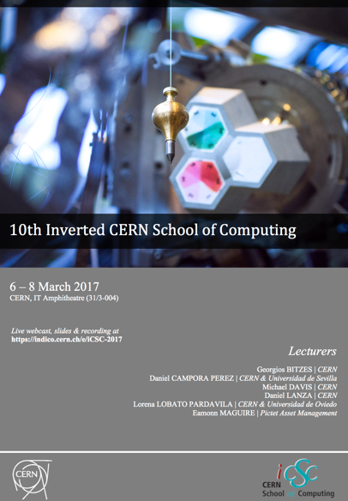
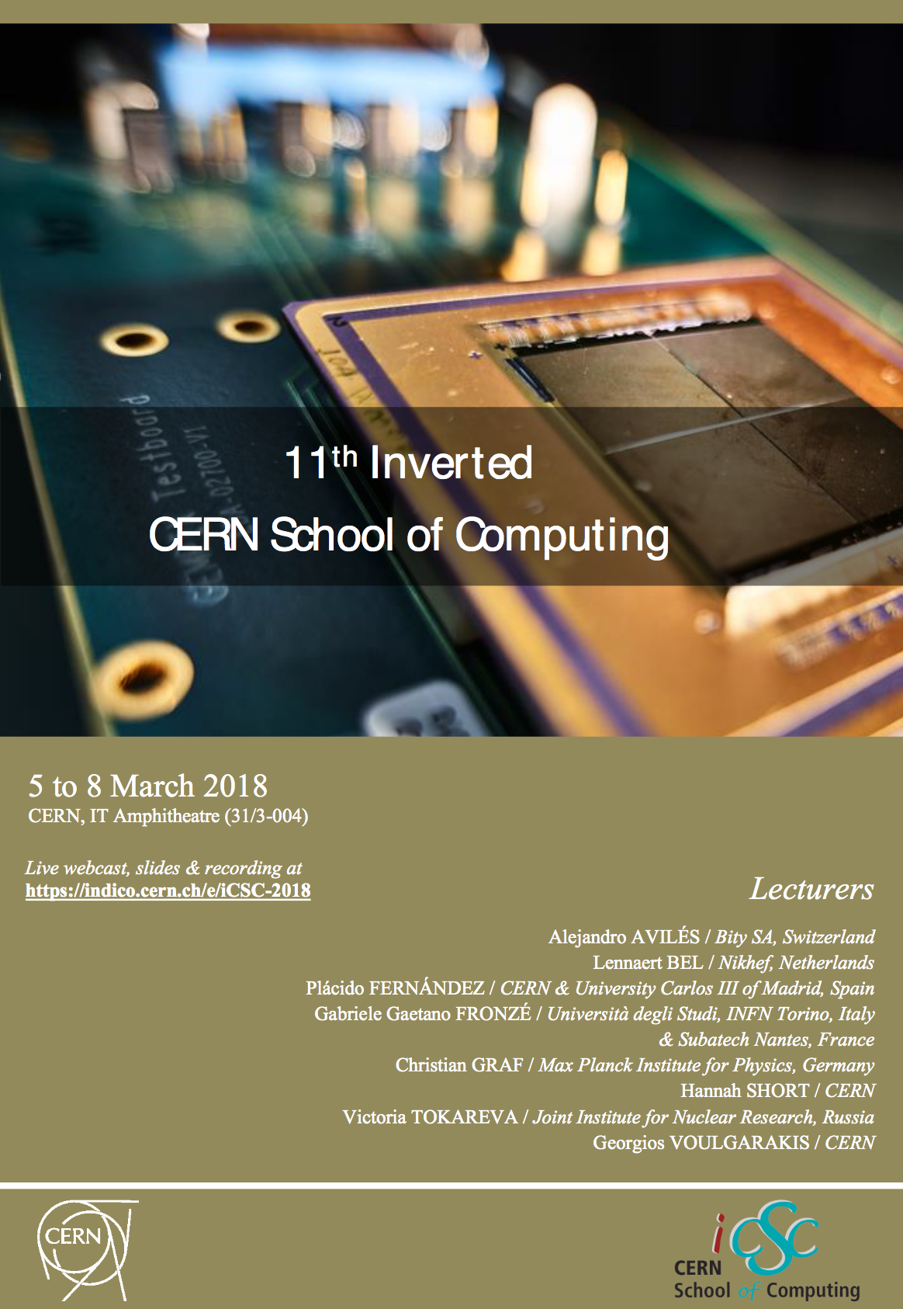
2018: the 11th edition of the iCSC
2005
2006
2008
2010
2011
2013
2014
2015
2016
2017
2018

Slide 5
Past Inverted Schools
  iCSC 2005: 3 days 11 lecturers 16 hours
  iCSC 2006: 2.5 days 6 lecturers 12 hours
  iCSC 2008: 2.5 days 5 lecturers 12 hours
  iCSC 2010: 1.5 days 7 lecturers 8 hours
  iCSC 2011: 1.5 days 6 lecturers 6 hours
  iCSC 2013: 1.5 days 4 lecturers 7 hours
  iCSC 2014: 1.5 days 5 lecturers 9 hours
  iCSC 2015: 2 days 5 lecturers 10 hours
  iCSC 2016: 3 days 10 lecturers 16 hours
  iCSC 2017: 2.5 days 6 lecturers 12 hours

Slide 6

iCSC lecturers becoming full CSC lecturers
  Sebastian Lopienski (iCSC 2005)
  Andrzej Nowak (iCSC 2008)
  Benjamin Radburn-Smith (iCSC 2010)
  Thomas Keck (iCSC 2016)
  Eamonn Maguire (iCSC 2017)

Slide 7

2018

Slide 8
Inverted CSC 2018
We encouraged lecturers to propose hands-on exercises
Received 13 proposals of lectures and exercises
for a total of 43 (25+18) hours by students from:
  CSC 2017 (Madrid, Spain)
  tCSC 2017 (Split, Croatia)
  CSC 2015 (Kavala, Greece)
9 proposals retained – 20 (13+7) hours
Notes:
Interestingly, some lecturers proposed two different topics
We were not able to accommodate all proposals.

Slide 9
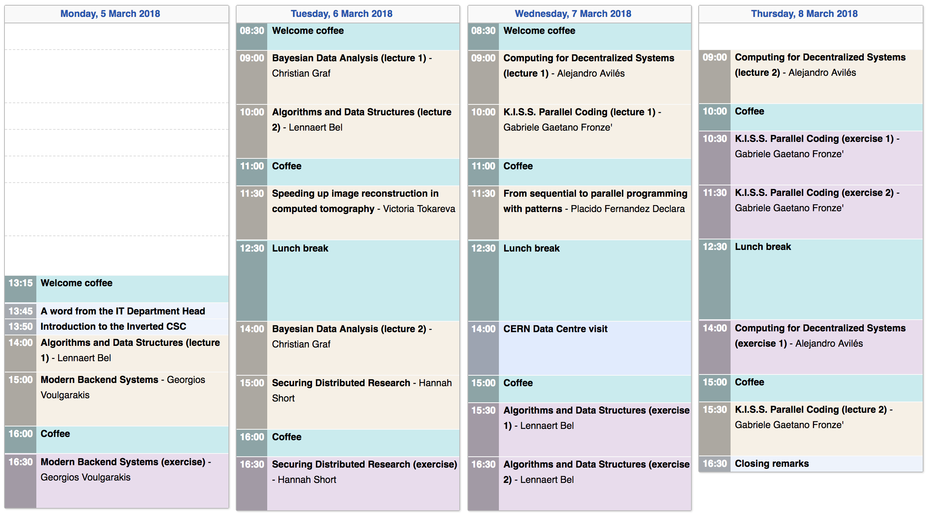
Schedule https://indico.cern.ch/event/671879/timetable/
Exercises in 513-1-024
Come with your laptop
Data Centre visit
registration – see email

Slide 10
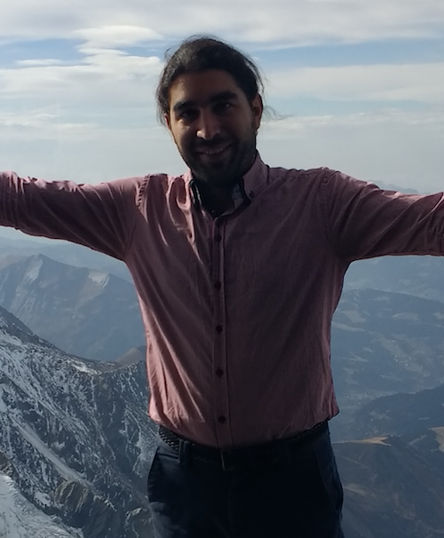
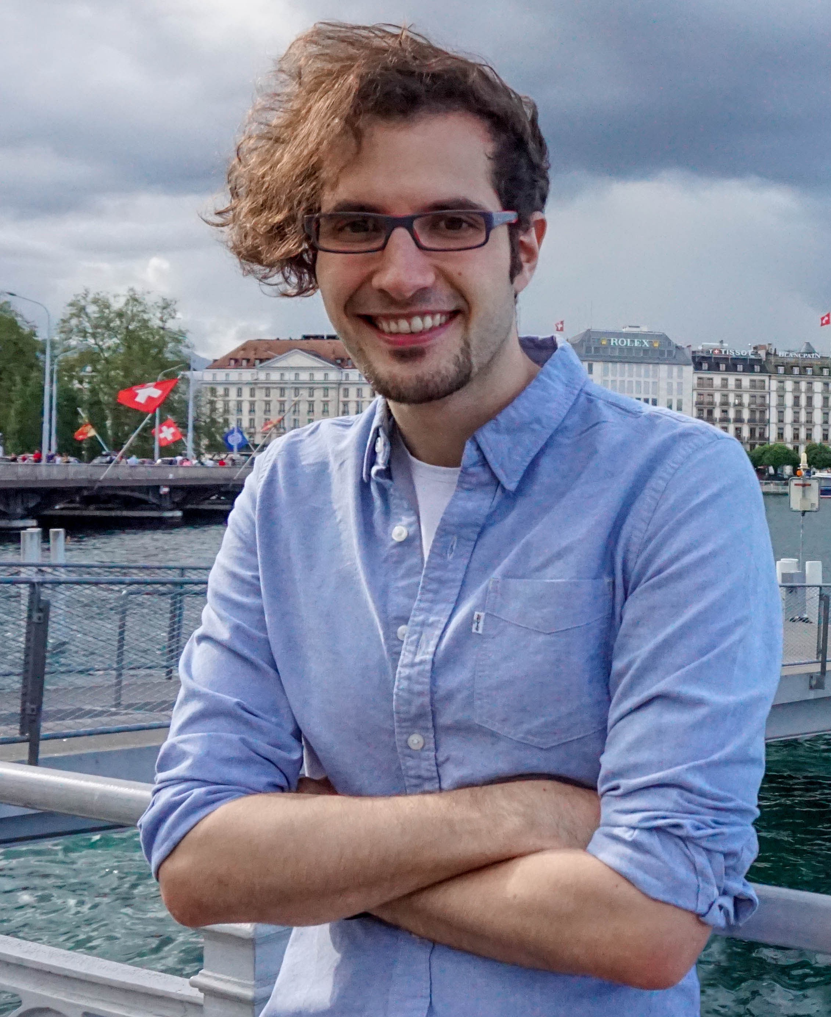
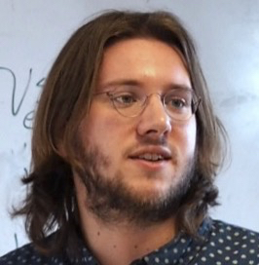
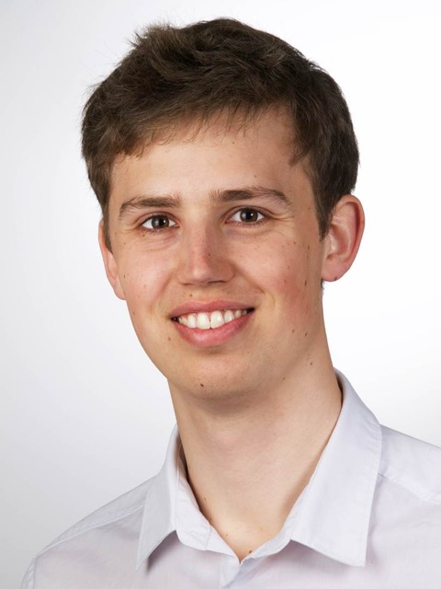
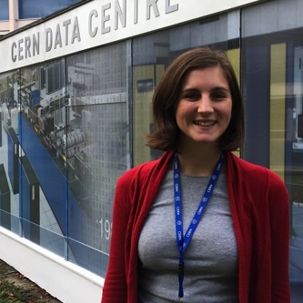
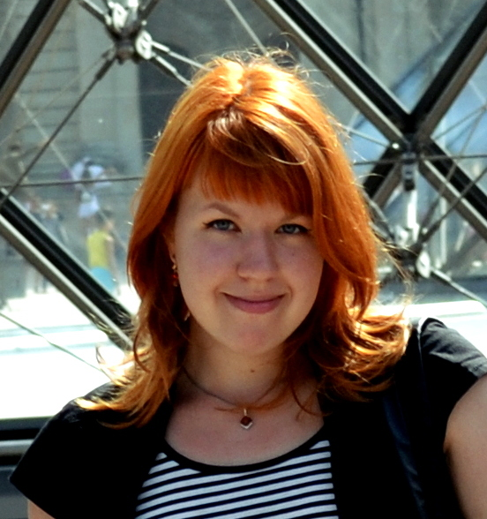
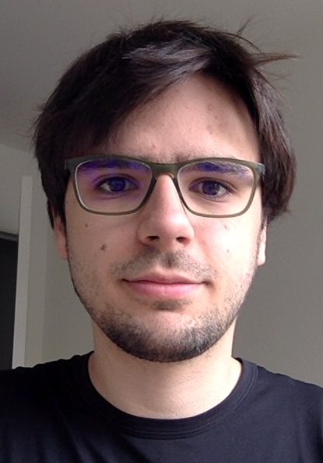
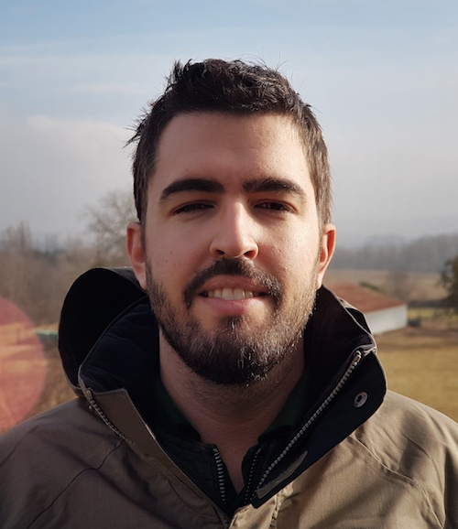
Topics
Backend Systems
Blockchain and Decentralized Consensus
Complexity and Data Structures
Bayesian Data Analysis
Identity Federation
Medical Imaging
Parallel Programming with OpenMP
Parallel Programming Patterns

Slide 11
Lecturers https://indico.cern.ch/event/671879/page/11702-speakers
Alejandro Avilés
Bity SA
(Switzerland)
Lennaert Bel
Nikhef
(Netherlands)
Plácido Fernández
CERN, and University Carlos III of Madrid (Spain)
Gabriele Fronzé
INFN Torino (IT),
Subatech Nantes (FR)
Christian Graf
Max Planck Institute (Germany)
Hannah Short
CERN
Victoria Tokareva
JINR (Russia)
Georgios Voulgarakis
CERN
Notes:
Students of tCSC 2017, CSC 2017 and CSC 2015
5 Ph.D. students (AFAIK)

Slide 12
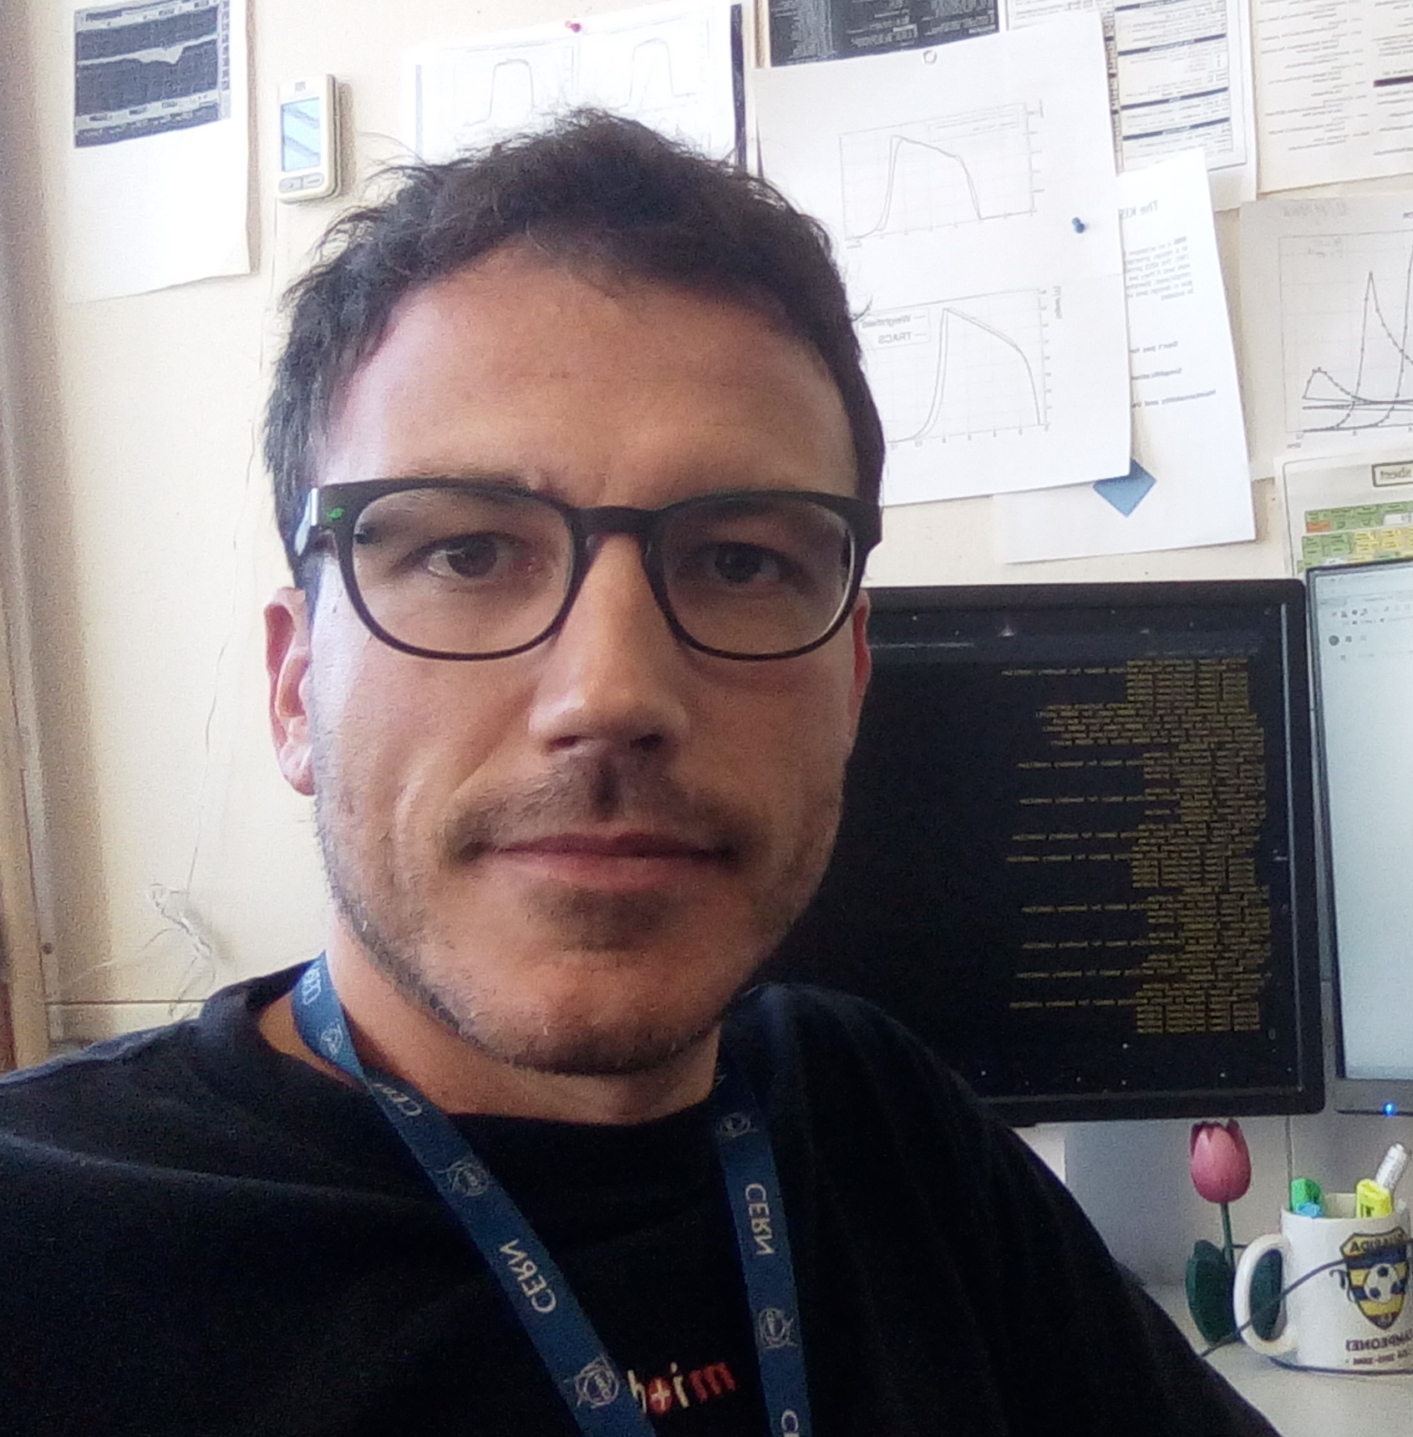
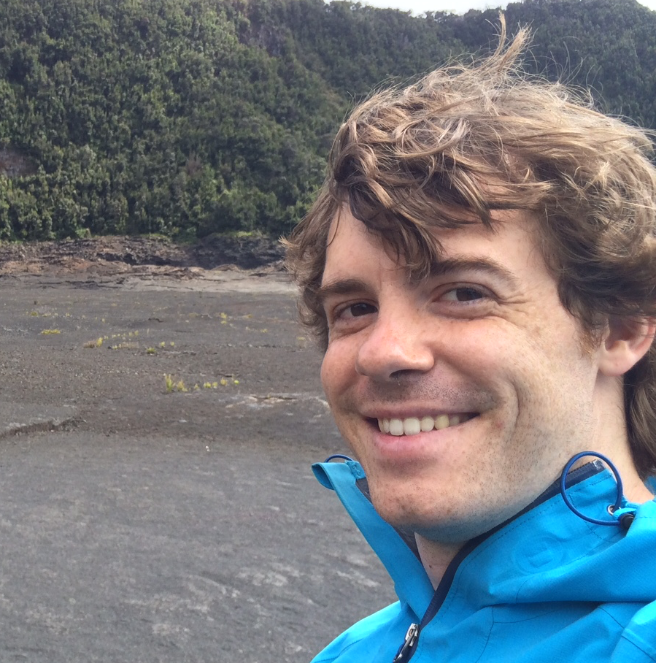
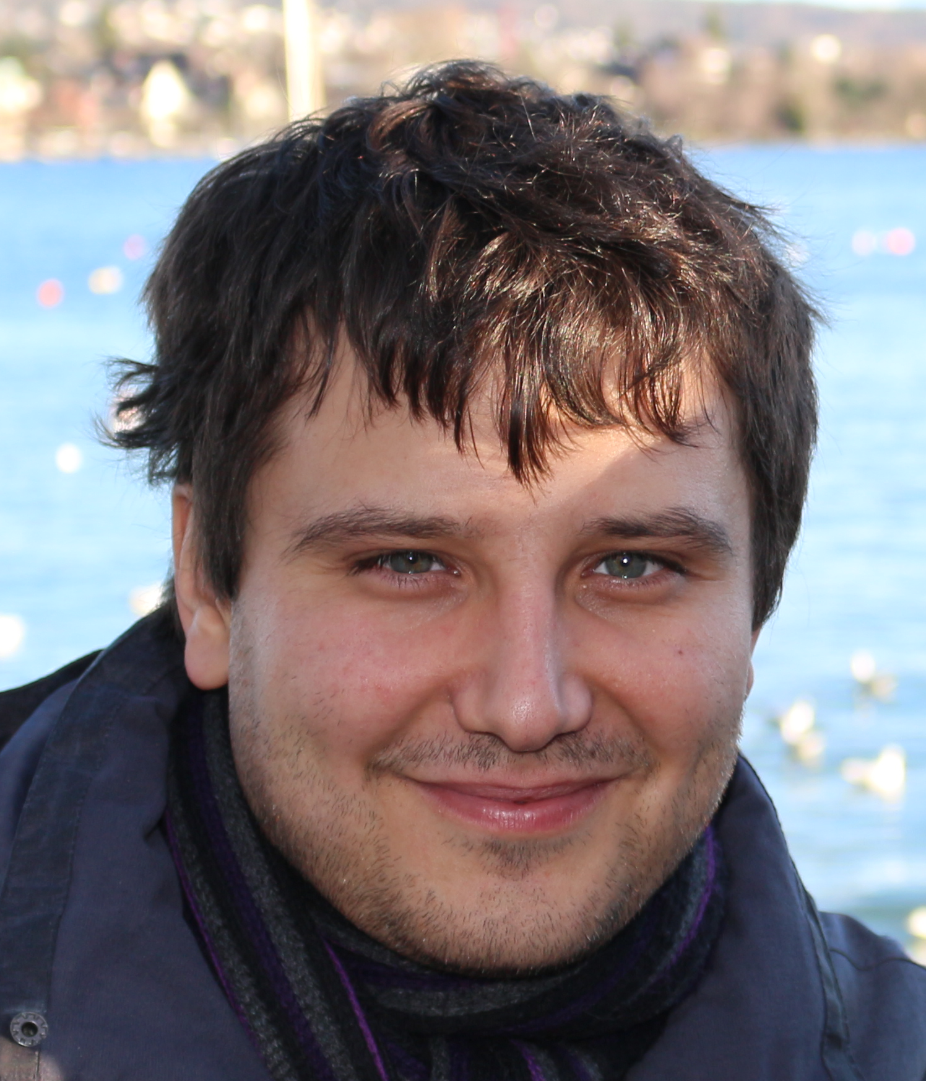
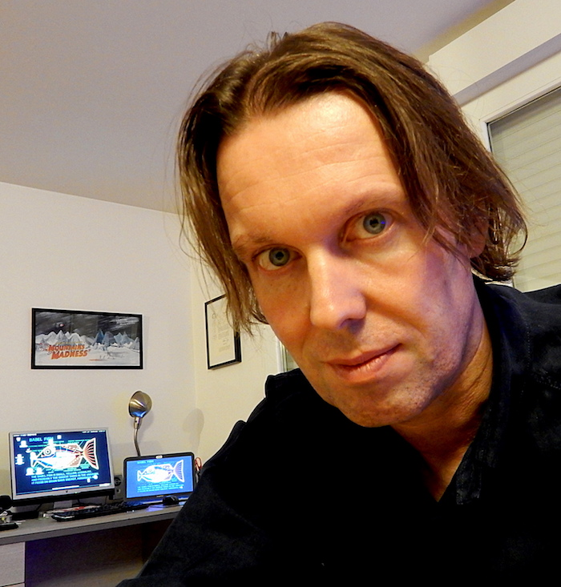
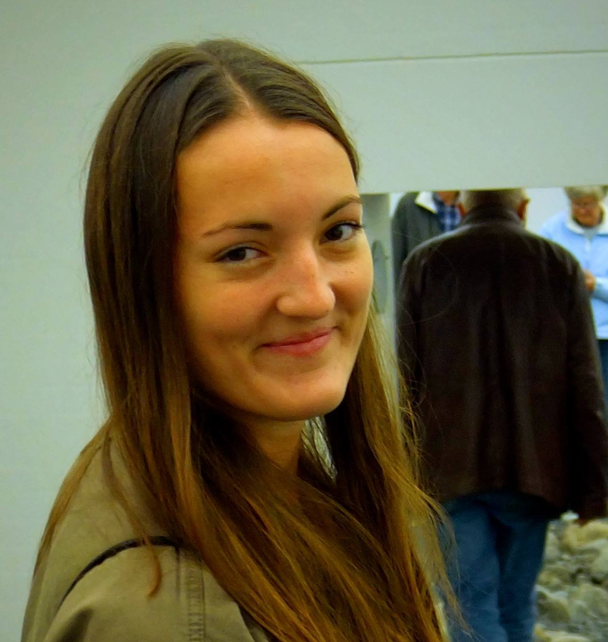
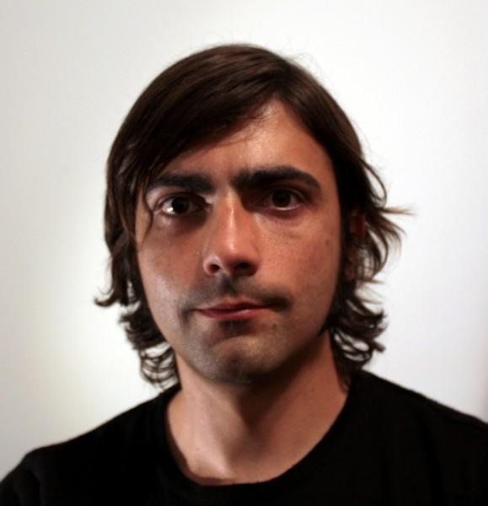
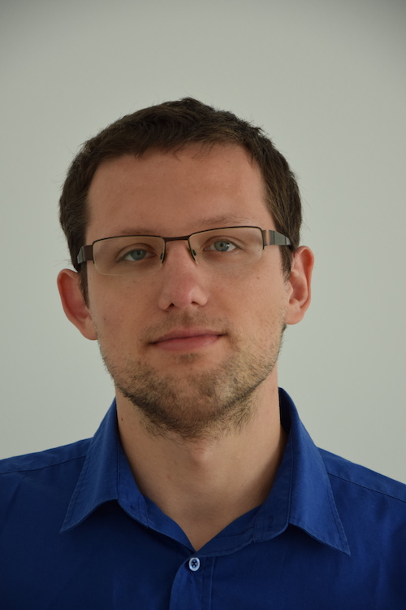
Conveners (session chairs)
Julio Calvo
Daniel Campora
Stefan Chitic
Michael Davis
Eva Hansen
Miguel Hermo
Benedikt Wurkner

Slide 13
Mentors (providing advice&feedback to lecturers)
Danilo Piparo Nikos Kasioumis Sebastian Lopienski Alberto Pace
Sebastien Ponce Are Strandlie Enric Tejedor Ivica Puljak

Slide 14
CSC Organizers
Joelma Tolomeo
(CSC Administrative Manager)
Nikos Kasioumis
(CSC Technical Manager)

Slide 15

Logistics
You can attend only selected lectures
  but please be on time for the start,
  and avoid leaving in the middle of a lecture
Please silence your phone
Please use the microphone when asking questions
  lectures are webcast and recorded
Enjoy coffee and snacks
  an opportunity to discuss with lecturers and colleagues

Slide 16
iCSC booklet
For those registered participants
… and others, if enough copies

Slide 17
Enjoy the School!

