Slide 1
Motivation for PSB-PS transfer studies and PS observations
F. Asvesta, H. Bartosik, H. Damerau, A. Huschauer,
G. Rumolo, E. Senes, M. Serluca, G. Sterbini, F. Tecker, P. Zisopoulos
LIU-PS beam dynamics working group meeting, 12 October 2017

Slide 2
Introduction – LIU beam parameters
Based on achieved parameters the acceptable space charge tune spread at PS injection is 0.31
Performance of LIU beams crucially relies on bunches with large longitudinal emittance
G. Rumolo, https://edms.cern.ch/file/1296306/

Slide 3
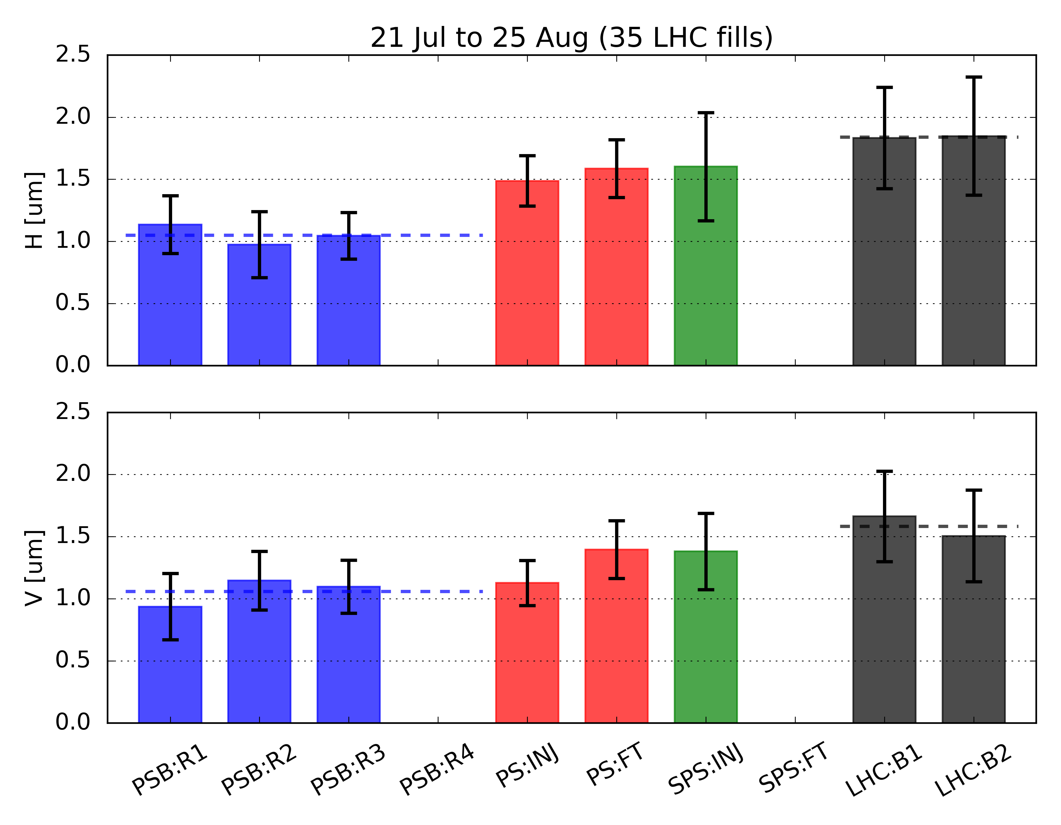
2016 observations on operational BCMS
data from LHC super table
Injection H: ~20% blow-up expected from dispersion mismatch*
data from LHC super table
Injection V: ~5-10% expected from dispersion+betatron mismatch
Vertical blow-up during PS cycle
*W. Bartmann, MSWG 2016

Slide 4
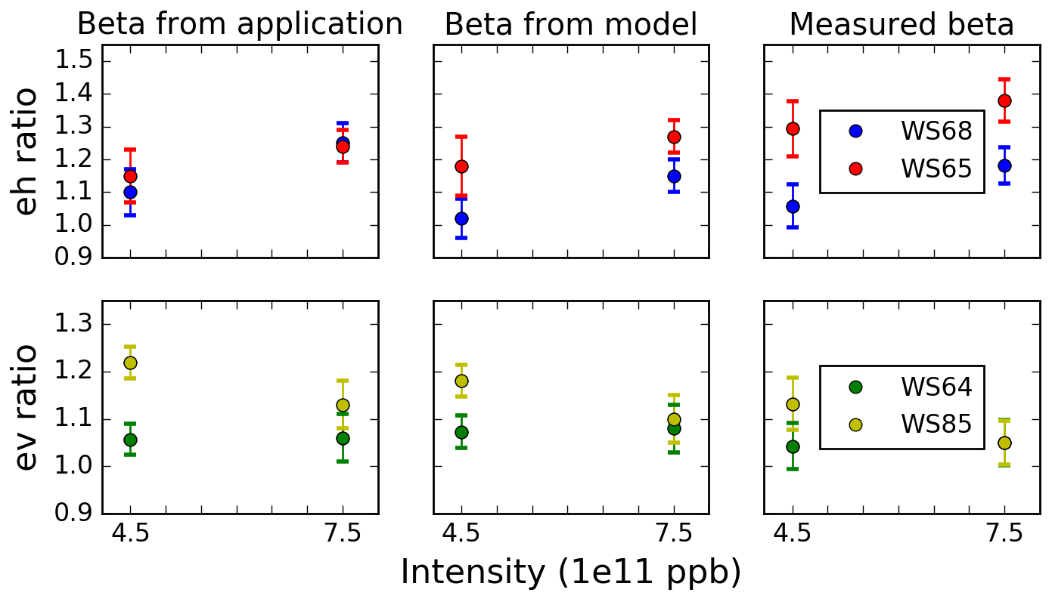
Impact of the ring optics on the blow-up evaluation
Emittance correlation between PSB and PS measurements
  rather significant impact of the optics on the measured emittances
  Clear observation of a horizontal blow-up
H. Bartosik, https://indico.cern.ch/event/609486/

Slide 5
Observations during the injection bump
Observation of a dynamic variation of the tune during the bump (points at Eddy current effects)
Additional activities
  Chromaticity measurements during the bump
  Modification of the optics: measurements of the beta-beat
  Injection error vs. emittance blow-up
    Identification of possible hidden players
  space charge simulations including the effect
  Magnetic measurements
    Investigating possible means of compensation
position at BPM43
horizontal tune
P. Zisopoulos

Slide 6
Summary & Outlook
Horizontal emittance blow-up of the BCMS beam at PS injection
  Difficult to measure precisely due to various uncertainties:
    Non-Gaussian longitudinal profile, knowledge of the ring optics, large dispersive contribution,…
  Possible explanations:
    Contribution of the optics mismatch
    Contribution of the injection bump (non-closure, beta-beat, space charge,…)
    Contribution of the injection error (TFB being operationally set on all users)
  Investigations on various fronts ongoing
Towards the LIU baseline
  LHC cycle with low chromaticity, no coupling, TFB active along the cycle
  Blow-up evaluation injecting bunches with large longitudinal emittance
    Dependency of blow-up on dp/p

Slide 7
Emittance blow-up due to injection error

