Slide 2
TE MANPOWER PLAN 2017
L. v.d. Boogaard (TE-PPR)

Slide 3
What?
The TE department prepares once a year a Manpower Plan.
It contains:
  An overview of the department demographics (age, contract situation, grades) of staff
  A summary of other resources (fellows, students, PJAS)
  Planning assumptions (retirements, other departures)
  A section on the Medium Term Plan and the materials budget, and the personnel allocation
  AND after discussion:
  The policy and planning for LD2IC, extensions and LD2LD

Slide 4
Why?
Groups are in constant demand for resources
Our personnel budget is limited (in FTE and kCHF)
The department has to make numerous contributions to projects and operations
Priorities may shift in time
The department has many short term and project posts it needs to keep track of
Retirements are not automatically replaced but the liberated FTE returns to the department.

Slide 5
How?
Retirements are simulated to identify the liberated FTE in the years to come
The groups are requested to identify the needs and priorities in the coming years (replacement of retirement, new posts, extensions, LD2LD, LD2IC)
These needs are grouped and usually discussed in a retreat
Arbitration is made by the TE DH on how many posts will be opened and in which groups.

Slide 6
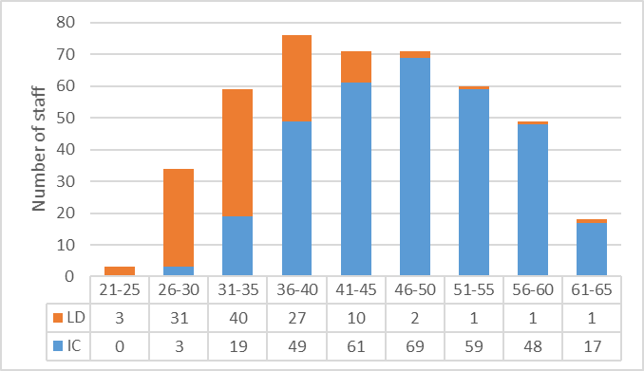
TE in numbers
On 1st of July 2017 TE had:
Headcount of 451 staff members (446 FTE)
73% IC, 27% LD
Average age of staff: 44 years
TE staff by age and contract

Slide 7
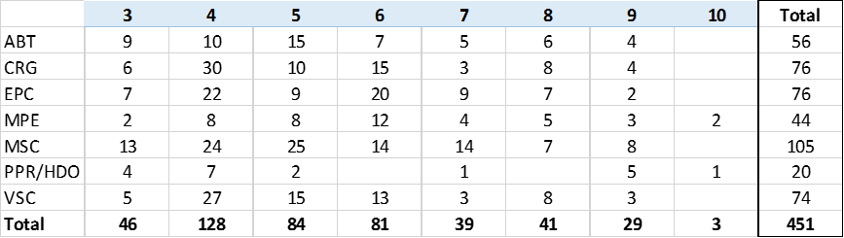
TE Staff by grade and by contract situation

Slide 8
The other resources
130 Fellows (94 Academic and 36 Technical);
41 Trainees;
34 Doctoral Students, 35 Technical Students, and 5 Administrative Students
92 associated members of personnel linked to International collaborations (57 COAS and 35 PJAS);
8 Visiting Scientists;
10 persons with a Temporary Labour contract
The TE department has over 800 people in total (excluding the industrial support)

Slide 9
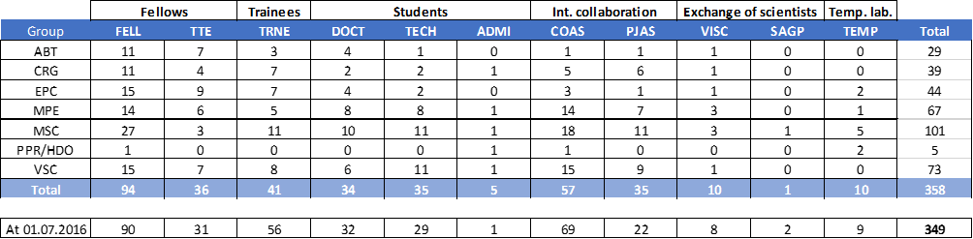
Additional resources by group
The number of fellows, PJAS and students is growing….

Slide 10
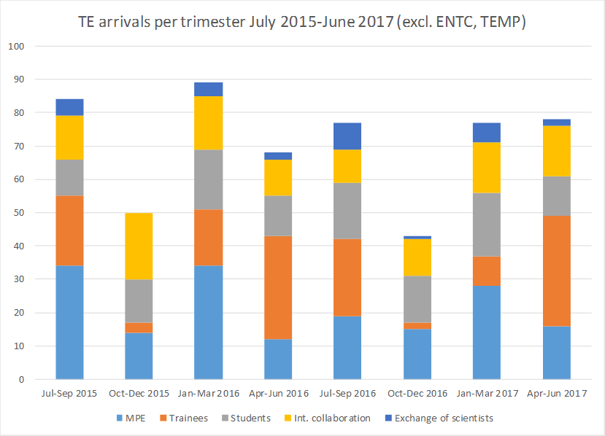
TE arrivals per trimester

Slide 11
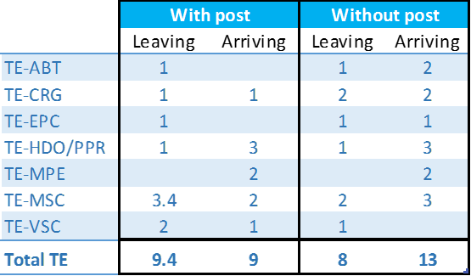
Mobilities of staff to/from and within TE

Slide 12
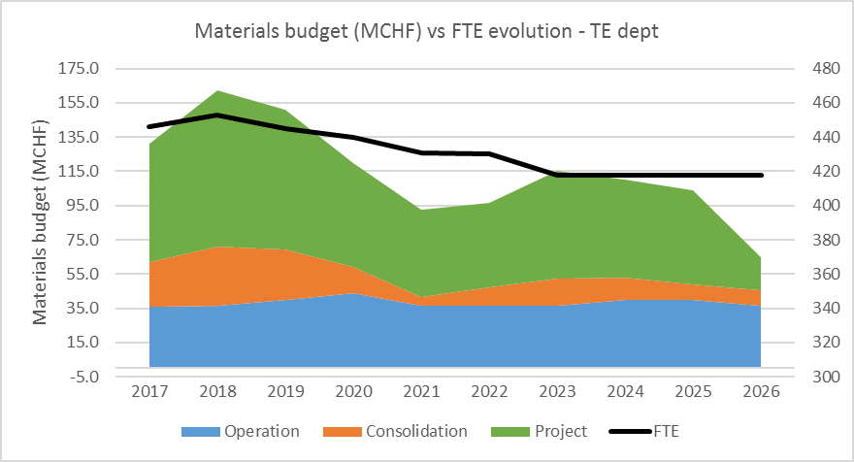
Materials budget vs FTE

Slide 13
The TE MPP 2017 exercise
The updated 2016 MPP foresaw the opening of 13 new posts in 2017 and 6 in 2018.
Due to less retirement than simulated, less other departures and less recruitment delays, the TE department was heading to an overshoot of 5 FTE per year for 2017-2019
Additional arbitration to delay or cancel posts was therefore necessary
The overshoot will not be «free»: some materials budget will need to be used to pay for this year’s overshoot

Slide 14
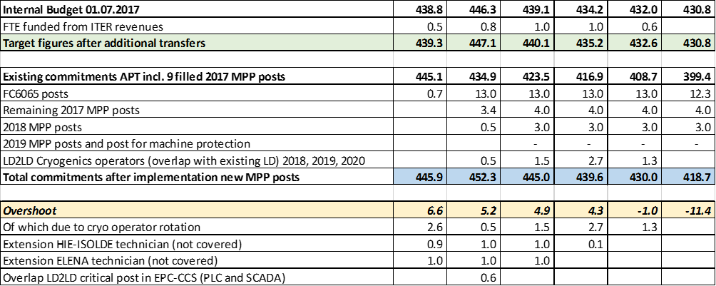
The MPP2017: overview

