Slide 1
Applications of Metamaterials for Particle Accelerators.
Tom Vaughan
John Adams Institute, Royal Holloway, University of London

Slide 2
Overview
Metamaterials.
Multibunch Resonance
Simulations
Unit and Bulk target design
Proposed Experiment

Slide 3
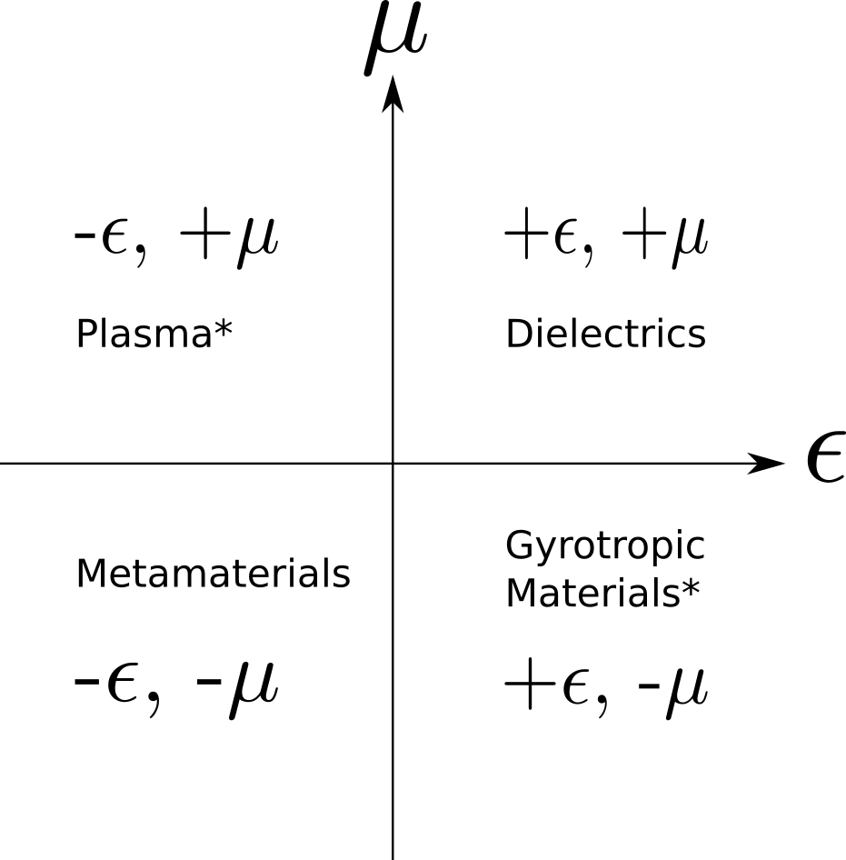
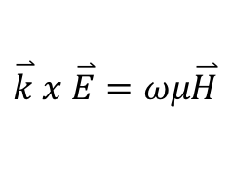
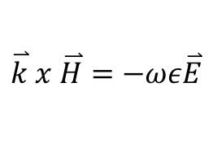

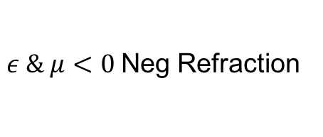
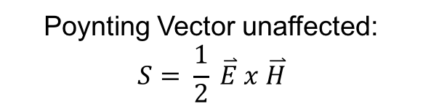
Metamaterials
What are they?
Man-made materials that can be engineered to have properties that do not appear in natural materials.
First theorised by Vasalago in 1959.
Most natural materials
Still found in nature; metal below plasma freq.
Reverse propagation:
$$\overset{⃑}{k} x \overset{⃑}{E}=ωμ\overset{⃑}{H}$$
$$\overset{⃑}{k} x \overset{⃑}{H}=−ωε\overset{⃑}{E}$$
Negative Refraction:
$$n^{2}=εμ$$
$ε \& μ<0$Neg Refraction
Momentum Check:
Poynting Vector unaffected:
$$S= \frac{1}{2} \overset{⃑}{E} x \overset{⃑}{H}$$
Not found in nature

Slide 4
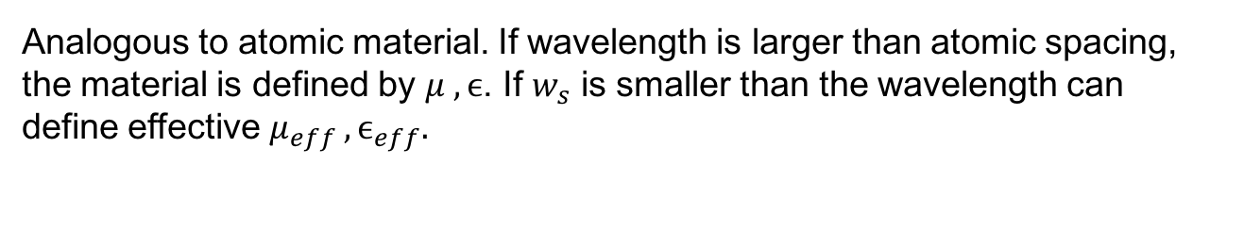
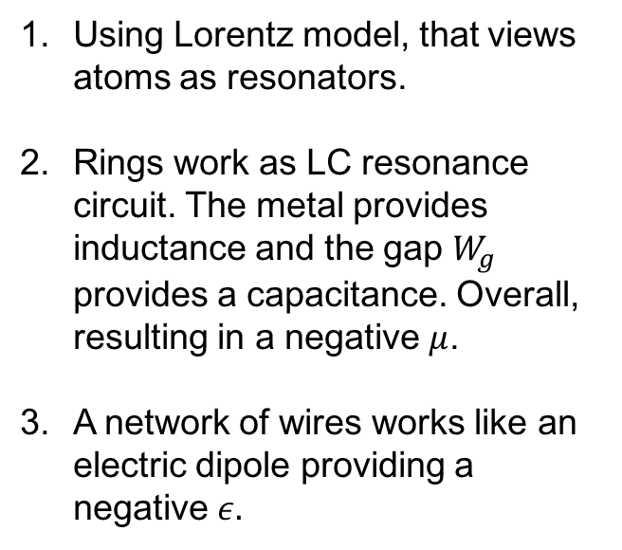
Designing a Metamaterial
Analogous to atomic material. If wavelength is larger than atomic spacing, the material is defined by $μ , ϵ$. If $w_{s}$ is smaller than the wavelength can define effective $μ_{eff} , ϵ_{eff}.$
Using Lorentz model, that views atoms as resonators.
Rings work as LC resonance circuit. The metal provides inductance and the gap $W_{g}$ provides a capacitance. Overall, resulting in a negative $μ$.
A network of wires works like an electric dipole providing a negative $ε.$
Advantages
Disadvantages
Extremely tunable
Negative refraction
Pos better noise
Manufacturing
Extremely Sensitive

Slide 5
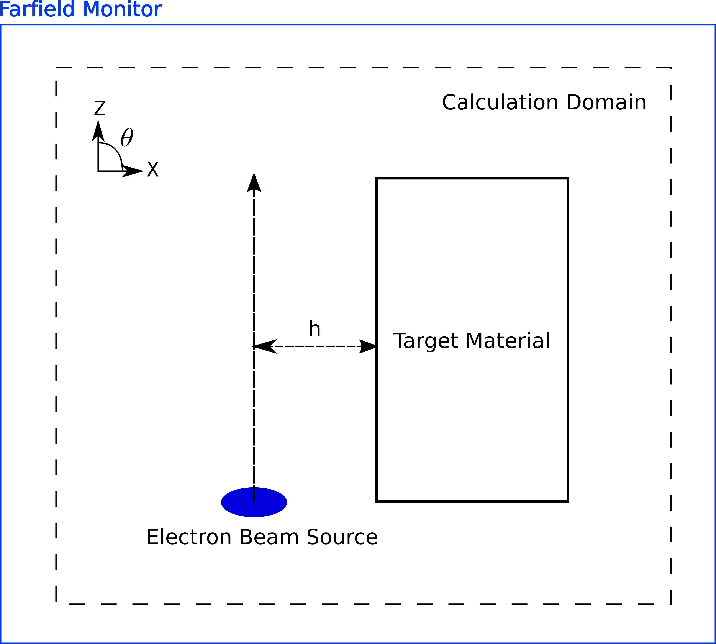
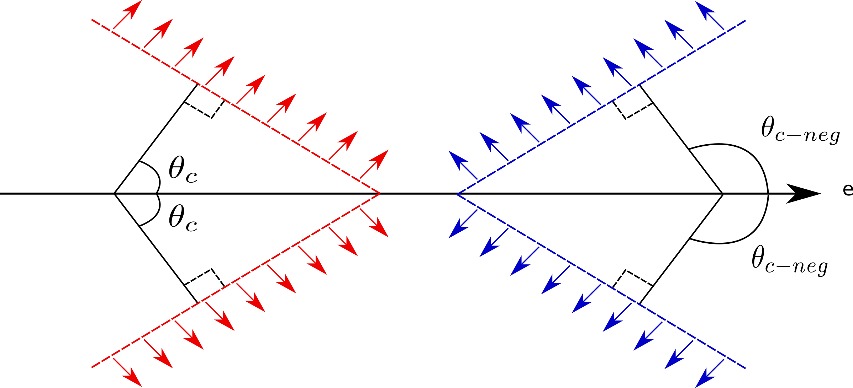

Diagnostics – Cherenkov Radiation
To be used as a diagnostics tool ideally we want to be non invasive.
Cherenkov radiation
If the beam moves faster than speed of light In the material Cherenkov radiation is generated:
Cherenkov Angle: $θ_{c}=\cos^{−1}{(\frac{1}{βn}) }$
Beam doesn’t have to pass through the material, it just has to be in the vicinity so that beam E-field can interact with target.

Slide 6
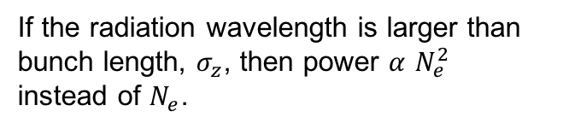
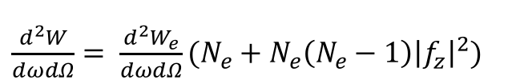
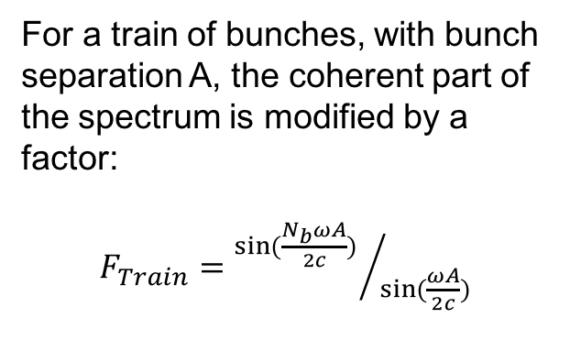
Multibunch Resonance
A single bunch of $N_{e}$ electron will radiate power according to:
Incoherent
If the radiation wavelength is larger than bunch length, $σ_{z}$, then power $α$ $N_{e}^{2}$ instead of $N_{e}$.
$\frac{d^{2}W}{dωdΩ}= \frac{d^{2}W_{e}}{dωdΩ}(N_{e}+N_{e}\left(N_{e}−1\right)\left|{\left.f_{z}\right|}^{2})\right.$
Coherent
For a train of bunches, with bunch separation A, the coherent part of the spectrum is modified by a factor:
$F_{Train}={sin⁡(\frac{N_{b}ωA}{2c}) }/{sin⁡(\frac{ωA}{2c})}$
This extra factor gives rise to a series of harmonic peaks whose fundamental frequency is determined by the RF freqeuncy.
ISSN 0021-3640, JETP Letters, 2017, Vol. 106, No. 2, pp. 127–130.

Slide 7
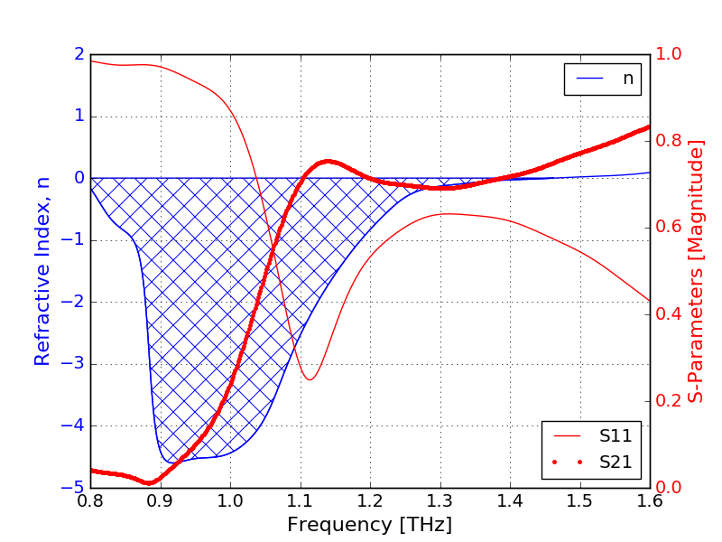
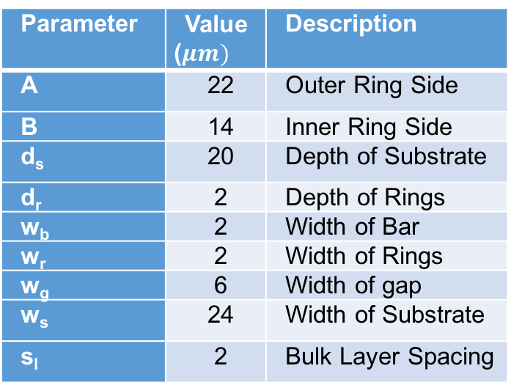
Target around 1THz
A target that will operate around 1THz has been designed and optimised using CST Microwave Studio.
Parameter | Value ($μm)$ | Description
A | 22 | Outer Ring Side
B | 14 | Inner Ring Side
d_{s} | 20 | Depth of Substrate
d_{r} | 2 | Depth of Rings
w_{b} | 2 | Width of Bar
w_{r} | 2 | Width of Rings
w_{g} | 6 | Width of gap
w_{s} | 24 | Width of Substrate
s_{l} | 2 | Bulk Layer Spacing
The grey area represents the range of frequency over which the refractive index is negative. The red points show the values of the minimum refractive index. The blue points represent the value of frequency at which the minimum refractive index occurs.
Optimise unit cell to have:
1. Negative refractive index in the 1THz region.
2. Bulk target to avoid total internal reflection.

Slide 8
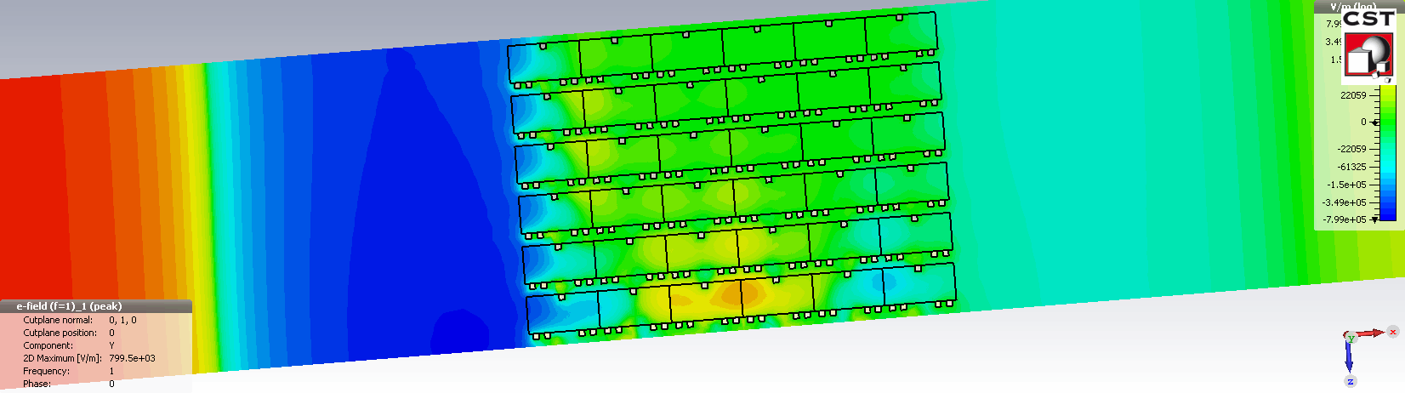
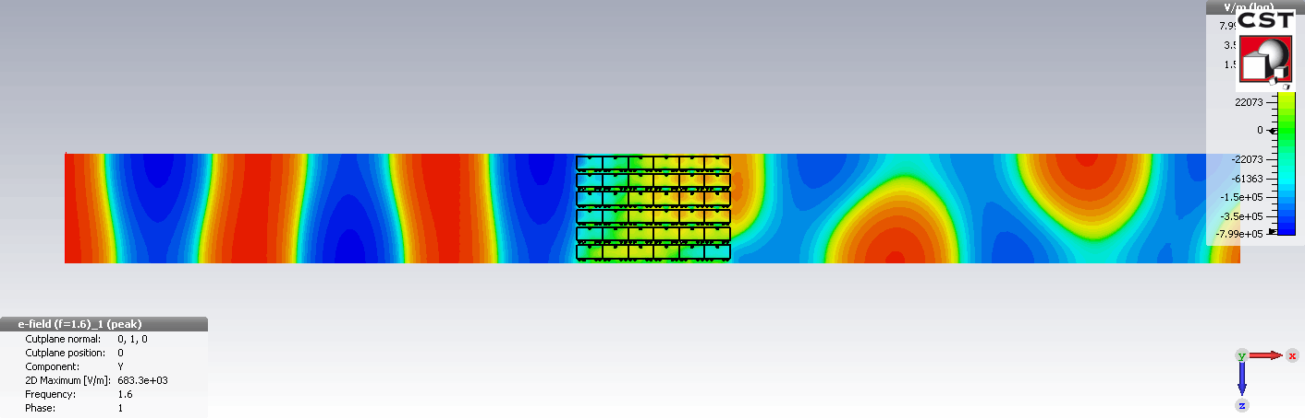
Reverse Propagation
Phase Evolution at 1THz. n = -2.3
Phase Evolution at 1.6THz. n = 1.48

Slide 9
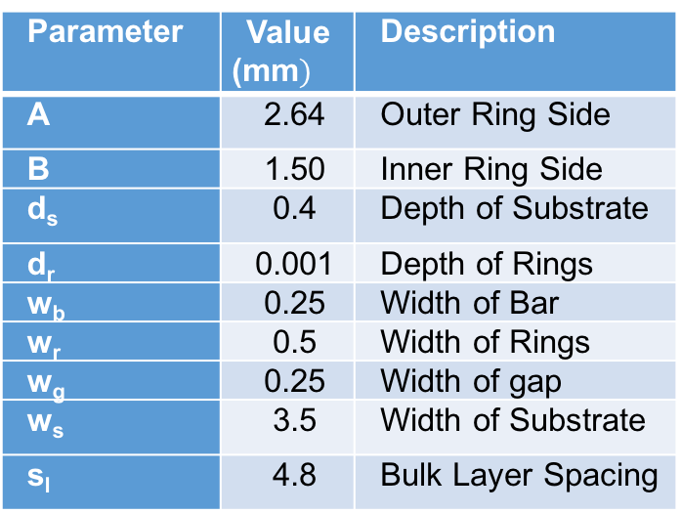
Lower Frequency Target
The detector response and the manufacture is much easier for a lower frequency as the dimension of the structures is larger. Therefore, we would like to do a proof of principle first at lower frequency.
Manufacturing
Parameter | Value (mm$)$ | Description
A | 2.64 | Outer Ring Side
B | 1.50 | Inner Ring Side
d_{s} | 0.4 | Depth of Substrate
d_{r} | 0.001 | Depth of Rings
w_{b} | 0.25 | Width of Bar
w_{r} | 0.5 | Width of Rings
w_{g} | 0.25 | Width of gap
w_{s} | 3.5 | Width of Substrate
s_{l} | 4.8 | Bulk Layer Spacing
A mask is created from 50um thick stainless steel with the pattern laser cut.
100nm of conducting metal is then deposited onto Si wafer
The wafer is cracked and layers can be aligned.

Slide 10
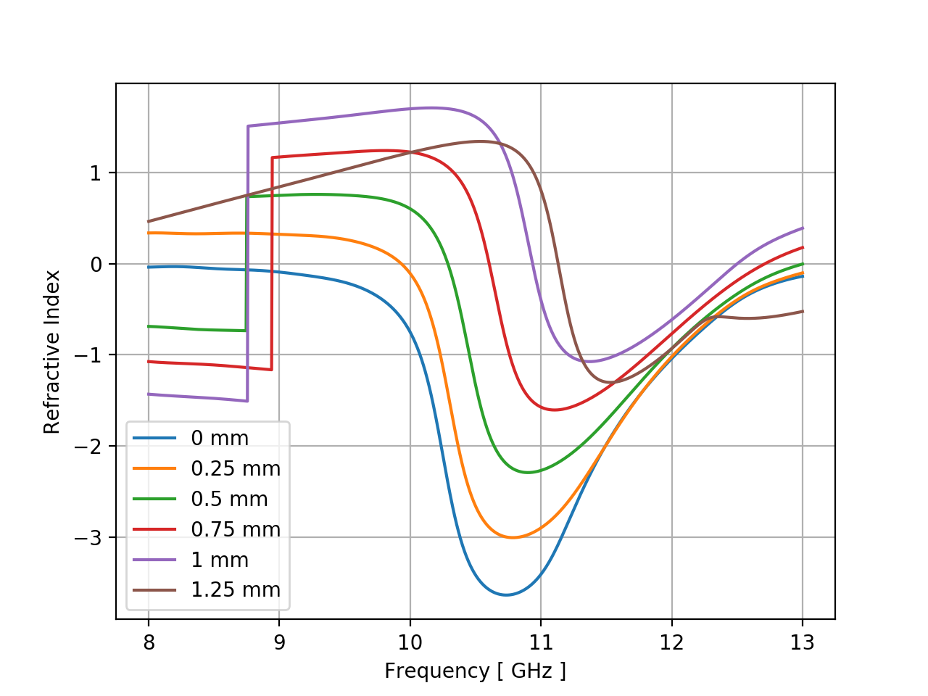
Ring – Bar Alignment
We were interested to see how much of an effect the alignment between the pattern on the front and back of the wafer has on the refractive index!
0mm is when the center of the bar is perfectly aligned with the center of the rings.
This effect may not seem very large, however, the wafer is not see through and we have no infrared aligner.
Solution! – Each wafer is drilled using the alignment marks on the masks to get the best possible alignment.

Slide 11
Final Design Result
Final unit cell plot
Bulk Structure
The lines represent the same as the previous plot.
For n >-1, there will be no Cherenkov radiation as it is unphysical.
The unit cell are then arranged into a a prism shape target. The length along the beam line must be larger than the wavelength to avoid it just being a diffraction target.

Slide 12
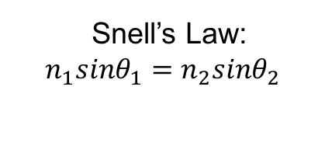
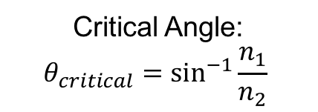
Bulk Target angle
To ensure that Total Internal Reflection (TIR) does not occur at the boundary of the bulk target, we used the refractive index spectrum on the previous slide along with Snell’s law, which still holds for metamaterials, to calculate the critical angle and the actual angle.
Snell’s Law:
$$n_{1}sinθ_{1}=n_{2}sinθ_{2}$$
Critical Angle:
$$θ_{critical}=\sin^{−1}{\frac{n_{1}}{n_{2}}}$$
Blue curves show critical angle. The red curve must be neither above nor below to not get TIR. The black curve shows the Cherenkov angle with respect to the forward direction.

Slide 13
CLEAR Experiment
For example, the CLEAR facility if a 150ns long train with 225 bunches per train, has a 666ps bunch spacing, the first harmonic will be around 1.5 GHz. The 7th harmonic would then be around 10.5 GHz, the same as the 4th harmonic for the Tomsk Micron configuration.
We would like to test the feasibility of using the metamaterial to select a certain frequency band within the spectrum. Although not a THz, could be modified if initial experiment proves theory.
The measurement that we would like to carry out can be carried out in air.
Collect radiation with horn antenna and analyse with spectrum analyser or Michelson interferometer
To get signal from tunnel, maybe a cable that transmits around 10.5 GHz?, or we can down mix the signal if easier.
Compare to Teflon target of the same dimensions.
Has many potential application; filter, bunch length monitor, arrival time.

Slide 14
Conclusions
Metamaterials offer advantages compared to traditional materials due to there tunability and reverse wave propagation. However, they can be difficult to manufacture and high precision required
A metamaterial target can be used in a non-destructive manner as a diagnostics tool.
A negative refractive index leads to a reversed Cherenkov angle which may reduce noise on a signal.
There are many FUN things that we would like to try; maybe having each layer a slightly different response to see if we can get an overall broadband response, or try different designs to get a more narrow band response or try 3D printing the pattern onto the wafer.

