Slide 1
Tunable terahertz source based on the slotted-foil technique and transverse defecting cavities
Jürgen Pfingstner,
University of Oslo
7 November 2017

Slide 2
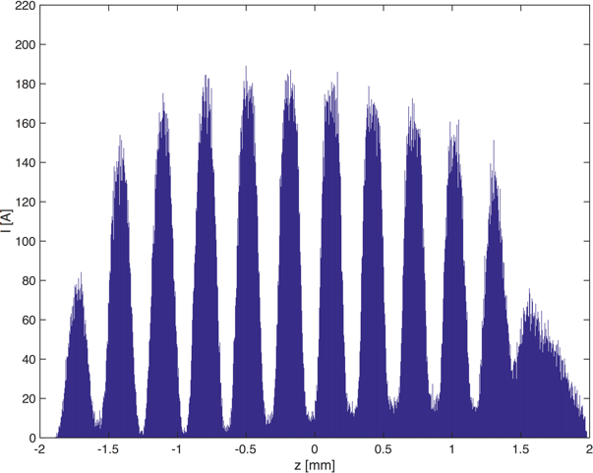
Content
Motivation
Parameters and design
Simulation results
Foil wakefields
Summary

Slide 3
1. Motivation

Slide 4
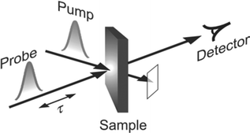
Pump-probe experiments at FELs
Process of interest in material sample is started with pump pulse.
Then after time τ sample is probed with FEL X-ray.
Time difference is varied to get time evolution of process.
Laser pump: (E_{γ} ≈ 1eV)
Lift electrons to higher electric states.
E.g. triggering of photo-chemical reactions.
THz pump: (E_{γ} ≈ 10meV)
Many interesting processes are excited by longer wavelength (THz).
But no lasers available.

Slide 5
THz source for sample excitation at SwissFEL
Motivation:
High demand from material scientists for THz source:
  Excitation of vibration of molecules.
  Lattice vibrations (phonon).
  Free electrons (plasmon).
  Spin coupling (magnon).
State of the art of THz sources:
  Very small bandwidth but low power.
  High power, but broadband radiation.
The needed intermediate regime is not really covered.
Challenging specifications:
  Narrow-bandwidth (< 10%).
  Wide-range tunable (1 - 20 THz).
  Pulse-energy > 100 μJ.
  Fixed phase from pulse to pulse.
Studied solution:
  Electron beam in undulator which is tuned to correct frequency: free-electron laser.

Slide 6
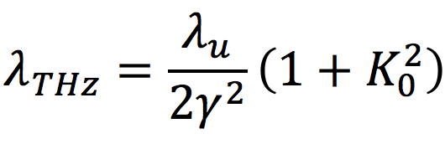
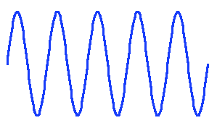
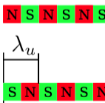
THz radiation via undulator radiation
Undulator parameter:
Challenge to go to so large λ_{THz}.
Helical undulator (symmetric strong natural focusing).
γ = 50 (E_{b} = 25MeV, space charge).
λ_{u} = 6cm.
K₀ = 0.75 - 4.9 (for tuning 1-20 THz); equals to B₀ = 0.09T – 0.88T.
Q_{und} of about 1nC charge necessary.
Phase locking:
SASE: easy, but no phase locking.
Seeding: THz lasers not quite strong enough.
Comb beam: create bunching before undulator.

Slide 7
2. Parameters and design

Slide 8
Slotted-foil technique with transverse deflecting cavities (TDC)
U_{t}
s
foil
U_{t}
Δx
L_{D} = 1.5m
Transverse deflection cavity
Alias crab cavity
X-band linear enough for 3mm beam length
For 10% BW≈1/N_{b}, 10 micro-bunches are necessary.
1 THz: λ = 300μm (66μm at 4 THz)
Min. bunch length: 3mm.

Slide 9
Beam parameter at foil
σ_{x,s} = 0
σ_{x,s} > 0
beam
d
2σ_{x,s}
2Δx
foil
foil
I(s)
I(s)
σ_{x,s} causes reduction of bunching.
σ_{x,s} ≤ d/6
Choice: β_{x} = 0.5m, d = 1mm
For 10 micro-bunches: 2Δx = 1cm
Need beam focusing to get 0.5m beta at foil.
Need TDC kick to get Δx = 0.5 cm tilt at foil for 1 THz (x 4 for 4THz).

Slide 10
Facility layout
L_{D}
L_{D}
Laser
Matching
to drift
Matching
to drift
Δx’
-Δx’
-Δx’
Δx’
Gun with solenoids
S-band accel. struct. with solenoids
TDC1
TDC2
Undulator
Imprint foil
Advantages:
Much simpler system as before.
No energy chirp/dispersion necessary.
More compact:
  L_{D} = 1.5m
  L_{TDC} = 0.3m
Frequency tuning:
Via tilt variation (fixed foil, fixed optics).
Symmetric input power for both TDCs.
Disadvantage:
Additional RF system necessary.

Slide 11
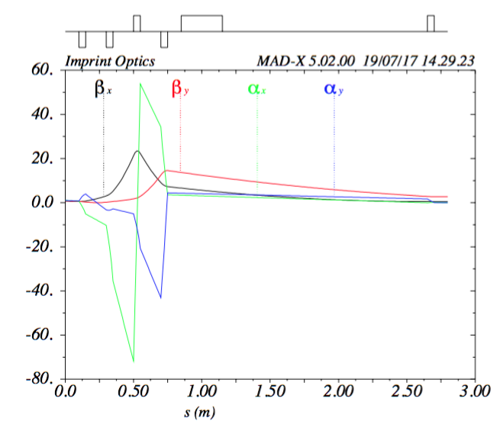
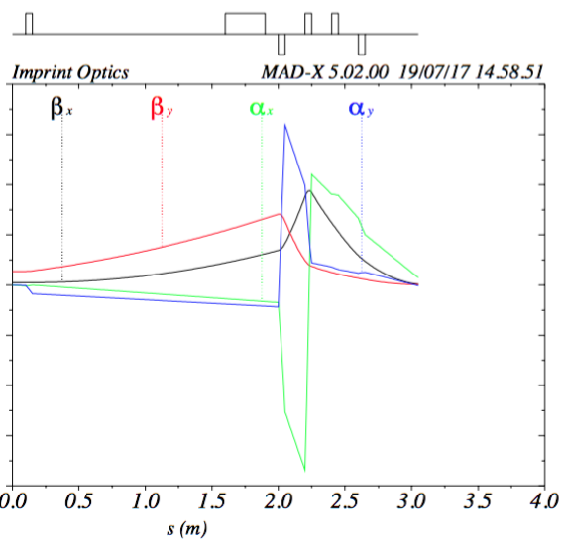
Optics design
Matching 1
TDC1
180°
Foil
180°
TDC2
Matching 2
Injector
Foil
Undulator
β_{x} =1m
β_{y} = 1m
α_{x} = 1.8
α_{y} = 1.8
β_{x} = 0.50m
β_{y} = 3.12m
α_{x} = 0
α_{y} = 0
β_{x} = 0.1m
β_{y} = 0.1m
α_{x} = 0
α_{y} = 0

Slide 12
Basic RF design
Input power:
V_{t} (peak):
  0.84 MV for 1THz
  3.36 MV for 4THz
For parameters from literature [1,2], approximate power needed:
Power level tuned by LLRF.
Klystron
50:50 Splitter
Δφ
Δφ
P_{in} | S-band | X-band
1 THz | 0.25 MW | 2 kW
4 THz | 4 MW | 32 kW
ΔA
ΔA
P_{in}
P_{in}
X-band would be sufficiently linear for 3mm beam length.
TDC 1
TDC 2
S-band is preferable due to larger aperture and lower wake fields.
Total power needed for S-band is still only around 10-15 MW including losses.
[1] G.E. Burt et al., ”Status of radio-frequency (RF) deflec- tors at Radiabeam”, in Proceedings of the 6th Interna- tional Particle Accelerator Conference, Richmond, 2015, WEPHA054.
[2] L. Faillace et al., ”Commissioning of the transverse de- flecting cavity on VELA at Daresbury laboratory”, in Proceedings of the 27th Linear Accelerator Conference, Geneva, 2014, THPP120.

Slide 13
3. Simulation results

Slide 14
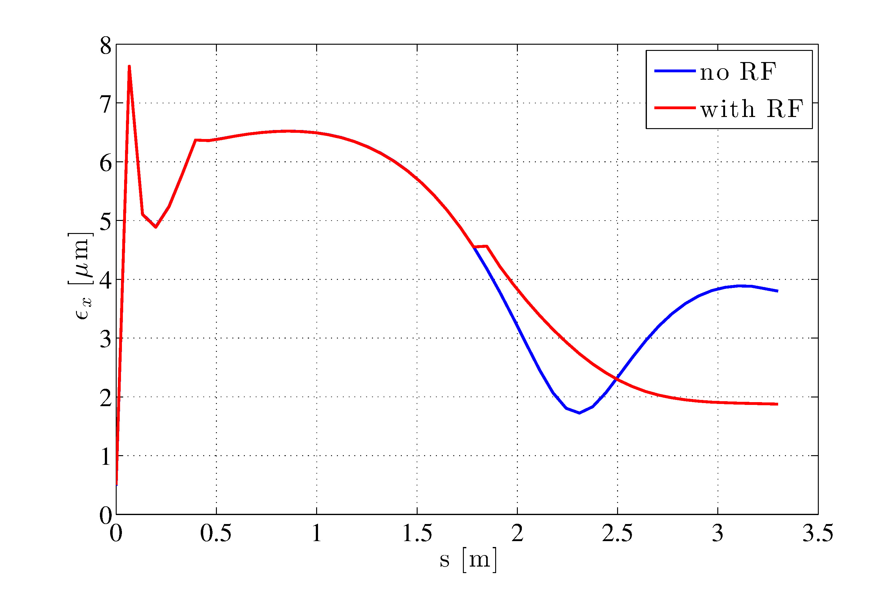
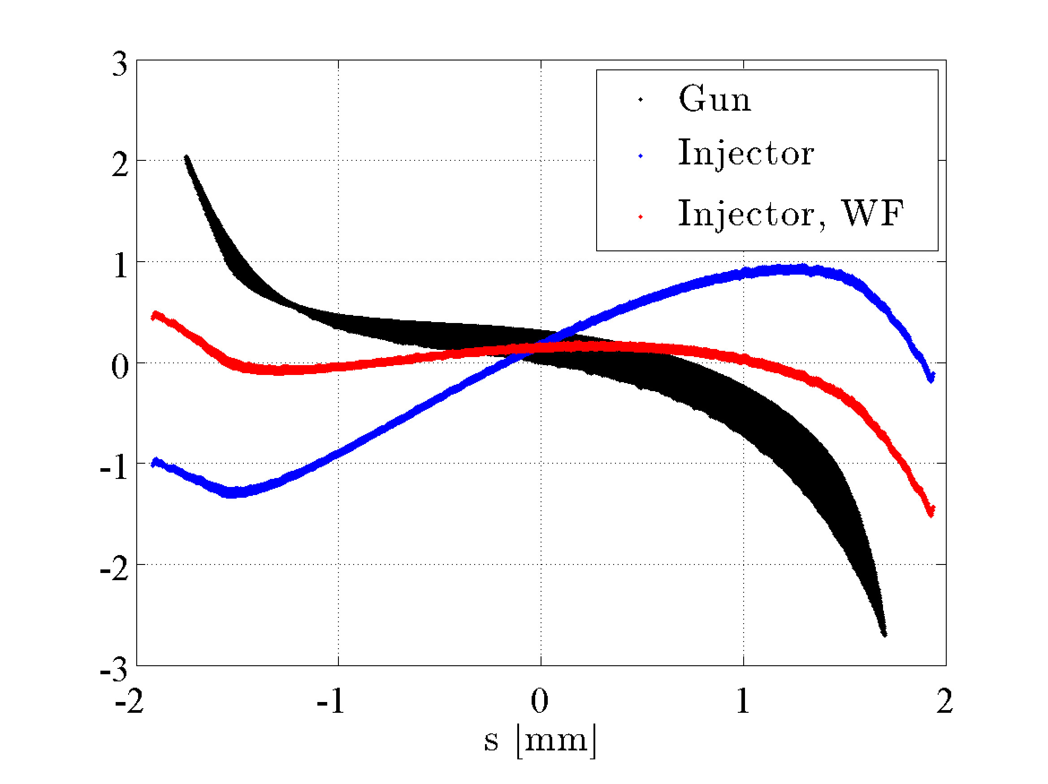
Injector optimisation (ASTRA)
Evolution of transverse emittance
Longitudinal phase space
δ [%]
head
tail
100MV/m gun RF.
Solenoid to control emittance minimum.
Injector RF “freezes” emittance to about 1.9 μm.
By running gun RF off-crest, energy spread and bunch lengthening is minimised (black).
By running injector off-crest (blue), energy chirp from wakefields is compensated (red).

Slide 15
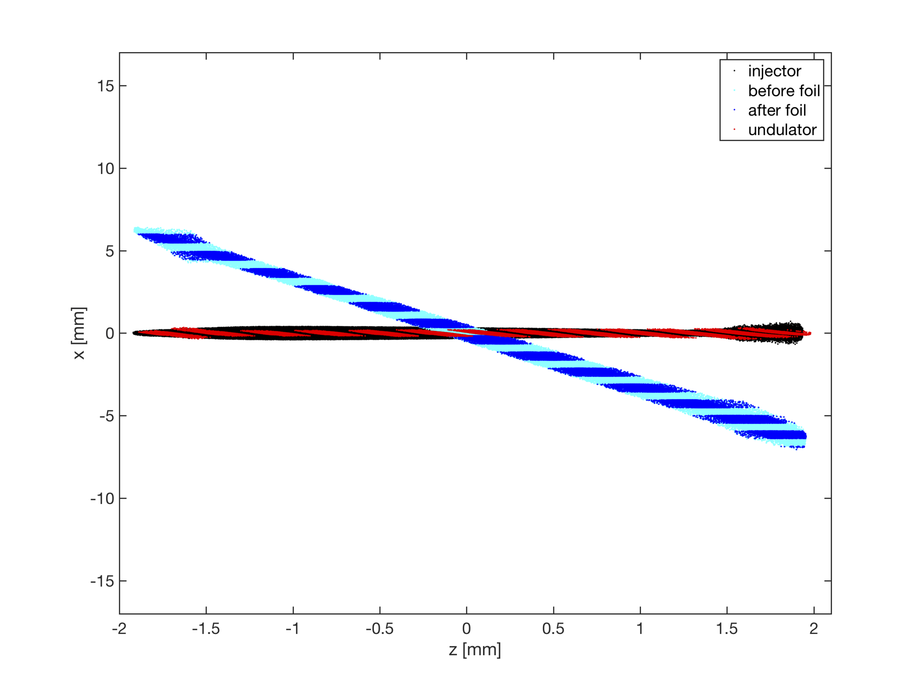
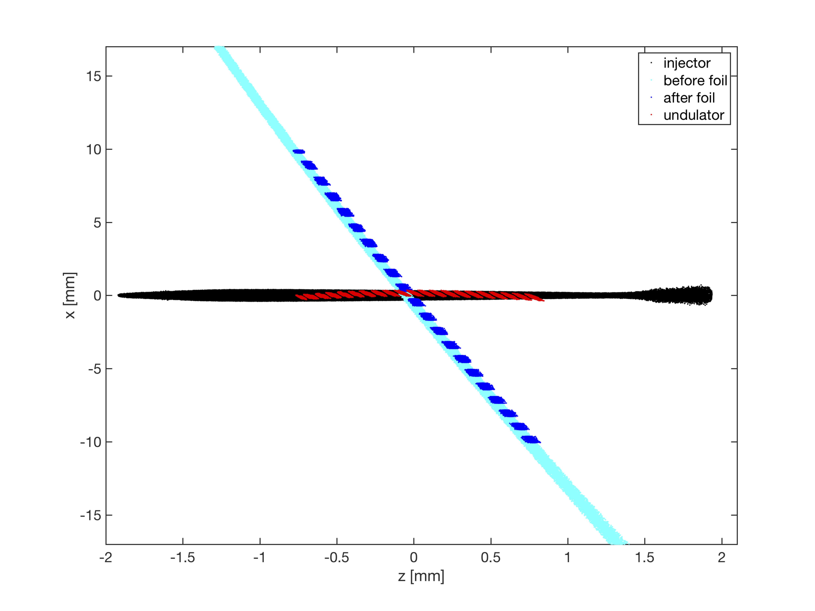
x-z phase space (ELEGANT)
1THz
4THz
β at injector and foil approx. the same.
Smaller beam at undulator.
Limited imprint efficiency visible.
Focusing errors at tail (chromaticity).
Much stronger tilt for 4 THz.
Beam length is reduced, with foil to +/- 1 cm:
  To limit aperture.
  To avoid dispersive/geometric effects.

Slide 16
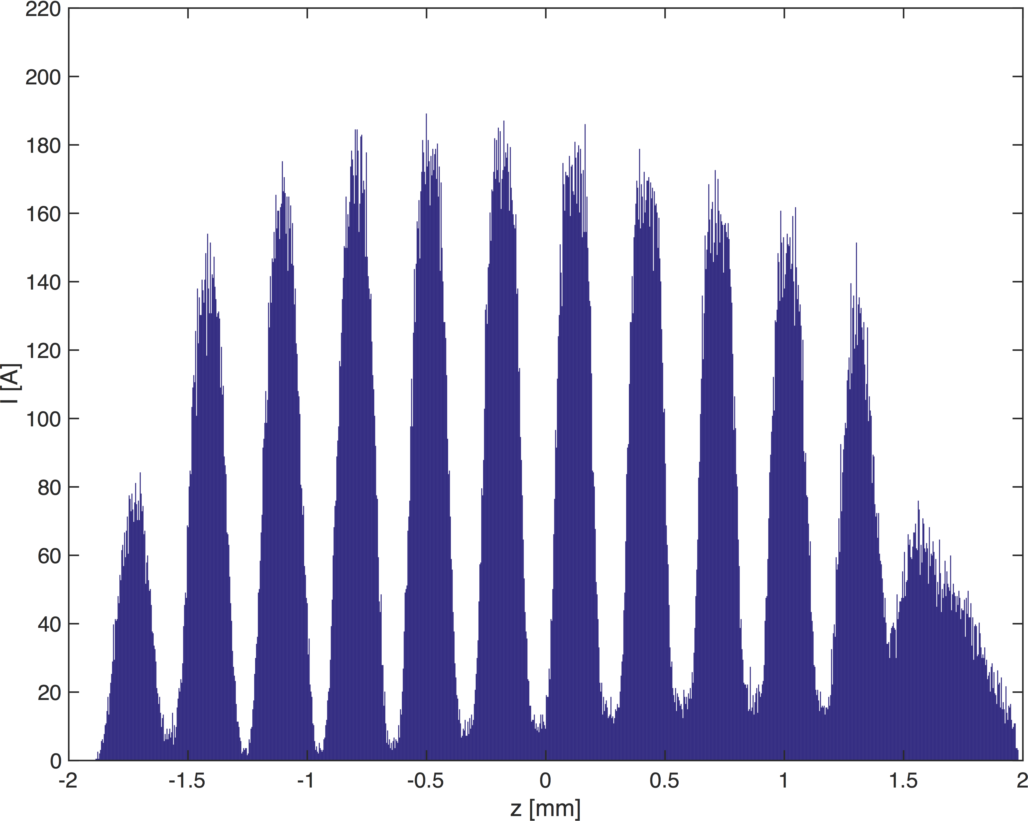
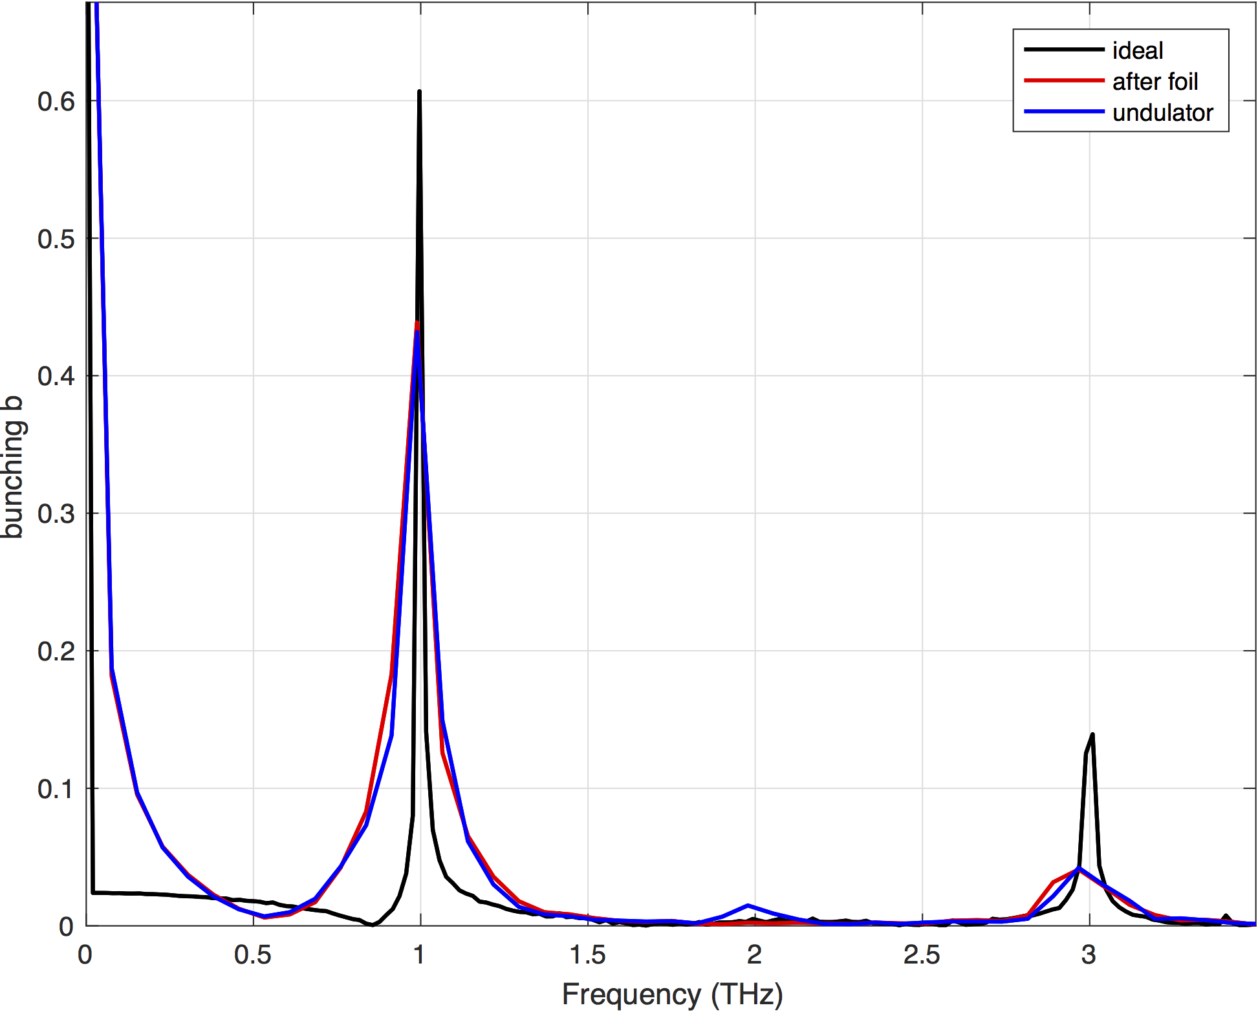
Bunching at 1 THz
Bunching at undulator: b = 0.43.
Limited imprint efficiency visible due to chromaticity at tail.
No smearing due to beam transport visible in spectrum.
But not much higher order frequency content.

Slide 17
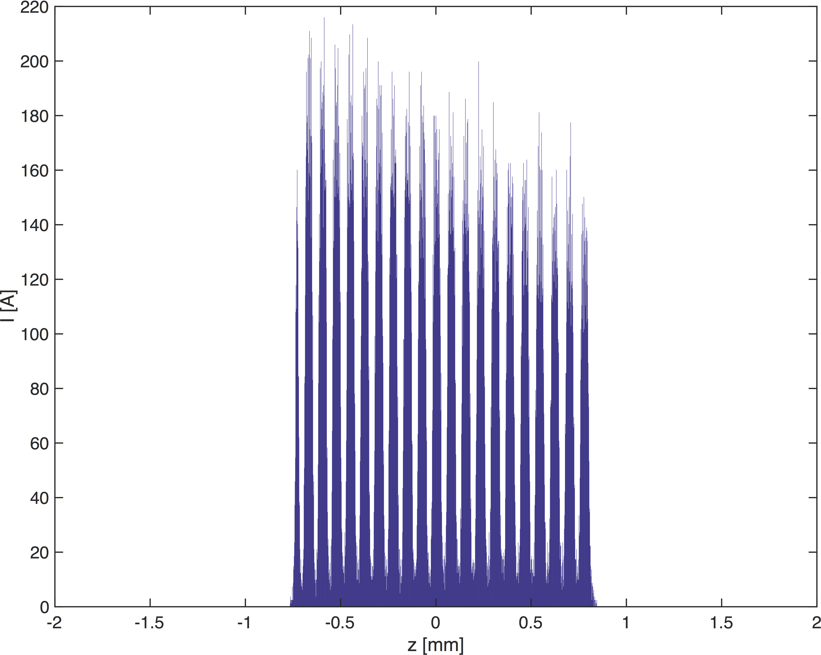
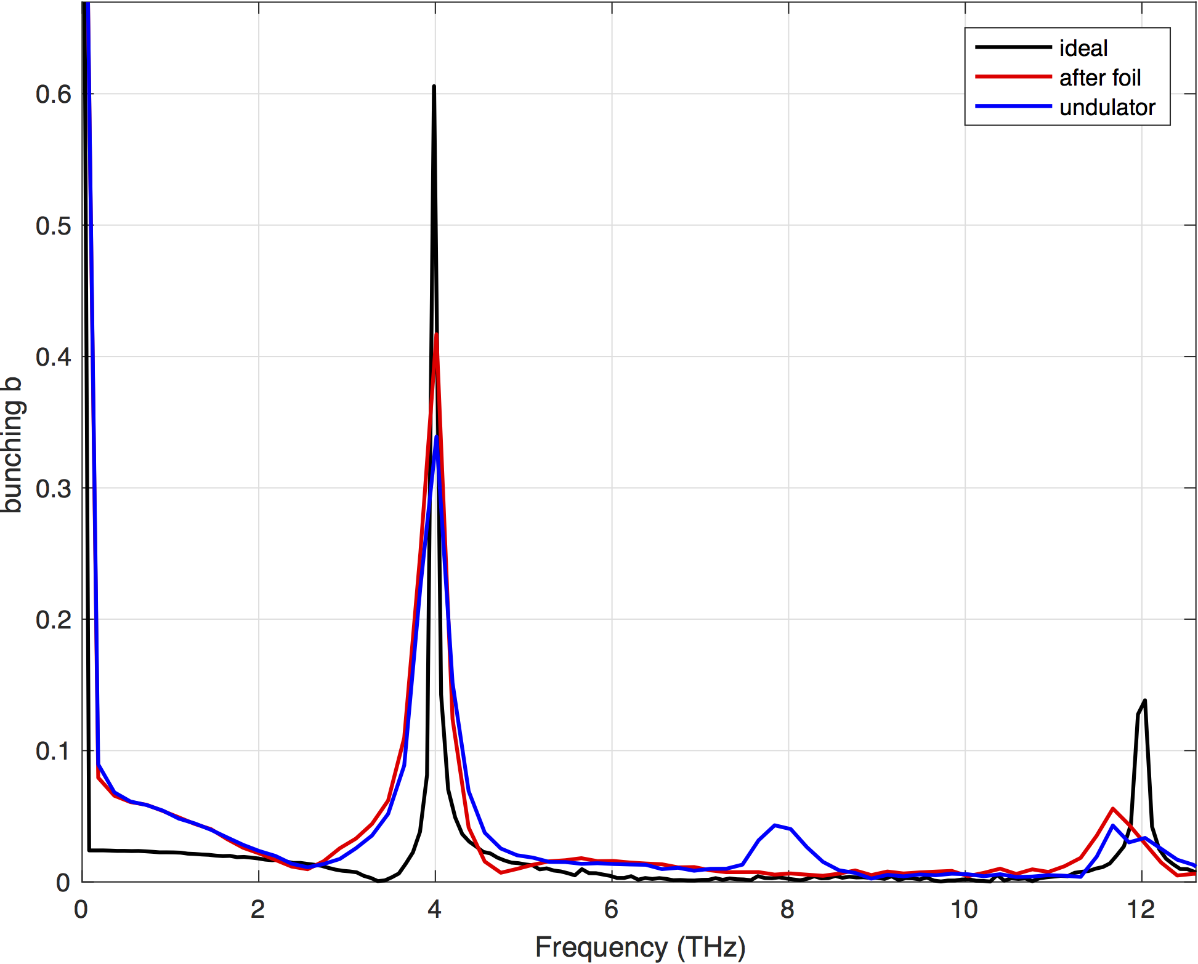
Bunching at 4 THz
Bunching at undulator: b = 0.31.
Beam is cut by foil, to avoid to large aperture and dispersive effects.
Total charge is reduced by a factor 2.
Slight smearing of bunching in beam transport.
Hardly any higher order frequency content.

Slide 18
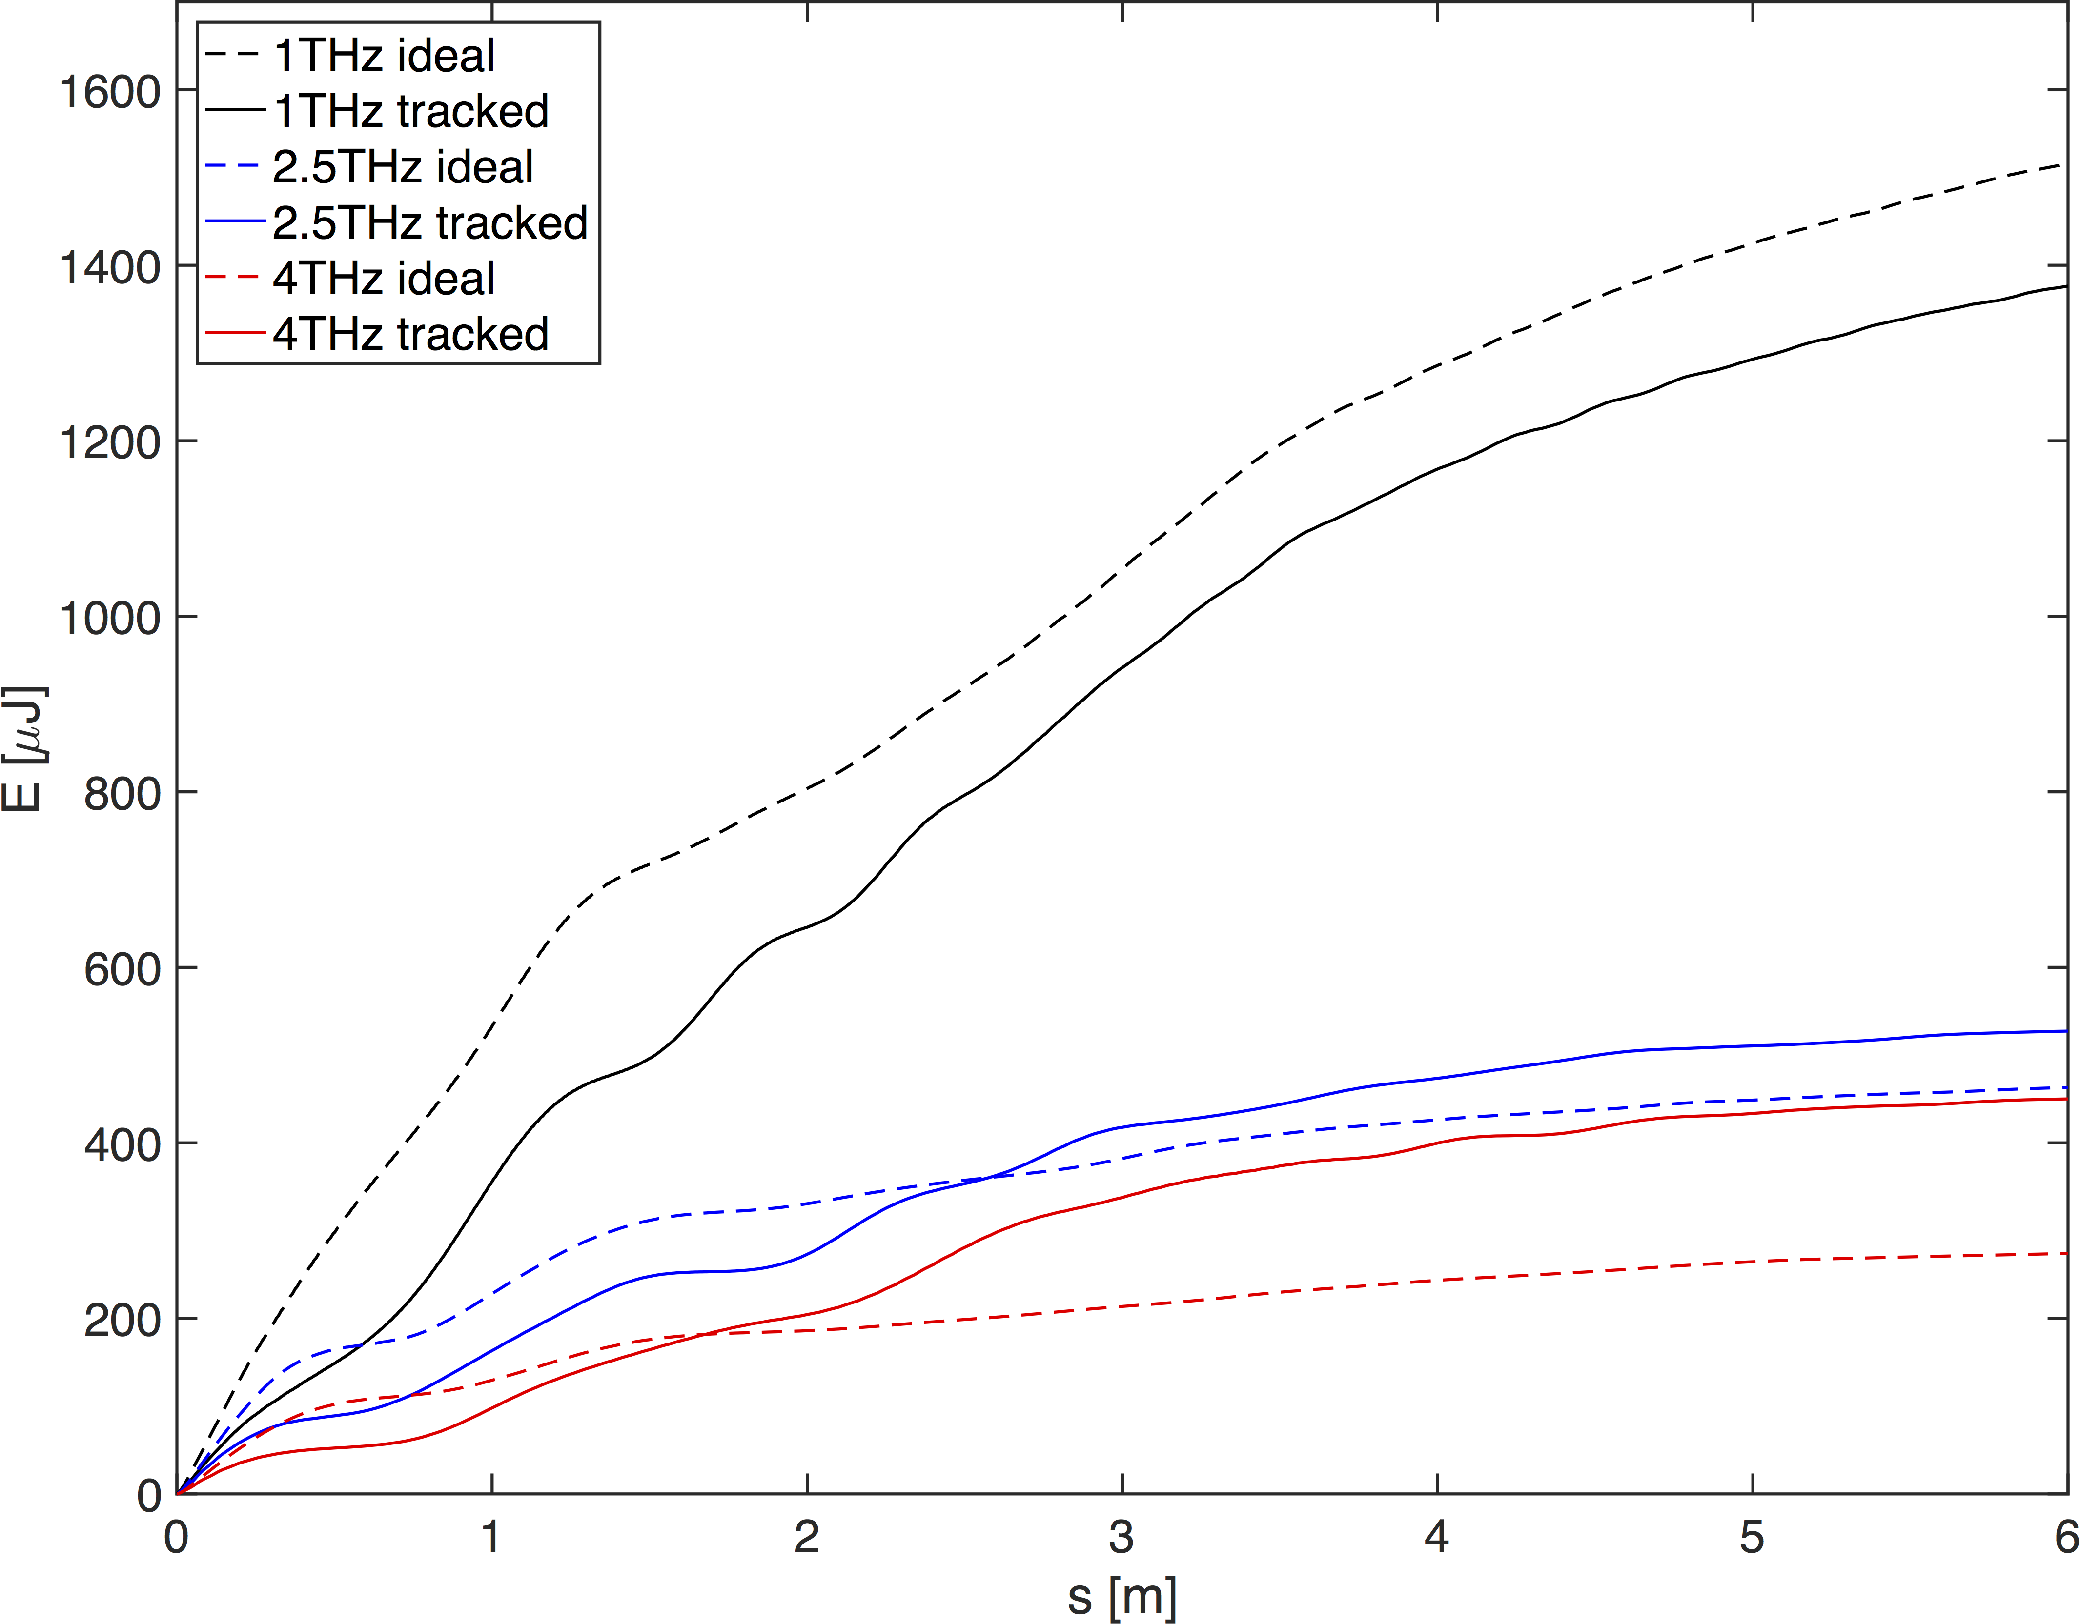
Pulse energy in undulator
Undulator simulations in GENESIS.
Specifications of 100μJ easily meet.
1.5m undulator would be enough.
Ideal and tracked beams perform similar: not too sensitive setup
Waveguide (1 cm radius) in undulator approximated in simulations via boundary conditions on field grid.
Waveguide is beneficial (suppresses edge effects).

Slide 19
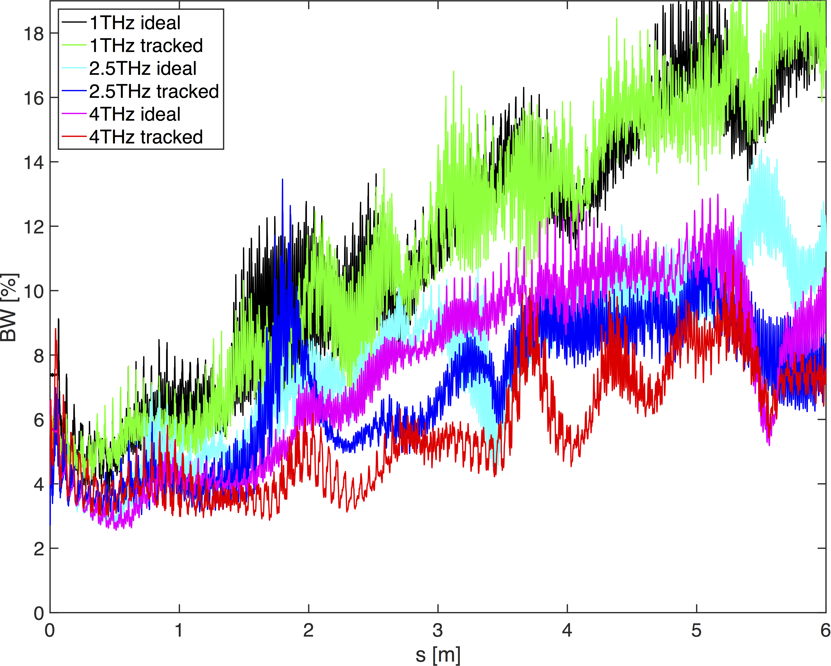
Bandwidth of terahertz radiation
Specification of < 10% BW met for undulator <1.5 – 3m.
Most critical for 1 THz (as expected).

Slide 20
4. Foil wakefields

Slide 21
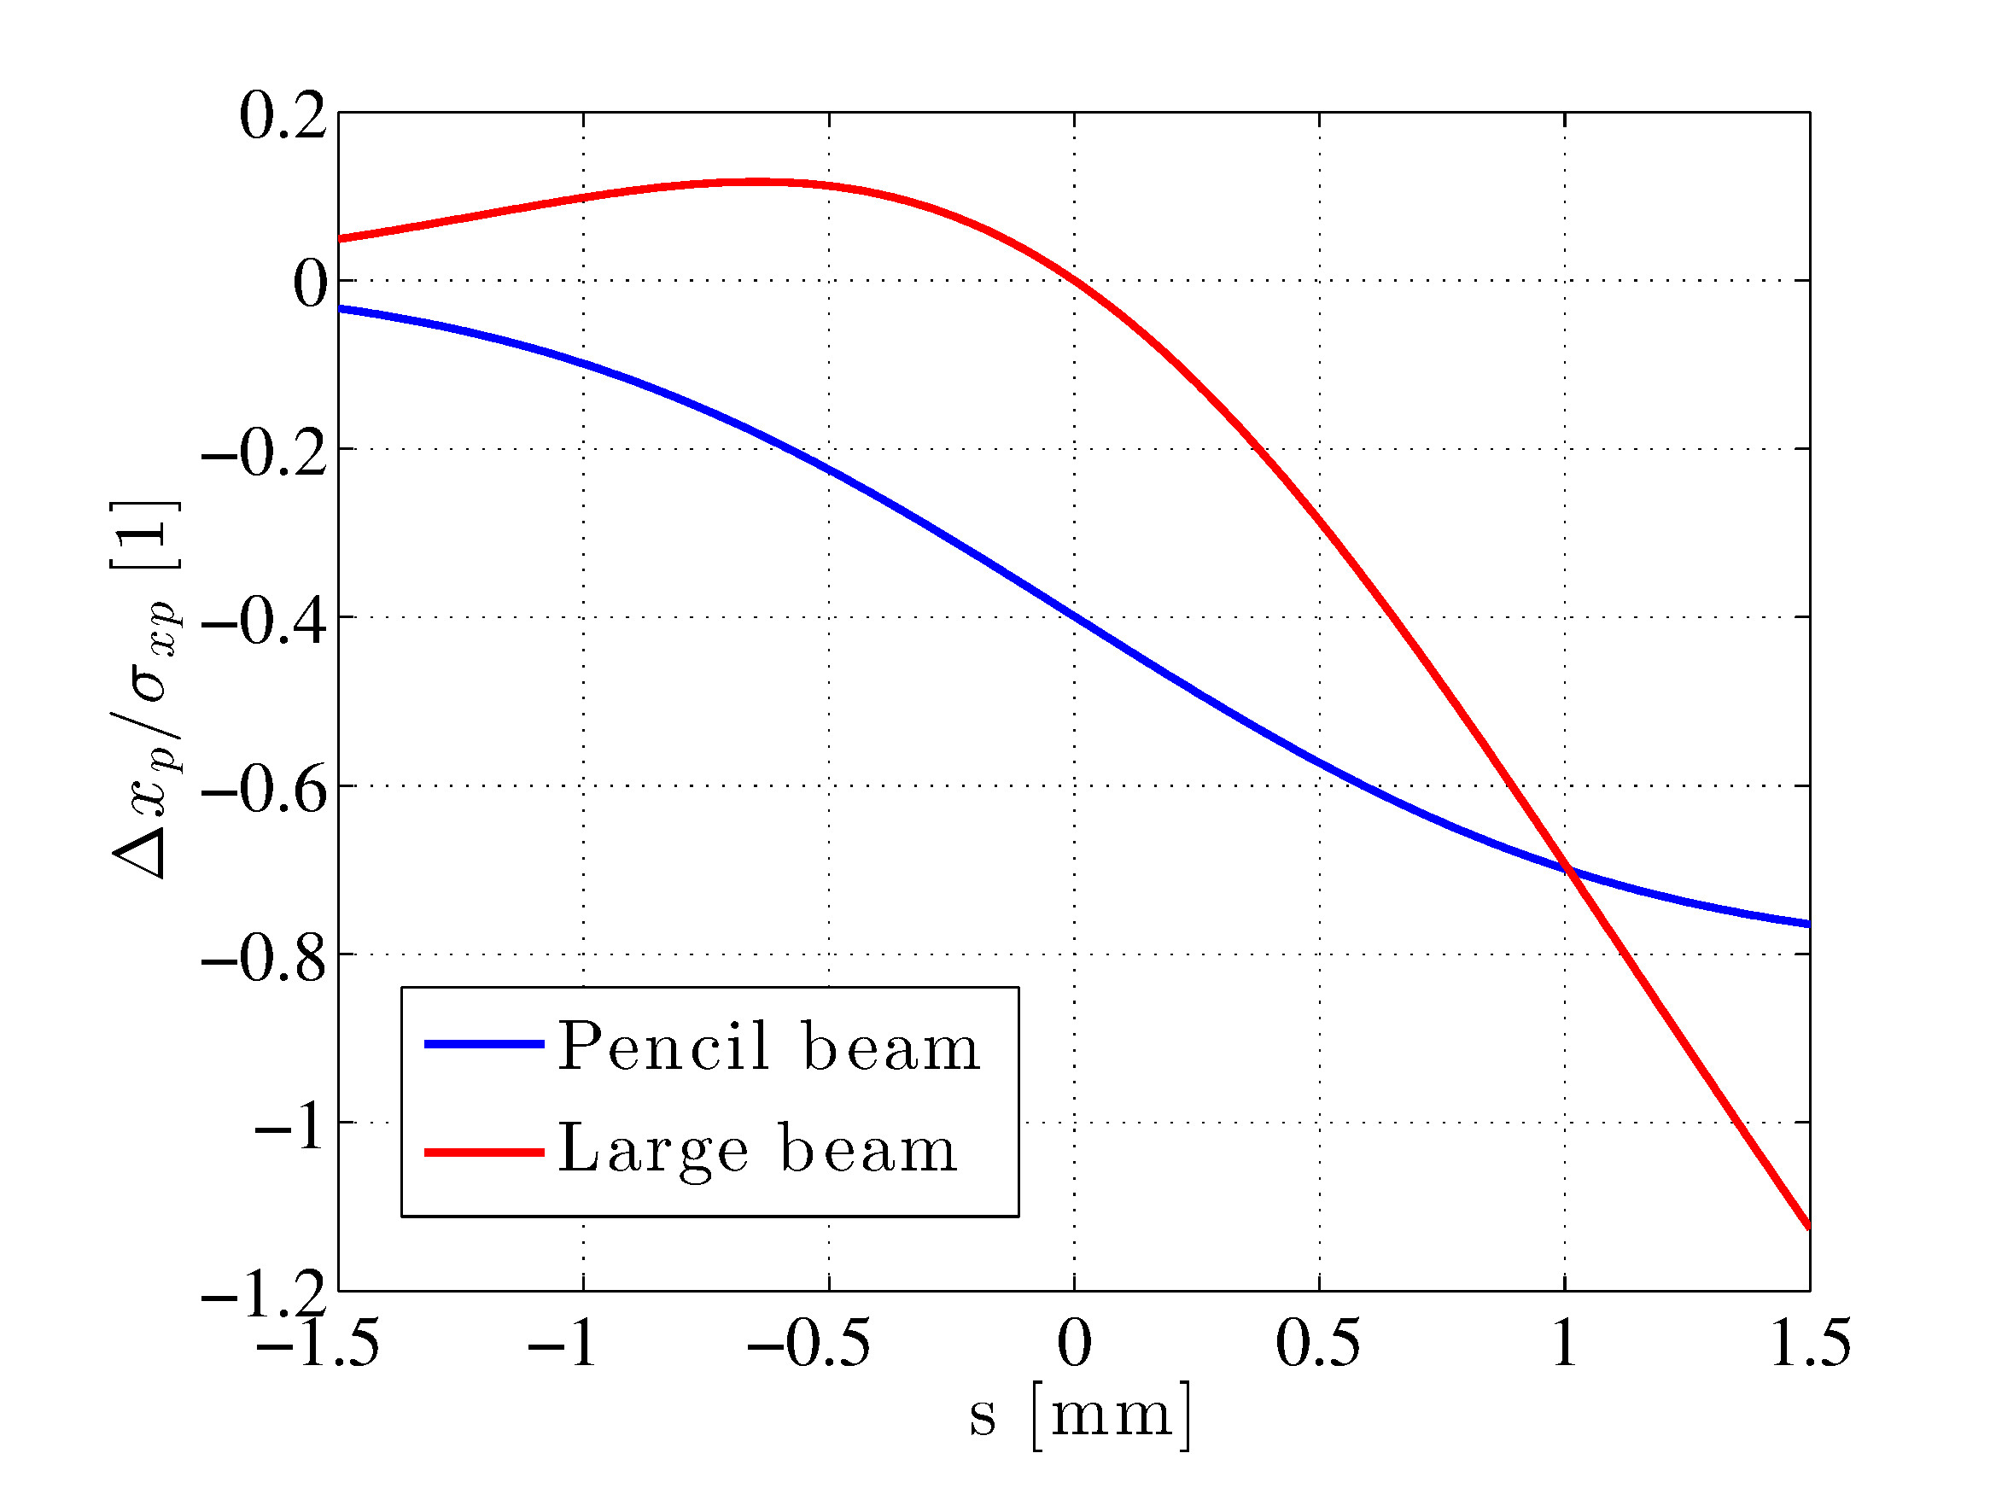
Estimates for wakefields from foil
Only reference found: K. Bane and G. Stupakov , SLAC-PUB-9726, (2003):
  “Transition Radiation Wakefield for a Beam Passing through a Metallic Foil.”
Different estimates with different assumptions:
  Gaussian beams.
  Only foil, no slits.
Longitudinal wakefield:
  Pencil beam estimate: Δδ_{max} = 0.43%.
  Tilted beam (on-axis particles): Δδ = 0.56%
  This energy change can most likely be neglected.
Transversal wakefield:
  Most realistic estimate gives a value only for the centre of the beam: Δx_{p}/σ_{xp} = -1.9.
  Other estimates give a varying relative kick of about 0.5.
  Significant effect: detailed EM-field simulations necessary!
  Help needed!

Slide 22
5. Summary
Conclusions:
After several THz source designs, a scheme using transverse deflecting cavities seems to be promising and reasonable simple.
Overall facility length of 8.5m (for 1.5m undulator).
Start to end simulations show production of THz radiation which meets specifications.
Most urgent future work:
Open point that could still cause problems is the transverse wakefield effect from the foil.
Help on this complex topic would be highly appreciated.

Slide 23
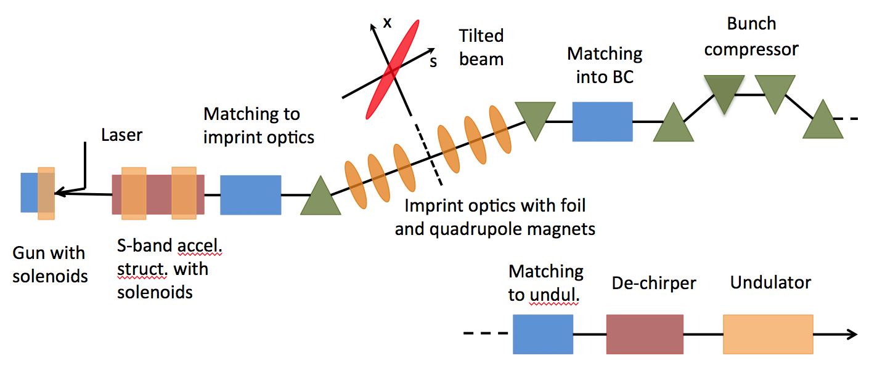
History of designs
Comb laser
  Use lase with correct bunching.
  Recreate electron bunching after space charge smearing via RF BC.
  Problem:
  Tuning: Finding correct injector step for bunching is delicate.
  Frequency tuning seems to be very challenging.
Dielectric wakefield
  Use long. wake to introduce energy modulation on beam.
  Then bunching via BC.
  Problems:
  Sub-mm aperture: fundamental problem for low energy.
  Tuning via variable thickness of dielectric layer.
  Have not seen any technique to produce such a layer.
Slotted-foil (dispersion-based)
  xz-correlation is created via energy chirp in a dispersive area.
Problem:
Beam transport: 7% energy chirp, 1.6m dispersion.
Very difficult to transport and focus without smearing of bunches.
Maybe possible, but very difficult to commission.

