Slide 1

Hollow Electron Lens Impedance Simulations
Giacomo Mazzacano, Benoit Salvant
BE-ABP-HSC
Acknowlegments:
Nicolo’ Biancacci, Antti Kolehmainen, Elias Métral, Diego Perini, Gerhard Schneider, Adriana Rossi

Slide 2
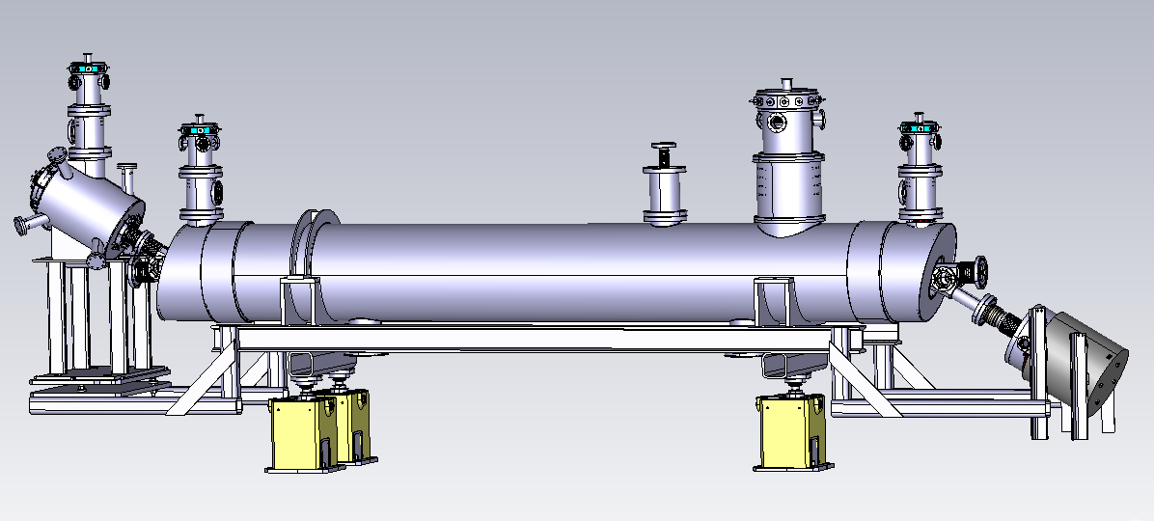
ELECTRON LENS MODEL
This new structure is planned for HL-LHC, it will be assembled and mounted in the next years (LS1 or LS2)
It is capable to interact with the beam for different purposes (acting on the emittance, bunch by bunch compensation, halo scraping etc.)

Slide 3
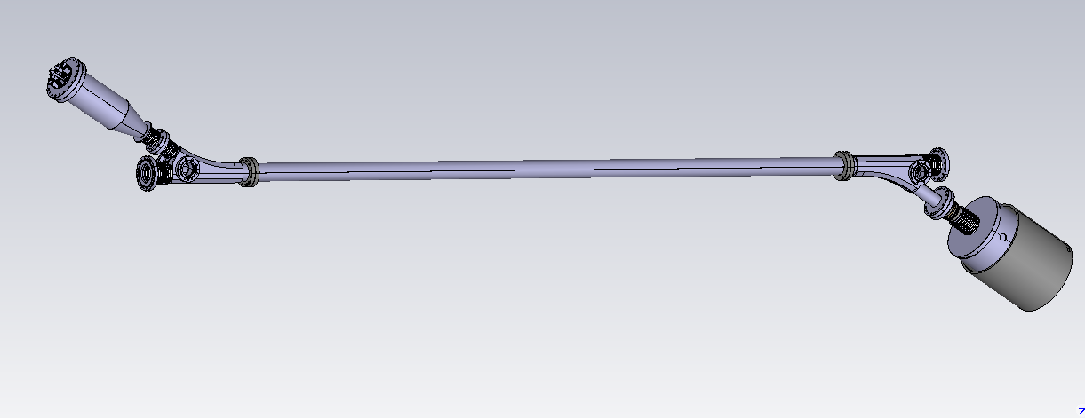
→ The Pipe was extracted in order to be characterized from the electromagnetic point of view
(this work was already presented at : Impedance Meeting, 17/03/2017)

Slide 4
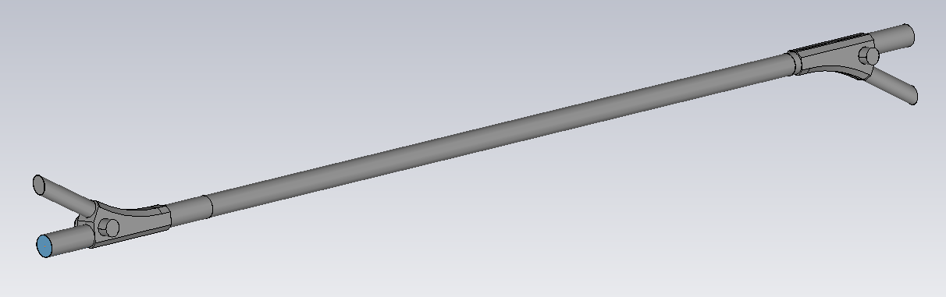
→ The structure was simplified in order to perform CST simulations, all the original dimensions and materials were preserved

Slide 5
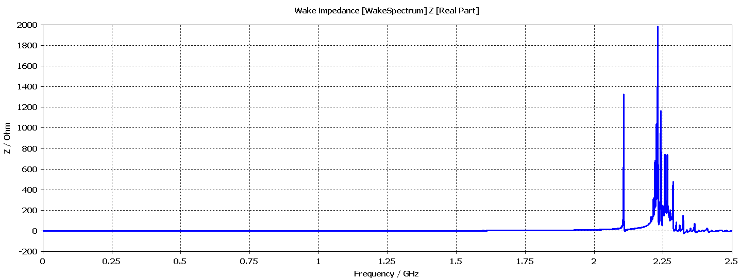
Longitudinal Impedance, Real part
1st mode beyond 2.19 GHz → good news!

Slide 6
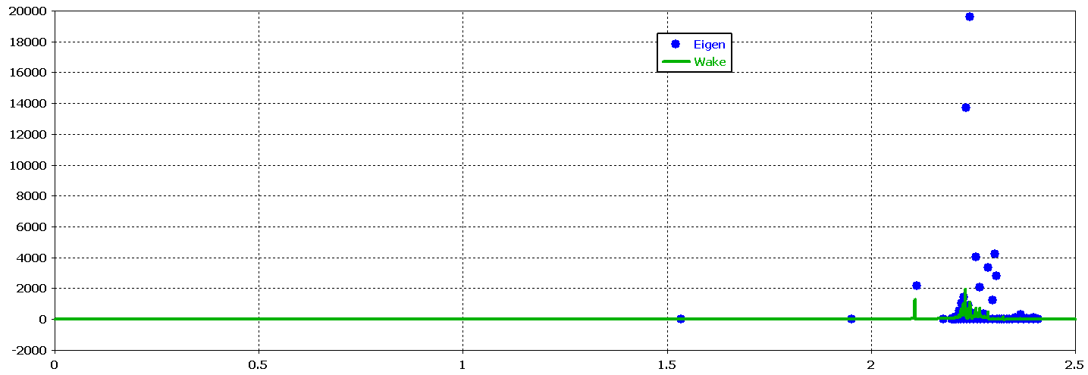
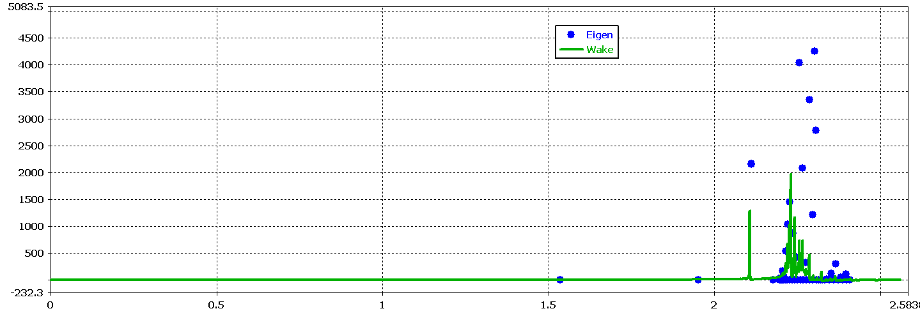
Longitudinal Impedance, Wake vs Eigen
ZOOM IN
1st mode beyond 2.19 GHz → good news!

Slide 7
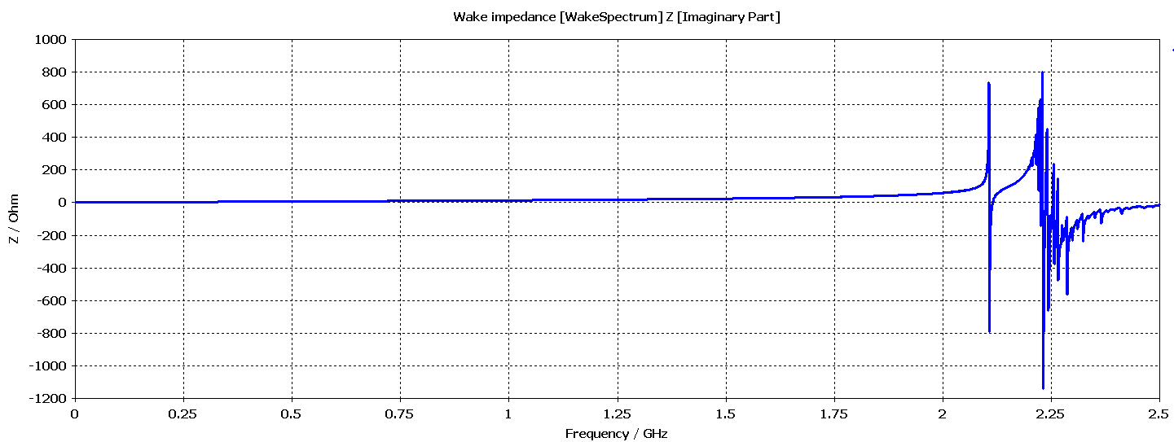
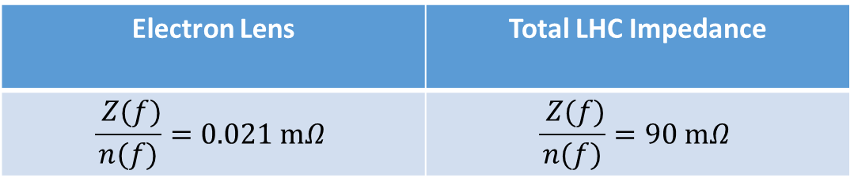
Longitudinal Impedance, Imaginary Part
Electron Lens | Total LHC Impedance
$$\frac{ Z(f)}{n(f)}=0.021 mΩ$$ | $$\frac{ Z(f)}{n(f)}=90 mΩ$$

Slide 8
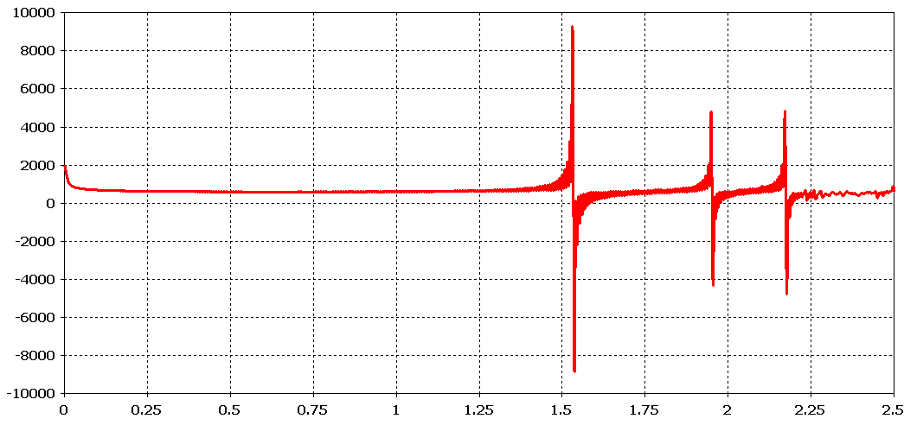
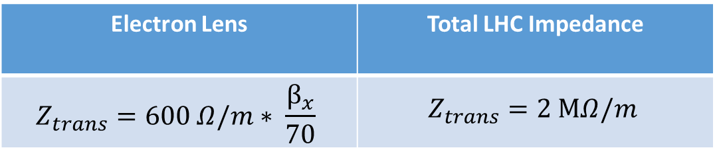
Dipolar X Impedance, Imaginary
Electron Lens | Total LHC Impedance
$$Z_{trans}=600 Ω/m∗ \frac{β_{x}}{70}$$ | $$Z_{trans}=2 MΩ/m$$

Slide 9
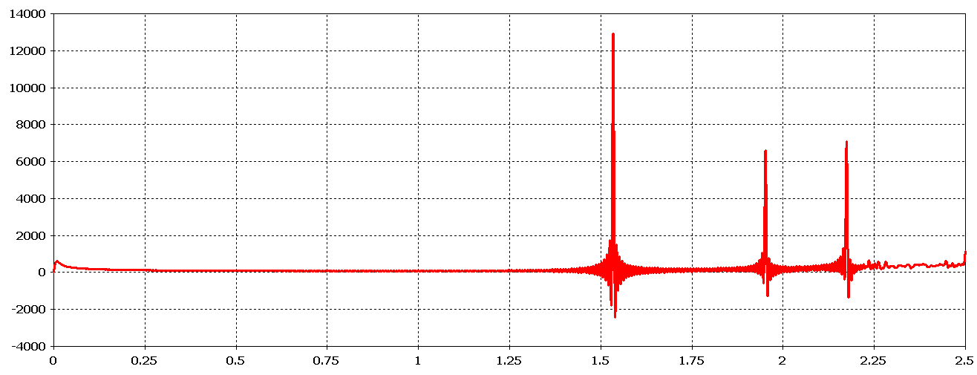
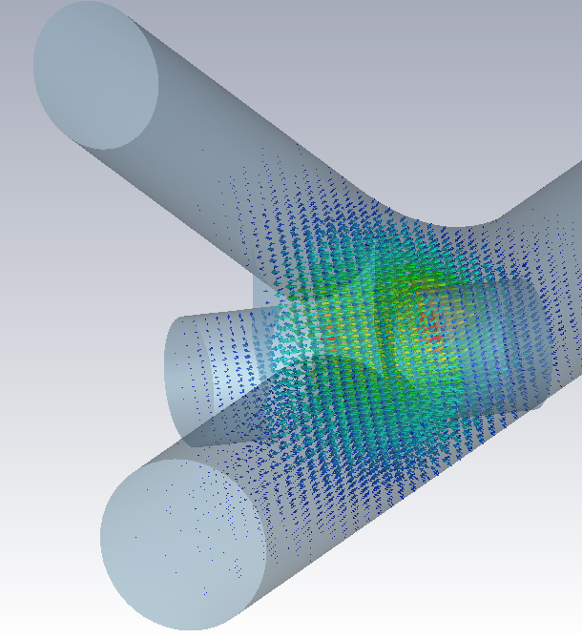
Dipolar X Impedance, Real

Slide 10
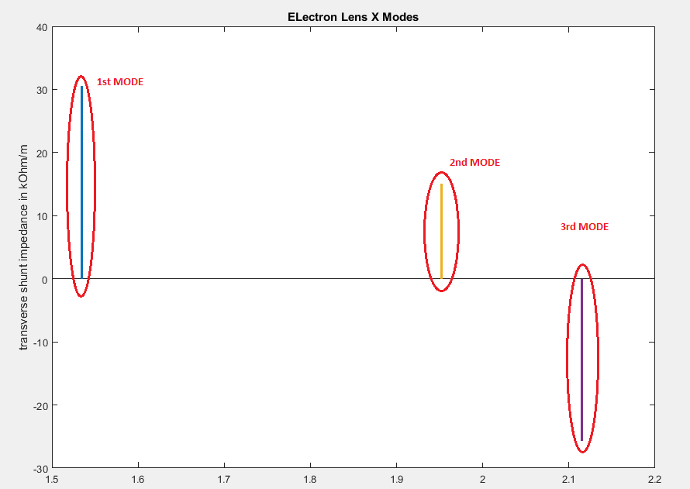

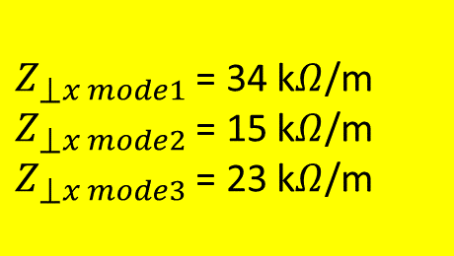
Dipolar X Impedance, Real
From Panowsky-Wenzel
$Z_{⟘x mode1}$ = 34 k$Ω$/m
$Z_{⟘x mode2}$ = 15 k$Ω$/m
$Z_{⟘x mode3}$ = 23 k$Ω$/m
To be multiplied by $\frac{β_{x}}{70}$

Slide 11
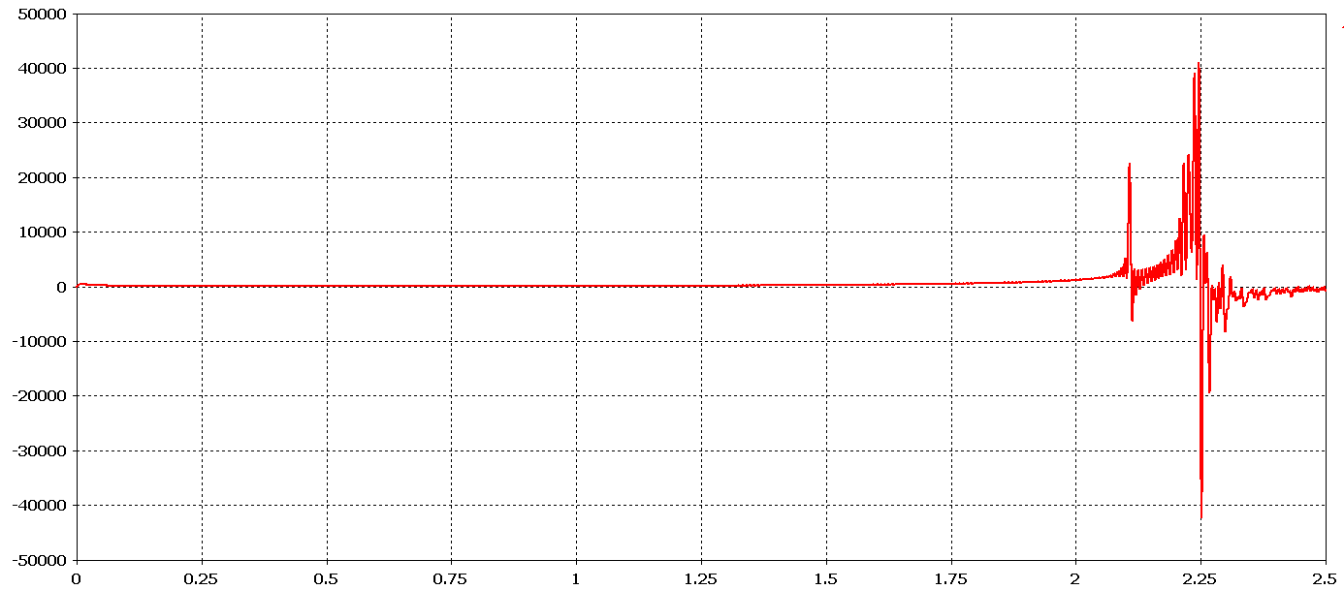
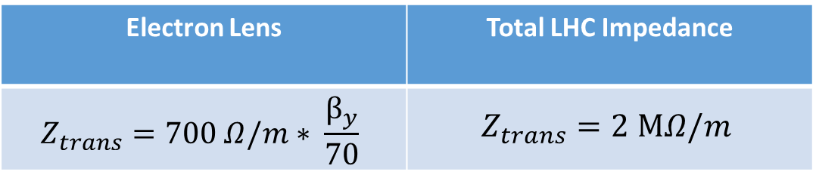
Dipolar Y Impedance, Imaginary
Electron Lens | Total LHC Impedance
$$Z_{trans}=700 Ω/m∗ \frac{β_{y}}{70}$$ | $$Z_{trans}=2 MΩ/m$$

Slide 12
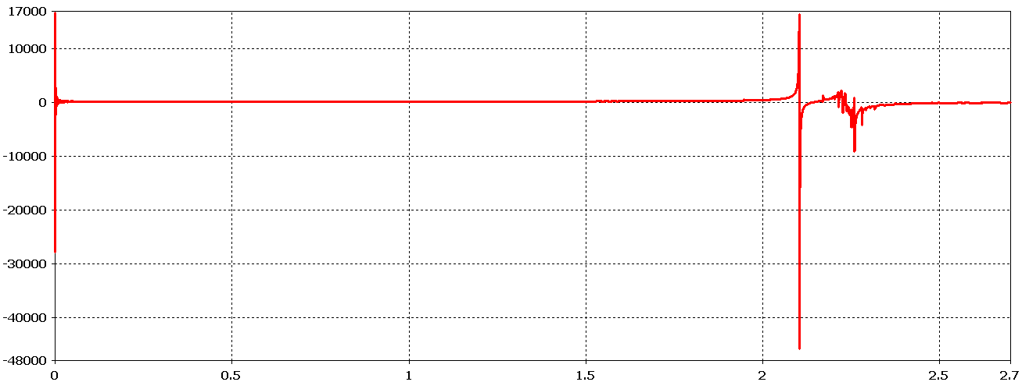
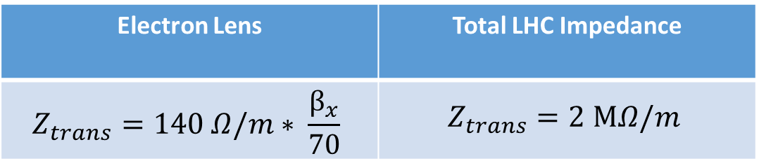
Quadrupolar X Impedance, Imaginary
Electron Lens | Total LHC Impedance
$$Z_{trans}=140 Ω/m∗ \frac{β_{x}}{70}$$ | $$Z_{trans}=2 MΩ/m$$

Slide 13
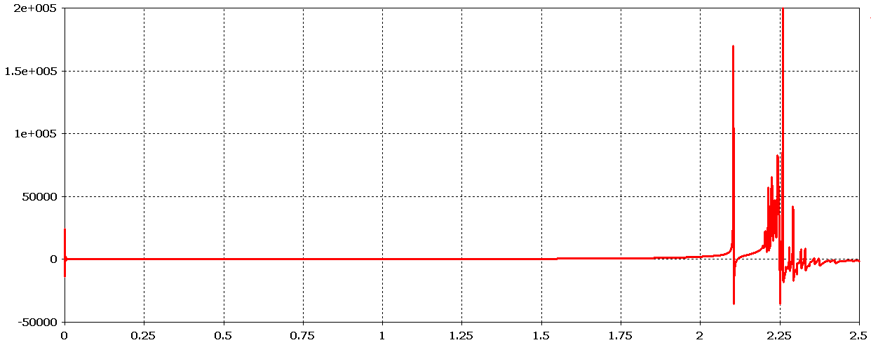
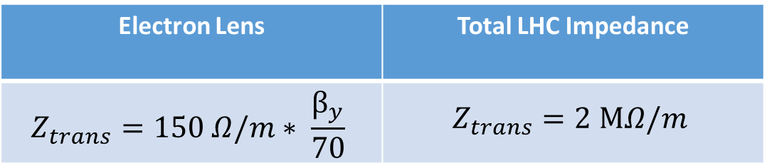
Quadrupolar Y Impedance, Imaginary
Electron Lens | Total LHC Impedance
$$Z_{trans}=150 Ω/m∗ \frac{β_{y}}{70}$$ | $$Z_{trans}=2 MΩ/m$$

Slide 14
CONCLUSIONS
The device has shown good performance from the impedance point of view
All the values obtained are significantly below the LHC budget
For more info:
[G.Mazzacano, Hollow Electron Lens Impedance Simulations] https://indico.cern.ch/event/623679/

Slide 15
Thank you for your time

Slide 16
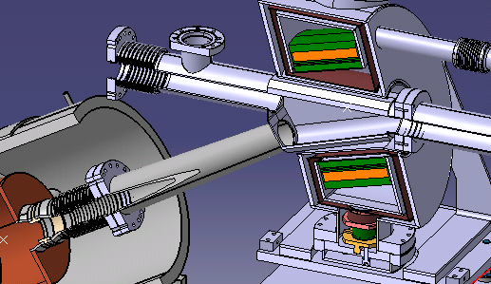
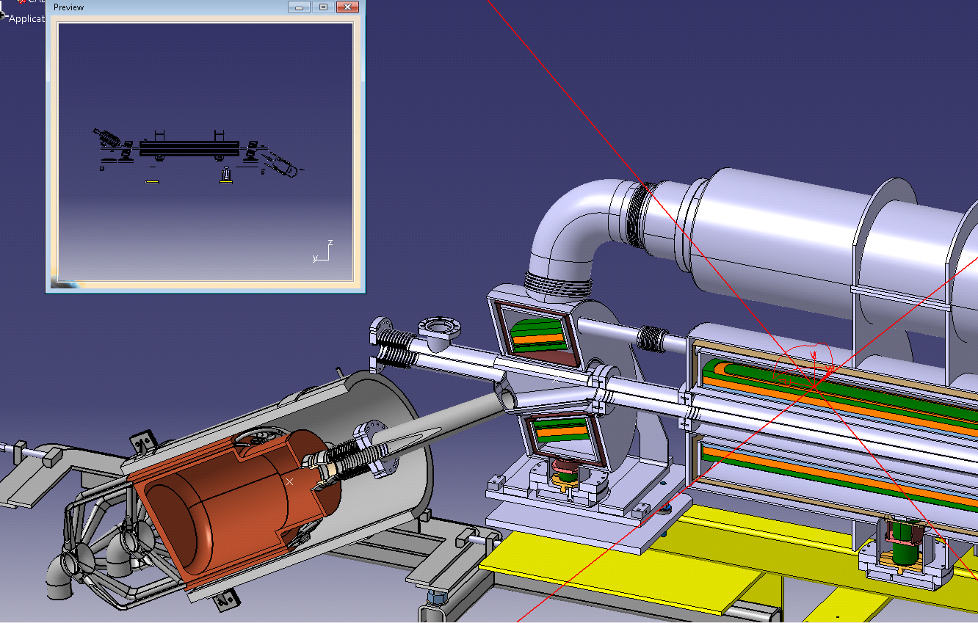
Updated design
(last change on Oct 13 on SMARTEAM)
Main points:
The ports on top and
bottom of Y chamber disappeared
The smoothing of the
chamber was removed
We will redo detailed
simulations.

Slide 17
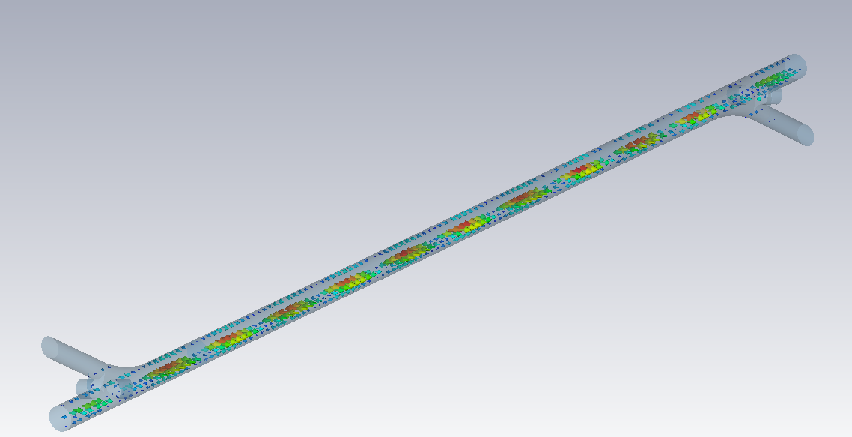
- The family of modes between 2.19 GHz and 2.35 GHz gives the biggest longitudinal impedance contribution. The values are not critical (out of LHC beam spectrum frequencies) and apparently from Eigenmode simulations they seem to be fake modes due to the main pipe…. But they are not:
They don’t shift in frequency if the length of the structure is changed
TE modes present a Ez component
In Wakefield simulations (open boundaries) they are still inside the structure
Frequency | Q factor | Shunt Imp. | R/Q
2.24 GHz | 3040 | 1.80 Ohm | 0.0005 Ohm

Slide 18
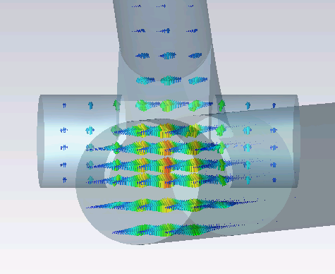
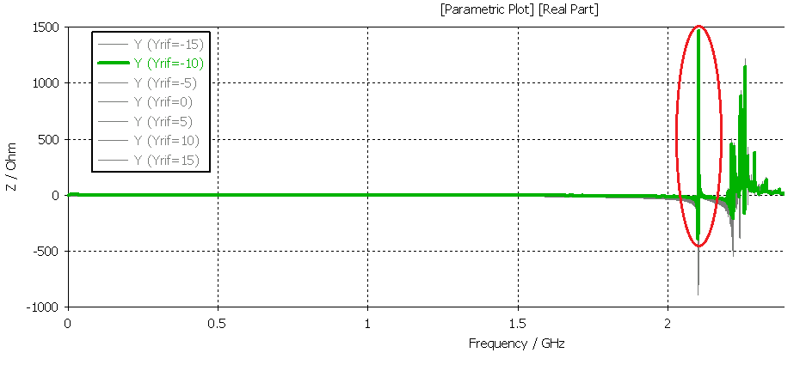
First significant trapped mode along Y below cutoff
It is due to a vertical aperture of the structure
Not clear what type of mode it is, to be checked.
Frequency | Q factor | Shunt Imp. | R/Q
2.114 GHz | 3325 | 850 Ohm | 0.255

Slide 19
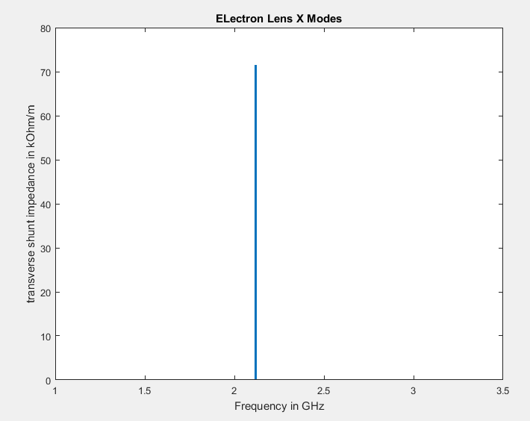
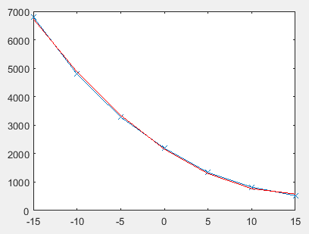
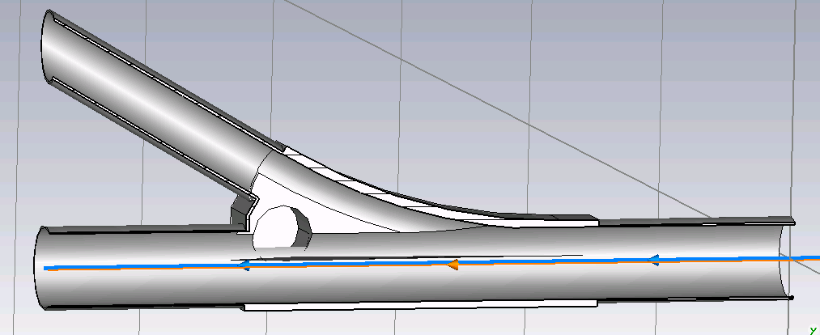
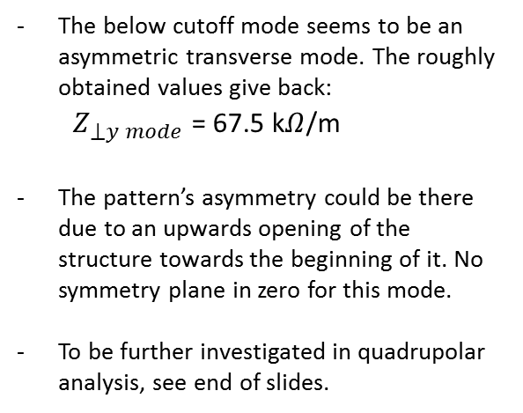
Shunt impedances for different Y displacements
The below cutoff mode seems to be an asymmetric transverse mode. The roughly obtained values give back:
$Z_{⟘y mode}$ = 67.5 k$Ω$/m
The pattern’s asymmetry could be there due to an upwards opening of the structure towards the beginning of it. No symmetry plane in zero for this mode.
To be further investigated in quadrupolar analysis, see end of slides.

Slide 20
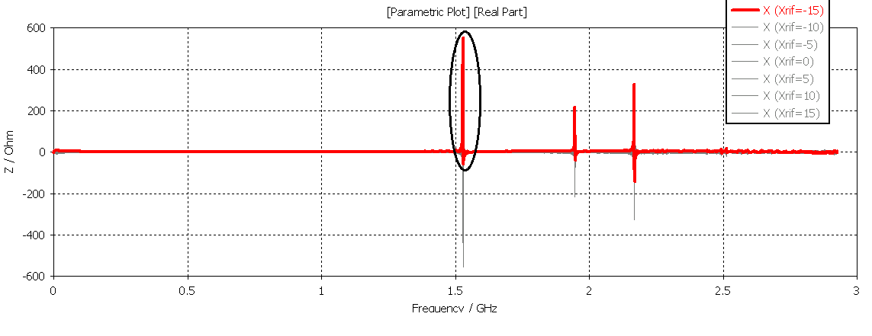
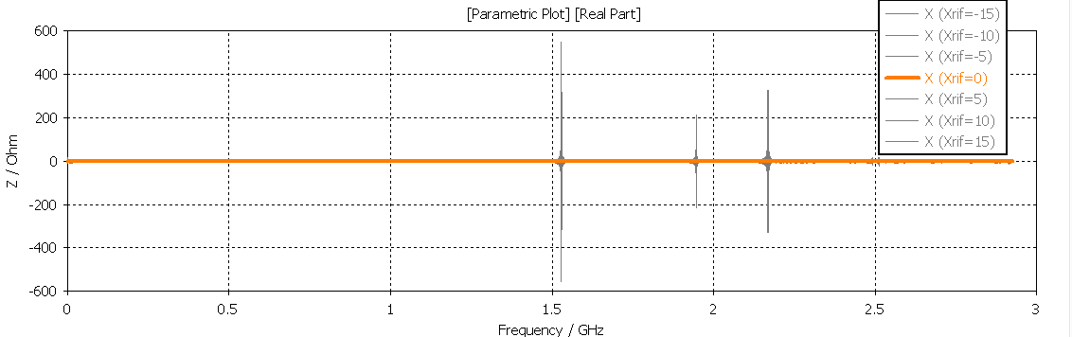
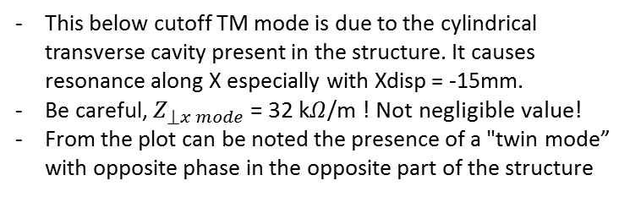
This below cutoff TM mode is due to the cylindrical transverse cavity present in the structure. It causes resonance along X especially with Xdisp = -15mm.
Be careful, $Z_{⟘x mode}$ = 32 k$Ω$/m ! Not negligible value!
From the plot can be noted the presence of a "twin mode” with opposite phase in the opposite part of the structure
Frequency | Q factor | Shunt Imp. | R/Q
1.53 GHz | 3168 | 1650 Ohm | 1.92 Ohm
- No contribution to impedance for Xposition = 0, all the modes are pure transverse dipolar ones, they totally depend on the Xdisplacement. This agrees with theory, the structure is totally symmetric along X axis as a matter of fact.

Slide 21
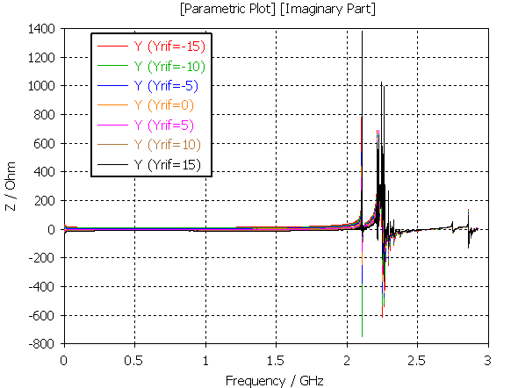
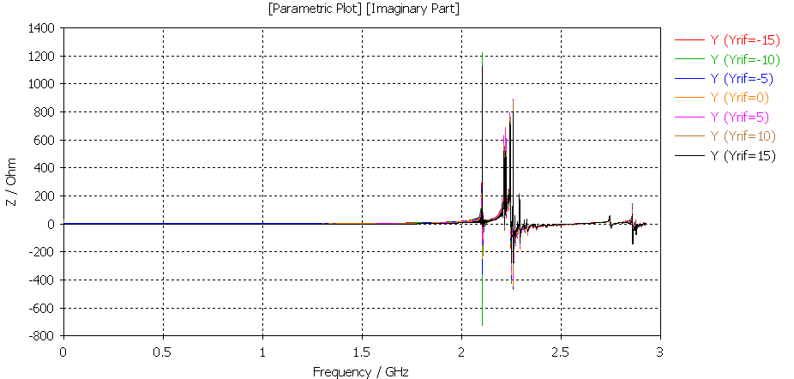
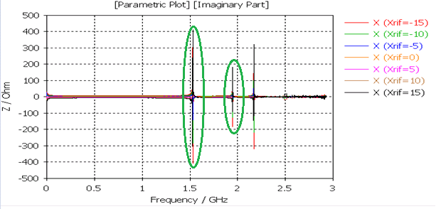
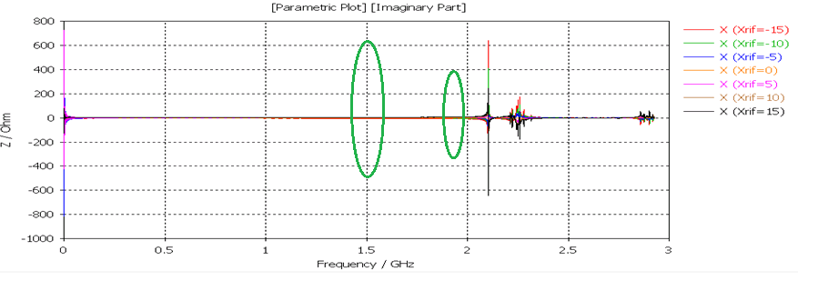
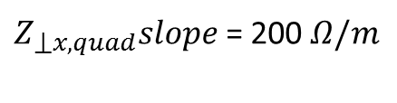
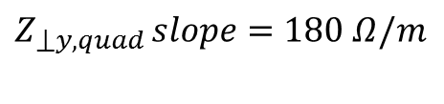


COMPARING DIPOLAR AND QUADRUPOLAR IMPEDANCE
$${ Z}_{⟘x,dip}slope=500 Ω/m$$
$Z_{⟘x,quad}slope$ = 200 $Ω/m$
$$Z_{⟘y,dip }slope= 800 Ω/m$$
$Z_{⟘y,quad }slope=180$ $Ω/m$
The quadrupolar part of the transverse impedance gives a smaller broadband contribution than the dipolar one
No transverse X modes below cutoff.
Quadrupolar Y impedance is similar.
Dipolar
Quadrupolar
Y
X

