Slide 2
Troubleshooting Performance in Oracle
Emil Pilecki
Notes:
Introduce myself: 8 years data engineering, data analytics (make sense)

Slide 3
Agenda
Importance of the design phase
  Performance implications, design tips
My query is slow! – diagnosing perfromance issues
  Oracle query optimization
  Troubleshooting methods and tools
Fix my query! – how can we improve the situation?
  What can the developers do?
  What can the DBAs do?
  Performance tips & tricks for SQL and PL/SQL
Assorted recommendations

Slide 4
Typical challenging use-cases
High rate of concurrent transactions
High rate of queries
Queries that scan large amounts of data
Complex joins and aggregations on data
Strict requirements on response time

Slide 5
Importance of the design phase
Bad schema design = poor performance
Bad application design = poor performance
Good design = foundations for good performance
  Does not guarantee good performance but makes it much easier to achieve
  Still a lot depends on the data and how you use it

Slide 6
Schema normalization
OLTP applications: use highly normalized schema
  For data consistency and maintainability
  Typically access small amount of data in each call
  Proper indexing is critical
Data warehouse, reporting and analitics applications:
use denormalized schema
  For improved performance (avoiding multiple table joins)
  Typically access large data volumes in each call
  Should be derrived from a normalized OLTP schema

Slide 7
Indexing your tables
Don’t index all possible columns of all tables!
  Maintaining indexes is not cost free
  DML operations will suffer from excessive indexing
  Storage space is wasted
Index columns which you expect to appear
in WHERE clause conditions
Use LOCAL indexes on partitioned tables
  Global indexes still better for quick single row lookups

Slide 8
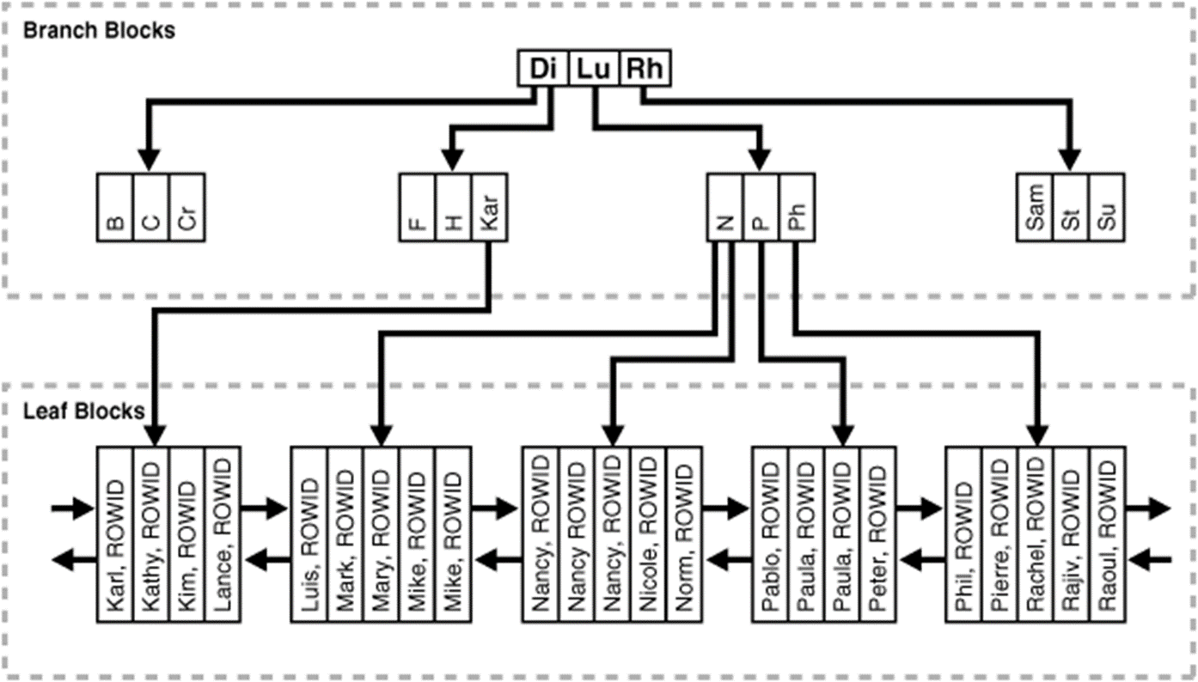
B-tree index
* Is the default type
* Best for retrieving a single row or small range of rows, especially from large tables
* Alleviate sorts
* Can skip table scan if index contains all selected coulmns
SQL> SELECT name FROM persons
WHERE name LIKE ’N%’
ORDER BY name;

Slide 9
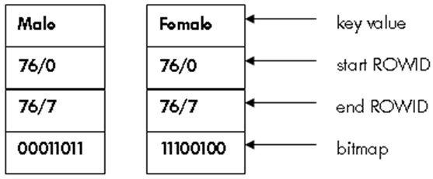
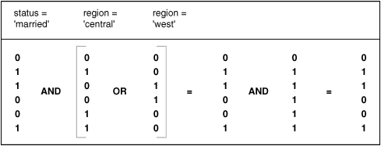
Bitmap index
* Separate bitmaps for each column value
* Space efficient for low cardinality columns
* NULL values indexed by default
* Key compression applied by default
* Very efficient for counting rows
* Very efficient handling of logical operations in WHERE clause
SQL> SELECT COUNT(*) FROM customer
WHERE status = 'married'
AND ( region = 'central' OR region = 'west' );

Slide 10
Indexing tips
Use composite indexes wisely (b-tree only)
  When all columns appear together in WHERE conditions
  The leading column(s) can be used independently
  Column order is important
  To index NULL values use extra, not-NULL column
  SQL> CREATE INDEX emp_dobnn ON employees (date_of_birth, '1');
Use bitmap indexes for low cardinality columns
  Single column indexes only!
  Do not use in case of high concurrency DML workload

Slide 11
Indexing tips
Use UPDATE INDEXES clause when manipulating partitions of a partitioned table
SQL> ALTER TABLE sales DROP PARTITION p2016 UPDATE INDEXES;
Use functional index if functions or expressions appear in query WHERE clause
SQL> SELECT first_name, last_name FROM persons WHERE UPPER(person_name)=UPPER(:1);
Don’t rebuild your indexes every day
  It may make sense only after a massive data deletion,
  or in some cases massive update of index key column(s)

Slide 12
Monitoring index usage
Enable / disable usage monitoring
SQL> ALTER INDEX moni_idx [NO]MONITORING USAGE;
Check if index was ever used
SQL> SELECT * FROM V$OBJECT_USAGE; -- Oracle 11.2
SQL> SELECT * FROM USER_OBJECT_USAGE; -- Oracle 12.1+
Can only identify indexes that are never used
  Cannot tell how many times the index was used
Mark index invisible to see if it makes any difference
  Invisible to SELECT but still maintained by DML operations
SQL> ALTER INDEX moni_idx [IN]VISIBLE;

Slide 13
Partitioning
  Physically splits tables and indexes into smaller, faster to scan data segments
Partition pruning
  Can skip some partitions when reading data
  There must be WHERE predicate on the partition key column
Partition-wise joins
  Oracle can join partition to partition instead of whole tables
Can use DDL on partitions to avoid costly DML
  DROP, TRUNCATE, EXCHANGE

Slide 14
Parallel execution
Difficult to use, easy to abuse
  Excessive parallel execution can starve DB servers easily
  Unpredictible - other queries may exhaust parallel server pool
  Scanning small data sets can actually be slower due to parallel overhead (slave coordination)
Use with caution, only in specific queries
  Scanning large data sets, especially with FULL TABLE SCAN
  Partitioned tables, especially if partition-wise joins can be used
  Do not use very high DOP

Slide 15
Materialized Views
Like views, but result data stored in physical segment
  Fast access to transformed data
  Can be indexed, partitioned and cascaded
  Not real-time data, need to be refreshed after DML operations
FAST REFRESH feature – incremental refresh
  Much faster if small percentage of rows changes over time
  Require materialized view logs (MLOG$) to be created on base tables
  Don’t use ON COMMIT FAST REFRESH on OLTP base tables!!!
  Full list of prerequisites and restrictins for fast refresh can be found here:
  https://docs.oracle.com/database/121/DWHSG/basicmv.htm#GUID-505C24CF-5D56-4820-88AA-2221410950E7

Slide 16
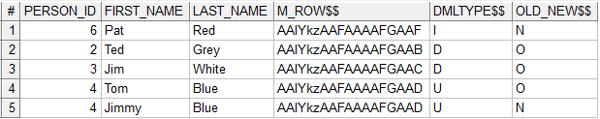
Creative usage of mview logs
Materialized view logs can track changes in base tables
  This can be useful for various incremental operations
  Don’t forget to clean MLOG$ tables if you use them this way
  SQL> CREATE MATERIALIZED VIEW LOG ON persons WITH ROWID, PRIMARY KEY, SEQUENCE
  (first_name, last_name) INCLUDING NEW VALUES;
  SQL> INSERT INTO persons VALUES ('6','Pat','Red');
  SQL> DELETE FROM persons WHERE person_id IN ('2',3);
  SQL> UPDATE persons SET first_name='Jimmy' WHERE person_id=4;

Slide 17
My query is slow!
Before creating a SNOW ticket…
  Is this a new query or a new PL/SQL code?
  Was it ever faster? Or just wish it were faster…
  Did the underlying data or table statistics change recently?
  When exactly did it start, is it constantly slow or just sometimes?
Please gather the following information:
  Database name or TNS alias used to connect
  DB schema, exact query text or SQL ID (include bind variables)
  Timestamp or time range of slow execution

Slide 18
My query is slow!
Typical root causes of performance issues
  Badly written SQL or PL/SQL (very common case!)
  Poor design of the underlying schema / data model
  The query execution plan is not optimal (possibly changed)
  Missing or inappropriate indexes
  Missing or inaccurate table and index statistics
  High database or storage server load (CPU, IO)
  High concurrency and high number of transactions
  Large data volumes to be scanned and complex transformations

Slide 19
Cost based query optimization
CBO – cost based (query) optimizer
  For each SQL statement considers different ways of execution
  Estimates the cost of each execution plan and chooses the cheapest one
CBO input
  Query syntax and bind variables values
  Table and system statistics
  Presence of indexes and index statistics
  Other factors: materialized views, partitioning, DB parameters

Slide 20
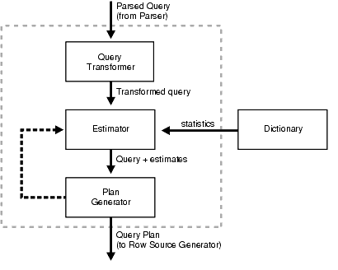
Cost based query optimization
Query optimization steps
Evaluation of expressions
and conditions
Statement transformation
Choice of optimization goals
Choice of access paths
Choice of join orders
Choice of join algorithms

Slide 21
Cost based query optimization
Choosing the optimization goal
  ALL_ROWS (default) – get all rows as fast as possible
  FIRST_ROWS – get first few rows as fast as possible
  FIRST_ROWS_N [1,10,100,1000]
  Can be set on DB, session or query level
  SQL> ALTER SESSION SET optimizer_mode = FIRST_ROWS;
  SQL> ALTER SESSION SET optimizer_mode = FIRST_ROWS_100;
  SQL> SELECT /*+FIRST_ROWS(10)*/ category, COUNT(*) FROM products
  WHERE price<1000 GROUP BY category ORDER BY category;

Slide 22
Importance of object statistics
Table and index statistics are essential for Oracle DB!
  Allow CBO to generate sensible execution plans
  Are automatically updated every night – not guaranteed!
Oracle can use dynamic sampling for missing statistics
Beware massive DML/DDL operations
  Significant difference between data and its statistics may
  cause very bad performance of queries!
  Statistics gathered on empty table followed by massive insert
  TRUNCATE on a very large table

Slide 23
Manual statistics gathering
Recommended after major DML/DDL operations
  SQL> EXEC DBMS_STATS.gather_table_stats('HR', 'PERSONS', …);
Alternatively use locking / transfering of statistics
  Locking excludes tables from automatic stats gathering
  SQL> EXEC DBMS_STATS.lock_schema_stats('HR');
  SQL> EXEC DBMS_STATS.lock_table_stats('HR', 'PERSONS');
  Backing up stats, e.g. throughout table recreation
  SQL> EXEC DBMS_STATS.create_stat_table('DBSTATS','STAT_TAB');
  SQL> EXEC DBMS_STATS.export_schema_stats('HR','PERSONS',…,'STAT_TAB',…,'DBSTATS'); -- recreate table and reload data from external source
  SQL> EXEC DBMS_STATS.import_schema_stats('HR','PERSONS',…,'STAT_TAB',…,'DBSTATS');

Slide 24
Object statistics - tips
Use histograms only for columns with skewed
(not even) data distribution
FOR ALL COLUMNS SIZE SKEWONLY / AUTO
Gather statistics for indexes CASCADE = TRUE
Gather both local and global statistics for partitioned objects GRANULARITY = 'ALL'
Use 100% sample size, or as high as possible
ESTIMATE_PERCENT = 100

Slide 25
Query execution plan
Represents the route Oracle takes from data to end result
Is a tree in which every node is a DB server operation
  Prepared during hard parsing of a statement and kept inside database instance library cache
  There can be multiple execution plans for the same query
      Depending on bind variables, statistics, hints
      Plans may change when they age out of library cache

Slide 26
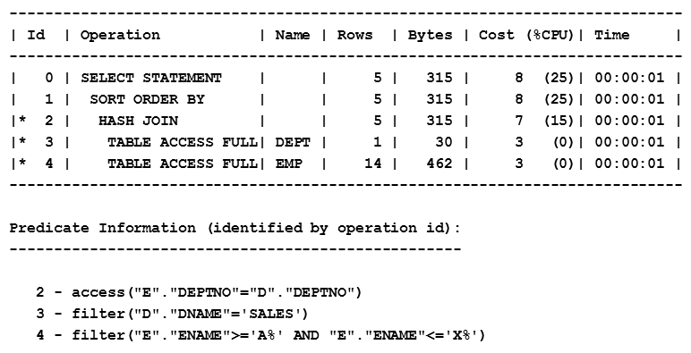
Query execution plan
Few simple rules of reading execution plans
  Parent operations get input only from their children (data sources)
  Data access starts from the first line without children
  Rows are „sent” upwards to next operations in cascading fashion
SQL> SELECT d.dname, d.loc, e.empno,
e.ename
FROM emp e, dept d
WHERE e.deptno = d.deptno AND
d.dname = 'SALES‘ AND
e.ename BETWEEN 'A%' AND 'X%'
ORDER BY e.deptno;

Slide 27
Viewing the execution plan
SQL*Plus command line EXPLAIN PLAN
  Generates the plan without executing the query
SQL> EXPLAIN PLAN FOR
SELECT *
FROM emp e, dept d
WHERE e.deptno = d.deptno
AND e.ename = 'SMITH';
SQL> SET LINESIZE 130
SQL> SET PAGESIZE 0
SQL> SELECT * FROM
TABLE(DBMS_XPLAN.DISPLAY);
----------------------------------------------------------------------------------------
| Id | Operation | Name | Rows | Bytes | Cost (%CPU)| Time |
----------------------------------------------------------------------------------------
| 0 | SELECT STATEMENT | | 1 | 58 | 4 (0)| 00:00:01 |
| 1 | NESTED LOOPS | | | | | |
| 2 | NESTED LOOPS | | 1 | 58 | 4 (0)| 00:00:01 |
|* 3 | TABLE ACCESS FULL | EMP | 1 | 38 | 3 (0)| 00:00:01 |
|* 4 | INDEX UNIQUE SCAN | PK_DEPT | 1 | | 0 (0)| 00:00:01 |
| 5 | TABLE ACCESS BY INDEX ROWID| DEPT | 1 | 20 | 1 (0)| 00:00:01 |
----------------------------------------------------------------------------------------
Predicate Information (identified by operation id):
---------------------------------------------------
3 - filter("E"."ENAME"='SMITH')
4 - access("E"."DEPTNO"="D"."DEPTNO")
18 rows selected.

Slide 28
Viewing the execution plan
SQL*Plus AUTOTRACE tool
  Very simple to use
  Also executes the
  query
Execution Plan
----------------------------------------------------------
Plan hash value: 3892127698
-----------------------------------------------------------------------------------------------------
| Id | Operation | Name | Rows | Bytes | Cost (%CPU)| Time |
-----------------------------------------------------------------------------------------------------
| 0 | SELECT STATEMENT | | 1 | 90 | 3 (0)| 00:00:01 |
| 1 | NESTED LOOPS | | 1 | 90 | 3 (0)| 00:00:01 |
| 2 | NESTED LOOPS | | 1 | 90 | 3 (0)| 00:00:01 |
| 3 | TABLE ACCESS BY INDEX ROWID BATCHED| EMPLOYEES | 1 | 69 | 2 (0)| 00:00:01 |
|* 4 | INDEX RANGE SCAN | EMP_NAME_IX | 1 | | 1 (0)| 00:00:01 |
|* 5 | INDEX UNIQUE SCAN | DEPT_ID_PK | 1 | | 0 (0)| 00:00:01 |
| 6 | TABLE ACCESS BY INDEX ROWID | DEPARTMENTS | 1 | 21 | 1 (0)| 00:00:01 |
-----------------------------------------------------------------------------------------------------
Predicate Information (identified by operation id):
---------------------------------------------------
4 - access("E"."LAST_NAME"='SMITH')
5 - access("E"."DEPARTMENT_ID"="D"."DEPARTMENT_ID")
Note
-----
- this is an adaptive plan
Statistics
----------------------------------------------------------
0 recursive calls
0 db block gets
…
SQL> SET AUTOTRACE ON;
SQL> SELECT *
FROM employees e, departments d
WHERE e.department_id =
d.department_id
AND e.last_name = 'SMITH';

Slide 29
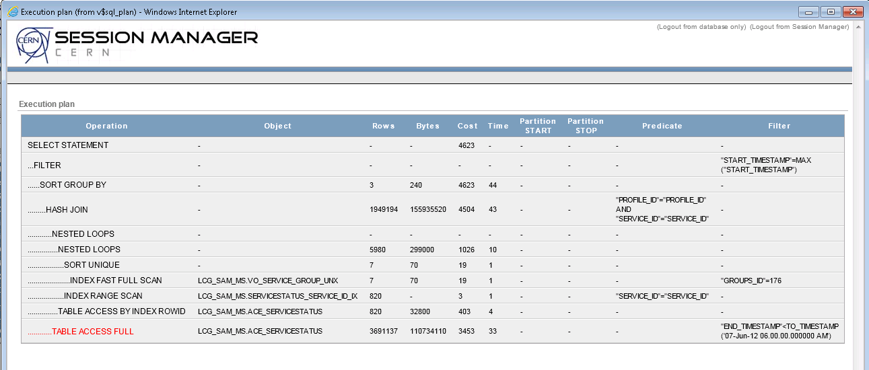
Viewing the execution plan
CERN Session Manager tool
  https://session-manager.web.cern.ch/

Slide 30
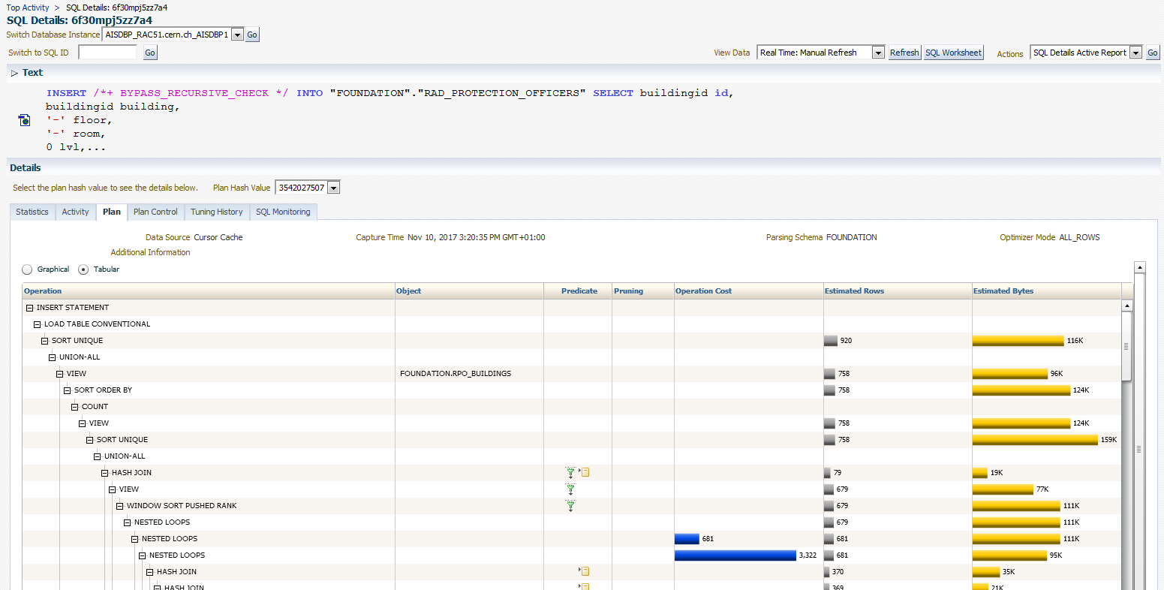
Viewing the execution plan
Oracle Enterprise Manager: https://oem.cern.ch/em

Slide 31
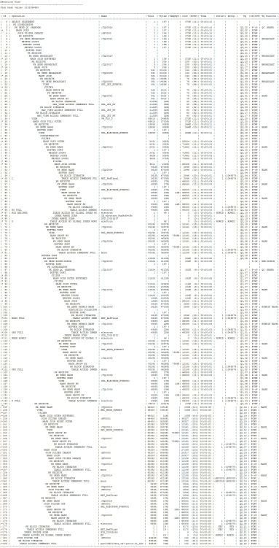
Understanding the execution plan
… can be quite difficult
Dozens of possible operations
  Access paths, join algorithms,
  transformations
Sometimes also dozens of steps
Don’t hesitate to ask IT-DB for help!
  Contact your DBA or create SNOW ticket

Slide 32
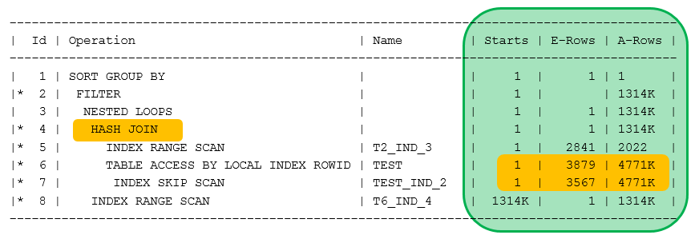
Execution plan quality
CBO can generate sub-optimal execution plans
  Object statistics can be inaccurate or incomplete
  It must apply heuristics for certain complex clauses
  Number of joins and subqueries metters OPTIMIZER_MAX_PERMUTATIONS
  Use /*+GATHER_PLAN_STATISTICS*/
  hint to verify cardinality
  estimates
  SQL> EXEC dbms_xplan.display_cursor
  (format=>'ALLSTATS LAST')

Slide 33
Expected vs actual execution plan
Explained plan may differ from actual execution
AUTOTRACE plan usually more accurate
  Can still show incorrect plan when bind variables are used
For actual execution use Real-Time SQL Monitoring
  Oracle Enterprise Manager Performance SQL Monitoring
  SQL Developer Tools Monitor SQL
  Statements longer than 5s or with /*+MONITOR*/ hint
  Session Manager tool

Slide 34
Note on bind variables (:var)
Bind variables should be used in OLTP type queries
  Minimize hard parsing of repetitive queries
  The same execution plan regardless of the variable value
  Beware: bind variable peeking happens at first parse
Bind variables have no advantages in expensive reporting and analytic queries
  Explicit values give more information to query optimizer
  Parsing time is negligible compared to execution time

Slide 35
Bind variable peeking
Peeked colum value (first parse) not always good!
Column data evenly distributed
  No need to worry, don’t need histogram statistics
Column data significantly skewed
  Adaptive, bind aware cursor sharing can be employed
  Histogram statistics should be collected on that column
  First few executions can be sub-optimal (still adapting…)
    Use /*+BIND_AWARE*/ hint to force bind aware parsing right away

Slide 36
Diagnosing performance issues
Quick performance checklist
  Is the query progressing or effectively hanging?
  Check for locks – are there any blockers?
  Single query issue or general DB performance problem?
  Check database server and storage subsystem load
  Check session wait events – where the time is spent?
  Check the execution plan – did it change, is it efficient?
  Check object statistics – did data change significantly?

Slide 37
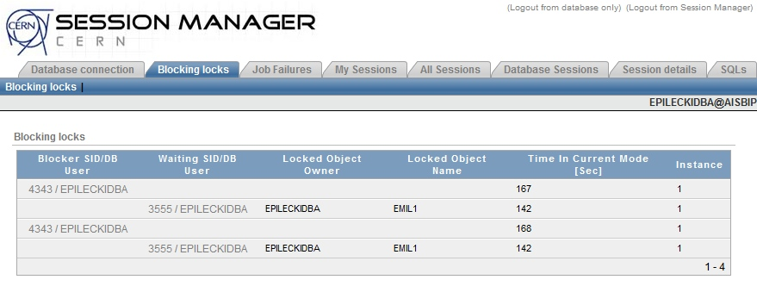
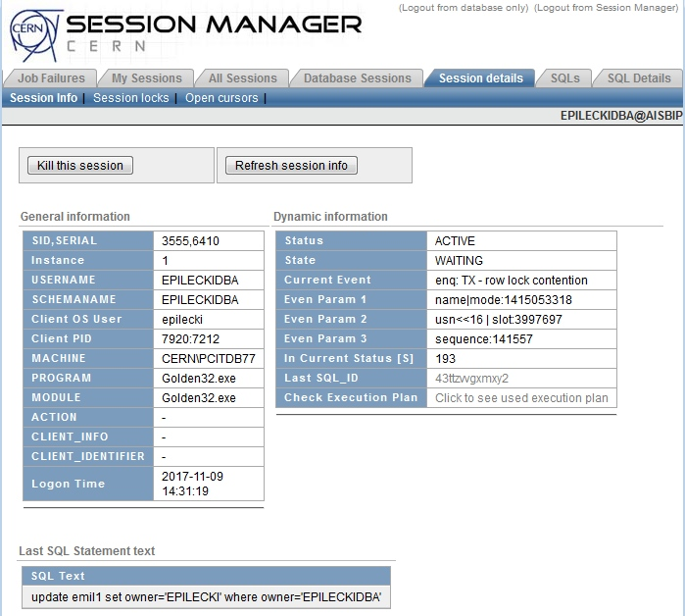
Is the query hanging?
Check if the query is blocked, check current wait event
SQL> SELECT inst_id, sid, serial#, event, seconds_in_wait, last_call_et,
final_blocking_instance, final_blocking_session
FROM gv$session WHERE final_blocking_session IS NOT NULL;
INST_ID SID SERIAL# EVENT SECONDS_IN_WAIT LAST_CALL_ET FINAL_BLOCKING_INSTANCE FINAL_BLOCKING_SESSION
------- ----- ------- -------------------------------- --------------- -------------- ----------------------- ----------------------
2 3650 57887 row cache lock 1 11892047 1 3437
1 461 62002 library cache lock 1 2 1 3437
1 2747 63531 enq: TX - row lock contention 3 1083 1 22
1 4226 54144 enq: TS - contention 1 114 1 3437
  https://session-manager.web.cern.ch/

Slide 38
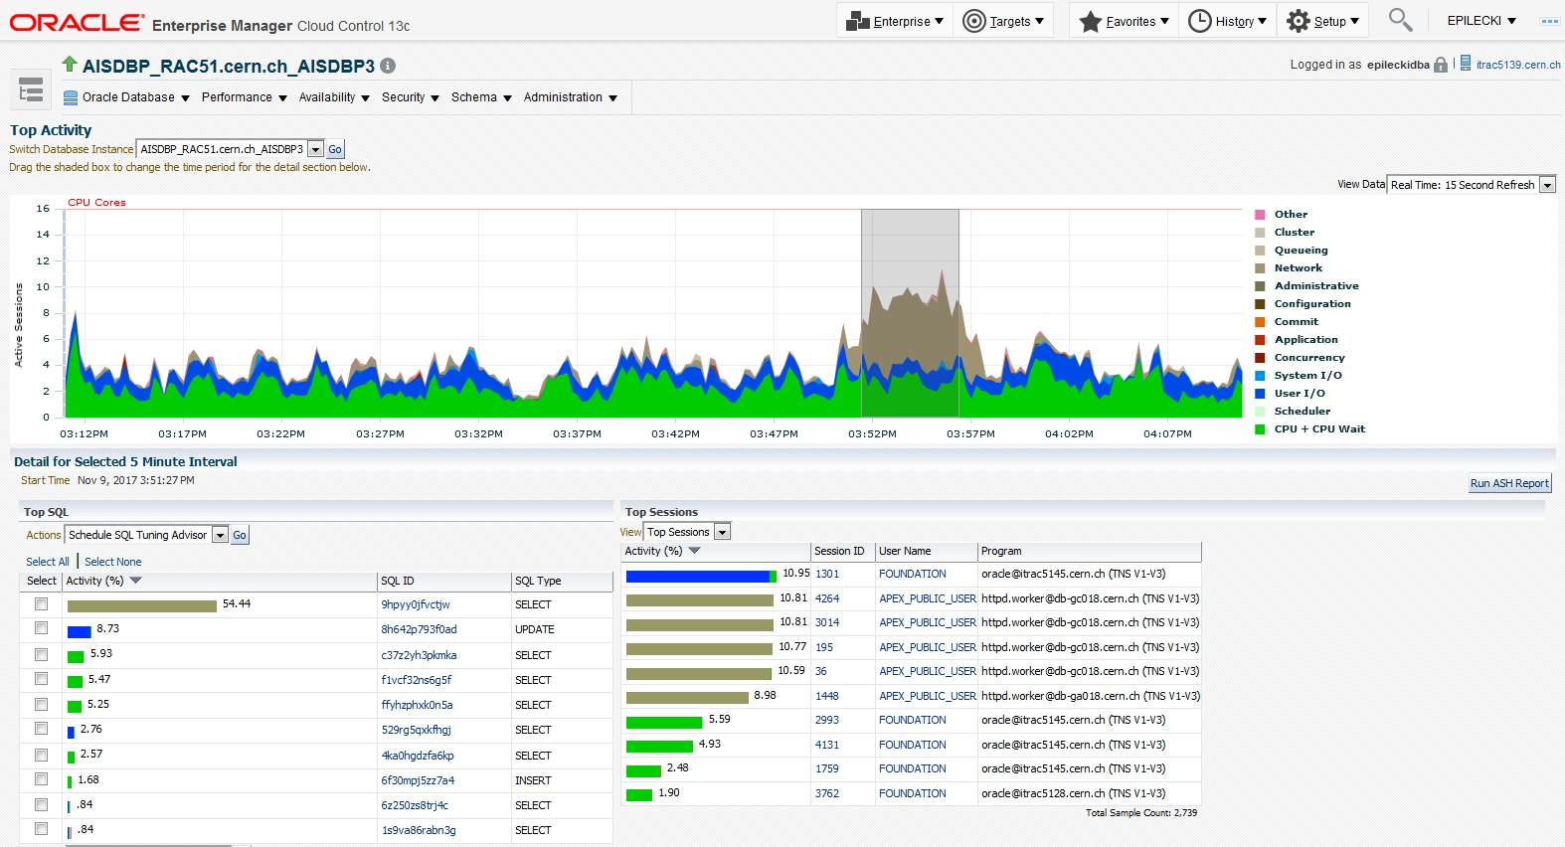
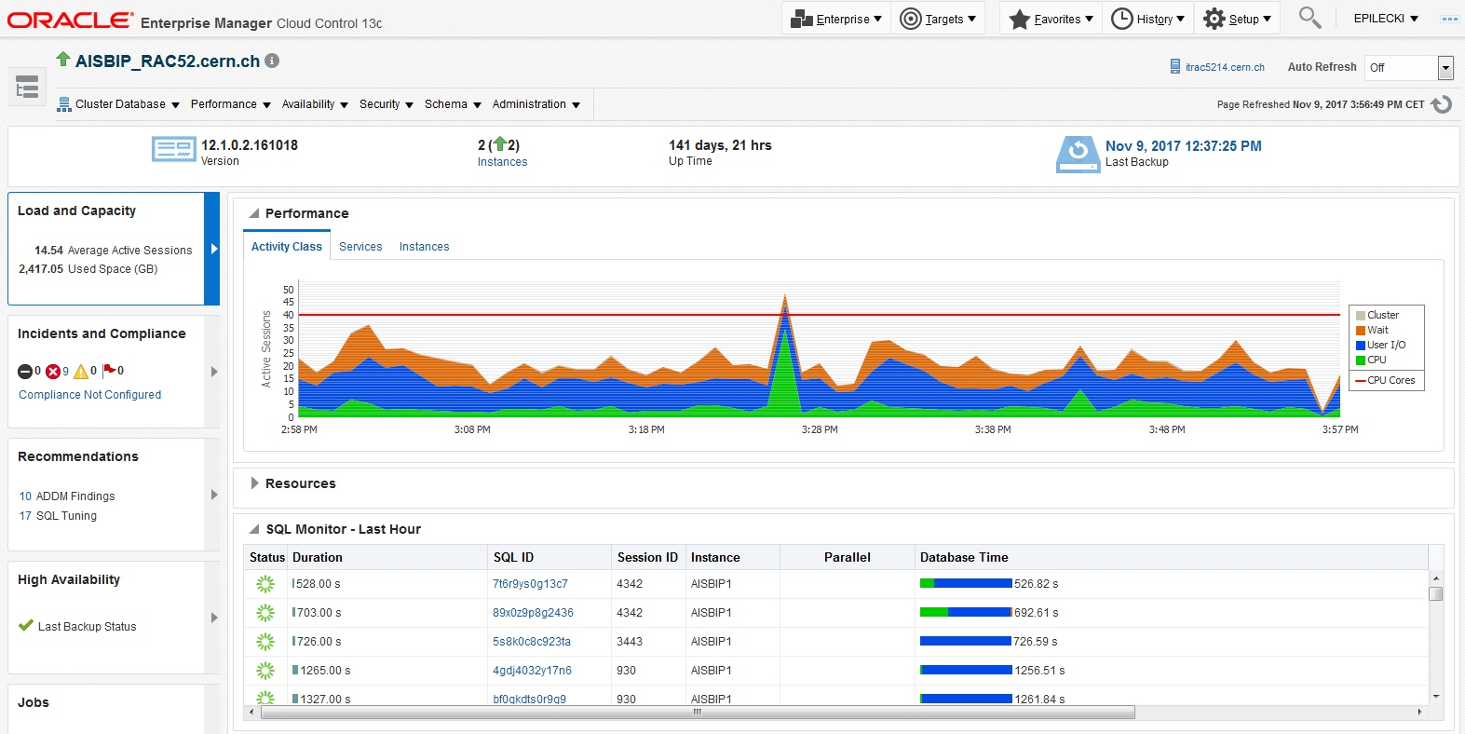
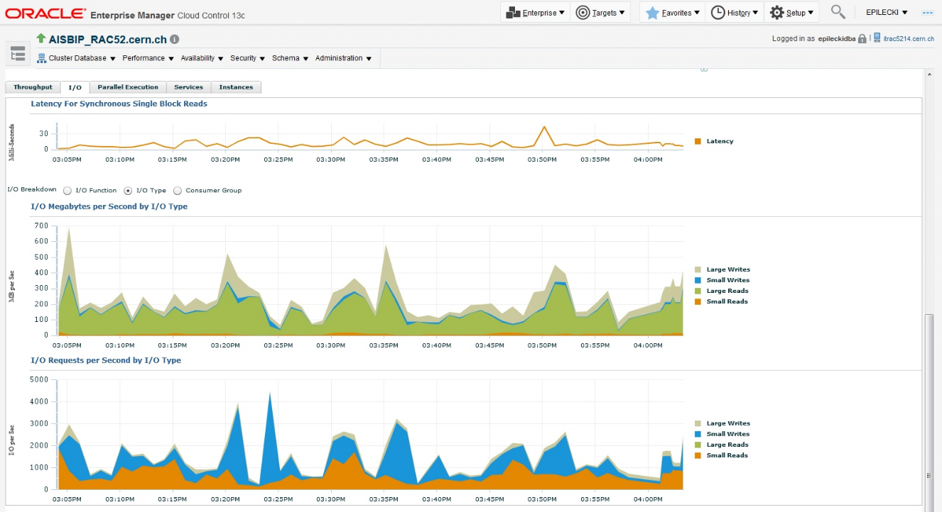
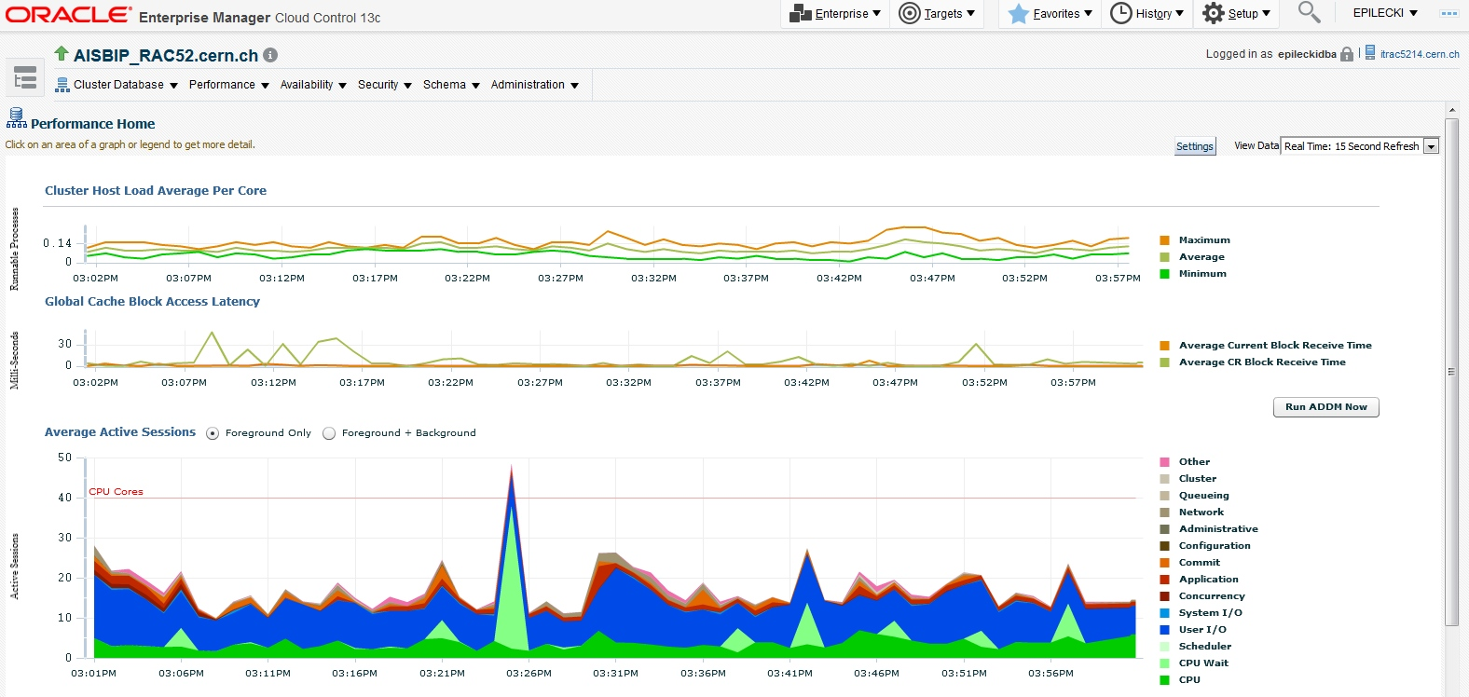
Database server overloaded
Typical scenarios
  High number of sessions
  High IO rate
  High CPU utilization
  High concurrency
Create SNOW ticket ☺
Check in Oracle Enterprise Manager
https://oem.cern.ch/em

Slide 39
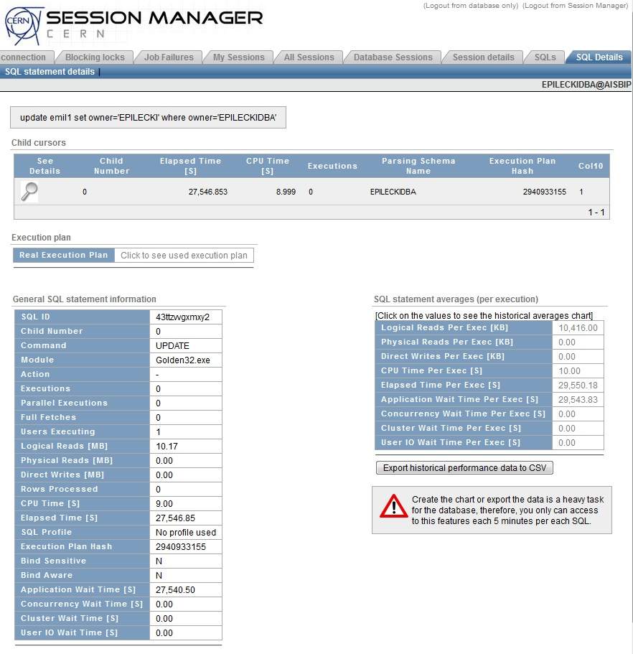
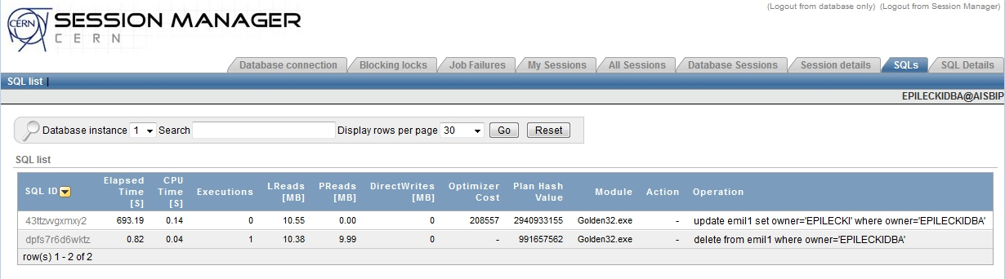
Single query issues
Check the query wait events and execution plan
  https://session-manager.web.cern.ch/

Slide 40
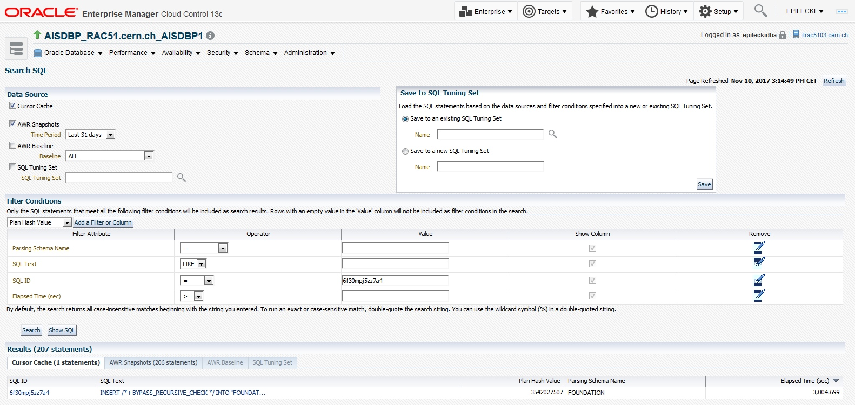
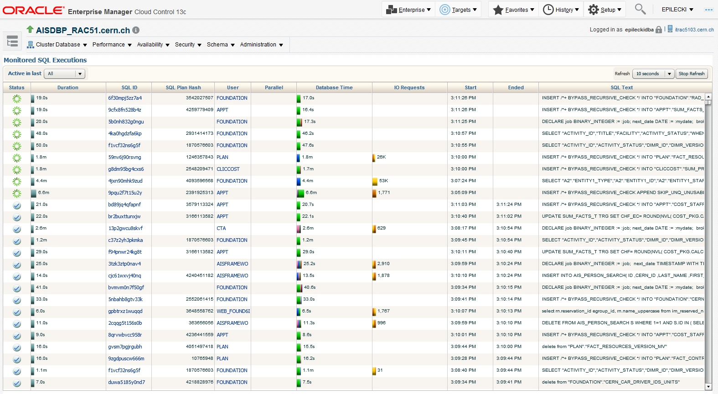
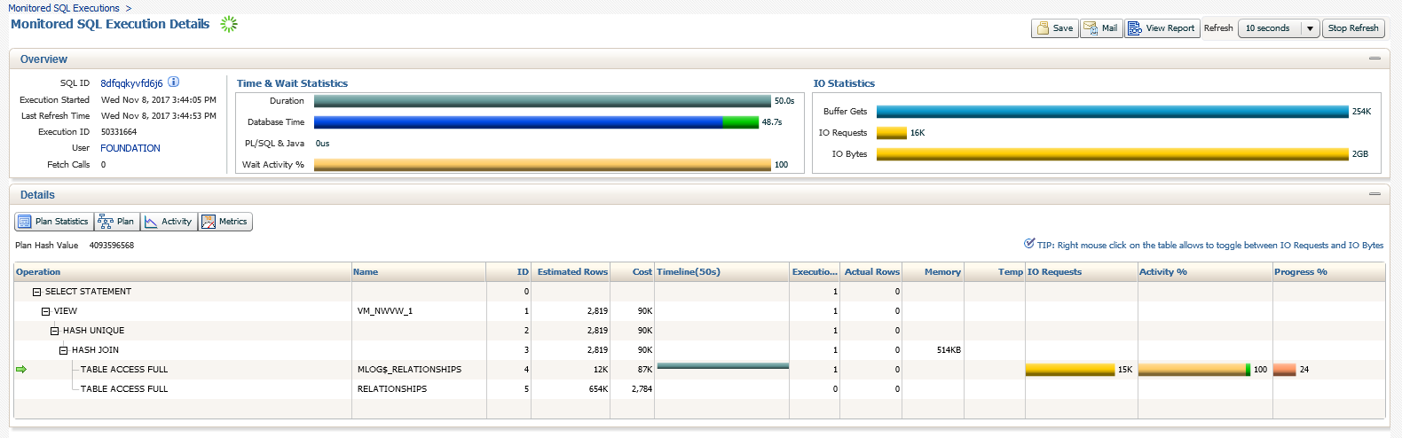
Single query issues
https://oem.cern.ch/em

Slide 41
Single query – the hardcore way
Query database dynamic performance views
  Sessions waiting long for resources
  SQL> SELECT inst_id, sid, serial#, event, seconds_in_wait, last_call_et FROM gv$session
  WHERE username = 'AISDWH' [AND wait_class<>'Idle'] ORDER BY seconds_in_wait DESC;
  Total wait statistics for a given session
  SQL> SELECT inst_id, sid, event, total_waits, time_waited FROM gv$session_event
  WHERE inst_id=1 AND sid=4116 ORDER BY time_waited DESC;
  Long running operations
  SQL> SELECT inst_id, sid, serial#, opname, target, elapsed_seconds, time_remaining
  FROM gv$session_longops WHERE inst_id=1 AND sofar<totalwork
  ORDER BY time_remaining DESC;
INST_ID SID SERIAL# OPNAME TARGET ELAPSED_SECONDS TIME_REMAINING
------- ------ -------- ------------- -------------------------------- --------------- --------------
1 931 65090 Sort Output 67 6245
1 2400 30440 Table Scan AISDWHETL.STG_CFU_ROLE 14 563
1 2861 4415 Table Scan AISDWHETL.SRC_REC_ANSWER 33 53
1 2742 62059 Table Scan AISDWHETL.STG_LMS_ABSENCE_SLICE 153 10
INST_ID SID SERIAL# EVENT SECONDS_IN_WAIT LAST_CALL_ET
------- ----- ------- -------------------------------- --------------- --------------
1 3664 26812 enq: TX - row lock contention 303 560
1 4462 11881 enq: FB - contention 0 3387
1 2401 61545 db file sequential read 0 1
1 2403 11312 db file sequential read 0 109
INST_ID SID EVENT TOTAL_WAITS TIME_WAITED
------- ------ ------------------------------ -------------- --------------
1 1267 db file sequential read 1401151 3470086
1 1267 direct path read temp 51366 257211
1 1267 direct path write temp 20743 11477
1 1267 db file scattered read 2407 6354
1 1267 direct path read 410 3279
1 1267 SQL*Net message from dblink 93360 3127
1 1267 db file parallel read 628 3054

Slide 42
Fix my query! Statistics
Check table and index statistics
  Should be gathered with high sample size (e.g. 100%)
  Should be recent if the data changes on regular basis
  SQL> SELECT table_name, last_analyzed, num_rows, sample_size
  FROM user_tables [user_indexes] ORDER BY last_analyzed;
  Dynamic sampling performed by default
  for tables without statistics
  SQL> SELECT table_name FROM user_tables
  WHERE last_analyzed IS NULL;
TABLE_NAME
--------------------------------
COR_D_PF_CONTRACT
COR_D_PF_CONTRIBUTION_DETAILS
COR_D_PF_CONTRIBUTION_FILE
COR_D_PF_CONTRIBUTION_LINE
COR_D_PF_CONTRIBUTION_WARNING
COR_D_PF_MEMBERSHIP
COR_D_PF_PERSON
COR_D_PF_PERSON_RECORD
…
TABLE_NAME LAST_ANALYZED NUM_ROWS SAMPLE_SIZE
-------------------------------- -------------------- -------------- --------------
D_CERN_USER_PRIVILEGES 22-JAN-2015 22:00:10 39902 39902
D_CERN_TARGET_TYPES 22-JAN-2015 22:00:10 6 6
CORODS160F_PROPOSITION_OK 26-APR-2015 22:03:28 111635 111635
CORODS200F_CONTRACTS_LINES_OK 27-APR-2015 22:00:11 1439 1439
CORODS190F_STOCK_LEVEL_OK 29-APR-2015 22:12:09 44119320 44119320
D_COR_F_HR_ACTIONS 19-JUN-2015 22:00:38 948205 948205
CORODS170F_ORDERPIPELINE_OK 02-SEP-2015 22:02:10 269688 269688
…

Slide 43
Fix my query! Statistics
For partitioned tables also check user_tab_[sub]partitions and user_ind_[sub]partitions
  Local partition statistics as important as global!
Use /*+DYNAMIC_SAMPLING(n)*/ hint to quickly check if higher statistics accurracy can help
If column value significantly skewed
consider gathering histograms
  SQL> SELECT owner, count(*) FROM epileckidba.objects
  GROUP BY owner ORDER BY 2 DESC;
OWNER VAL_COUNT
-------------------- ---------
SYS 42568
PUBLIC 32766
AISDWHETL 1873
AISDWH 1095
XDB 966
SYSTEM 643
AISDWH_READ 427
CTXSYS 409
AISDWH_STATS 271
AISDWH_IRIS 93
DBSNMP 56
AISDWH_CONTROL 44
CERNDB_DPMGR 24
CERN_DBA 13
OUTLN 10
SM_USER 9
ORACLE_OCM 6
APPQOSSYS 5
CERN_ACCT_AGENT 2

Slide 44
Fix my query! Indexes and mviews
Missing index causes unnecessary IO and slowness
  Full table scan shows up in query execution plan
  when selecting few rows from a large table
  SQL> SELECT object_name FROM objects WHERE owner = 'CERN_DBA';
Very complex view with slow underlying query
  Replace view with a materialized view (properly indexed)
  Materialized view is not real time, needs to be refreshed
  Works best for slow changing data, e.g. daily loads
Execution Plan
----------------------------------------------------------
Plan hash value: 80137940
-----------------------------------------------------------------------------
| Id | Operation | Name | Rows | Bytes | Cost (%CPU)| Time |
-----------------------------------------------------------------------------
| 0 | SELECT STATEMENT | | 13 | 429 | 208K (1)| 00:00:09 |
|* 1 | TABLE ACCESS FULL| OBJECTS | 13 | 429 | 208K (1)| 00:00:09 |
-----------------------------------------------------------------------------
Predicate Information (identified by operation id):
---------------------------------------------------
1 - filter("OWNER"='CERN_DBA')
Execution Plan
----------------------------------------------------------
Plan hash value: 276035095
---------------------------------------------------------------------------------------------------
| Id | Operation | Name | Rows | Bytes | Cost (%CPU)| Time |
---------------------------------------------------------------------------------------------------
| 0 | SELECT STATEMENT | | 13 | 429 | 2 (0)| 00:00:01 |
| 1 | TABLE ACCESS BY INDEX ROWID BATCHED| OBJECTS | 13 | 429 | 2 (0)| 00:00:01 |
|* 2 | INDEX RANGE SCAN | IDX_OBJ_OWN | 13 | | 1 (0)| 00:00:01 |
---------------------------------------------------------------------------------------------------
Predicate Information (identified by operation id):
---------------------------------------------------
2 - access("OWNER"='CERN_DBA')

Slide 45
Fix my query! Rewriting the query
There are multiple ways of achieving the same results
Try to make it simple for the optimizer
  So it can generate better execution plan
Some examples
  Replace WHERE column IN (…) subquery with a join or vice versa
  Replace complex queries with multiple simpler ones connecting
  with set operators: MINUS, UNION ALL, INTERSECT
  Consider replacing certain joins with a subquery in SELECT clause

Slide 46
Fix my query! Hints
Optional directives given to CBO by the developer
  Specified as comments SQL> SELECT /*+HINT*/ * FROM …
  Can change and stabilize query execution plan
  Can be siliently ignored if incorrectly specified or not aplicable
  Hinted query will not adapt to changes in data
  Because of maintenance overhead should be used only
  as a last resort
    After checking statistics, indexes and considering rewriting of the query

Slide 47
Fix my query! Some useful hints
/*+FULL(table)*/ – force full or in-memory full table scan
/*+[NO_]INDEX(table [index])*/ - force usage or forbid usage
of a specific index
/*+USE_HASH(table1 table2 …)*/ also USE_NL and USE_MERGE – force
table join method: hash, nested loops, or sort-merge
/*+ORDERED*/ - table join order as appear in FROM clause
/*+DRIVING_SITE(table)*/ - for DB links, force query execution on local or remote DB - where the table resides
  https://docs.oracle.com/cd/E11882_01/server.112/e41573/hintsref.htm#PFGRF005

Slide 48
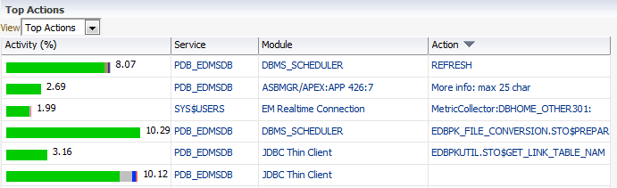
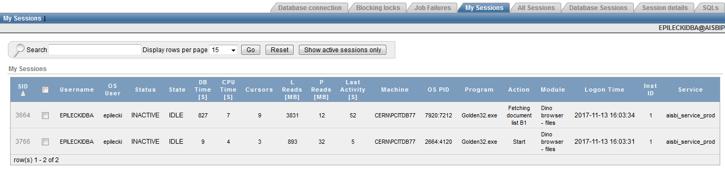
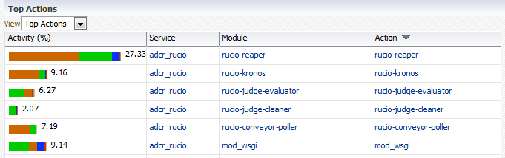
Fix my query! Code instrumentation
Use DBMS_APPLICATION_INFO package
SQL> EXEC DBMS_APPLICATION_INFO.SET_MODULE ('Dino browser - files','Start');
SQL> EXEC DBMS_APPLICATION_INFO.SET_ACTION ('Fetching document list B1');
SQL> EXEC DBMS_APPLICATION_INFO.SET_CLIENT_INFO ('Client version 2.56');
Visible in GV$SESSION, Session Manager, OEM
  SQL> SELECT inst_id, sid, serial#, username, sql_id, module, action FROM gv$session;
Use /*+MONITOR*/ hint to ensure live SQL monitoring
  Visible in OEM, Active Session History
INST_ID SID SERIAL# USERNAME SQL_ID MODULE ACTION
------- ----- ------- -------------- ------------- -------------------- -----------------------------------
1 3766 62611 EPILECKIDBA Dino browser - files Start
1 3664 26812 EPILECKIDBA Dino browser - files Fetching document list B1
1 240 26831 AISDWHETL 9m7787camwh4m PL/SQL Developer SQL Window - New
1 1164 3408 AISDWH 2hwz1bh204j07 DBMS_SCHEDULER OOP_REF_GRIUXAXSBJ
1 1264 63534 AISDWH 1jvbj7gadjwh6 DBMS_SCHEDULER OOP_REF_AOYPTFNNVL
1 1265 12129 AISDWH_READ 9m7787camwh4m PL/SQL Developer SQL Window - Old-PensionFund.sql
1 2745 30780 AISDWHETL 9m7787camwh4m PL/SQL Developer alter table cor_d_person_a ...
1 4242 53 AISDWH_STATS 9m7787camwh4m PL/SQL Developer select *--count(*) from ai ...

Slide 49
Fix my query! SQL baselines
DBA instructs CBO to use a good, efficient execution plan for a specific query
  The good plan have to be already known to the database
Used to mitigate execution plan instability
  Previously fast query sudenly gets slow after
  an execution plan change
Only usable with immutable queries
  Having exactly the same query text, no literal variables

Slide 50
Fix my query! SQL profiles
DBA instructs CBO to employ certain choices when generating the query execution plan
  The good plan does not have to be known to the database
Used to improve existing, underperforming plan
  DBA can come out with a better execution plan using hints
  Implementing hints directly isn’t possible - 3rd party application
Only usable with immutable queries
  Having exactly the same query text, no literal variables

Slide 51
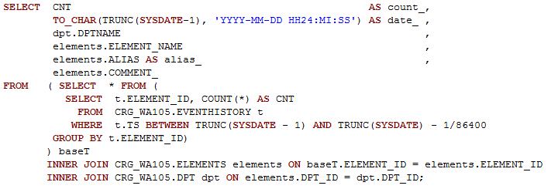
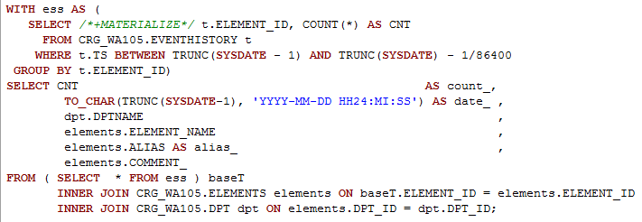
SQL tips: WITH + MATERIALIZE
Complex subquery should be replaced by WITH clause
  If repeating multiple times in the query
  If appears once, but is very complex or operates on large tables, and at the same time returns few rows
This can make for a dramatic performance gain
  If subquery returns many rows the benefit can be lost
Using /*+MATERIALIZE*/ hint guarentees persistence of the temporary subquery results

Slide 52
SQL tips: subquery in SELECT
Join with a large table can sometimes be replaced
with a subquery in SELECT clause
  If the subquery returns one column and a single row
  Assuming fast INDEX UNIQUE scan can be employed
  for the subquery
  If the main query does not return too many rows
The subquery is executed for final result rows only
  Separate execution for each row returned

Slide 53
SQL tips: subquery in SELECT
SQL> SELECT ut.owner, ut.table_name, ut. tablespace_name, uo.created create_date
FROM user_tables ut, user_objects uo
WHERE dt.owner = do.owner AND dt.table_name = do.object_name
AND uo.object_type = 'TABLE'
ORDER BY ut.owner, ut.table_name;
SQL> SELECT ut.owner, ut.table_name, ut.tablespace_name,
( SELECT created FROM user_objects WHERE owner = ut.owner AND
object_name = ut.table_name AND object_type = 'TABLE' ) create_date
FROM user_tables ut
ORDER BY ut.owner, ut.table_name;

Slide 54
SQL tips: IN subquery or a join
IN with a subquery – common construct
  SQL> SELECT region_code, department_name FROM departments
  WHERE department_id IN ( SELECT department_id FROM employees
  WHERE salary_grade = 'EXCEPTION' );
This can perform poorly if subquery returns too many rows (typically 100k+)
Consider replacing with a join
  SQL> SELECT distinct d.region_code, d.department_name
  FROM departments d, employees e
  WHERE d.department_id = e. department_id AND e.salary_grade = 'EXCEPTION';

Slide 55
SQL tips: multi-IN subquery
IN subquery can work on multiple columns at once
SQL> SELECT book_key FROM sales
WHERE ( store_key, order_date ) IN ( SELECT store_key, MAX( order_date )
FROM sales JOIN store USING ( store_key ) WHERE store_state = 'SC'
GROUP BY store_key );
This can save us repeating a simillar subquery for the second time
  Simpler query synatax
  Faster query execution

Slide 56
SQL tips: thinking in sets
Oracle supports various operations on query result sets
  UNION and UNION ALL – sum of 2 sets, with or without duplicates
  MINUS – substraction of 2 sets, no duplicates
  INTERSECT – common part of 2 sets, no duplicates
Working with result sets allows for query simplification
Performance often better with set operators
Can be used for incremental table synchronization

Slide 57
SQL tips: thinking in sets
Select ordered products that are currently available
SQL> SELECT product_id FROM order_items INTERSECT SELECT product_id from inventories;
Select odered products that are missing from stock
and need to be manufactured
SQL> SELECT product_id FROM order_items MINUS SELECT product_id from inventories;
Synchronize two tables using MINUS
SQL> DELETE FROM target_table WHERE id IN ( SELECT id FROM target_table
MINUS SELECT id FROM source_table );
SQL> INSERT INTO target_table SELECT * FROM source_table WHERE id IN (
SELECT id FROM source_table MINUS SELECT id FROM target_table );

Slide 58
SQL tips: the case of CASE
CASE – efficient way of transforming the query result set
Can use LOV, single, and multi column expressions
SQL> SELECT sensor_name, CASE mode WHEN 1 THEN 'On' WHEN 2 THEN 'Debug'
WHEN 3 THEN 'Error' ELSE 'Unknown' END sensor_status FROM sensors;
SQL> SELECT salary, CASE WHEN salary < 2000 THEN 'Slavish'
WHEN salary < 3000 THEN 'Decent'
WHEN salary < 4000 THEN 'Extravagant'
ELSE 'Sumptuous' END salary_category FROM employees;
SQL> SELECT sensor_name, CASE WHEN mode IN (1, 2) AND value IS NOT NULL
THEN 'Operational' ELSE 'Offline' END sensor_state FROM sensors;

Slide 59
SQL tips: NOT IN or NOT EXISTS
NOT IN and NOT EXISTS are not functionally equivalent!
NOT EXISTS construct checks whether a row is returned
  Evaluates to TRUE if subquery returns no rows
Query with NOT IN will return no rows if NULL is encountered on either side of the condition
SQL> SELECT * FROM sensors WHERE master_sensor_id IS NOT NULL AND master_sensor_id NOT IN
  ( SELECT master_sensor_id FROM locations WHERE location_type = 'External' );

Slide 60
SQL tips: advanced SQL features
  Analytic functions – WINDOW clause
    Allow calculations on a group of rows
    More customizable than GROUP BY
  CUBE, ROLLUP and GROUPING SETS
    Calculate aggregations on different levels at once
  MODEL clause
    Spreadsheet like functionality

Slide 61
SQL tips: advanced SQL features
  String manipulation with regular expressions
    REGEXP_LIKE, REGEXP_INSTR, REGEXP_SUBSTR, REGEXP_REPLACE
  MERGE INTO clause
    INSERT, UPDATE, (DELETE) in one go
    SQL> MERGE INTO test_table a USING all_objects b ON ( a.object_id = b.object_id )
    WHEN MATCHED THEN UPDATE SET a.status = b.status
    WHEN NOT MATCHED THEN INSERT ( object_id, status )
    VALUES ( b.object_id, b.status );
  Hierarhical queries – CONNECT BY clause

Slide 62
PL/SQL tips: bulk collect
  Bulk loads query results into a PL/SQL collection
  Most efficient way of processing multiple rows
  Limits context switching between SQL and PL/SQL
  Watch out collection size (uses PGA memory)
  PL/SQL> DECLARE
  TYPE tObjects IS TABLE OF user_objects%ROWTYPE;
  lObjects tObjects;
  BEGIN
  lObjects := tObjects();
  SELECT * BULK COLLECT INTO lObjects FROM user_objects;
  END;

Slide 63
PL/SQL tips: bulk bind
Executed by means of the FORALL statement
  Together with IN INDICES OF
Can be used with INSERT, UPDATE or DELETE
Uses PL/SQL collections as data sources
  The collection needs to be indexed by BINARY_INTEGER
-- BULK INSERT
PL/SQL> FORALL it IN INDICES OF lObjects INSERT INTO user_objects_copy VALUES lObjects (it);

Slide 64
PL/SQL tips: bulk bind
-- BULK UPDATE
PL/SQL> DECLARE
TYPE tRowIds IS TABLE OF ROWID;
TYPE tObjects IS TABLE OF user_objects_copy.created%TYPE;
lObjects tObjects := tObjects();
lObjectRowIds tRowIds:=tRowIds();
BEGIN
SELECT ROWID, created BULK COLLECT INTO lObjectRowIds,lObjects FROM user_objects_copy;
FOR i IN lObjects.FIRST .. lObjects.LAST LOOP lObjects(i):=SYSDATE; END LOOP;
FORALL it IN INDICES OF lObjects
UPDATE user_objects_copy SET created = lObjects(it) WHERE ROWID = lObjectRowIds(it);
COMMIT;
END;

Slide 65
PL/SQL tips: autonomous transaction
An independent transaction within another transaction
Useful for staus and error logging
  Commit data to log table without commiting the main transaction
An error in autonomous transaction block doesn’t cause failure of the master transaction
  PL/SQL> CREATE OR REPLACE PROCEDURE log_error( ... ) AS
  PRAGMA AUTONOMOUS_TRANSACTION;
  BEGIN
  INSERT INTO logging_table ( ... ) VALUES ( ... );
  COMMIT;
  END;

Slide 66
Assorted – job scheduler
Prefer new job scheduler DBMS_SCHEDULER
over the old DBMS_JOBS
Better maintainability – based on job name
Easier to create complex schedules
Can attach to a DB service and therfore stick
to specific instance(s)
  DBMS_JOB jobs can spawn on any DB instance

Slide 67
Assorted – connecting properly
Use IT-DB supplied TNS aliases for DB connections
  They support HA and are maintained through HW migrations
Use connection pooling – reuse connections!
  It is costly to open a new connection
  Opening a new connection for each <1s query is an overkill
Close your connections when no longer needed!
  Especially when not using connection pooling ☺
  Good connection pool would close some sessions if long unused
  Not closed connections stay in the DB when client dies

Slide 68
Assorted – transactions
Do not code unnecessary long transactions
  Increased concurrency due to lock conflicts
  Higher chance of running into deadlocks
  Can cause UNDO tablespace issues
  Slower queries on data blocks changed by the transaction
Do not commit too often
  Frequent REDO buffer flush impacts DB performance
A transaction should cover logically dependant changes

Slide 69
Assorted – common ORA errors
ORA-01555 Snapshot Too Old
  Your query is running too long and cannot get
  a consistent view of all required data
  Check the execution plan – did it change recently?
  Check historic query runtimes
  Database DML activity is abnormally high causing
  frequent overwritting of UNDO tablespace blocks
  If higher activity is the new normal ask your DBA
  to increase the UNDO tablespace size

Slide 70
Assorted – common ORA errors
ORA-1652: unable to extend temp segment by 128 in tablespace TEMP
  Your query is performing extermely large join or sort operation
  Check the execution plan – did it change recently?
  It’s almost never an issue with too small TEMP tablespace!
ORA-30036: unable to extend segment by 8 in undo tablespace 'UNDOTBS1'
  Very long transactions – consider more frequent commits

Slide 71
Assorted – common ORA errors
ORA-00060: deadlock detected while waiting for resource
  DML concurrency – typically an application issue
  One statement fails with this error so the other can continue
ORA-08103: object no longer exists
  A DDL was executed on the object used by the query
ORA-00600, ORA-07445, ORA-04031
  Most likely a bug – contact your DBA

Slide 72
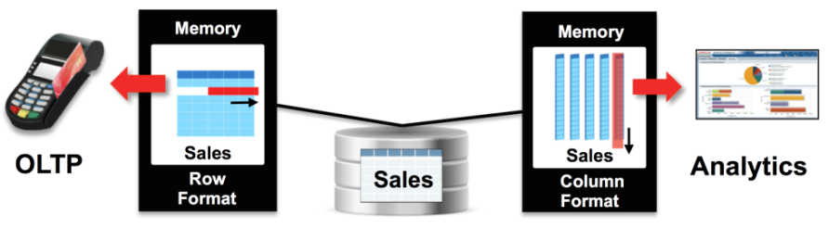
Assorted – 12c In-memory feature
New in-memory cache keeping data in columnar format
  Additional to standar row-format buffer cache
  With guaranteed transactional consistency
Very useful for analytic queries, reporting, BI applications
Can be enabled transarently to applications
  No code change needed
  No additional sorage required

Slide 73
Q & A
CERN IT-DB
  Don’t hesitate to ask our help
  Open a ticket with us using SNOW
See also: https://db-blog.web.cern.ch/

Slide 74




Thank you for your attention!

