Slide 1
PS Impedance Model Status
SPS Injection Losses Review: 30/11/17
B. Popovic
Acknowledgements: C. Vollinger, A. Lasheen, H. Damerau

Slide 2
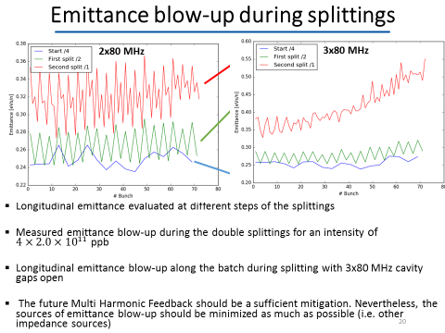
Overview: Sources of Emittance Blow Up
From A. Lasheen Talk: PS beam injected into SPS : measurements & simulations
Large impedances at low frequencies
  Coupled bunch instabilities
  Especially the cavities
Broadband impedance sources
  Loss of Landau damping
Large impedance sources at high frequencies
  Microwave instabilities

Slide 3
Introduction to PS Impedance Model
Necessary to continue to build & maintain a longitudinal impedance model of the PS machine
Build CST models for Wakefield & Eigenmode simulations
  From CATIA files (when available), otherwise 2D drawings
Confirm Wakefield & Eigenmode simulations with measurement (when possible and required)
  RF measurements
  Beam based impedance measurements
Provide confirmed results for BLonD code
Identify objects whose impedance can be reduced

Slide 4
Overview of Model Elements so Far
40 & 80 MHz Cavities
  CST Models of the bare cavities created
    No feedback system effects
    No HOM couplers or frequency tuners
10 MHz Cavity Model developed by G. Favia
Transmission Line Kickers
  CST Models of the KFA13, KFA21, KFA45, KFA71 & KFA79 created
    Compare longitudinal impedances to previous CST models (S. Persichelli, Transverse)
    Ferrite material from previous CST models (S. Persichelli, Transverse)
Baseline Magnet Unit Section
  CST models of the most common pumping manifold & bellows types
UHV Gate Valves
  10 Valves in the PS
  CST model (including internal mechanisms) created
    Model confirmed via EM measurements
PS Dump
  CST model of the two identical dumps currently in the machine
  Working with EN-STI on the replacement dump design to reduce its impedance*
*IWG #14 : https://indico.cern.ch/event/671318/

Slide 5
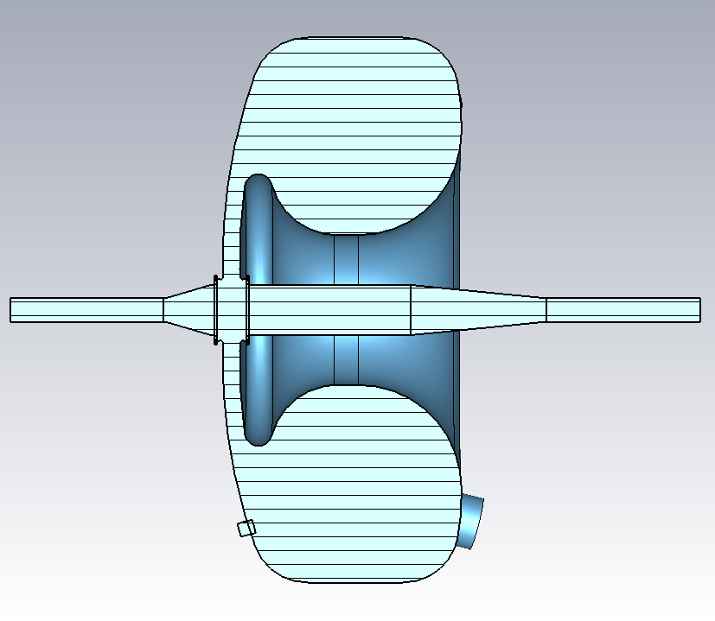
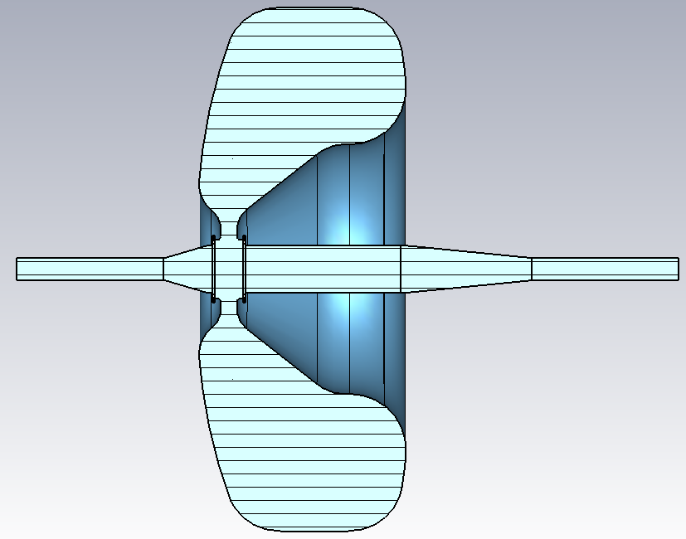
40/80 MHz Bare* Cavities: CST Models
*Note that the actual impedance seen by the beam is much lower, due to feedback systems
Source of :
Uncontrolled Emittance Blow Up
40 MHz cavity | Eigenmode | Measured
Res. Freq | 39.03 MHz | 40.06 MHz
Q | 25,795 | 13,352
R/Q | 33.7 | -
80 MHz cavity | Eigenmode | Measured
Res. Freq | 79.96 MHz | 80.11 MHz
Q | 37,246 | 19,300
R/Q | 57.4 | -
Notes:
40 MHz Cavity Measured by us on 040417
80 MHz Measured by CV (???) for tuner

Slide 6
40/80 MHz Cavities: Model Summary
Impedance performance is dominated by feedback systems
  Necessary to incorporate the effect of feedback systems
  CST Model is just one small part of the model
Options proposed for dealing with the feedback
  Model cavity together with feedback loops as was done with the PS 10 MHz cavity (presented by H. Damerau today)
  Obtain impedance of 80 MHz cavity using measurements of gap voltage instead of modeling the feedback loops
Geometry is starting point for the model
Shape of mechanical short is included
  Separate model of the mechanical short has been analyzed
Does not include tuners that adjust frequency
Does not include HOM dampers
  Explore how to implement this in Wakefield Simulations
Notes:
Impedance seen is defined by feedbacks around cavities NOT GEOMETRICAL STRUCTURE
Feedback systems are narrow band, around 80 MHz

Slide 7
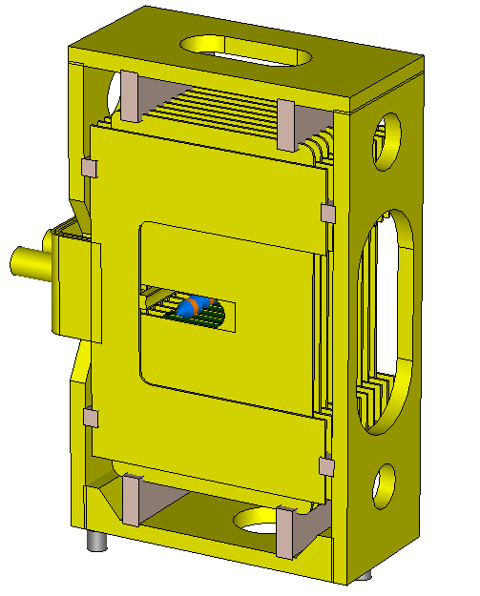
Transmission Line Kickers
CST models built from old drawings and CATIA
KFA13, 21, 71 & 79 all contain identical modules
  KFA13 & KFA21 are identical units
Important step would be to measure at least one module to benchmark simulations
8C11 Ferrite
  Using ABP provided definition*
  Ferrite sample to be characterized
Module
*https://impedance.web.cern.ch/impedance/PS.htm

Slide 8
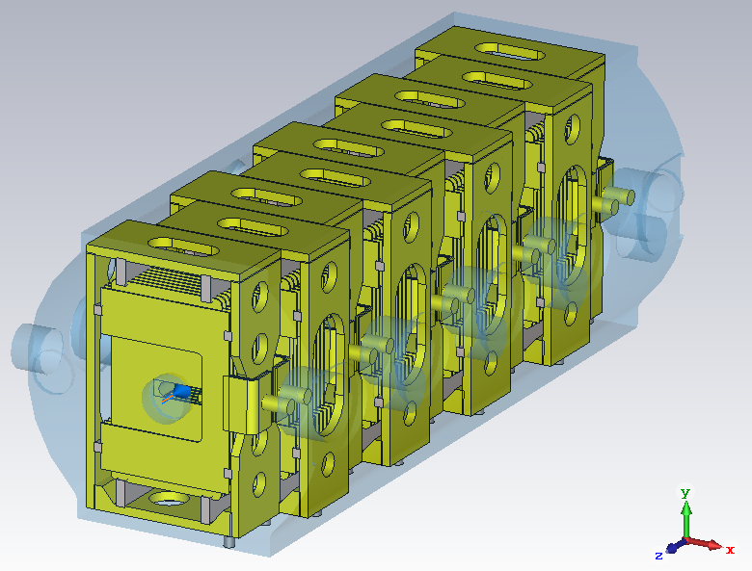
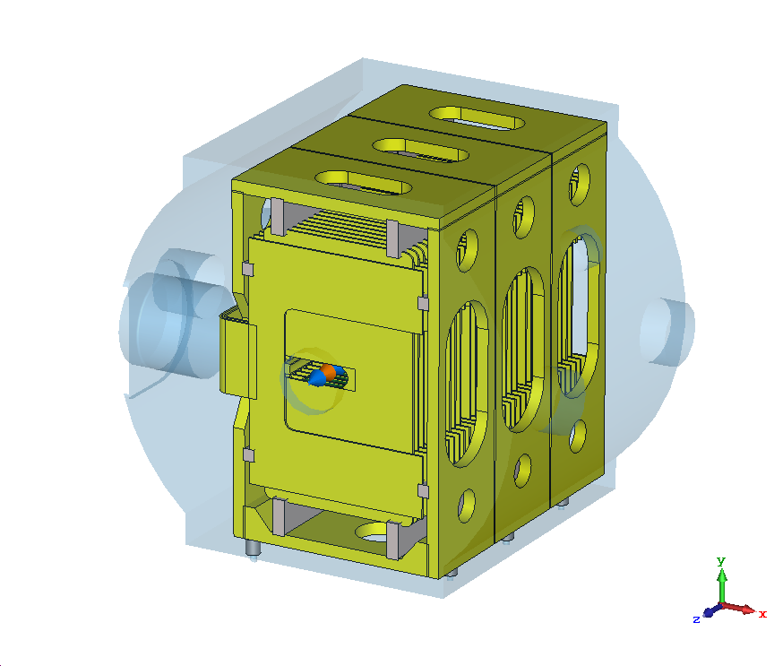
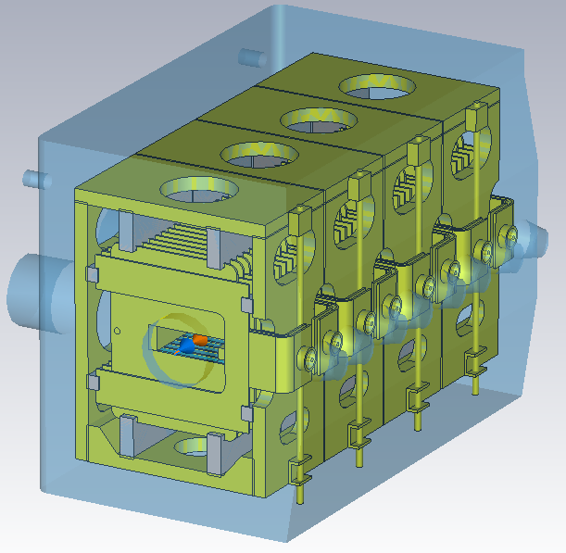
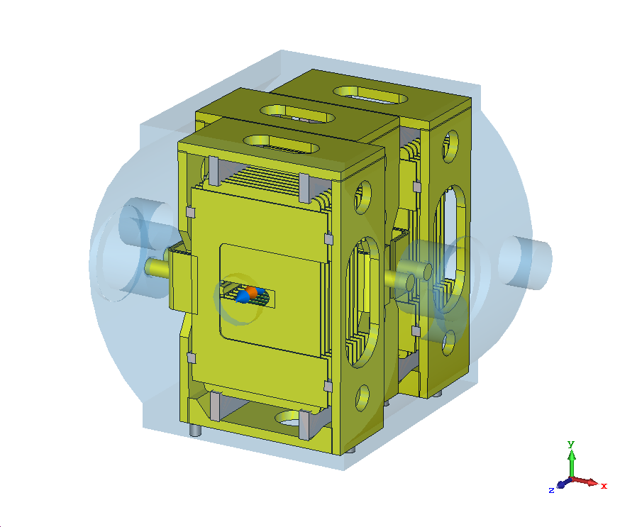
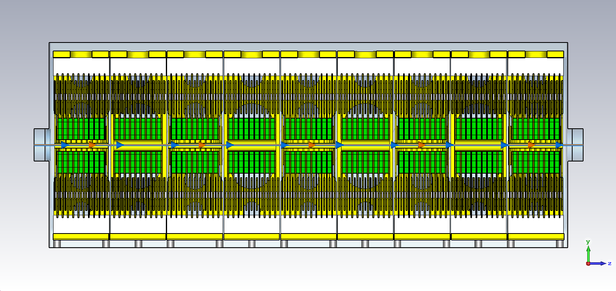
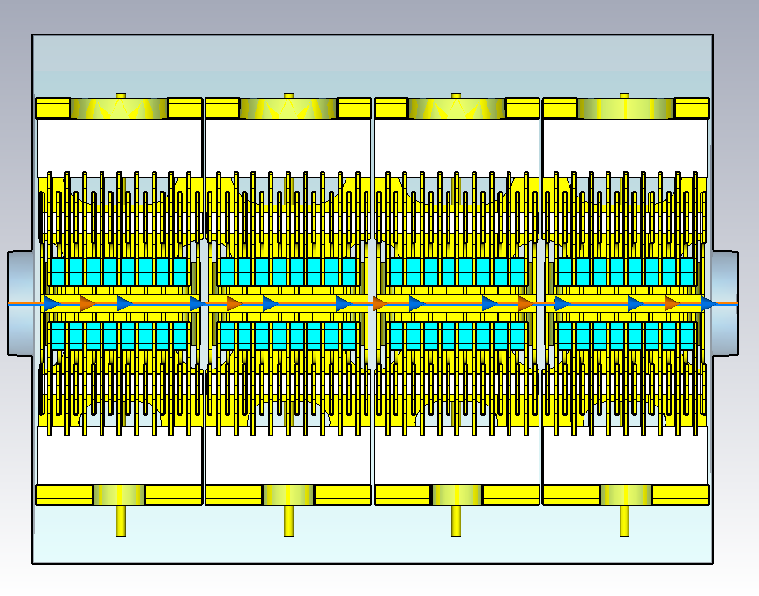
Transmission Line Kicker Models
KFA13 & KFA21
KFA71
KFA45
KFA79

Slide 9
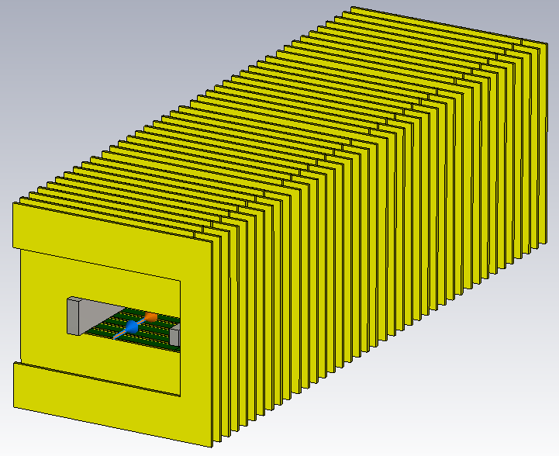
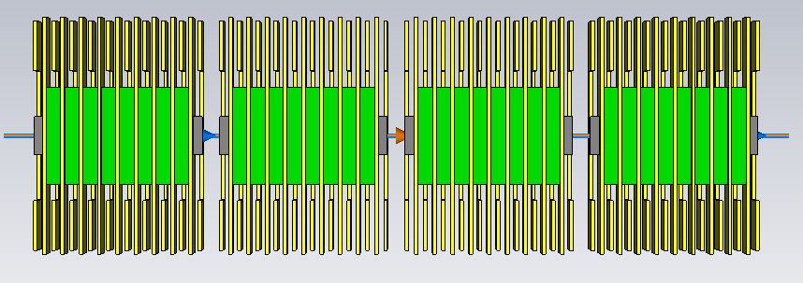
KFA45: Models
Previous Impedance Model
New Longitudinal Impedance Model

Slide 10
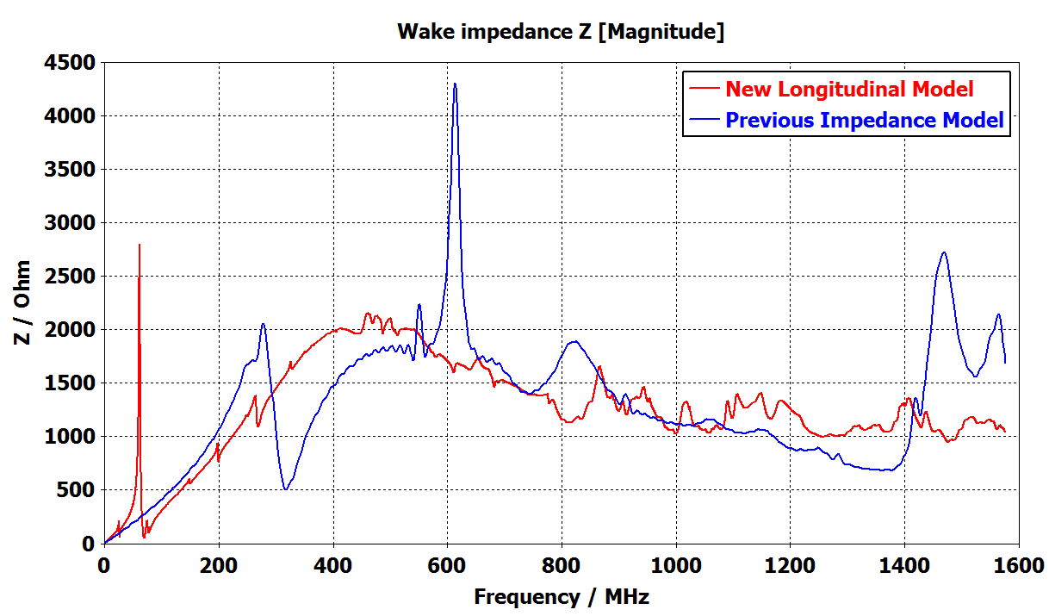
KFA45: Comparing Wakefield Simulation Results
Source of :
Loss of Landau Damping
Probable Source of Emittance Blow Up
Notes:
Show abs or (real & imaginary)…check with Alex

Slide 11
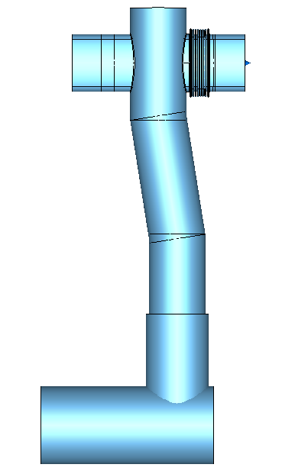
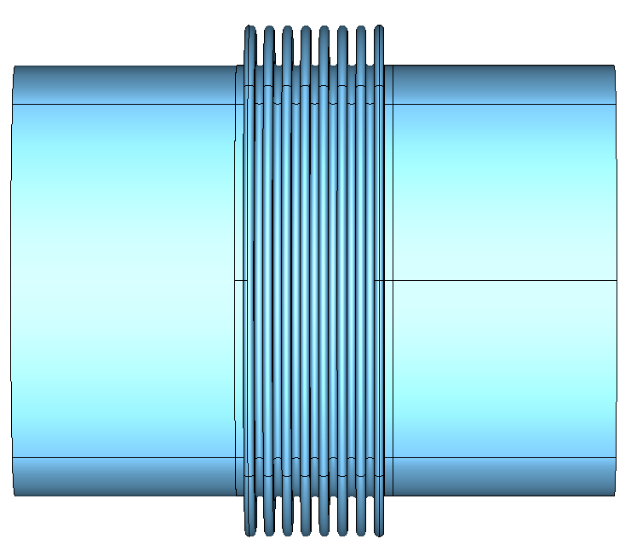
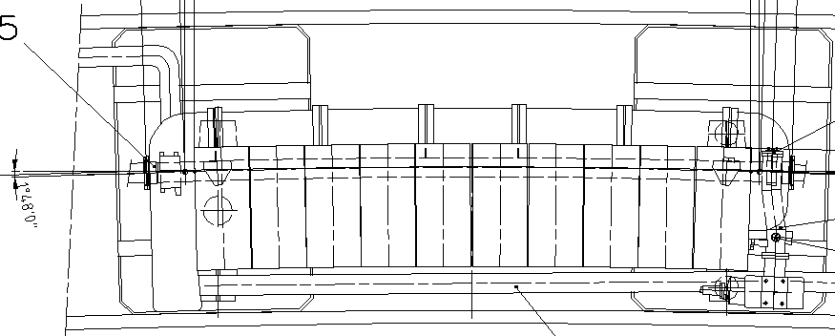
Vacuum Elements of MU Sections (100 Total)
Upstream Assembly Types (99):
Standard (67)
Enlarged (25)
‘Exotic’ Variations (7)
  Wide, special, etc.
Pumping Manifold Slot (99):
Pickup Assembly
  Standard (40)
  Large (12)
Group Pumping Coupling (8)
Actuator of SEM Grid Detector (3)
Cover/Empty (36)
Pumping Manifold Types (100):
Internal (29) & External (37)
Enlarged Internal (10) & External (8)
Remainder (16) are ‘exotic’ variations
  Wide, Narrow etc.
Pumping Manifold: Internal Downstream Assy. (29)
Standard Upstream Assembly (67)
Equipment Owner to Confirm/Provide:
Accuracy of models (number of bellow convolutions, etc.)
Complete/detailed models (integration model only)
Number of elements (vacuum report)
Top View of MU 49
Beam
Downstream Assembly
Notes:
Std. Upstream Assembly (P-0m0401 / ST0371940)
Std. Int. Downstream Assy (P-00407 / ST0371891)
MSG 48-52-54 (ST0520401_01 ) Actuator of SEM Grid Detector
*MU62 Has an Enamelled Upstream Flange DN273 instead of a Upstream Assy. (bellow)
•MU41 has no slot for pickup ( Downstream Compensator Assy/ ST0516001 )

Slide 12
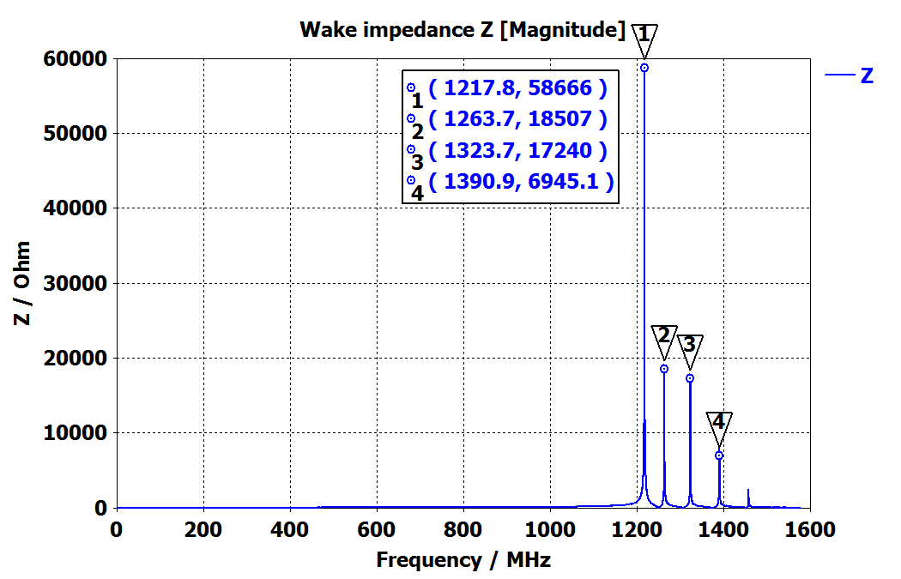
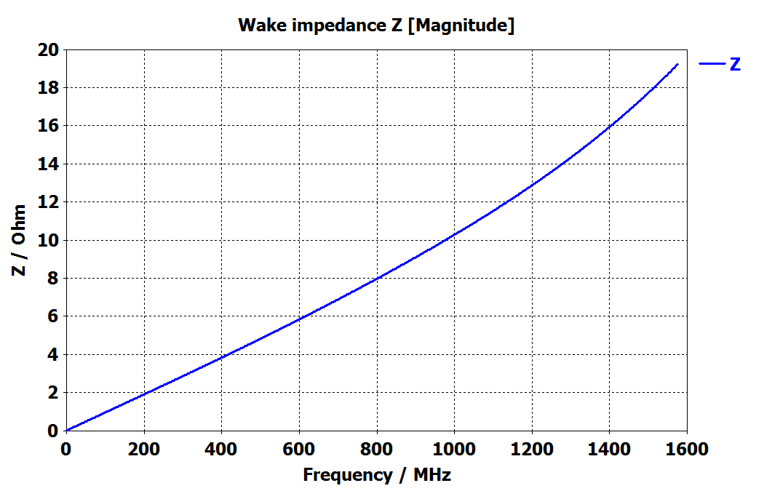
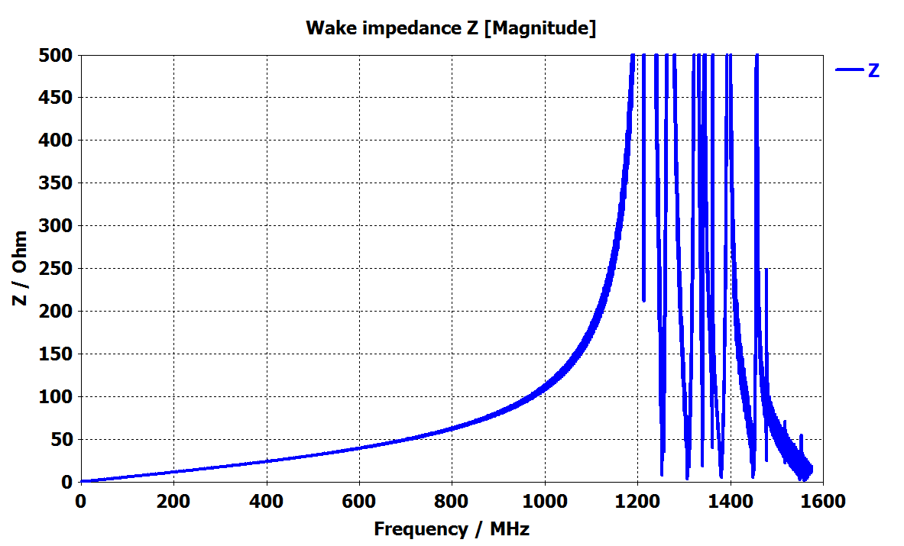
Impedance of Baseline MU Section
Standard Upstream Assembly (67)
Standard Internal Downstream Assy. (29)
Sources of :
Loss of Landau Damping
Possible Emittance Blow Up
Microwave Instability
Notes:
Std. Upstream Assembly (P-0m0401 / ST0371940)
Std. Int. Downstream Assy (P-00407 / ST0371891)
1.6 GHz => Bunch Length of PS (ns????)
Imaginary Z /n (n=freq/revolution freq (470KHz (?))
*MU62 Has an Enamelled Upstream Flange DN273 instead of a Upstream Assy. (bellow)

Slide 13
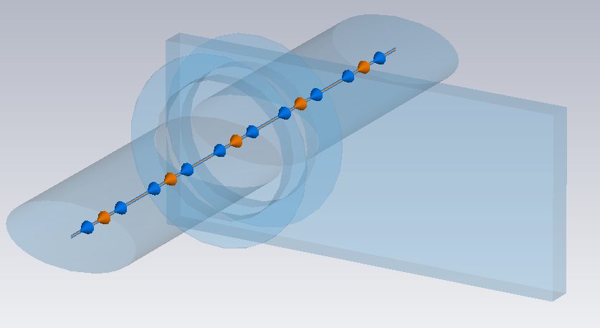
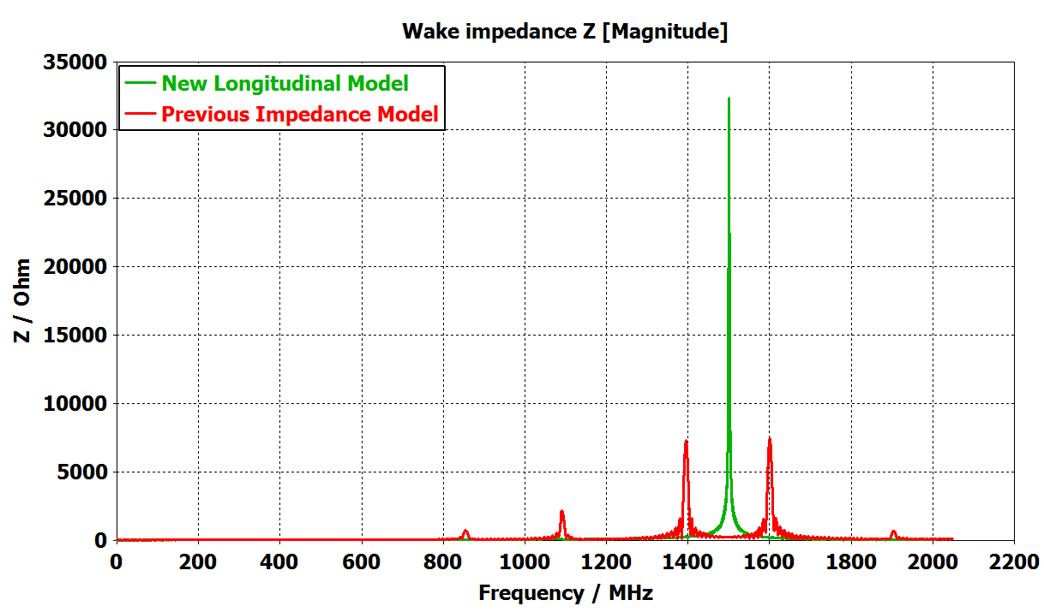
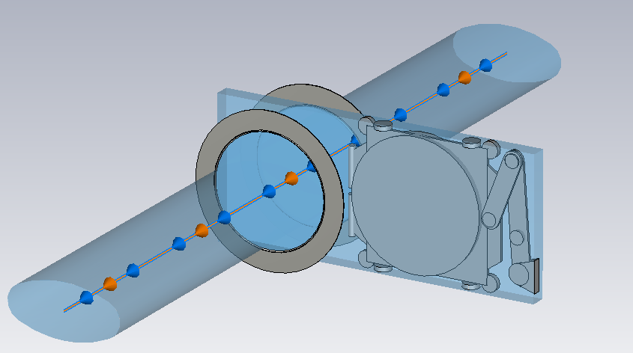
UHV Gate Valve: CST Models
Previous Impedance Model
10 Valves total
No internal model available
  Not included in previous model
  Proprietary
  Drawn using datasheet
  Measurements necessary
New Longitudinal Impedance Model
Source of :
Microwave Instability

Slide 14
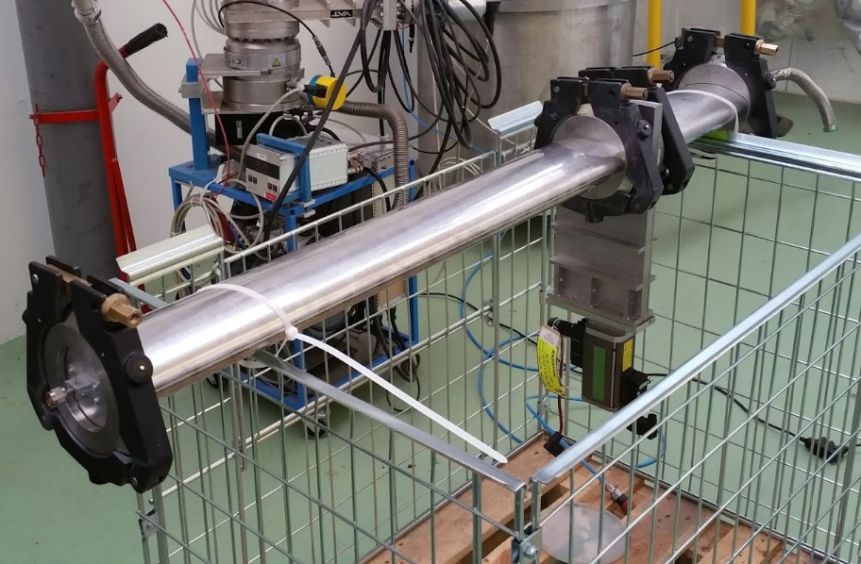
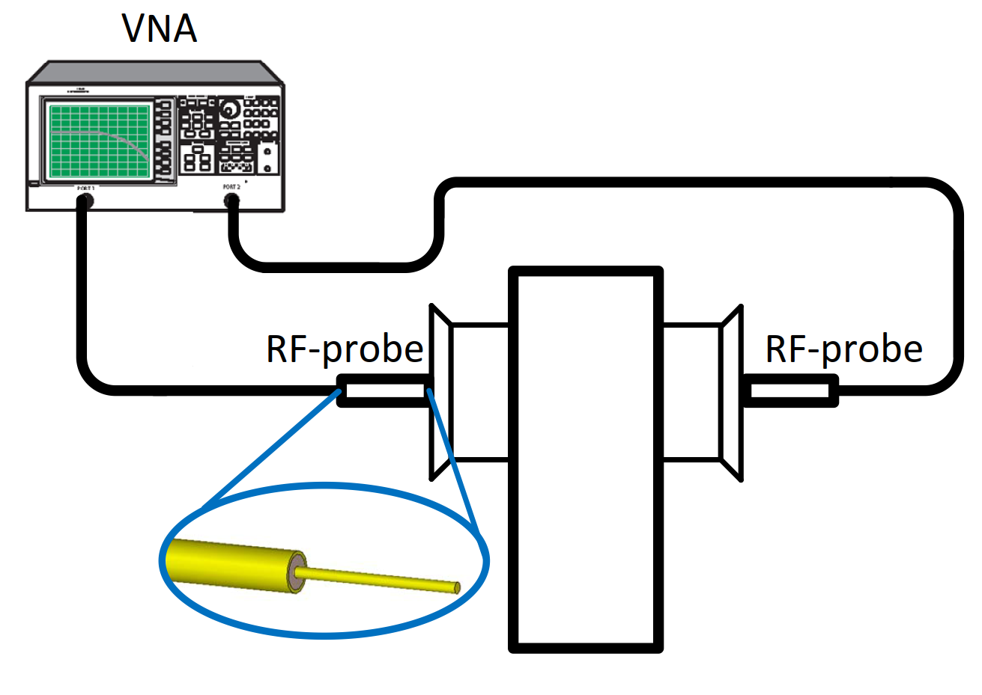
UHV Gate Valve: Measurement Setup
Measured using probe method
Setup closed at both ends
  Traps travelling wave modes
  TE_{11p}
Investigated resonances at
  1.2 GHz, 1.34 GHz & 1.5 GHz
Notes:
VAT UHV Gate Valve Series 108 Order No. 10844-Xe44-BIH1 DN 160 Flange X Dimensional Drawing 544734

Slide 15
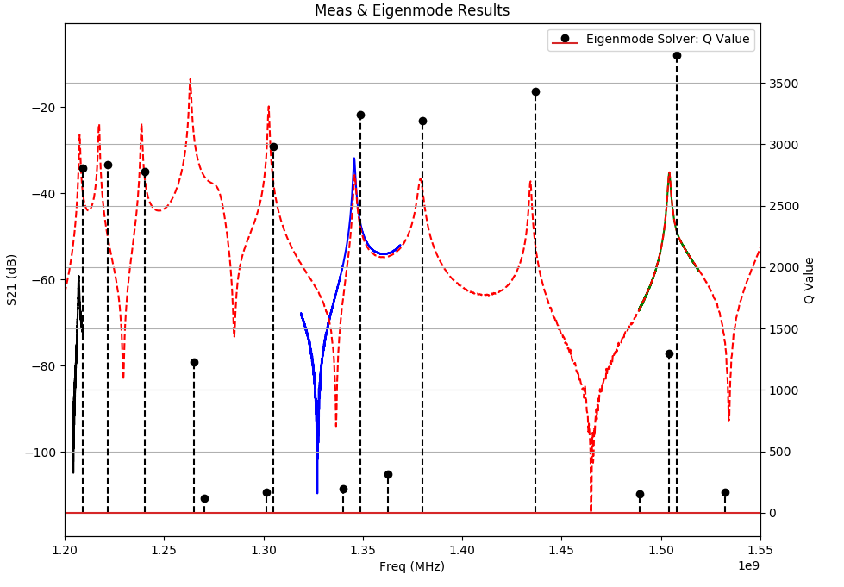
UHV Gate Valve: Comparing Measurement & Simulation Results
TE₁₁₉
TE₁₁₈
TE₁₁₁
TE₁₁₆
TE₁₁₇
TE₁₁₂
TE₁₁₅
TE₁₁₃
Cavity Mode
TM₀₁₀
1504.18
Q: 1184
TE₁₁₄
TE₁₁₆
1345.67 MHz
Q: 1442
TE₁₁₁
1207.04 MHz
Q: 2352

Slide 16
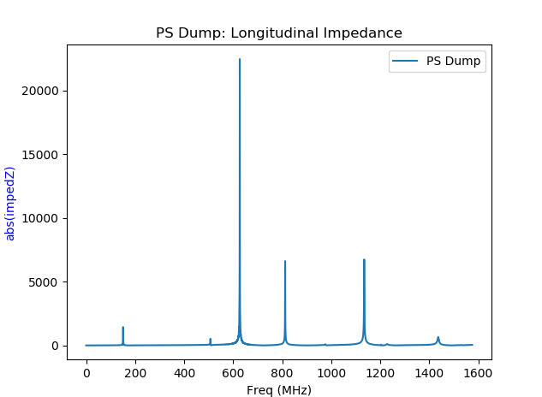
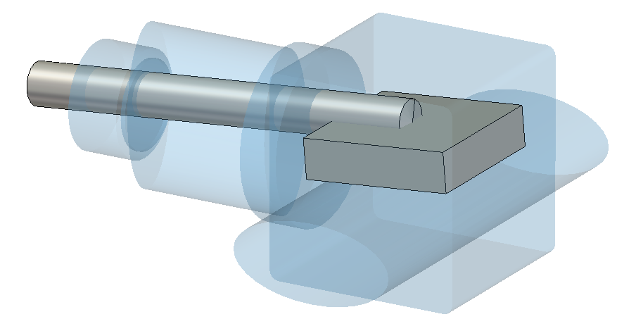
Preliminary PS Dump Model
Installed in straight sections 47 & 48
Main problem modes are ‘Coax Cavity’-like
Simplified moveable dump
Source of :
Emittance Blow Up
Microwave Instability
Moveable
Dump
Actuator
PS
Beam Pipe
Beam
Notes:
CONCERNS:
LENGTH OF ACTUATOR
ELECTRICAL CONNECTION

Slide 17
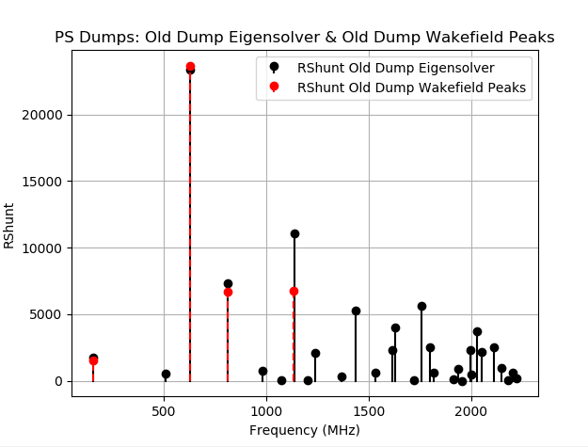
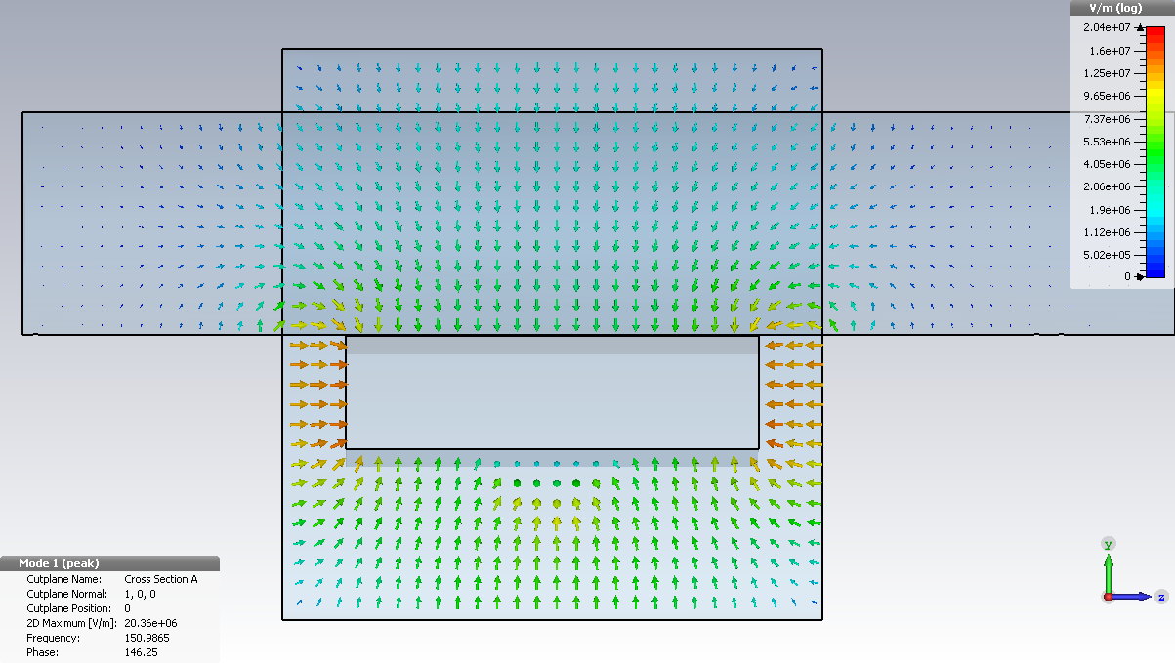
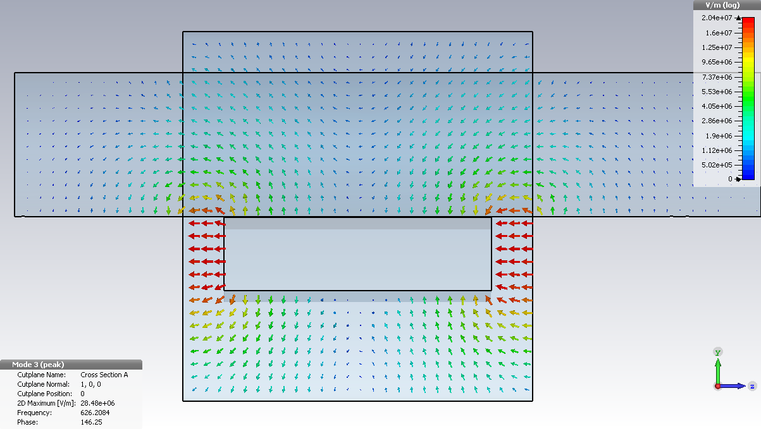
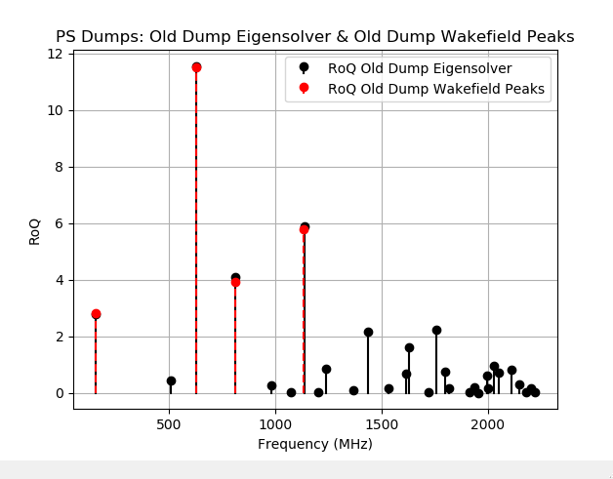
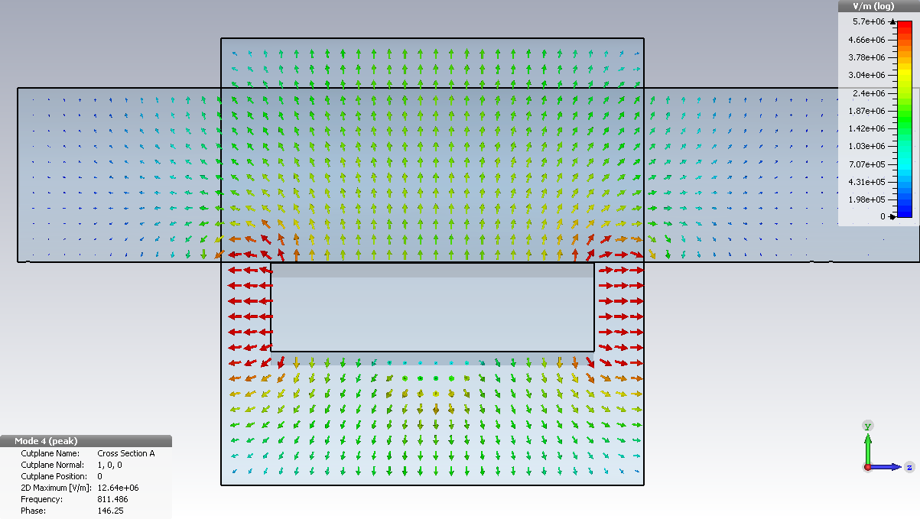
‘Coax Cavity’-like Modes
Eigenmode Solver: Front View
150 MHz
Beam
626 MHz
Beam
811 MHz
Beam

Slide 18
Path Forward
Cavities
  Implementing the effects of the feedback systems
  HOM Couplers
  Validation with measurements
Kickers
  Measure 8C11 Sample
    Ferrite measurement script in development
    8C11 samples to be machined
  If available, attempt to measure individual kicker modules
Straight (SD) & Magnet (MU) Sections
  Begin to model beam instrumentation devices (pickups, BPMs)
  Confirm counts of passive elements
PS Dump
  Confirm length of actuator & electric connection
  Add realistic material definitions to the moveable dump
  New PS dump design is in progress (EN-STI)
    Current replacement design is a higher impedance contributor than the current design

Slide 19
Further Elements to add
Complete survey of straight sections (SD)
20 MHz & 200 MHz Cavities
Septa
Remaining Kickers
  KFA4 & KFA28
Beam instrumentation
  Wall current monitors
  Wire scanners
  Pick-ups
Vacuum elements
  Flanges, bellows, transitions
  Vacuum report, such as in the SPS, or similar document
Notes:
Wideband PU (SD90 & SD94)
Sensitive Pick-ups (SD83 & SD93)
Position Sensitive Wall current monitors (PSWCM) (SD00)
Wall Current Monitors (WCM) (SD03 & SD95)
Wire Scanners

Slide 20
Summary
Cavities are most obvious candidates for admittance blow up
  Large impedance values
  Reduction via feedbacks (H. Damerau talk)
Other sources of impedances
  Kickers’ resonances at low frequency
Future elements need to be impedance analyzed & reduced when possible
  Example: New beam dump design
Wideband impedance sources (Kickers)
  Reductions in Landau damping
Microwave instabilities
  Gate valves
  Pumping manifolds in magnet unit (MU) sections
Maintenance of impedance model

Slide 21
Supplemental Slides

Slide 22
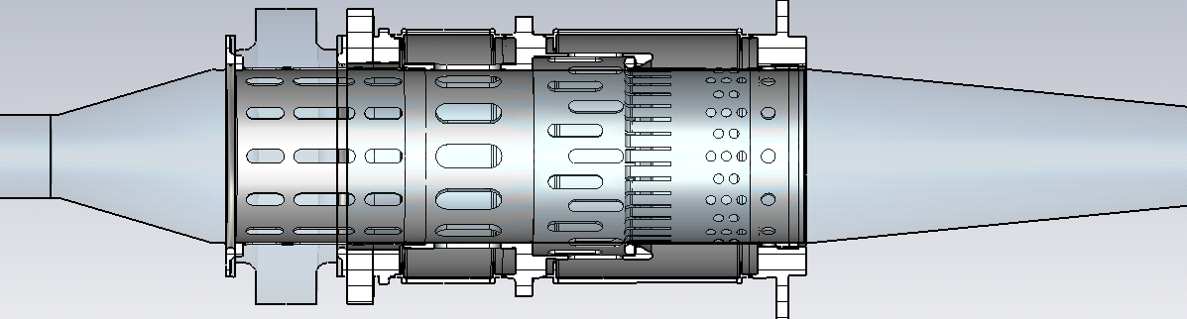
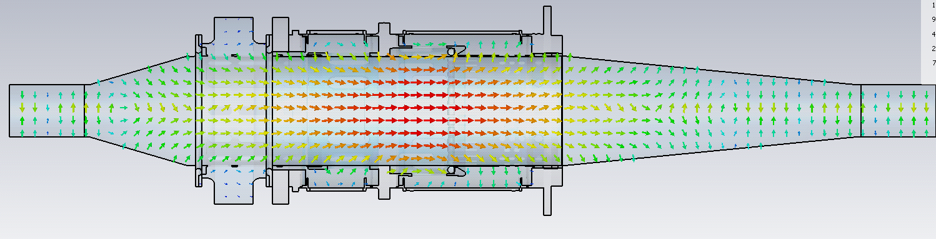
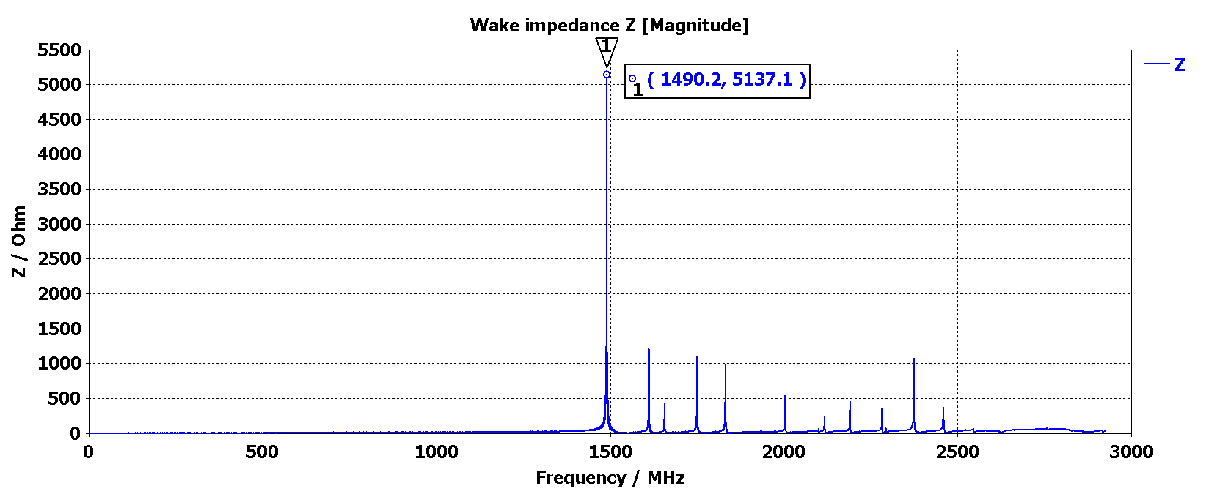
Wakefield Simulation of the Closed Mechanical Short
Mode at 1.49 GHz
Notes:
Cutoff of TM01 a=73 mm => 1.572 GHz (Simple Cav Model)
Cutoff of TM01 a=103 mm => 1.114 GHz (Simplified bellow inner Radius)
1.491 GHz, for cut off of TM01 => a =76.96 mm

Slide 23
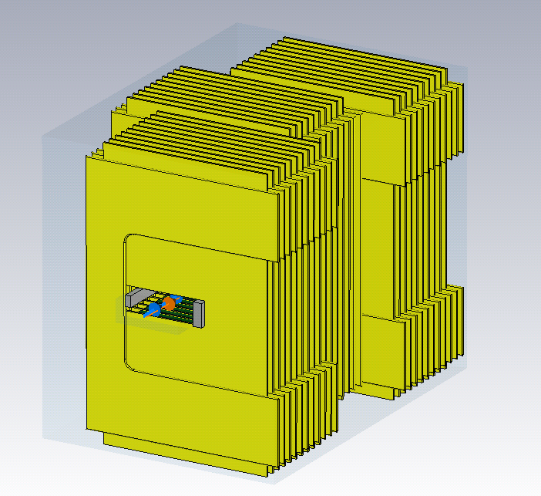
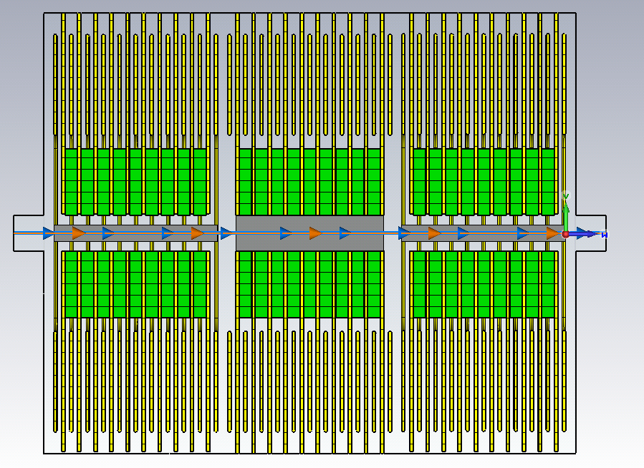
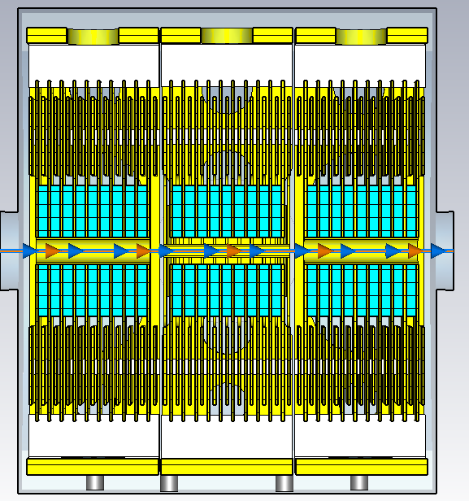
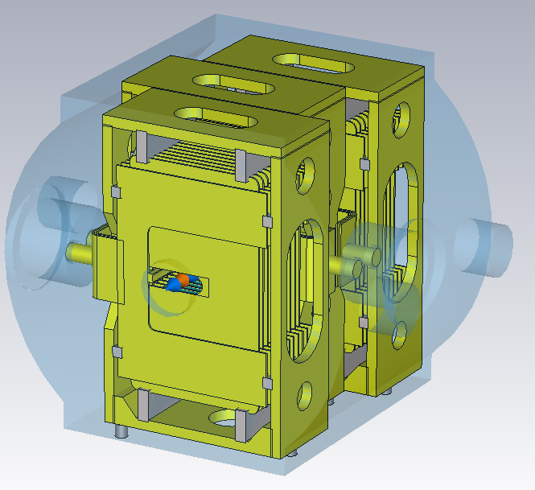
KFA79: Models
Previous Impedance Model
New Longitudinal Impedance Model

Slide 24
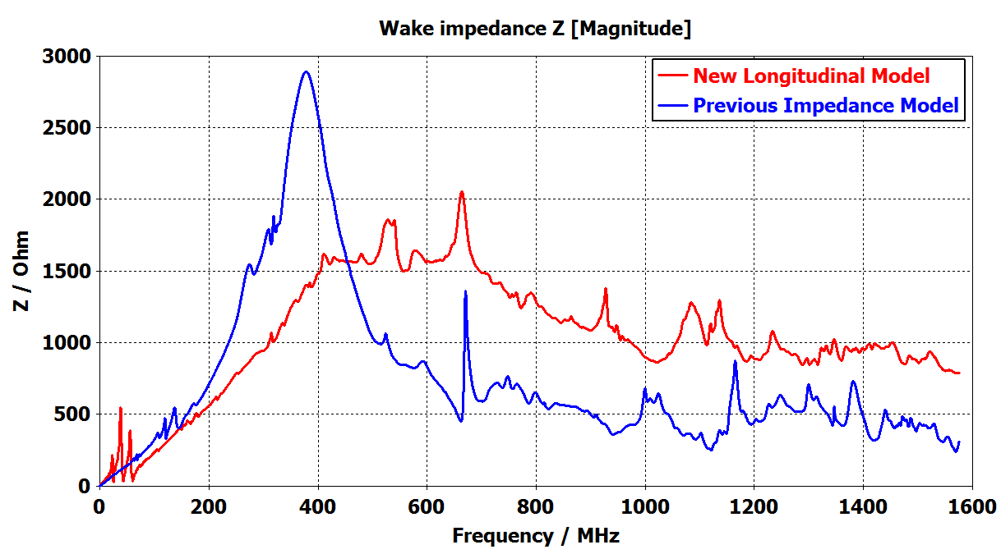
KFA79: Comparing Wakefield Simulation Results

Slide 25
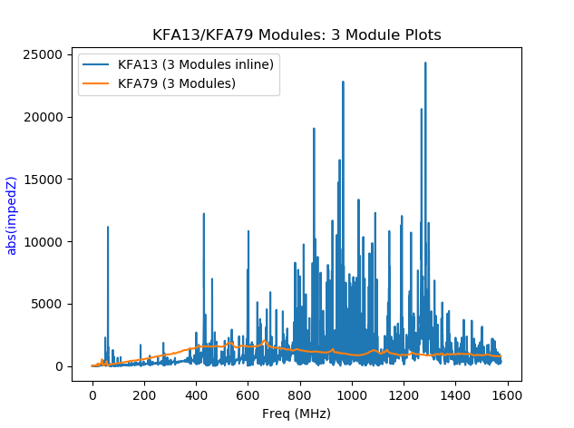
Comparing KFA79 to KFA13
KFA79
Inline modules produce a ‘forest’ of resonances (KFA13)
Inline modules seem to allow additional modes to build up along beam path
  I.E. Higher coupling between modules
KFA13

Slide 26
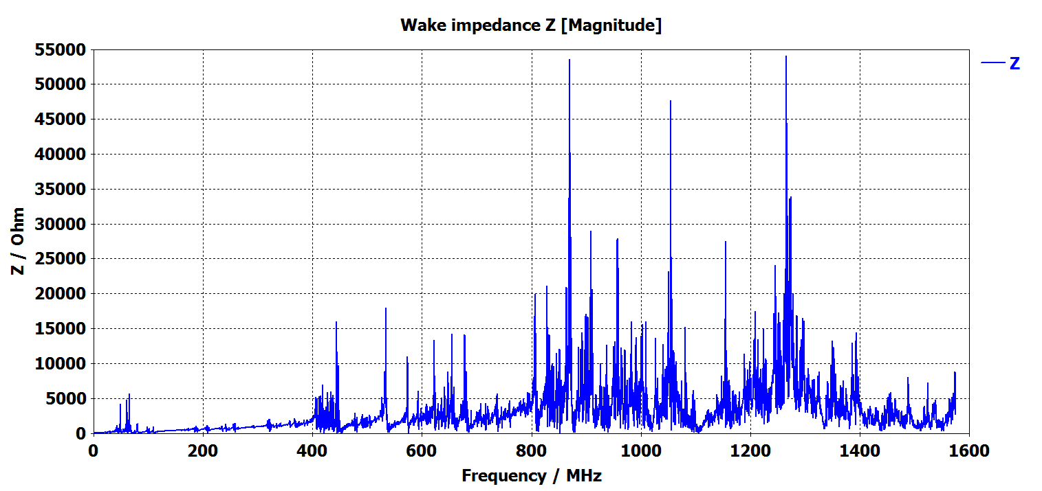
KFA71: Preliminary Wakefield Simulation Results
Preliminary Wakefield Results
  Need to run longer wakelength to further resolve peaks
Notes:
400 meter wakelength, decays down to -8.75 dB
2.370 meter long structure

Slide 27
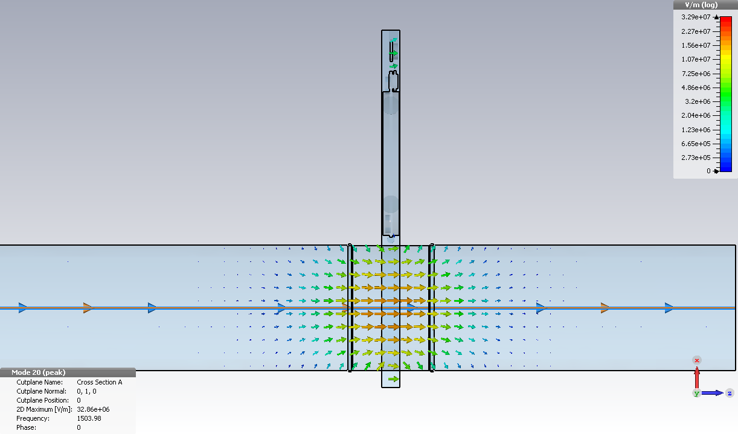
UHV Gate Valve: TM₀₁₀ Cavity Mode in the Valve
 | Eigenmode Simulation | Wakefield Simulation | Measured
Res. Freq | 1.503 GHz | 1.496 GHz | 1.504 GHz
Q | 1294 | 1206 | 1184
R Shunt | 39.0k Ohm | 36.2k Ohm | -

