Slide 1

Effect of WP, chromaticity, orbit correction on FB losses
Kevin Li, H. Bartosik, M. Carla’, B. Goddard, G. Iadarola, V. Kain, G. Kotzian, A. Lasheen, L. Mether, G. Papotti, J. Repond, G. Rumolo, M. Schenk, M. Schwarz, E. Shaposhnikova SPS OP Crew
SPS injection losses review – 30 November 2017

Slide 2
Outline
The goal is to maximize transmission at injection (and throughout the cycle) and to maintain the best possible beam quality (brightness).
In the transverse plane, there are a couple of parameters that effect both transmission and beam quality evolution. These can be categorized into:
  Orbit → losses from aperture limitations
  Working point → losses from interaction with resonances – incoherent effects
  Chromaticity → losses from tune spreads and beam quality degradation from instabilities – incoherent and coherent effects
Ultimately, all effects are linked and the goal is to find the best settings forming the ideal compromise in obtaining the maximum transmission in combination with the best possible beam quality.

Slide 3
Outline
The goal is to maximize transmission at injection (and throughout the cycle) and to maintain the best possible beam quality (brightness).
In the transverse plane, there are a couple of parameters that effect both transmission and beam quality evolution. These can be categorized into:
  Orbit → losses from aperture limitations
  Working point → losses from interaction with resonances – incoherent effects
  Chromaticity → losses from tune spreads and beam quality degradation from instabilities – incoherent and coherent effects
Ultimately, all effects are linked and the goal is to find the best settings forming the ideal compromise in obtaining the maximum transmission in combination with the best possible beam quality.

Slide 4
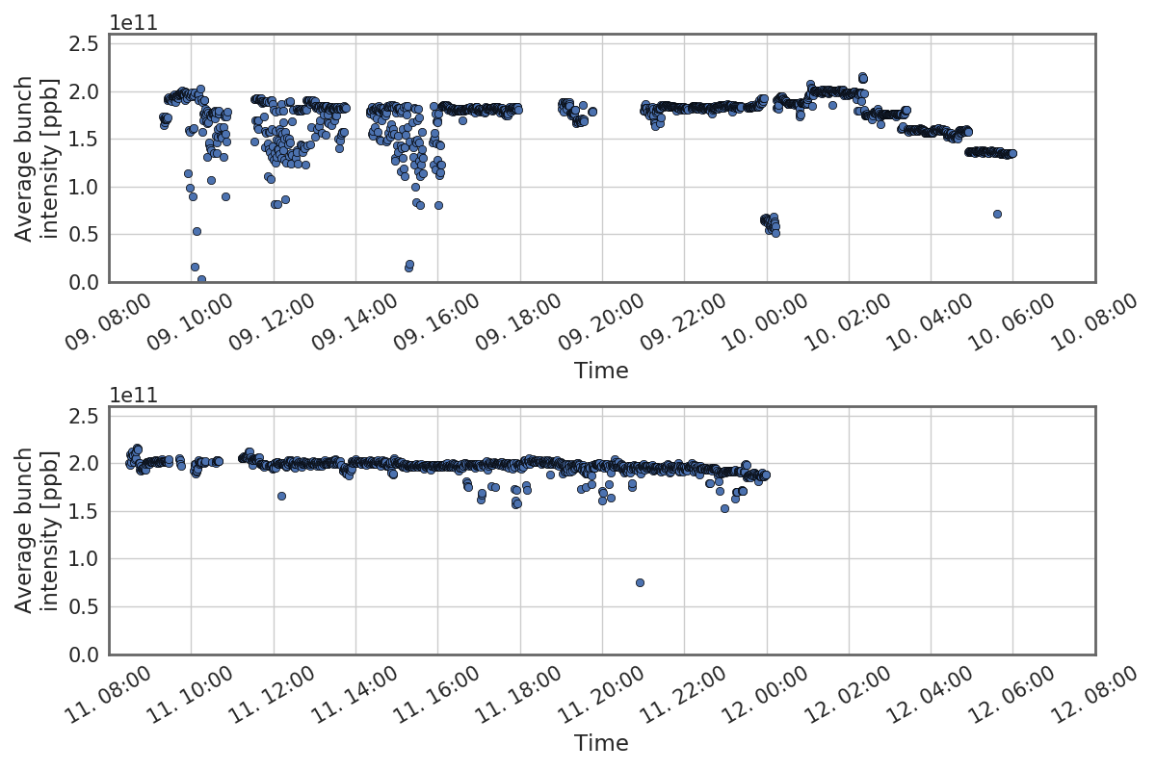
BCT overview
Injection of 72 bunch batches (standard 25 ns) and 48 bunch batches (BCMS) with up to 2e11 ppb
Nominal longitudinal parameters (0.35 eVs) from the PS

Slide 5
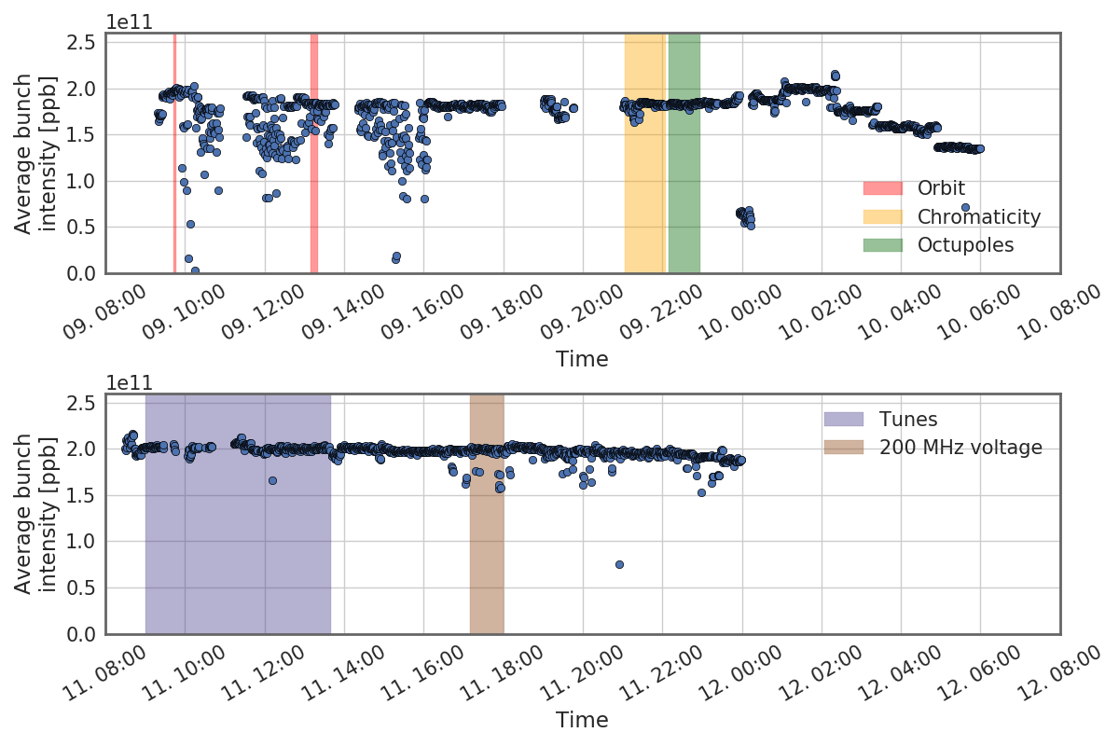
BCT overview
Injection of 72 bunch batches (standard 25 ns) and 48 bunch batches (BCMS) with up to 2e11 ppb
Nominal longitudinal parameters (0.35 eVs) from the PS
Orbit optimization together with studies of incoherent and coherent effects on beam lifetime and beam quality

Slide 6
Spotlight – incoherent effects and WP optimization
Investigation of losses as a function of tunes for potential working point optimization for high intensity beams.
BCMS beam – 1 x 48 bunches

Slide 7
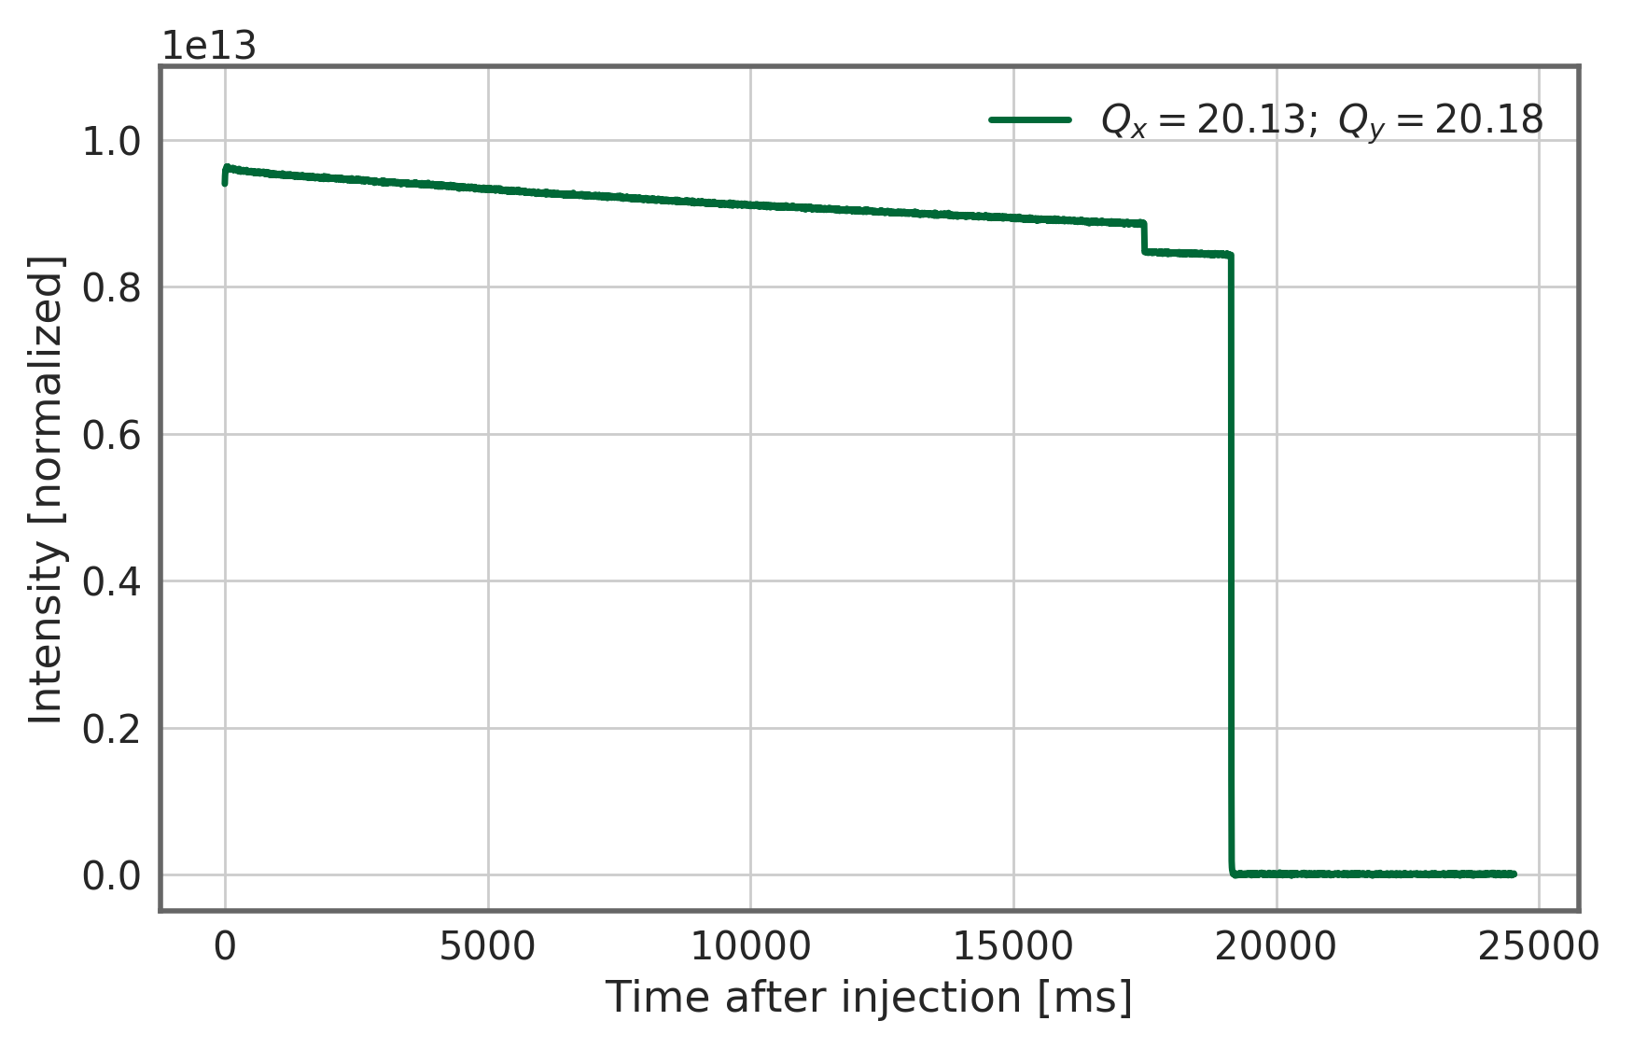
Spotlight – incoherent effects and WP optimization
  Aperture limitations → orbit

Slide 8
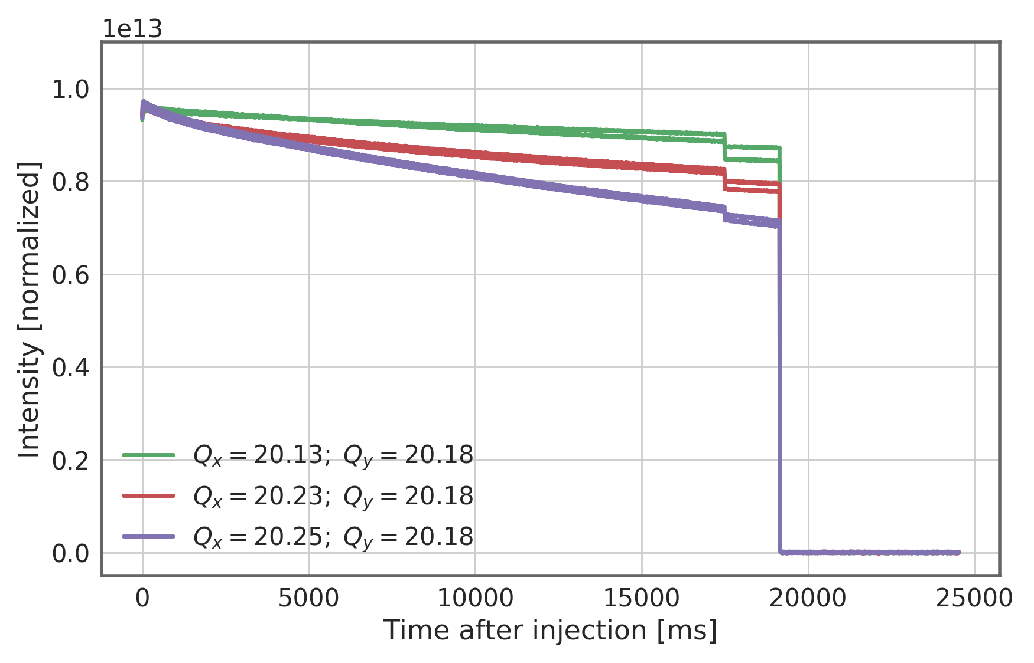
Spotlight – incoherent effects and WP optimization
  Aperture limitations → orbit
Clear dependence of slow losses on working point – which is the optimum?

Slide 9
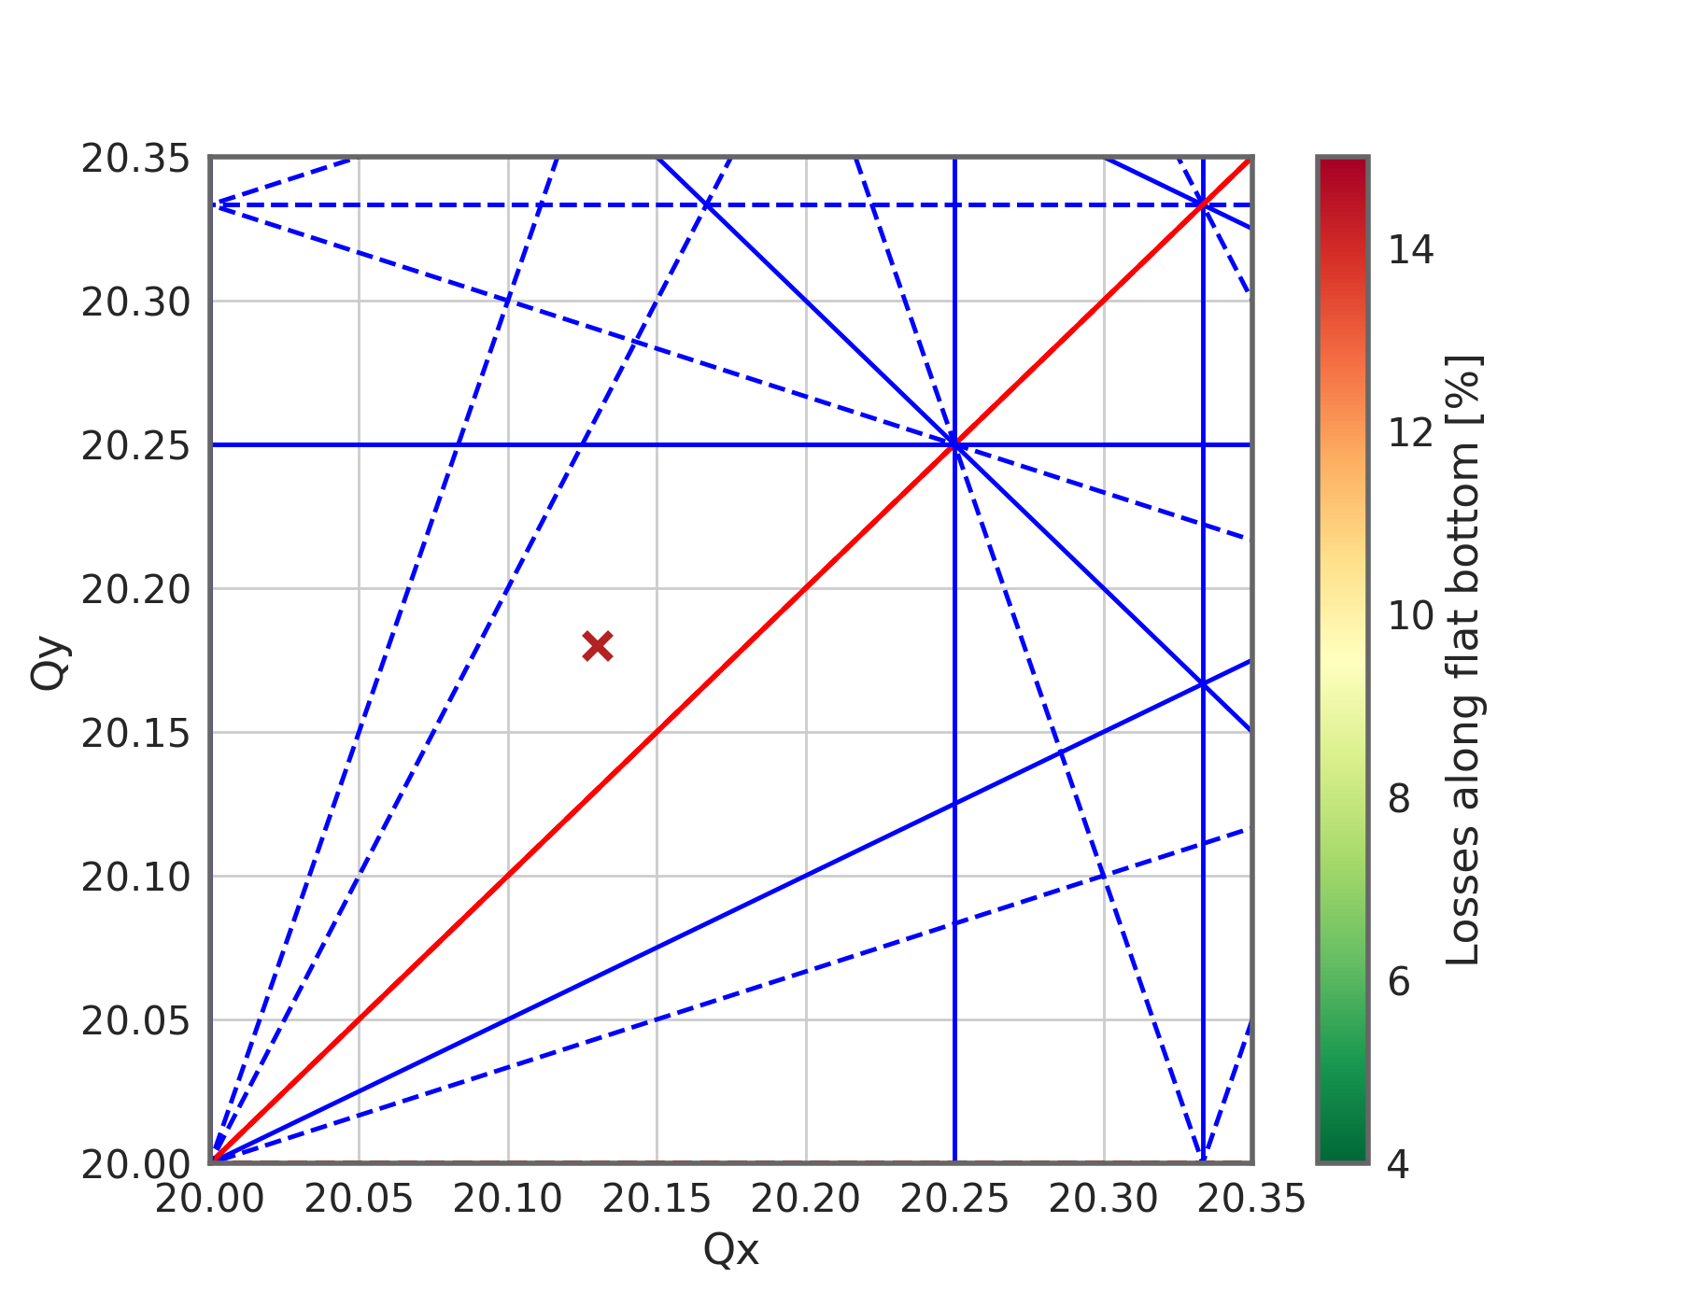
Impact of working point on flat bottom losses
The working point is typically set to about:
  Qx = 20.13
  Qy = 20.18

Slide 10
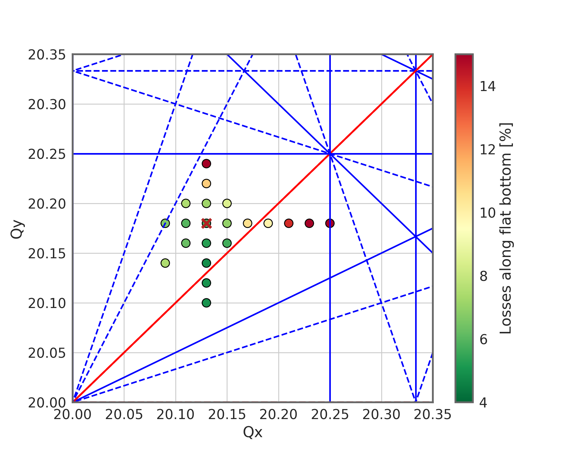
Impact of working point on flat bottom losses
The working point is typically set to about:
  Qx = 20.13
  Qy = 20.18
In this study we try to optimize the coherent tune in terms of losses
It turns out that the usual working point is already very close to an optimum – losses can be higher for other working points (in particular when increasing the tunes…)
The typical working point at (0.13, 0.18) is already well optimized in terms of losses – there is not much to gain in a WP optimization.
With the impact seen from chromaticity (later) we will nevertheless try gain a qualitative insight in the loss mechanism…

Slide 11
Impact of working point on flat bottom losses
The working point is typically set to about:
  Qx = 20.13
  Qy = 20.18

Slide 12

Impact of working point – qualitative analysis
The working point is typically set to about:
  Qx = 20.13
  Qy = 20.18
Impedance effects lead to a coherent tune shift. The measured coherent tune is the manifestation of the coherent ensemble motion.
In a qualitative view we focus on large off-momentum/uncaptured particles
We neglect incoherent tune shifts from quadrupolar wakes and space charge
This will be a recurring view and we will see later why this makes sense

Slide 13
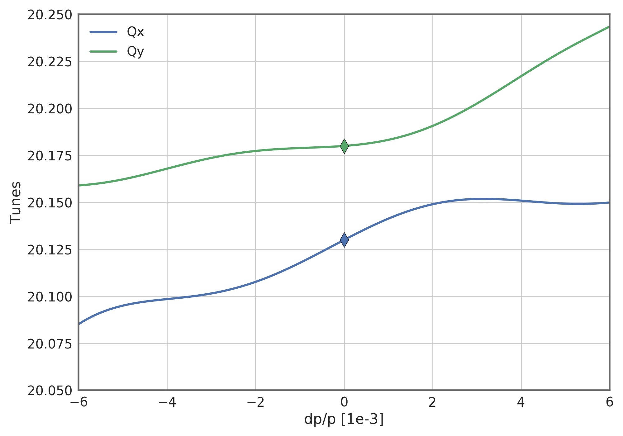
Impact of working point – qualitative analysis
The working point is typically set to about:
  Qx = 20.13
  Qy = 20.18
Impedance effects lead to a coherent tune shift. The measured coherent tune is the manifestation of the coherent ensemble motion.
Non-linear chromatic detuning (from multipole errors in dipoles)
In a qualitative view we focus on large off-momentum/uncaptured particles
We neglect incoherent tune shifts from quadrupolar wakes and space charge
This will be a recurring view and we will see later why this makes sense

Slide 14
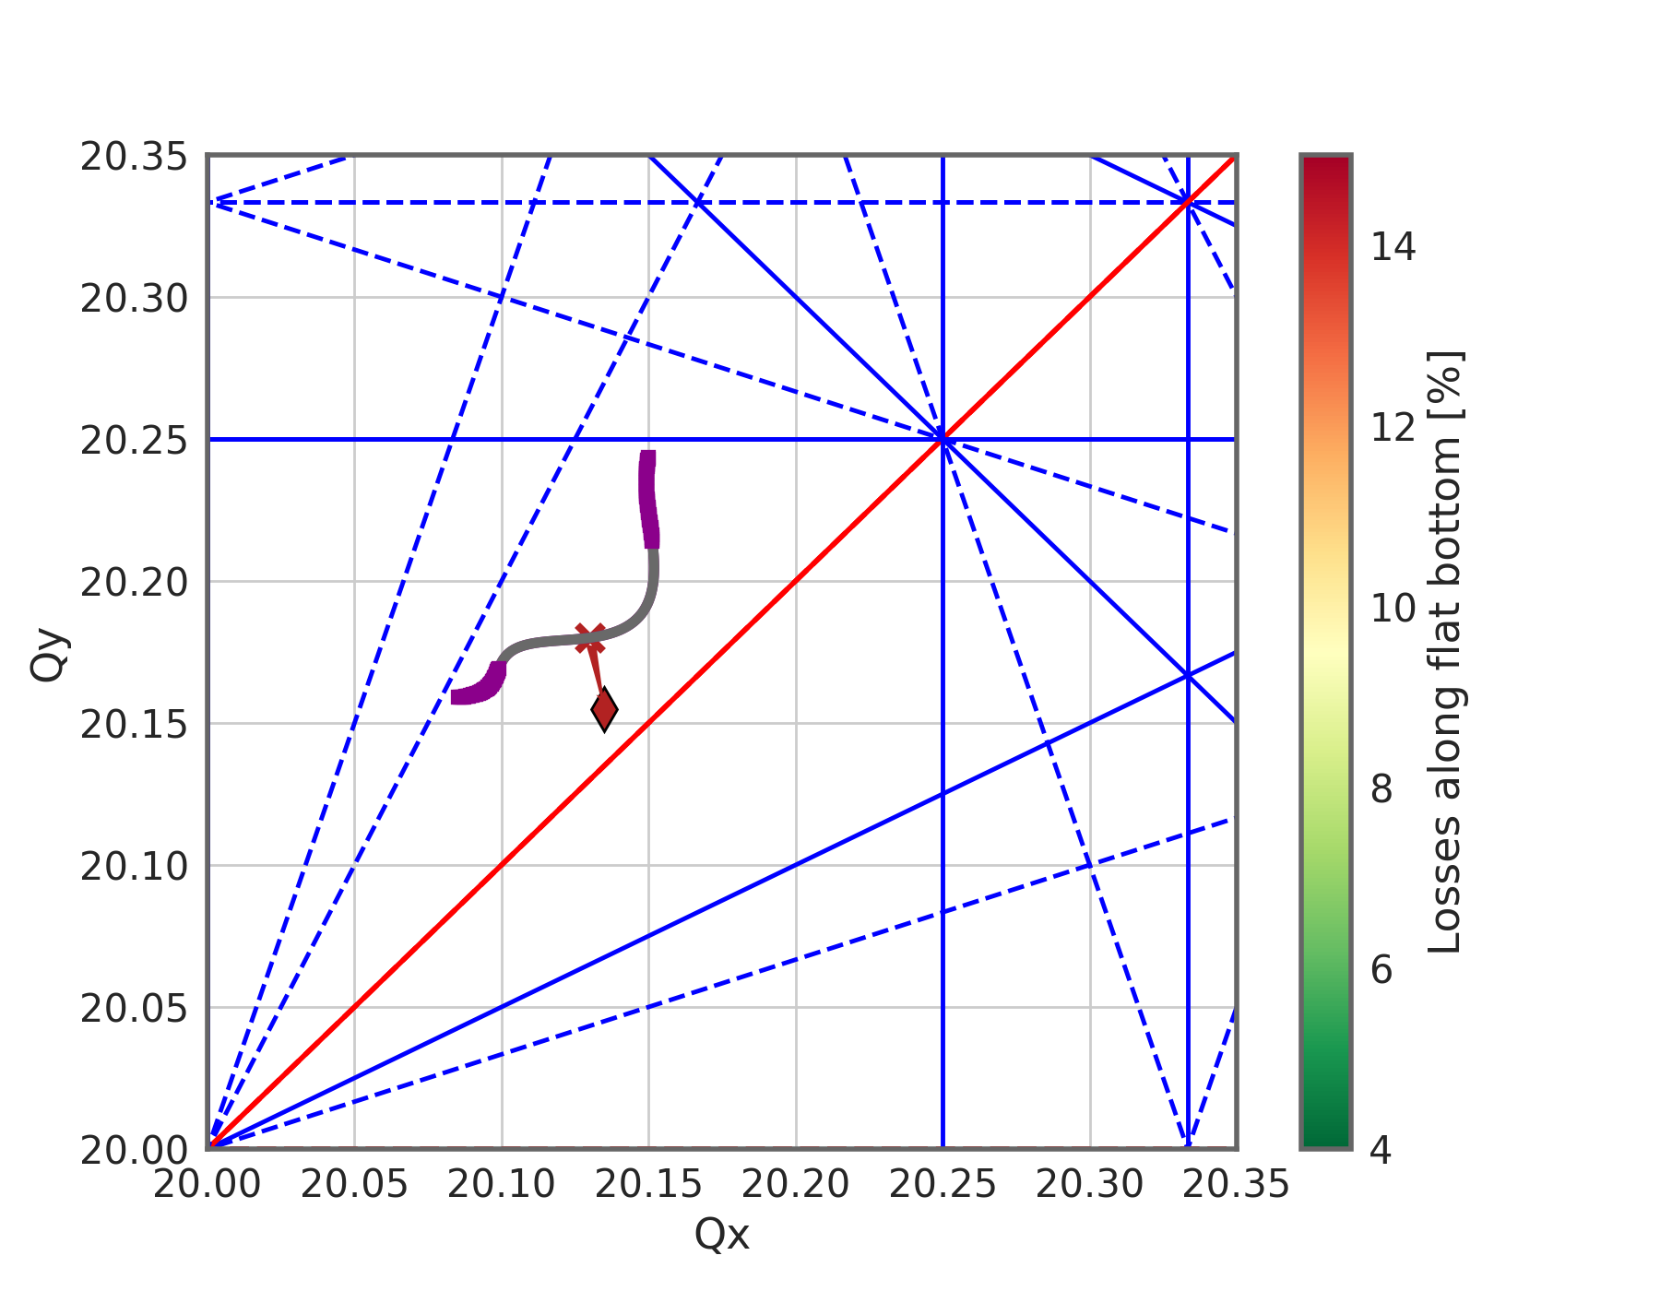
Impact of working point on flat bottom losses
The working point is typically set to about:
  Qx = 20.13
  Qy = 20.18
Impedance effects lead to a coherent tune shift. The measured coherent tune is the manifestation of the coherent ensemble motion.
Single particle (or incoherent) motion takes place still around the bare machine tune
The tune footprint is generated by off-momentum particles in combination with chromaticity (gray: up to RF bucket height – magenta: up to momentum aperture)

Slide 15
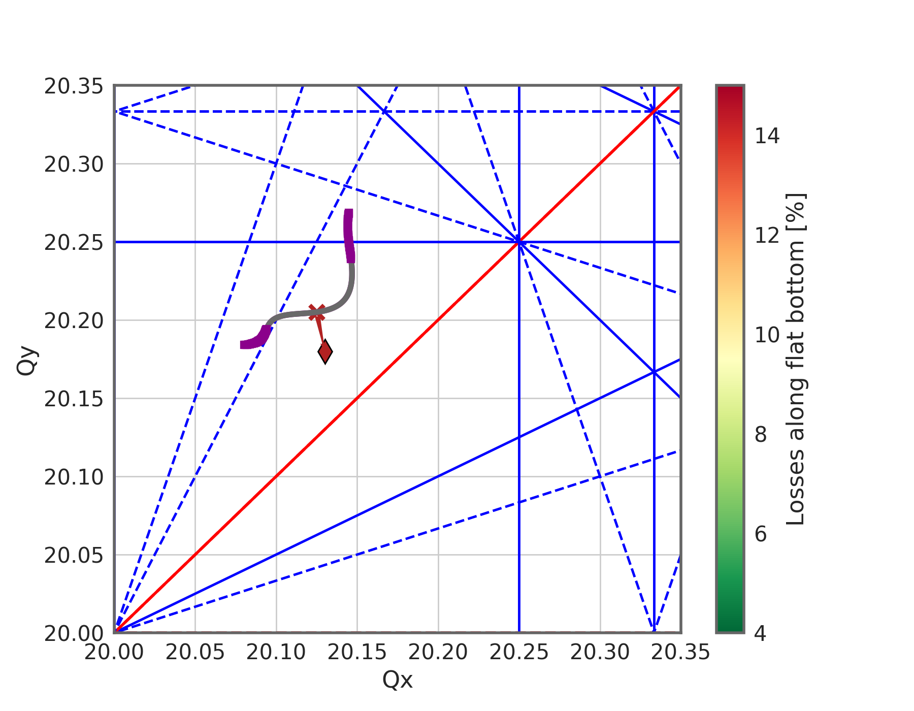
Impact of working point on flat bottom losses
The tune correction of the SPS shifts the measured coherent tune back to the set working point. This is required for the transverse damper to work correctly.
Consequently, the bare machine tune changes and the footprints are shifted…

Slide 16
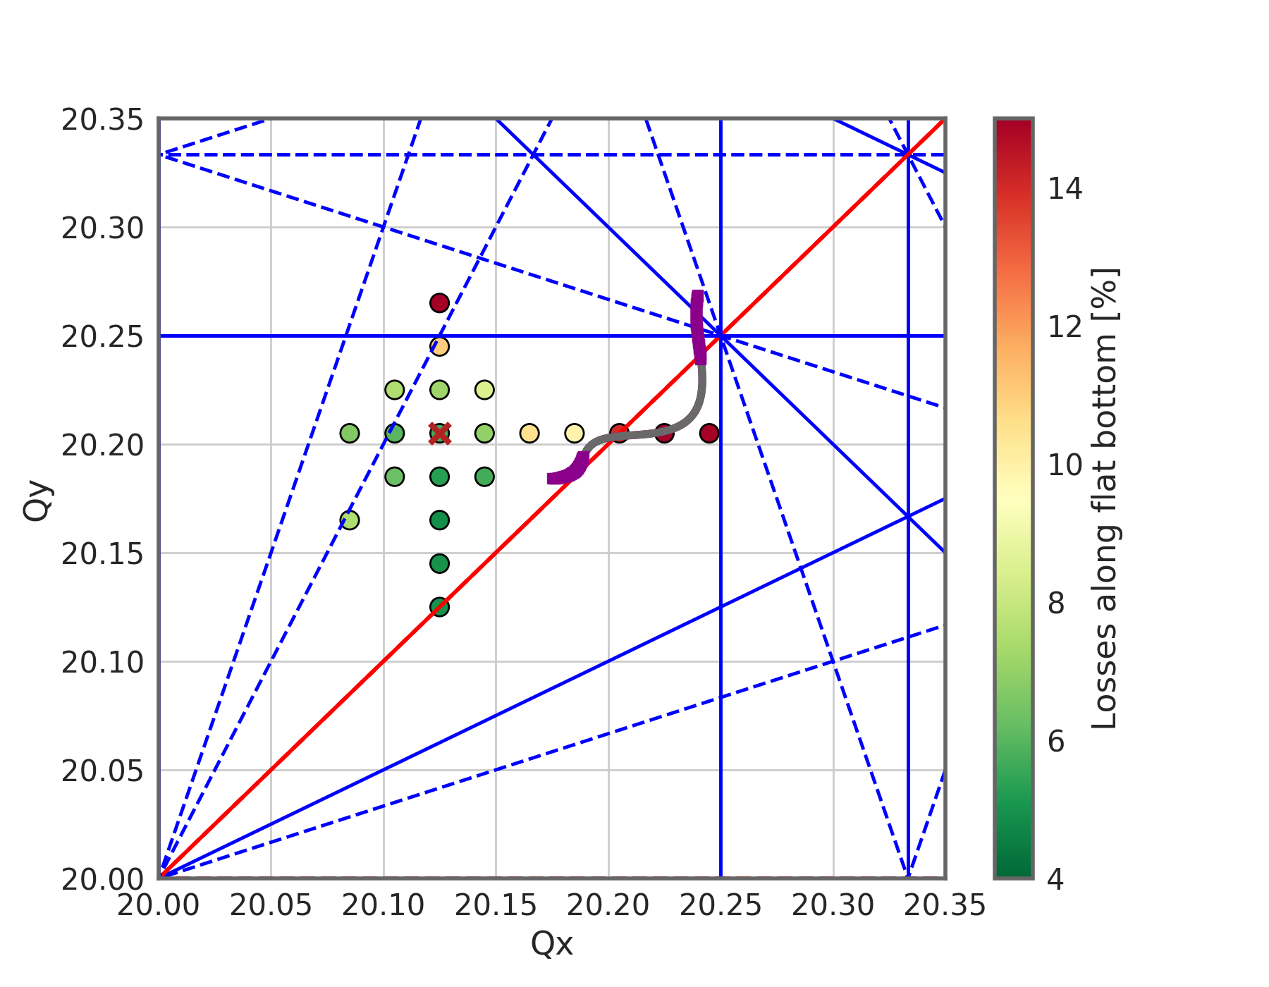
Impact of working point on flat bottom losses
Losses are generated by single particles crossing resonances
In the measurements shown, large off-momentum particles can cross several resonances leading to enhanced losses
Which resonances are the detrimental ones taking into account the coherent and incoherent tune shifts is still under study
The observed loss pattern correlates well with the footprint traced out by off-momentum particles. Hence, these are a likely contributors to losses (especially, also, when moving the working point).
This footprint will change sensitively with chromaticity. We therefore expect to see an impact of chromaticity on the beam lifetime – this should originate from large off-momentum particles.

Slide 17
Spotlight – voltage scan and connection to losses
Investigation of losses as a function of 200 MHz voltage for high intensity beams.
BCMS beam – 1 x 48 bunches

Slide 18
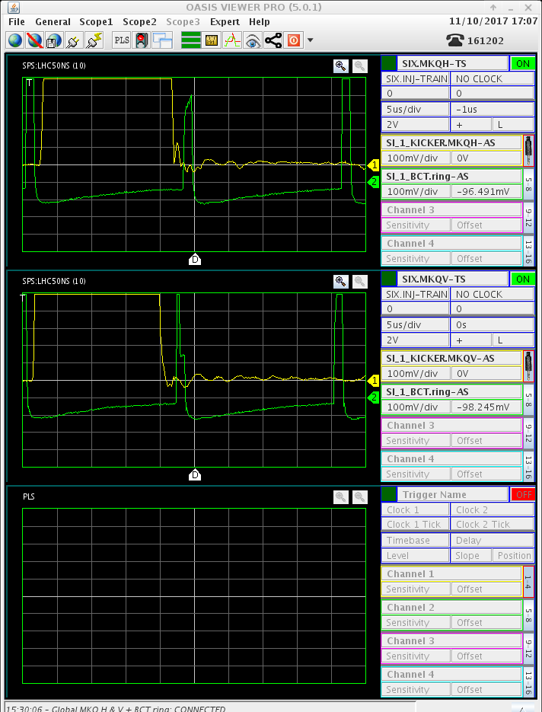
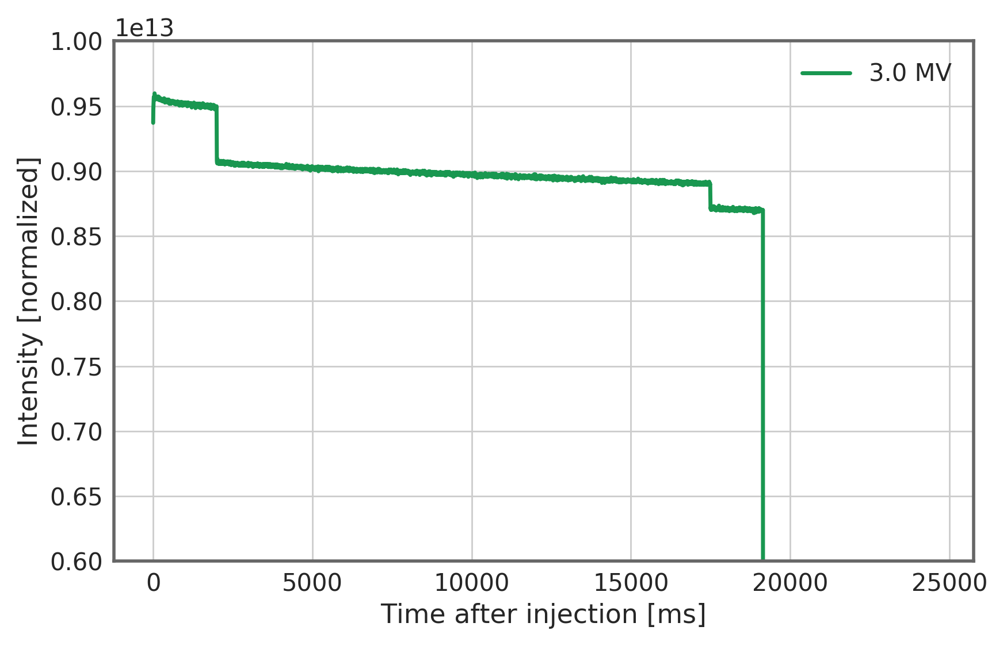
Spotlight – voltage scan and connection to losses
tune kicker to clear uncaptured beam
kick
ring circumference

Slide 19
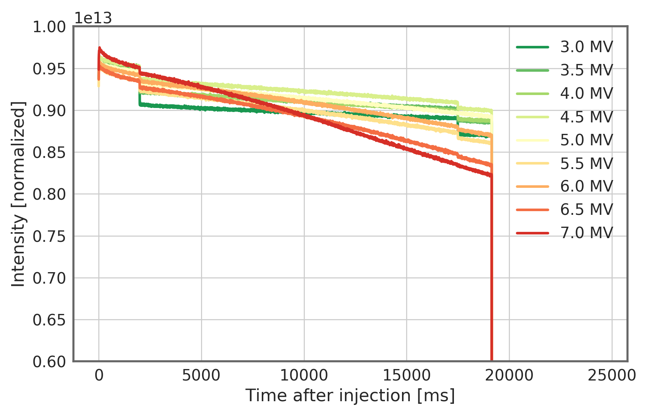
Spotlight – voltage scan and connection to losses

Slide 20
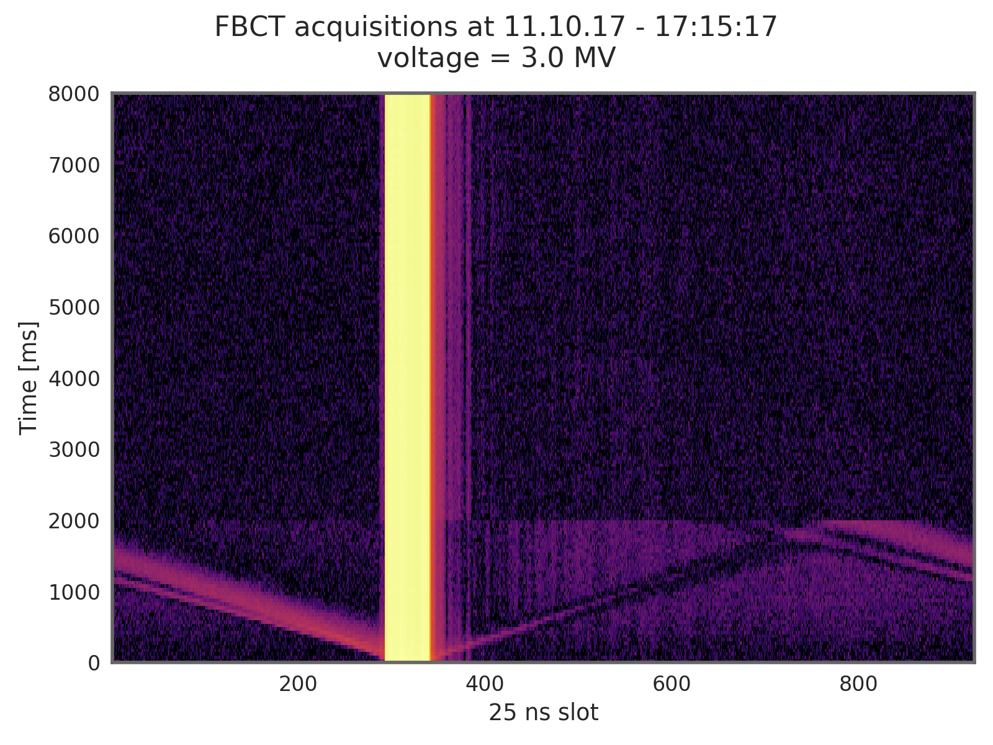
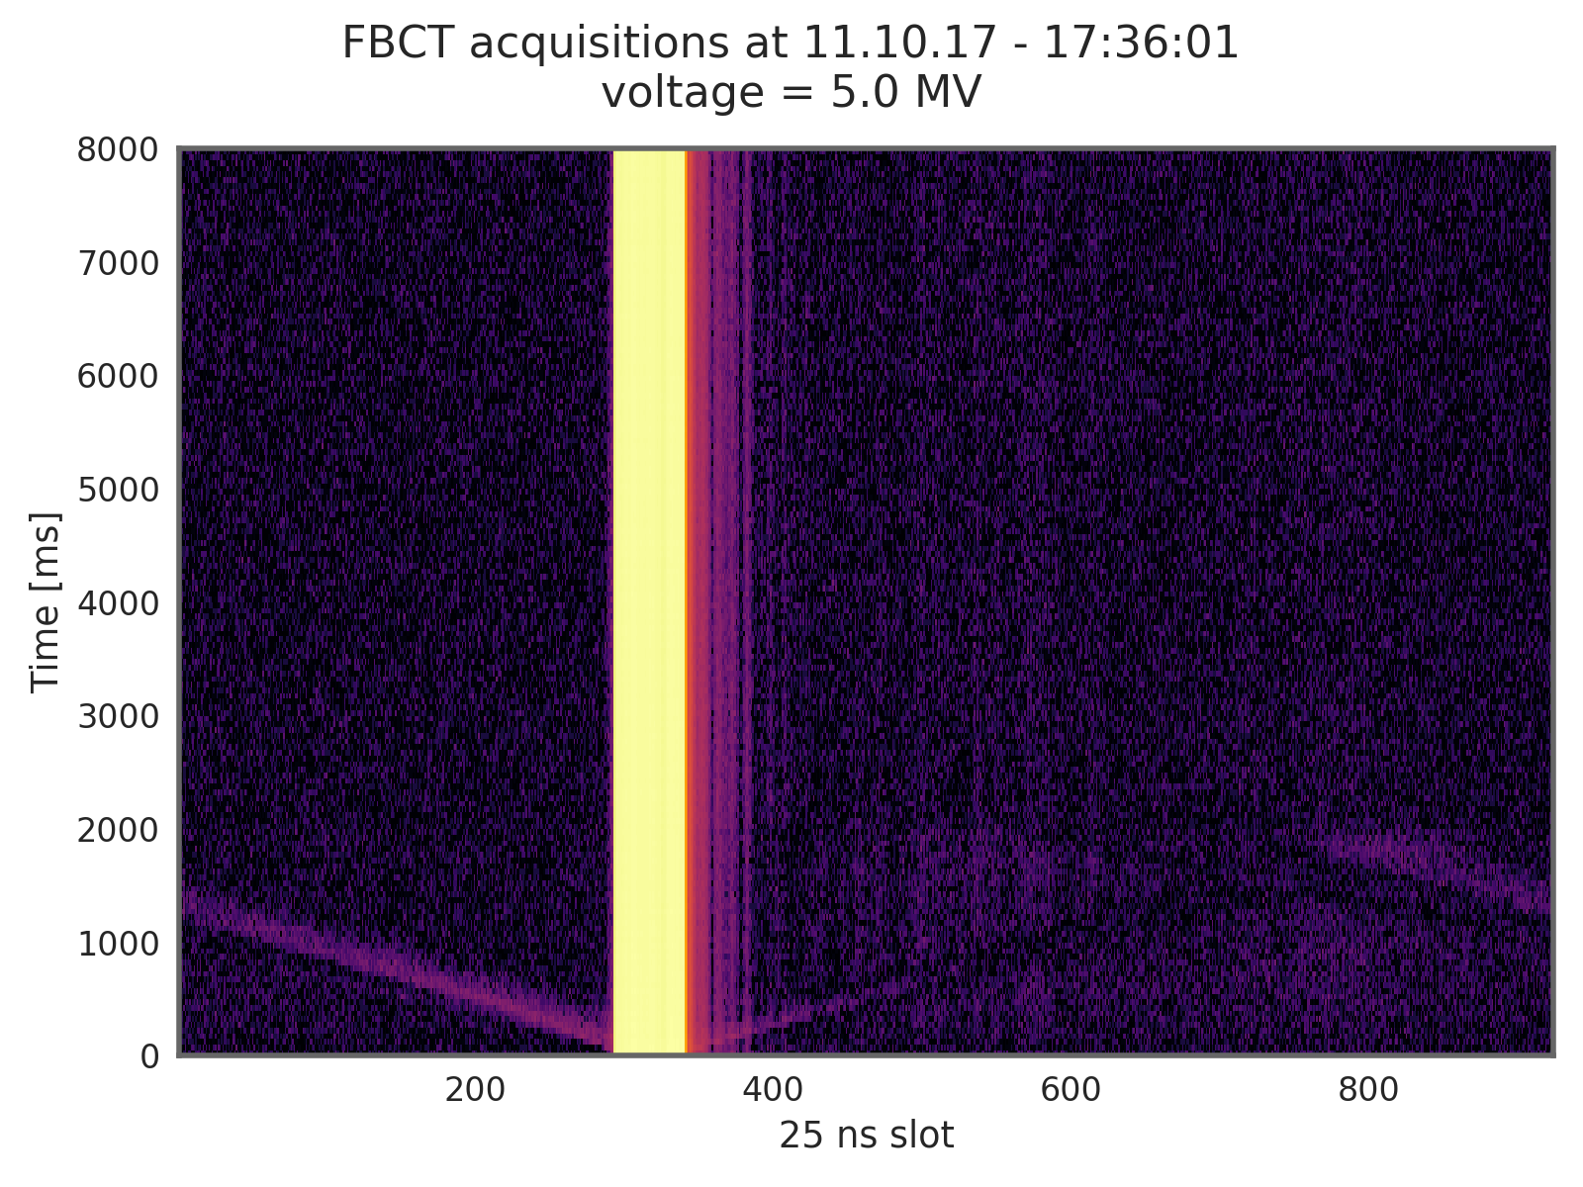
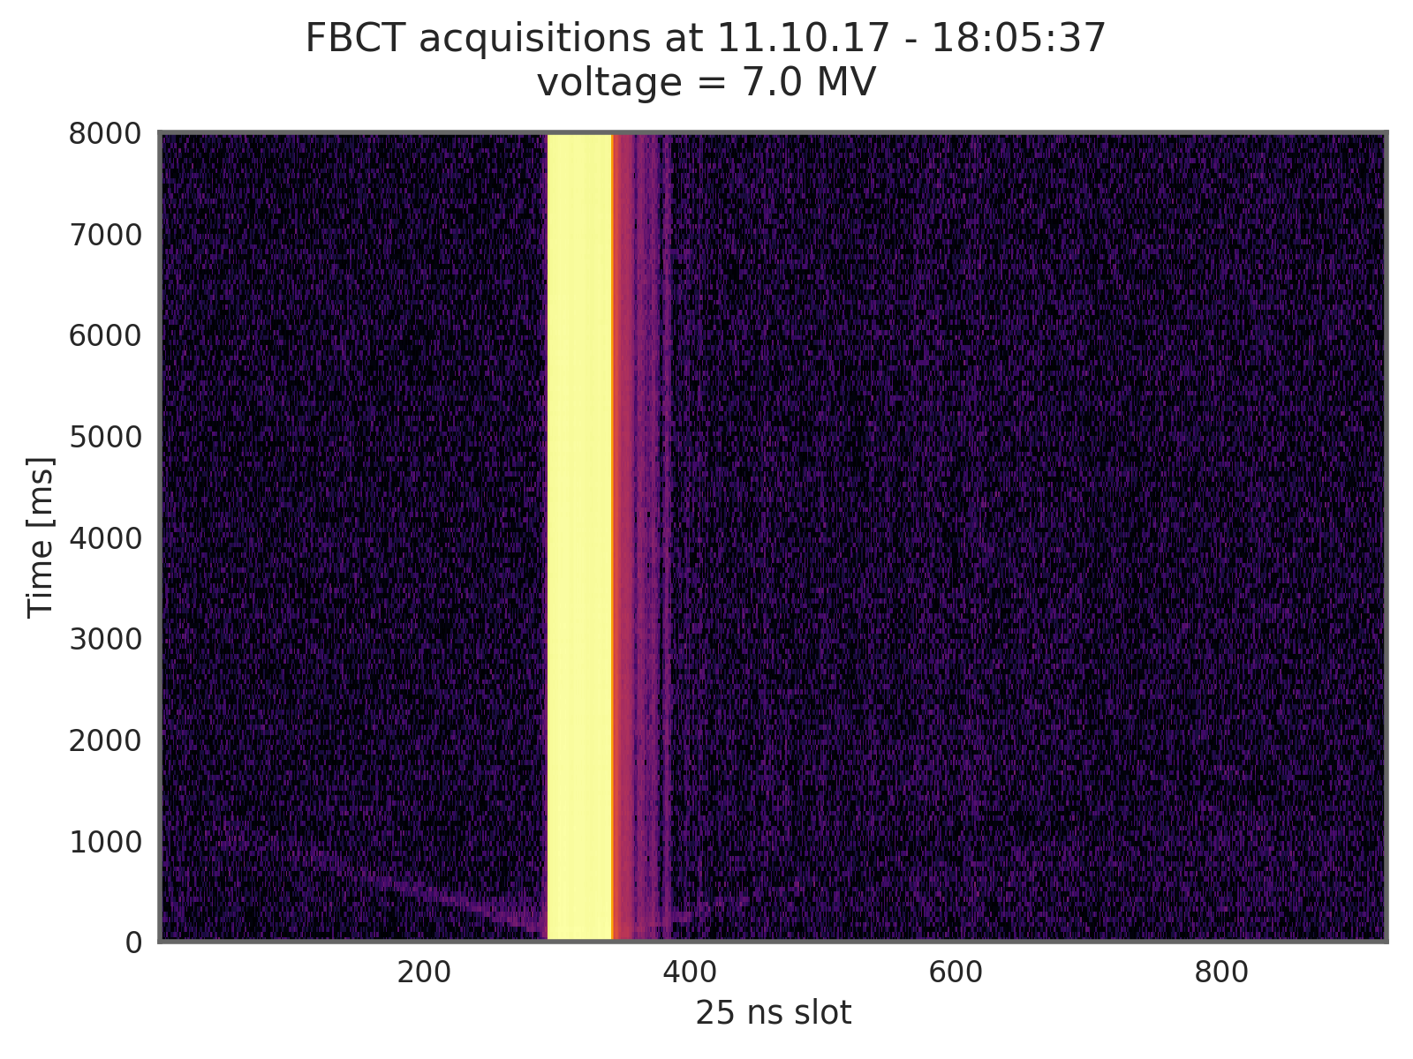
Uncaptured beam seen with the FBCT

Slide 21
Uncaptured beam seen with the FBCT
During the chromaticity scans the voltage was set to 4 MV – we expect a not insignificant fraction of uncaptured particles.
We expect to see slow losses on the BCT – these will also depend on chromaticity.

Slide 22
Spotlight – coherent effects and incoherent losses
Investigation beam stability and incoherent losses as a function of chromaticity for high intensity beams.
BCMS beam – 4 x 48 bunches

Slide 23
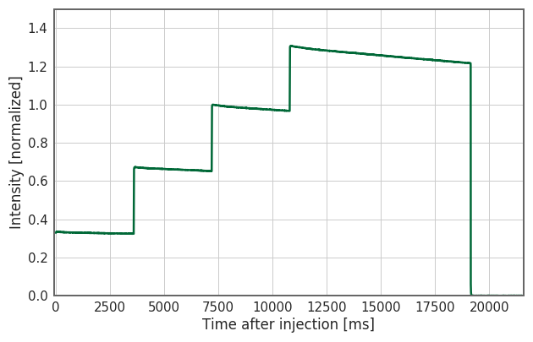
Spotlight – coherent effects and incoherent losses

Slide 24
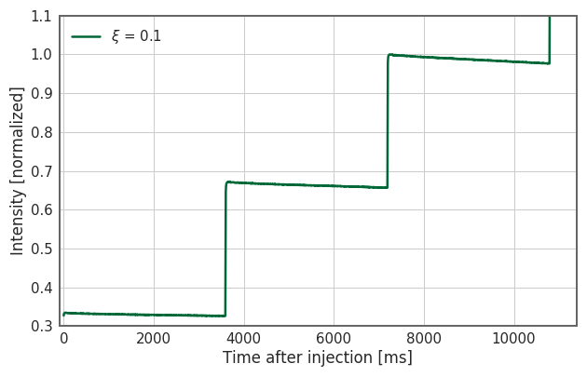
Spotlight – coherent effects and incoherent losses

Slide 25
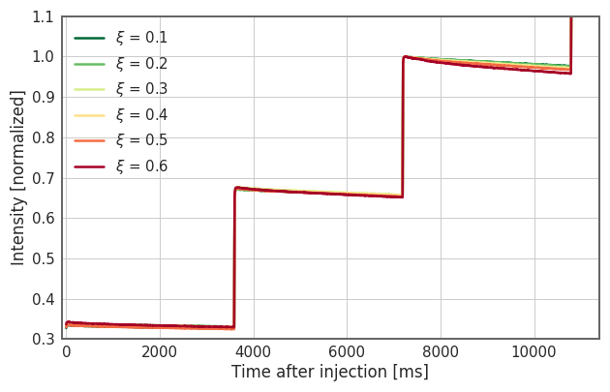
Spotlight – coherent effects and incoherent losses

Slide 26
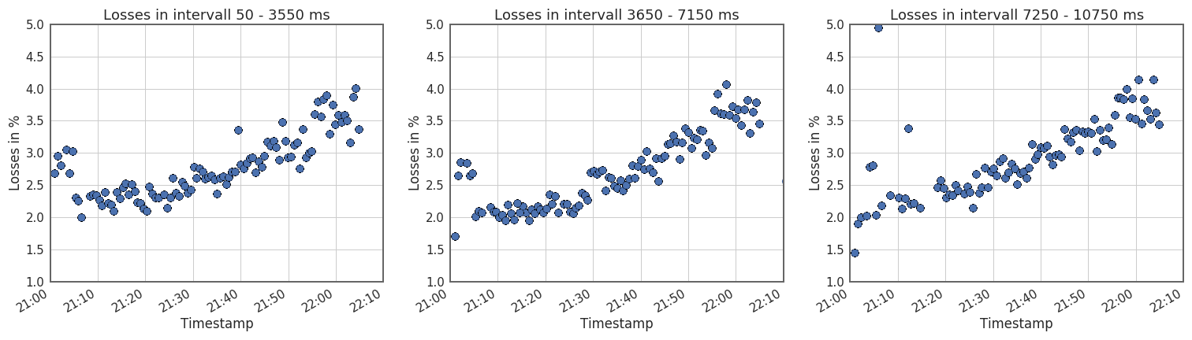
Spotlight – coherent effects and incoherent losses
Looking at losses during fixed interval (3500 ms) after each injection

Slide 27
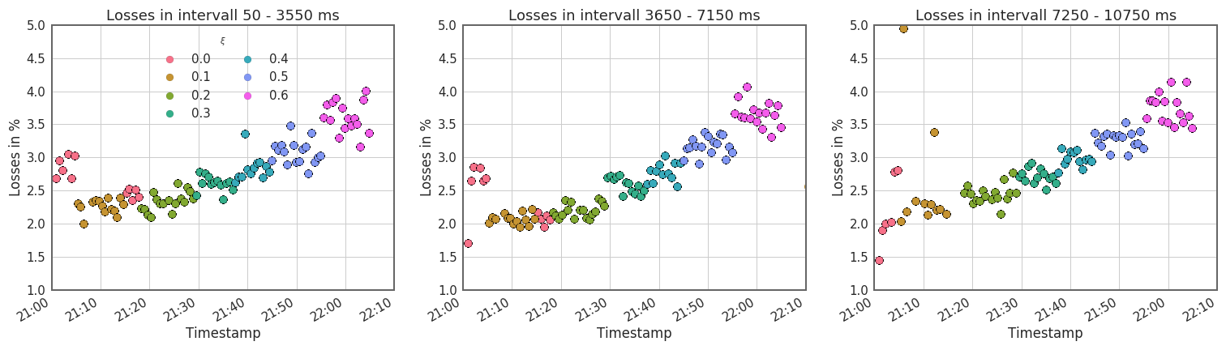
Spotlight – coherent effects and incoherent losses
Looking at losses during fixed interval (3500 ms) after each injection
Clear correlation with chromaticity visible
ξ Horz.

Slide 28
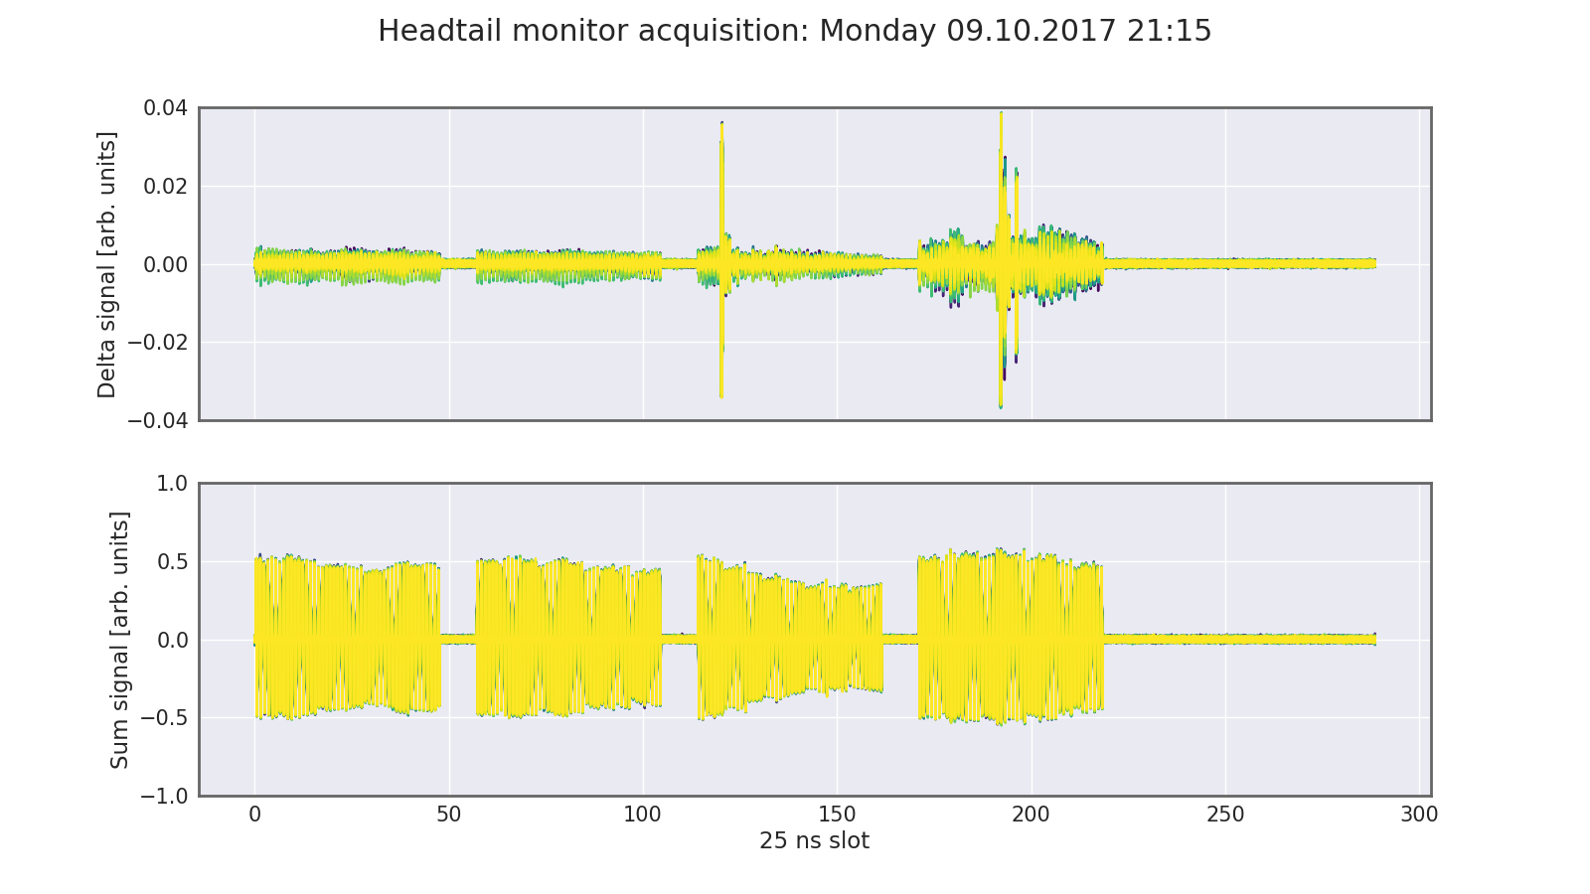
Horizontal instabilities and cure
So why not just run at zero chromaticity?
Headtail instability – mode 1
ξ Horz.

Slide 29
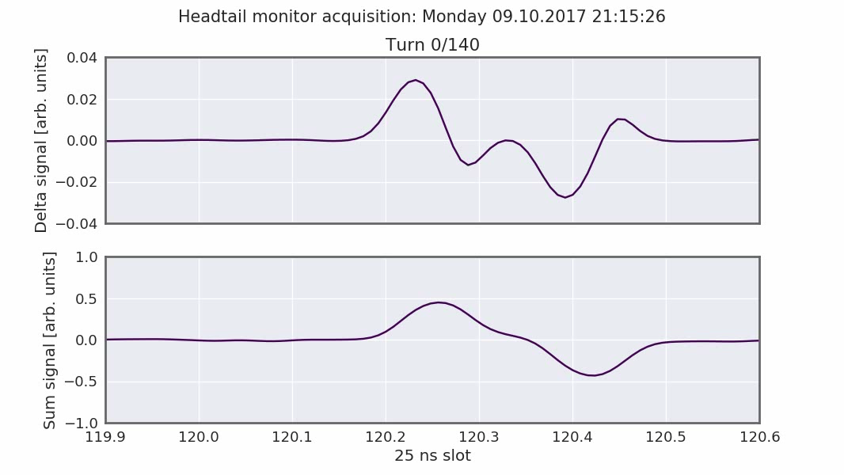
Horizontal instabilities and cure
So why not just run at zero chromaticity?
Headtail instability – mode 1
ξ Horz.

Slide 30
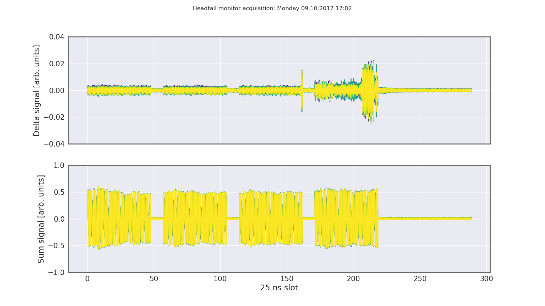
Horizontal instabilities and cure
So why not just run at zero chromaticity?
Headtail instability – mode 2
ξ Horz.

Slide 31
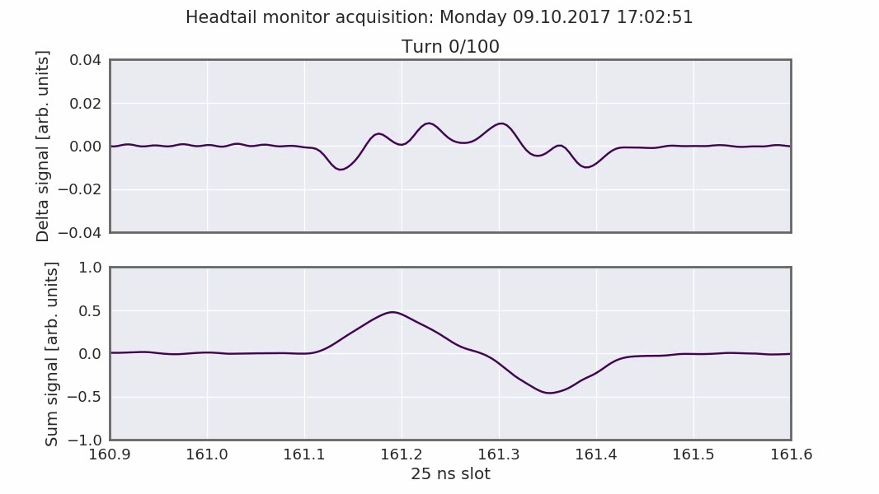
Horizontal instabilities and cure
So why not just run at zero chromaticity?
Headtail instability – mode 2
ξ Horz.

Slide 32
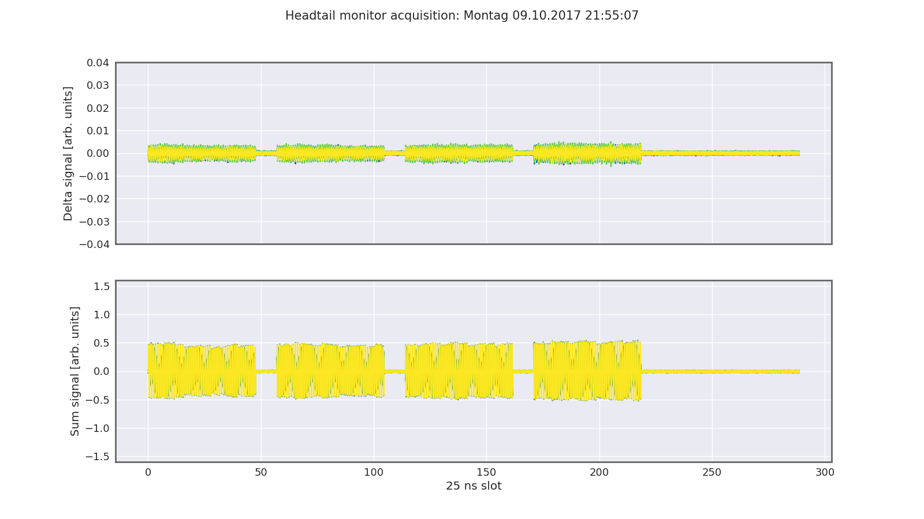
Horizontal instabilities and cure
So why not just run at zero chromaticity?
With chromaticities above ξ≈0.5 we are able to stabilize the beam
ξ Horz.

Slide 33
Impact of chromaticity on flat bottom losses
Being able to run at low chromaticities, it appears that losses can be reduced by about 40% (1.5% absolute).
Is this gain persistent?
ξ Horz.
1.5%

Slide 34
Impact of chromaticity on flat bottom losses
Being able to run at low chromaticities, it appears that losses can be reduced by about 40% (1.5% absolute).
Is this gain persistent?
During the chromaticity scans the voltage was set to 4 MV – we expect a not insignificant fraction of uncaptured particles.
We expect to see slow losses on the BCT – these will also depend on chromaticity.
Uncaptured particles are less likely to get lost at low chromaticities – they will get lost, however, at the start of the ramp. This may fake potential gains that can be achieved when moving towards low chromaticities.
ξ Horz.
1.5%

Slide 35
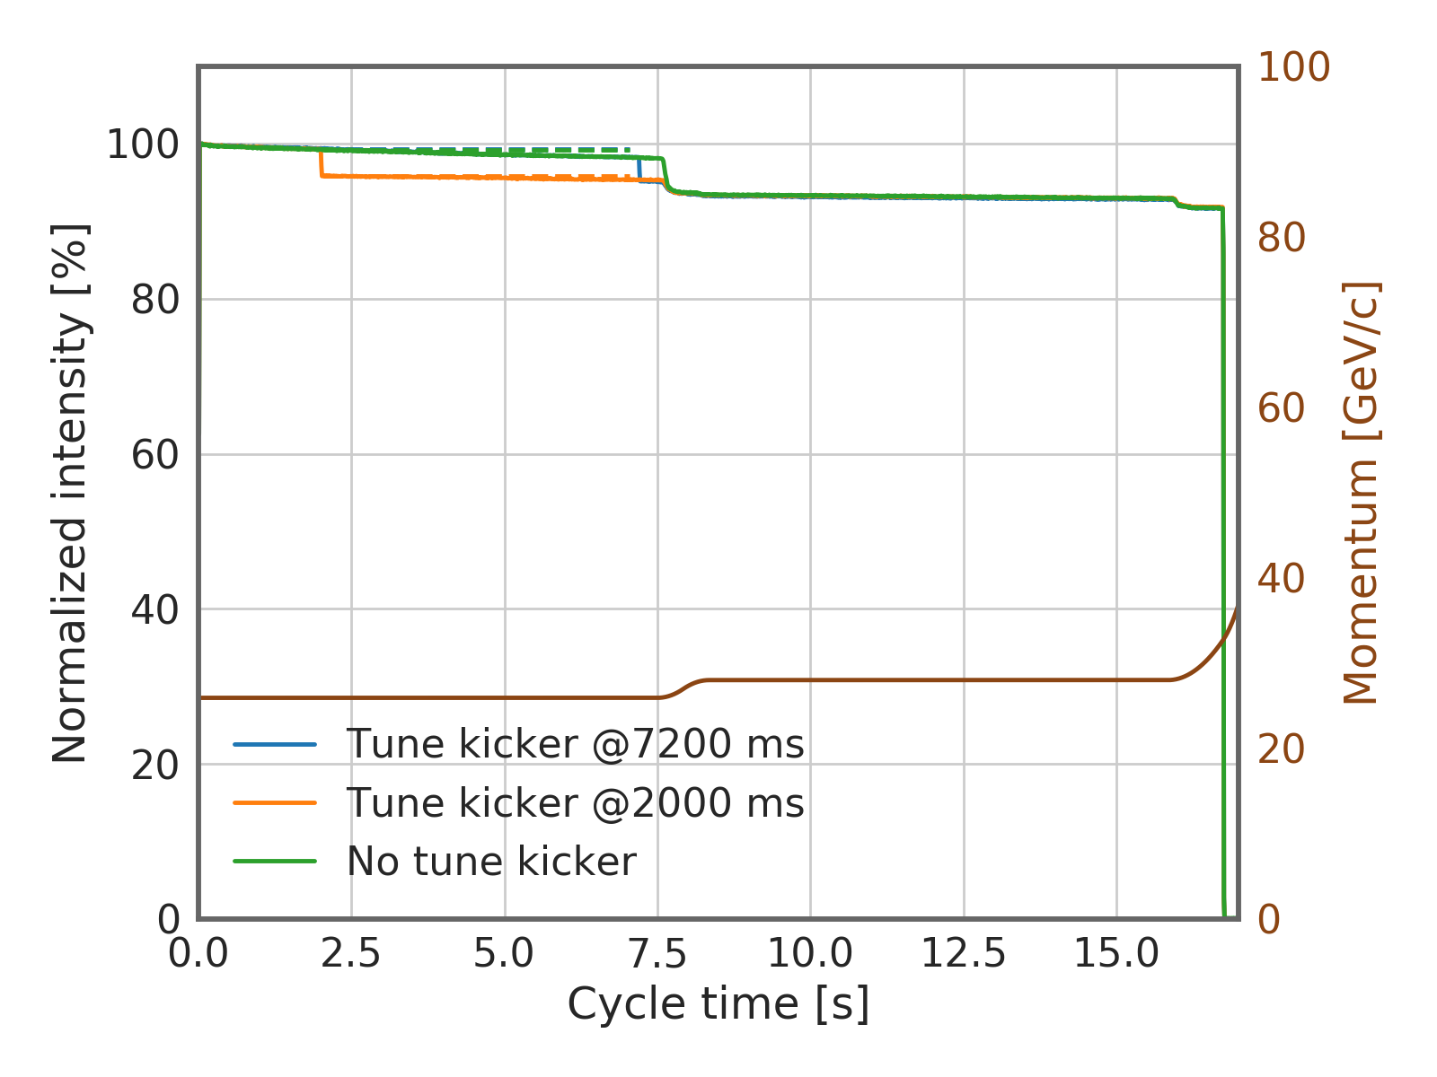
Measurements done in July 2016
Experiment with a special cycle consisting of a small ramp from 26 GeV to 28 GeV to simulate the start of ramp.
Tune kicker programmed at 2000 ms and at 7200 ms to clean uncaptured beam

Slide 36
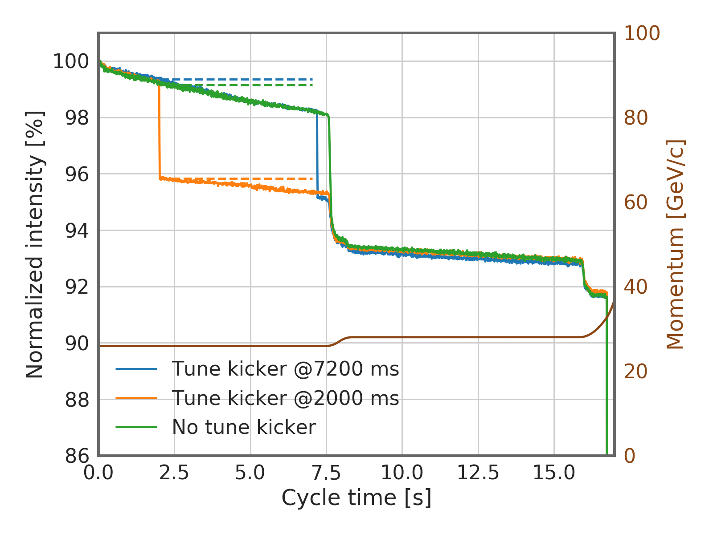
Measurements done in July 2016
Experiment with a special cycle consisting of a small ramp from 26 GeV to 28 GeV to simulate the start of ramp.
Tune kicker programmed at 2000 ms and at 7200 ms to clean uncaptured beam
After the start of the ramp, all intensities ultimately reach the same value
Particles removed or lost during the flat bottom are mainly large (longitudinal) amplitude particles which are lost anyway at the beginning of the ramp (non-adiabatic).

Slide 37
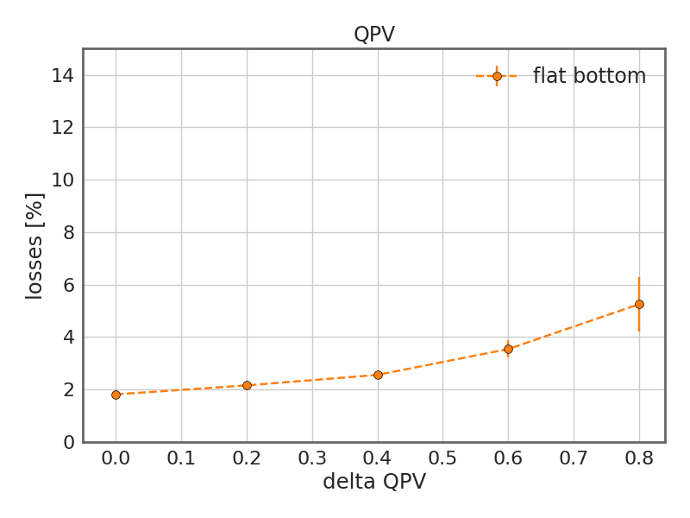
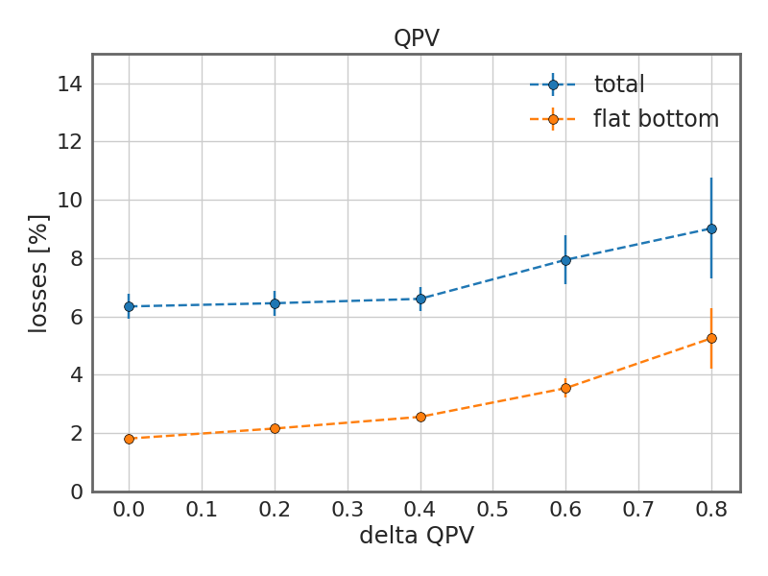
Measurements done in July 2016
Experiment with a special cycle consisting of a small ramp from 26 GeV to 28 GeV to simulate the start of ramp.
Tune kicker programmed at 2000 ms and at 7200 ms to clean uncaptured beam
After the start of the ramp, all intensities ultimately reach the same value
Losses mainly from large off-momentum particles
Losses affecting also the core
Limiting these losses during flat bottom might not actually give a net improvement after start of the ramp – as particle will be lost there in any case.

Slide 38
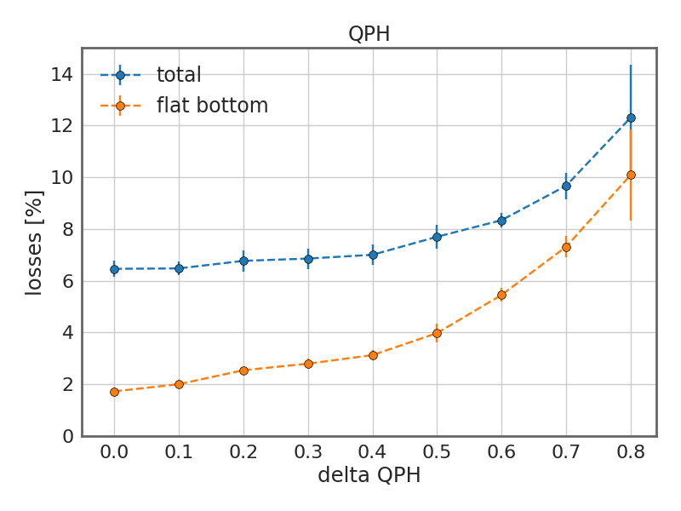
Measurements done in July 2016
Experiment with a special cycle consisting of a small ramp from 26 GeV to 28 GeV to simulate the start of ramp.
Tune kicker programmed at 2000 ms and at 7200 ms to clean uncaptured beam
After the start of the ramp, all intensities ultimately reach the same value
Limiting these losses during flat bottom might not actually give a net improvement after start of the ramp – as particle will be lost there in any case.

Slide 39
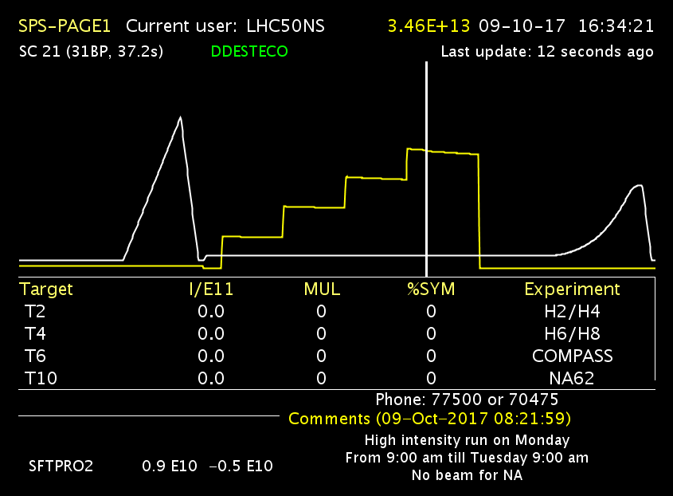
Measurements done in July 2016
Experiment with a special cycle consisting of a small ramp from 26 GeV to 28 GeV to simulate the start of ramp.
Tune kicker programmed at 2000 ms and at 7200 ms to clean uncaptured beam
After the start of the ramp, all intensities ultimately reach the same value
Possible scenario
Limiting these losses during flat bottom might not actually give a net improvement after start of the ramp – as particle will be lost there in any case.

Slide 40
Measurements done in July 2016
Experiment with a special cycle consisting of a small ramp from 26 GeV to 28 GeV to simulate the start of ramp.
Tune kicker programmed at 2000 ms and at 7200 ms to clean uncaptured beam
After the start of the ramp, all intensities ultimately reach the same value
Possible scenario
Better?
Limiting these losses during flat bottom might not actually give a net improvement after start of the ramp – as particle will be lost there in any case.
Optimizing for running at lower chromaticities will yield improved lifetimes at flat bottom.
Whether or not this will ultimately lead to more beam at flat top depends sensitively on the amount of large off-momentum particles and uncaptured beam.

Slide 41
Spotlight – orbit optimization
Orbit optimization by implementation of local bumps for high intensity beams.
Standard 25 ns beam – 1 x 72 bunches

Slide 42
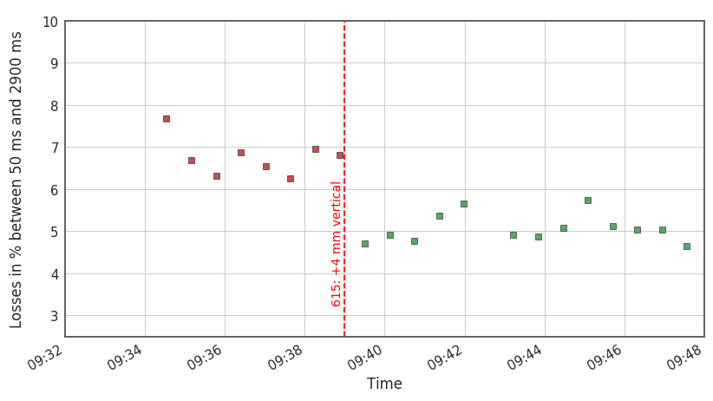
Spotlight – orbit optimization
Local orbit bumps lead to an improved transmission in locations with aperture bottle-necks.

Slide 43
Conclusions
The operational working point is already close to an optimum.
Off-momentum particles or uncaptured beam are prone to incoherent losses at flat-bottom.
For high intensity (>1.8e11 p/b) the chromaticity needs to be high around 0.5 in the horizontal plane to avoid instabilities.
Running at lower chromaticities will reduce flat-bottom losses but the ultimate gain will depend sensitively on the amount and distribution of off-momentum particles and uncaptured beam.
Slightly improved transmission after orbit bumps in locations with aperture bottle-necks.

Slide 45
Transfer overview – losses overview; with studies, trims inside
Orbit → aperture limitations, momentum acceptance etc. with reference to Verena’s talk
WP → tune spread, bunch-by-bunch tune shifts with SC and Michele’s plots
Chromaticity → impact on beam stability – lifetime plots, trims, also with octupoles; show second order chromaticity effects from octupoles, warn about large off-momentum particles and uncaptured beam, show examples from voltage scan with FBCT and potential no-gains from chroma improvement. Studies scanning chroma with kicking the uncaptured beam and ramping will help.
Conclude with gains per effect, optimization/mitigation methods and lmitations/warnings.

Slide 46
Chromaticity and non-linear model
Chromaticity will lead to a detuning of individual off-momentum particles
Due to the multipole errors in dipoles, the chromatic detuning is non-linear
Measurement of the non-linear chromaticity allow to deduce the tune footprint of these off-momentum/uncaptured particles (without other incoherent tune shift)
In a qualitative view we focus on large off-momentum/uncaptured particles
We neglect incoherent tune shifts from quadrupolar wakes and space charge
This will be a recurring view and we will see later why this makes sense

Slide 47
Spotlight – coherent effects and incoherent losses

Slide 48
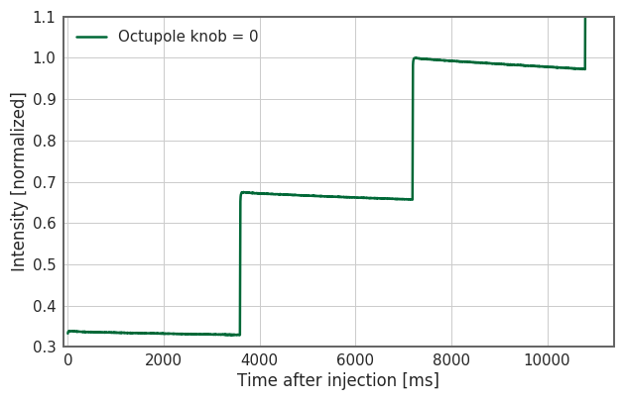
Spotlight – coherent effects and incoherent losses

Slide 49
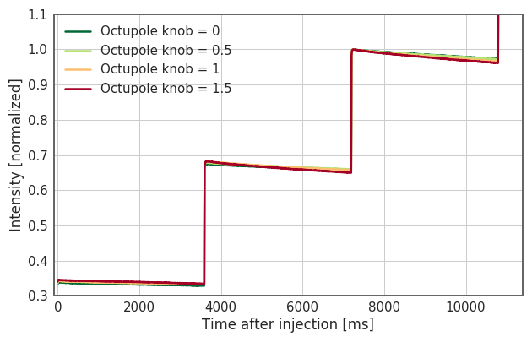
Spotlight – coherent effects and incoherent losses

Slide 50
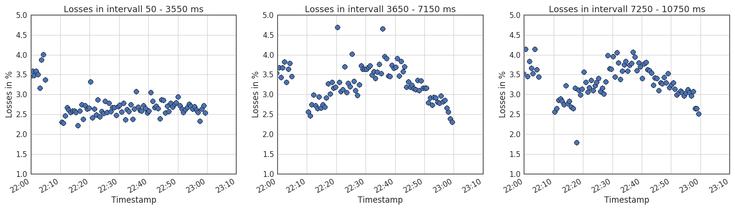
Spotlight – coherent effects and incoherent losses
Looking at losses during fixed interval (3500 ms) after each injection

Slide 51
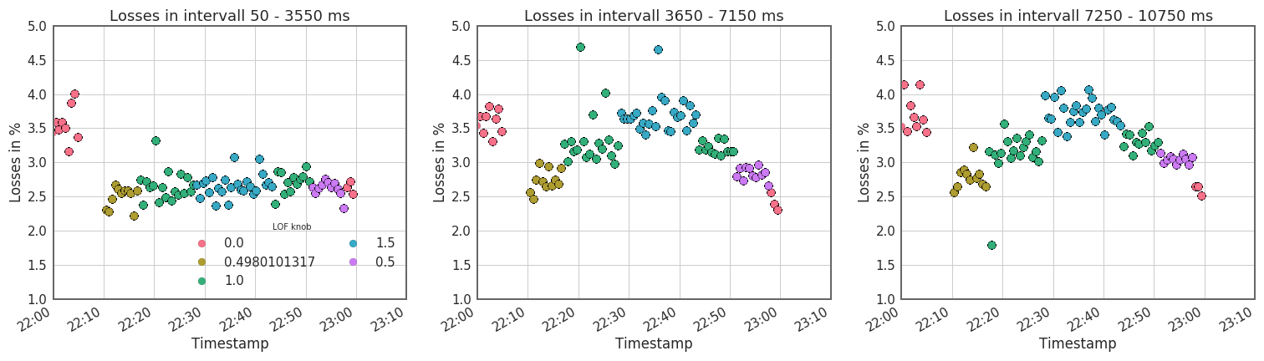
Spotlight – coherent effects and incoherent losses
Looking at losses during fixed interval (3500 ms) after each injection
Clear correlation with chromaticity visible

Slide 52
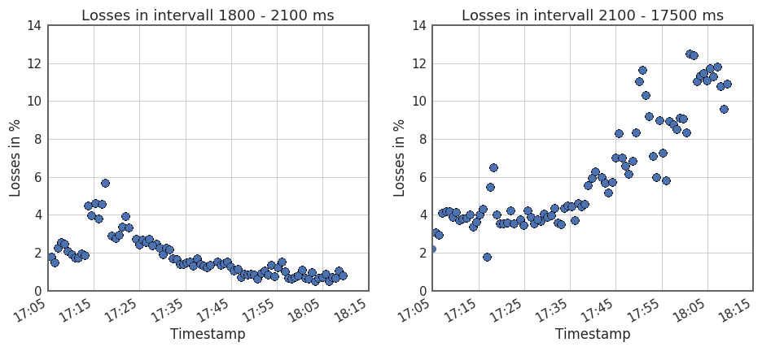
Focus voltage scan

Slide 53
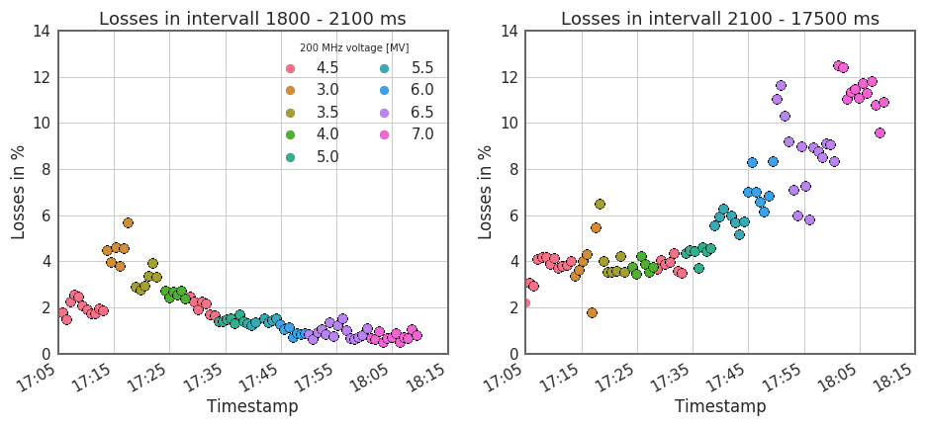
Focus voltage scan

Slide 54
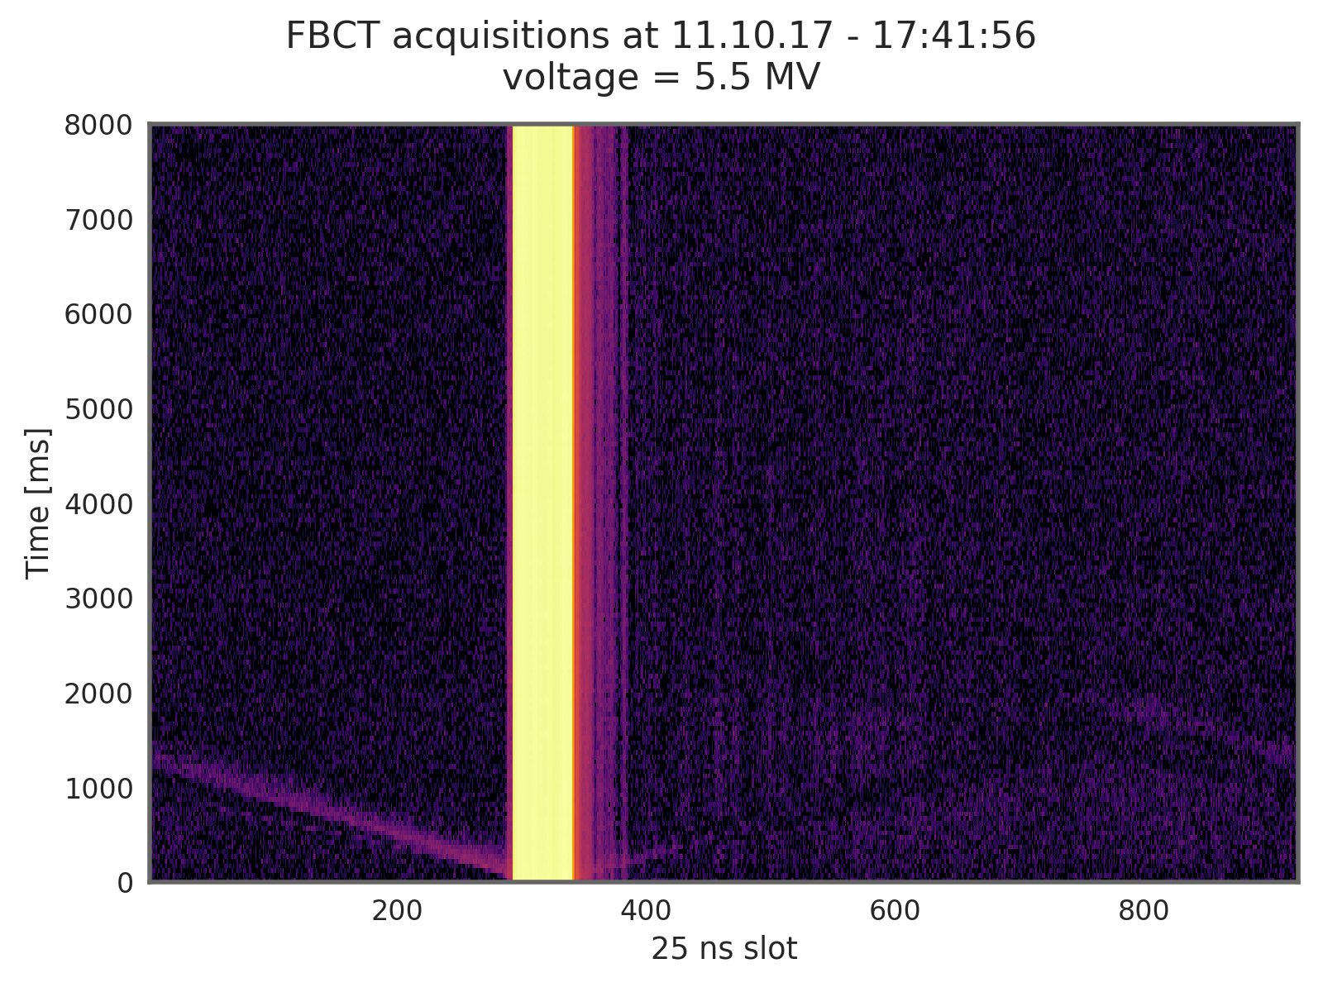
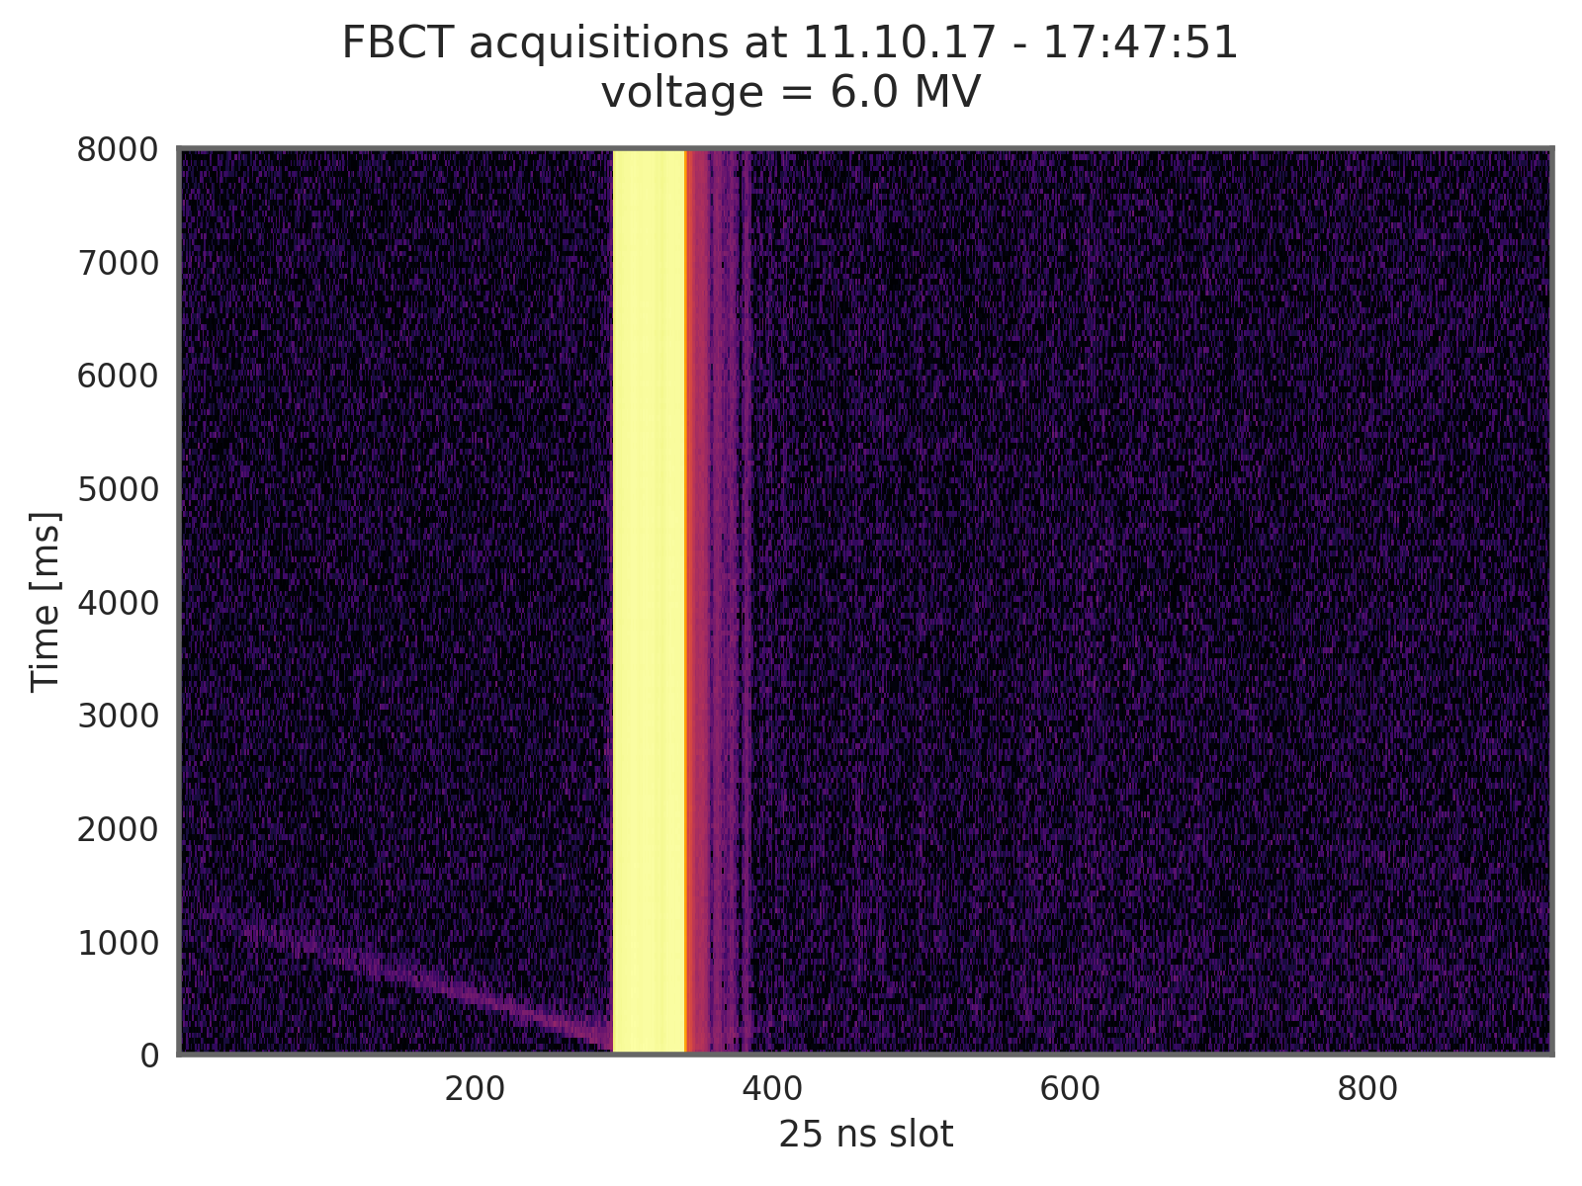
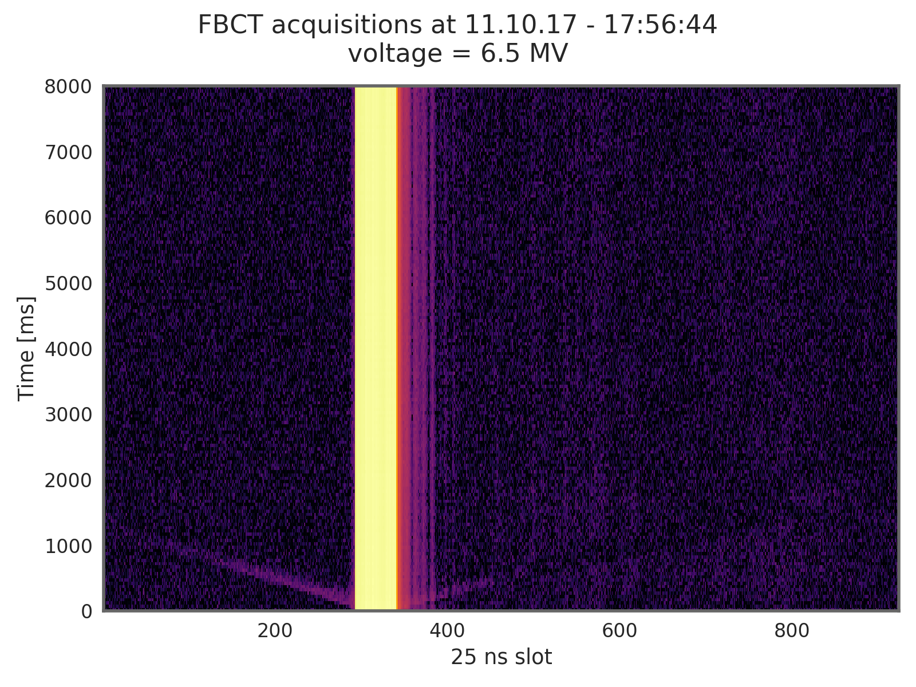
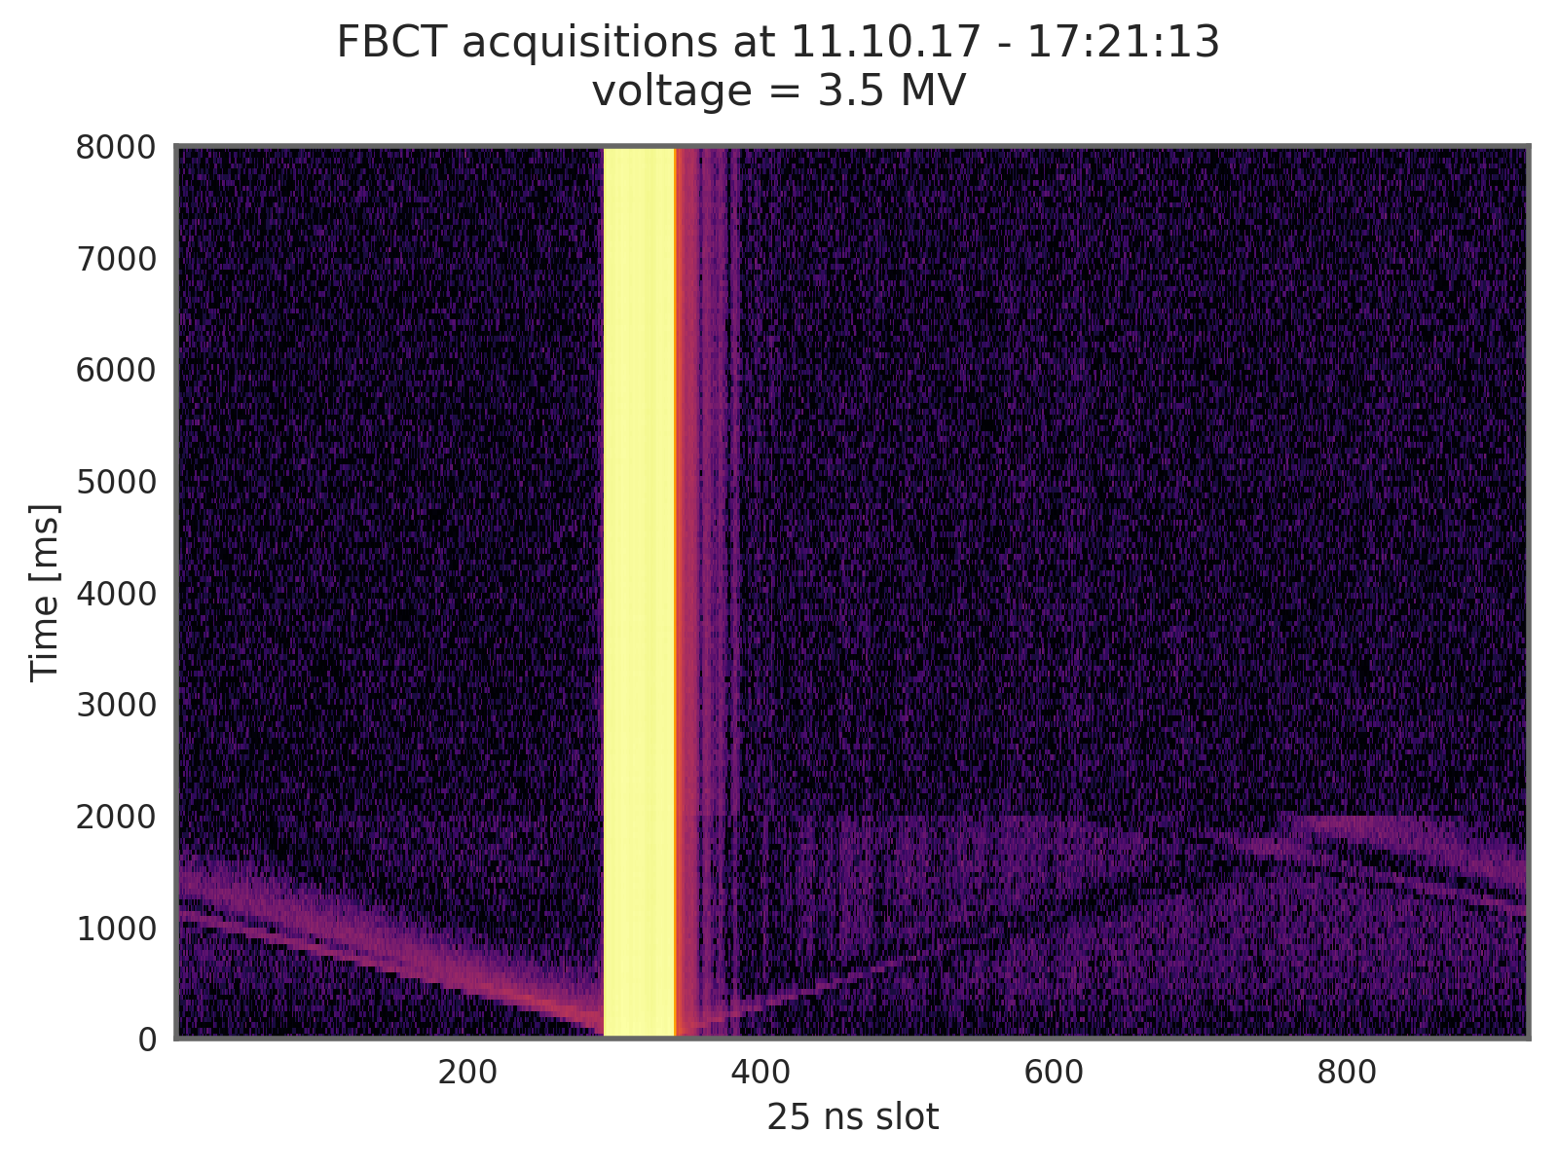
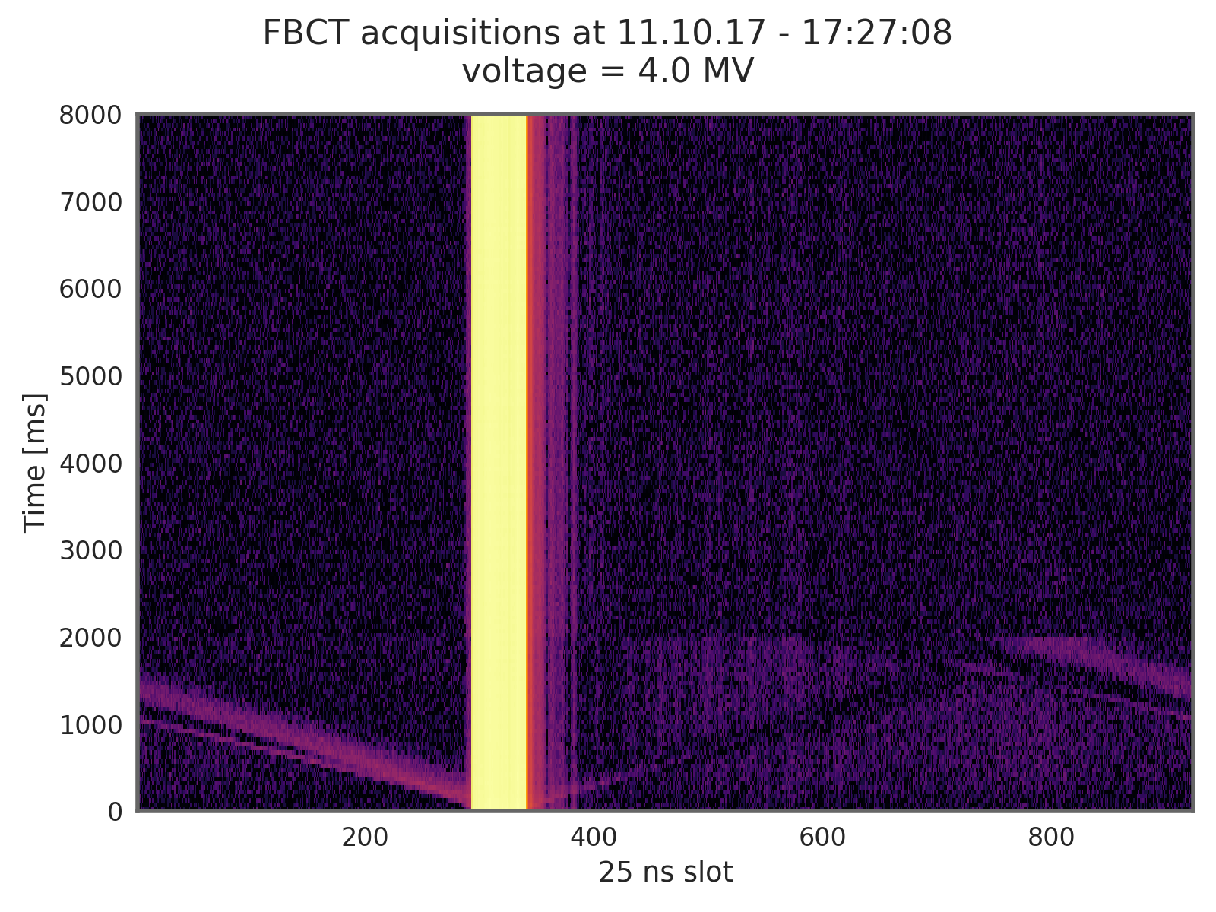

Uncaptured beam seen with the FBCT

Slide 55
Uncaptured beam seen with the FBCT
During the chromaticity scans the voltage was set to XX?? – we expect quite a fraction of uncaptured particles

Slide 56
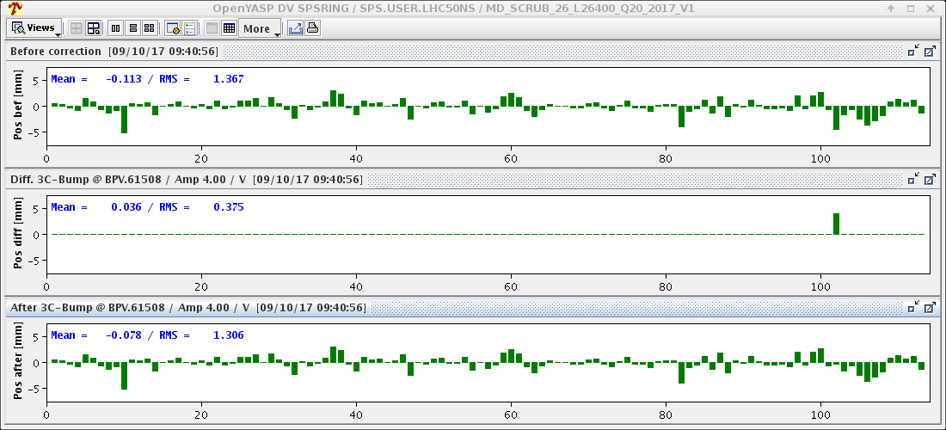
Spotlight – orbit optimization

Slide 57
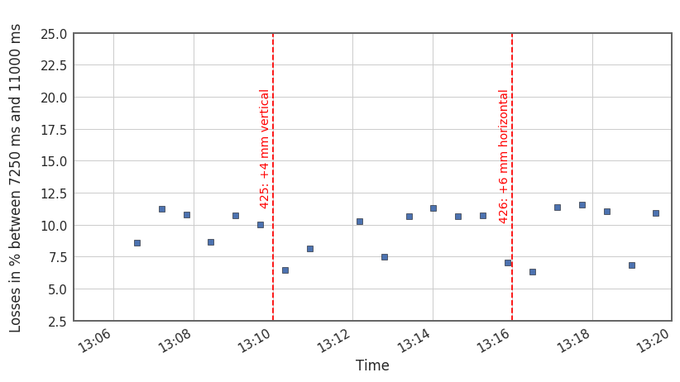
Spotlight – orbit optimization

Slide 58
Spotlight – orbit optimization
Orbit effects in conjunction with (more global) aperture limitations – will be discussed later!

