Slide 1
Momentum Aperture and Flat Bottom Losses
H. Bartosik, T. Bohl, K. Cornelis, P. Cruikshank, B. Goddard, V. Kain, K. Li, E. Shaposhnikova, M. Schwarz, J. Repond, G. Papotti, C. Pasquino, F. Velotti

Slide 2
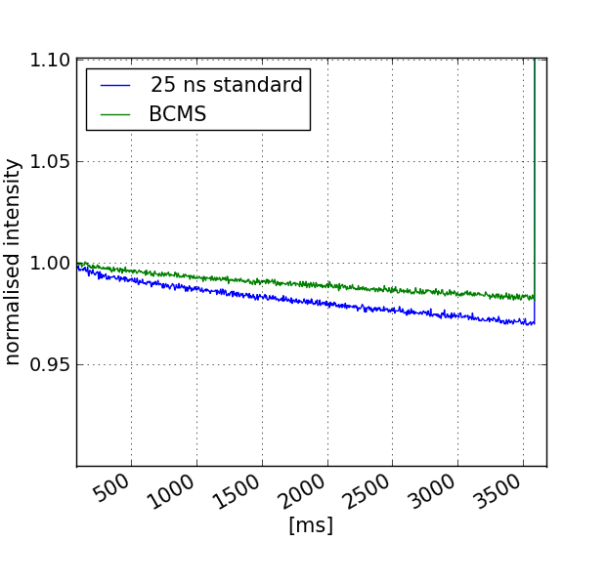
Observation
High intensity run 2017 in the SPS
  Up 2 x 10¹¹ p⁺ per bunch
  Comparison 25 ns standard (48 bunches) with BCMS
  Standard ε ~ 4 μm, BCMS ε ~ 2 μm
  Same longitudinal emittances
Lower losses with lower emittance
  ~ 5 % @ 11 s for BCMS
  ~ 7 % @ 11 s for standard

Slide 3
Theoretical aperture bottleneck with Q20
Beam envelope for Q20 with 2 um emittance
Aperture tight at QD locations with large dispersion
  Fits loss pattern

Slide 4
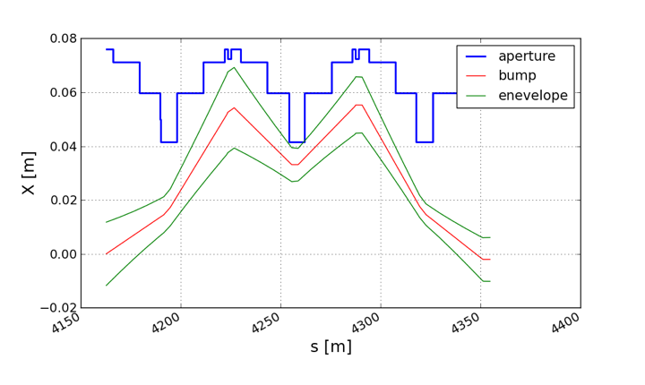
Measurement of mechanical aperture at QDs in H
Measured at all QDs except locations *17 and *19
Measurement at 14 GeV, Q26 with 4C bump
Interpolate orbit at QD location and correct measured max. bump amplitude

Slide 5
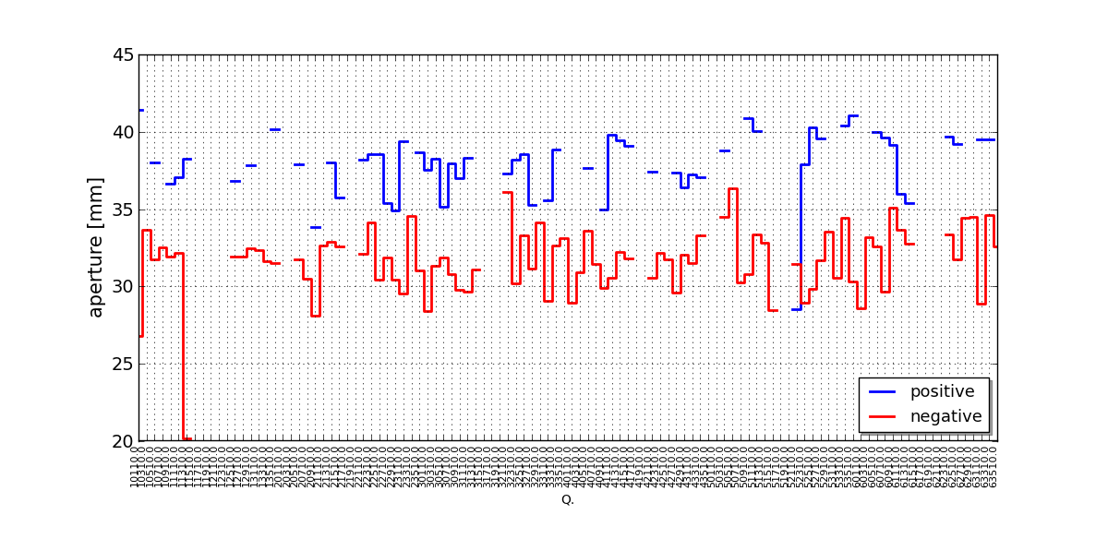
Result in mm
Systematically smaller aperture towards the inside than towards the outside. Aperture on paper 41.5 mm

Slide 6
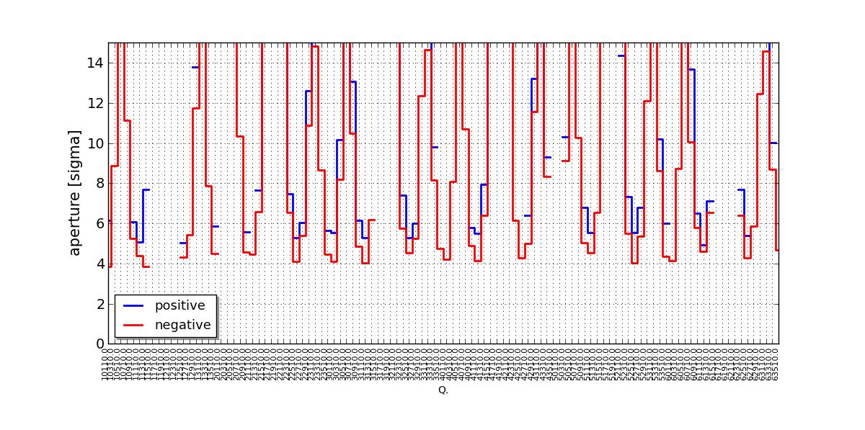
Result in sigma in Q20
2 um emittance, 2 mm orbit error, 1.5e-3 momentum spread
Aperture: +4.9 σ/-3.8 σ

Slide 7
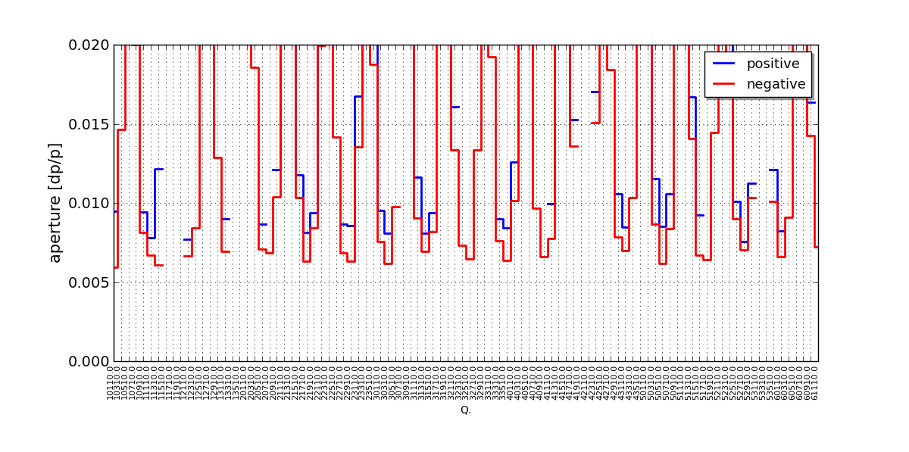
Result in dp/p in Q20
What is radial steering limit?
Aperture: +0.76 % / -0.59 %

Slide 8
Compare to momentum aperture measurement with radial steering
Assuming 2 mm orbit error
Aperture measurement:
+0.76 % / -0.59 %

Slide 9
Probable explanation of asymmetric momentum aperture
Transition MBB – SSS(QD): MBB is aligned 4.5 mm to outside
topview
Center of flange aligned with MBB and not with QD
Transition occurs in bellows
→ miss 5.3 +/- 2 mm on the inside of flange….systematically
Notes:
Drawing SPSLGSSS0038

Slide 10
MBB – SSS (QD) transition
QD
MBB

Slide 11
Comparison of different optics
Given the aperture
  Assume 2 um emittance, 1.5e-3 dp/p, 2 mm orbit
Optics | dp/p [%] | Aperture [σ]
Q20 | +0.76 / -0.59 | +4.9 / - 3.8
Q22 | +0.9 / - 0.73 | + 5.8 / - 4.8
Q26 | +1.7 / - 1.3 | +10.5 / - 8.3

Slide 12
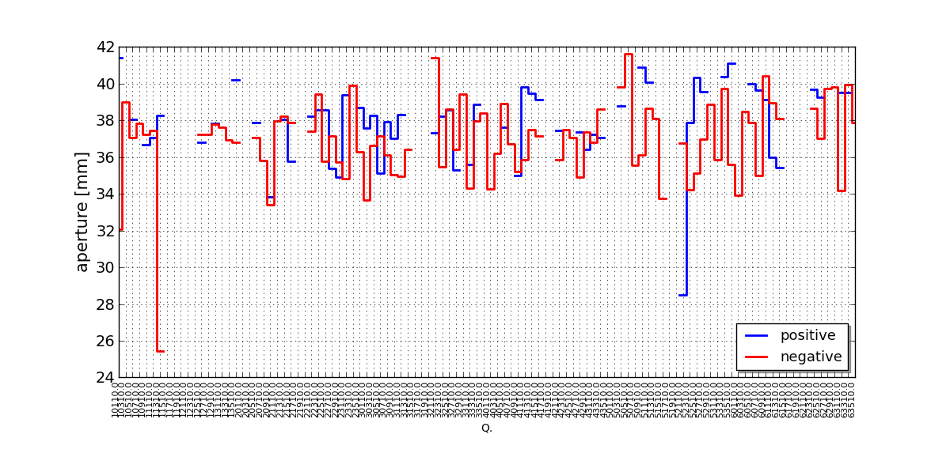
Measured aperture corrected by 5.3 mm
Difference between negative and positive aperture less pronounced
Possibly a few locations with pumping port shield flange on QD-MBB transition installed wrongly
Would gain roughly 1 σ in aperture

Slide 13
Locations to increase aperture
~ 26 locations for LS2
Reason for cutoff: QF aperture not larger than 5 σ
5 σ cutoff

Slide 14
aperture increase – impact on Transmission

Slide 15
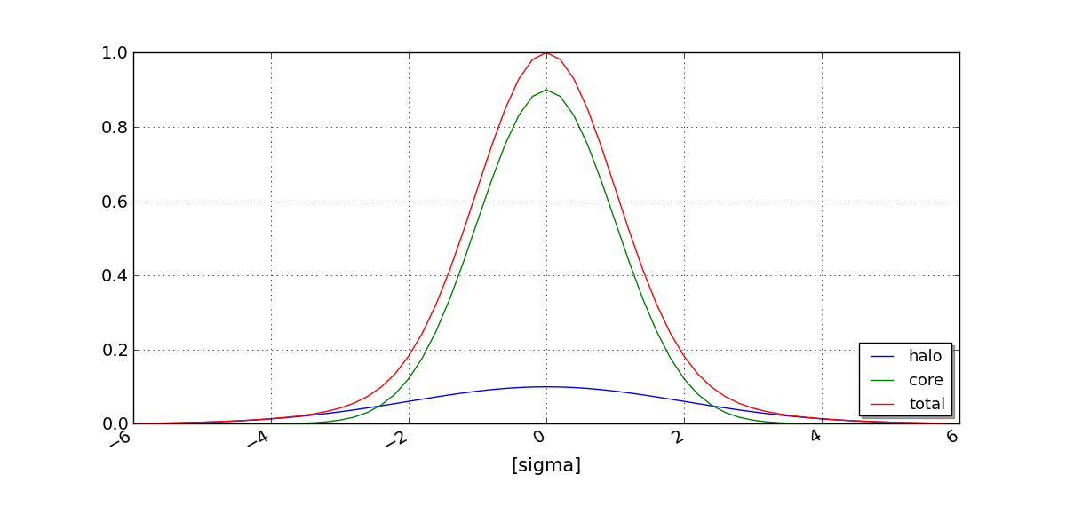
Diffusion
Ideally could have used Q22 – need comparable dataset Q20/Q22
Thus : Assume linear diffusion process in the horizontal plane from I₁ to I₂ in Double Gaussian
Use as input: 1.9e+11 ppb; 48 bunches: ε = 4 um for standard, ε = 2 um for BCMS
Larger losses for 25 ns standard than for BCMS
  ~ 5 % for BCMS, ~ 7 % for standard
core
halo

Slide 16
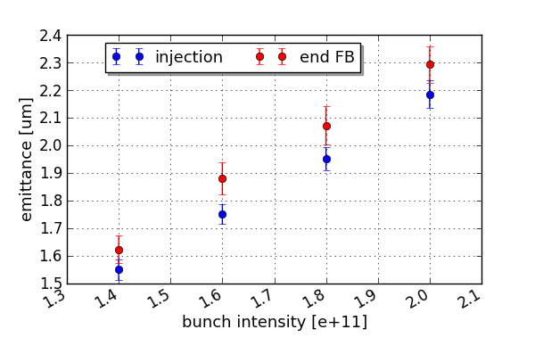
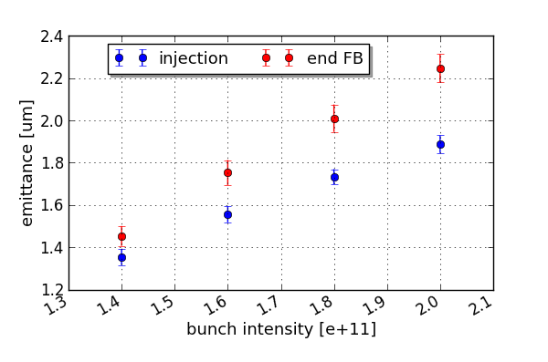
What about emittance growth?
Measurements for BCMS
Corresponds to < 1 % of loss
Horizontal
Vertical

Slide 17
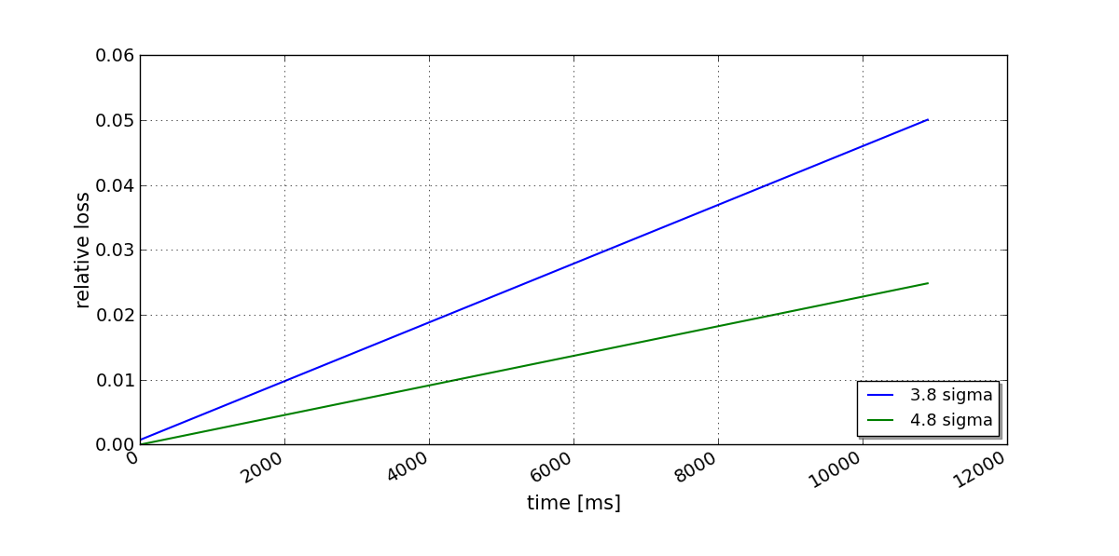
Assumption of diffusion to calculate loss improvement with larger aperture
For a given assumption on tail distribution and diffusion rate
  Adjusted such to end up with 5 % loss @ 11 s with 2 um emittance
  The gain for larger aperture depends on tail distribution and diffusion rate

Slide 18
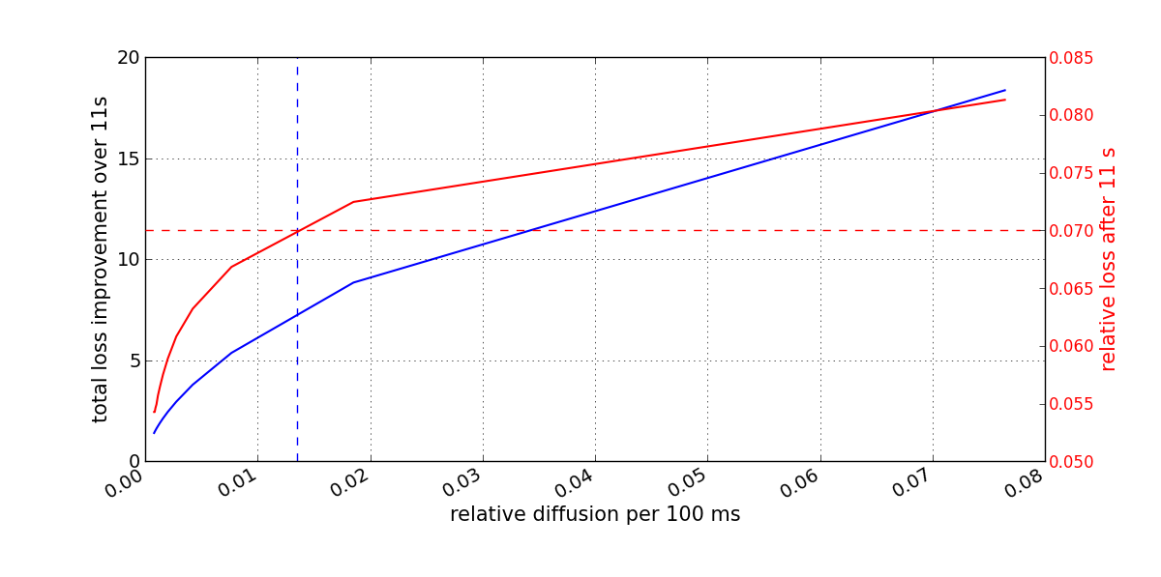
Assumption of diffusion to calculate loss improvement with larger aperture
Can fix diffusion rate and tail distribution: needs to give 7 % for ε = 4 um
Blue curve gives loss improvement over 11 s as function of diffusion rate for 3.8 σ → 4.8 σ aperture increase
> factor 5 improvement for 2 um emittance
losses for 4 um emittance

Slide 19
Scraping MDs

Slide 20
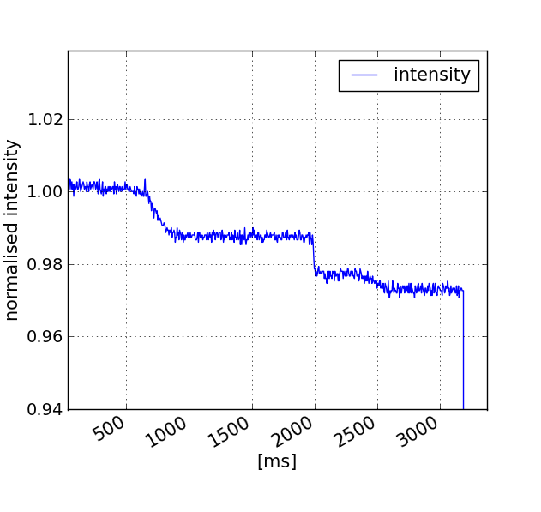
Nature of diffusion? Scraping measurements
MD 24th of November
  Q22, 1.5e+11 p+ per bunch, BCMS
  Establish bump at high dispersion QD location for 200 ms and remove it again
  Repeat at later time: bump at same amplitude
First bump cleans
Losses from second (third) bump from diffusion
bump 1
bump 3
Q kick @ empty buckets
Example: function for H corrector in bump

Slide 21
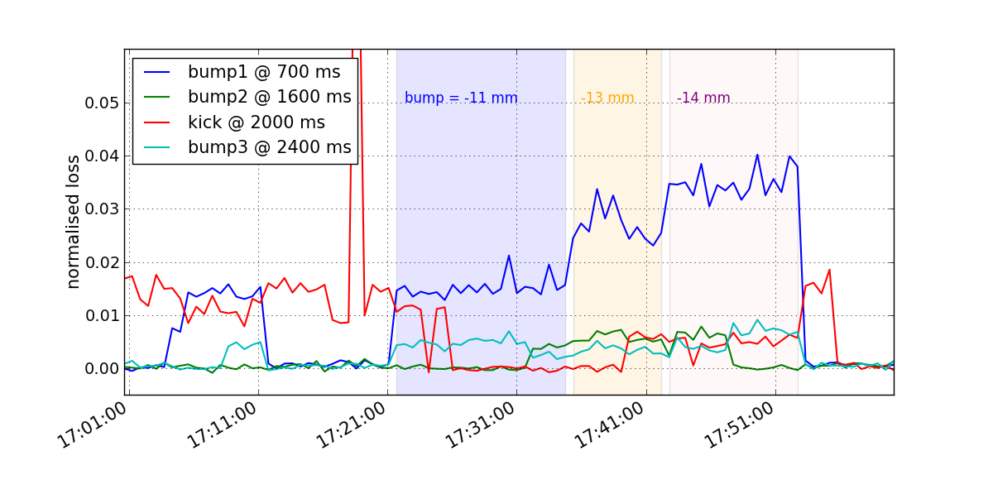
Results of scraping MD
Particle amplitudes are growing slowly with time
The losses at bump 3 are not affected by Q kick removal of uncaptured beam
Q kick losses reduced by first bump

Slide 22
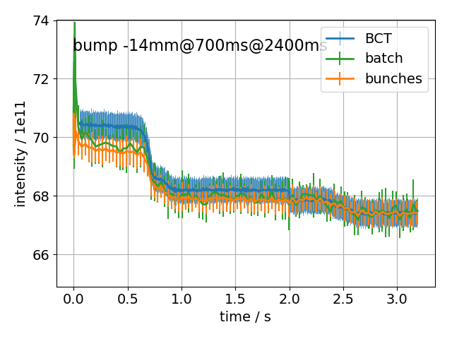
Results of scraping MD
Example of measurements of longitudinal profiles during scraping MD
  Comparison of:
    Intensity integrated over bunch
    Intensity integrated over batch
    Intensity measured by BCT
Beam inside buckets is scraped
tune kick

Slide 23
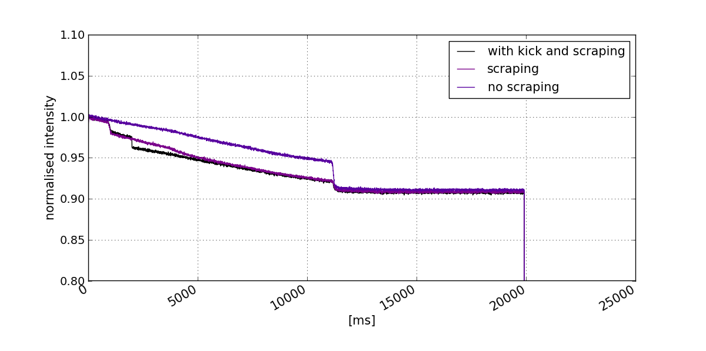
However…
MD on 8/11/2017: bump x = - 6.8 mm at QD.325 from 550 ms to end flat bottom
  Bump and loss at QD.325 did not change overall losses
Flat bottom losses due to uncaptured beam and large amplitude dp/p particles??
48 bunches, BCMS, 1.7e+11 ppb
Bump start
acceleration
Tune kick @ empty buckets

Slide 24
Conclusion
The horizontal aperture is only ~3.8 σ for Q20 and beams of 2 um emittance
  Aperture limitation due to vacuum flanges at the MBB-QD transition
Increase of MBB-QD vacuum flange aperture will reduce losses at flat bottom
  26 locations are proposed for LS2: estimate 7k CHF per location
Benefit for the overall transmission cannot be guaranteed, as the nature of the lost particles is not fully understood
  Particles with large dp/p from inside or outside of bucket?
  More studies with Q22 required where there is ~1 σ more aperture
An increase of the horizontal aperture is nevertheless in our interest
  Will give margin for voltage and emittance
  Now there is (virtually) none for Q20…

Slide 25
EXTRA slides

Slide 26
Possible explanation of asymmetric momentum aperture
Transition QD-MBB
Pumping port with asymmetric shielding for 4.5 mm MBB offset

Slide 27
QD – MBB transition
Pumping port shield
Sideview
Centered around QD axis
Nominal case: asymmetry of design compensates for 4.5 mm shift
Problem if installed the wrong way: then 9 mm error missing on inside.
Topview

