Slide 1
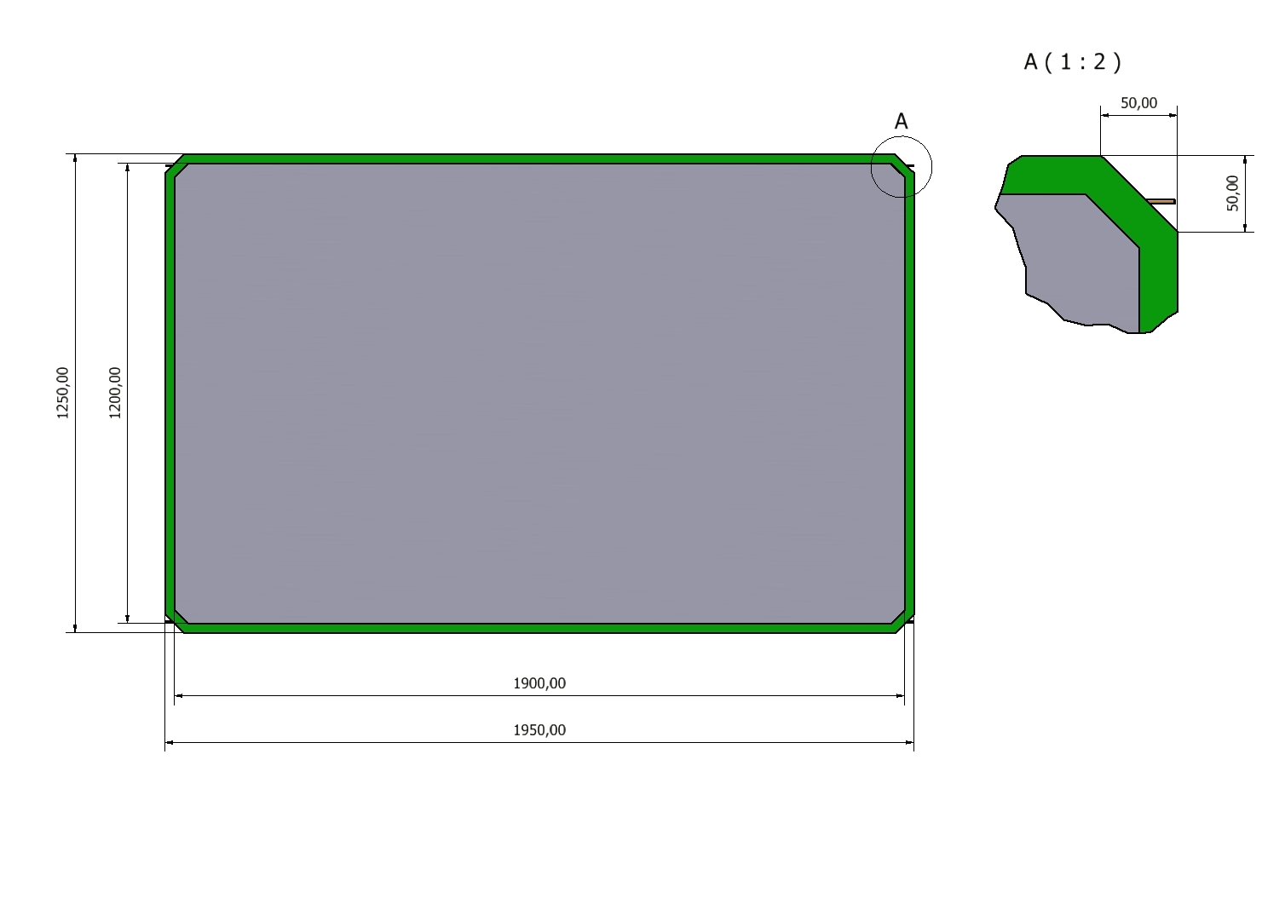
RPC GAP

Slide 2
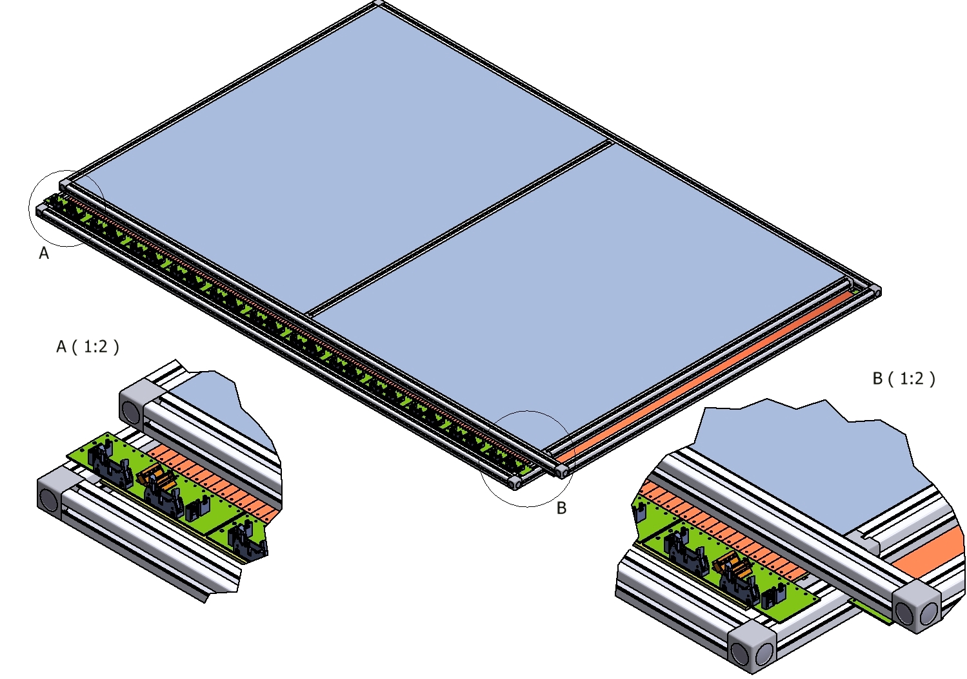
Stiffener Panel
Aluminum Honeycomb
30 mm thick
Standard BOSCH Tubular
Aluminum Frame
Preamplifiers FERICC 11
Cards

Slide 3
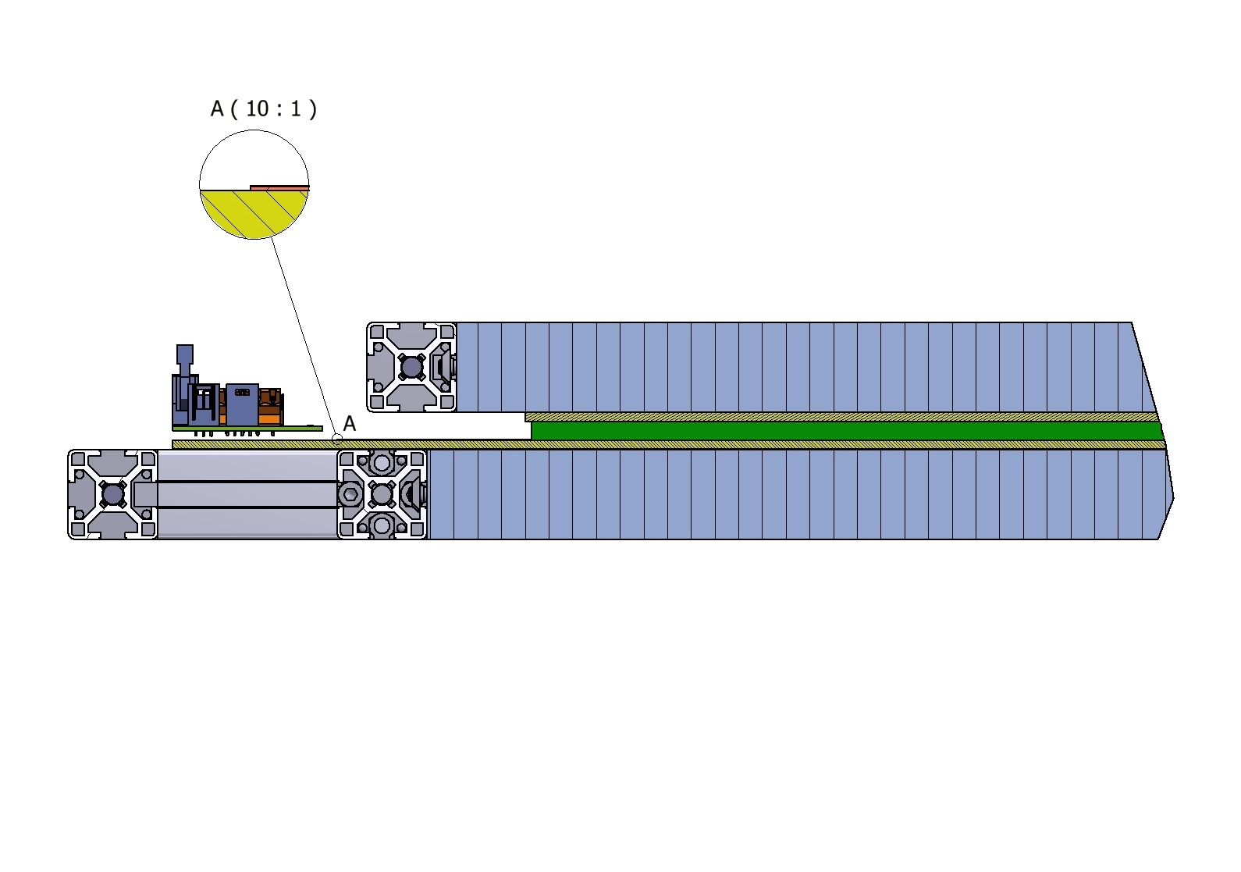
30 mm stiffener Al panel
*0,21 mm +3mm + 0,21 mm
Cu Strip + Foam + Cu GND
6 mm GAP
*ALICE STRIP foils are 0,19 mm Mylar coated with 0,020 mm copper
R. Arnaldi et al. / Nuclear Physics B (Proc. Suppl.) 158 (2006) 83–86

Slide 4
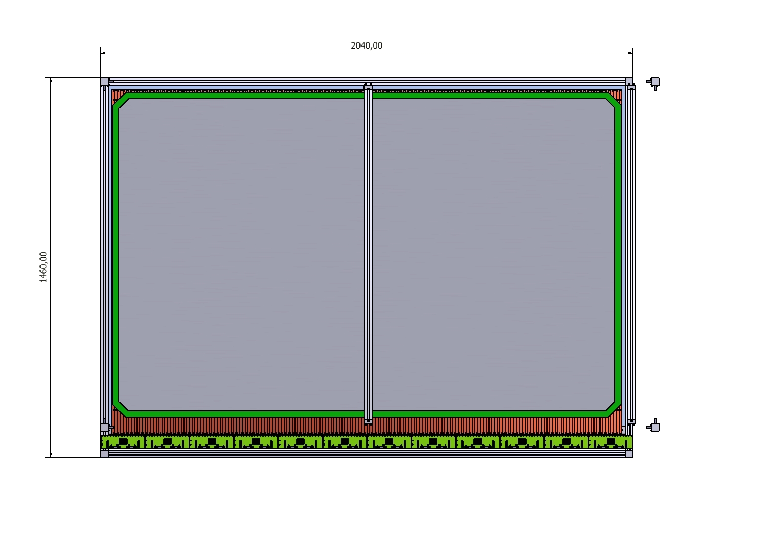

Slide 5
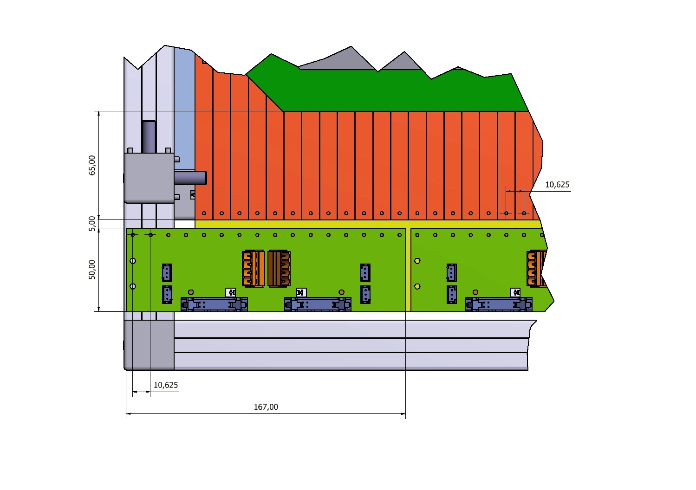
To be soldered
with a short wire
To be soldered with a braided wire to
ground on back of strip plane

Slide 6
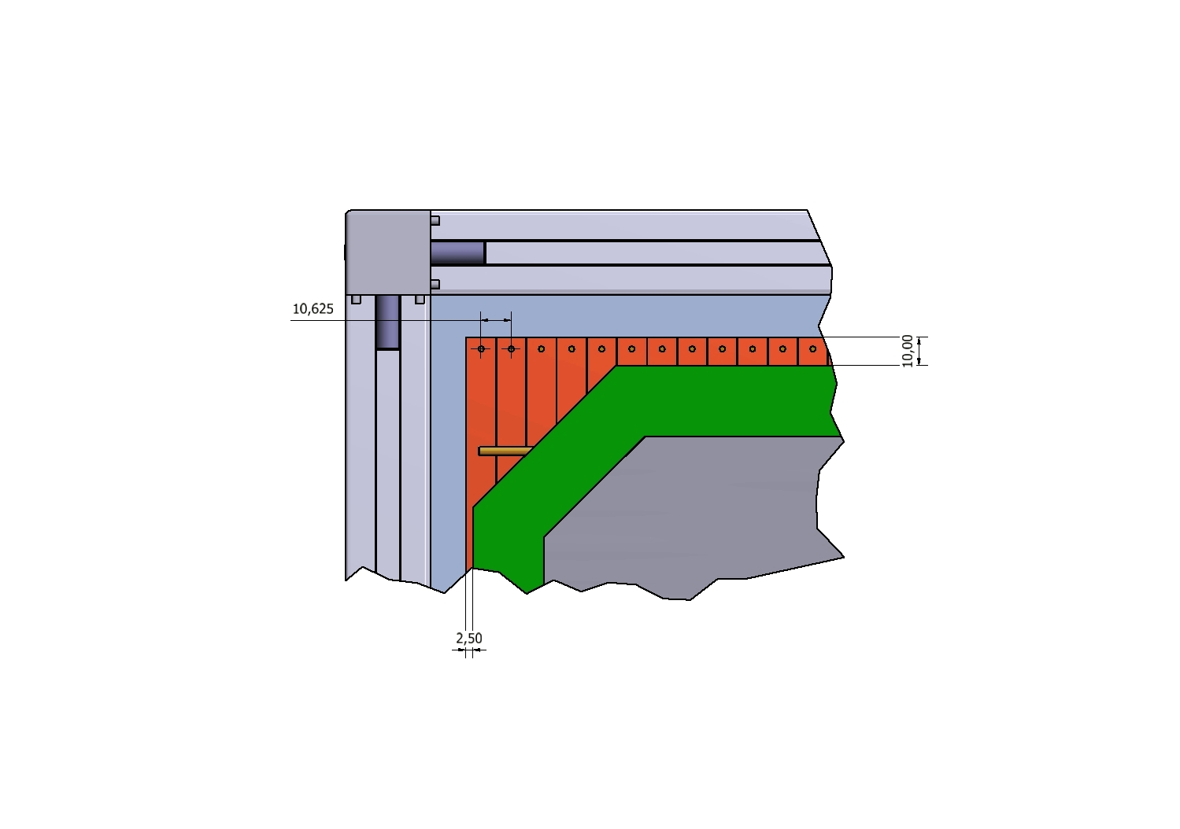

Termination resistor 50 Ohm

Slide 7
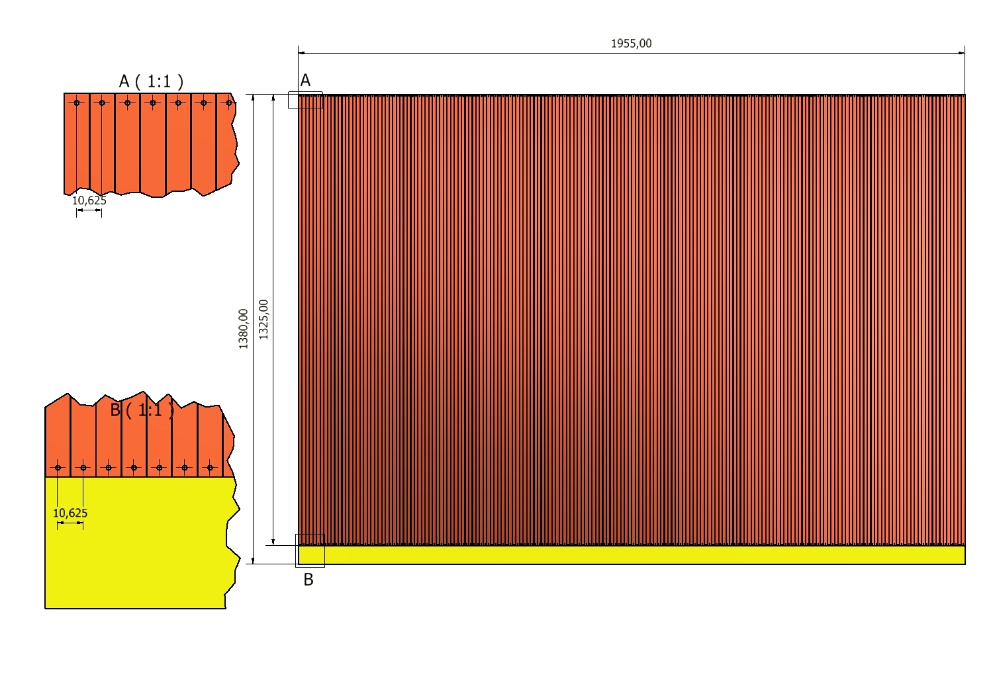


Slide 8
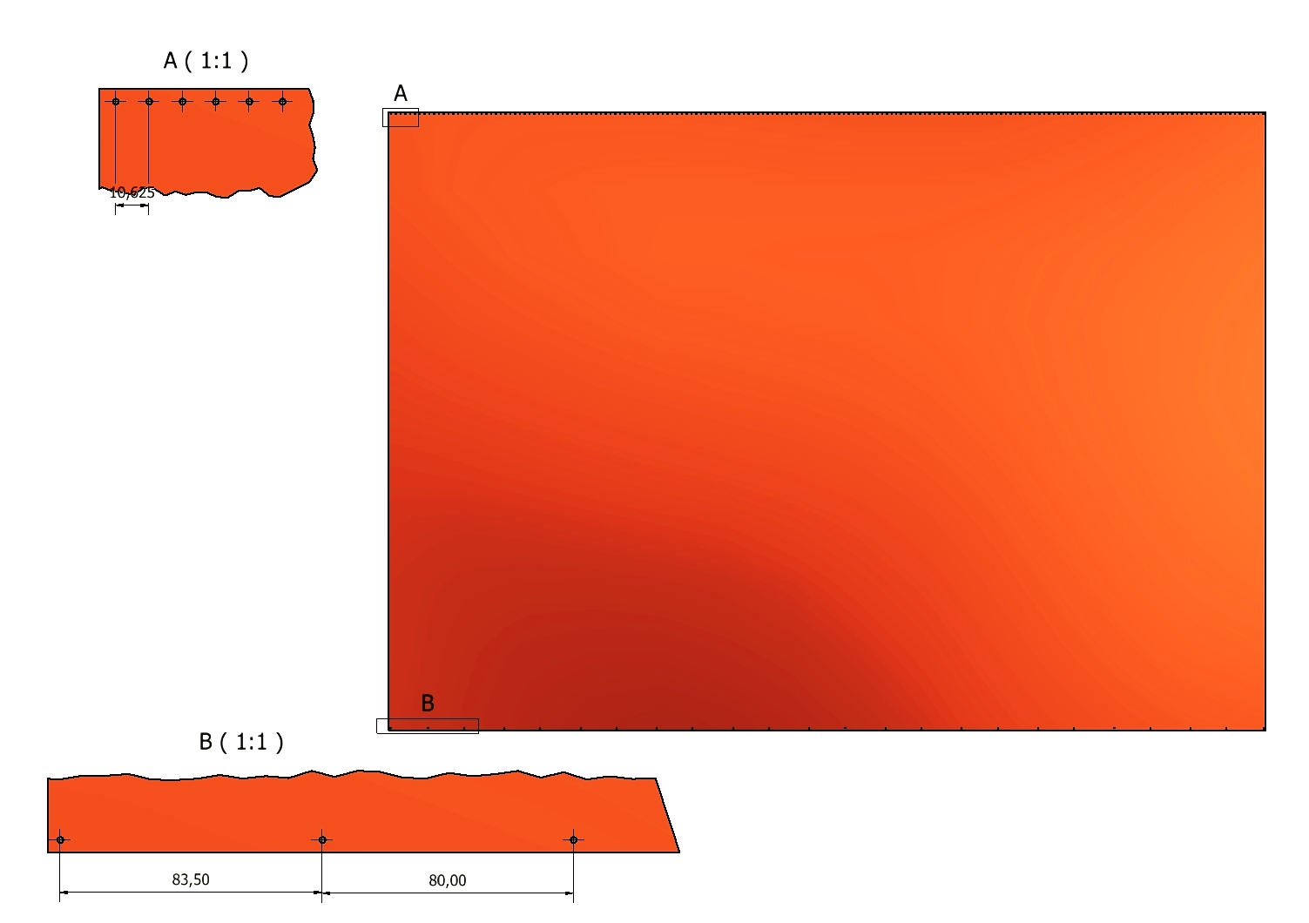

Slide 9
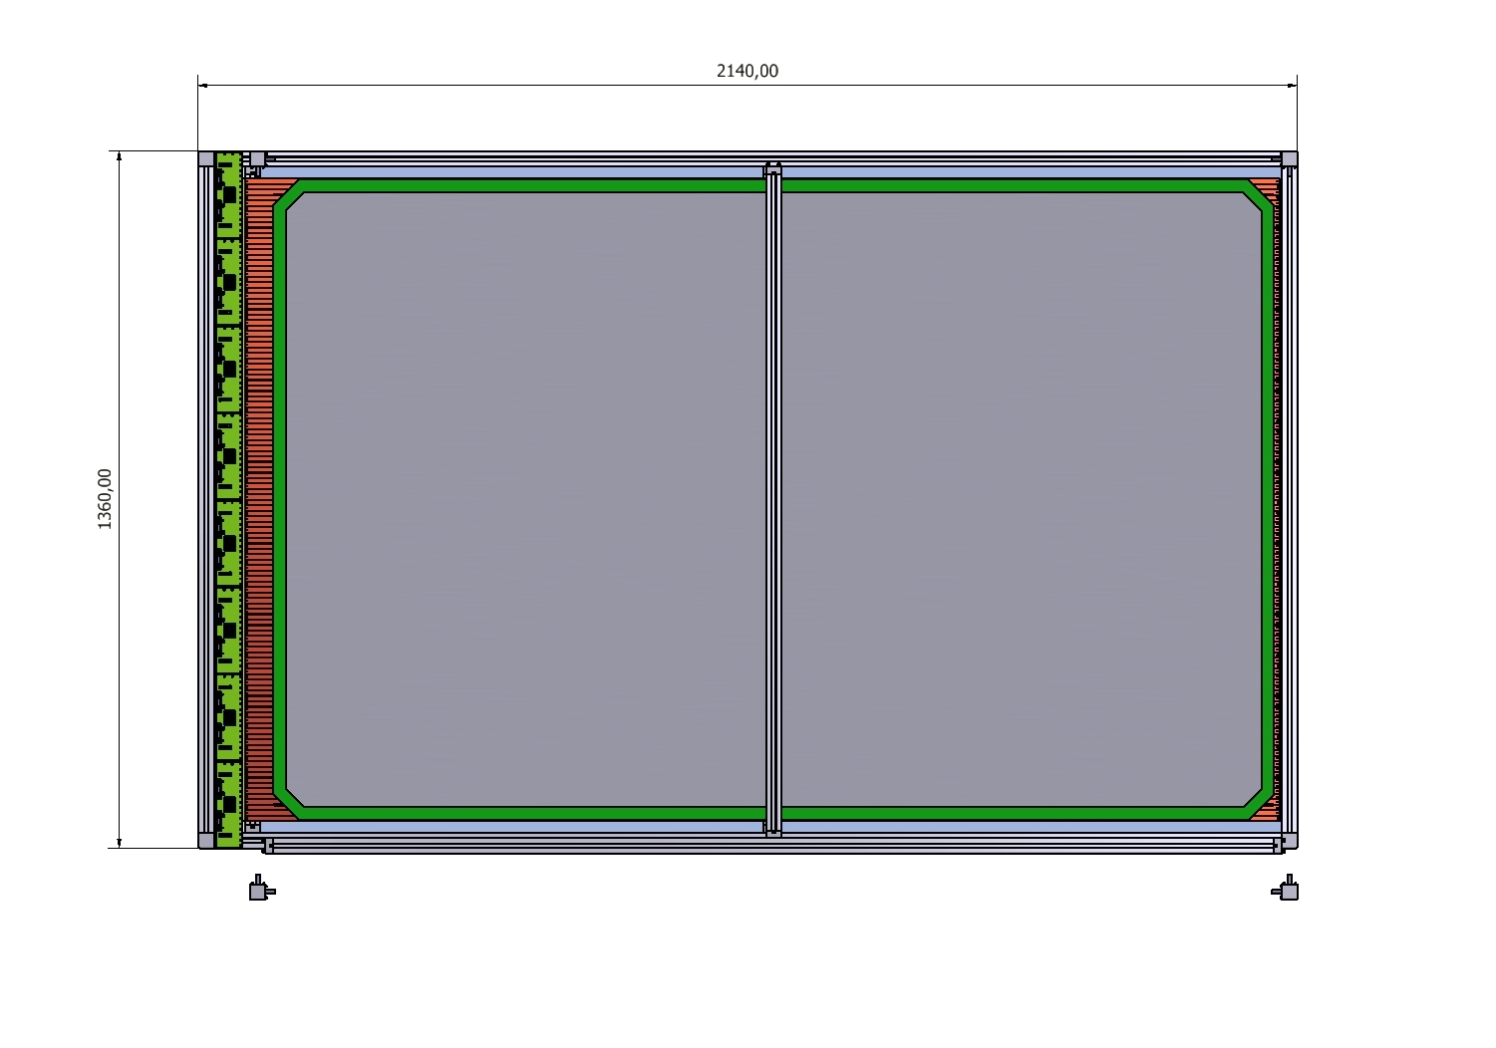

Slide 10
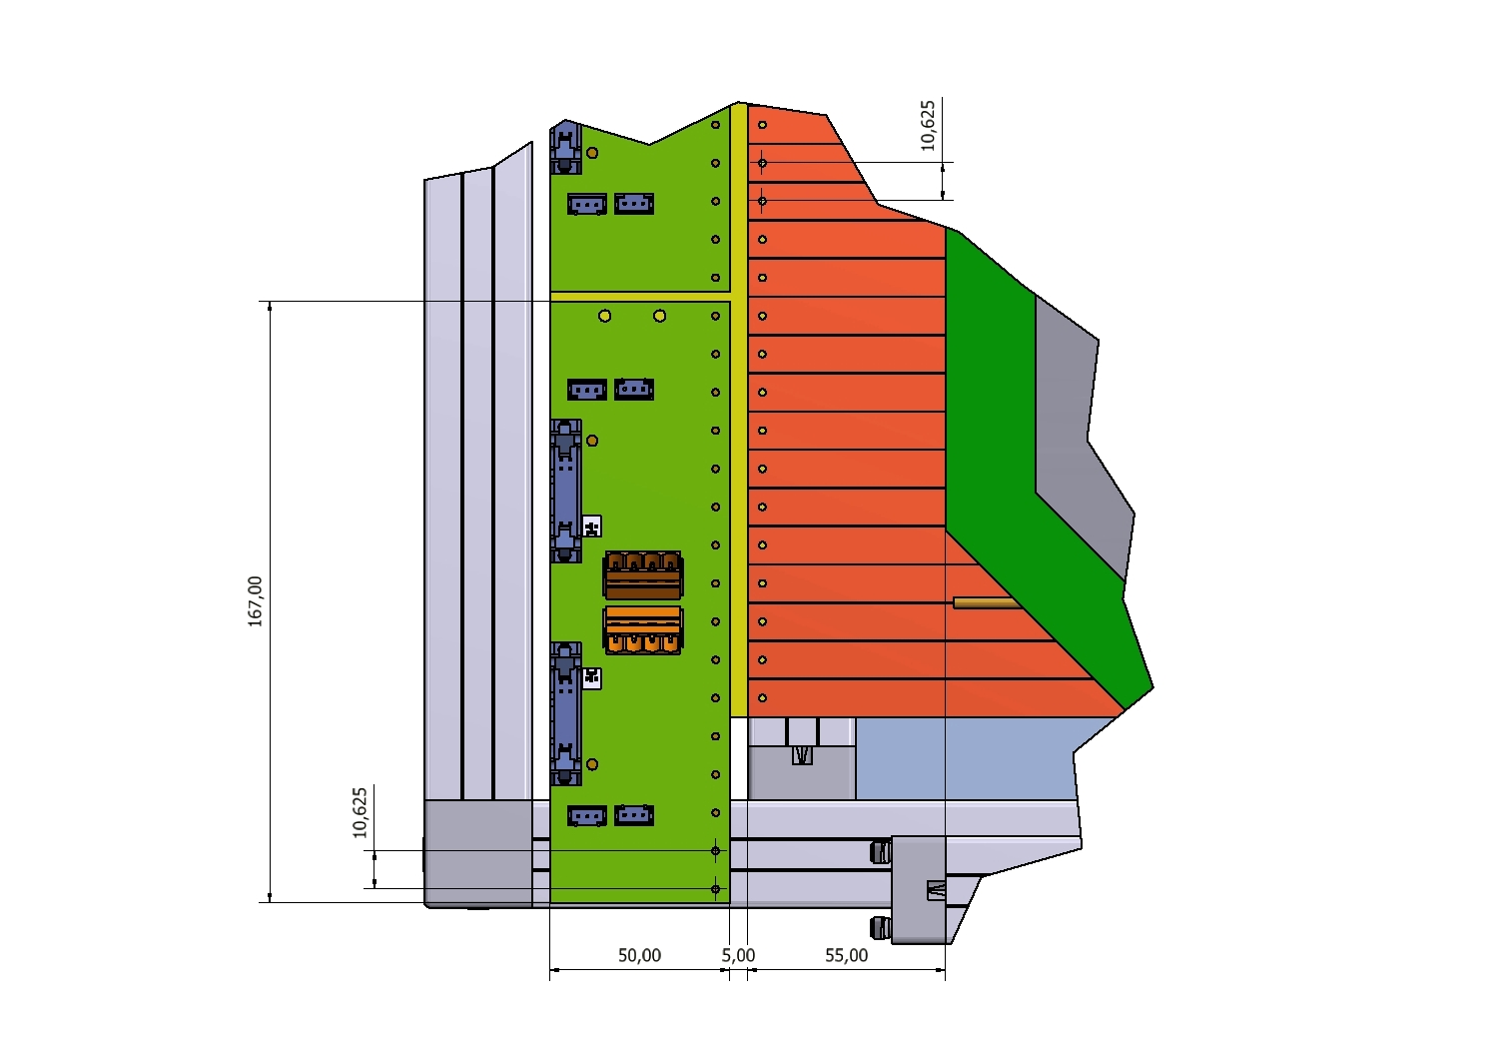

Slide 11
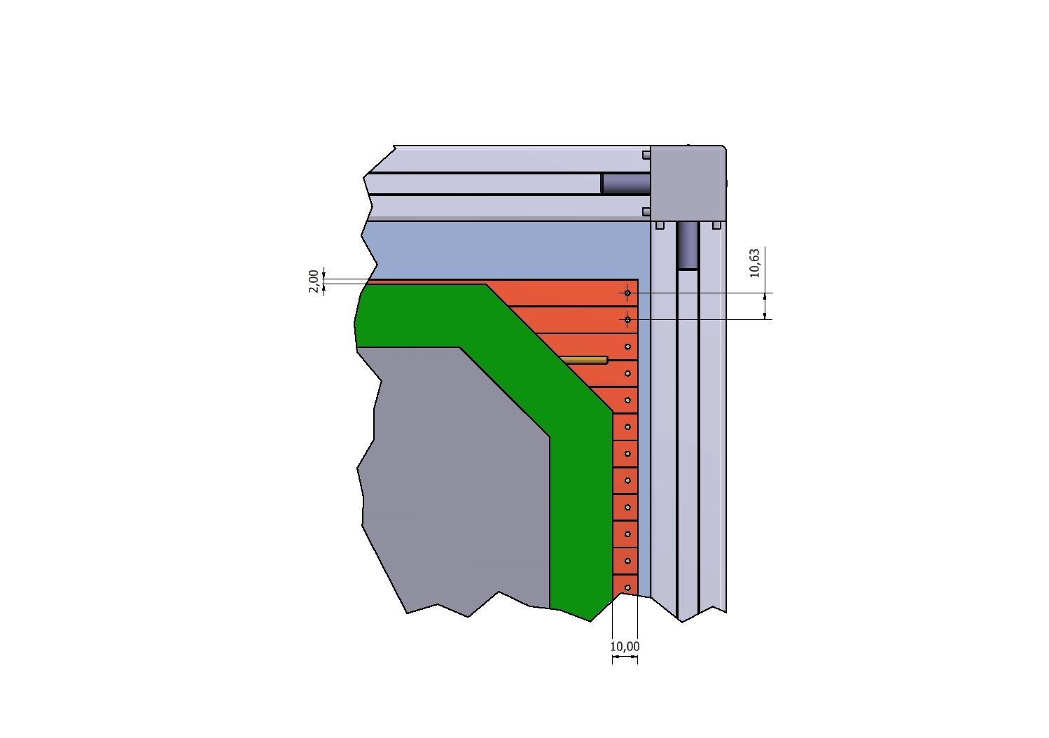

Slide 12
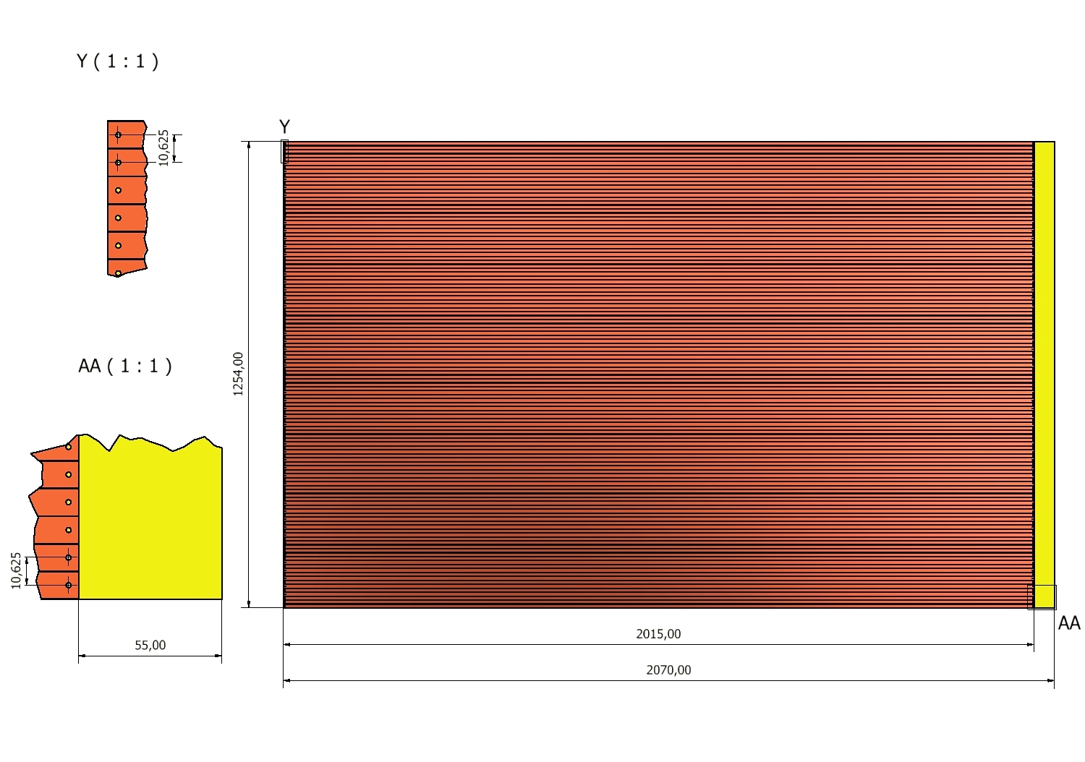

Slide 13
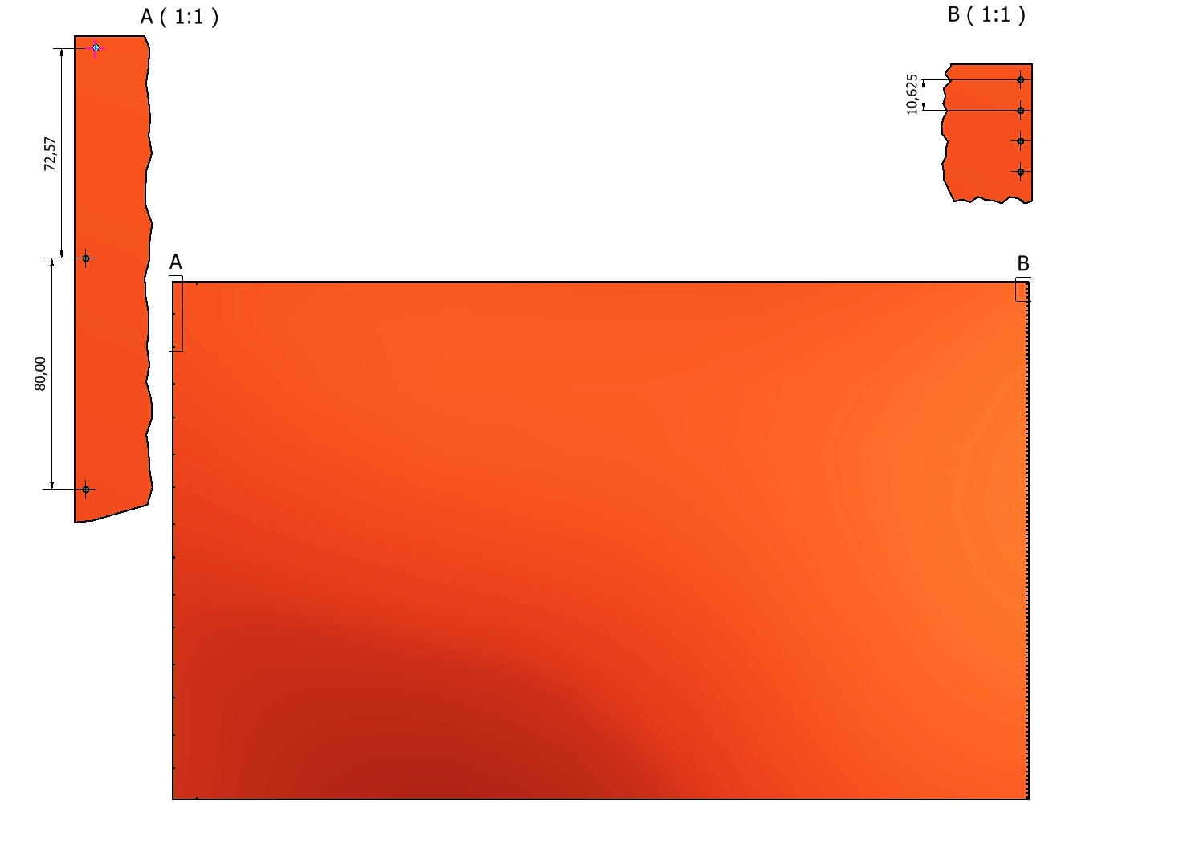

Slide 14
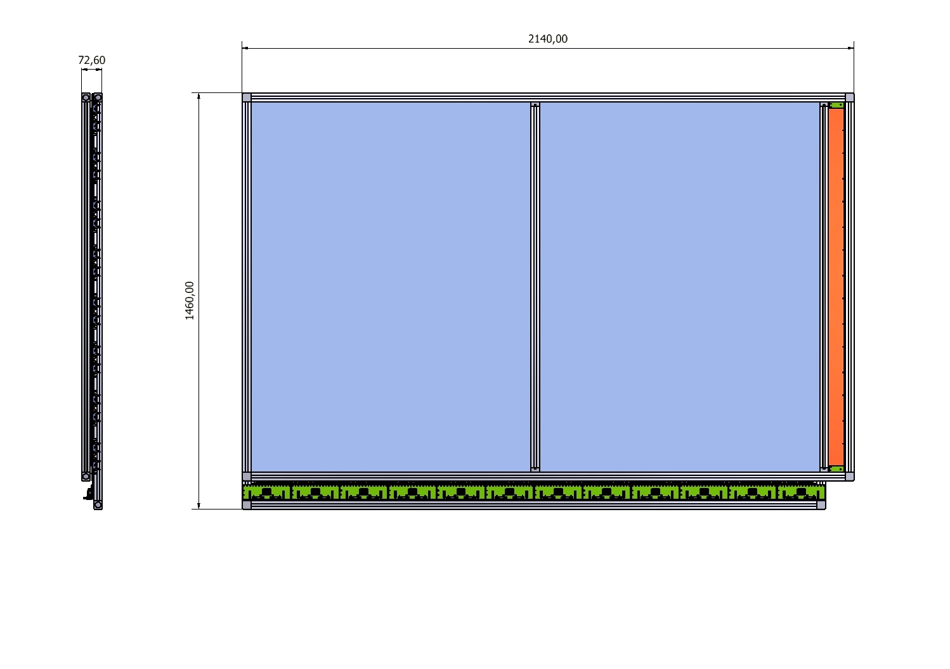
SIDE VIEW
TOP VIEW

Slide 15
Back up slides

Slide 16
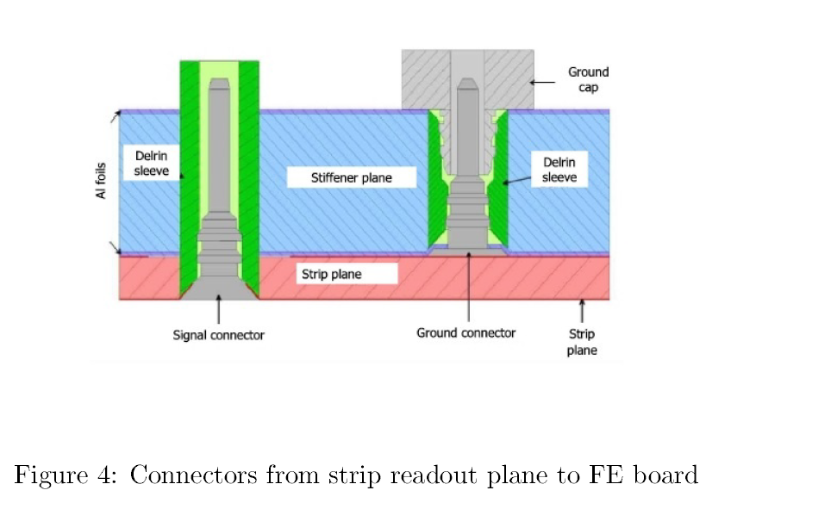

Slide 17
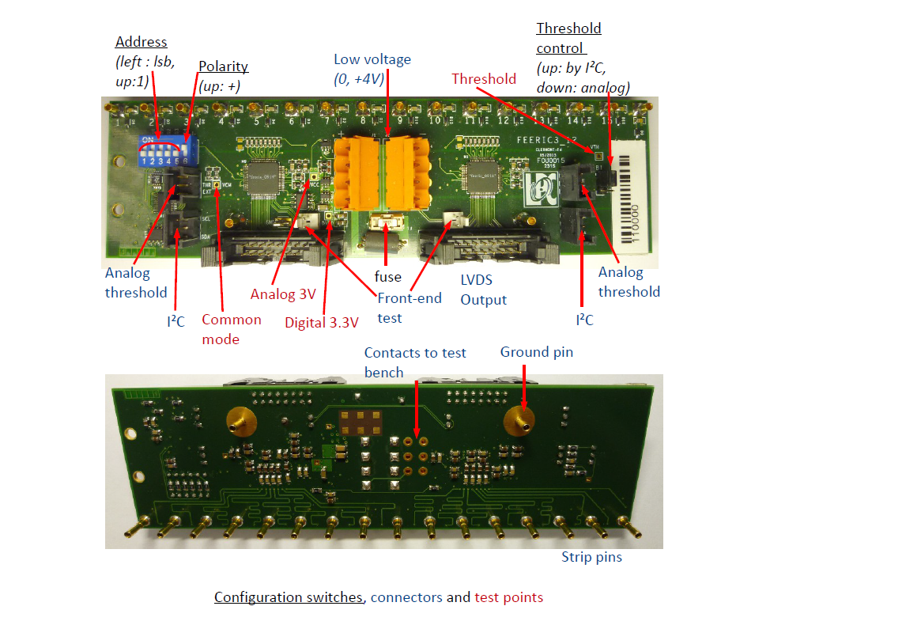

Slide 18
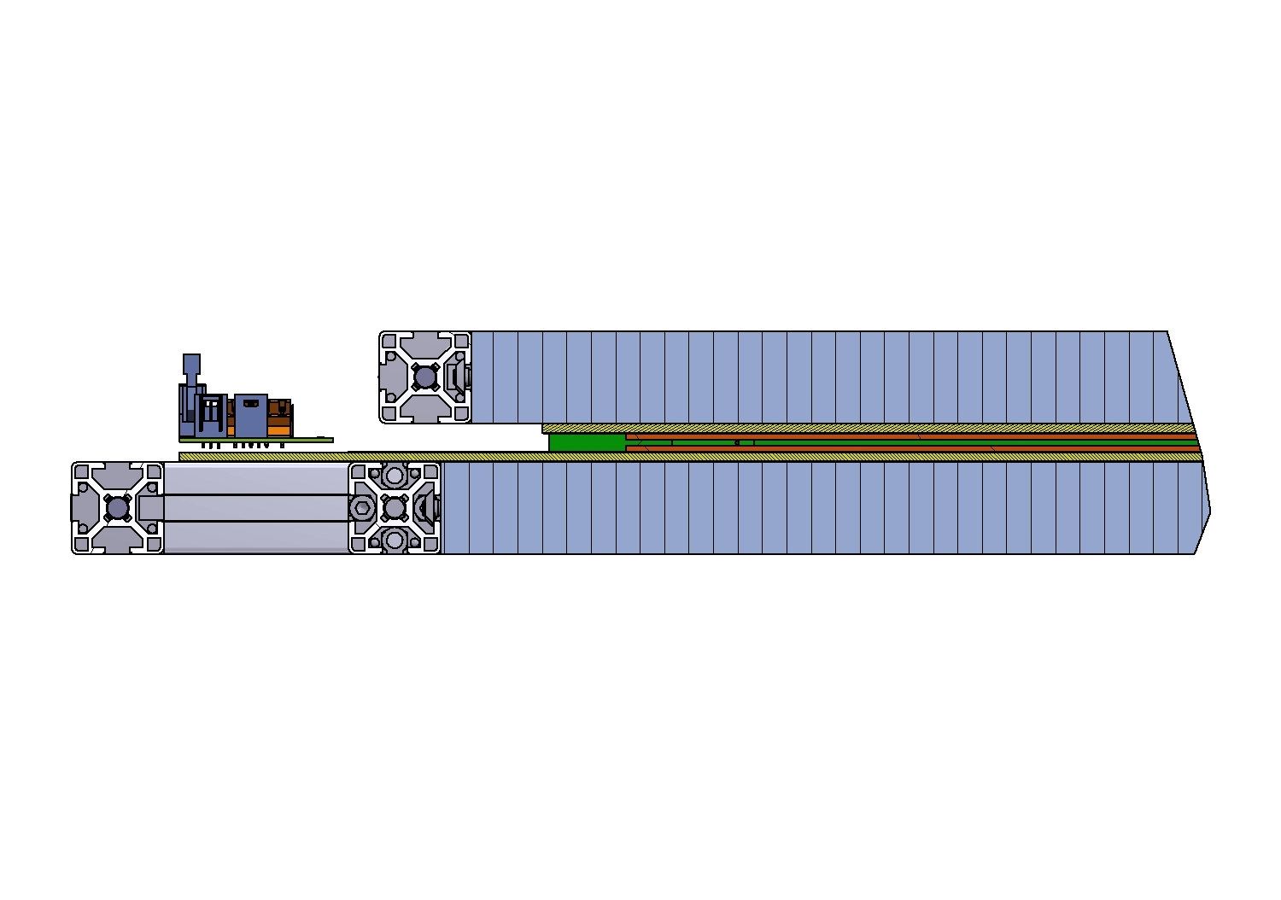
30 mm stiffener Al panel
*0,21 mm +3mm + 0,21 mm
Cu Strip + Foam + Cu GND
6 mm GAP
*ALICE STRIP foils are 0,19 mm Mylar coated with 0,020 mm copper
R. Arnaldi et al. / Nuclear Physics B (Proc. Suppl.) 158 (2006) 83–86

