Slide 1
Technical Studentship overview and
Docker containers setup for the LCG Project
Javier Cervantes Villanueva
Supervisor: Patricia Mendez Lorenzo
Technical Student
Universidad de Murcia (ES)

Slide 2
About me
BS in Computer Science
MS in Big Data and Machine Learning (in progress)
Technical Student in the LCG Project (Sept 2016)

Slide 3
My work in SFT
New LCG stack using Python3
LCG Operations
Spack
Containerisation of LCG builds
  From build nodes to Docker containers
  Monitoring infrastructure with Grafana and Graphite
LCGdocs, documentation webpage

Slide 4
New LCG stack using Python3
Included a new HEP toolchain*: dev3python3
Cloned from dev3 with the Python version as the only difference:
2.7.3 → 3.5.2
Several patches needed (further details):
  Long list of non-Python3-compliant packages
Publishing Python3 LCG releases since LCG_88 (March 2017)
Currently used in production by SWAN
  * A toolchain defines a stack of packages+versions to install with LCGCMake
  Full list: https://gitlab.cern.ch/sft/lcgcmake/blob/master/cmake/toolchain

Slide 5
LCG Operations – Main contributions
Actively helped with the following tasks:
  Installing new packages
  Updating package versions
  Including new compilers
  Managing the build infrastructure (nodes, jenkins, …)
  Taking care of regular nightlies and releases
Refactoring of LCG jenkins scripts
  Modular approach (easier to add new installation processes)
  Homogenous incremental way for both nightlies and releases (faster installations)
Notes:
Own tests can be run as well
Very basic test
Make(“test”)

Slide 6
LCG Operations – Main contributions
Implemented a Python Library (releasepy) for managing nightlies/releases in CVMFS:
  Check release installation
  Remove packages, platforms or releases
  Check RPM consistency
Compiler wrapper to force use of compiler flags in new architectures (-avx2)
  Using CMake templates
Notes:
Own tests can be run as well
Very basic test
Make(“test”)

Slide 7
Spack - Reminder
  Package manager tool from SuperComputing
  One of the most suitable candidate for a common packaging tool for the HEP community
  Active community
  More info: Spack – Package manager tool
HSF Meetings

Slide 8
Spack – Proof of principle
Full nightly builds running with Spack instead of LCGCMake
Integration with our Jenkins and CDash instances
Customized recipes for ROOT and Geant4 projects
Contributions to upstream project on Github
  Adding support for more than 25 new packages
  Most of them Python and R modules
Creation of our own CERN Spack repo
  Containing mostly MC Generator packages
  Used and recognized by HSF groups actively working on Spack

Slide 9
Containerisation of the LCG builds

Slide 10
Containerisation - Why Docker containers?
Current build nodes scenario in numbers:
Puppet configuration tool:
  Extremely useful
  Not enough to ensure exactly the same environment for every new build
              8 CentOS7
              3 CC7
              2 SLC6 Physical machines
              17 SLC6
              7 Ubuntu
Notes:
Own tests can be run as well
Very basic test
Make(“test”)

Slide 11
Containerisation – Benefits
Environment isolation
  Fixed container image, same build environment
All Docker hosts run the same OS (CentOS7)
  Only one platform to manage with Puppet
  Still possible to build for the same platforms (CentOS7, SLC6, Ubuntu)
More flexibility defining different environments
  New platforms just need a new Docker image
  No need of new Hardware / Quota / VM
  Docker images can be forked to apply changes on existing ones
Notes:
Own tests can be run as well
Very basic test
Make(“test”)

Slide 12
Containerisation – Limitations
LCG Build processes may take up to 100GB
  Difficult to manage containers running such processes
Reproducibility is complicated
  All of the data inside a container disappears once the container shuts down
Basic monitoring
  Docker stats command offer very basic information about containers
No images for MacOS
Notes:
Own tests can be run as well
Very basic test
Make(“test”)

Slide 13
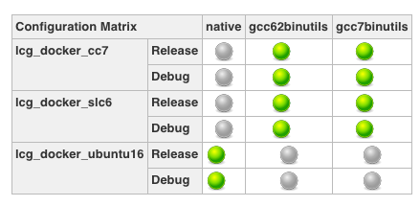
Containerisation
Migration from build nodes to Docker containers:
  Nightly builds – Production
  Releases – Prepared for production
Image: Build #143 lcg_ext_dev4_archdocker
Notes:
Own tests can be run as well
Very basic test
Make(“test”)

Slide 14
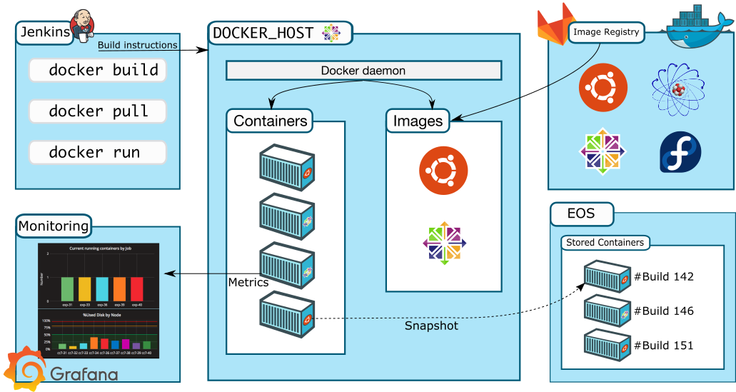
From Build nodes to Containers
OVERVIEW
Notes:
Own tests can be run as well
Very basic test
Make(“test”)

Slide 15
From Build nodes to Containers
INFRASTRUCTURE
Bunch of 10 new powerful CentOS7 added
Fully dedicated to act just like Docker hosts
  Free resources for the non-LCG builds (ROOT, Geant, …)
  Easier to manage
Notes:
Own tests can be run as well
Very basic test
Make(“test”)

Slide 16
From Build nodes to Containers
CONFIGURATION
New Puppet configuration for Docker hosts:
  Docker software and configuration
  Ccache (directory and configuration)
  CVMFS
  Statistical scripts
Existing Jenkins job configurations (defined variables, shell script actions, triggered jobs, …) wrapped into scripts
  These scripts are injected inside the container
  Result: Same builds as for build nodes
Notes:
Own tests can be run as well
Very basic test
Make(“test”)

Slide 17
From Build nodes to Containers
IMAGES
Container images hosted in a Gitlab Repository registry
  Private alternative to Dockerhub
Dockefiles hosted in the same repo
Images based on Puppet configuration used for build nodes
  Same base packages
  Ccache configuration + Code to export/recover to/from EOS
Available images:
  Ubuntu16
  SLC6
  CentOS7
  Fedora25
$ docker run –it gitlab-registry.cern.ch/sft/docker:cc7
Notes:
Own tests can be run as well
Very basic test
Make(“test”)

Slide 18
From Build nodes to Containers
WORKFLOW
Jenkins Server -> Connect to any available Docker host
Launch container with code to execute
Notes:
Own tests can be run as well
Very basic test
Make(“test”)

Slide 19
From Build nodes to Containers
WORKFLOW
Jenkins Server -> Connect to any available Docker host
Launch container with code to execute
$ docker run -e WORKSPACE=$WORKSPACE
-e ENVIRONMENT_VARIABLES
-u sftnight
--name $NAME
--hostname $HOSTNAME-docker
--cpus=$DOCKER_CPUS -v BIND_MOUNTS_FROM_HOST
gitlab-registry.cern.ch/sft/docker:$DOCKER_IMAGE
bash -c "/lcgjenkins/runall-docker.sh $BUILDTYPE $COMPILER $LCG_VERSION"
Notes:
Own tests can be run as well
Very basic test
Make(“test”)

Slide 20
From Build nodes to Containers
WORKFLOW
Jenkins Server -> Connect to any available Docker host
Launch container with code to execute
  Trigger other jobs once finished
Export container to EOS (tar format)
Clean up node
To recover a container stored in EOS, from ANY docker host:
$ ./docker_scripts/restore_build.sh $NAME
Notes:
Own tests can be run as well
Very basic test
Make(“test”)

Slide 21
Containerisation – Optimisations applied
IMPROVED BUILD TIME
Context
  Building same packages every night
  (Usually) Few changes from one day to another
Solution: CCache
  The more we build the same the more CCache helps
  Different builds from different jobs share compiling information
  CCache directory persists on the Docker host
Notes:
Own tests can be run as well
Very basic test
Make(“test”)

Slide 22
Containerisation – Optimisations applied
REDUCE RUNNING OUT OF SPACE PROBLEMS
Context
  Problem of full disk nodes causing failed builds
Solution
  LCG latest released every week
  Clean up build artifacts and containers once finished.
  Daily cronjob to ensure removal of possible remaining containers
  Monthly cronjob to ensure on removal of docker images
Notes:
Own tests can be run as well
Very basic test
Make(“test”)

Slide 23
Containerisation – Optimisations applied
KEEP REPRODUCIBILITY OF BUILDS
Context
  Containers are terminated when the build process finishes.
  Once terminated, there is no way to manually test the build to find out problems
Solution
  Export containers before removal
Notes:
Own tests can be run as well
Very basic test
Make(“test”)

Slide 24
Containerisation – Optimisations applied
REDUCE EXPORT PROCESS LATENCY
Context
  Exporting large containers images may take hours
    Docker host blocked during this time
    Bottleneck in jenkins
Solution
  Reduce size of containers → LCG latest releases
  Export only containers most likely to be recovered: Only failed builds
Notes:
Own tests can be run as well
Very basic test
Make(“test”)

Slide 25
Containerisation – To further optimise
Integration of Graphdriver plugin (WIP)
  Although there is no benefit when uploading, download time may be drastically reduced
Find out best directory policy for CCache
    Same CCache directory for every build
    Different CCache directories (for dev3, for dev4, …)
Notes:
Own tests can be run as well
Very basic test
Make(“test”)

Slide 26
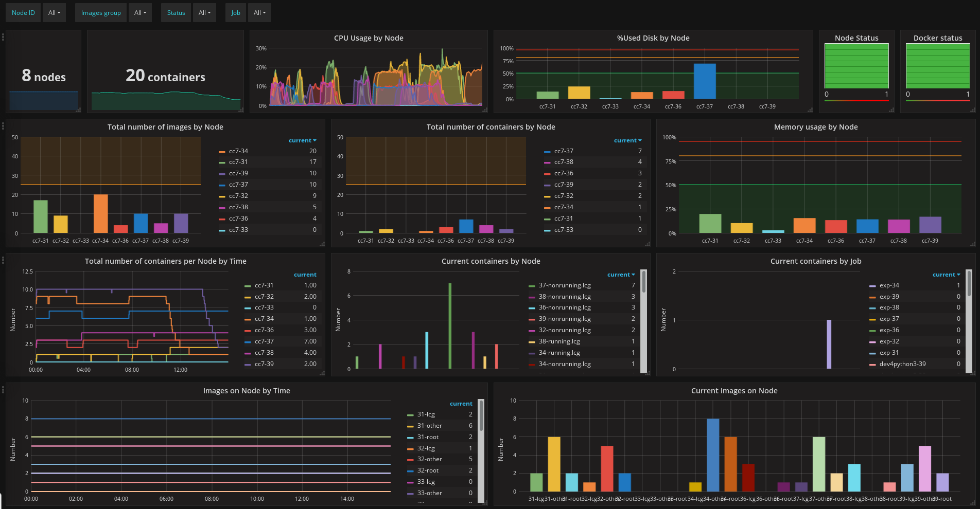
Containerisation - Monitoring with Grafana & Graphite
Live demo
Notes:
Own tests can be run as well
Very basic test
Make(“test”)

Slide 27
LCGDocs, documentation website
Main goals:
  Gather documentation from different sources (Evernote, notebooks, mails, …)
  Facilitate the job for newcomers
Based on Gitbook
EOS hosted (/eos/project/l/lcgdocs)
Notes:
Own tests can be run as well
Very basic test
Make(“test”)

Slide 28
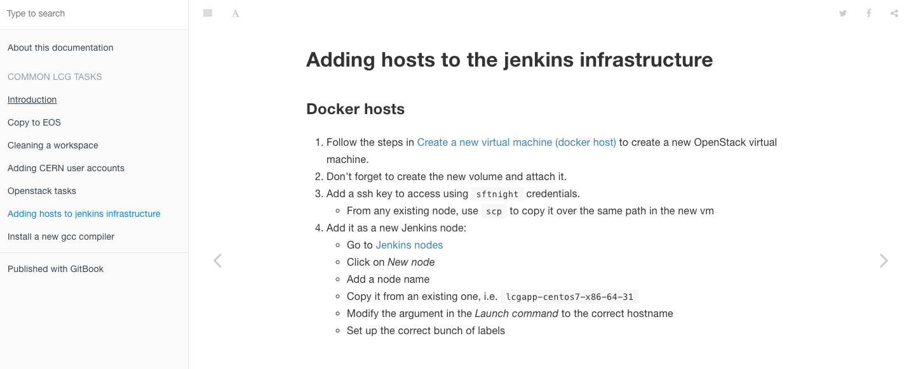
LCGDocs, documentation website
http://lcgdocs.web.cern.ch/lcgdocs/
Notes:
Own tests can be run as well
Very basic test
Make(“test”)

Slide 29
Thank you
Big thanks to Patricia Mendez and Pere Mato
Thanks to everyone else on EP-SFT
Notes:
Own tests can be run as well
Very basic test
Make(“test”)

Slide 30

What’s next?
Fellowship in EP-SFT (1st November)
Working for the FCC experiment
  Building infrastructure
  Supervisor: Benedikt
Really excited to continue being part of this team ☺
Notes:
Own tests can be run as well
Very basic test
Make(“test”)

