Slide 1
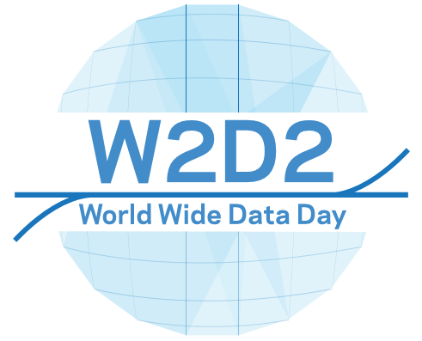

World Wide Data Day and more
Ken Cecire
University of Notre Dame
QuarkNet

Slide 2
World Wide Data Day
“24-hour shift” for simple but meaningful measurements from ATLAS, CMS
Students measure theta and phi for dimuon events, plot histograms.
School do measurements, have VCs
November 14, 2017 – 36 groups, ~480 students so far
http://tiny.cc/w2d2-17
We need moderators!

Slide 3
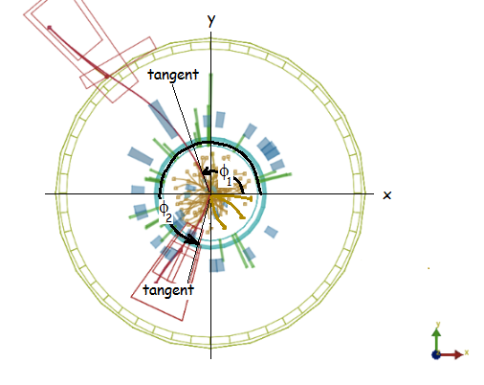
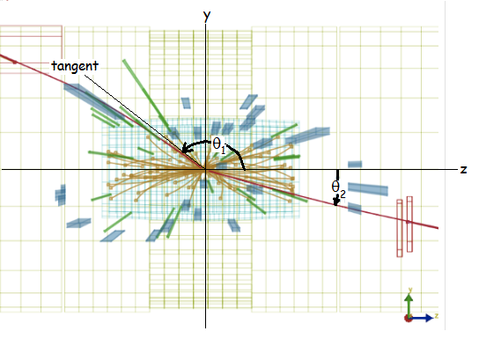
Enough talk
Let’s play...

Slide 4
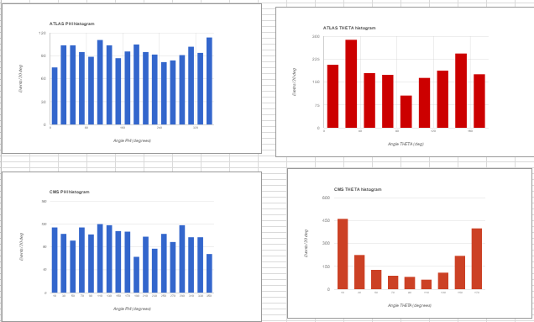
Student results from 2016

Slide 5
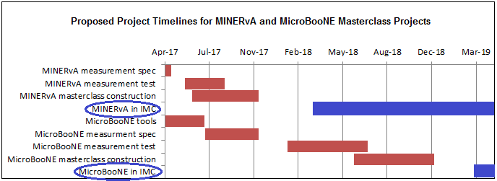
Fermilab Neutrino plan
Still in development
Big goal: DUNE
More neutrino masterclasses welcome – and not just at Fermilab

Slide 6
MINERvA masterclass
First IMC neutrino masterclass
Roll out in March and May (1 week each)
Simple measurement
  reject background; select signal events
  find px, py, pz of neutron in nucleus from ejected proton and muon
pz implies neutrino beam energy
Uncertainty in px and py → diameter of nucleus

Slide 7
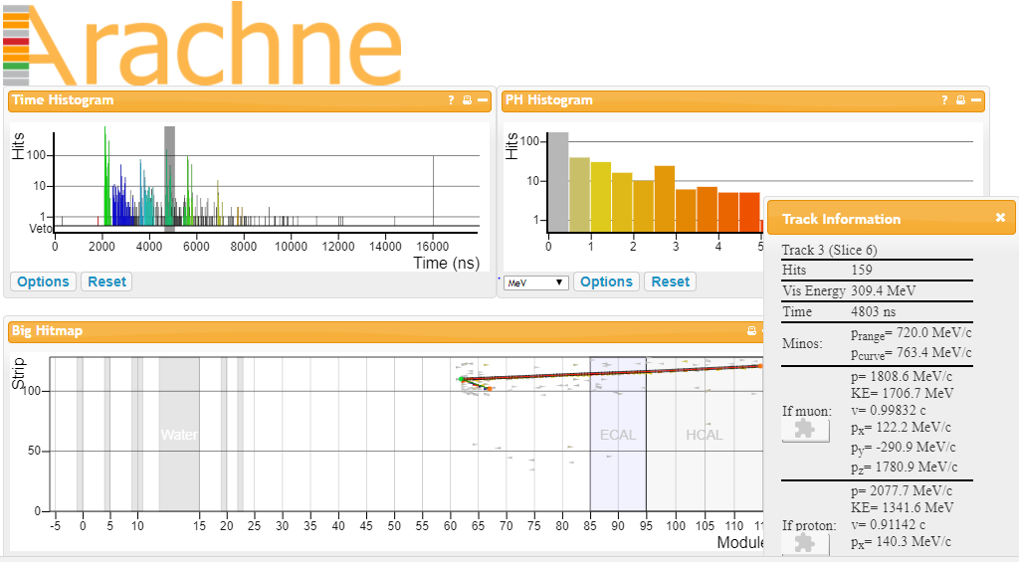
MINERvA event

Slide 8
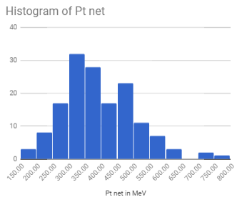
MINERvA analysis

Slide 9

My questions:
Continue W2D2 each year? Are there alternatives?
How will we integrate MINERvA, other neutrino masterclasses?
What are your concerns about W2D2 and neutrino masterclasses?

