Slide 1
Report Central Coordination
Uta Bilow + Ken Cecire
IMC steering group meeting, CERN
02.11.2017

Slide 2
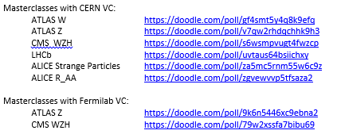
Registration to IMC18
Doodles opened Oct 27 (Fri last week)
Dates for LHCb and ALICE doodled beforehand
max. 2 VCs in parallel at CERN, always 4-5 pm CET
single VCs at Fermilab, variable times
More slots will open if required
Doodles will close on Nov 20
Registration still possible after that date by direct contact

Slide 3
Registration – the numbers
 | ATLAS Z | ATLAS W | CMS | LCHb | ALICE S.P. | ALICE R_AA | ATLAS Z | CMS WZH
 | CERN |  |  |  |  |  | Fermilab
VC slots | 110 | 40 | 60 | 45 | 35 | 5 | many | many
slots taken (No. 2017) | 85 (103) | 32 (34) | 56 (52) | 36 (41) | 14 (21) | 4 (4) | 1 | 15
Still available | 25 | 18 | 4 | 9 | 21 | 1 | many | many
Institutes | 68 (78) | 21 (31) | 37 (39) | 30 (31) | 13 (19) | 4 (4) | 1 | 8

Slide 4
New Countries / Institutes / Groups for IMC18
Confirmed:
Bulgaria: Sofia (CMS)
Qatar: Doha (CMS)
Iran: Tehran (CMS)
Strasbourg: ALICE group
Interest expressed:
India
Palestine
Lebanon

Slide 5
IDWGS
UN International Day of Women and Girls in Science = Feb 11
IMC pilot in 2017 on Feb 10+11
  10 institutes
  3 video conferences
  320 girls
  Very well received
Talk at LCHP Shanghai (Julia Djuvsland) + proceedings
Poster at EPS-HEP Venice + proceedings
2018: IMC IDWGS on Feb 12

Slide 6
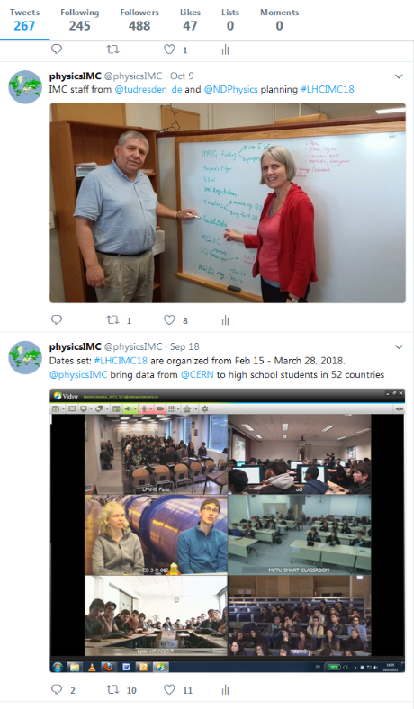
Communication
Circulars
  Biweekly Friday circulars in 2017
  Weekly Friday circulars in 2018
Twitter
  @physicsIMC
  #LHCIMC18
  Team: Nicolas, Ken, Uta, more volunteers?
  Schedule
  Encourage institutes to tweet with specific tips (circular)
Press release
  Template for institutes

Slide 7
Timeline
Nov:
Preliminary schedules
WG VC
Dec:
Recruiting moderators
WG VC
Jan:
updates:
  Instructions for tutors
  Moderators´ manual + twiki
Vidyo tests
WG VC
Feb:
Question time
Moderators training

Slide 8
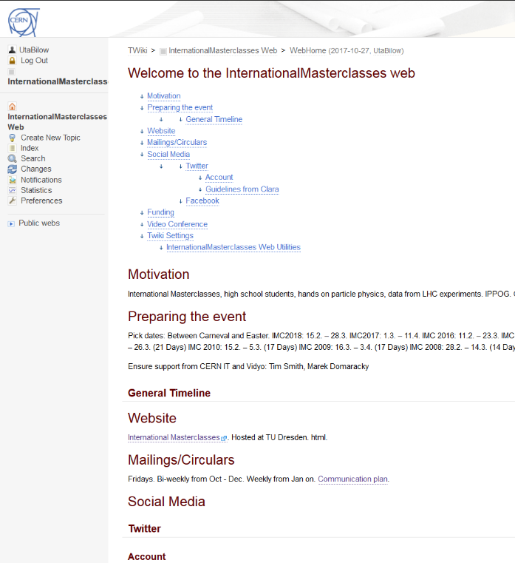
Documentation on Coordination
Create a documentation of our work, timeline, to dos, documents, announcements, email lists, contacts, etc.
https://twiki.cern.ch/twiki/bin/viewauth/InternationalMasterclasses/WebHome
Will be filled after April 2018
Access restricted to ippog-mc-ct

Slide 9
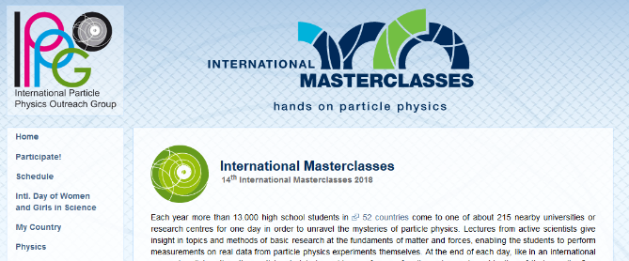
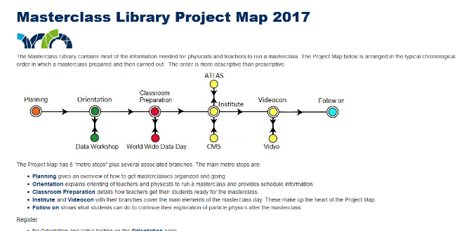

Website
www.physicsmasterclasses.org
  hosted at TU Dresden
  html
https://quarknet.i2u2.org/page/masterclass-library-project-map-2017
  hosted at Fermilab
  Drupal 7
ippog.org so far only links to physicsmasterclasses.org
Integrate content in ippog.org
Long term project
  Combined content
  Functionalities
  Ability to incorporate new MC
  Design

Slide 10
Miscellaneous
Working Group Video Conference:
Michael Hauschild stepping down → need replacement

Slide 11
Measurements
New data?
New tasks?
New stuff?

