Slide 1


IMC steering group meeting, CERN 02.11.2017
Masterclass with Belle II data
Rok Pestotnik
Jožef Stefan Institute, Ljubljana, Slovenia
for the Belle II collaboration

Slide 2
Contents
Introduction
Design
Implementation
Status

Slide 3
Belle II experiment
Asymmetric e+e- collider : KEKB → SuperKEKB (40x higher luminosity)
Running on Y resonance which decays to B-mesons
Studies of rare B, D and tau decays
Upgrade Belle → Belle II
Experiment starts data taking in 2018

Slide 4
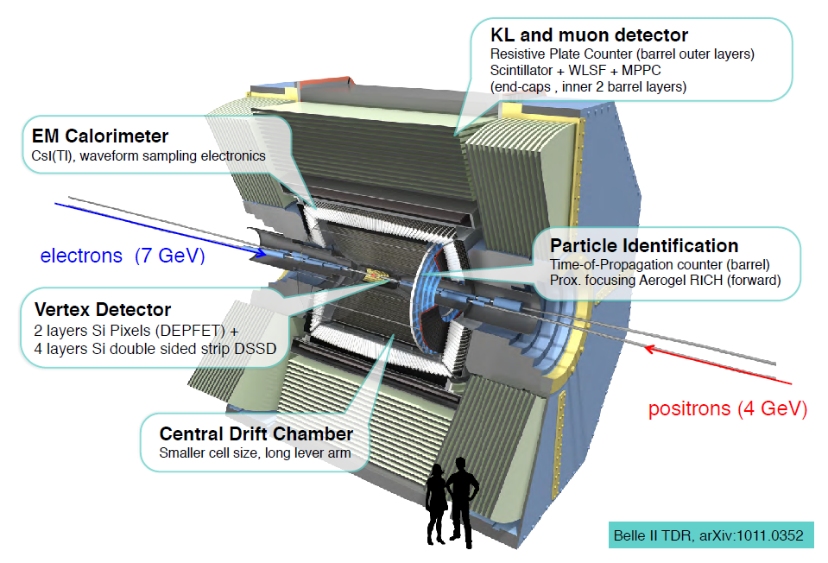
Belle II spectrometer

Slide 5
Belle II masterclass
Belle II effort to disseminate our knowledge to the general public
Explain what we are doing ?
How does the Belle II detector look like?
What are our research methods?
What do we expect to see?
What are our results?

Slide 6
Target audience and Masterclass structure
students of physics
high school students
primary school students
general public (assume finished high school)
Create an educational package which can be used on the web and also in the school
Structure:
General introduction
Introduction to Belle II : Virtual reality
Exercises with the data:
  Event display
  Easy analysis tool

Slide 7
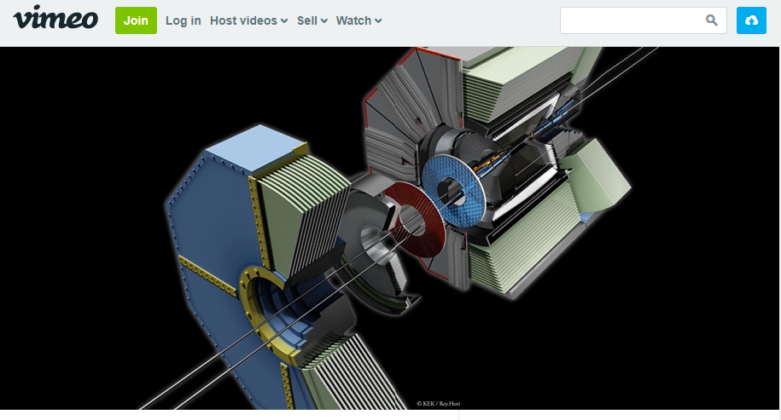
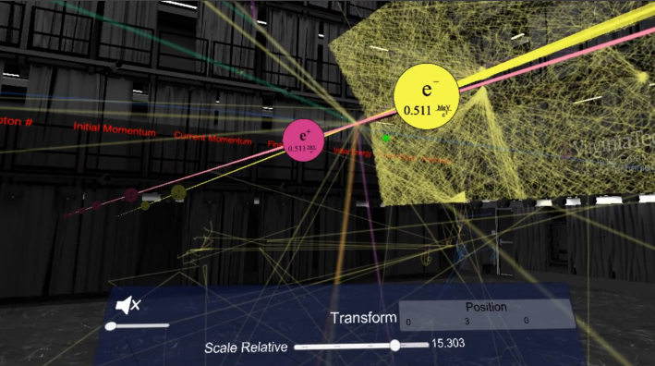
Belle II Virtual Reality
Virtual walk through the Belle II spectrometer, view of the collisions and particle info display
Sources: http://www1.phys.vt.edu/~piilonen/VR/
Preview on vimeo: Narrated , Captioned
Requires Oculus Rift headset + PC with a hihh performance graphic card
Screen broadcast to a presentation display
  great for observers without headset

Slide 8
Exercises: User friendly insight in our data
Prepare exercises at different level of complexity
Make data sample available to the general public
  Graphical user interface which generates pseudocode which runs the analysis in the backend
    user friendly
    expose physics of particles
    minimize the starting errors made during coding
  Web version runs on a single web server
  enables access to everyone and
  Virtual appliance with data and the software pre-installed
  allows download → for schools & workshops

Slide 9
Design
  Data sample: Belle, when available, switch to Belle II
Several exercises:
  spectroscopy examples for the pilot run.
  Based on the feedback and our experiences we will extend it later with more complex examples.
Design the exercises to be used by larger groups of people
Underlying code based on Belle educational B-lab exercices:
http://belle.kek.jp/b-lab/b-lab-english/
Web interface
  The graphical user interface based on Blockly - google graphical library

Slide 10
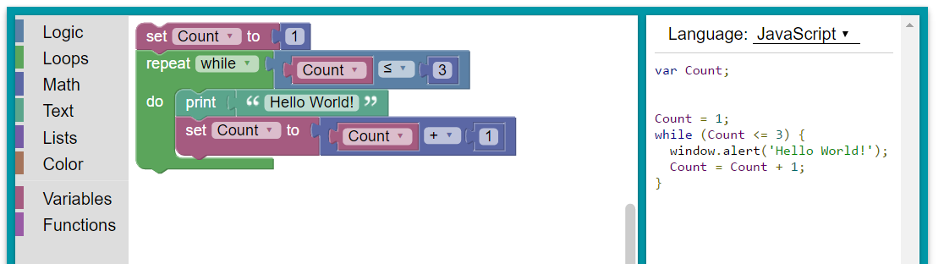
Visual programming environment to interface the Belle II data
Blockly http://developers.google.com/blockly/
Inspired by MIT Scratch https://scratch.mit.edu
Blockly JavaScript generates JSON text strings
they are sent to the server
converted into the computer code (python steering file)
The code is executed on the server
histograms are sent back to the client
displayed using JSROOT JavaScript.

Slide 11
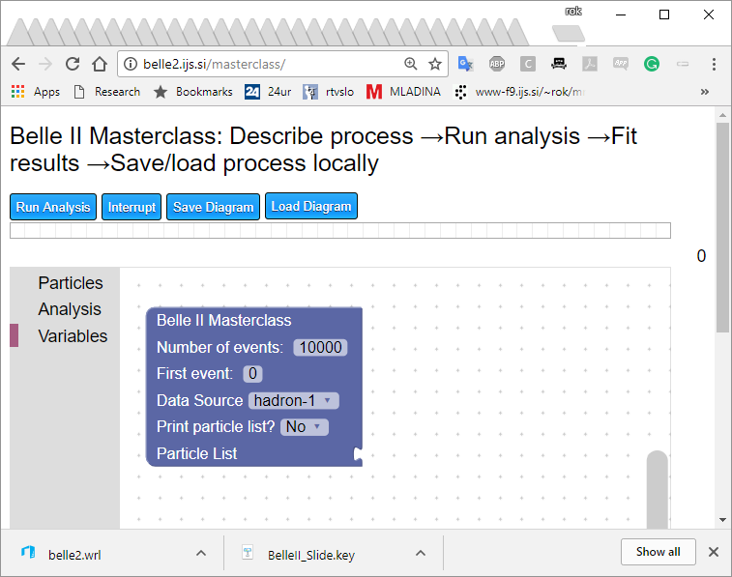
Web application
http://belle2.ijs.si/masterclass/

Slide 12
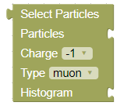
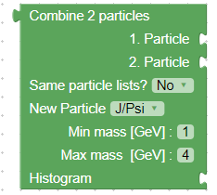
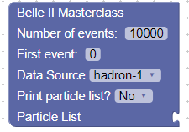
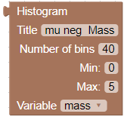
Basic blocks
Limited number of blocks:
  Select particles … to select particle type for analysis
  Combine two particles … combination of particles from two lists
  Belle II Masterclass … analysis conditions:
    data source
    Number of events
  Histogram … plotting of the variable distribution
    Define range and variable to plot

Slide 13
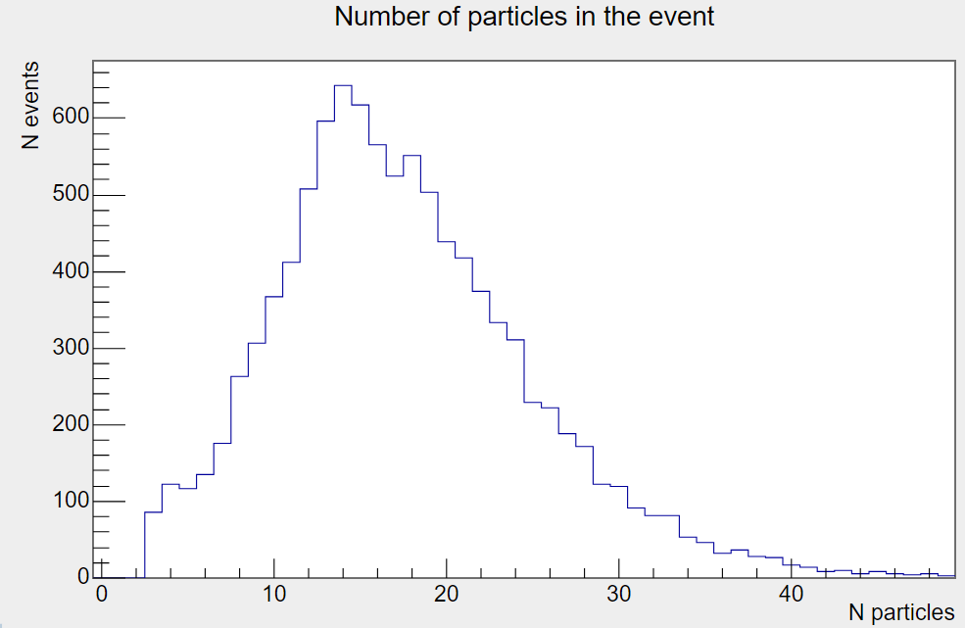
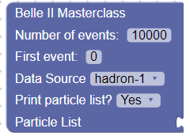
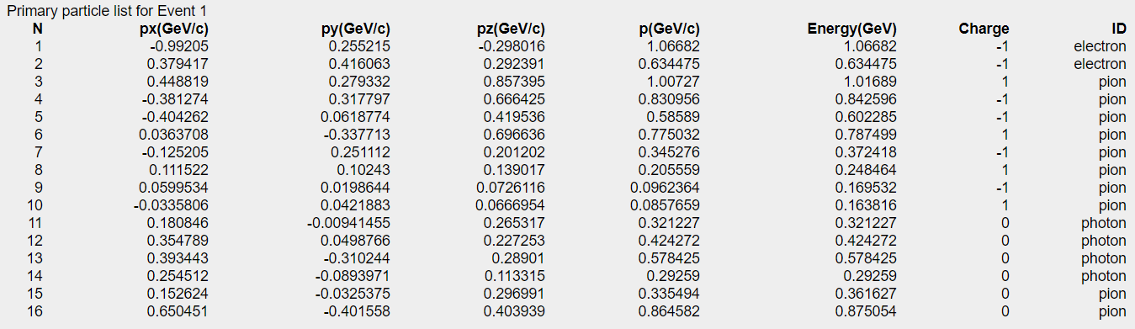
Particle list

Slide 14
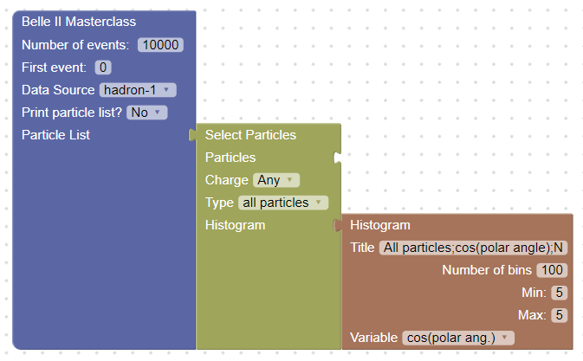
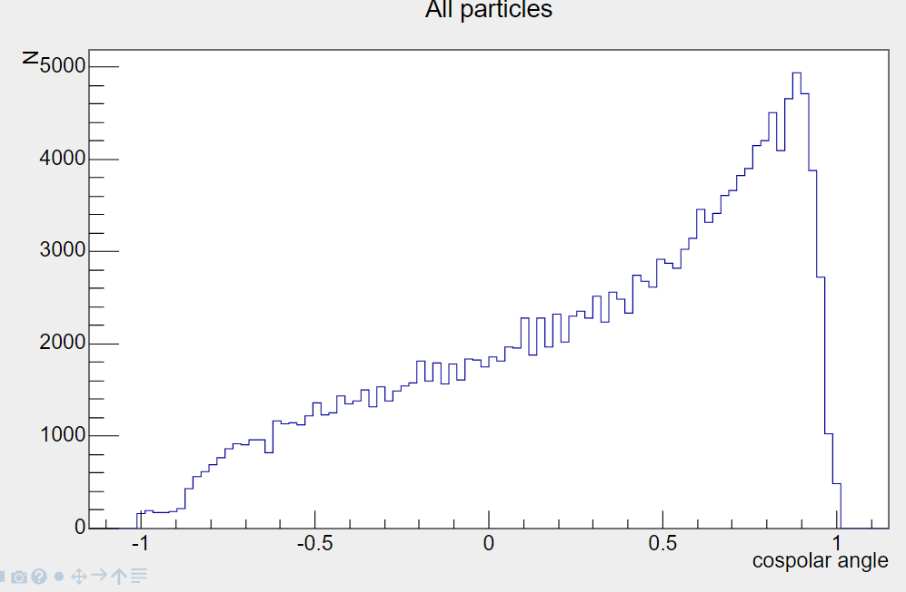
Start putting the blocks together
Fixed block connectiors – minimize errors
Basic quantities of the particles
Plot different variables :
mass,
momentum,
energy,
charge,
identity,
px,py,pz,pT
cos(theta),
theta

Slide 15
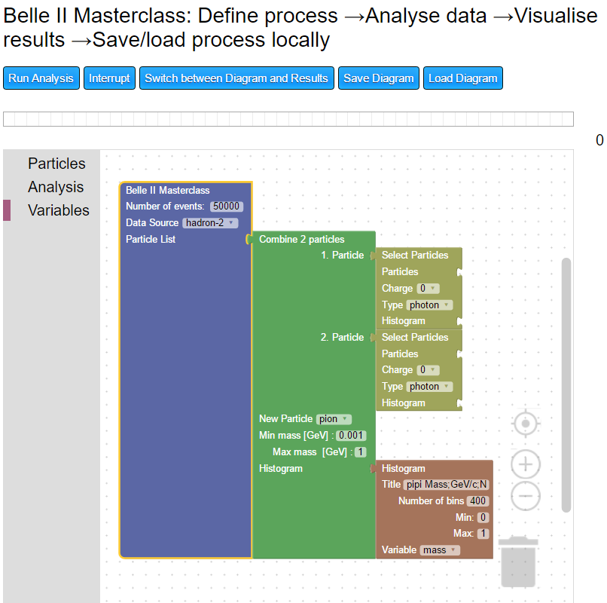
Decay to two particles
User describes a decay by blocks:

Slide 16
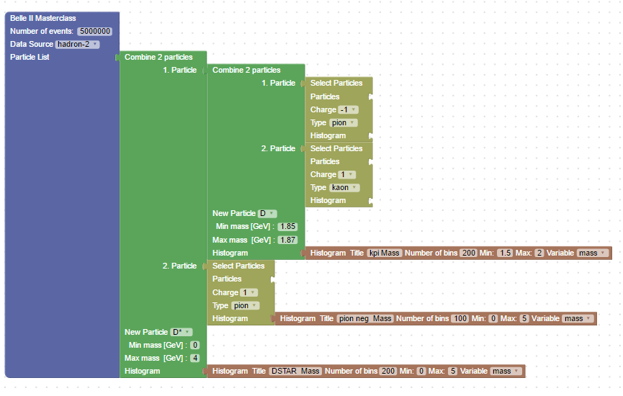
Combination of three particles

Slide 17
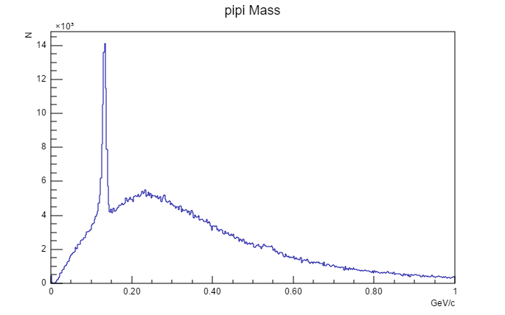
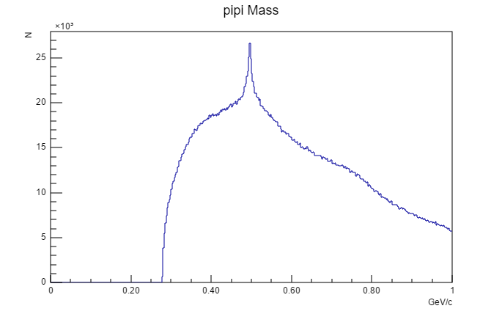
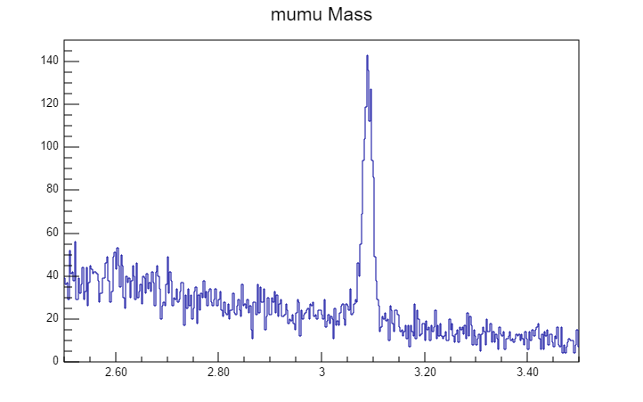
Different decays

Slide 18
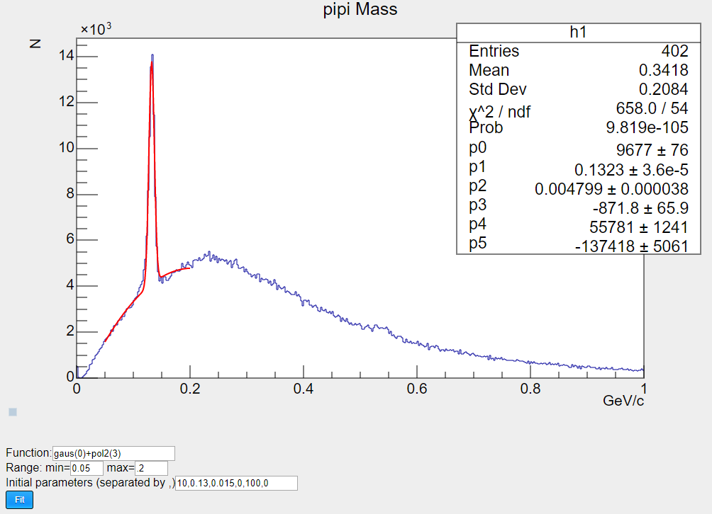
For more ambitious: Fit the resulting histograms
Basic version available

Slide 19
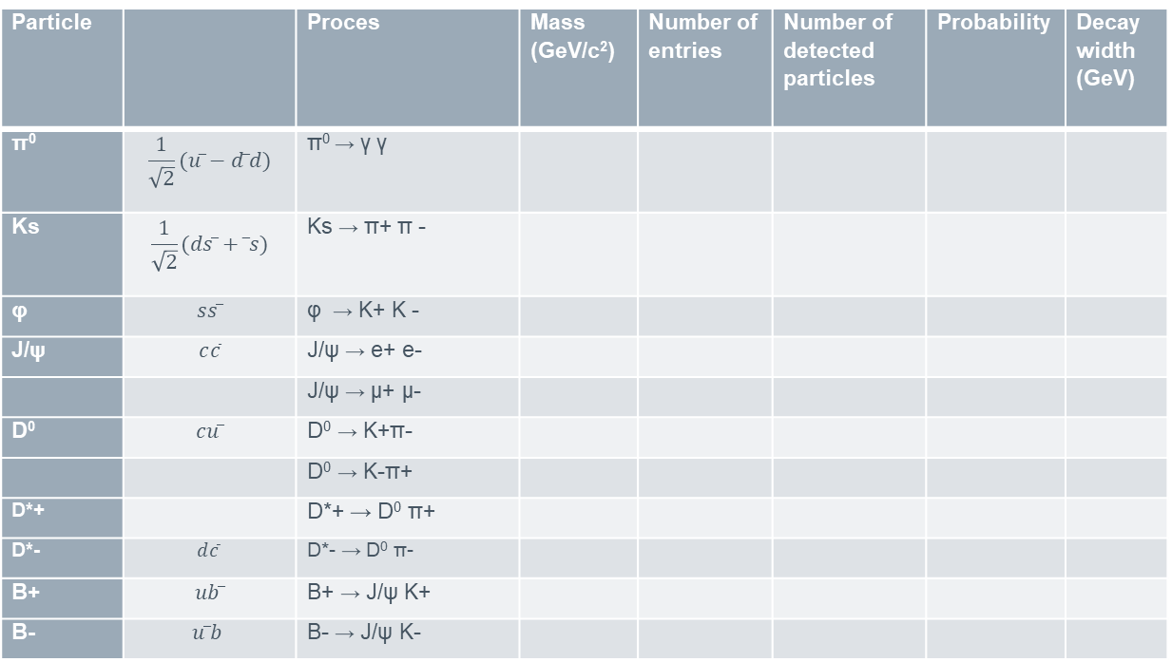
Example table to be filled by students
Particle |  | Proces | Mass (GeV/c²) | Number of entries | Number of detected particles | Probability | Decay width (GeV)
π⁰ | $$\frac{1}{\sqrt{2}}(uu̅−d ̅d)$$ | π⁰ → γ γ
Ks | $$\frac{1}{\sqrt{2}}(ds ̅+d̅s)$$ | Ks → π+ π -
φ | $$ss ̅$$ | φ → K+ K -
J/ψ | $$c\overline{c}$$ | J/ψ → e+ e-
 |  | J/ψ → μ+ μ-
D⁰ | $$cu ̅$$ | D⁰ → K+π-
 |  | D⁰ → K-π+
D*+ |  | D*+ → D⁰ π+
D*- | $$d\overline{c}$$ | D*- → D⁰ π-
B+ | $$ub ̅$$ | B+ → J/ψ K+
B- | $$u ̅b$$ | B- → J/ψ K-

Slide 20
Virtual appliance
VirtualBox VM: http://belle2.ijs.si/belleIIubuntu16.04.3.7z
→ unpack with http://www.7-zip.org/
→ run with https://www.virtualbox.org/
Start the VirtualBox
Open the browser inside the virtual appliance and navigate to http://localhost/masterclass

Slide 21
First experience
Training of the high school students:
  Virtual appliances installed to 45 computers
  9 exercises
  25 participants of the Summer school of Faculty of Mathematics and Physics, University of Ljubljana, Aug. 2017, materials in Slovene language
  2 hours dedicated to the masterclass
  Students had a lot of fun
Introduction of basic concepts very important:
Different knowledge of students

Slide 22
Summary
Belle II masterclass - use Blockly graphical user interface to access and analyze the data
We will use Belle II Virtual Reality app and Event display for the introduction to the class
Localization: translate the documentation to different languages
Class content (target time 3 hours)
  Common place to collect the results
  Video conference at the end to discuss the results between the groups
We have base version, which is working:
  First deployment expected in March 2018

