Slide 1

Exotics and heavy ion collisions
Su Houng Lee
1. Few words on Compact Multiquark configurations
2. Where are the compact multiquark states?
3. Exotica production from heavy ion collisions
4. Summary
+ S. Cho
Multiquark configuration in quark model:
PRD92.014037, PRD93.074007, PRD94.054027, PRD95.054027, PRD96.034029,
2. Exotics and Heavy ion: PRL 106(2011)212001, PRC84(2011)06491, PPNP 95(2017)279
+T. Song, K. Morita, Maeda

Slide 2
I: Few words on “Multiquark states”

Slide 3

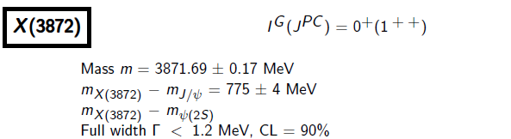


X(3872)
- 2003 -
- 2013 -
Z(4430)
- 2007 -
- 2014 -
Spin parity = 1+

Slide 4
Pentaquark - Pc
- 2015 -
Baryon with ccu
PRL119 (2017)112001
- 2017 -

Slide 5
d*(2380)
- WASA-at-COSY-

Slide 6
Normal meson, compact multiquark, molecules, resonances
 | Normal meson | Compact multiquark | Molecules | Resonance
Geometrical configuration
Examples | Nucleon, pion, kaon | ? | X(3872) | K*, rho meson
u
u
d
u
u
u
u
d
d
u
u
d
d
d
Pc, d*

Slide 7
II: Where are the compact “Multiquark states”

Slide 8
Lattice Results : HAL QCD collaboration for H dibaryon in SU(3) symmetric limit
SU(3) flavor 1 state
SU(3) flavor 27 state
→ Flavor 1 channel could give compact configuration
Compact multiquark states could exists if there is a strong short range attraction
The r→0 behavior should be understood from quark model
Notes:
First could give compact configuration, the second may be resonance. So what does give the short distrance behavior ?

Slide 9

Quark wave function for multiquark states (W.Park, A.Park, SHL)
- Some Previous works have limited Fock space: diquark picture …
- Hard to picture interplay between various contribution
- Hard to understand SU(3) breaking effects.
→ Work out the full (color) x (spin) x (flavor) wave function for all multiquark configurations at least for the ground state s-wave states

Slide 10
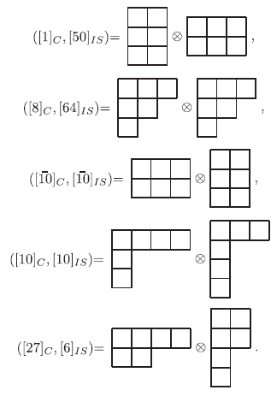
Quark wave function for light dibaryons (W.Park, A.Park, SHL15.)
- Choose the spatial part to be symmetric
- Choose the Color-Isospin-Spin part to be antisymmetric : SU(12)
Physical State

Slide 11
- Dibaryon: 5 Independent color singlet bases
1
2
3
4
5
6
1
3
2
4
5
6
1
2
3
5
4
6
1
3
2
5
4
6
1
4
2
5
3
6

Slide 12
- Pentaquark: 3 Independent color singlet bases (W.Park, A. Park, S.Cho, SHL PRD95,054027)
1
2
3
4
5
6
1
3
2
4
5
6
1
2
3
5
4
6
1
3
2
5
4
6
1
4
2
5
3
6

Slide 13
- Heptaquark: 11 Independent color singlet bases (W.Park, A. Park, SHL PRD96,034029)

Slide 14
In quark model: wave function should follow Pauli Principle
Totally antisymmetric (color x spin x flavor) wave function (s-wave ground state)
1
2
3
4
5
6
Example: ΩΩ in the Spin=3 channel is highly repulsive because
Flavor is totally symmetric
Spin is totally symmetric
Remaining part should be totally antisymmetric
But color singlet implies
Hence, assuming all quarks are in the S wave, Pauli principle forbids compact configuration.
Such forbidden configuration are highly repulsive at r→0 (Oka et al quark cluster model)

Slide 15
When allowed, Where are the Compact multiquark configuration?
In Constituent quark model
1) Additional Kinetic energy compared to separated hadrons
Β
Β
1
2
4
5
3
6
2) Color-color will not add much
If color singlet
3) Color-spin interaction is important

Slide 16
Color spin interaction
 | qq |  |  |  | qq
Color | A | S | A | S | 1 | 8 | 1 | 8
Flavor | A | A | S | S
Spin | A(1) | S(3) | S(3) | A(1) | 1 | 1 | 3 | 3
K | -8 | -4/3 | 8/3 | 4 | -16 | 2 | 16/3 | -2/3
- Jaffe (77) : K for H and two Λ
H
Λ
Λ
u
s
d
vs
u
s
u
d
s
d
s
d
u
using Nucleon(K=-8) to Delta (K=+8) mass difference of 290 MeV
ΔK=-8 corresponds to about 145 MeV attraction > additional Kinetic energy of 100 MeV

Slide 17
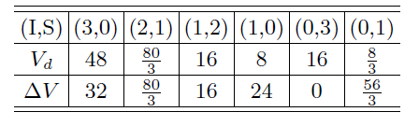
Where are the compact multiquark states? - Examples
Dibaryons with 6 light quarks: W.Park, A. Park, SHL, PRD92(2015)014037
Color spin interaction of 6 quark state and their decays
The only non repulsive channel, but also no attraction
Strong indication that d*(2380) is a molecular configuration
(A. Gal, PLB769(2017)436 )
No compact dibaryon in flavor SU(2)

Slide 18
Perhaps a heptaquark ?: W.Park, A. Park, SHL, PRD92(2015)014037
 | q²s³ s² heptaquark | Λ + φ + φ | Δ E_{hyperfine}
 |  |  | -56 MeV

Slide 19
H dibaryon with realistic quark masses: W.Park, A. Park, SHL, PRD93(2016)074007
If the SU(3) breaking is taken into account. Color spin with constituent quark mass
H
Λ
Λ
u
s
d
vs
u
s
u
d
s
d
u
d
s
 | H dibaryon | Λ + Λ | Δ E_{hyperfine} | E_{kinetic}
 |  |  | -145 MeV | +100MeV
 |  |  | -20 MeV | + 84 MeV
19

Slide 20
Where are the compact multiquark states? - What we need
1) Need Strong Color spin interaction
→ that survive in the SU(3) breaking limit
2) Need heavy quarks to suppress additional kinetic term
→ both baryons should have heavy quarks

Slide 21
Is Pentaquark (Pc) compact ? W.park, A. Park, S.Cho, SHL, PRD95(2017) 054027
1) Color spin interaction of Pc(4380) 3/2 – state
- 2015 -
Pc(4380) can be reconstructed from
Pc(4380) | J/ψ + π | Δ E_{hyperfine} | E_{kinetic}
 |  | -3 MeV | + 70MeV
→ Most likely a molecular states

Slide 22
Heavy Tetraquarks ( Spin=1 case)
1) Heavy quark-antiquark:
c
q
c
q
 | Tetraquark | J/ψ + π | Δ E_{hyperfine} | E_{kinetic}
 |  |  | 0 MeV | +100MeV
2) Heavy quark-quark:
c
c
q
q
 | Tetraquark | D + D* | Δ E_{hyperfine} | E_{kinetic}
 |  |  | -97 MeV | +50MeV

Slide 23
Heavy Tetraquarks
1) Previous works on Tcc
Z. Zouzou, B. Silverstre-Brac, C. Gilgnooux, J Richard (86), D. Janc, M. Rosina (04), Y. Cui, S. L. Zhu (07)
QCD sum rules: F Navarra, M. Nielsen, SHLee, PLB 649, 166 (2007)
simple diquark: SHL, S. Yasui, W.Liu, C Ko EPJ C54, 259 (2008), SHL, S. Yasui: EPJ C (09)
2) Promising final state signals
→ Most likely a compact tetraquark states

Slide 24
III: Exotica production from Heavy Ion Collision

Slide 25
Hadron production in ( p+π→C+X ) collision
c
C
u
β
d
G_{b/π}
D_{C/c}
π
c
u
b
dσ
γ
a
d
d
G_{a/p}
p
c
u
α
X

Slide 26
Particle production in heavy ion collision
Hadron
Multiquark formation
Light nuclei
Molecular structure formation
T
T_{C}
T_{μ}
T_{F}
τ
QGP
Hadron phase
1 fm/c
5 fm/c
7 fm/c
17 fm/c

Slide 27
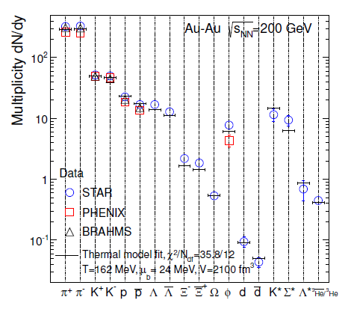
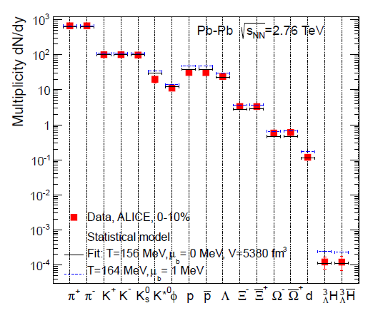
Production of hadrons near Tc
RHIC – Statistical model (PBM ..)
ALICE – Statistical model

Slide 28
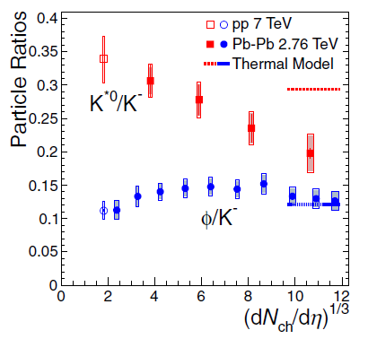
Production of resonances
ALICE (2015 prc)
Reconstruction
STAR collaboration (PRL 2006) find

Slide 29
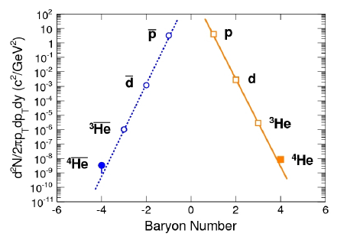
Production of light nuclear
RHIC/STAR (Yugang Ma)
ALICE – Statistical model
S/N i conserved (Siemens, Kapusta 79)

Slide 30


Details of coalescence model calculation (ExHIC PPNP 2017)
Model central rapidity, central collision using Lattice EOS
Heavy quark production (T Song)
Coalescence Parameters:
fit production of normal hadrons
from statistical model

Slide 31
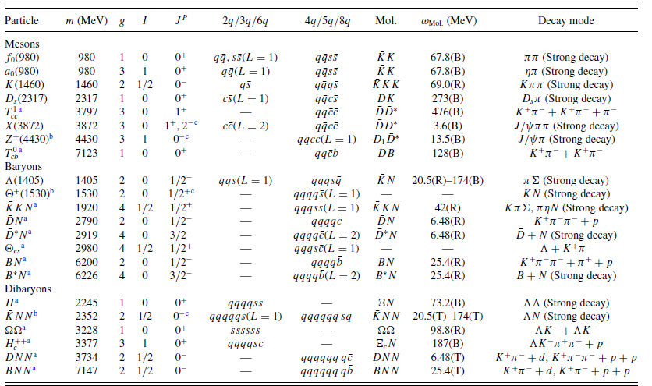
Hadron coalescence for molecules at kinetic freezeout point

Slide 32
Fachini [STAR]

Slide 33
Summary I
1] Compact multiquark states can be understood from color spin flavor wave function:
- A strong attractive short range interaction is needed in the SU(3) broken limit
- Heavy quarks are needed to reduce extra Kinetic energy
→ Tcc could be strongly bound
→ Vertex detector: weakly decaying exotics : FAIR 10⁴ D⁰ /month,
LHC 10⁵ D⁰/month
T_{cc}/D > 0.34 x 10 ⁻⁴ RHIC
> 0.8 x 10 ⁻⁴ LHC
→ T_{cc} production

Slide 34
Summary II
2] Measurements from Heavy Ion can discriminate the structures
 | Normal meson | Compact multiquark | Molecules | Resonance
Geometrical configuration
Examples | Nucleon, .. | Tcc , … | Pc, d*, .. | K*, ρ meson
Production rate | = Statistical Model | << Statistical Model | = Statistical Model | < Statistical Model
u
u
d
u
u
u
u
d
d
u
u
d
d
d

Slide 35
Back up slides

Slide 36
Suggestions
1. Lambda (1405): two poles?
2. Dibayrons: d*(2323)→ Δ+Δ H, N-Omega, Hc(uuudsc)
3. Light molecules or tetraquarks
4. Heavy Tetraquarks
5. Heavy Pentaquarks

