Slide 1

SYNPA2017, 전남대학교
Skyrmion and Exotic Baryons
Hyun Kyu Lee, Hanyang Univ.

Slide 2
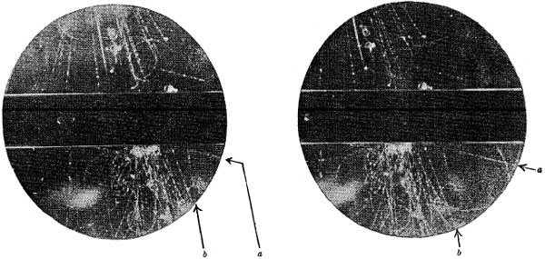
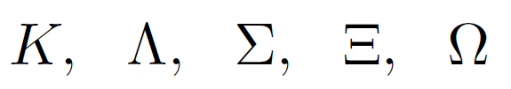
I. Exotic hadrons
A. Strange particles in 1940’s
V - particle
Rochester and Butler, Nature 160, 855-857 (1947)
Strange particles

Slide 3

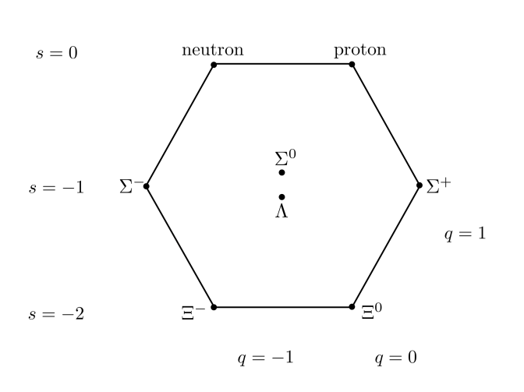

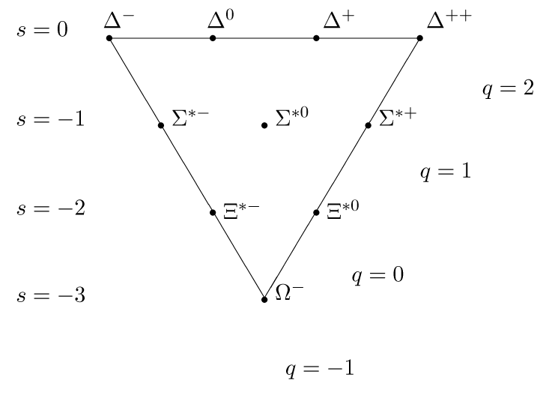
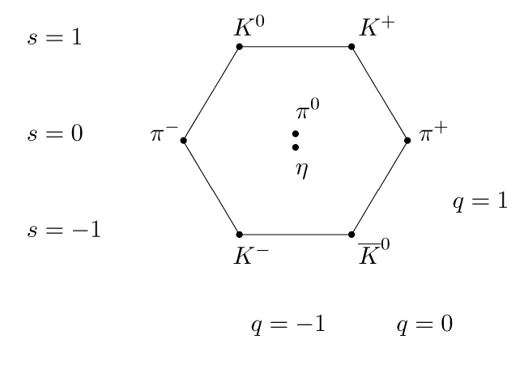
Flavor symmetry: SU(3)_{f}

Slide 4

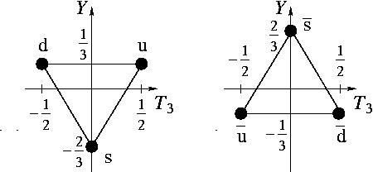


Exotic multiplets :
B. Quarks
Clue for nucleon structure
→ quark model , quantum chromodynamics QCD SU(3)_{c}
Proton (uud) and neutron (udd)

Slide 5
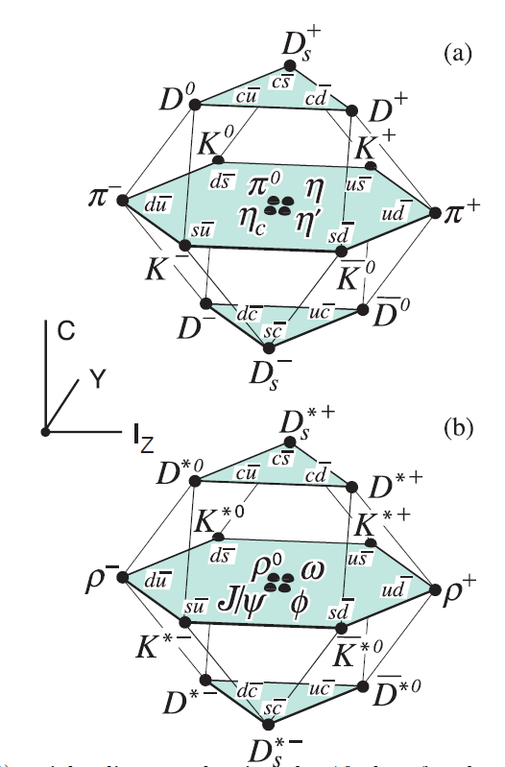
C. Charmed hadrons :

Slide 6

SU{3} multiplets : quark model selection
- Light-Quark selection : qqq
- Heavy-Quark selection: qqQ, qQQ
qqQ:
qQQ: {3}

Slide 7





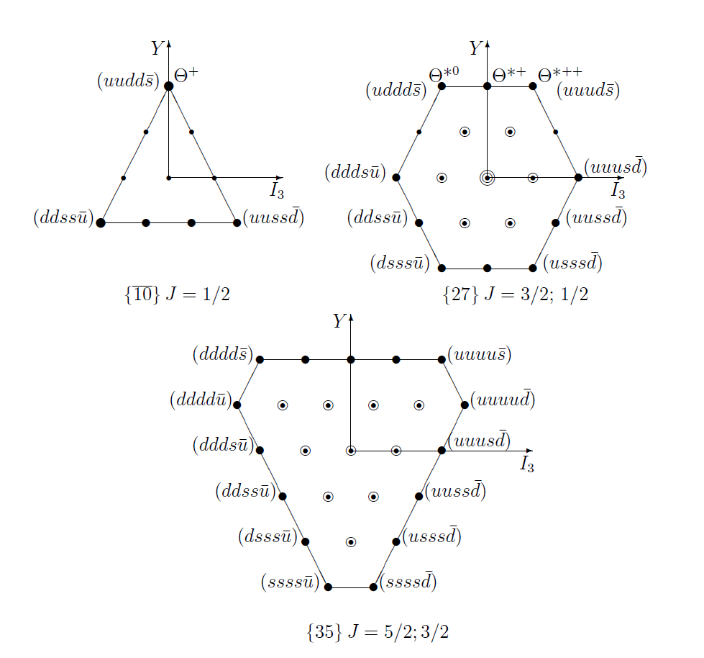
C. Multi-quark selection : Exotic Hadrons

Slide 8
H di-baryon uuddss {1}
Neutron star : {3} x {3} x ……… x {3} ~10^57
Strange quark star ~ {1}

Slide 9
Exotic baryons in SU{3} multiplets
Quark model selection
Skyrmion selection

Slide 10
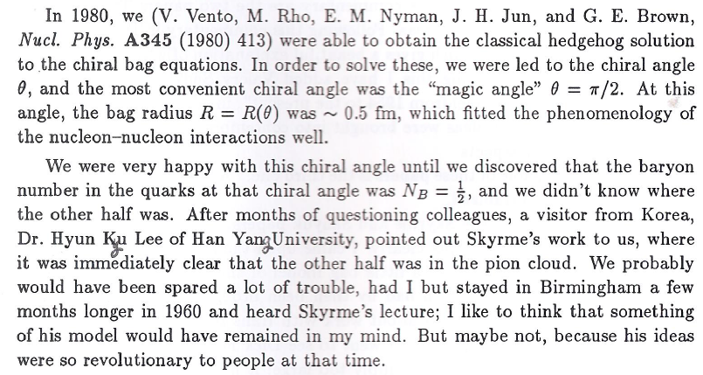
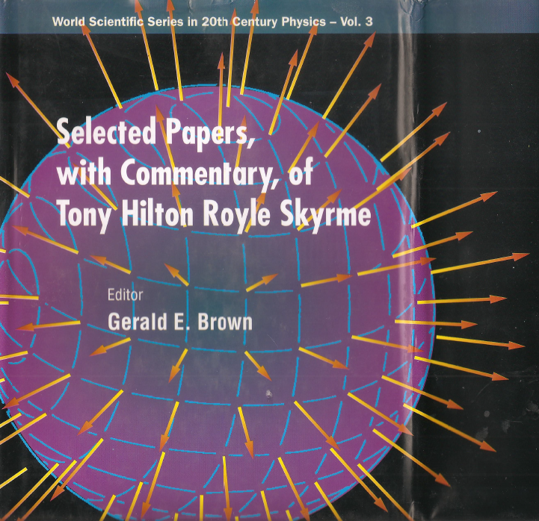
II. Skyrmion
Skyrmion at Stony Brook, 1982 Winter

Slide 11
T.H.R. Skyrme, Proc. Roy. Soc. Lond., A252(1961)127

Slide 12

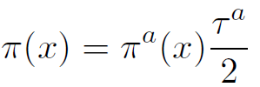


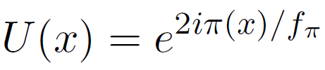
A. Topological soliton
Spontaneous breaking of chiral symmetry
Glodstone bosons : pions
transformation:
linearly under
non-linearly under
Non-linear realization

Slide 13

Skyrme (1961)
Baryon : topological soliton of nonlinear meson theory
‘t Hooft(1974)
QCD ~ effective meson theory at
Witten
(1979) Baryon: soliton of effective meson Theory
(1983) Winding number = Baryon number

Slide 14

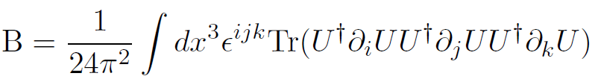


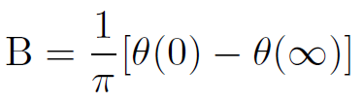
Non-trivial mapping: topological number B
Skyrme(1961), Witten(1983)
topological number B → Baryon Number
Skyrmion: Baryon number B

Slide 15

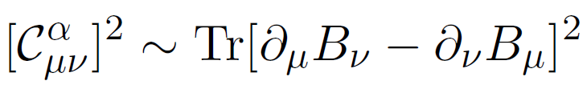


B. Effective lagrangian for skyrmion
Skyrme 1961
Mass term
Kinetic term
Gauge field in 1-form
Skyrme term

Slide 16
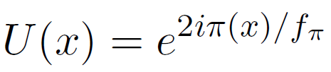

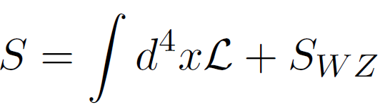

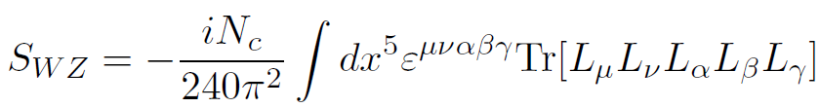


effective action for goldstone bosons(skyrmion)
Wess-Zumino term
Symmetry breaking term

Slide 17
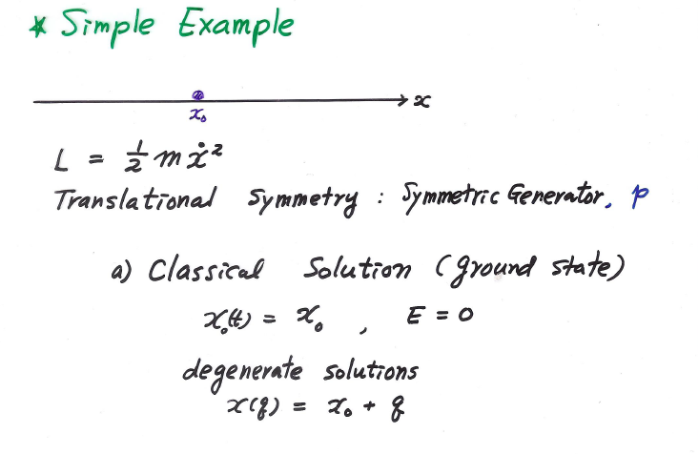
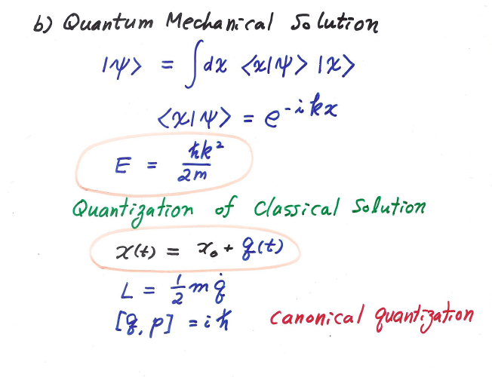
C. Quantum states of skyrmion
- Quantization of classical soliton

Slide 18
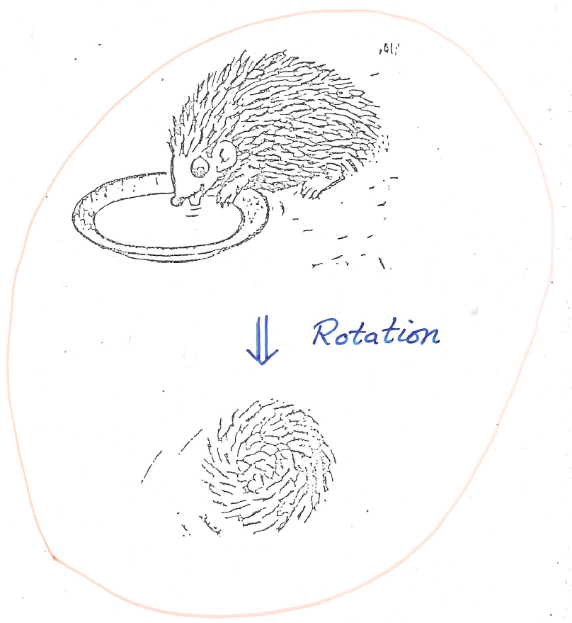


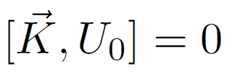



skyrmion
symmetric generator
collective coordinates
degenerate in energy

Slide 19
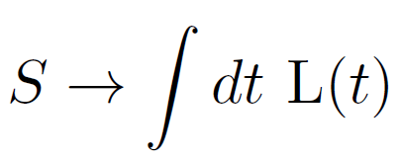




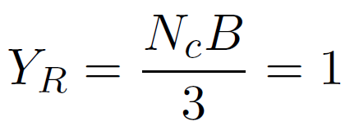

Quantum mechanical lagrangian
Canonical quantization
quantum state :
I = 3/2 → J = 3/2

Slide 20



I = 1/2
I = 1/2, J = 1/2
J = 1/2
I = 3/2, J = 3/2
I = 3/2 , J = 3/2
I = 5/2 , J = 5/2

Slide 21
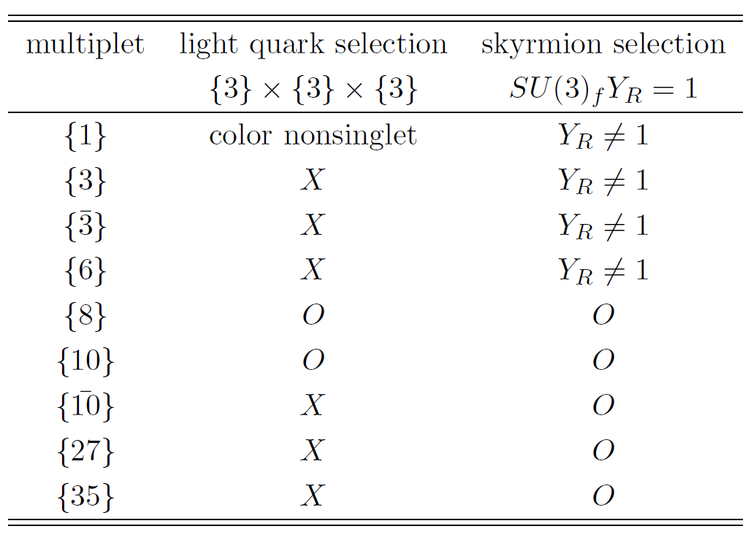

B. Exotic baryons
exotics
O
O
O
Heavy quark selection → Talk by Hyun-Chul Kim

Slide 22
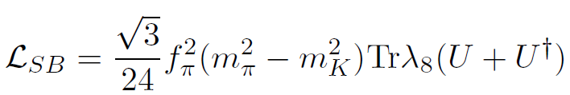
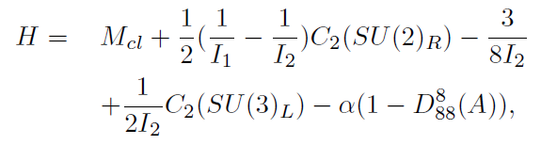



III. Exotic baryons
Symmetry breaking term
A. Representation mixing
Non-diagonal matrix elements

Slide 23


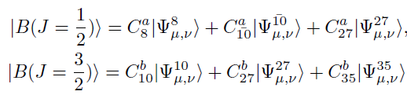


Diagonalization
HKL, H.Y. Park, PRD 70, 074033(2004)
Baryons in ?

Slide 24

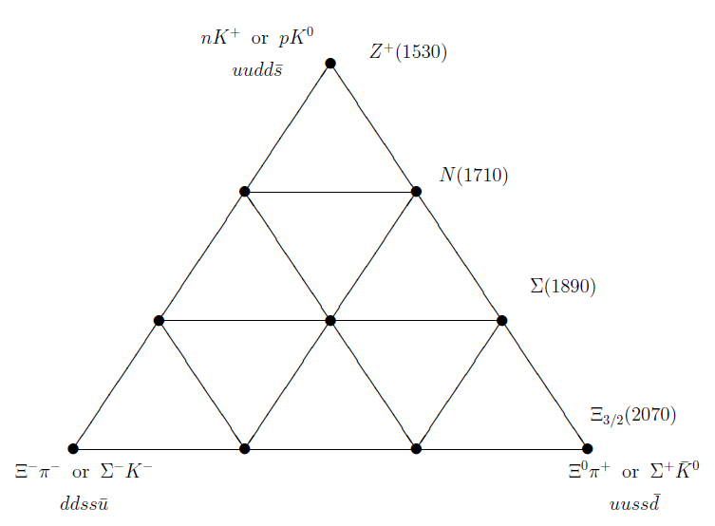




B. Exotic baryons
D.Diakonov,V.Petrov, M. Polyakov, Z. Phys.A359,305(1997)

Slide 25
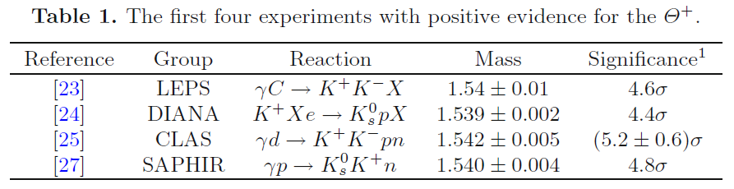
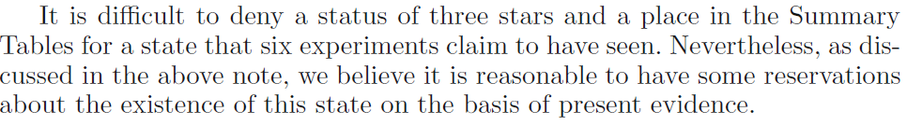
Positive and negative results
K.H.Hicks, Eur. Phys. J. H37, 1(2012)
PDG 2004

Slide 26
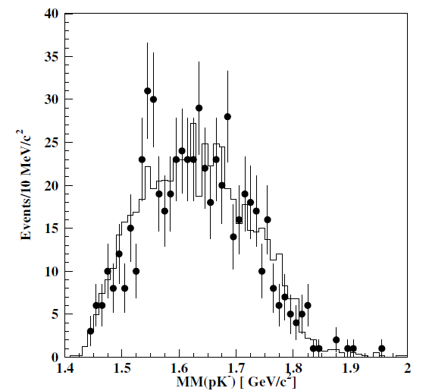
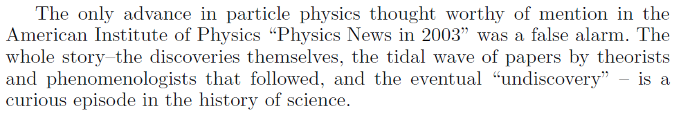
PDG 2009

Slide 27

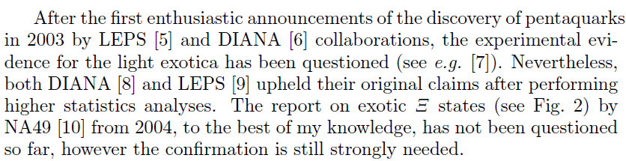
PDG 2017
M. Praszalowicz, arXiv:1707.08474

Slide 28

Nuclear matter
Condensed matter
Hedgehog power

