Slide 1
Exotic particles and nuclei and their implication in the BBN and stellar evolution
Myung Ki Cheon (Soongsil University)
“ International Journal Modern Physics E, Vol 26, No.8 (2017), 1741004 ”
“ International Journal Modern Physics E, Vol 26, No.8 (2017), 1741006 ”
Joint Symposium on Nuclear, Particle & Field, and Astro Physics (SYNPA2017) and Heavy-Ion Meeting (HIM) - 17 Nov 2017-18 Chonnam National University.

Slide 2
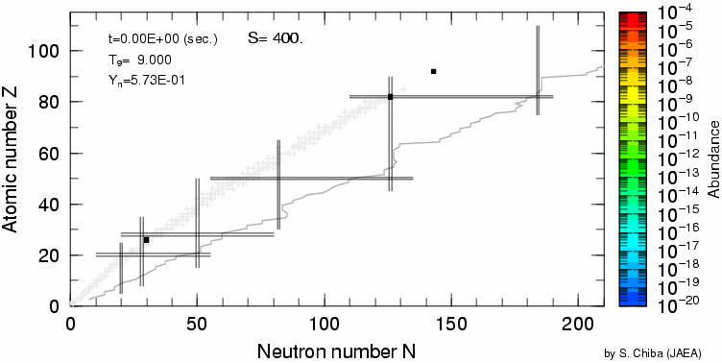
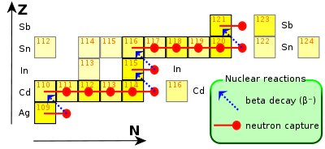
1. 연구 개요 및 목표
1-1. 연구 개요 : 원소의 생성 과정
Supernova Nucleosynthesis in Neutrino-Driven Winds
Movie by Chiba, Koura & Kajino
²³⁵U
²⁰⁸Pb
Exotic Nuclear Structure and Reactions
heavily depend on Nuclear Models
184
126
82
50
28
20
¹³²Sn
Proton Number Z
⁵⁸Ni
⁵⁶Fe
⁴⁰Ca
Neutron Number N

Slide 3
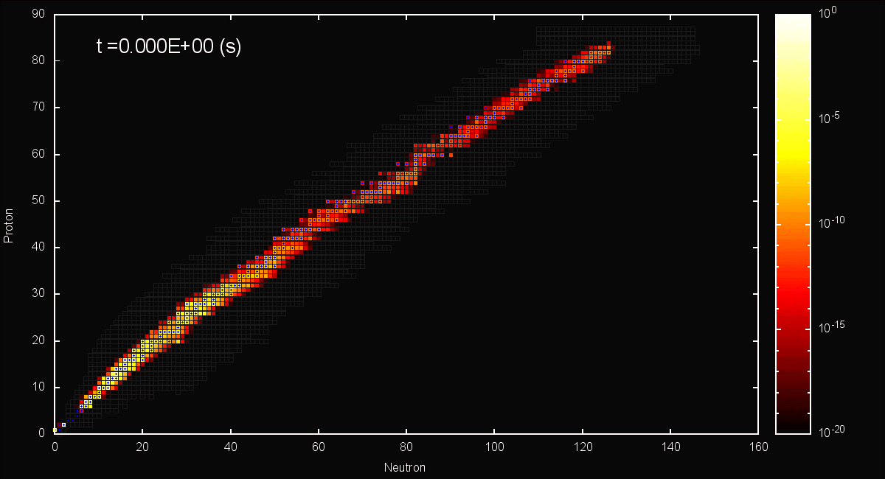



Nuclear chart simulation
N=50
$${}_{}^{98}Tc$$
Z=50
N=28
N=20
N=8
Z=28
Z=20
Z=8
Middle of O-rich ~ He/C layer (2.4 ~ 6 $M_{⨀}$)

Slide 4
X-particles in BBN

Slide 5
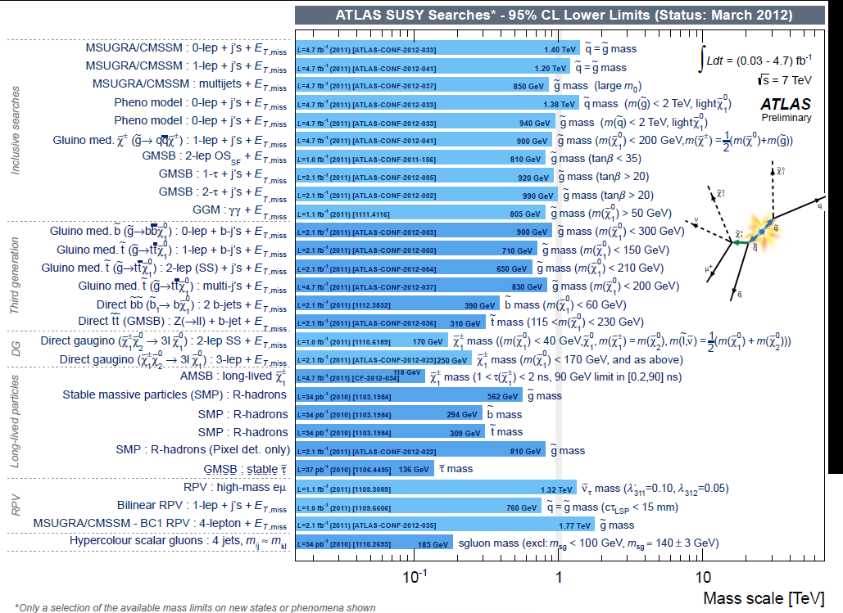
XBBN

Slide 6
I. Introduction
1. Thermal history of the universe
Big Bang Theory → It was hot in the early universe
→Signatures may be left on elemental abundances
ħ=c=k_{B}≡1
1MeV=1.1605×10¹⁰ K
Big
Bang
200 MeV
1-0.01MeV
0.3eV
0.2meV
Quark Hadron
Transition
Big Bang
Nucleosynthesis
(BBN)
Recombination of
Nuclei with e⁻
Decoupling of γ and e⁻
Temperature
[Components]
Neutrino
Background
Leptons
& quarks
?
Abundances
Observation!
Gauge
boson
Any signature
of new physics?
Observation!
Photon
3K
Background
Exotic
particles

Slide 7
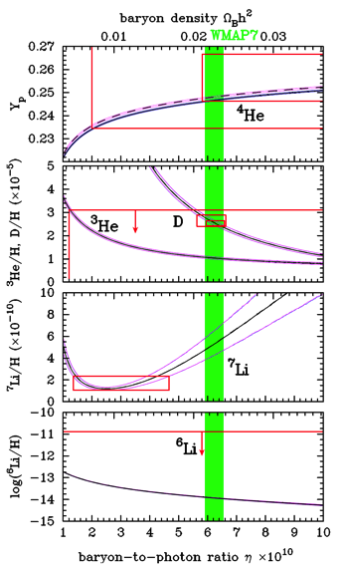
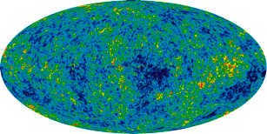
2. BBN Theory and observation
WMAP7
Standard big bang nucleosynthesis (SBBN)
parameter: baryon-to-photon ratio η
Observation of CMB →constraint on η
Observation of metal-poor stars (MPSs)
    ⁷Li abundance is smaller than theory
    by a factor of ~3
Find the solution of the ⁷Li problem,
& identify the processes in the early universe
Derive constraints on particle models
WMAP Science Team
Signature of new physics?
Goals
Kawasaki & MK, PRD 86,
063003 (2012)

Slide 8
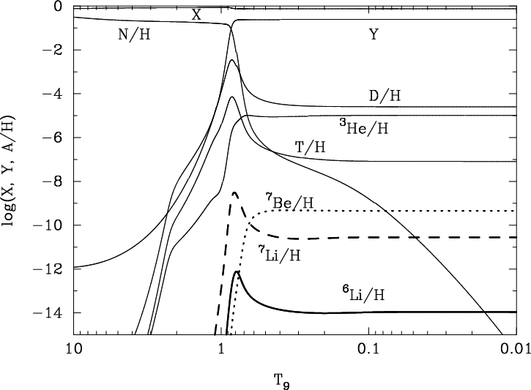
3. Standard Big Bang nucleosynthesis (SBBN)
n↔p equilibrium (n/p)_{EQ}=exp(-Q/T) Q≡m_{n}-m_{p}=1.293MeV
t~1sec,T=T_{F}~1MeV(week interaction freeze-out)
  νν e⁺e⁻ γγ
  n↔p
  e± γγ (T~m_{e}/3)
  (n/p)_{freeze-out}=exp(-Q/T_{F})~1/6
(1MeV=1.16×10¹⁰ K)
Kawano code (1992)
Rates…Smith et al. (1993)
+Descouvemont et al. (2004)
+Cyburt & Davids (2008)
τ_{n}=881.9s
(Mathews et al. 2005)
⁷Li(p,α)⁴He
⁷Be→⁷Li
e⁻-capture after recombination
⁶Li(p,α)³He
T(α,γ)⁷Li
η=n_{b}/n_{γ}=6.3×10⁻¹⁰
←WMAP(Dunkley et al. 2008)
³He(α,γ)⁷Be
D(α,γ)⁶Li
T₉≡T/(10⁹K)

Slide 9
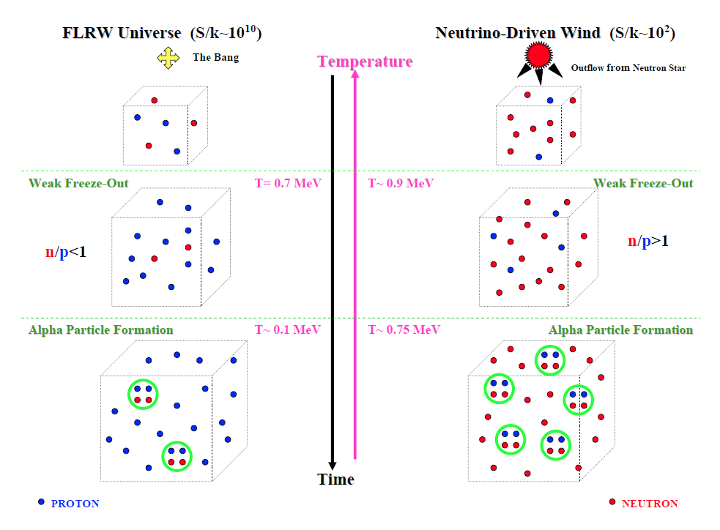
Courtesy by W. Fowler

Slide 10
II. Effect of Negatively charged massive particle (CHAMP) on BBN
CHAMP X⁻ recombines with nuclide A, and
X-nuclide (A_{X}) forms (Cahn & Glashow 1981)
X-nucleus
X⁻
exotic atoms form →exotic nucleosynthesis
(Pospelov 2007, Kohri & Takayama 2007, Kawasaki et al. 2007-,
Hamaguchi et al. 2007, Jedamzik 2008-, Kusakabe et al. 2007-)
nuclide A
  Recombination of X⁻ and nuclide (e. g. De Rujula et al. 1990, Dimopoulos et al 1990)
  Nuclear reaction of X-nuclide (e.g. Kohri & Takayama 2007)
  resonant reaction via exotic atoms of ⁸B_{X}* (Bird et al. 2008; MK et al. 2007)
X⁻
γ
A
X⁻
A
a
X⁻
A
X⁻
B
b
p
⁷Be
γ
X⁻
X⁻
⁸B*
X⁻
⁸B
Important reactions related to ⁷Be abundance
(1) Another process for ⁷Be_{X} formation
⁷Be(X⁻, γ)⁷Be_{X}
⁷Be_{X}+p→⁸B_{X}*→⁸B_{X}+γ
⁷Be(e⁻, γ)⁷Be³⁺(X⁻, e⁻)⁷Be_{X}
(MK, Kim, Cheoun, Kajino, Kino, PRD 88, 063514, 2013)

Slide 11
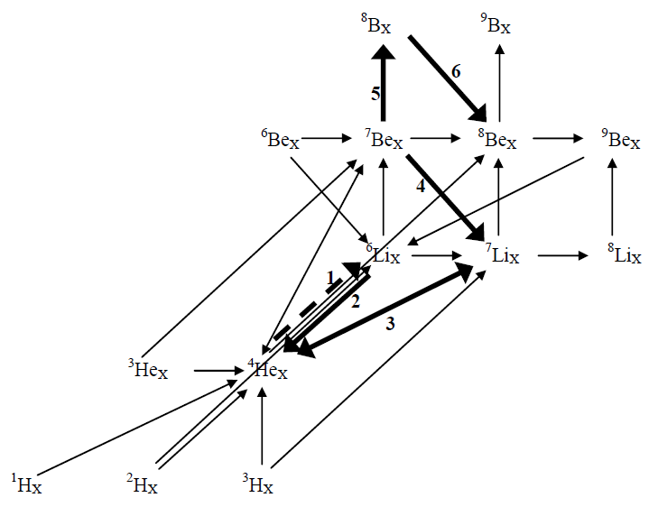
Reaction network of X-nuclei
Up to C_{X}
MK, Kajino, Boyd, Yoshida, Mathews,
PRD 76, 76,121302 (2007); Astrophys. J. 680, 846 (2008);
PRD 81, 083521 (2010)
Important reactions
X⁻ recombination: 16
X nuclear reaction: 59
（including β-decay: 2）
X⁻ charge transfer: 3
X-decay: 11
⁴He_{X}(d, X⁻)⁶Li
⁶Li_{X}(p, ³He α)X⁻
⁴He_{X}(t, γ)⁷Li_{X} & ⁷Li_{X}(p, 2α)X⁻
⁷Be_{X}(, X⁰)⁷Li
⁷Be_{X}(p, γ)⁸B_{X}
⁸B_{X}(, e⁺ν_{e})⁸Be_{X}

Slide 12
4. Nuclear reaction rate
Binding energies of X-nuclei → reaction Q-values, detailed balance
Reaction rates of X-nuclei are estimated with those of normal nuclei
correcting for charge number and reduced mass
We adopt cross sections calculated with a quantum three-body model (Hamaguchi et al. 2007, Kamimura et al. 2008)
Important resonant reaction:
p
⁷Be
γ
X⁻
X⁻
⁸B*
X⁻
⁸B
energy
(MeV)
⁸B_{X}*ª(n=2, l=1)
atomic ES
(Bird et al. 2007)
⁸B*(1⁺)_{X}
0.166
atomic GS composed of nuclear ES and X⁻
(MK, Kajino, Boyd, Yoshida, Mathews, PRD 2007)
0.117
⁷Be_{X}+p
0.770
0.819
⁸B_{X}
2⁺
(m_{X}=∞)

Slide 13
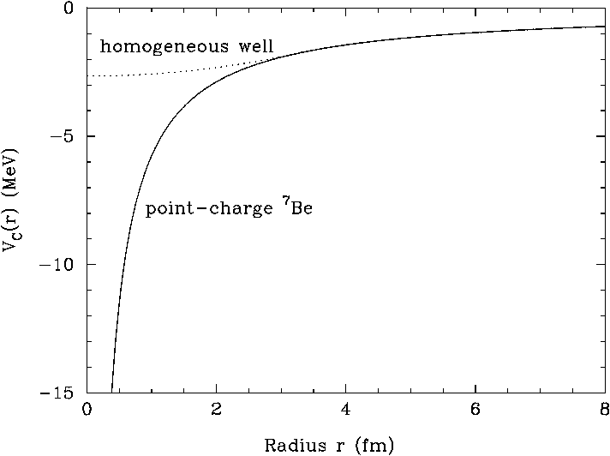
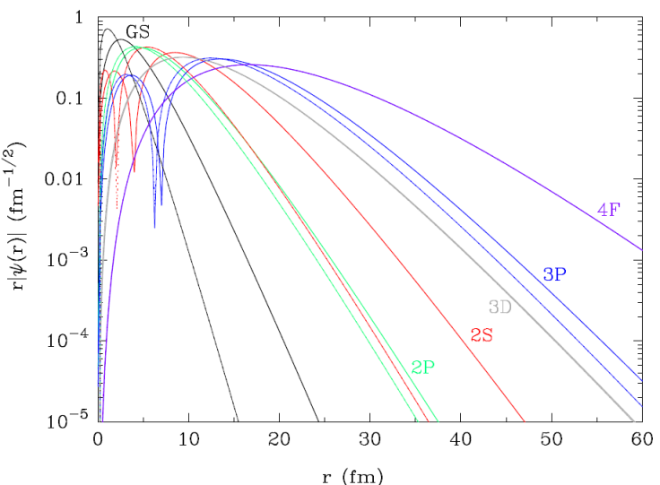
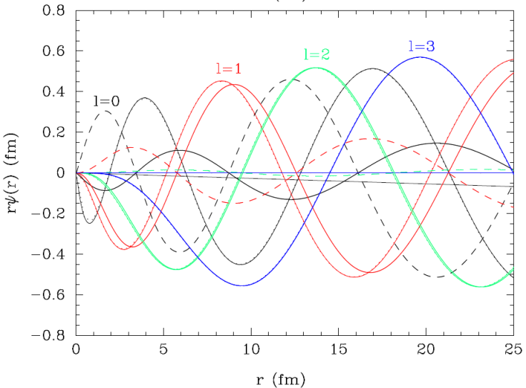
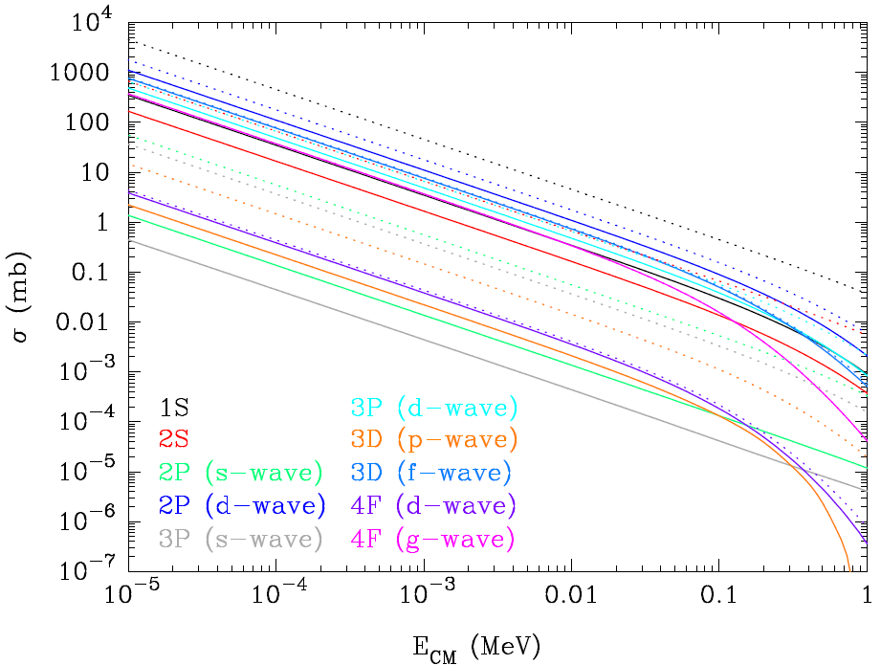
3. Recombination cross section
Resonant and nonresonant cross sections for (⁷Be, ⁷Li, ⁹Be, ⁴He)
Finite size of nuclear charge
→binding energies of tightly bound states are smaller than those of point-charges
→wave functions and recombination cross sections are also different
ex ) ⁷Be_{X} (m_{X}=1 TeV)
b.s. wfs
s. s. wfs
Nonresonant cross section
Smaller binding energies of lower states
→The most important transition is
d-wave →2P state
(cf. p-wave → 1S state for electronic ion case)
→inclusion of many transitions
→rate is 6 times larger than previous result

Slide 14
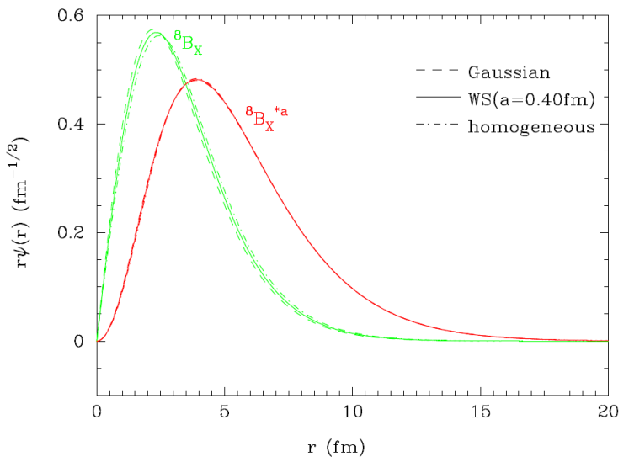
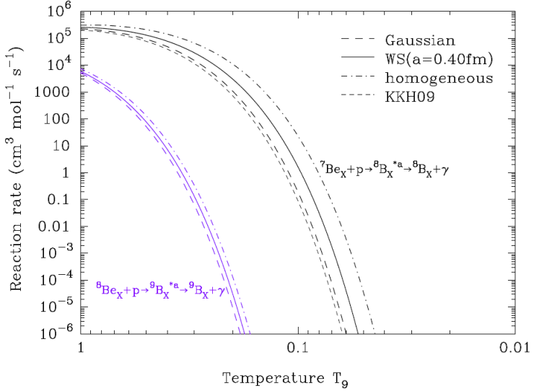
4. Nuclear reaction rate
Binding energies of X-nuclei → reaction Q-values, detailed balance
Reaction rates of X-nuclei are estimated with those of normal nuclei
correcting for charge number and reduced mass
We adopt cross sections calculated with a quantum three-body model (Hamaguchi et al. 2007, Kamimura et al. 2008)
Important resonant reaction:
p
⁷Be
γ
X⁻
X⁻
⁸B*
X⁻
⁸B
ex) m_{X}=∞
b.s. wfs (⁸B_{X})
Thermal reaction rates

Slide 15
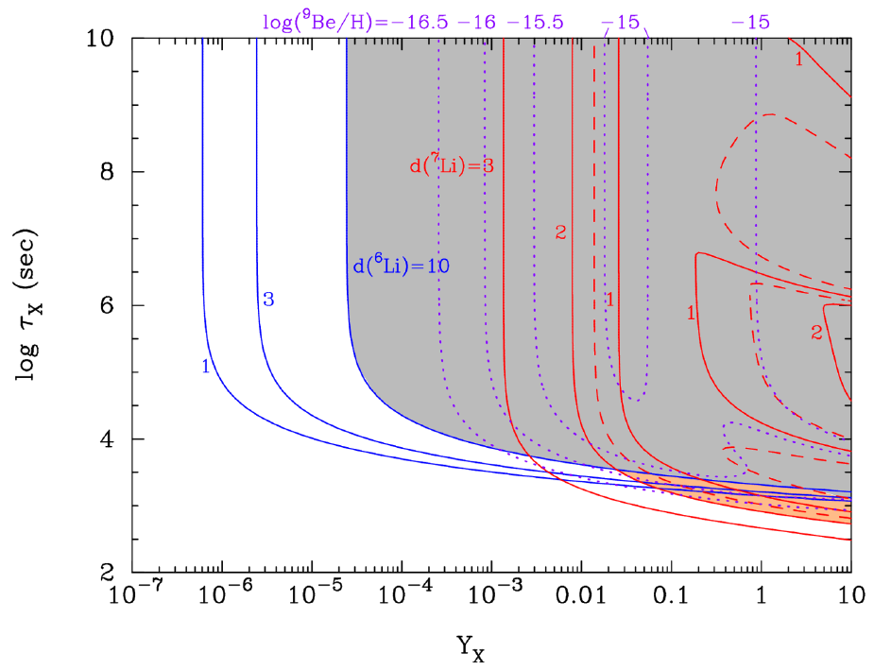
Parameter search: case 1 (m_{x}=1 TeV)
Contours of calculated Li abundance relative to the
observed value: d(^{A}Li)=^{A}Li^{Calc}/^{A}Li^{Obs}
η=6.19×10⁻¹⁰
(WMAP 9yr)
Lifetime
⁶Li production
⁷Li reduction
Region for
⁷Li reduction without
⁶Li overproduction
Abundance Y_{X}=n_{X}/n_{b}
Realistic parameter region is shifted to Y_{X} ≿ 0.02 and τ_{X}≈(0.6-3)x10³s
from the previous one: Y_{X} ≿ 1 and τ_{X}≈(1-2)x10³ s (MK et al. 2010)

Slide 16
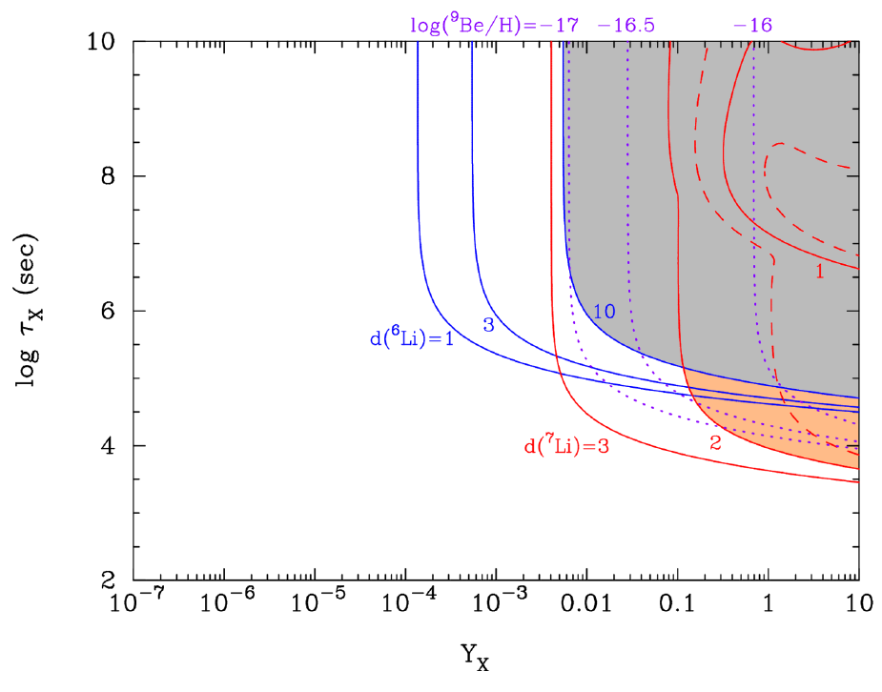
Parameter search: case 2 (m_{x}=1 GeV)
Contours of calculated Li abundance relative to the
observed value: d(^{A}Li)=^{A}Li^{Calc}/^{A}Li^{Obs}
η=6.19×10⁻¹⁰
(WMAP 9yr)
Lifetime
⁶Li production
⁷Li reduction
Region for
⁷Li reduction without
⁶Li overproduction
Abundance Y_{X}=n_{X}/n_{b}
Parameter region for smaller mass cases locates at longer lifetime region:
Y_{X} ≿ 0.1 and τ_{X}≈5x10³-2x10⁵ s (for m_{X}=1 GeV)

Slide 17
Summary
We calculated light-element nucleosynthesis during BBN with negatively-charged X⁻ particles dynamically.
New route of ⁷Be_{X} formation (⁷Be exchange between ⁷Be³⁺ and X⁻)
We calculated rates of recombination of X⁻ and ⁷Be, ⁷Li, ⁹Be, ⁴He
New ⁹Be production reaction [⁷Li_{X}(d, X⁻)⁹Be].
Parameter region of ⁷Li reduction is moved
  Y_{X} ≿ 0.02 and t_{X}≈(0.6-3)x10³s (for m_{X}=1 TeV)
  →required abundance of X⁻ particle is smaller than the previous estimate by more than a factor of 10
Resulting ⁷Li abundance depends significantly on assumed nuclear charge distribution
  Energy levels of X-nuclides are affected by charge distribution
  → resonant reaction rates are also affected

Slide 18
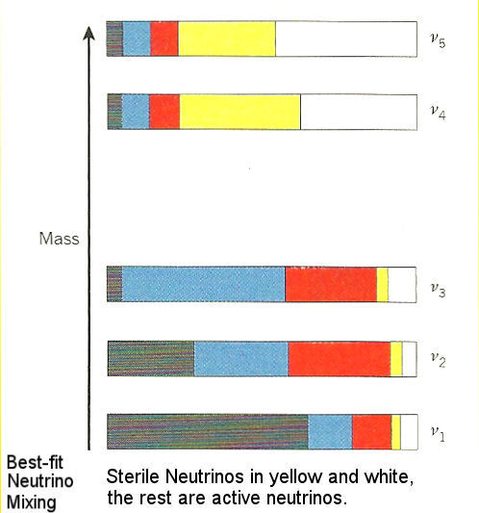
Sterile
Neutrino

Slide 19
However, Four Experimental Anomalies
Do Not Fit Within the 3ν Mixing Picture
  LSND
  MiniBooNE
  The Gallium Anomaly
  The Short Base-Line Reactor Neutrino Anomaly
These anomalies possibly suggest a fourth sterile neutrino, requiring a mass on the 1 eV scale.
However, there are also complex nuclear physics issues associated with each anomaly.

Slide 20
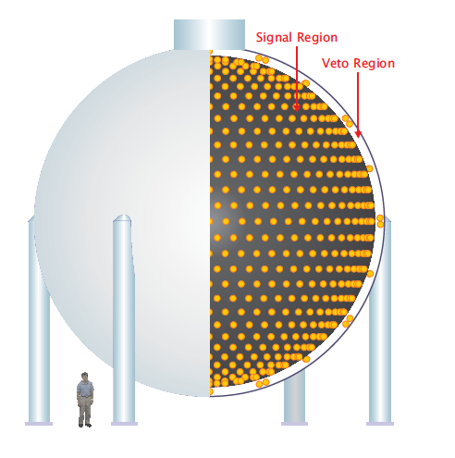


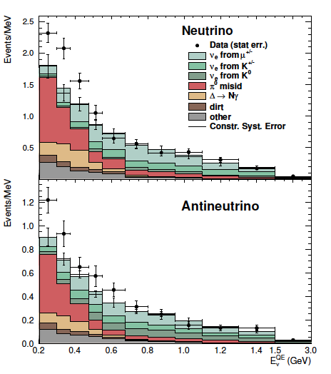
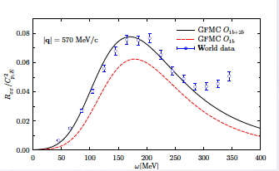
MiniBooNE
Uses the Booster Neutrino Beam at Fermilab
Designed to test LSND , same L/E, but with <E>~ GeV, L=541 m
Searched for:
Observed an excess below 500 MeV
Observed no excess above 500 MeV
To explain both LSND and MiniBooNe by oscillations requires 3 active & 2 sterile neutrinos (3+2 models)
Conrad et al., Rev. Nucl. Part. Sci. 63, 45 (2013)
Kopp, JHEP05(2013)050; Gariazz0 et al., arXiv:1507.08204 (2015)
Lavato et al. find that 2-body currents enhance both the vector and axial contributions to the neutrino cross sections
arXiv:1509.00451
PRL, 98 (23): 231801

Slide 21
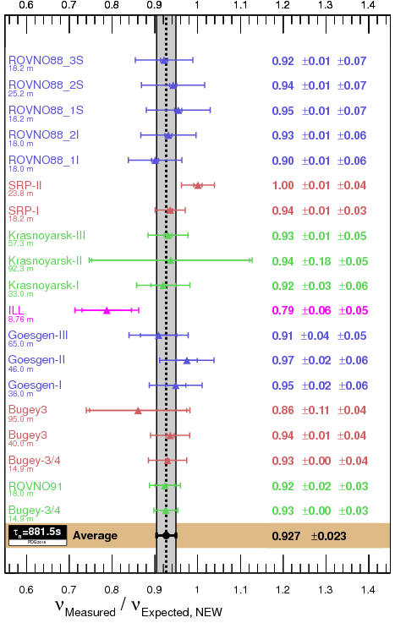
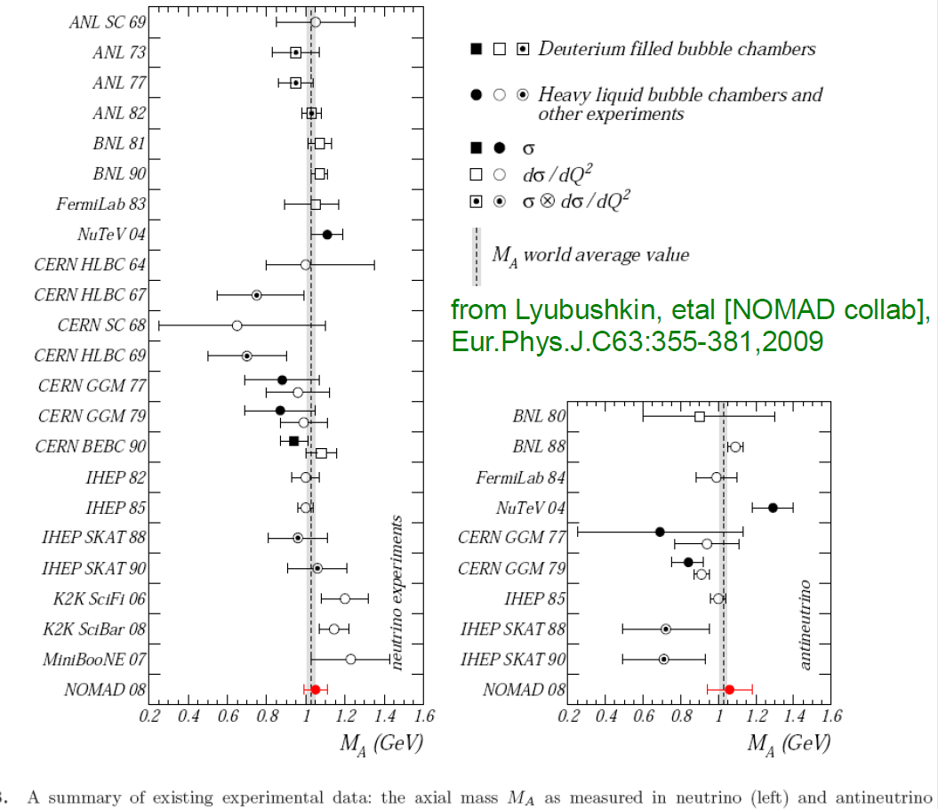
Summary of M_{A} experiments
M_{A} = 1.03 ~ 1.32 GeV ? OPEN PROBLEM !

Slide 24
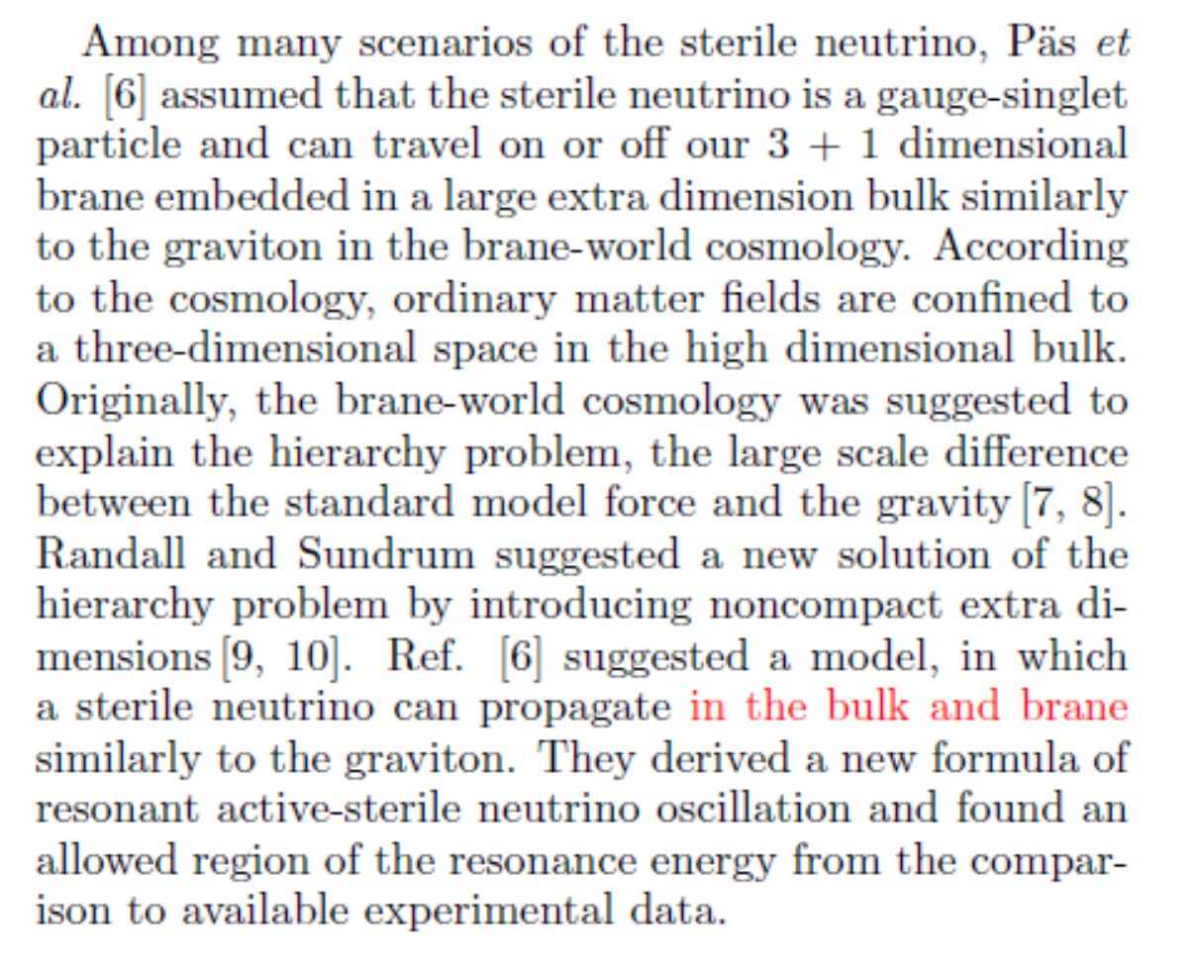
How to understand the origin of Sterile Neutrino ?

Slide 25
Sterile-active neutrino oscillations
and shortcuts in the extra dimension
[H. pas et al., Phys. Rev. D 72, 095017 (2005)]
Brane
How does it affect the big bang nucleosynthesis?

Slide 26
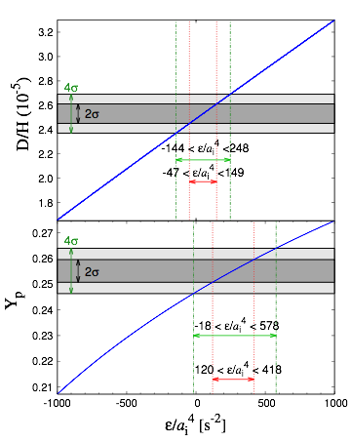


The cosmic expansion rate in five-dimensional universe
P. Binetrun et al., Phys. Lett. B 477, 285 (2000)
D/H : R. Cooke et al., Astrophys. J. 781, 31 (2014)
Yp : Y. I. Izotov et al., Astron. Soc. 445, 778 (2014)

Slide 27
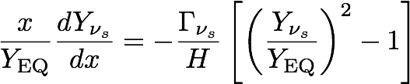

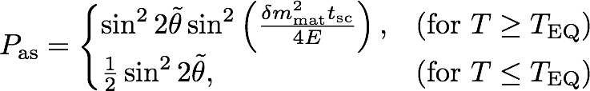
The energy density of the sterile neutrino
Rate equation
The production rate of the sterile neutrino :

Slide 28
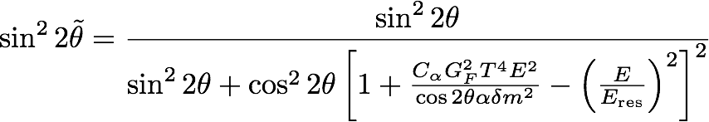
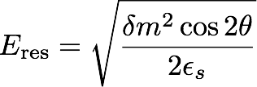


The effective mixing angle
Geodesic
differences between
bulk and brane
Matter effect
Resonance energy

Slide 29
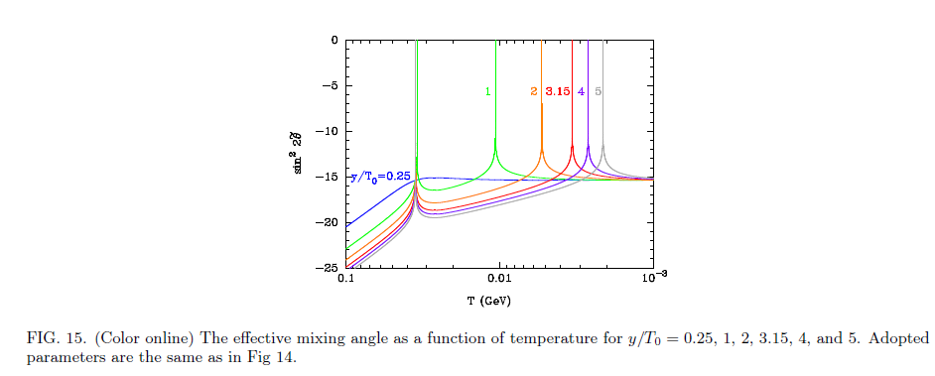

Slide 30

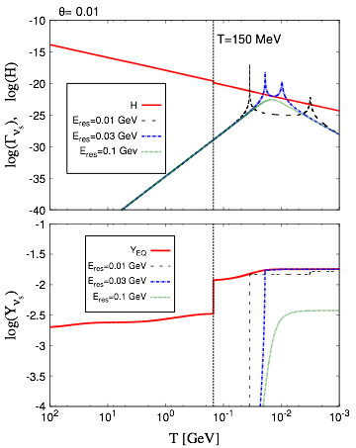
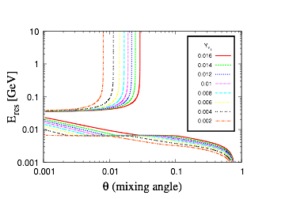
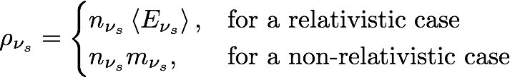
The result of the rate equation
Contour
Temperature evolution

Slide 31


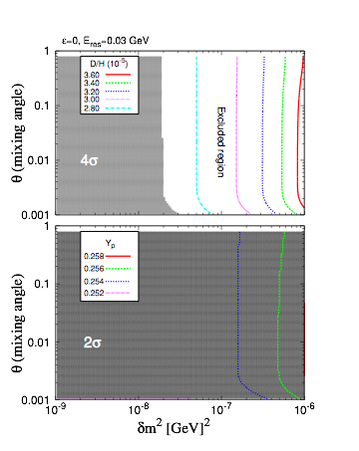
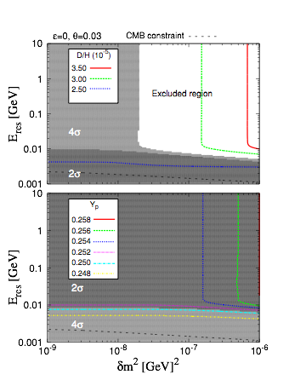
BBN constraint

Slide 32
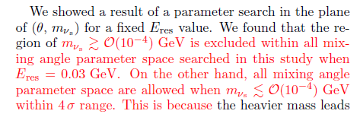

Slide 33
Nuclear Pasta in Neutron Star

Slide 34
Tsuyoshi Miyatsu, Myung-Ki Cheoun (SoongSil U.), Koichi Saito (Tokyo U. of Sci., Noda Campus).
Published in Astrophys.J. 813 (2015) no.2, 135

Slide 35
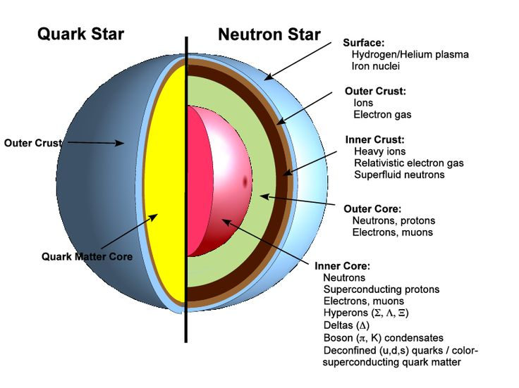
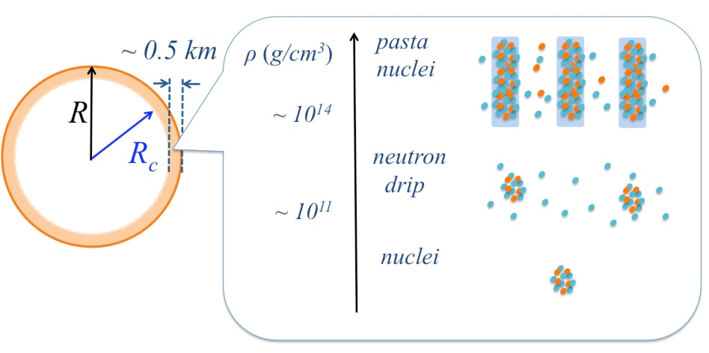
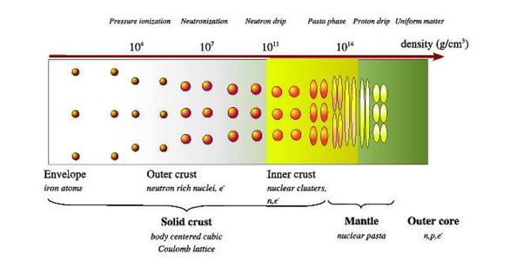

Slide 36
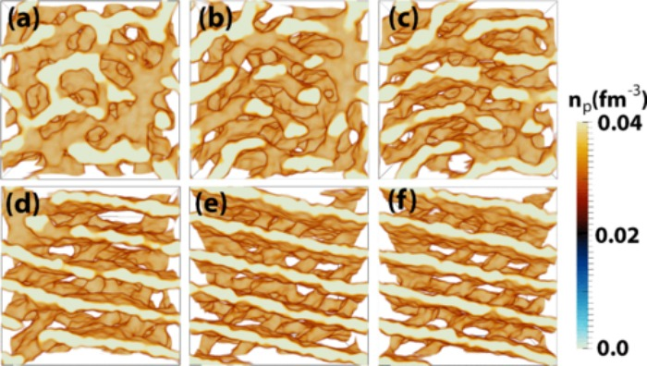
This nuclear pasta forms in the dense crust of a neutron star thanks to long-range repulsive forces competing with something called the strong force, which is the force that binds quarks together.
In other words, two powerful forces are working against one another, forcing the matter – which consists of various particles – to structure itself in a scaffold-like (pasta) way.
As one of the team, Greg Huber, a biological physicist from the University of California, Santa Barbara, explains:
"When you have a dense collection of protons and neutrons like you do on the surface of a neutron star, the strong nuclear force and the electromagnetic forces conspire to give you phases of matter you wouldn't be able to predict if you had just looked at those forces operating on small collections of neutrons and protons."
Now, it turns out that these pasta-like structures look a lot like the structures inside biological cells, even though they are vastly different.
This odd similarity was first discovered in 2014, when Huber was studying the unique shapes on our endoplasmic reticulum (ER) – the little organelle in our cells that makes proteins and lipids.

Slide 37
Particle Production in Strong Magnetic Field

Slide 38
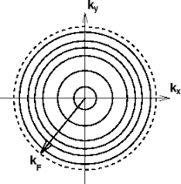
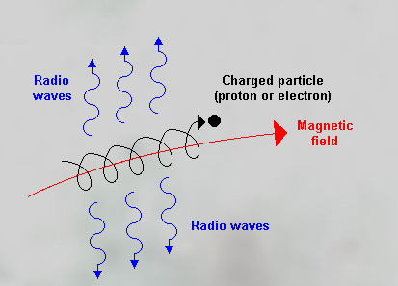


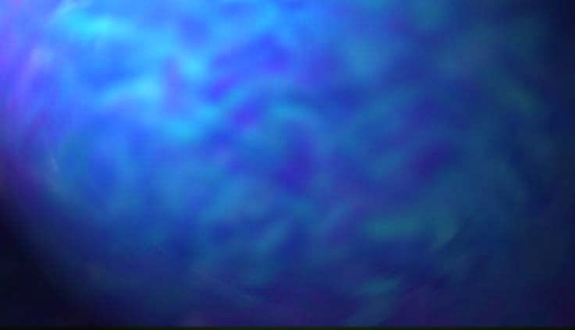
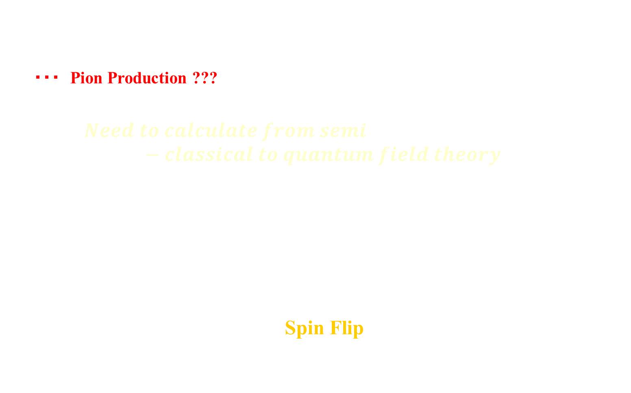
Beyond Synchrotron Radiation
1GeV～1TeV of proton
⇒ Synchrotron Radiation
・・・ Pion Production ???
$(Strong Force > E.Mag. Force)$
$$Need to calculate from semi−classical to quantum field theory$$
Ref: V.L.Ginzburg et al., UsFiN 87, 65, ARA&A 3, 297 (1965)
T.Kajino et al., ApJ 782, 70 (2014)
However, Scalar particle (not PS particle)
PV coupling source term
$q⊥B$ Spin Flip process is dominant?
Anomalous Magnetic Moment ⇒ Tensor field kinematics

Slide 39

Temperature Dependence of Axion Luminosity
Magnetar & SMaF
Axion Luminosity from Magnetar
Axion–N, e Coupling
1/100 of Max. Value
N. Iwamoto, PRL53, 1198 (84)
(keV)

Slide 40

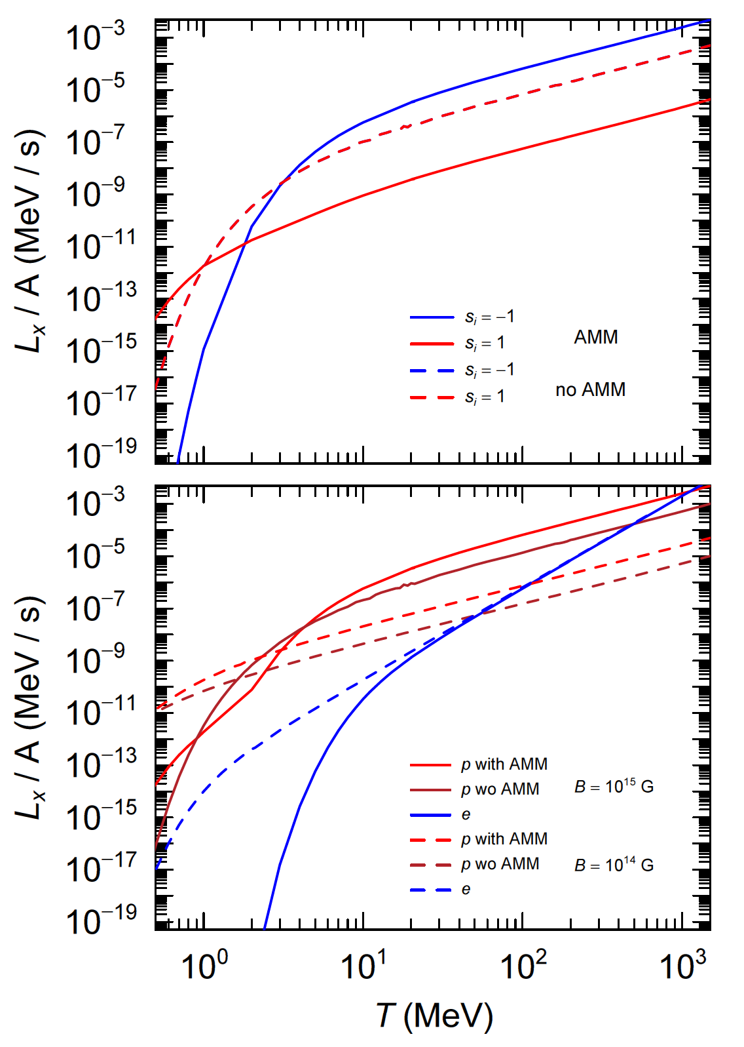
Energy-Interval

Slide 41
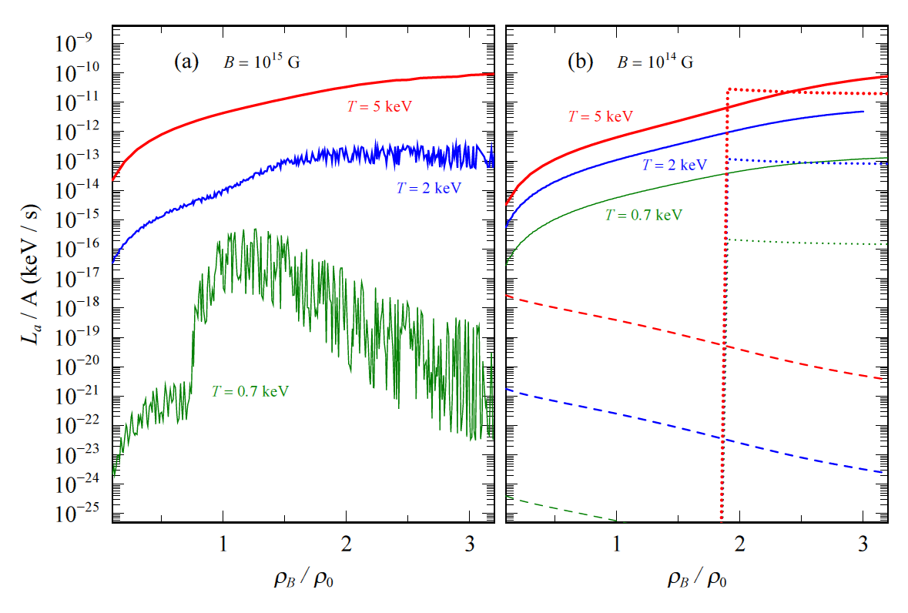
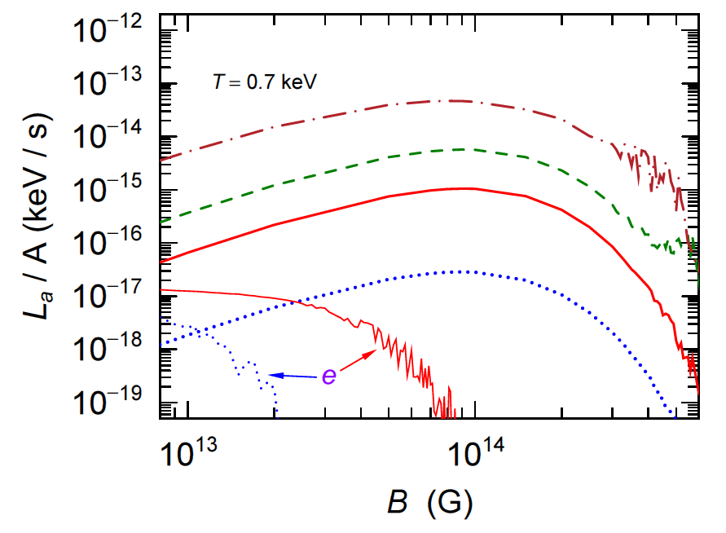
Density Dependence of Axion Luminosity
Magnetar & SMaF
Axion Luminosity from Magnetar
DU
MU
SMaF Dep.

Slide 42
감사합니다.

Slide 43
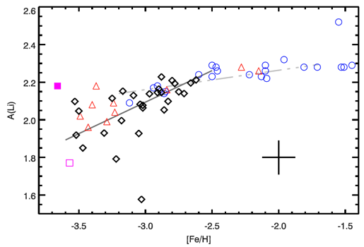
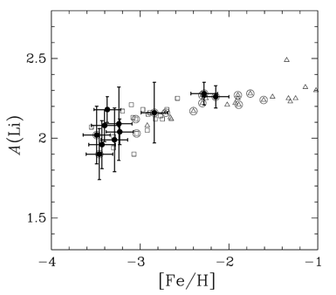
4. ⁷Li problem
⁷Li/H in MPSs < ⁷Li/H in SBBN
⁷Li/H=(1.1-1.5)×10⁻¹⁰ ←fit of LiI 6708 A line
(Spite & Spite 1982, Ryan et al. 2000, Melendez & Ramirez 2004, Asplund et al. 2006, Bonifacio et al. 2007, Shi et al. 2007, Aoki et al. 2009, Sbordone 2010)
log(Li/H)+12
Sbordone et al. (2010)
⁷Li_{SBBN}
Aoki et al. (2009)
Asplund06
Li problem
Aoki09
Sbordone10
Gonzalez Hernandez08
Old stars ~ primordial

Slide 44

4. ⁶Li problem
log(^{6,7}Li/H)+12
Asplund et al. (2006)
⁷Li abundance observed in
metal-poor stars are a
factor~3 smaller than SBBN
It has been reported that
some of the stars have
large abundances of ⁶Li
But, Lind et al. firstly perform
3D NLTE analysis for atmosphere, and found
no detection
⁷Li_{BBN}
Li problem
⁷Li/H=(1.1-1.5)×10⁻¹⁰
Old stars ~ primordial
≿10³x
⁶Li/H ≈ 6×10⁻¹²
⁶Li problem?
⁶Li_{BBN}
-2.0
[Fe/H]=log{(Fe/H)/(Fe/H)₈}
News! Lind et al. Astron. Astrophys. (2013)

