Slide 1
Phénomènes dangereux d’origine chimique

Slide 2
Subjects:
1. CERN chemical safety rules
6. Mitigation
2. Chemical hazards and labelling
7. Personal protective equipment
3. Safety Data Sheet (SDS) – Fiche de Données de Sécurité
8. Disposal of chemicals
4. Chemical storage
9. Safety Training
5. Collective protection

Slide 3
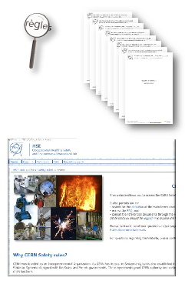
CERN chemical safety rules
CERN has defined its chemical safety rules.
The Safety Regulation on Chemical agents sets out the minimum requirements for the protection of persons from risks to their occupational health and safety.
General Safety Instructions (GSI) have also been established and apply to:
prevention and protection measures
explosives atmospheres
monitoring of exposure to hazardous chemical agents in workplace atmospheres
Chemical safety rules

Slide 4
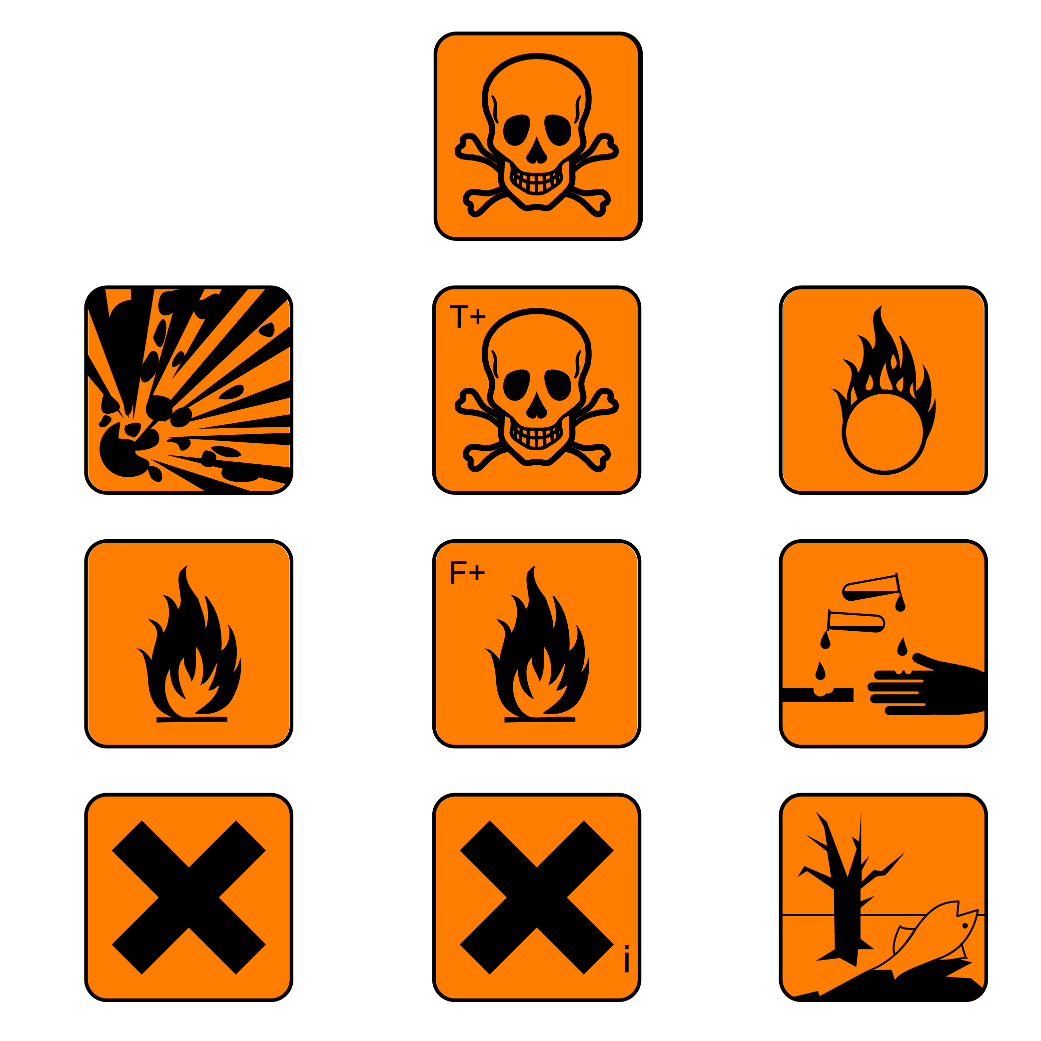
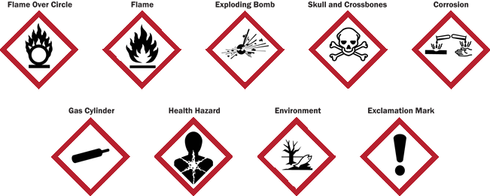
Chemical hazards and labelling
Chemical products must be labelled.
An international classification and labelling system of chemical products is now used
Former
New

Slide 5
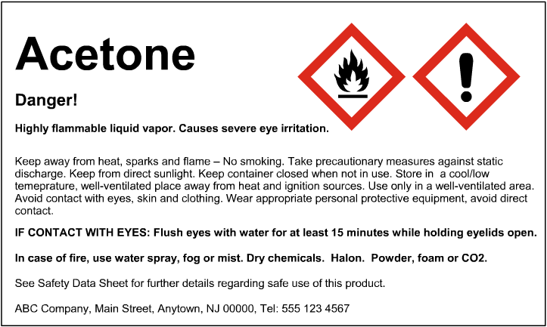
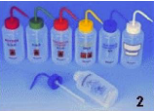
Chemical hazards and labelling
Labels available from the CERN Stores
EC labels
edh.cern.ch
SCEM: 19.19.35
SCEM: 50.55.20

Slide 6
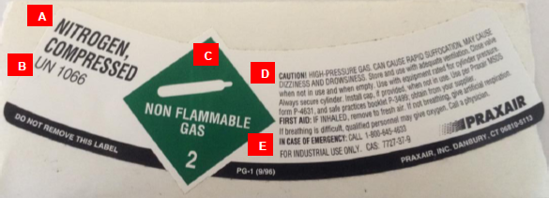
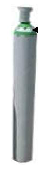
Chemical hazards and labelling
The label is used to provide mandatory information about the gases contained in the bottle.
1
2
3
Label
4
5
1. Name of product
2. Material identification number
3. Hazard diamond
4. Hazards and precautions
5. Contact information

Slide 7
Chemical hazards and labelling
“Toxics”
These substances can be poisonous even at small doses, can pose a serious health risk, in the short or long term, and may even result in death.
Examples: cyanides, methanol, asbestos, wood dust, mercury, lead…
CMR products are carcinogenic, mutagenic and toxic to reproduction.
Examples of carcinogens: asbestos, beryllium and some of its compounds, tobacco, wood dust, chromic acid, chromium VI…
Examples of mutagens: chromic acid, bromine, benzene…
Examples of substances that are toxic to reproduction: lead and some of its compounds, carbon monoxide, mercury…

Slide 8
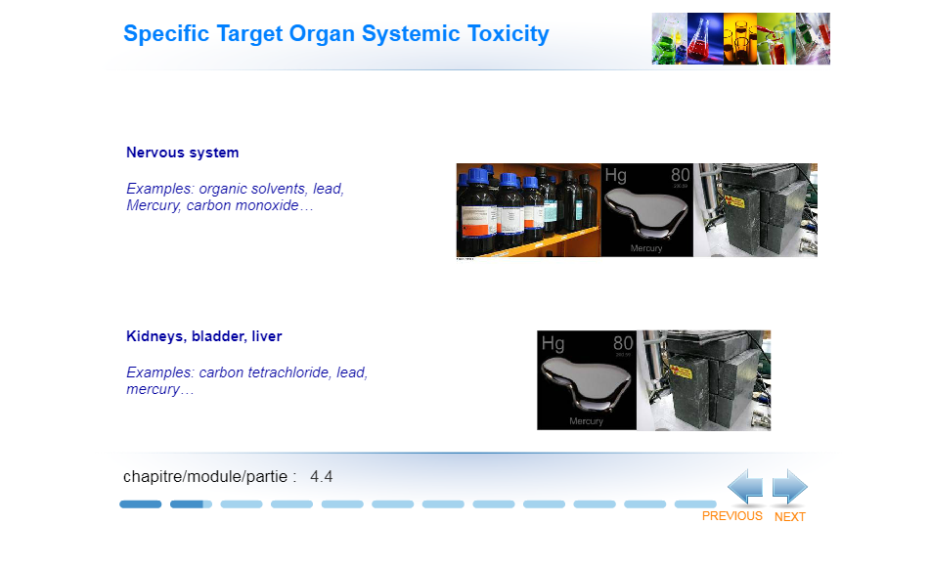
Chemical hazards and labelling
Specific Target Organ Systemic Toxicity
Nervous system
Examples: organic solvents, lead, mercury, carbon monoxide…
Kidneys, bladder, liver
Examples: carbon tetrachloride, lead, mercury…

Slide 9
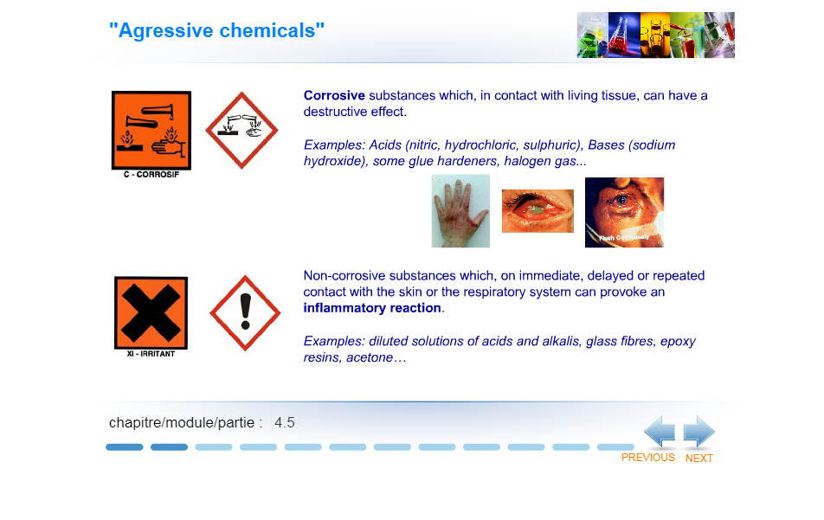
Chemical hazards and labelling
“Agressive chemicals”
Corrosive substances which, when in contact with living tissue, can have a destructive effect.
Examples: acids (nitric, hydrochloric, sulphuric), bases (sodium hydroxide), some glue hardeners, halogen gas…
Non-corrosive substances which, on immediate, delayed or repeated contact with skin or the respiratory system can provoke an inflammatory reaction.
Examples: diluted solutions of acids and alkalis, glass fibres, epoxy resins, acetone…

Slide 10
Chemical hazards and labelling
Physical hazards
Substances which can provoke or aggravate a fire, or even provoke an explosion, if in the presence of flammable materials.
Examples: oxygen, hydrogen peroxide, sodium hypochlorite, nitric acid, perchlorates, permanganates, persulfates…
Substances which can explode:
in contact with a flame, a spark, static electricity,
heat, shock, friction…

Slide 11
Chemical hazards and labelling
Physical hazards
Flammable substances
Self-heating and self-igniting in air normal temperature,
Solids, easily self-igniting in brief contact with an ignition source,
Liquids, which have a flash point below 60°C,
Gases which are flammable in air at normal atmospheric pressure,
Substances which, in contact with water or humidity in the air, react to produce flammable gases in dangerous quantities
Examples: flammable gases (acetylene, methane, isobutane, hydrogen), flammable liquids (ethanol, methanol, acetone), flammable solids (certain metals in the form of dust), alkali metals (“water-reactive”): potassium, sodium, lithium)…

Slide 12
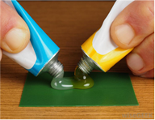
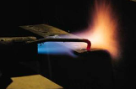
Chemical hazards and labelling
Others
Sensitising agents are chemicals that cause a substantial proportion of people exposed to them to develop an allergic reaction in normal tissue after repeated exposure.
Sensitising in case of skin contact, or respiratory sensitisers (asthma).
Typical reactions to sensitisers can include skin disorders such as eczema.
Examples: some glues, some epoxy resins, some fluxes used in welding/soldering…

Slide 13
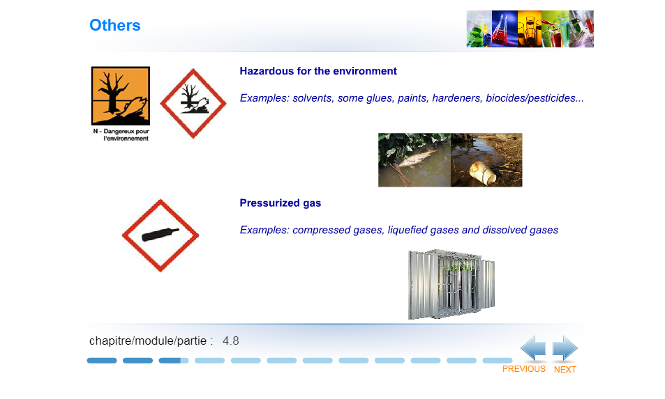
Chemical hazards and labelling
Others
Hazardous for the environment
Examples: solvents, some glues, paints, hardeners, biocides/pesticides…
Pressurised gas
Examples: compressed gases, liquefied gases and dissolved gases

Slide 14
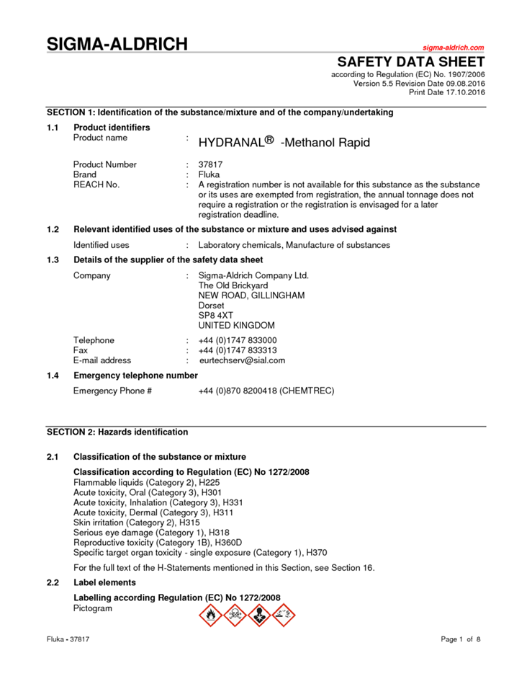
Safety Data Sheet (SDS) – Fiche de Données de Sécurité
Safety Data Sheet
=
main tool to communicate information on chemical product risks
The SDS is:
provided by a supplier to the customer before or at the time of first delivery
free of charge,
on paper or in electronic form,
in English or French.
Note: SDS are available in EDH for chemical products purchased from the CERN Store

Slide 15
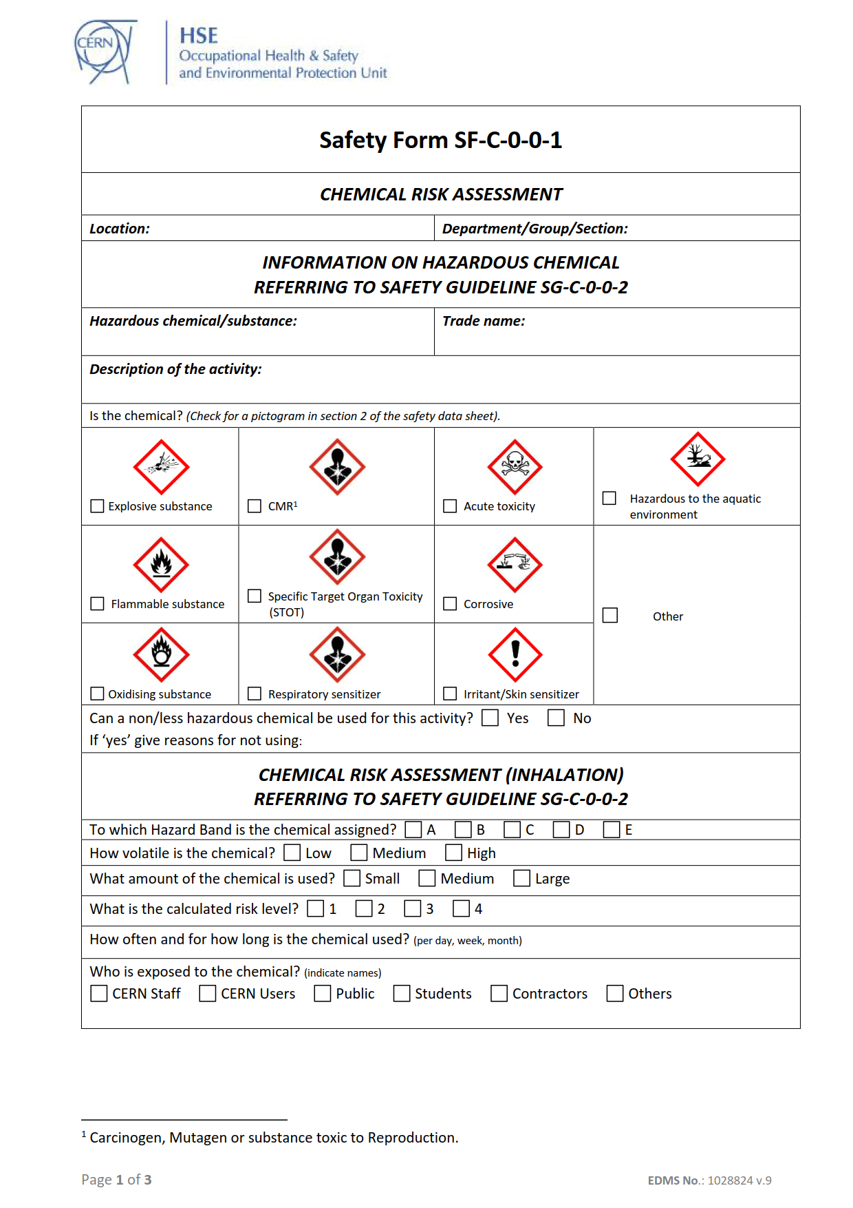
Chemical storage
Use original containers, in good condition,
Legible labels,
Limit the quantities stored,
Permanent general ventilation,
Fill-in the chemical inventory form
(SF-C-1-0-2).

Slide 16






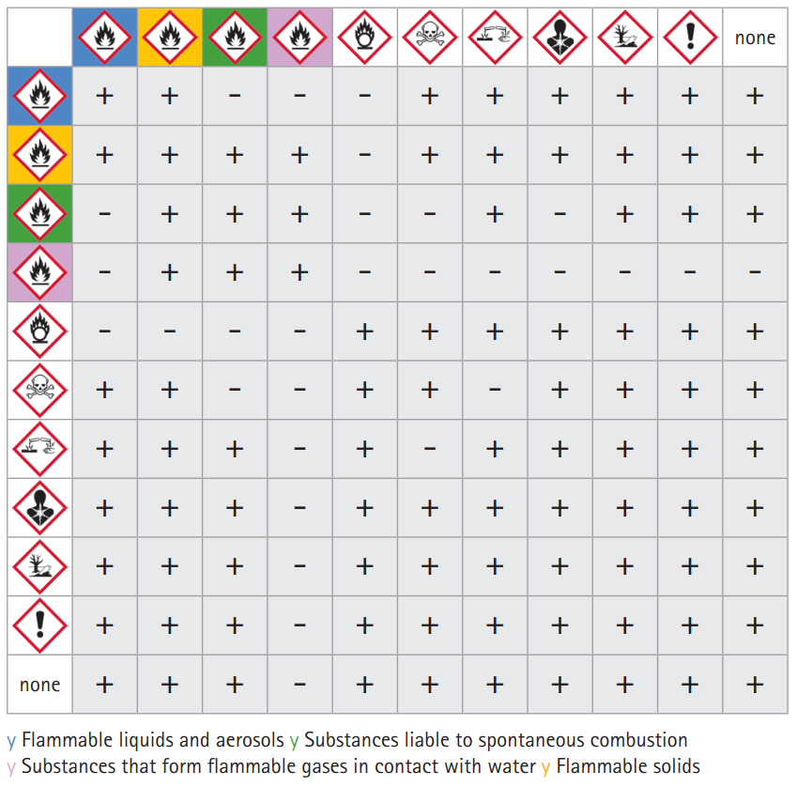
Chemical storage
Separate incompatible chemicals
Place flammable liquids / water reactive chemicals / oxidising / in specific cupboards
Place toxic chemicals in ventilated cupboards
Separate strong acids and bases
Click on the sign to enlarge it
+ | - | - | +
O | - | + | -
+ | + | - | -
+ | + | O | +
 |  |  |  |  |  |  |  |  |  |  | none
 | + | + | - | - | - | + | + | + | + | + | +
 | + | + | + | + | - | + | + | + | + | + | +
 | - | + | + | + | - | - | + | - | + | + | +
 | - | + | + | + | - | - | - | - | - | - | -
 | - | - | - | - | + | + | + | + | + | + | +
 | + | + | - | - | + | + | - | + | + | + | +
 | + | + | + | - | + | - | + | + | + | + | +
 | + | + | + | - | + | + | + | + | + | + | +
 | + | + | + | - | + | + | + | + | + | + | +
 | + | + | + | - | + | + | + | + | + | + | +
none | + | + | + | - | + | + | + | + | + | + | +
Flammable liquids and aerosols
Substances liable to spontaneous combustion
Substances that form flammable gases in contact with water
Flammable solids
Click here to see the colour key

Slide 17
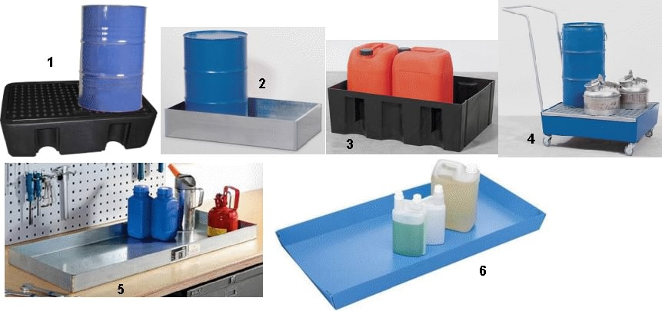
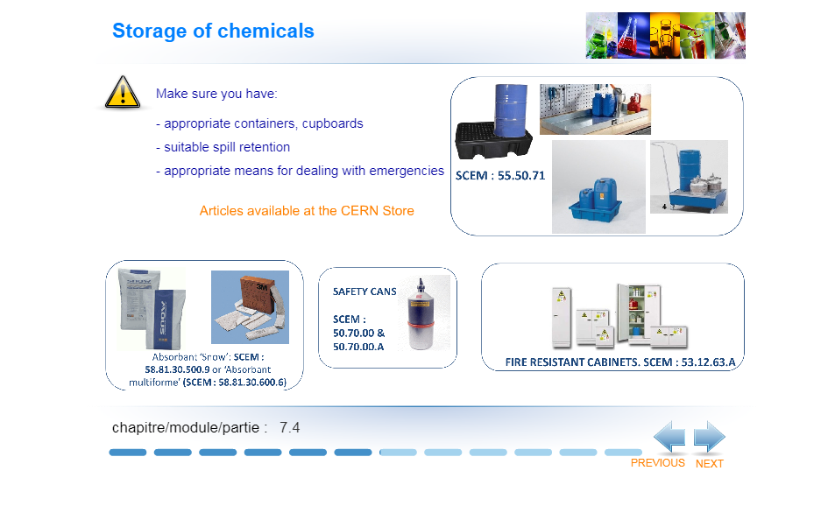
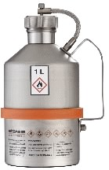
Chemical storage
Make sure you have:
Appropriate containers and cupboards
Suitable spill retention
Appropriate means for dealing with emergencies
(absorbent materials for liquid spills)
SCEM: 55.50.71
Articles available from the CERN Store
Absorbent ‘Snow’: SCEM:
58.81.30.500.9 or ‘Absorbent multiforme’ (SCEM: 58.81.30.600.6)
FIRE RESISTANT CABINETS. SCEM: 53.12.63.A
SAFETY CANS
SCEM: 50.70.00 & 50.70.00.A

Slide 18
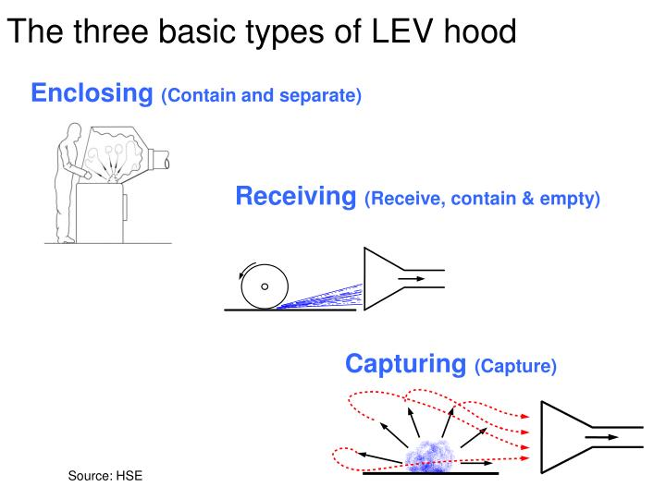
Collective protection equipment
Local exhaust ventilation (LEV) systems are used to eliminate hazardous chemical agents which are likely to become airborne
They must be designed, built, installed and maintained to enable:
either the safe and effective evacuation of the contaminated air from the workplace to a safe area,
or the filtration or treatment of the contaminated air.
Three basic types of LEV hood:
Enclosing
(Contain and separate)
Receiving
(Receive, contain and empty)
Capturing
(Capture)

Slide 19
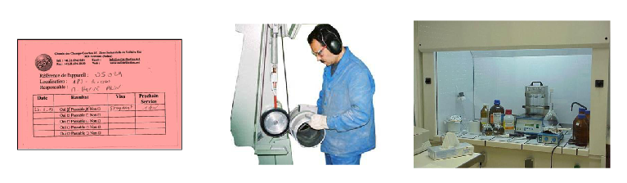
Collective protection equipment
All Local Exhaust Ventilation systems (fume cupboard, capturing/receiving hood…) are subject to an annual inspection and the HSE Unit should have a record of them.
A label which indicates the result of the test and the date for the next control must be visible on the equipment (pink label if test was failed).

Slide 20
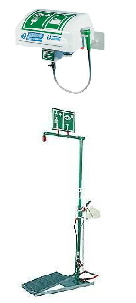
Mitigation
The installation should be based on an assessment of the hazards present
It should be:
as close to the hazard as possible,
at a maximum distance of 30 metres (corresponding to a maximum walking time of 10 seconds),
at a maximum distance of 10 metres (where the risk is judged to be elevated),
easily visible, with unobstructed access (no doors / steps),
safe distance from electrical equipment in the vicinity.

Slide 21
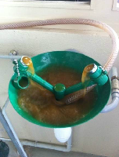
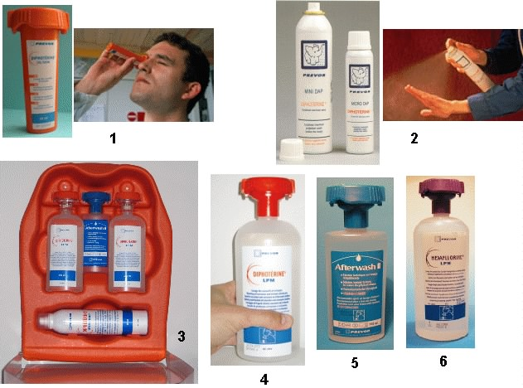
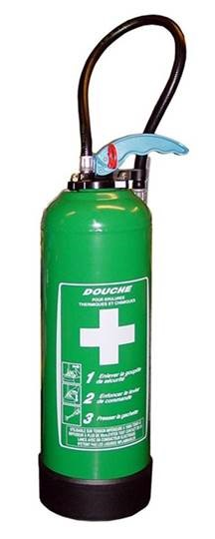
Mitigation
For situations where the installation of a fixed safety shower or eye wash is not practical (e.g. maintenance) or where there are problems with the quality of the water supply…
… portable equipment (e.g. wash bottles, sprays, portable safety shower, etc.) should be used (CERN Stores, SCEM: 50.64.41).

Slide 22


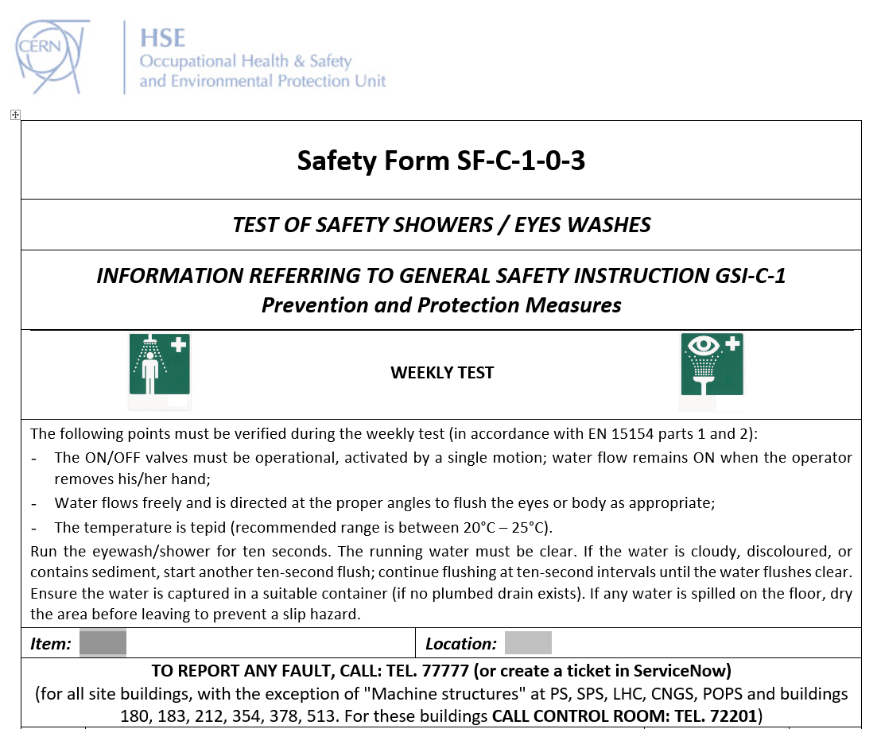
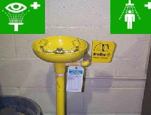
Mitigation
Use the Safety form “Test of safety showers / eyes washes” to register:
weekly test,
faults, observations…
The form should be displayed next to the apparatus

Slide 23
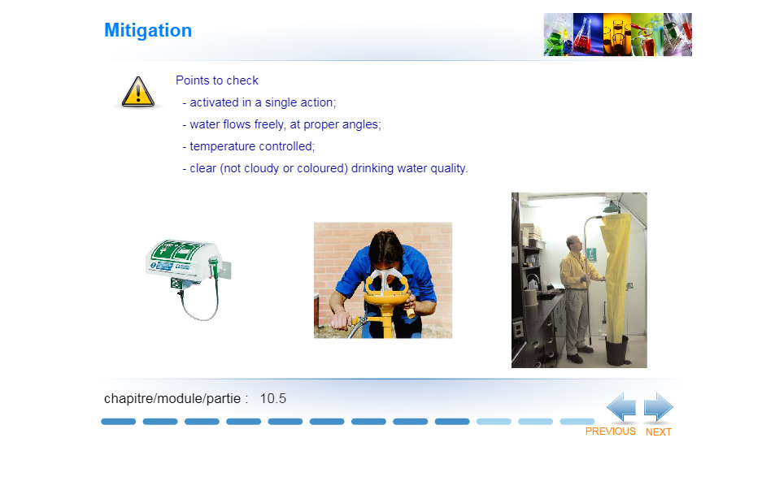
Mitigation
Points to check:
activated in a single action;
water flows freely, at correct angles;
temperature controlled (tepid water, 20-25 °C);
clear (not cloudy or coloured) drinking water quality.

Slide 24
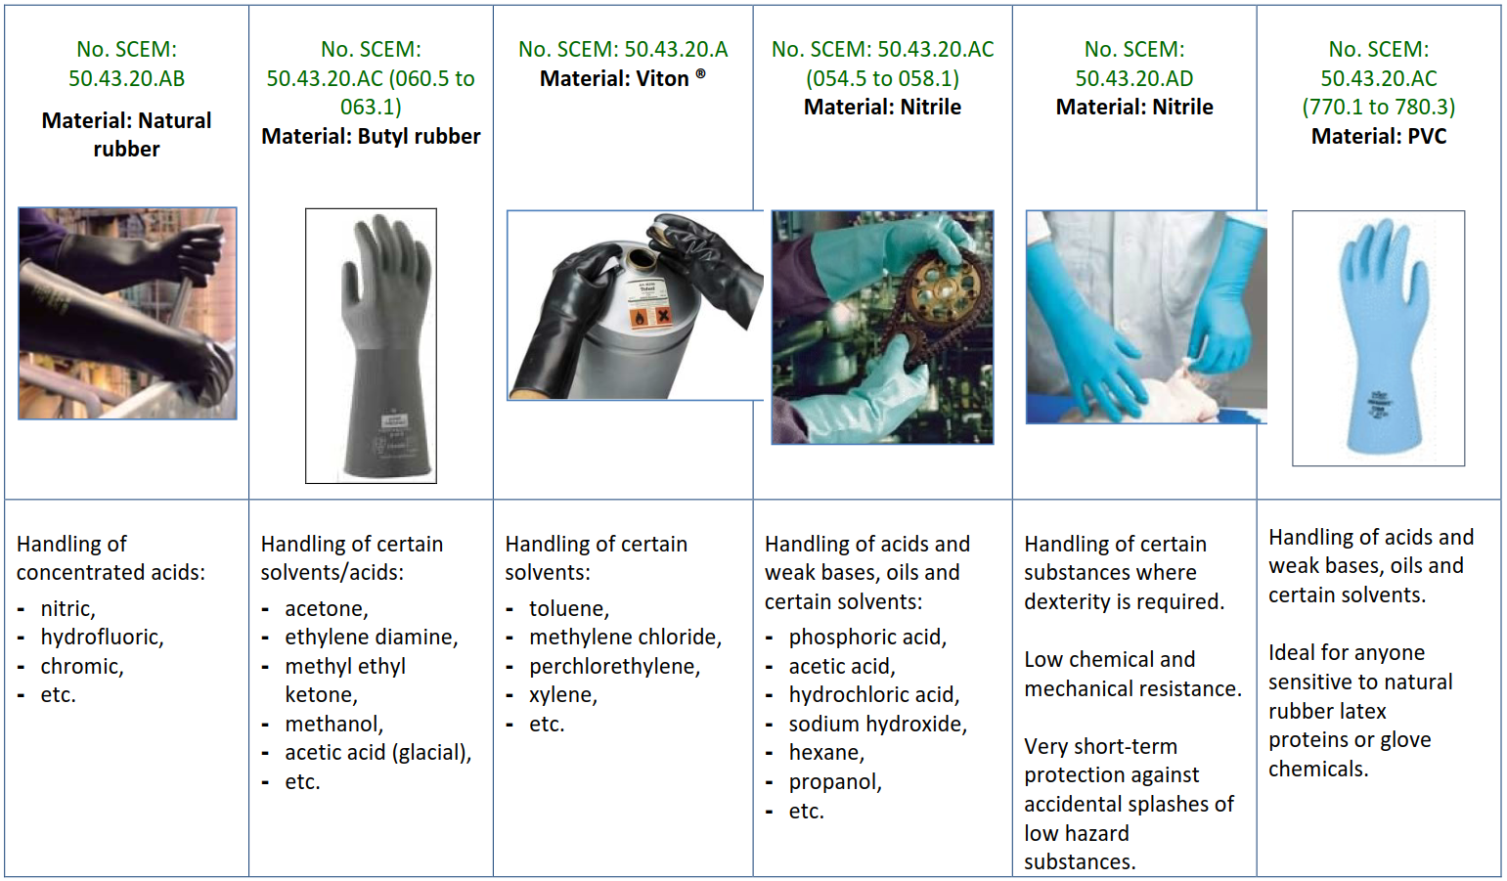

Personal protective equipment
Chemical protective gloves
A range of chemical protective gloves is available from the CERN Stores. Safety Guideline SG-C-1-0-2, Chemical protective gloves.

Slide 25
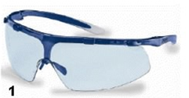

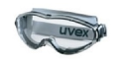
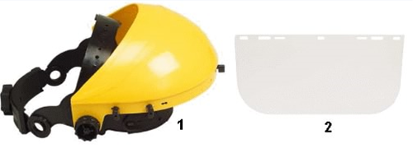
Personal protective equipment
Eye protection.
Safety glasses are the minimum protection required when handling hazardous chemicals. Risk of splashing – use a visor, or even a visor and goggles.
50.49.10.BD – SAFETY GLASSES
50.49.10.D – CHEMICAL GOGGLES
50.49.15.A – VISOR

Slide 26
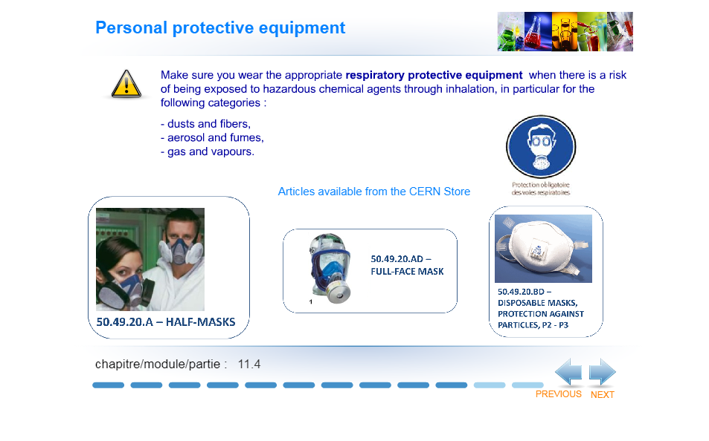

Personal protective equipment
Make sure you wear the appropriate respiratory protective equipment when there is a risk of being exposed to hazardous chemical agents through inhalation, in particular for the following categories:
Dusts and fibers,
Aerosol and fumes,
Gas and vapours.
Articles available from the CERN Store
50.49.20.A – HALF-MASKS
50.49.20.AD – FULL-FACE MASK
50.49.20.BD – DISPOSABLE MASKS, PROTECTION AGAINST PARTICLES, P2 – P3

Slide 27
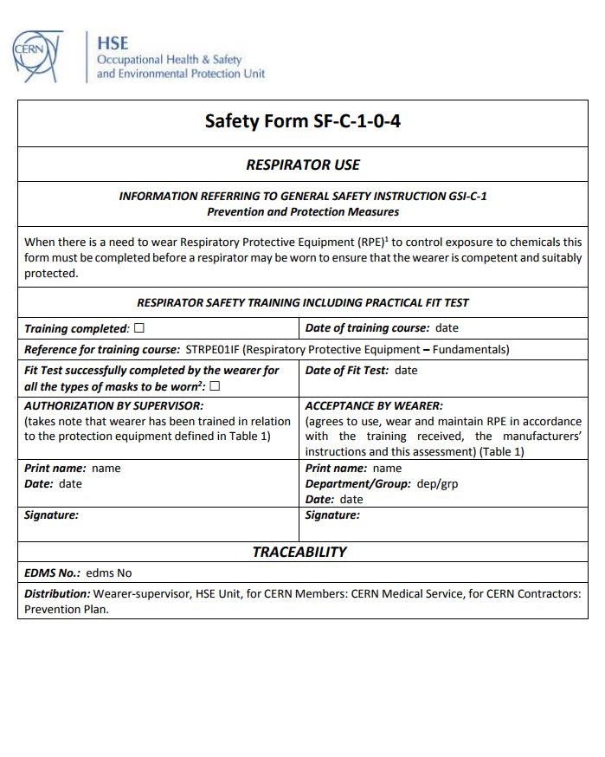
Personal protective equipment
Respiratory protective equipment
If you need to wear respiratory protective equipment, complete the Safety form SF-C-1-0-4 – Respirator use.
To be authorised, you must:
complete the assessment form
attend the training course “Use of respiratory protective equipment” from the safety training catalogue
successfully complete your «Fit-test»

Slide 28
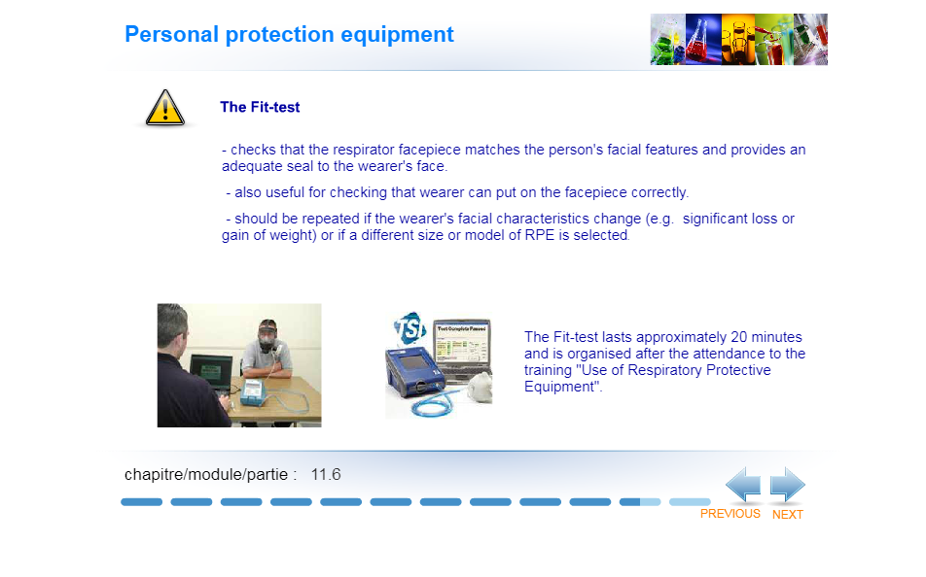
Personal protective equipment
The fit-test
checks that the respirator facepiece matches the person’s facial features and provides an adequate seal to the wearer’s face.
also useful for checking that wearer can put on the facepiece correctly.
should be repeated if the wearer’s facial characteristics change (e.g. significant loss or gain of weight) or if a different size or model of RPE is selected.
should be redone every year
The Fit-Test normally takes 15-20 minutes and is organised after registering for the course “Respiratory Protective Equipment - Fit Test” in the Training Catalogue. This should normally occur after attendance of the half-day training course "Respiratory Protective Equipment – Fundamentals".

Slide 29
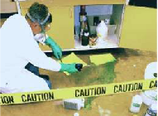
Disposal of chemicals
Systematically dispose of chemicals that are no longer used or are out-of-date !
Have at hand a means of recovering chemicals in the event of small spills (e.g. absorbent materials)
Use original or suitable containers, identified with the name of the chemical and appropriate hazard warning symbols.
Don’t dispose of chemicals down the sink.
Empty containers are still classed as waste.
All containers (full or empty) must be transported to Building 262, by completing an internal transport request (via EDH).
Consult the dedicated procedure for dealing with chemical waste:
http://smb-dep.web.cern.ch/en/Waste/Chemical_waste

Slide 30
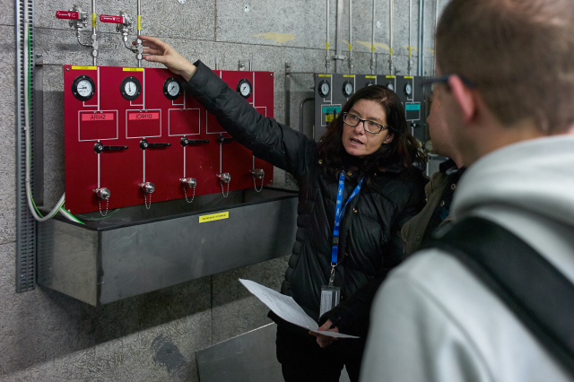
Chemical safety training
SIR – on-line training:
  Chemical Safety – Awareness
Classroom courses:
  ATEX Habilitation - Level 1
  ATEX Habilitation - Level 2
  Respiratory Protective Equipment – Fundamentals
  Respiratory Protective Equipment - Fit Test

