Slide 1
WG1 – Integration
Thorsten Lux
On behalf of the WG1 conveners

Slide 2
Who we are
Davide:
Post-doc at the University of Geneva (Davide.Sgalaberna@cern.ch)
Marcela:
Post-doc at Institute of Nuclear Physics Polish Academy of Sciences (IFJ PAN) (Marcela.Batkiewicz@ifj.edu.pl)
Thorsten:
Senior researcher at Instituto de Fisica de Altas Energias (IFAE) (Thorsten.Lux@ifae.es)
A mechanical engineer for the technical aspects of the integration would be more than welcome!

Slide 3
Purposes of WG1
What we consider the following purposes for WG1:
Ensuring that all subdetectors fit into the basket and magnet, to get out all electronic signals and to avoid interference between the different subdetectors
Offering a plattform to discuss the detector configurations (from the integration point of view)

Slide 4
Interaction with WGs
TOF
TPC
Integration (basket)
Physics Simulations
Target

Slide 5
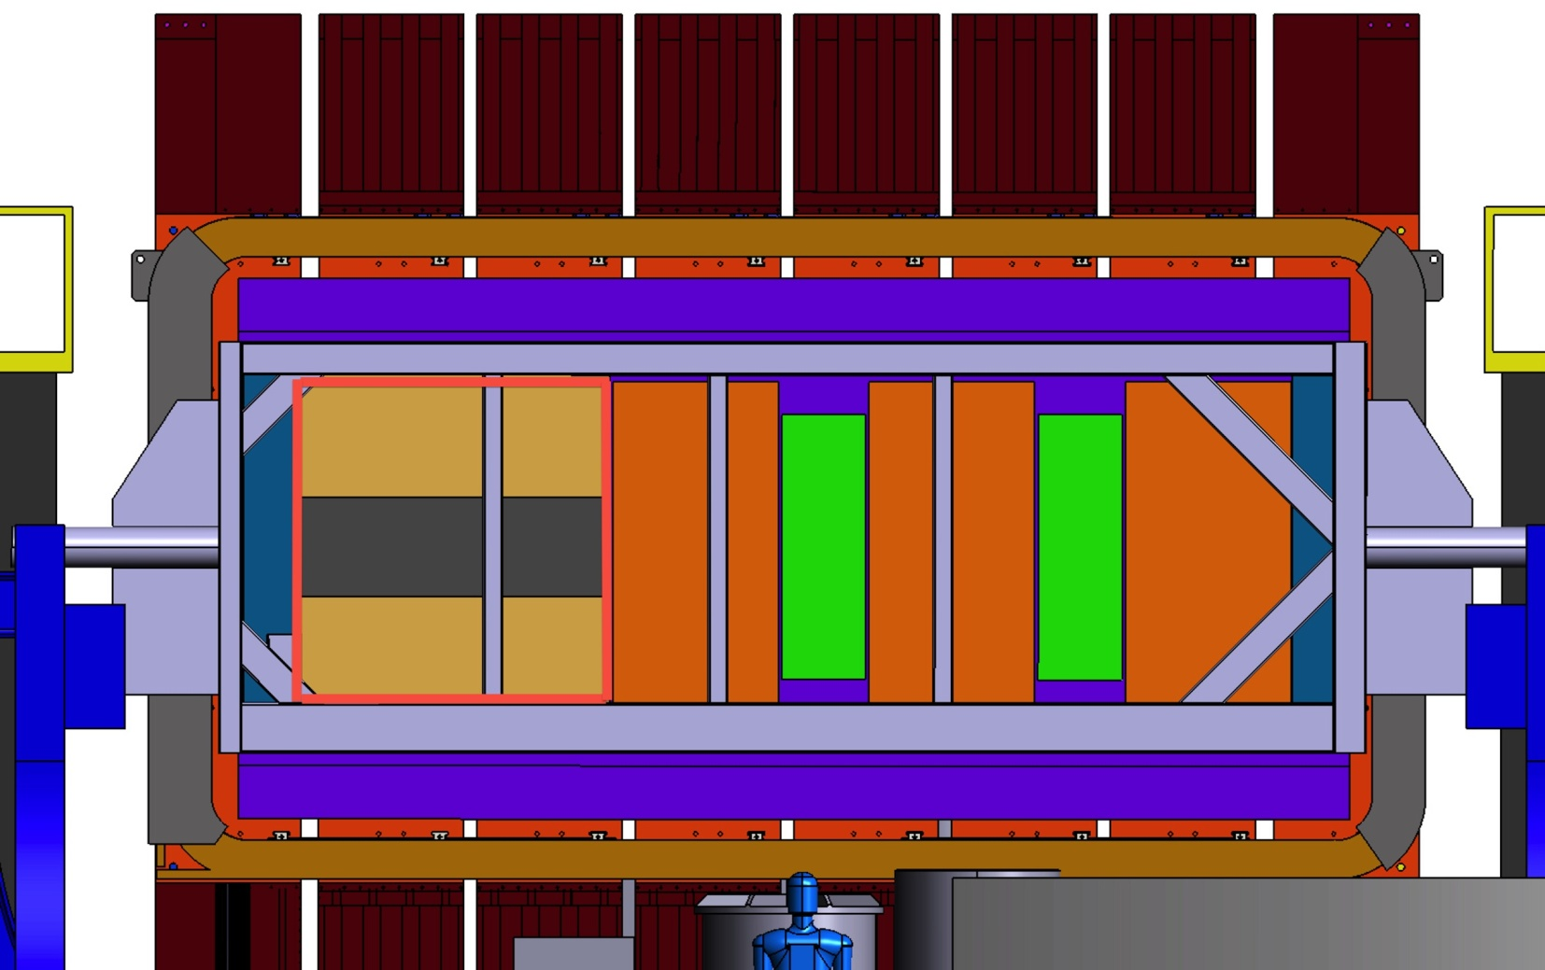
T2K ND: Upgrade Design
Please, always remember in your design considerations, there are more subdetectors close by and space is valuable!

Slide 6
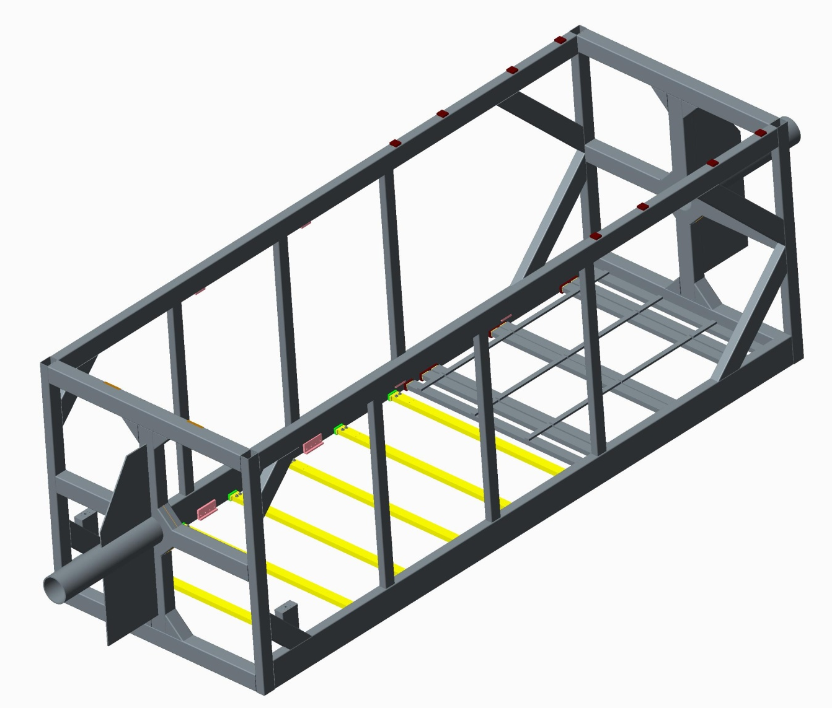
Stainless Steel basket Dimensions
2320mm
Internal
6650mm
Internal
Please download the CAD files from:
https://t2k.org/ndup/general/nd280-upgrade/mechanical-design-wp1/CADDRAW
Does anybody have the CAD files of the magnet and the ECAL?

Slide 7
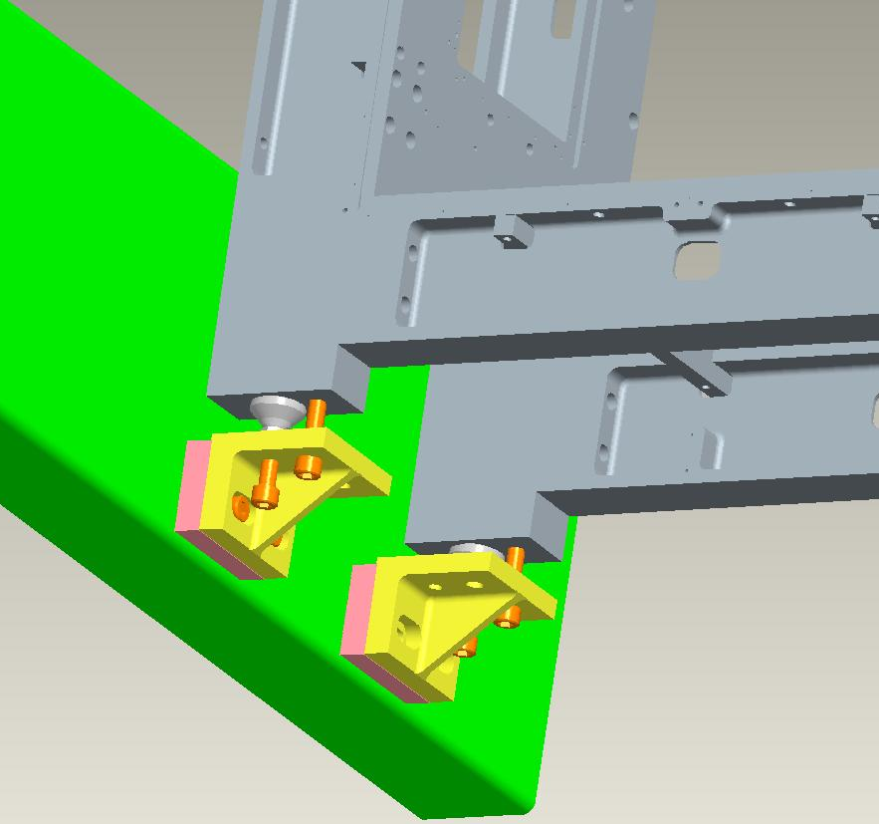
Subdetector Fixation
high angle detector section very different situation to forward detector section
subdetectors will be placed one on top of the other => fixation structures must not increase distance between detectors
probably easy to solve but will need good communication between subdetector groups

Slide 8
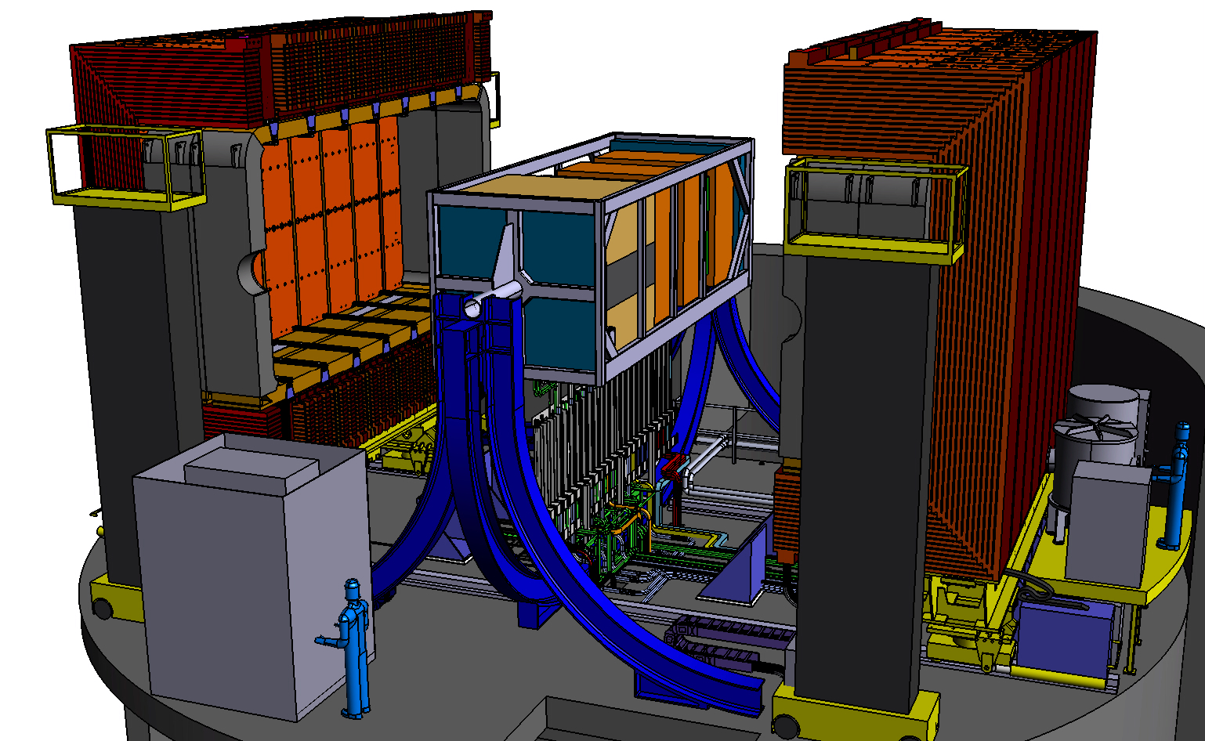
Insertion of the Detectors
We need to develop a protocol how to insert the detectors and to route cables and gas tubes, so please take this into account in your design considerations!

Slide 9
Detector Configuration Discussion
Review of detector configuration from integratin point of view might be useful e.g.:
up- and downstream TOF very close to target and blocks acces to fraction of target electronics:
  move downstream TOF to 1st FGD (Alain)?
  needed for high angle detector section?
  or only to cover TPC sides with TOF?
similar for upstream POD-ECAL:
  what happens if we take it out?
  Upstream TOF could be moved more upstream which would improve performance
Requests to Software WG and with result back to Subdetector group!

Slide 10
Manpower and Milestones
To identify possible problems it would be good to know for each subdetector the available:
  Physicists (staff/postdocs)
  Electronic engineers
  Mechanical engineers
  Students (which could participate in the simulations)
Responsibilities for each person, especially the engineers
Do you have already defined milestones/dates?
Are you missing manpower for your sub-detector?

Slide 11
Meetings and Email List
First meeting 2 weeks ago (although not extremely high participation)
Probably better to have currently meetings every month since focus clearly still lays on basic subdetector developments
But integration already should be considered in design studies for subdetectors
Sign up for CERN e-group: EOI15-WG1-Mechanics or write to one of us to add you
Ensure that you and your engineers are subscribed to SRN and T2K.org

Slide 12
Conclusions
WG1 started to work with 1st SRN meeting
Participation is more than welcome
Time schedule for T2K upgrade is tight => mandatory to think in integration from the beginning to avoid need of changes in subdetector concept later
Integration means: Geometry, fixation to basket, electronics positioning and cable/gas tube routing
Mechanical engineer to join WG1 efforts will be mandatory at some point => think about it

Slide 13
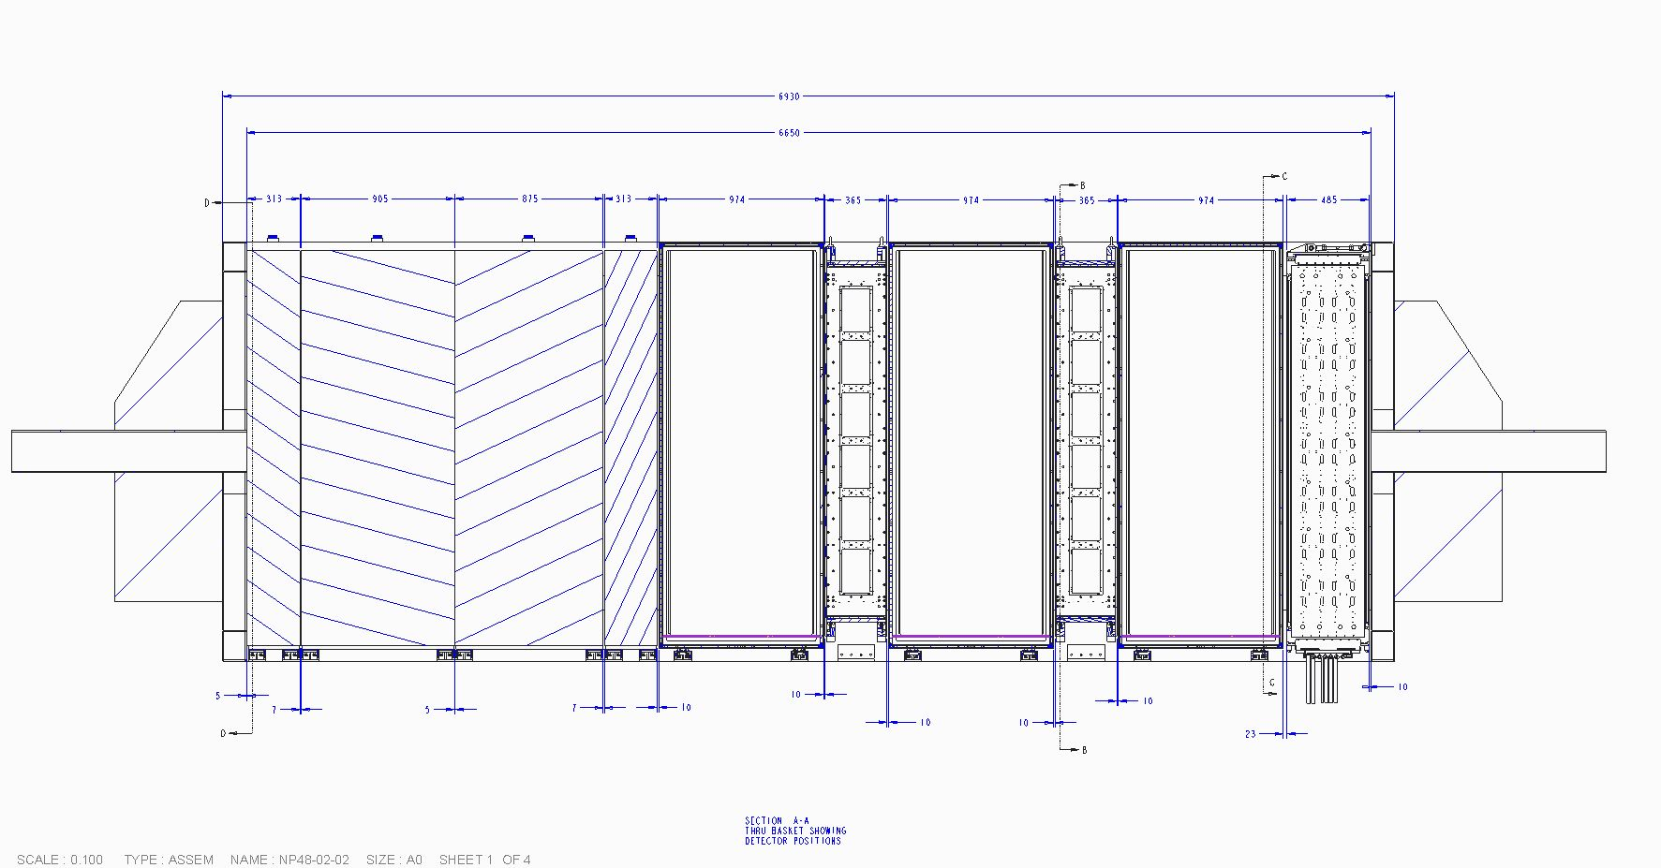
T2K ND: Current Design
POD
ECAL
POD
TARGET
POD
ECAL
TPC
FGD
TPC
FGD
TPC
D/Stream
ECAL

