Slide 1
Readout Electronics for T2K-II TPCs:
Progress Report
D. Calvet,
Irfu, CEA Saclay, 91191 Gif sur Yvette Cedex, FRANCE

Slide 2


Current Baseline Design outline
New TPC A
CurrentTPC N°1
CurrentTPC N°1
CurrentTPC N°1
New TPC A
CurrentTPC N°1
CurrentTPC N°2
CurrentTPC N°3
New TPC B
New TPC B
magnet
M0
M2
M4
M6
Resistive Micromegas
36 (h) × 32 (v) pads
~80 cm
~34 cm
M1
M3
M5
M7
~180 cm
~41 cm
  Structure
  2 TPCs, each composed of 2 end-plates supporting 8 Micromegas modules segmented in 36 x 32 pads
  Total of 32 detector modules; 36 K-channels (36.864)
  → No change from what was presented at the previous meeting in August

Slide 3
Proposed Readout Architecture
36.864 detector pads
ASIC
ASIC
…
ASIC
…
ASIC
ASIC
…
ASIC
ASIC
ASIC
…
ASIC
…
ASIC
ASIC
…
ASIC
512 ASICs (72 channels)
Front-End Card
Front-End Card
…
Front-End Card
Front-End Card
64 FECs (with 8 ASICs each)
FPGA
Front-End
Mezzanine
Card
FPGA
Front-End
Mezzanine
Card
32 FEMs (each drives 2 FECs)
Inside magnet
Detector module
Optical fiber
Outside magnet
…
FPGA
Trigger and Data
Concentrator Module
2 TDCMs (each controls 16 FEMs, i.e. 1 TPC)
RJ45 cable
Private Ethernet
Slave Clock Module
PC for TPC Control & DAQ
1 PC (controls 2 TDCMs)
nd280 network
Global Event Builder,
Run Control, Condition Database,
Event Display, Mass Storage
  Structure
  Identical to that of T2K phase 1, with the adaptations to match segmentation of new detector
  → Also already presented at last meeting. Described in draft Technical Proposal

Slide 4
Back-end Variants
16 fibers
16 fibers
16 fibers
16 fibers
FPGA
TDCM#0
FPGA
TDCM#1
CPU bare
metal
FPGA
TDCM#0
FPGA
TDCM#1
CPU
Linux
Command
Interpreter
program
MIDAS
Front-end
program
Private Ethernet
UDP/IP
TCP/IP
Slave Clock Module
PC for TPC Control & DAQ
Front-end MIDAS
bridge program
Slave Clock Module
TCP/IP
nd280 network
nd280 network
Global Event Builder,
Run Control, Condition Database,
Event Display, Mass Storage
Global Event Builder,
Run Control, Condition Database,
Event Display, Mass Storage
Variant A (similar to T2K TPC phase 1 scheme)
Variant B (similar to T2K FGD phase 1 scheme)
  Pros and cons
  Task decoupling, incremental development
  One more layer of hardware and sofware
  Pros and cons
  More integrated and modern
  Additional efforts on embedded side
  My personal view
  For hardware/firmware development, make software simple on the embedded side
  Keep means for low level debugging by experts – see the use of clientUDP in the current TPCs
  UDP can be robust over point-to-point links or small private networks. Both UDP and TCP sometimes fail
  Long term software maintenance is harder on the embedded CPU of a FPGA than on a common PC
  → Both variants are in technical proposal. What will be done depends on time, competence, and manpower

Slide 5

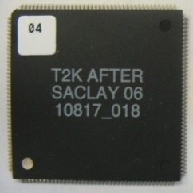
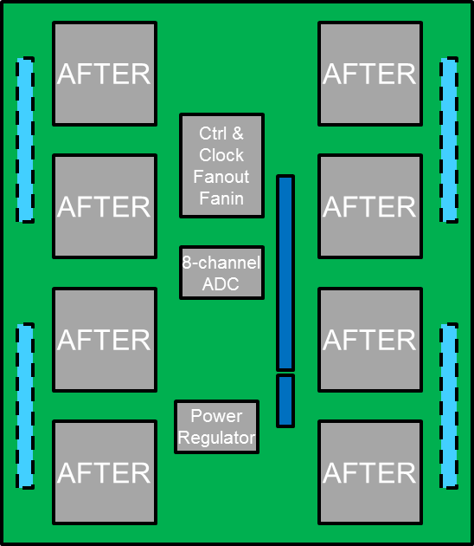
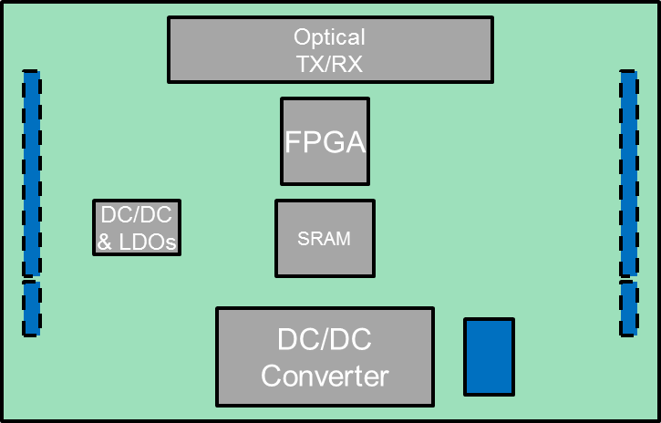
Update on Various Components
  Front-end ASIC
  AFTER remains the best solution that was identified. ~700 tested chips in stock
  Front-end cards
  Concept of a 576-channel FEC unchanged.
  No progress to report on development
  Front-end Mezzanine cards
  Concept of a 1152-channel FEM unchanged
  (reads out 2 FECs).
  No progress to report on development
  → Some work can be done now, but real design of front-end boards requires that approximate detector size, exact segmentation and detector technology (resistive Micromegas or not) choices are made

Slide 6
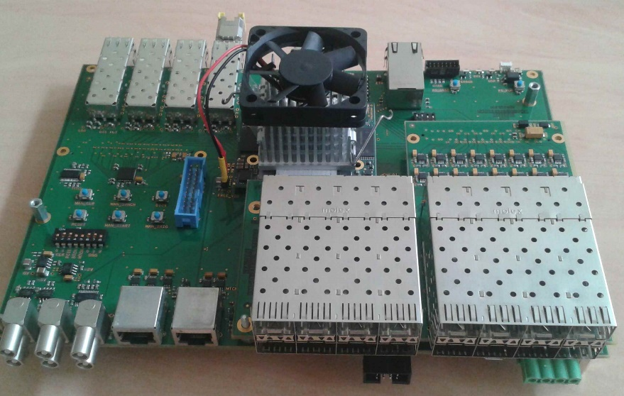
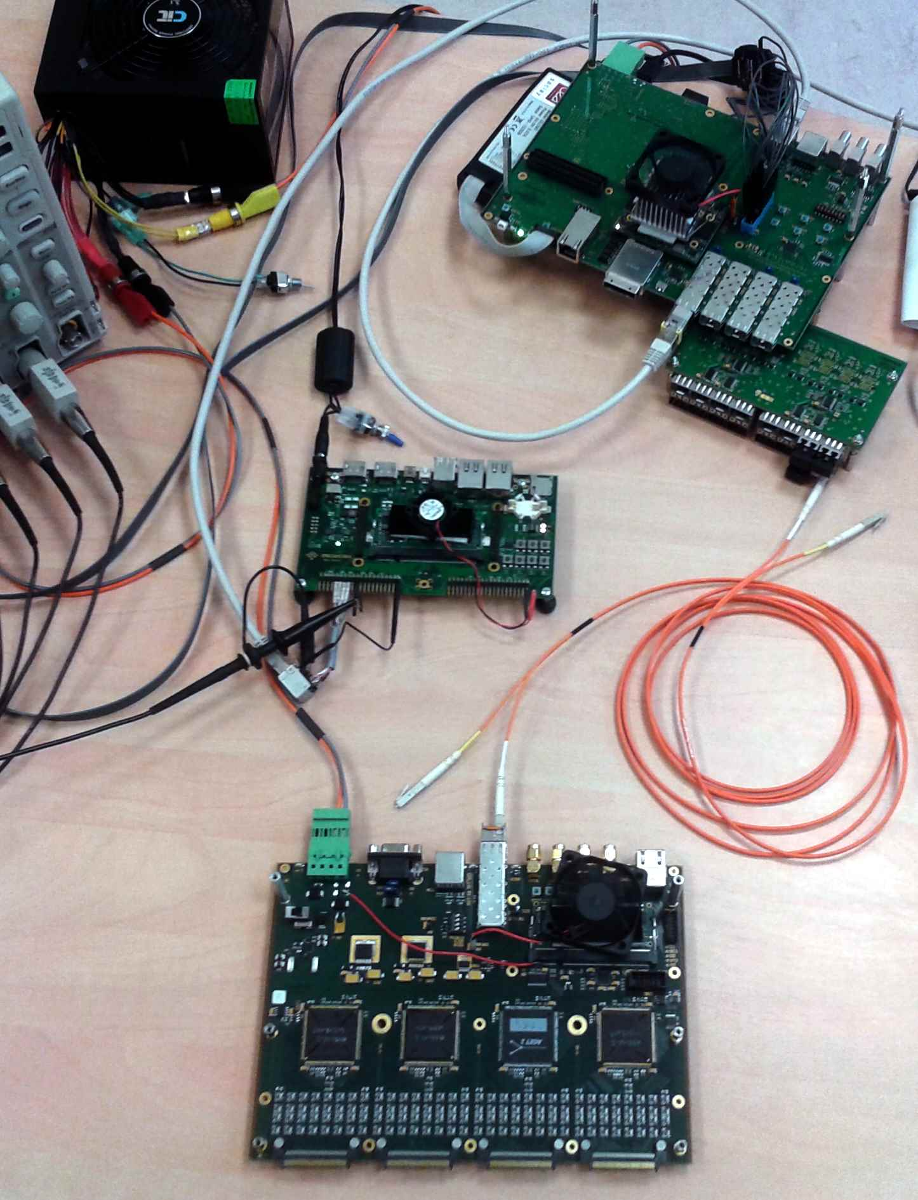
Progress on Back-end – Pandax-III TDCM
Custom 6U
carrier
TDCM
prototype
Commercial Mercury ZX1
Zynq 7045/30
Custom 16-optical port
mezzanine
Master Trigger Clock
Emulator
TDCM assembly concept
(with the correct orientation of the connectors for the physical layer mezzanine cards)
256-channel front-end card “ARC”
(compatible AFTER-AGET- ASTRE)
Readout chain vertical slice
  Current status
  System now running, full functionality and final speed performance. Only checked with 1 ARC so far
  Configuration and data acquisition via console application program with ASCII script files
  Develop a MIDAS frontend program? Minimize effort / allow some re-use between PandaX / T2K projects
  Expect to make final version of the carrier board of the TDCM in early 2018
  → Minor adaptations (mostly firmware and software) would be needed to use TDCM in T2K Phase-II

Slide 7
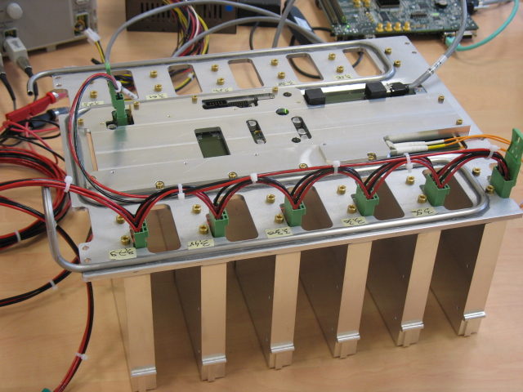
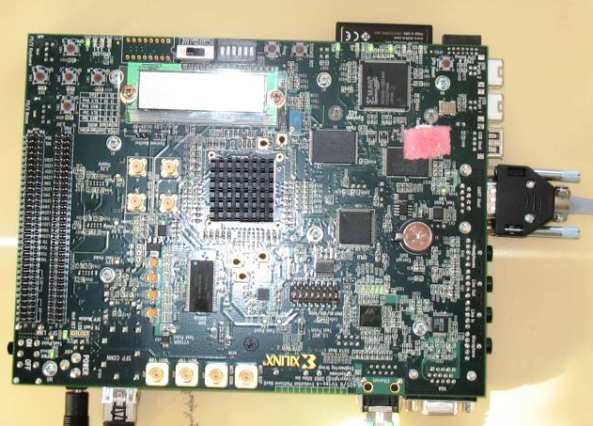
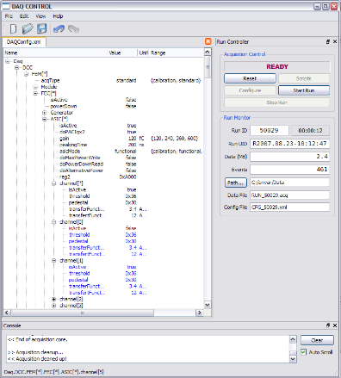
Anticipating test beam activities and detector test bench construction
  Needs
  A readout system and DAQ for 1 (maybe 2?) detector module(s) (1728 channel each max) ~fall 2018
  A readout system (possibly the same) for the detector test bench, starting construction in 2018
Control/DAQ PC
DAQ rate capability: 20-50 Hz max.
(511 time bins, with zero-suppression)
  Solution 1: same hardware and software as in the present T2K
  6 FECs + 1 FEM + 1 kit ML507 or ML405 + 1 DAQ PC + DaqT2K GUI based config/DAQ software
  Pros: existing now and available at no cost
  Cons: obsolescence, rigid structure: need to design cables/adapters to match new detector size,
  know-how to re-learn, almost impossible to make any firmware/software change

Slide 8
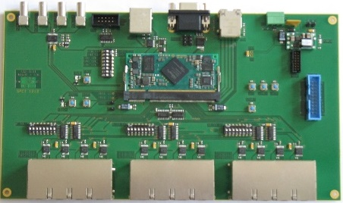
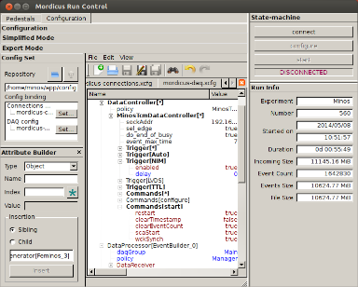
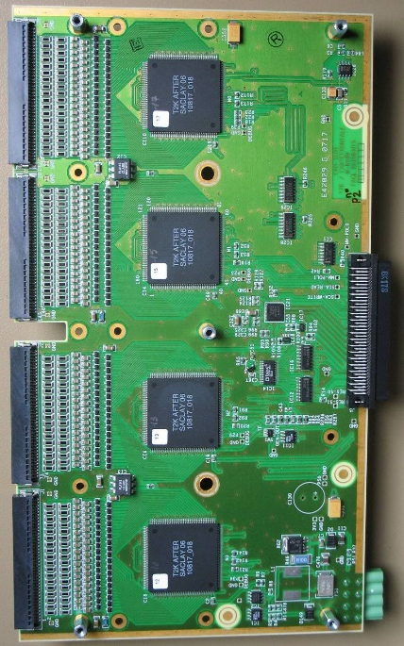
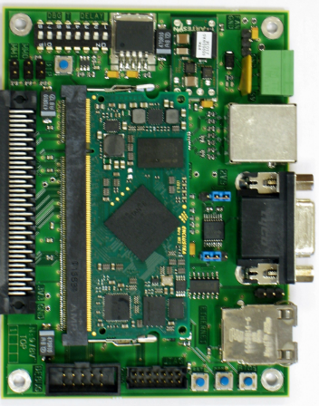
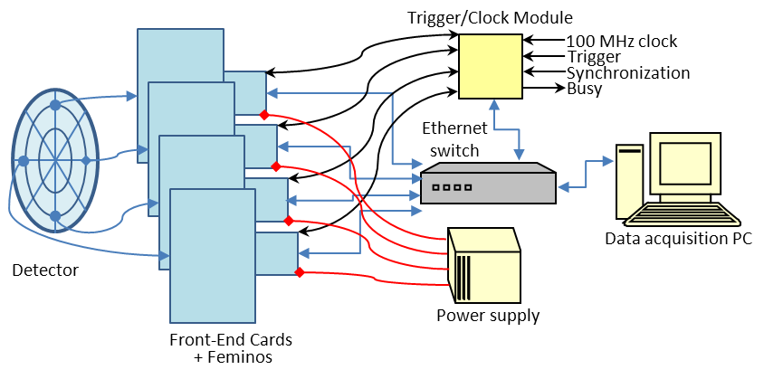
Anticipating test beam activities and detector test bench construction – con’t
FEMINOS
×24 max. i.e.
6K channels
T2K FEC: 4 AFTER chips
DAQ rate capability: 200-500 Hz max.
(511 time bins, with zero-suppression)
  Solution 2: Minos readout system
  4 or 6 * (FECs + 1 Feminos) + 1 TCM + 1 switch + 1 DAQ PC + Minos GUI based config/DAQ software
  Pros: also existing now, not a rigid assembly but still needs cable adapters, knowledge still exists
  Cons: need to produce Feminos cards for T2K which requires time and a bit of money (~500 € / card); does not bring us closer to what the final system for T2K Phase-II will look like

Slide 9
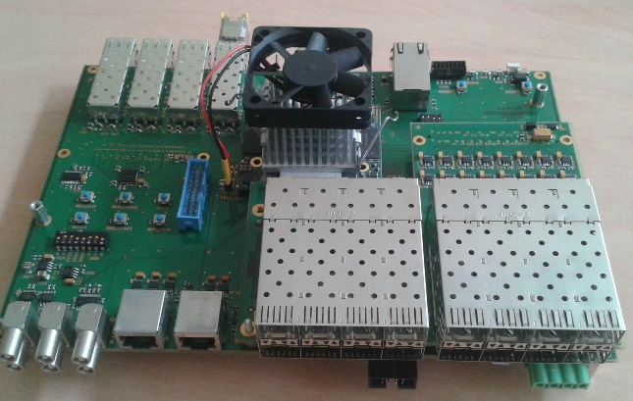
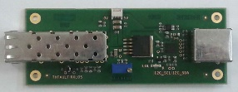
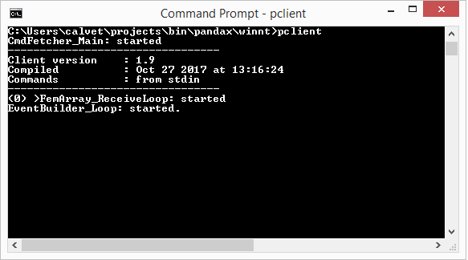
Anticipating test beam activities and detector test bench construction – con’t
Gigabit Ethernet
TDCM
Small RJ45 cable
Optical-electrical
converter
Control/DAQ PC
FEMINOS
Optical fibre
T2K FEC: 4 AFTER chips
  Solution 3: patching the Feminos
  4 or 6 * (FECs + 1 Feminos + 1 Optical-electrical converter) + 1 TDCM + 1 DAQ PC
  Pros: same as 2, hardware exists, goes in the direction of T2K Phase-II system,
  Cons: not very elegant, some effort needed to adapt firmware of Feminos Spartan 6 FPGA (now an old chip), no GUI-based configuration and DAQ software available at present

Slide 10
Anticipating test beam activities and detector test bench construction – con’t
Gigabit Ethernet
TDCM
16-port RJ45
Physical Layer
Mezzanine Card
Control/DAQ PC
FEMINOS
RJ45 cable
T2K FEC: 4 AFTER chips
  Solution 3 variant: make new physical layer board for the TDCM: 16-ports, RJ45 copper
  Pros: adds to the versatility of the TDCM with support of both optical and copper media
  Cons: still need firmware rework on Feminos; cost and development effort of new physical layer mezzanine card; limitations of copper media

Slide 11
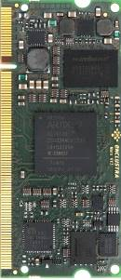
Anticipating test beam activities and detector test bench construction – con’t
Gigabit Ethernet
TDCM
Optical TX/RX
Control/DAQ PC
Artix 7
FPGA
Module
FEMINOS-II
Optical fibre
T2K FEC: 4 AFTER chips
  Solution 4: making a new Feminos
  4 or 6 * (FECs + 1 Feminos-II) + 1 TDCM + 1 DAQ PC
  Pros: same as solution 3, minor firmware effort on Feminos-II (re-use ARC firmware)
  Cons: need to rework Feminos design and produce new Feminos-II cards – no other use foreseen –
  no GUI-based configuration and DAQ software available at this time

Slide 12
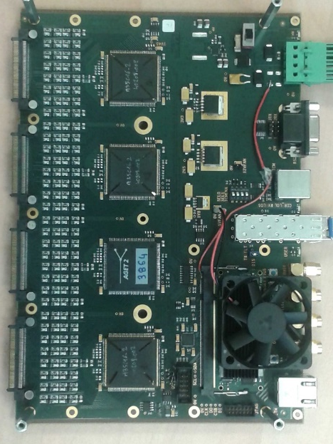
Anticipating test beam activities and detector test bench construction – con’t
Gigabit Ethernet
TDCM
Optical fibre
Control/DAQ PC
Artix 7
FPGA
Module
ARC
The ARC is a 256-channel readout card compatible with AFTER, AGET and ASTRE designed in the HARPO project.
Initially called ROC, I have changed the name to ARC which can mean AFTER Readout Card, AGET Readout Card or ASTRE Readout Card (I am still trying to invent a better name…)
DAQ rate capability: 200-500 Hz max.
(511 time bins, with zero-suppression)
  Solution 5: rework the ARC
  4 or 6 ARCs + 1 TDCM + 1 DAQ PC
  Pros: getting closer to what the system for T2K-II might be; allows to consolidate the development of a generic detector readout system re-useable for other projects (my intention when I started this work)
  Cons: need change design of ARC for 288-channels with AFTER, need to improve noise performance (now bad at longest peaking time), cost (~1000 €/ARC), no GUI-based config./DAQ software ready

Slide 13
Anticipating test beam activities and detector test bench construction – con’t
Gigabit Ethernet
TDCM
Control/DAQ PC
FEM-II
Version 0
Optical fibre
Connector adapter
2 FECs
  Solution 6: anticipating on FEM-II
  4 or 6 FECs + 2 or 3 FEM-II + 1 TDCM + 1 DAQ PC
  Pros: allows prototyping of FEM-II (but FEC-II will have 2 times more channels than FEC and interface connector will also probably be different); simplifies migration to future final electronics
  Cons: too early for final choices of board size and connectors for FEM-II, significant development effort
  → Still weighting the pros and cons of the different options – Solution 1 kept as backup in any case

Slide 14
Progress on the collaborative side
Front-End Card
design, production, test
Front-End Mezz.
design, production, test
Front-End Mezz.
firmware
Supply AFTER
chips
Front-end card
Prod. test-bench
Front-end mezz.
Prod. test-bench
on-detector
off-detector
Back-end Board
design, production, test
Embedded
Firmware & Software
DAQ hardware
& software
Power supplies
Cabling, …
Detector
test & calib.
Test-bench
Mechanics,
Cooling
Services and specific functions
Irfu – CEA Saclay
Lpnhe
Warsaw
IFAE
Shared and others
  Collaborative view
  Lpnhe has confirmed his intention to take responsibility for the FECs, except FEC production test bench
  Need discussions with IFAE to define a possible participation
  This work sharing remains a tentative plan at present – not yet approved by Irfu management at least

Slide 15
Summary and Next steps
  Components
  Pending confirmation of detector type and segmentation hypothesis to start work on front-end electronics
  Maturing ideas, interfaces, trying to identify main components
  Back-end electronics well advanced if re-use of PandaX-III TDCM – saves future design time anyway
  Configuration/DAQ software with GUI would help, bridge to MIDAS needed sooner or later in any case
  Preparation of readout electronics needed from 2018 (test beam and beyond)
  Multiple options available ranging from almost no work, no money to good piece of work and some money needed
  But work and money spent on this can also be a good investment for the future
  Collaborative
  Finalize technical proposal document
  Tentative plan of work sharing almost complete

