Slide 1
Upgraded Micromegas modules for the horizontal TPCs
S. Aune, P. Colas, A. Delbart, M. Riallot, M. Zito
CEA Saclay Irfu

Slide 2
A New endplate for the horizontal TPCs
Reminder: charge spreading allows improvement of resolution even with larger pads and protects readout.
Status of preliminary cosmic-ray test for T2K ND280 upgrade
03/10/2017
Horizontal ND280 TPC endplate - P. Colas
<number>

Slide 3
New design
For the horizontal TPCs, try a new configuration: ‘encapsulated resistive anode with grounded mesh’
  Charge spreading allows space point resolution improvement with less electronics channels
  The protection provided by the resistive foil allows lighter Font End Cards
  Less track distortions due to field inhomogeneity
  Less sensitivity to noise
dE/dx might be marginally degraded (under study)
few mm dead area on edges are necessary.
03/10/2017
Horizontal ND280 TPC endplate - P. Colas
<number>

Slide 4
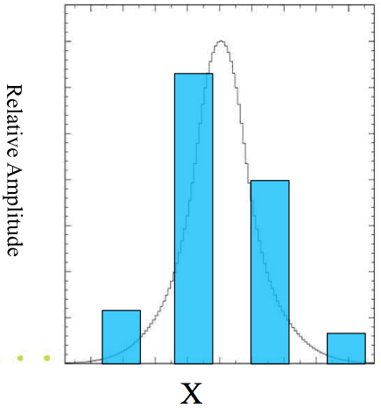
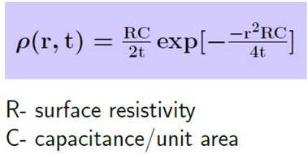
Charge spreading technique
Continuous RC network shares evenly the charge among several pads
mesh
~100μm Amplification gap:
E
B
resistive foil: ~75μm
insulator: ~100μm
pads
Gaussian spreading as a function of time with σ_{r} = sqrt(2t/RC)
t~shaping~few 100 ns
RC = 180 R(MΩ) /(d/175µ) ns/mm²
03/10/2017
Horizontal ND280 TPC endplate - P. Colas
<number>

Slide 5
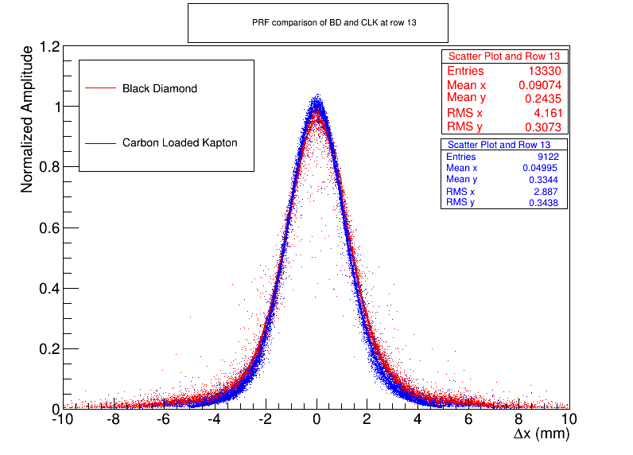
Dimensioning
Choose adequately R (per square) and C (per unit of surface) to spread enough and still protect against spark, without suppressing too much the signal.
Pad-Response Function
= 1.4 mm well suited for 3mm-wide pads but too small for a 7-mm and 9-mm pitch
Calculate optimal resistivity and thickness of insulator (assumed to be kapton)
03/10/2017
Horizontal ND280 TPC endplate - P. Colas
<number>

Slide 6
For R= 2 Mohm/sq, shaping 200 ns, 200 µ insulation in addition to the 50 µm kapton, one obtains sigma = 1.3 mm
With annealing, we can double this, which should be almost optimal.
(For 0.2 Mohm/sq, we would have sigma= 3.16 mm)
03/10/2017
Horizontal ND280 TPC endplate - P. Colas
<number>

Slide 7
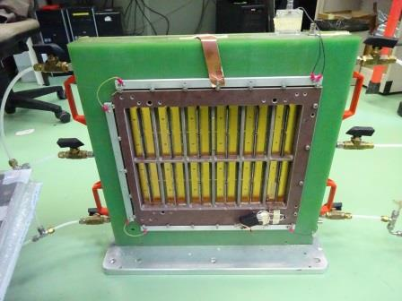
Test bench
Geneva U. testbox, moved to Saclay in July.
Being adapted to a 15cm drift to contain cosmics.
03/10/2017
Horizontal ND280 TPC endplate - P. Colas
<number>

Slide 8
New detector
Grounded mesh encapsulating the detector
HV ring with vias
DLC-coated
kapton
PCB
Metal back-frame
PCB with
Readout pads
03/10/2017
Horizontal ND280 TPC endplate - P. Colas
<number>

Slide 9
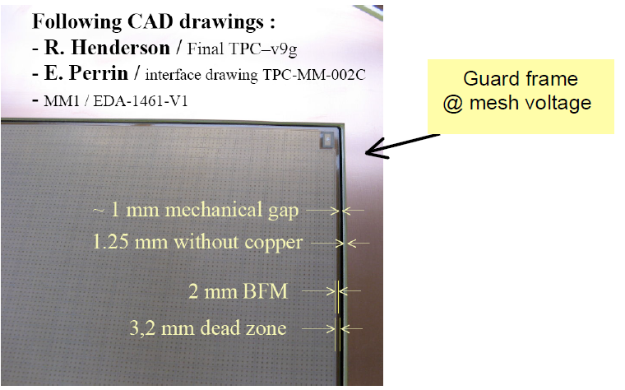
New detector – dead area
5 additional mm covered by insulator
03/10/2017
Horizontal ND280 TPC endplate - P. Colas
<number>

Slide 10
Status of the Saclay cosmic-ray prototype
Drawings for the gasbox ready (about 15 cm drift), tenders placed
4 PCBs made at CERN
DLC foils received at CERN (50 µ Apical, sputtered, 2 MΩ/sq)
2 will be bulked with DLC (mesh to ground, encapsulated)
One of them will be annealed at 200 °C to reduce the resistivity by a factor of about 4.
Other two are kept to try other resistive coverlays (screen printing by S. Aune at the Saclay fablab)
Selection of a readout electronics chain and of a cosmic trigger in progress (see D. Calvet’s talk this afternoon)
First cosmics in a few weeks time?
03/10/2017
Horizontal ND280 TPC endplate - P. Colas
<number>

Slide 11
New Stiffener (M. Riallot)
03/10/2017
Horizontal ND280 TPC endplate - P. Colas
<number>

Slide 12
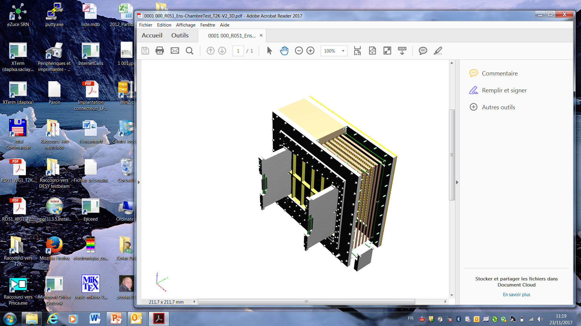
Bench test (S. Aune, M. Riallot)
03/10/2017
Horizontal ND280 TPC endplate - P. Colas
<number>

Slide 13
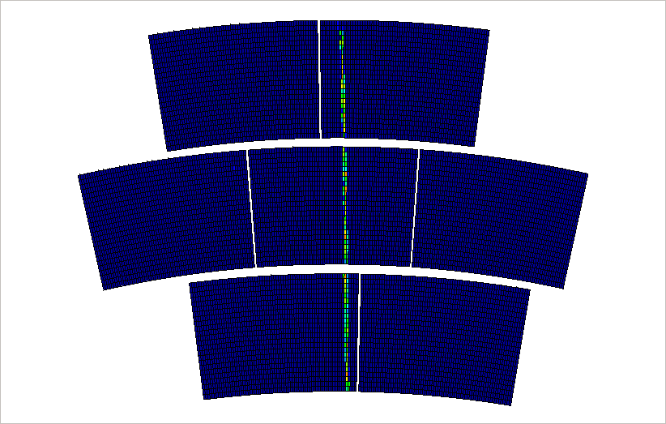
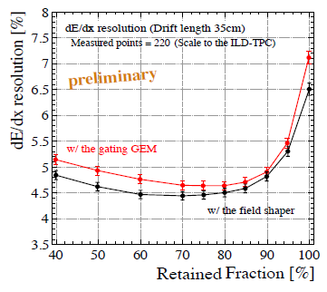
Real events from beam test at DESY (LC TPC R&D) -> dE/dx study
Preliminary studies with Asian double-GEMs for 1.2 m tracks.
But correlation and double-counting due to radial charge dispersion?
03/10/2017
Horizontal ND280 TPC endplate - P. Colas
<number>

