Slide 1
A Photon beam in T9 area
A. Blondel, L. Gatignon

Slide 2
Dear Lau,
We have submitted a test beam request for next year, in which we expressed interest
in having a photon beam to test the e/gamma separation in the SFGD. we did a photon beam in 1983 to test a water Cherenkov in the west area.
Question : has anyone made a photon beam in T9 before? Any documentation?
Dear Alain,
It has been done, but there is no specific documentation.
We can install a MDX bending magnet (horizontal with a maximum BL of 0.51 Tm.
The electron content in T9 is 50% at 1 GeV and drops towards higher energies,
see e.g. http://gatignon.web.cern.ch/gatignon/T9flux.pdf (second page).
It is then sufficient to put a radiator (few mm of e.g. CU) upstream of the magnet and
some position detector(s) a few meters downstream to measure the electron deflection angle.
From there it is easy to derive the photon energy.
The actual implementation is always a bit ad-hoc, in consultation with me.
Best regards, Lau

Slide 3
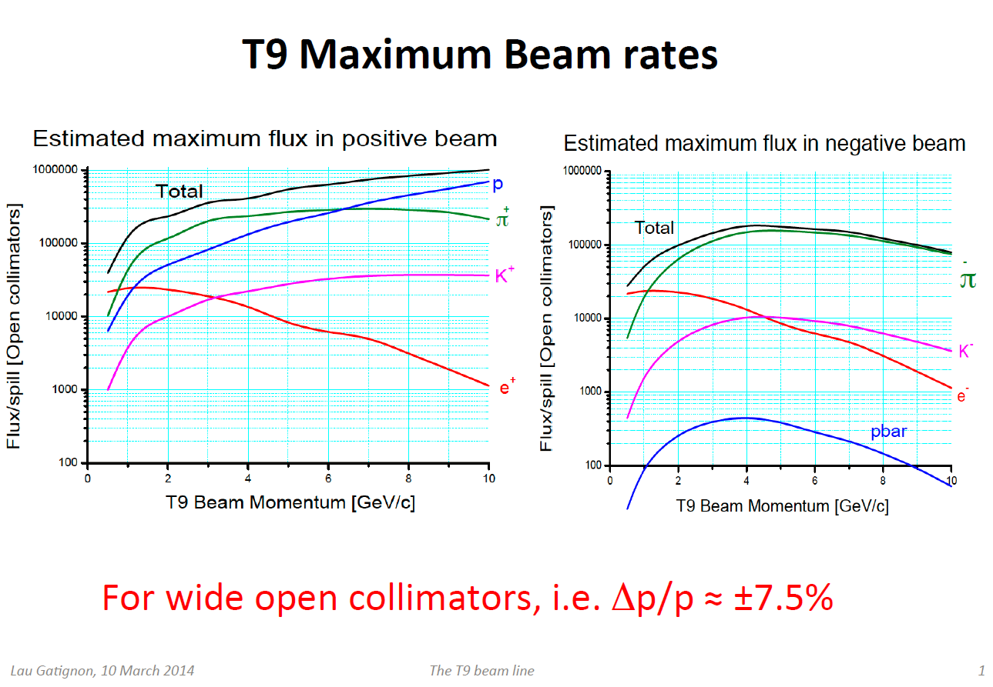

Slide 4
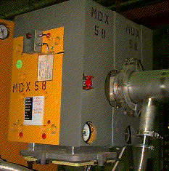
A Photon beam in T9 area
A. Blondel, L. Gatignon
Principle
e⁻ beam
Cu radiator
MDX magnet
0.51 T.m
γ beam
may need a position detector
best is probably
around 2 GeV/c e-
for 200-800 MeV
photons
(should be simulated)
hodoscope
(measures electron momentum
➔ photon energy)

Slide 5
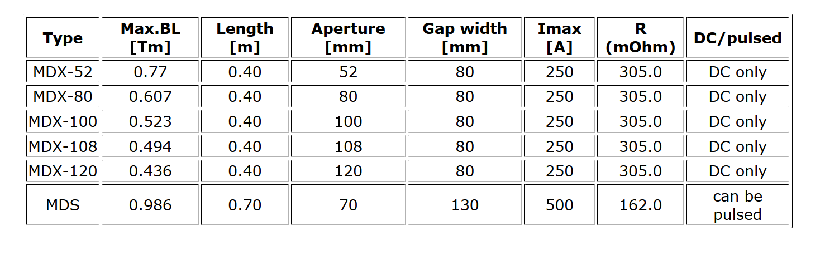
Other magnets are available if we want to place a small prototoype in magnetic field

