Slide 1
Apache Arrow: In-memory data processing and system interoperability
Wes McKinney @wesmckinn

Slide 2
Important Legal Information
The information presented here is offered for informational purposes only and should not be used for any other purpose (including, without limitation, the making of investment decisions). Examples provided herein are for illustrative purposes only and are not necessarily based on actual data. Nothing herein constitutes: an offer to sell or the solicitation of any offer to buy any security or other interest; tax advice; or investment advice. This presentation shall remain the property of Two Sigma Investments, LP (“Two Sigma”) and Two Sigma reserves the right to require the return of this presentation at any time.
Some of the images, logos or other material used herein may be protected by copyright and/or trademark. If so, such copyrights and/or trademarks are most likely owned by the entity that created the material and are used purely for identification and comment as fair use under international copyright and/or trademark laws. Use of such image, copyright or trademark does not imply any association with such organization (or endorsement of such organization) by Two Sigma, nor vice versa.
Copyright © 2017 TWO SIGMA INVESTMENTS, LP. All rights reserved

Slide 3
Me
Currently: Software Architect at Two Sigma Investments
Creator of Python pandas project
PMC member for Apache Arrow and Apache Parquet
Author of Python for Data Analysis
Other Python projects: Ibis, Feather, statsmodels

Slide 4
Changing hardware landscape
Intel has released first production 3D Xpoint SSD
  Reported 1000x faster than NAND, less expensive than RAM
Convergence between RAM vs. shared memory / mmap performance

Slide 5
Changing software landscape
Next-gen ML / AI frameworks (TensorFlow, Torch, etc.)
Open source architectures for machine learning in production
  Streaming / batch data processing pipelines
  Data cleaning and feature engineering
  Model fitting / scoring / serving

Slide 6
“Zero-copy” memory interfaces
Enables computational tools to process a dataset without any additional serialization, or transfer to a different memory space
Can do random access on a dataset that does not fit in RAM
Another interpretation: reading a dataset is a metadata-only conversion

Slide 7
Apache Arrow
Started early 2016, broad open source collaboration to define standards for in-memory analytical data processing
A cross-language development platform for in-memory data
Memory format specification for columnar (tabular) datasets
Zero-copy memory sharing tools (for shared memory, memory maps)
Languages (so far): C, C++, Java, Ruby, Python, JavaScript

Slide 8
What does Apache Arrow give you?
Cache-efficient columnar memory: optimized for CPU affinity and SIMD / parallel processing, O(1) random value access
Zero-copy messaging / IPC: Language-agnostic metadata, batch/file-based and streaming binary formats
Complex schema support: Flat and nested data types

Slide 9
Challenges to zero-copy memory sharing
Cross-language issues
  Type metadata + logical types
  Byte/bit-level memory layout
Language-specific issues
  In-memory data structures
  Memory allocation and sharing constructs

Slide 10
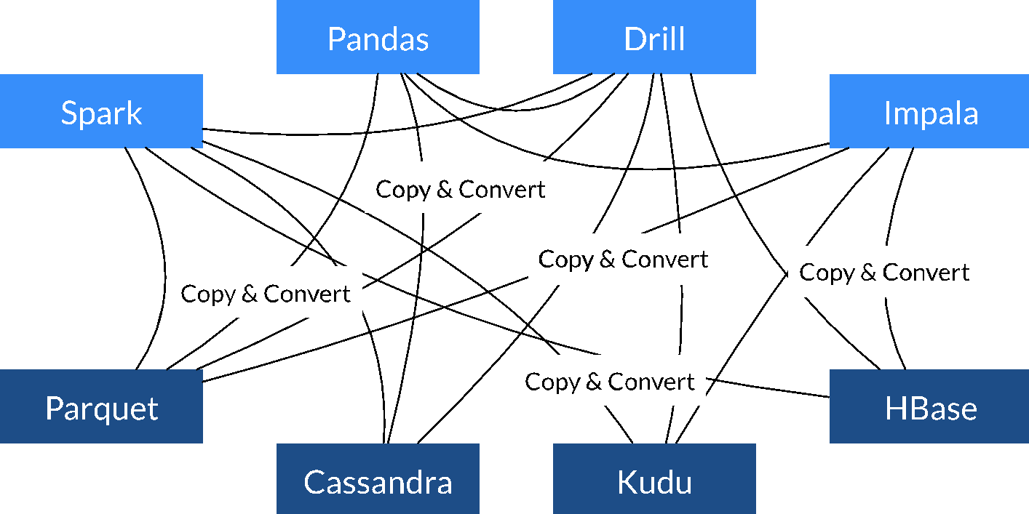
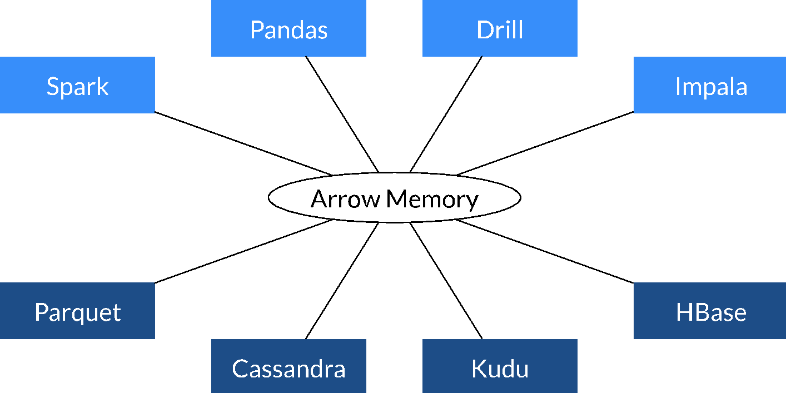
High performance data interchange
Today
With Arrow
Source: Apache Arrow

Slide 11
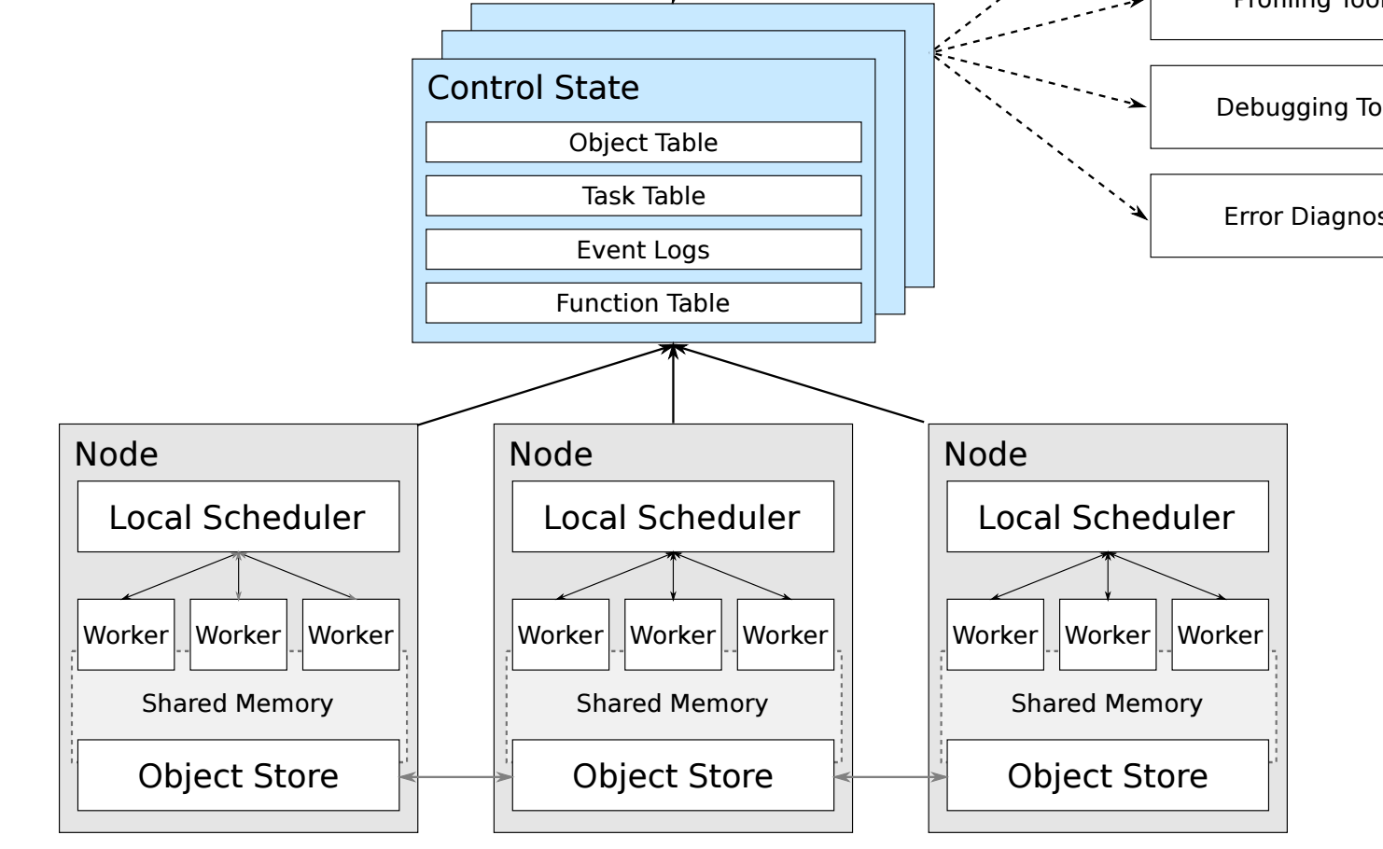
Example use: Ray ML framework from Berkeley RISELab
Shared memory-based object store
Zero-copy tensor reads using Arrow libraries
Source: https://arxiv.org/abs/1703.03924

Slide 12
Tensors and Tables
2 data structures best suited for zero-copy sharing
  Tensors: N-dimensional, homogeneously-typed arrays
  Tables: Column-oriented, heterogeneously typed
These data structures can be defined using common memory and metadata primitives

Slide 13
Arrow in C++
Reusable memory management and IO subsystem for native code applications
Layered in multiple components
  Memory management
  Type metadata / schemas
  Array / Table containers
  IO interfaces
  Zero-copy IPC / messaging

Slide 14
Arrow C++: Memory management
  arrow::Buffer
    RAII-based memory lifetime with std::shared_ptr<Buffer>
    arrow::MemoryMappedBuffer: for memory maps
  arrow::MemoryPool
    Abstract memory allocator for tracking all allocations

Slide 15
Arrow C++: Type metadata
  arrow::DataType
    Base class for fixed size, variable size, and nested datatypes
  arrow::Field
    Type + name + additional metadata
  arrow::Schema
    Collection of fields

Slide 16
Arrow C++: Array / Table containers
  arrow::Array
    1-dimensional columnar arrays: Int32Array, ListArray, StructArray, etc.
    Support for dictionary-encoded arrays
  arrow::RecordBatch
    Collection of equal-length arrays
  arrow::Column
    Logical table “column” as chunked array
  arrow::Table
    Collection of columns

Slide 17
Arrow C++: IO interfaces
  arrow::{InputStream, OutputStream}
  arrow::RandomAccessFile
    Abstract file interface
  arrow::MemoryMappedFile
    Zero-copy reads to arrow::Buffer
  Specific implementations for OS files, HDFS, etc.

Slide 18
Arrow C++: Messaging / IPC
  Metadata read/write using Google’s Flatbuffers library
  Encapsulated Message type
    Write record batches, read with zero-copy
  RecordBatchFileWriter, RecordBatchFileReader
    Random access / “batch” binary format
  RecordBatchStreamWriter, RecordBatchStreamReader
    Streaming binary format

Slide 19
arrow::Tensor
  Targeting interoperability with memory layouts as used in NumPy, TensorFlow, Torch, or other standard tensor-based frameworks
    data: arrow::Buffer
    shape: dimension sizes
    strides: memory ordering
  Zero-copy reads using Arrow’s shared memory tools

Slide 20
Example use: pandas 2.0
  In-planning rearchitecture of pandas’s internals
    libpandas — largely Python-agnostic C++11 library
    Decoupling pandas data structures from NumPy tensors
  Support analytics targeting native Arrow memory
    Multicore / parallel algorithms
    Leverage latest SIMD intrinsics
  Lazy-loading DataFrames from primary input formats
    CSV, JSON, HDF5, Apache Parquet

