Slide 1
M. Battistin (EN/CV/DC)
1st September 2009
ATLAS cooling Group
-
Thermosiphon solution for ATLAS ID cooling

Slide 2
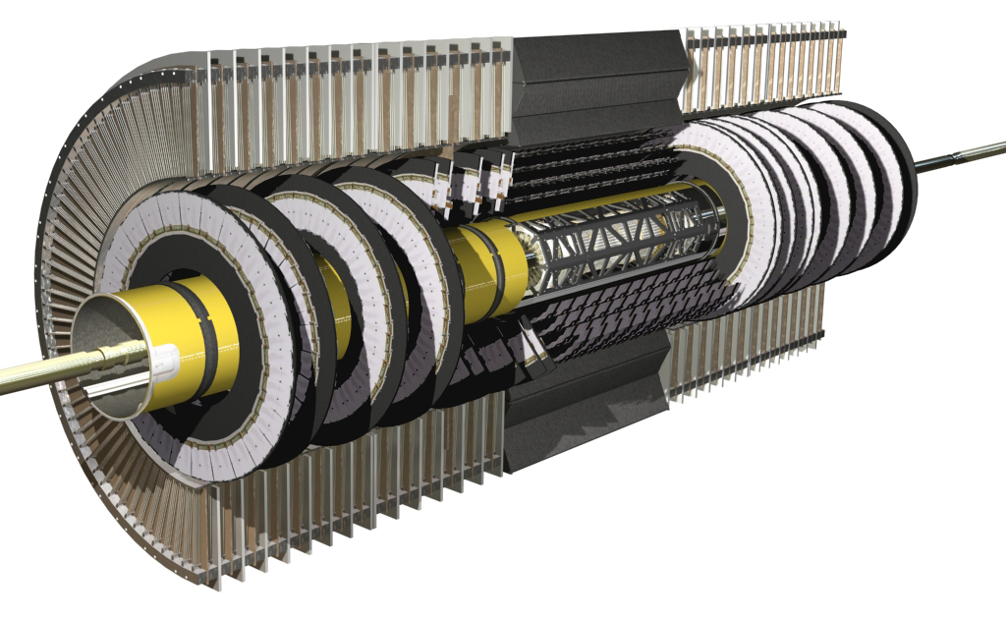
HAUG compressors show technical limits
ATLAS requested to evaluate a possible alternative to the present compressor station. The main reasons are:
Reliability: many failures registered in the present compressors
Cleanliness: wear of components obliges to an important filtering process
Leaks: developing with time due (in part) to vibrations
pneumatic
valve
others
liquid
tank
4 liquid lines
manual
valve
pneumatic
valve
PR
Sub-cooler
thermal
screen
UX15
USA15
mixed water
condenser
dummy
load
pixel
manual
valve
6 X SCT
4 gas lines
6 Haug
compressors
BPR
manual
valve

Slide 3
A thermosiphon solution
Low temperature
Chiller
condenser
A gravity driven circulation (thermosiphon) could be a solution.
The thermo-siphon solution could provide:
Reliability: no active component in the system
Cleanliness: no wear of components
Leaks: reduction of connection points and no vibrations
liquid
tank
pneumatic
valve
Surface
pneumatic
valve
USA15
others
manual
valve
4 liquid lines
PR
Heater
thermal
screen
UX15
USA15
dummy
load
pixel
manual
valve
6 X SCT
4 gas lines
BPR
manual
valve

Slide 4
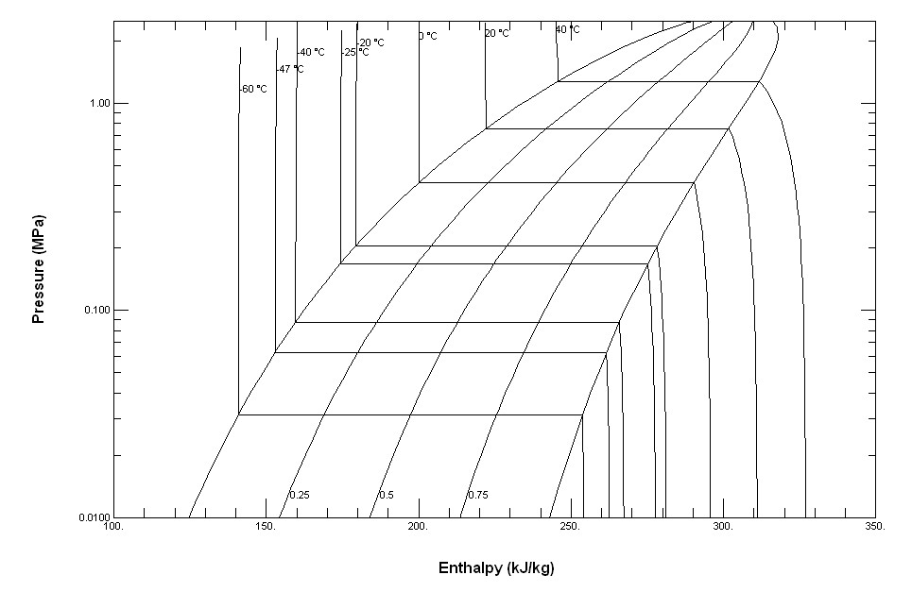
A low efficiency cycle
B
C
D
E
E₁
F
A

Slide 5
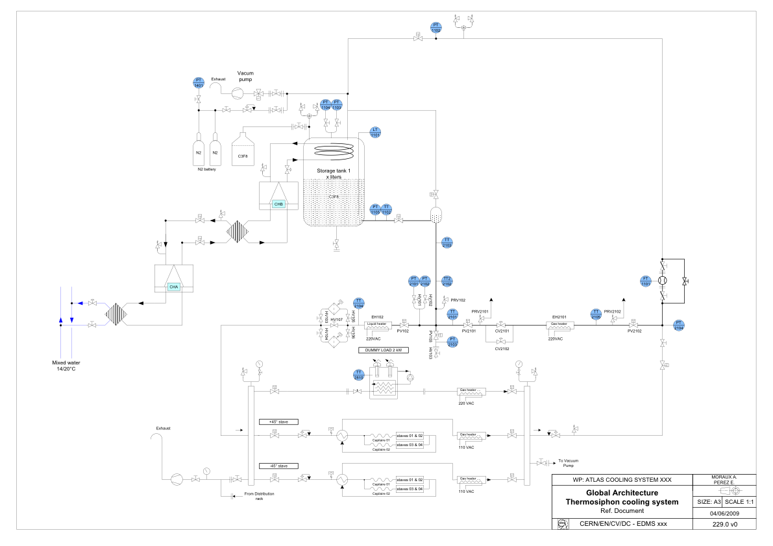
P&I of the installation
-55 °C = 400 mbar
-67 °C = 200 mbar
6 kW
Return DP = 80 mbar
-40 °C = 850 mbar
-30 °C = 1300 mbar
-25 °C = 1670 mbar
2 kW

Slide 6
The project organization
Alexandre Moraux, Elena Perez, Michele Battistin, Jose Direito, Jan Godlewski, Lukasz Zwalinski, Danilo Giugni, Antonio Romanazzi, Johan Bremer.
Thermo-siphon first action list:
First Workshop on thermo-siphon solutions at CERN 6th July 09.
First internal review at CERN 1st September 2009.
Technical and economical definition of the low temperature chiller solution – Visit to first possible supplier on June 29th.
Provisional design of the first prototype – August 09.
Presentation of the technical solution to ATLAS ID end of Sept 09.
Installation of the transfer lines in the PX15 – September 09.
Prototype assembly – Oct-Dec 09.
Commissioning and test – Jan - March 10
There is a need/possibility of a fast and intermediate prototype to be installed with recuperation material using an high of ≈15 meters in bdg 191.

Slide 7
Conclusions
Gravity driven circulation evaporative cooling systems seems a promising technology to replace the compressors in the evaporative cooling systems
It is foreseen to install a test bench in PX15; the design parameters of this test bench installation fit with ATLAS IBL cooling needs.
We are evaluating the need to realize a very small scale test bench to validate the first design assumptions in bdg 191
Perfluorocarbon blends solutions could be adopted to the thermo-siphon to improve the performances. Azeotropicity could be a problem.

