Slide 1
M. Battistin (EN/CV/DC)
1st September 2009
ATLAS Working Group
Thermo-siphon review
-
Low temperature condensation

Slide 2
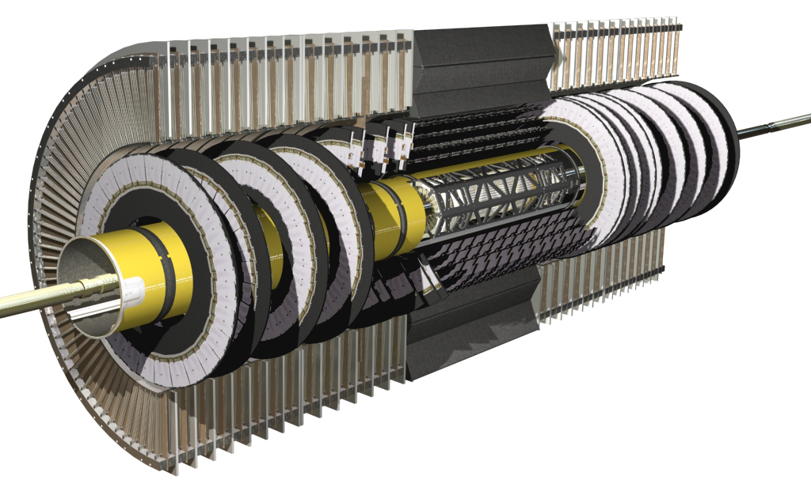
Moving the complication out
Low temperature
Chiller
condenser
Let’s explore the chiller part of this installation:
The cycle needs a condensation at low pressure and temperature.
C3F8 obliges to condensate between -50°C and -70°C to reach very low pressures, 450 and 200 mbara respectively.
liquid
tank
pneumatic
valve
Surface
pneumatic
valve
USA15
others
manual
valve
4 liquid lines
PR
Heater
thermal
screen
UX15
USA15
dummy
load
pixel
manual
valve
6 X SCT
4 gas lines
BPR
manual
valve

Slide 3
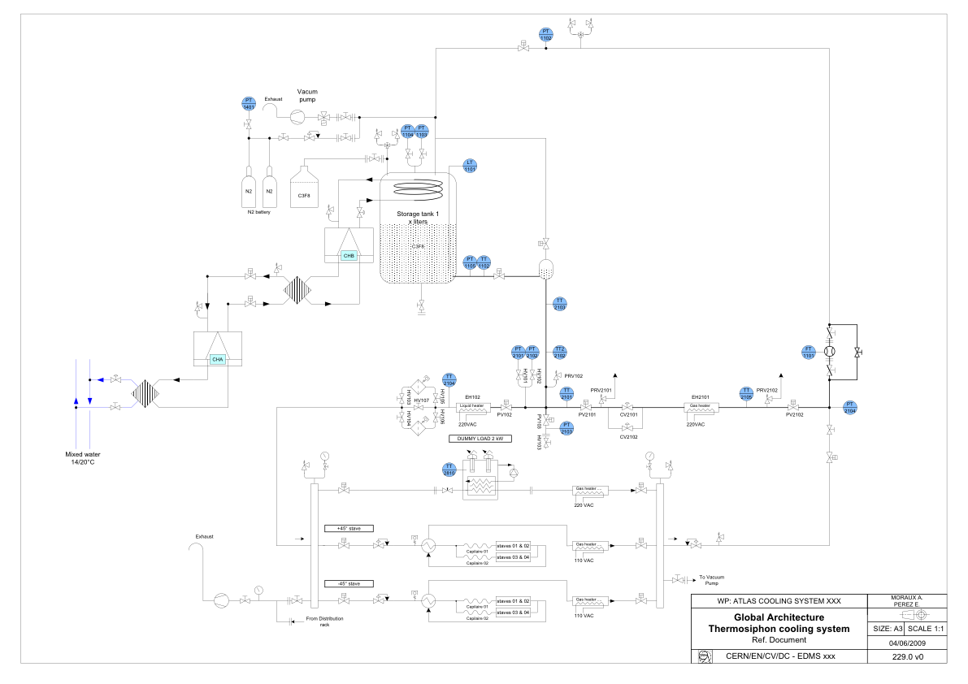
The chiller becomes the critical part of the installation

Slide 4
The fridge cascade
Cooling source is the primary water coming form the cooling towers: ≈25 °C
Two fridge systems in cascade takes the temperature to -70 °C.
The first stage uses R11 and the second stage R507a.
The second stage cools down a small liquid brine circuit R134a used to condensate the C3F8 in the condenser of the thermo siphon circuit. The condensed C₃F₈ falls in the liquid receiver due to gravity.
Condenser
-67°C
25°C
-30°C
-70°C
First
Chiller
(R23)
Second
Chiller
(R404a)
Brine
(R134a)
Primary
Water
25°C
Liquid
receiver

Slide 5
Many possible suppliers
The fridge cascade shall be:
Fully redundant (2 x 100% or 3 x 60% solutions can be adopted)
Highly reliable (proven performances and MTBF)
Automatic (the control system will be independent to the thermo siphon one)
We will search for fully industrial hand-key solutions realized by reliable company with a proven list of similar installation realized in the past.
We are now in the Market Survey (MS) phase. The visit to the companies premises will be part of the selection criteria of the MS. The Invitation to Tender (IT) will be sent to the selected companies only.
The long list is:
Axima Refrigeration (D), Axima (CH), Angelantoni (I), Froid Seicar (F), Mayekawa Europe (B), Clauger (F), others are going to be selected

Slide 6
Visit to Angelantoni on June 29th 2009
Clear previous experience on refrigeration for industry:
Brine chilling units, package design, air-cooled or water-cooled, refrigerating capacities from 30 to 800 kW, temperature range from 0°C to – 80°C.
Refrigerating systems for harmful gas or vapors condensation, to avoid environment pollution, custom-designed according to Customer requirements, capacity range from 30 to 2.000 kW, temperature range from 0°C to – 80°C.
We are waiting (this week) for the first detailed technical and commercial offer for a cooling unit 6 kW @ -60°C or -70°C. The budget offer is around 300 k€
2.0 m
≈300 k€
4.0 m
5.0 m

Slide 7
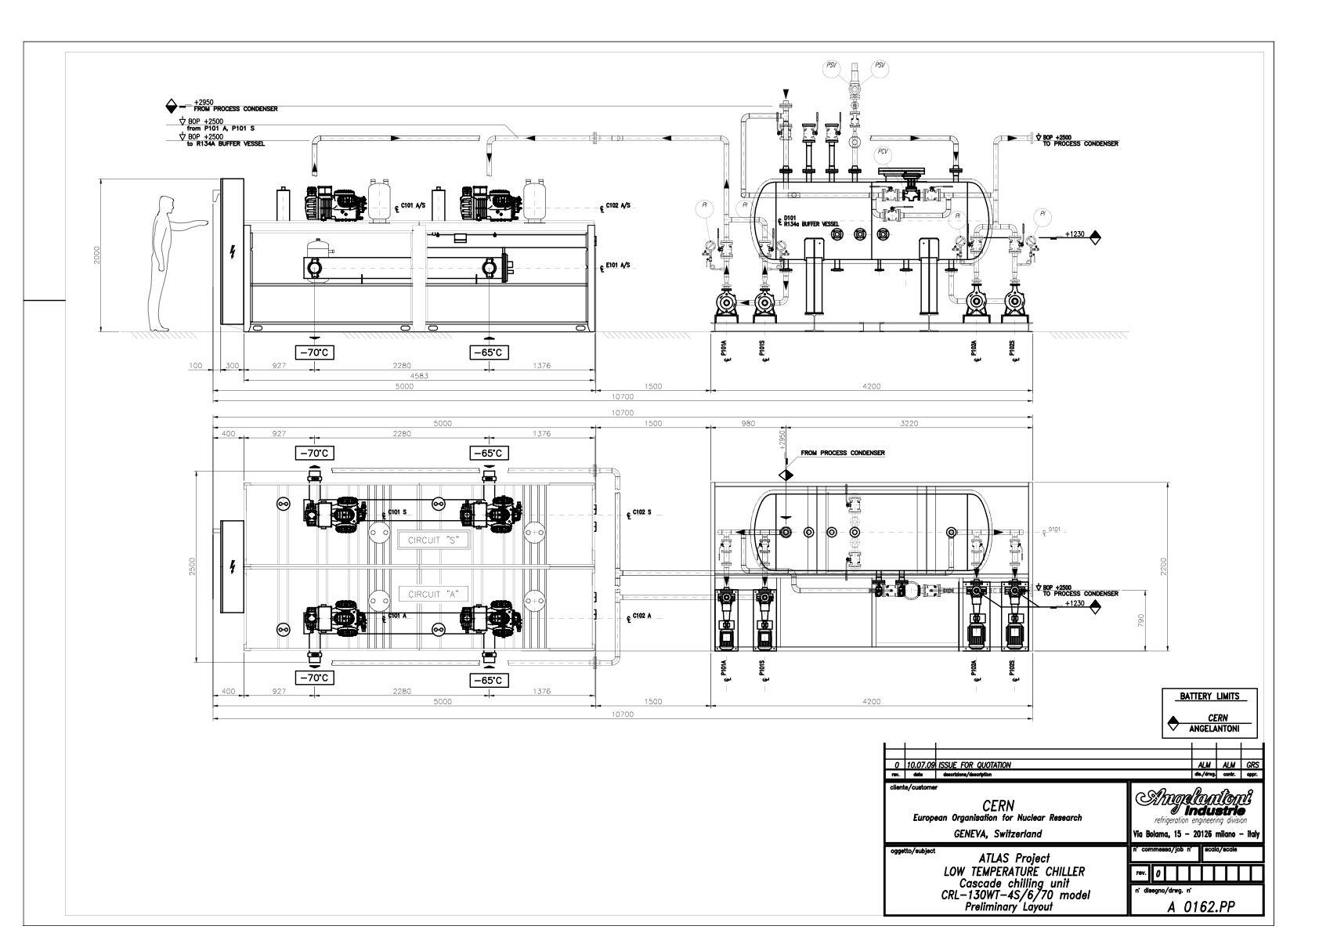
Space could be a problem

Slide 8
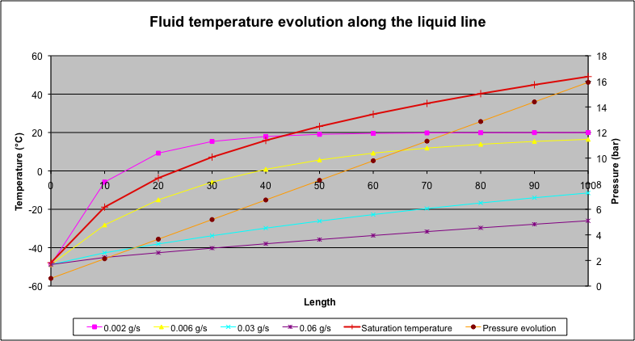
Is there any cheaper solution for a test bench?
The liquid temperature increases form the surface to the cavern due to the environmental thermal load.
The final (cavern) temperature increases with the mass flow.
There is a minimal mass flow required to avoid the temperature increases more than the saturation one.
There is a minimal cooling power we need to condensate the minimal flow rate required.
Some laboratory chiller can be used in this testing phase to provide the required minimal power.
LAUDA
JULABO
HUBER
A minimum requirement is around 2 kW@ -60 C

Slide 9
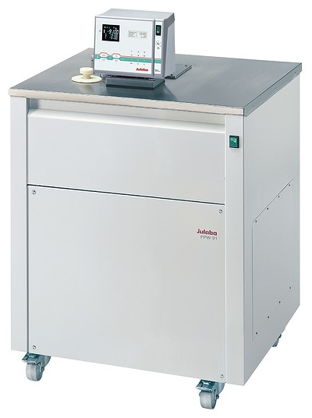
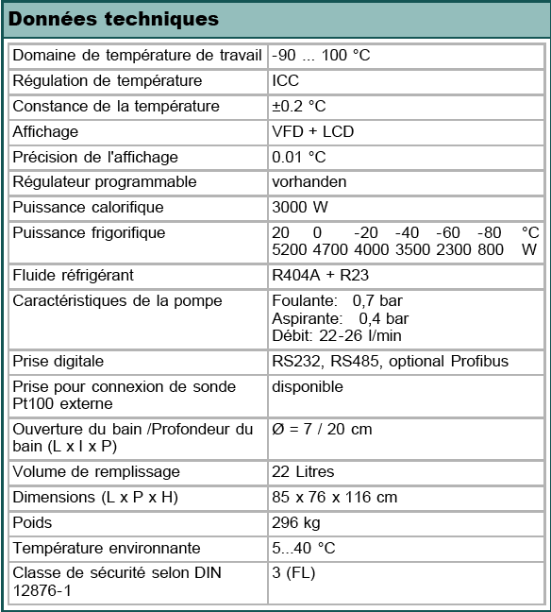
JULABO – FPW91-SL
50.000 CHF – 6 weeks delivery

Slide 10
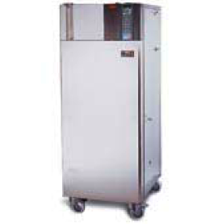
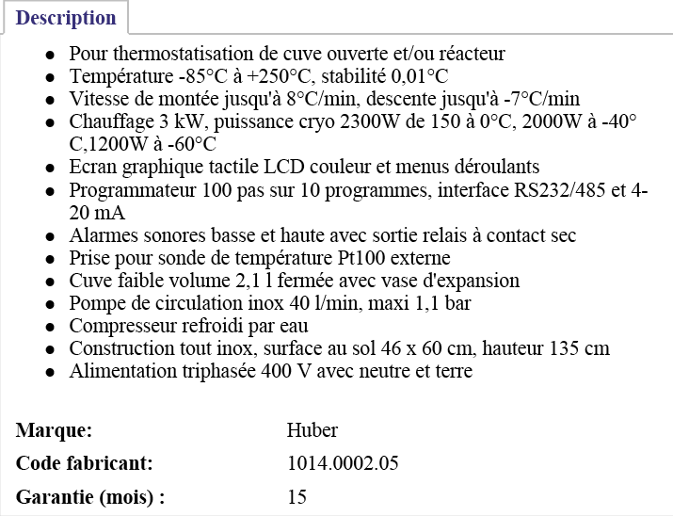
HUBER W85541
53.000 CHF – 4 weeks delivery

Slide 11
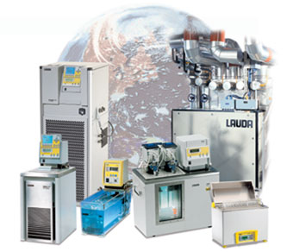
LAUDA ?
Waiting for the offer…

Slide 12
Conclusions
The low temperature cooling source is the critical part of the thermo siphon installation. It leads the MTBF of the system.
We believe that a fully redundant, fully industrial solution shall be adopted.
Previous experiences (EN/CV/DC) with industrial contract show how the supplier selection is a very critical point.
For the test phase a laboratory chiller seems much more attractive.
We are going to launch the Market Survey for the selection of the short list of companies for the supply and installation of this part of the system.
The first stage will be for low power (ATLAS IBL design parameters).
This will validate the solution for phase II.

