Slide 1
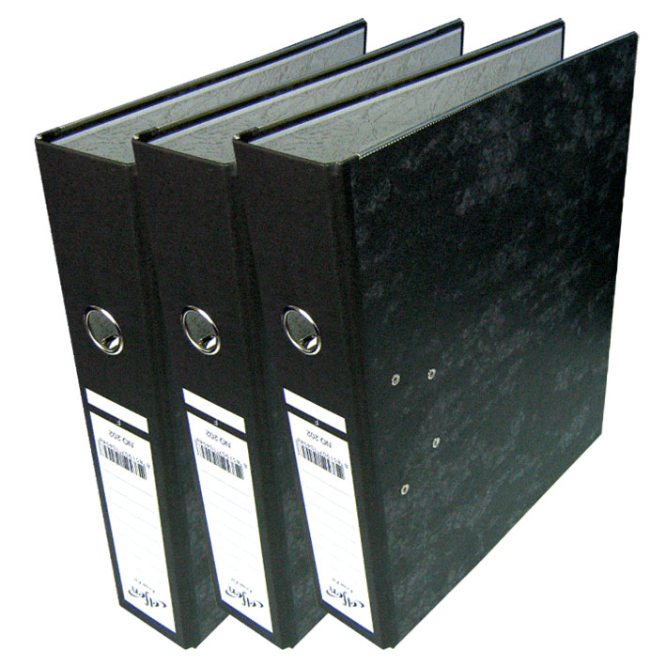
Thermosiphon project management and quality assurance
Presentation done by Elena Perez Rodriguez
For further information contact elena.perez.rodriguez@cern.ch
EN/CV/DC

Slide 2

Project management
EN/CV/DC

Slide 3
EVM Project management
This project will follow the Earned Value Management (EVM) technique
Definition
Conceptual design report
PBS
Project breakdown structure
Equipment coding convention
WBS & WU’s
Work breakdown structure
List of working units
RRM
Resource responsibility matrix
WUD
Work units dictionary
Project coordination schedule
Planning
EN/CV/DC

Slide 4
Project Breakdown Structure
Piping
Main pipes
Small piping and manifold
Tank
Vessel
Condenser
Vacuum system
Chiller
Evaporator
Control and instrumentation
Electricity
EN/CV/DC

Slide 5
Working Breakdown Structure
 | 1 | Project management and integration
 | 1.1 | Project management
 | 1.2 | Integration studies
 | 2 | Technical studies
 | 2.1 | Thermodinamical design
 | 2.2 | Mini-thermosiphon test
 | 3 | Piping
 | 3.1 | Main pipes
 | 3.2 | Small piping and manifold
 | 4 | Tank
 | 4.1 | Vessel
 | 4.2 | Condenser
 | 5 | Vacuum system
 | 5.1 | Vacuum system for tank
 | 5.2 | Vacuum system for distribution manifold
 | 6 | Chiller
 | 6.1 | Chiller
 | 7 | Evaporator
 | 7.1 | Dummy load
 | 7.2 | Cooling loops
 | 8 | Control and instrumentation
 | 8.1 | Instrumentation for data adquisition
 | 8.2 | Hardware
 | 8.3 | Software
 | 9 | Electricity
 | 9.1 | General
 | 9.2 | Signal cables
 | 9.3 | Power cables
 | 10 | Installation and commisioning
 | 10.1 | Infraestructures
 | 10.2 | Equipment
 | 10.3 | Commissioning
 | 11 | Operation
 | 11.1 | Data acquisition
 | 11.2 | Reporting
WU list = PBS + project management + installation
WBS Matrix : WU us tasks
94 tasks in this project
EN/CV/DC

Slide 6
Resource Responsibility Matrix
RRM : WU’s us Resources
Defines the responsible of the work unit and also
  X -> Execute the work
  R -> Review the work done
  I -> Must be informed
  H -> Can provide help or tuitions
  N -> Needed to have the work completed
EN/CV/DC

Slide 7
Working Units Dictionary
All the information is then collected in the WUD
  Includes not only the activities and the responsible person but also the material and persons needed for each task and subtask.
Planning
EN/CV/DC

Slide 8
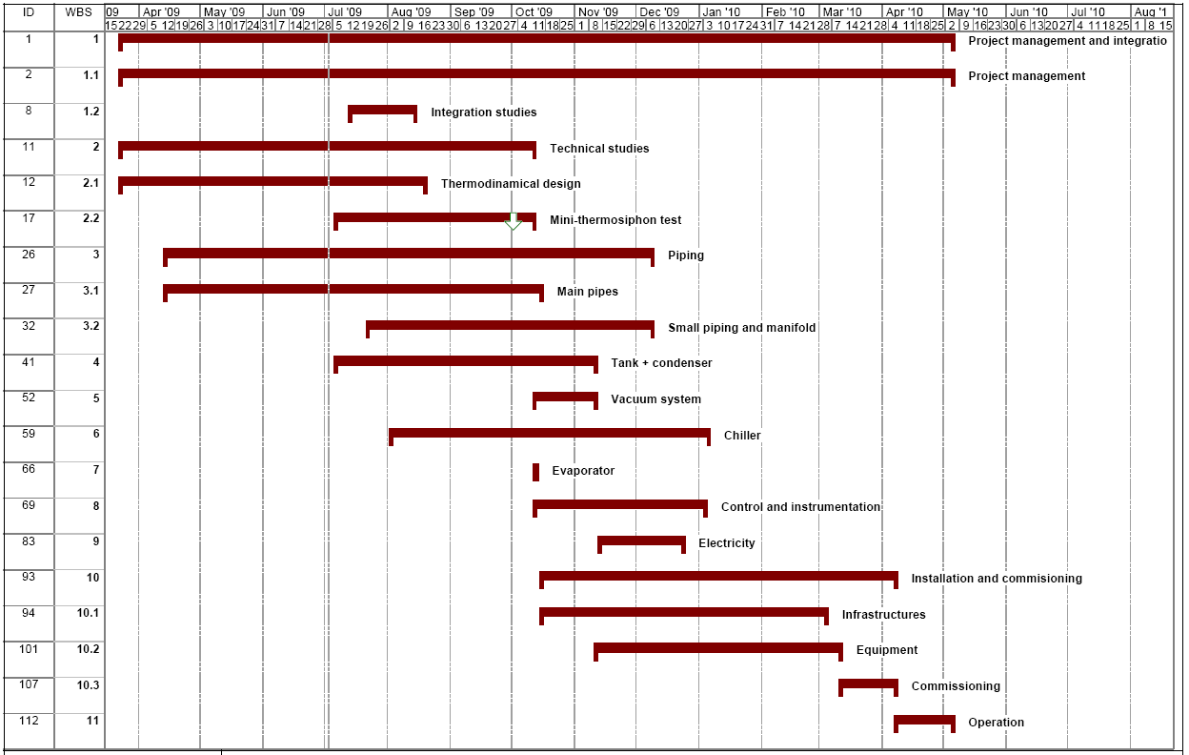
Planning
EN/CV/DC

Slide 9

Important milestones
August
  Safety commission approval of the project
  Purchase of tank and condenser
October
  Mini thermosiphon test
  Awarded contract for the chiller
  Installation of the main piping finished
December
  Distribution manifold built
March
  Thermosiphon built
April
  Thermosiphon ready to run
EN/CV/DC

Slide 10
Quality management
EN/CV/DC

Slide 11
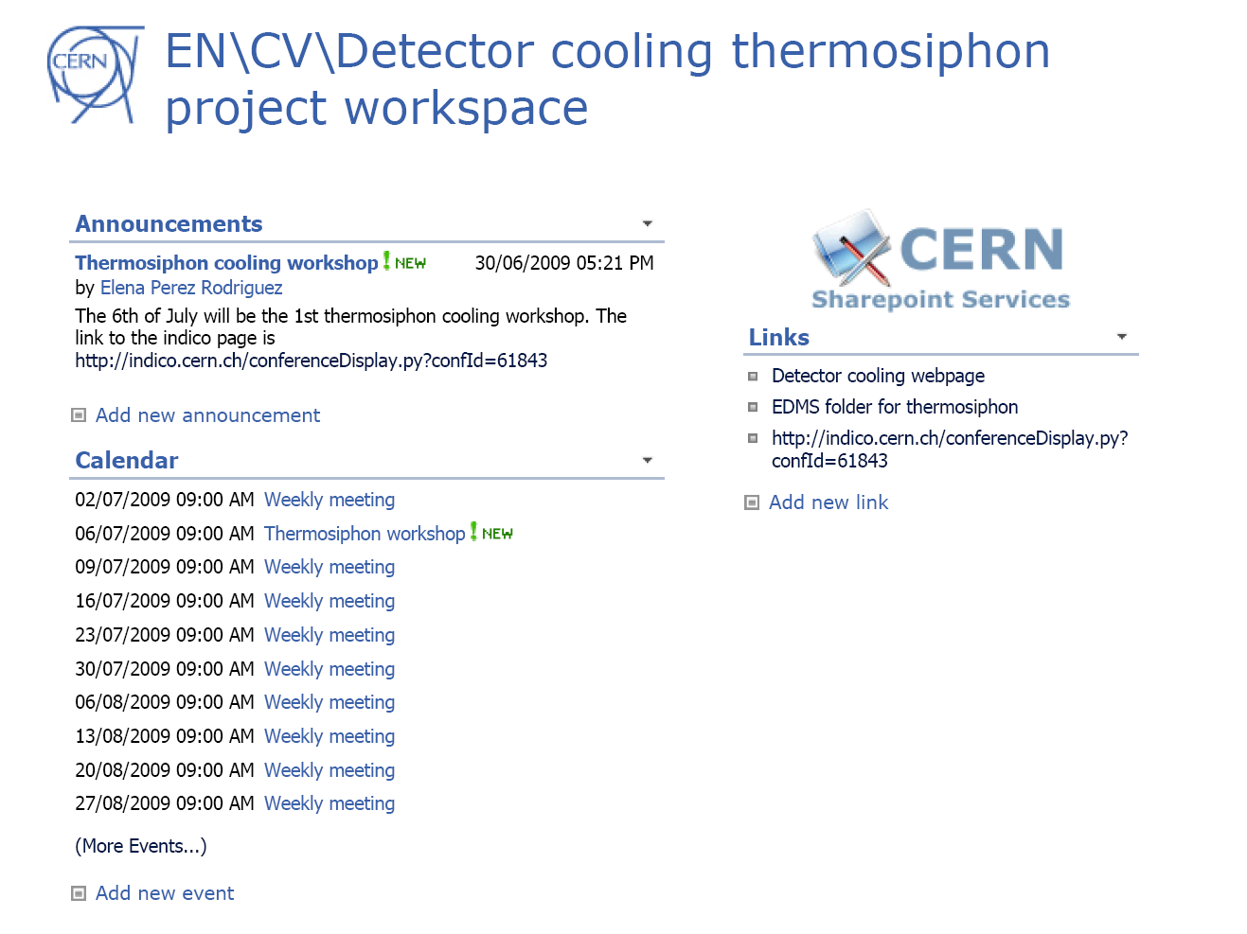
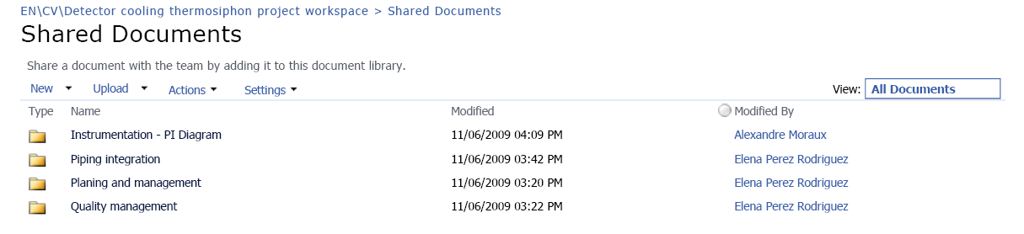
Workspace
Sharing working documents
  Use the workspace
  Includes a calendar, announcements and useful links !
  https://espace.cern.ch/thermosiphon
  In case of access problems contact elena.perez.rodriguez@cern.ch
EN/CV/DC

Slide 12
Long term documentation
Publishing definitive documents
  Use EDMS folder for the thermosiphon project
  CERN-0000078075 v.0
Main quality documents
  Naming convention EDMS 1016399
  Construction and testing procedure EDMS 1016400
  Risk analysis
  Working reports
  Users manual and technical documentation
EN/CV/DC

Slide 13

Construction and testing procedure
The main points are
  Components
    Materials
    Connectors
  Construction
    Cleaning standard
  Commissioning
    Pressure test
    Leak checking test
    Mapping and electrical test
It includes the leak rate specification calculations, the leak checking templates and a template for the commissioning reports
EN/CV/DC

Slide 14

Thank you for your attention
Presentation done by Elena Perez Rodriguez
For further information contact elena.perez.rodriguez@cern.ch
EN/CV/DC

