Slide 1


Mini-Thermosyphon CP Test
J. Direito
(EN/CV/DC)

Slide 2
Objectives
Validation of the Thermosyphon concept in a small scale test (low cost).
Report the behavior of system during Start up/operation/shut down (data acquisition)
Gain experience during operation of this small scale test.

Slide 3
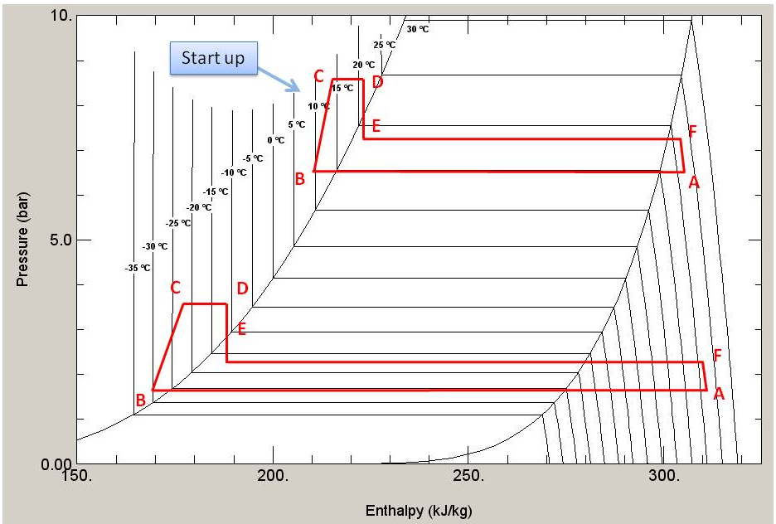
Thermodynamic Cycle
Available Height of 13m => max dP of 1.9 bar

Slide 4
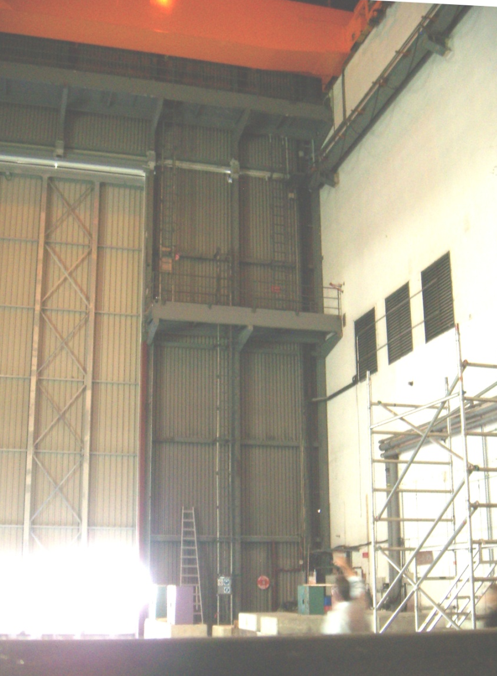
Layout at B-191
Condenser
Chiller
Dummy Load

Slide 5
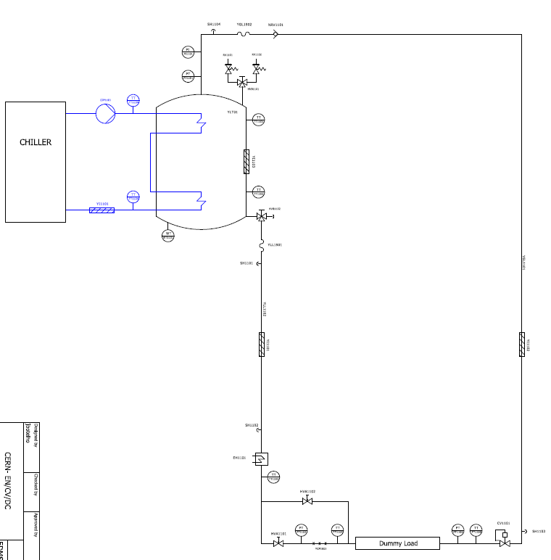
P&I

Slide 6
Part List

