Slide 2
40 MHz post-acceleration in the PS
LIU-PS beam dynamics working group meeting
26/10/2017
H. Damerau, A. Lasheen
Many thanks to D. Cotte, M. Delrieux and E. Shaposhnikova

Slide 3
Motivation and introduction
Suspicion: (part of) losses after PS-SPS transfer due to
  Uncaptured particles at PS extraction
  Large amplitude particles during rotation
In- and outside bucket may change during transfer
Proposal: post-acceleration in PS
  Acceleration with 40 MHz RF system before bunch rotation
  Lose uncaptured particles at PS extraction or transfer line

Slide 4
Fixed-frequency post-acceleration
  Basic idea:
  Advance triple splitting at 2.5 GeV by 105 ms
    Gain time for longer flat-top
  Accelerate to (intermediate) flat-top slightly below field for PS-SPS
    Leave headroom for post-acceleration
  Advance coarse synchronization and quadruple splitting
    RF manipulations at slightly lower field
    Radial displacement
    Valid signals from SPS required earlier
  Post-acceleration using 40 MHz RF system (h = 84)
  Standard Bunch rotation and extraction

Slide 5
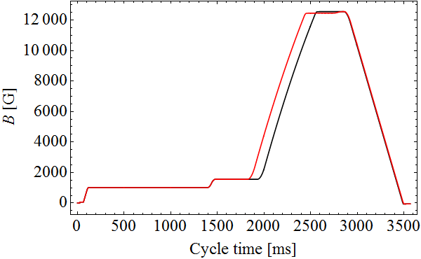
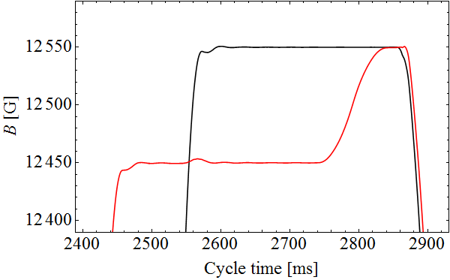

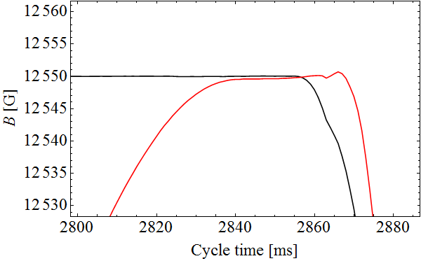
Magnetic cycle for post-acceleration
Entire cycle
Manipulation flat-top
ΔB
Final flat-top
  Longer flat-top already used in 2001 for electron cloud studies
  PFW settings adapted (not on plots yet)
  One cycle per super-cycle to reduce RMS current of PFW
  Tested ΔB up to 300 Gauss
  No issues with magnets or converters
[1] R. Cappi et al., PRST-AB 5 (2002): 094401

Slide 6
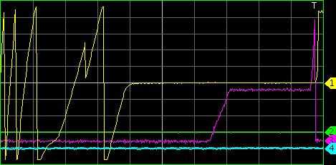
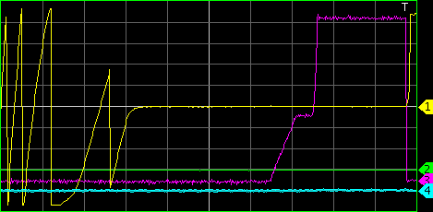
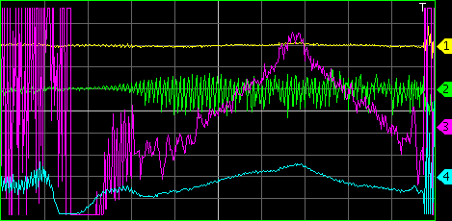
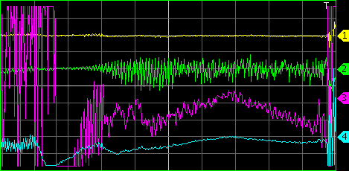
First fixed-frequency post-acceleration
  Proof-of-principle test using ΔB = 100 G
Last 500 ms bef. ejection, V_{RF} = 40 kV
Last 500 ms bef. ejection, V_{RF} = 100 kV
V_{det}, C40-78
V_{det}, C40-78
Δφ_{h=1}, synchronization
Δφ_{h=1}, synchr.
Last 100 ms bef. ejection
Last 100 ms bef. ejection
Δφ, h = 84
Δφ, h = 84
  Beam/cavity at h = 84 rises and falls during post acceleration
  Prove of acceleration using 40 MHz RF system

Slide 7
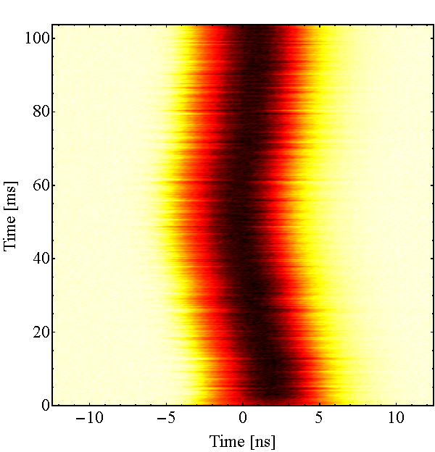
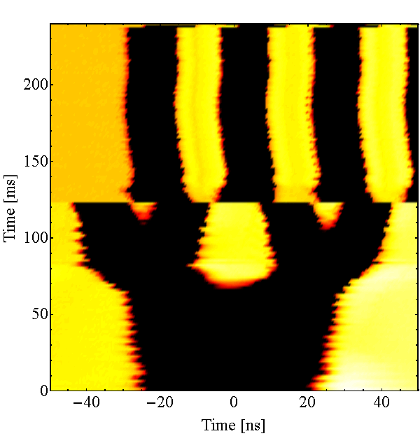
First fixed-frequency post-acceleration
  Proof-of-principle test using ΔB = 100 G
Post-acceleration mountain range
No loss of particles from buckets
  Beam/cavity at h = 84 rises and falls during post-acceleration
  Proves of acceleration using 40 MHz RF system

Slide 8
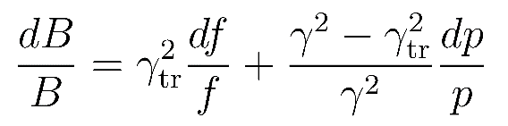
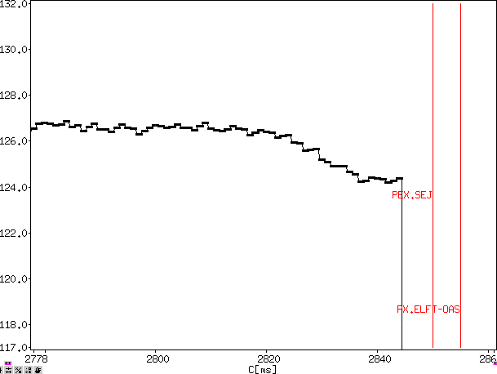
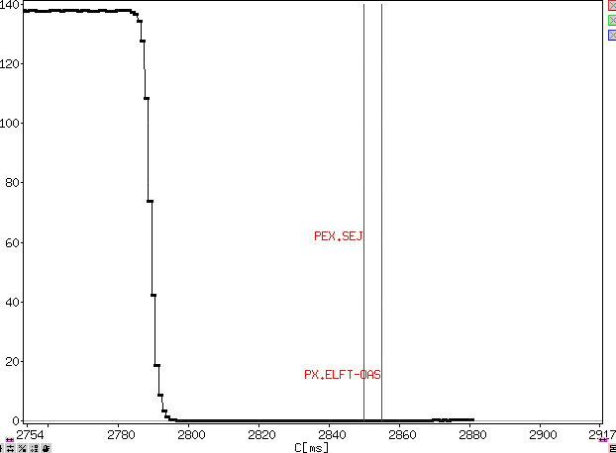
Choice of field difference ΔB
  Estimate of momentum aperture at flat-top via radial steering
    Frequency steering 476.643 kHz…476.984 kHz
    Using the Δp/p range becomes ~2.8%
    Keeping the frequency constant, but changing the magnetic field
    results in an allowed field range of ~350 G
  Losses during post-acceleration with RF off
  Use ΔB = 200 G → ΔE = 0.44 GeV = 16ΔE_{bucket} at V_{RF} = 100 kV
X
X
Intensity for ΔB = 200 G
Intensity for ΔB = 300 G
Intensity [10¹⁰ ppp]
Intensity [10¹⁰ ppp]

Slide 9
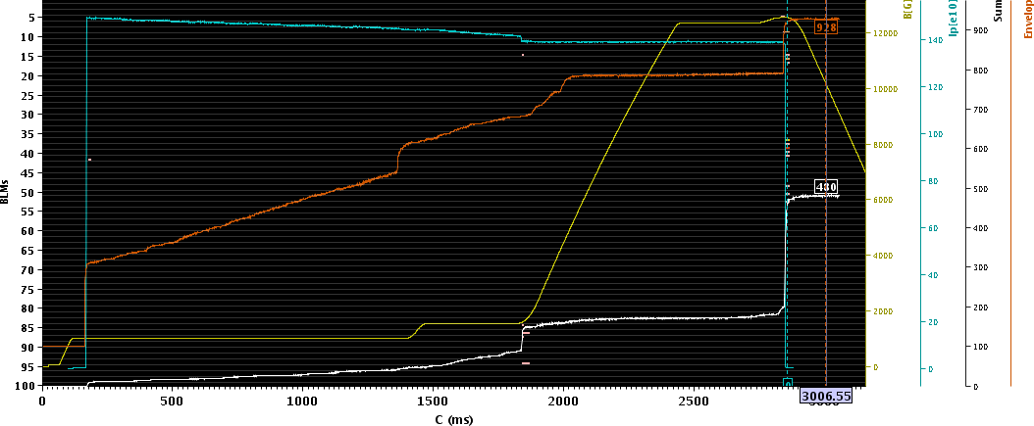
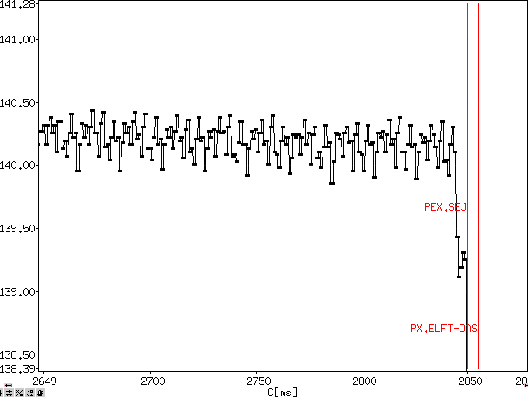
Losses with 40 MHz RF on
  Post-acceleration without significant losses with 40 MHz RF on
  About 1% losses when the ejection bump starts to opens
  Uncaptured particles left behind during post-acceleration?
Intensity [10¹⁰ ppp]

Slide 10
Limitation from beam loading
  Frequency trips of 40 MHz cavities, even at moderate intensity
C40-78
  40 MHz RF system designed for pulsed operation
    Energy mainly comes from capacitor bank
    40 MHz acceleration uses this energy
    Final amplifier anode voltage drops
    Final amplifier gain decreases
    Cavity trip due to driver amplifier overload
    Check with new prototype anode power supply
V_{a} (final)
V_{RF}
I_{a} (final)
V_{prog}
C40-77
V_{a} (final)
V_{RF}
I_{a} (final)
V_{prog}

Slide 11
Summary
First iteration beam preparation completed in PS
  Fixed-frequency post-acceleration at 40 MHz works
  ~105 ms longer flat-top acceptable
  Quick scan of ΔB for fixed-frequency acceleration: ΔB = 200 G
  Limitations from beam loading in 40 MHz cavities
  36 bunch batch with nominal bunch intensity N_{b} = 1.3 · 10¹¹ ppb
Next steps:
  Compare injection losses in SPS with and without fixed-frequency post-acceleration
  Apply longitudinal shaving during 40 MHz accelerator to tailor longitudinal emittance

