Slide 1
News from 10 MHz cavity impedance measurements
G. Favia
H. Damerau, V. Desquiens
LIU-PS Beam Dynamics Working Group MEETING
26/10/2017

Slide 2

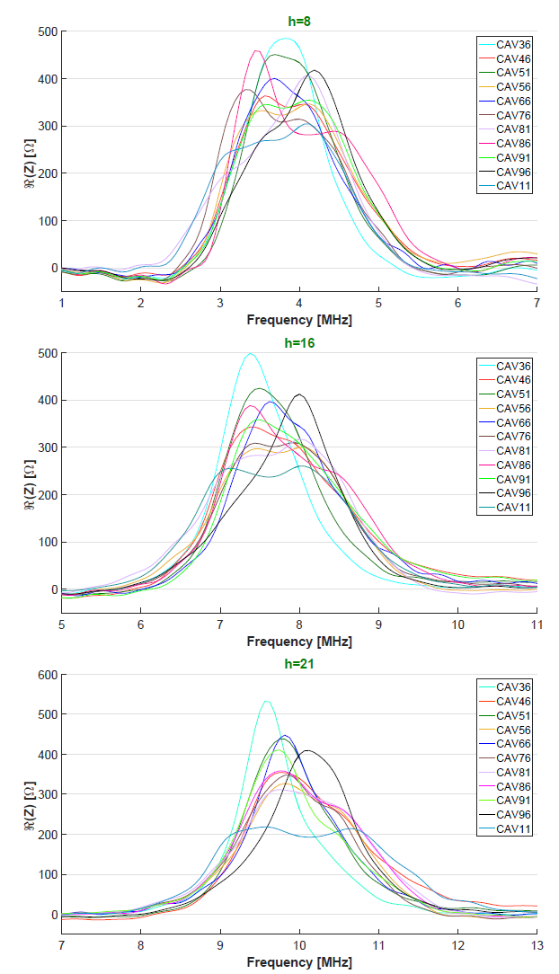

10 MHz cavities impedance
$$R(Z)[Ω]$$
Impedance evaluated from the voltage induced by a single bunch beam, with no accelerating voltage on the cavities gap.

Slide 3
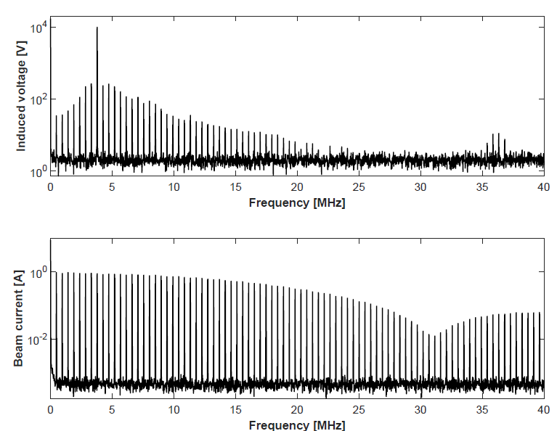
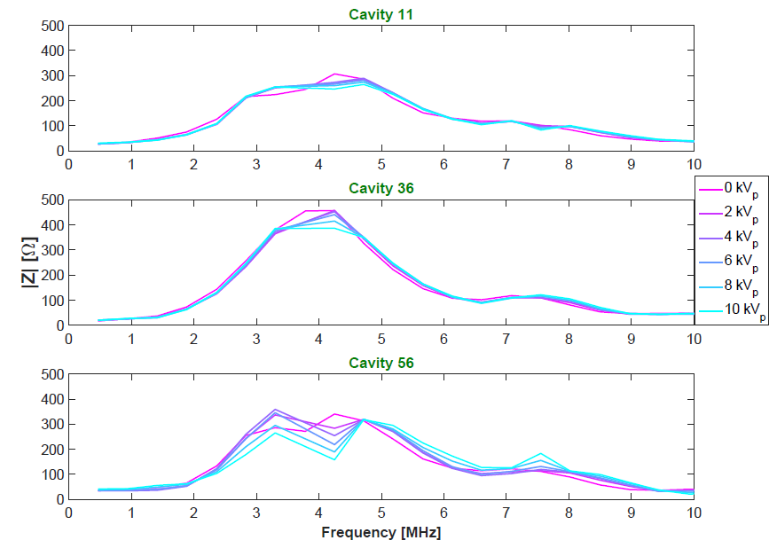
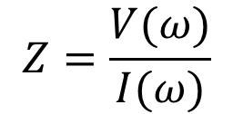
Measurements at high RF voltage
Motivation: Beam instabilities are observed during accelerations (~10 kV_{p} /gap)
Method: Measurement of voltage induced by a single bunch beam at h=8 (TOF beam), varying the RF on cavity gap
h=8
Induced voltage spectrum
$$Z=\frac{V(ω)}{I(ω)}$$
Beam spectrum

Slide 4
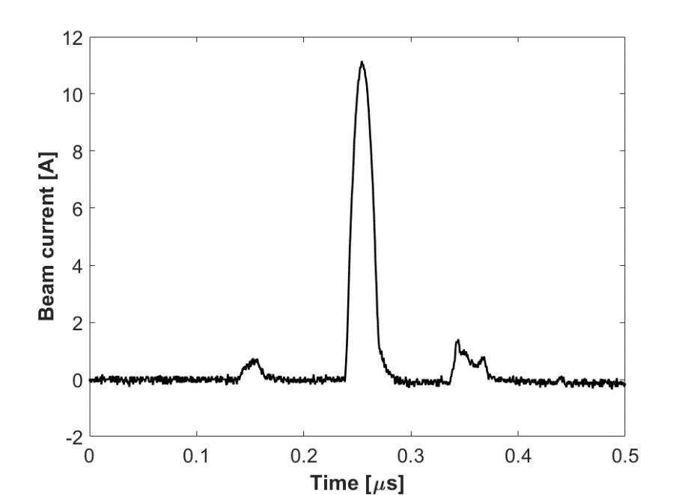
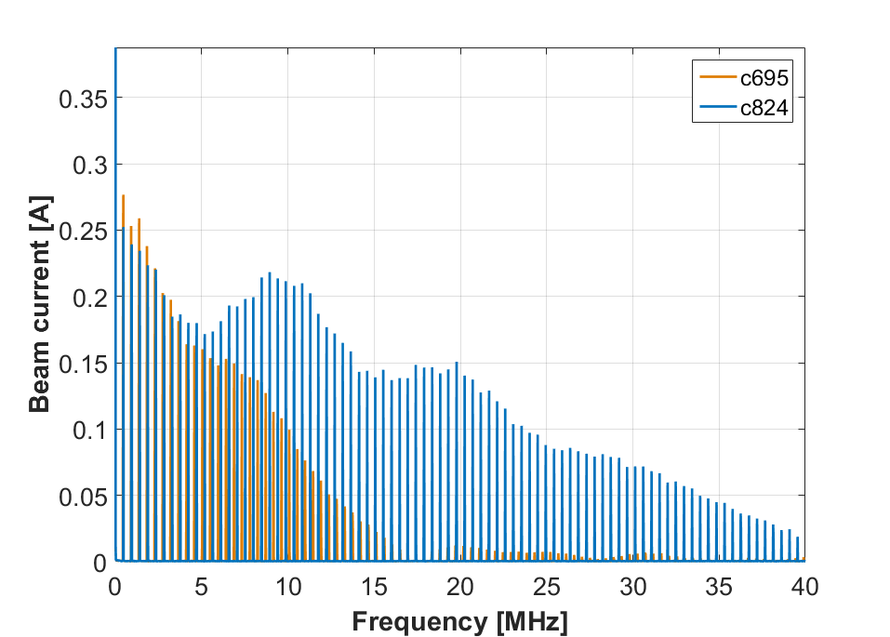
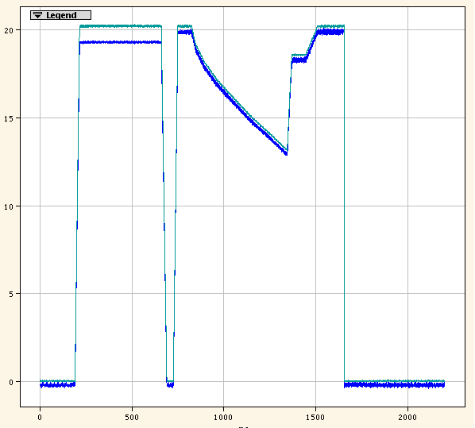
Measurements at h=21
Motivation: Instabilities observed after transition crossing
Method: Measurement of voltage induced by a single bunch beam at h=21, varying the RF on cavity gap
Difficulty: Develop a suitable single bunch beam at h=21 (courtesy of Heiko)
Single bunch beam
Satellites due to bucket shortening from h=7 to h=21
Measurements performed with using different beam spectra
c695
c824

Slide 5
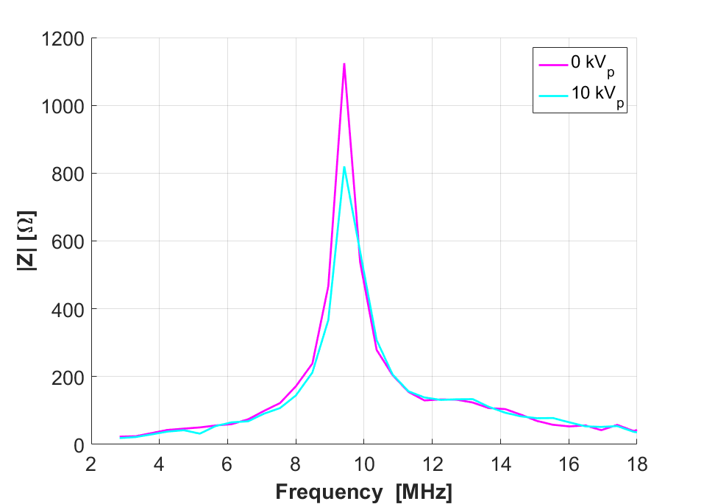

Measurements on cavity 11
Motivation: Measure the impedance of the first upgraded prototype, before replacing it with the newer version
Probable malfunctioning of tuning system.
Under investigation

Slide 6
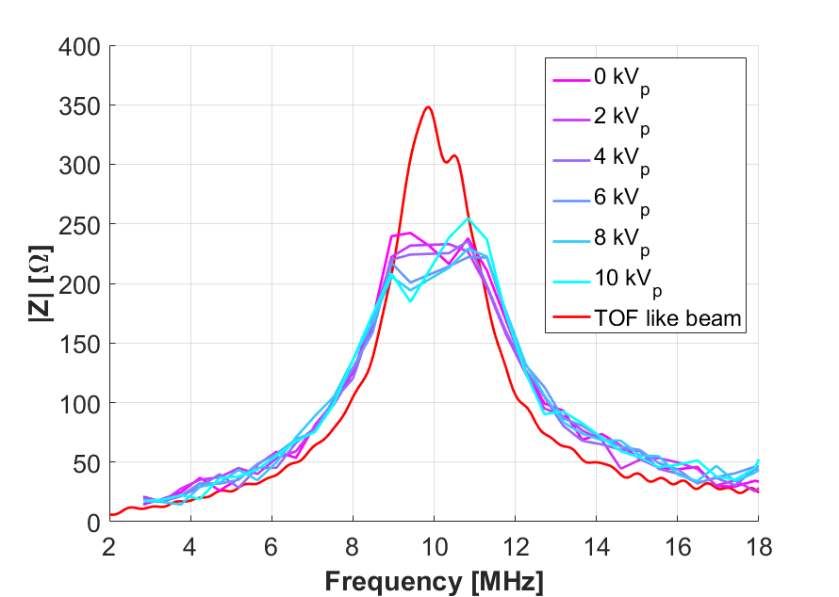
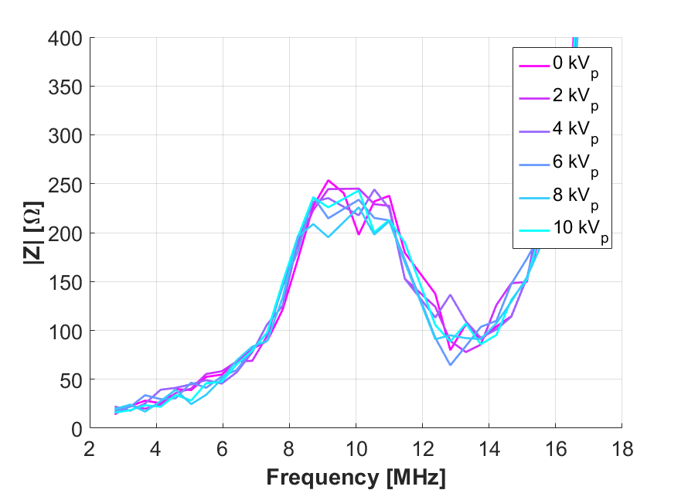
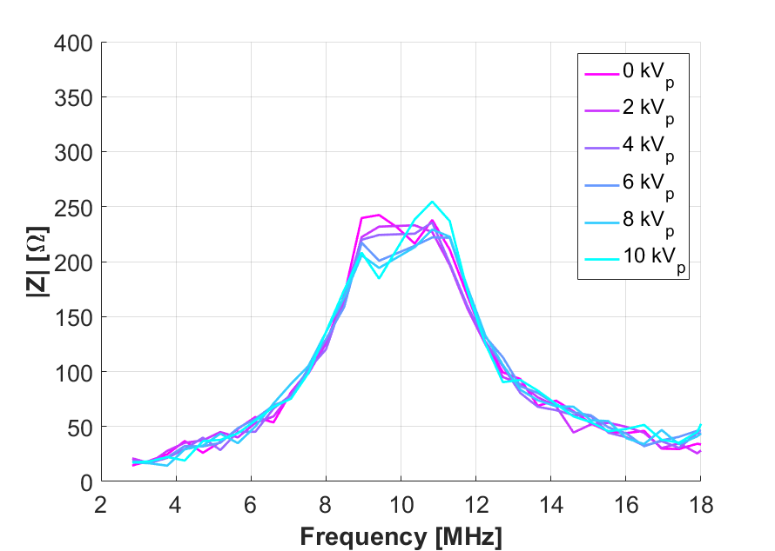
Measurements on cavity 76
C824
C695
Measurements performed in 2016.
Amplifier replaced?
Too narrow
beam spectrum

Slide 7
To do next
Measure the impedance of the other cavities at h=21 at high voltage on the gap;
Compare the results with the available data to validate the measurement method;
Measure the impedance of cavity 11 driven by the new version of the upgraded amplifier (presently a standard amplifier drives the spare cavity).

Slide 8
Thank you
for you attention

