Slide 1
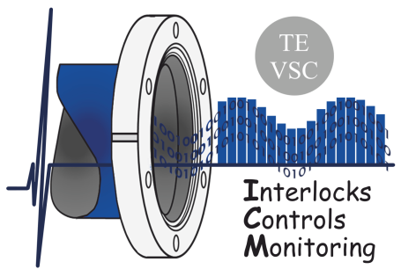
Vacuum UNICOS objects
Thijs van Winden(TE-VSC-ICM)
Presenting the group effort of:
Leonid Kopylov
Abel Gutierrez
Sebastien Blanchard
Notes:
Control systems
Architecture
What is UNICOS? And what is going to change?
Why prototype UNICOS?
What do we need for UNICOS?
Prototype
Benefits
Encountered issues
Trend
PLC Load

Slide 2
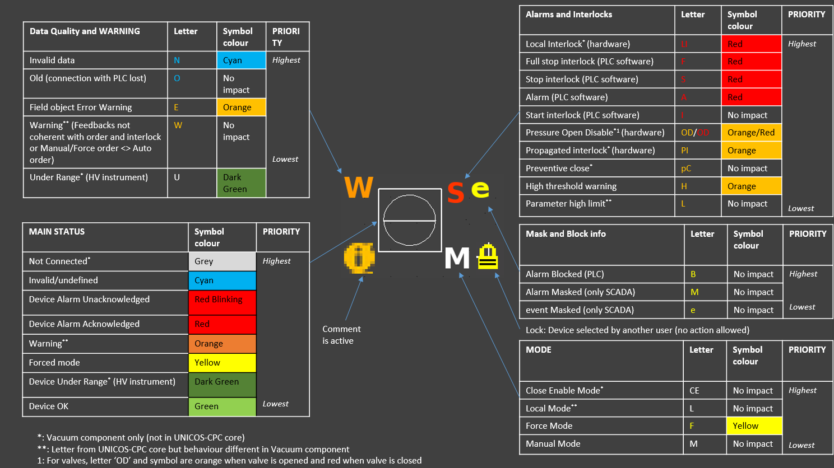
Widget Animation
Courtesy of S. Blanchard

Slide 3
Sector Valve

Slide 4
Demo

Slide 5
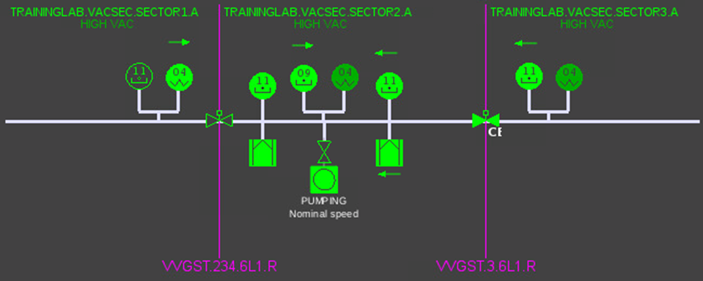
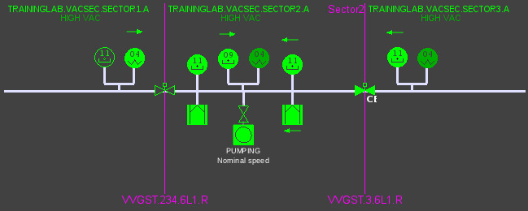
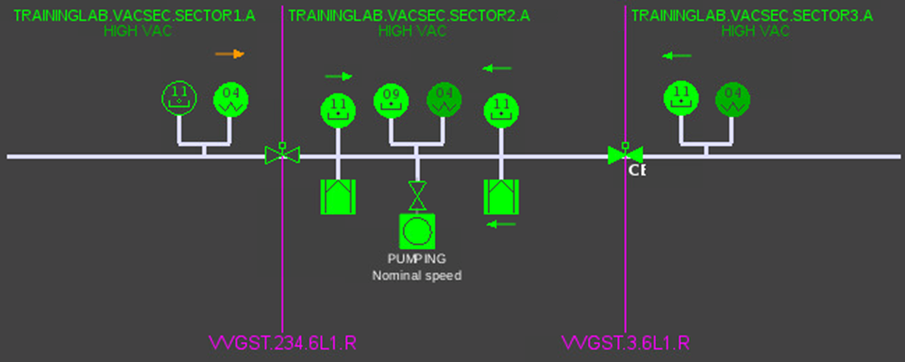
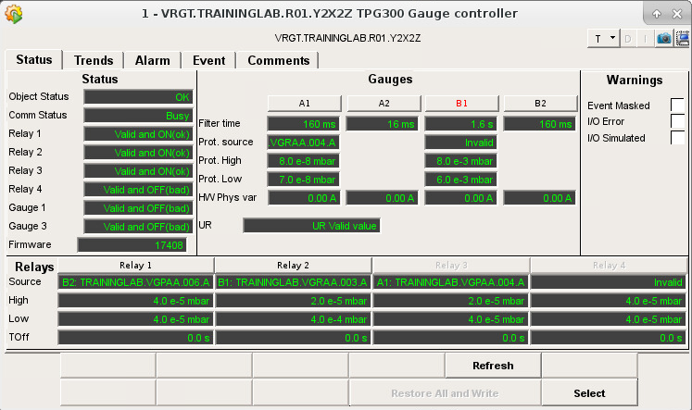
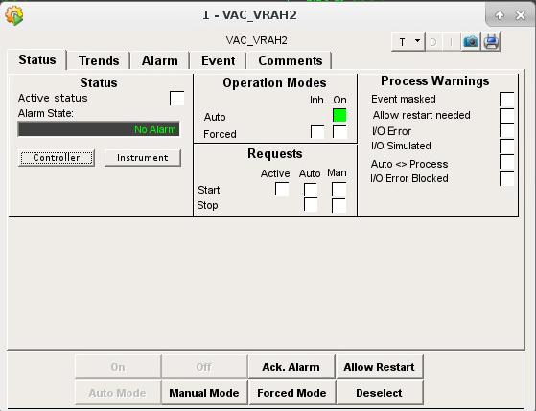
Hardware Alarm
Notes:
Explain here what we are going to test in the TrainingLab prototype
Objects
StateHistory
Group Actions
Automatic Synoptic

Slide 6

Hardware Alarm
Notes:
Explain here what we are going to test in the TrainingLab prototype
Objects
StateHistory
Group Actions
Automatic Synoptic

Slide 7
Demo

Slide 8
Thank you

