Slide 1
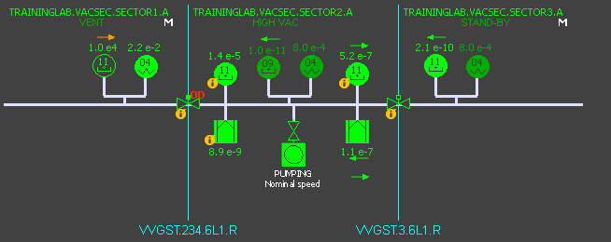
Introduction
Auto Synoptic
Vac Trending
State history
Pressure Profile
Device List
Monitoring List
Unicos Vacuum Package
SCADA Features
S. Blanchard
A. Gutierrez
L. Kopylov
T. van Winden
Vacuum Controls

Slide 2
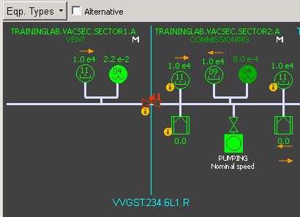
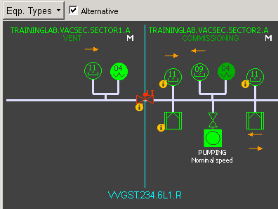
Introduction
Auto Synoptic
Vac Trending
State history
Pressure Profile
Device List
Monitoring List
Automatic Synoptic:
Select device types to be shown
With analog value
Without analog value

Slide 3
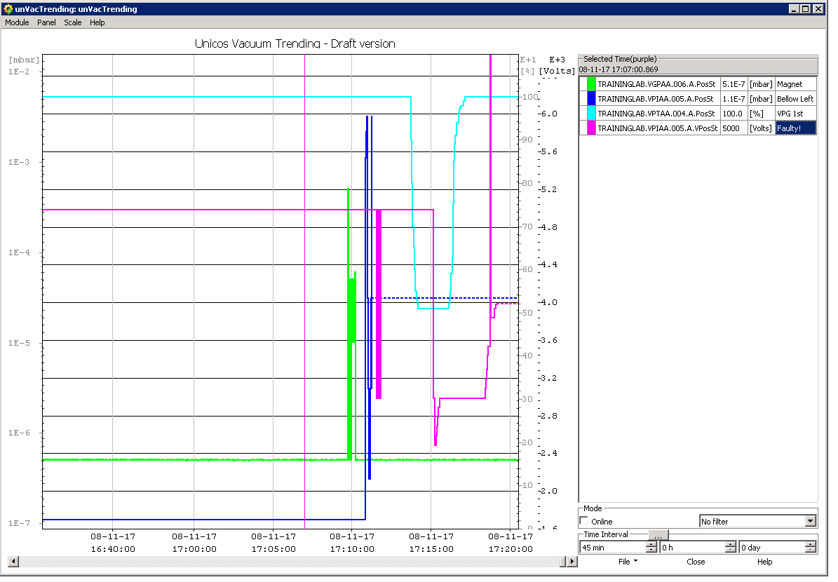
Introduction
Auto Synoptic
Vac Trending
State history
Pressure Profile
Device List
Monitoring List

Slide 4
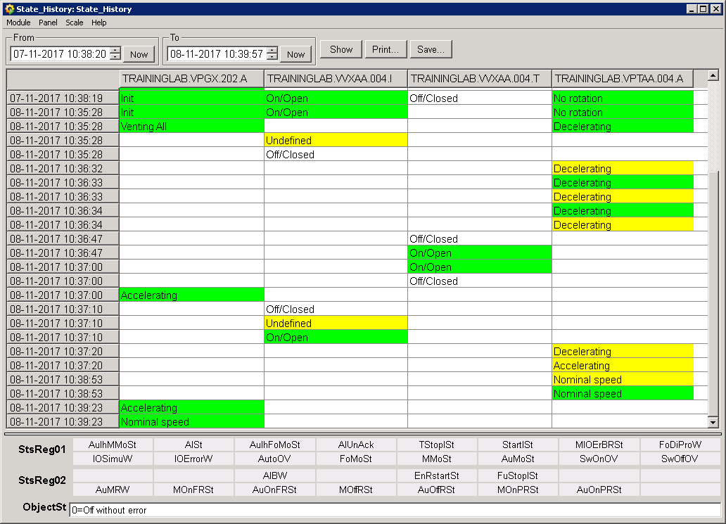
Introduction
Auto Synoptic
Vac Trending
State history
Pressure Profile
Device List
Monitoring List
State history:
Pumping Group
Intermediate Valve
Venting Valve
Turbo Pump

Slide 5
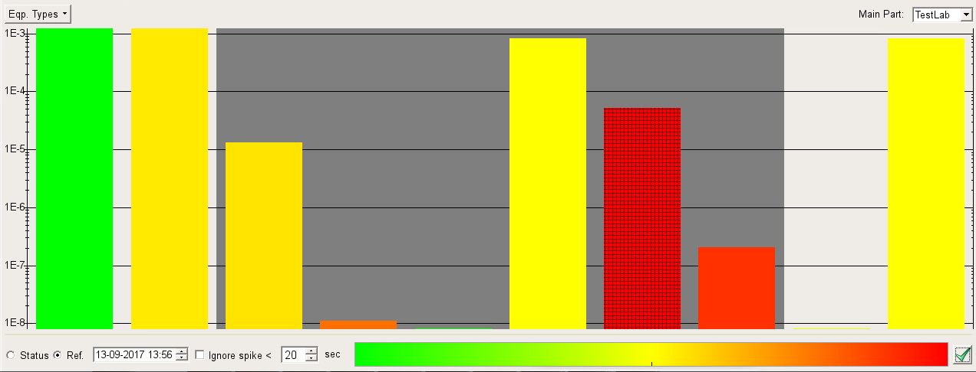
Introduction
Auto Synoptic
Vac Trending
State history
Pressure Profile
Device List
Monitoring List
In the pressure raised detection mode of profile panel, The colour of each bar corresponds to the maximum growth since a chosen moment in the past and current time.

