Slide 1
LINAC4 COMMISSIONING
Lombardi
BCC 8-19 Nov 09

Slide 2
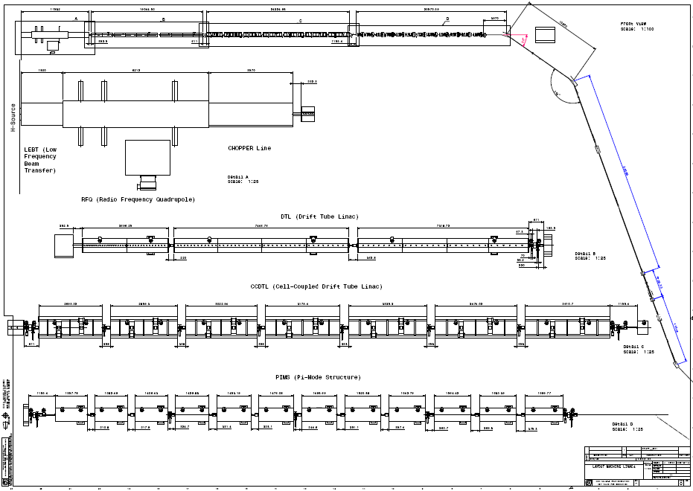
Layout and parameters
Source beam :
I=80 mA
Alpha, Beta=-6.6, 0.36 m
Emittance=0.25 pi mmmrad
Energy= 45 keV
Energy spread=1 keV (tot)
Beam at injection foil:
I=65 mA
Alpha, Beta=less than 1.0, less than 10.0 m
Emittance=0.4 pi mm mrad
Energy =160 MeV (±1.2MeV ramping)
Energy jitter = small as possible
Energy spread= 100 keV (1sigma)
D=0.0, -1.2 m ; Dp=0.05

Slide 3
Layout
 | LEBT | RFQ | CHOPPER | DTL | CCDTL | PIMS | Transfer line
Energy(MeV) | 0.045 | 3 | 3 | 50 | 100 | 160 | 160
Length (m) | 1.9 | 3 | 3.6 | 19 | 25 | 22 | 70 +100
RF |  | 1 tank | 3 cavities | 3 tanks | 21tanks | 12 tanks | 1 cavity
focusing | 2 Solen |  | 11 EMQ | 111 PMQ | 7 EMQ + 15 PMQ | 12 EMQ | 17 quads 4 bends + old line
To be set/tuned (till BHZ40) :
2 solenoids, 55 quads
48 steerers settings
22 amplitudes and phases
THERE ARE ABOUT 150 PARAMETERS TO SET

Slide 4
Stages
Pre-commissioning (now) :
  Simulate the commissioning with multi-particle codes with the aim of
    Consolidate a strategy
    Verify that the diagnostic is appropriate (number position sensitivity)
    Verify the possibility of setting parametrs with beam-based measurements
3 MeV test stand (south hall) (from 2011):
    Commissioning up to 3 MeV – most critical part
    Verify that the diagnostic is appropriate (number position sensitivity)
    Verify the possibility of setting parametrs with beam-based measurements
Linac4 commissioning (tunell):
    Recommission 3 MeV
    DTL tank1 – 12 MeV
    DTL tank2and 3 – 50 MeV
    CCDTL – 100 MeV
    PIMS – 160 MeV
    Transfer lines – 160 MeV
Todays’ topic

Slide 5
Milestones
Milestone |  | End-date
3 MeV test stand measurement plan; including RFQ commissioning. | ok | Mid 09
RF amplitude and phase setting with beam based measurements | today | 2009
Setting up strategy for DTL .CCDTL. PIMS. | today | 2009
Setting up strategy for transfer lines | To be addressed | 2009-2010
3 MeV test stand measurements |  | 2011
3 MeV re-commissioning in tunnel |  | Follow installation schedule and beam avaliability
DTL commissioning in Tunnel
CCDTL commissioning
PIMS commissioning |  | 2013
Transfer line commissioning |  | 2014

