Slide 1
Linac4 Beam Commissioning
Above 12 MeV
1.0 rf phase & amplitude
J. Stovall, M. Tedula, G. Bellodi,
J.B. Lallement, K. Crandall
19 November, 2009
CERN/BE-ABP

Slide 2


CCDTL longitudinal diagnostics
K
TOF
11βλ
φ_{in}
φ_{out}
ΔL≈1mm, Δt≈1°(352 MHz) ≈ 8 ps
CERN/BE-ABP

Slide 3
CCDTL longitudinal acceptance
σ_{0l}≈470°
Pencil beam
  I≈1 mA
  ε_{99%} . ≈0.25π mm-mR
  Δx = ±1 mm
σ_{0l}≈67°/module
CERN/BE-ABP

Slide 4
CCDTL “output” amplitude scans have no
distinctive identifiable features: φ_{out}-W_{out}
Module 1 Module 7
σ_{0l}≈73° σ_{0l}≈61°
CERN/BE-ABP

Slide 5
CCDTL “input” amplitude scans have
distinctive peaks & phase widths : φ_{in}-W_{out}
Module 1
σ_{0l}≈73°
CERN/BE-ABP

Slide 6
Single-particle phase scans simulate pencil-beam centroids
CERN/BE-ABP

Slide 7
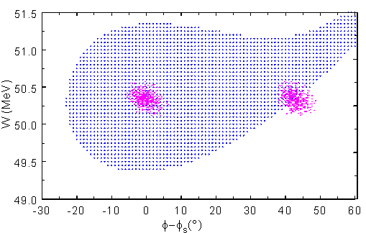
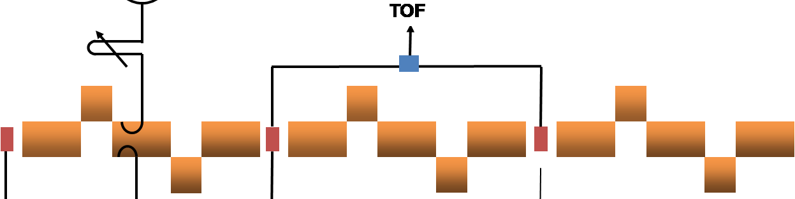
Pencil beam injected at +φ_{s}
is only slightly debunched at 2nd pickup
CERN/BE-ABP

Slide 8

PIMS Longitudinal Diagnostics
K
TOF
δφ_{­rf}
9βλ
φ_{in}
φ_{out}
Can modules be powered and phased independently?
Drive modules in pairs
  monitor/control relative phases
  beam loading effects?
CERN/BE-ABP

Slide 9
PIMS longitudinal acceptance
σ_{0l}≈264°
pencil beam
σ_{0l}≈22°/module, 44°/pair
CERN/BE-ABP

Slide 10
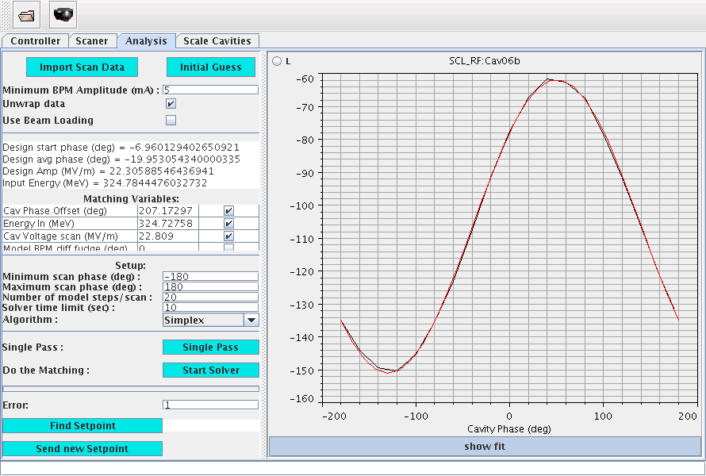
SNS uses TOF phase scans to set φ_{s} in SCL tanks,
amplitude is set for maximum acceleration
Relative phase measured between 2 BPMs – Can get ~ 1 degree (805 MHz) relative phase error if you are careful
Downstream Pickup TOF
Black = measured
Red = sine fit
RF Phase
Measure the “center-of-mass” of the beam
Horizontal, vertical, and arrival time
CERN/BE-ABP

Slide 11
PIMS single-module amplitude scans
are essentially sinusoidal
Module 1 Module 1
φ_{in}-W_{out} φ_{out}-W_{out}
σ_{0l}≈25°
CERN/BE-ABP

Slide 12
PIMS 2-module scans have distinctive
peaks & phase widths
Module 1 & 2 Module 1 & 2
φ_{in}-W_{out} φ_{out}-W_{out}
σ_{0l}≈50°
CERN/BE-ABP

Slide 13
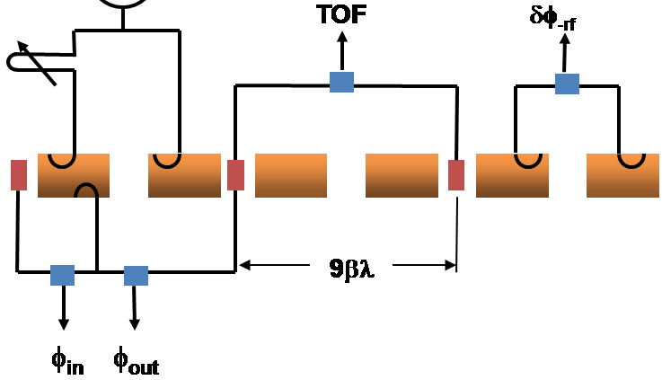
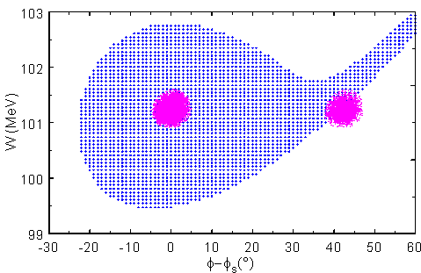
PIMS beam remains well bunched
at 2nd pickup
CERN/BE-ABP

Slide 14
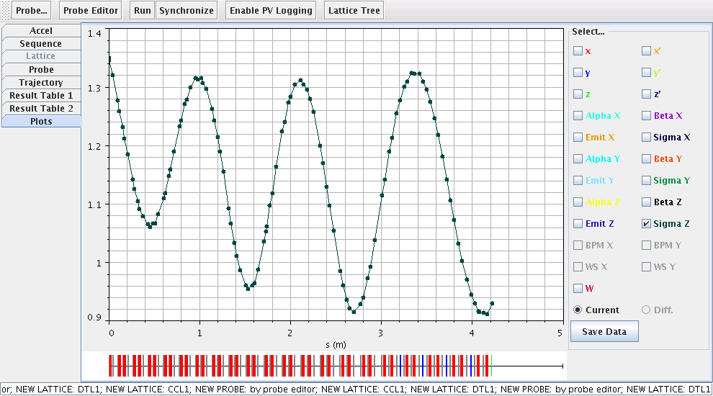
SNS DTL Phase Advance ≈ 11.2 π
W_{final}W=87 MeV, 216 cells, σ_{0l} ≈2020°
Large phase advance (longitudinal) and energy gain per accelerating structure
Single correct RF phase and amplitude setting
CERN/BE-ABP

Slide 15
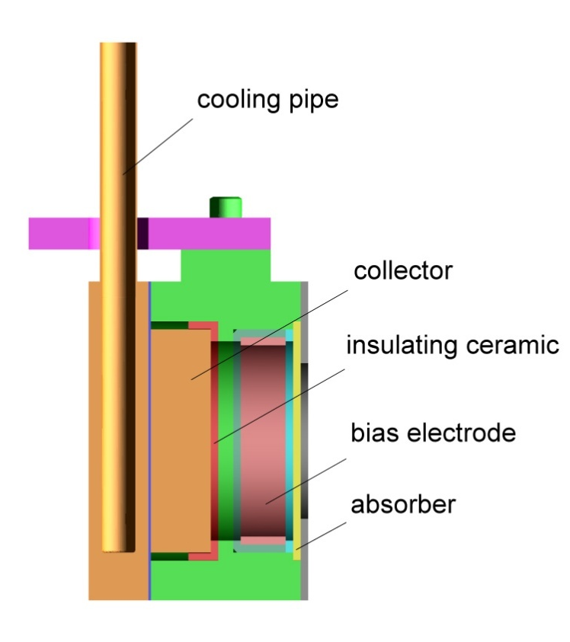
SNS accumulator ring
SNS DTL “absorber-collector”
in-line device mounted on actuators
collector can take 50μs full current beam pulse at 1 Hz and 185 MeV
(300W max)
absorber : removing low energy tail of beam
collector (Faraday cup) : collecting the surviving beam particles
CERN/BE-ABP

Slide 16
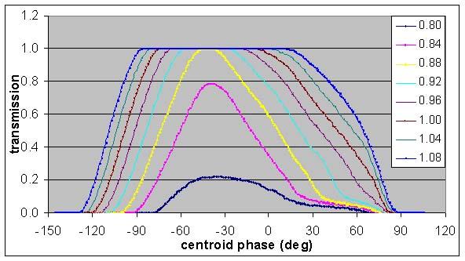
SNS DTL phase scan
CERN/BE-ABP

Slide 17
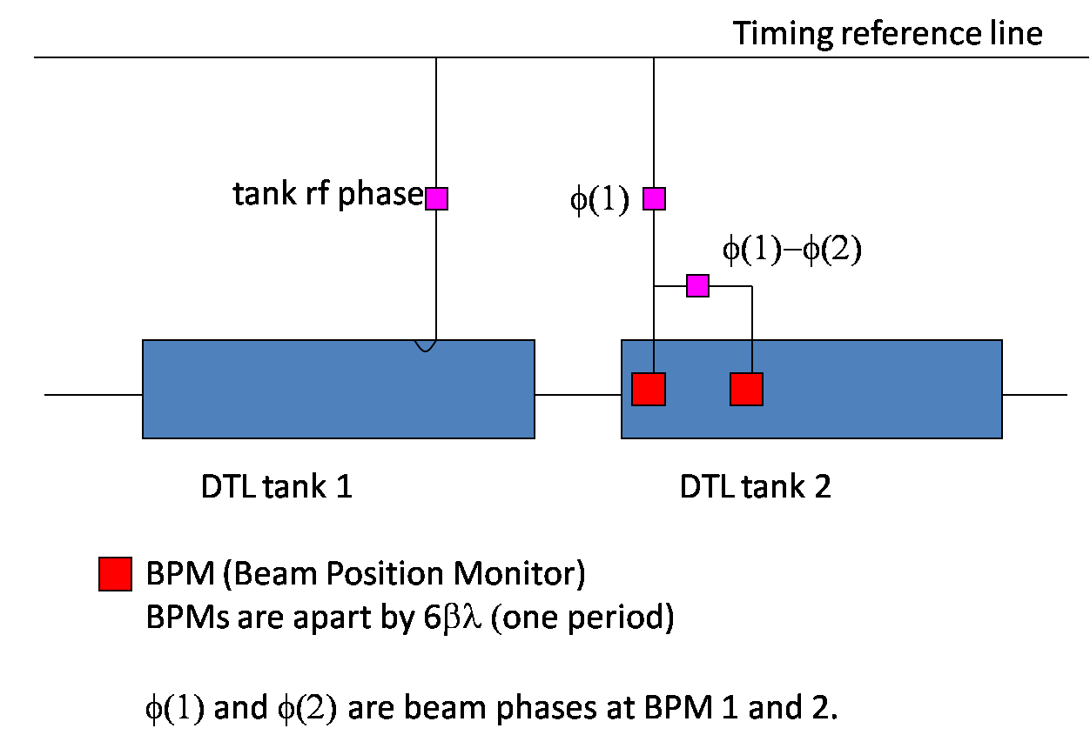
SNS DTL phase scan with two BPMs
CERN/BE-ABP

Slide 18
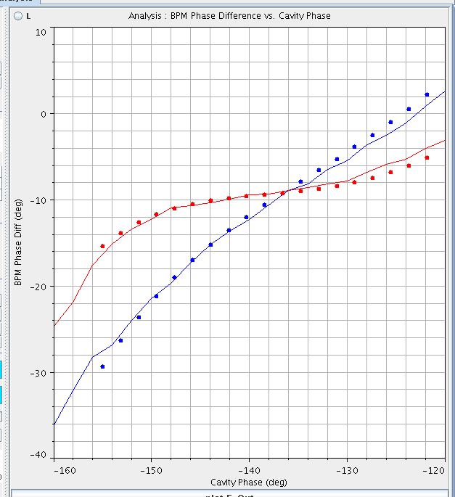
SNS DTL Phase Scans
Each cavity has a unique response (signature) to phase and amplitude scans
Phase scan signature matching method uses model to match measurements and determine RF amplitude and phase setpoints
Different RF amplitudes
TOF Chnge
RF Cavity Phase
CERN/BE-ABP

Slide 19
Linac4 DTL Phase Advance ≈ 6.7 π
DTL
acceptance
tank 2
input
σ_{0l} ≈6.7π
σ_{0l} ≈572°
tank 2
output
tank 3
output
σ_{0l} ≈400°
σ_{0l} ≈250°
CERN/BE-ABP

Slide 20
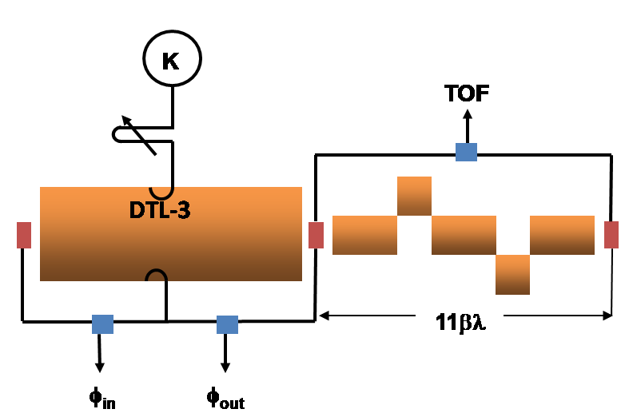
DTL Tank 3 amplitude scans have distinctive
measurable features
flat
intersection
Δφ_{left} vs. E₀
but…….
CERN/BE-ABP

Slide 21
DTL Tank 3 amplitude scans are distinctive but
unaccelerated beam debunches too rapidly
TOF used for energy discrimination only
CERN/BE-ABP

Slide 22

DTL-2 Longitudinal Diagnostics
K
TOF
DTL-2
DTL-3
31βλ
φ_{in}
φ_{out}
CERN/BE-ABP

Slide 23
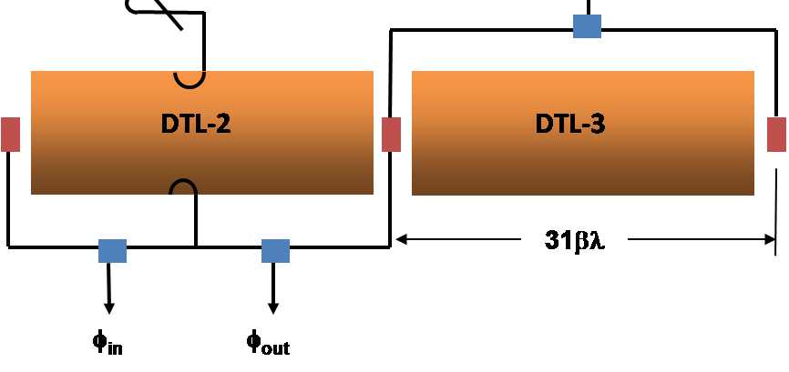
DTL Tank 2 amplitude scans have few
distinctive features
Intersection
lat at 102%
CERN/BE-ABP

Slide 24
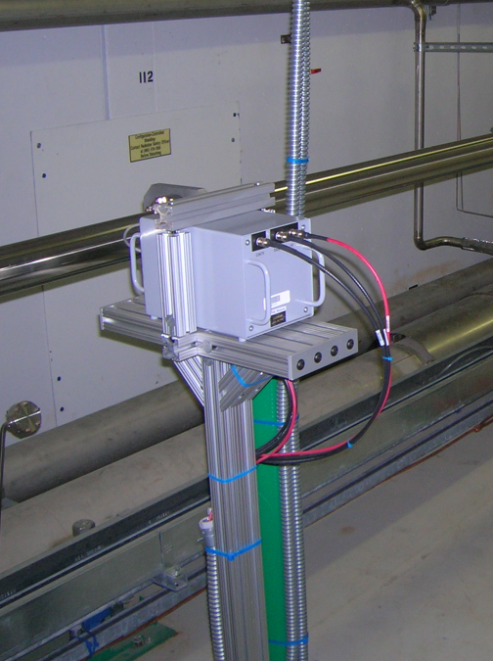
SNS Neutron Detector
35 mm poly moderator
Li (n,alpha)
Scintillator
PMT
10⁴ – 10⁸n/cm²/s
0.03eV - 3MeV
Advantages:
  No RF contamination
  Detects beam loss generated in well shielded structures (e.g. DTL tanks)
Disadvantage
  Hard to localize the loss source
  Slow (10 μsec)
CERN/BE-ABP

Slide 25
DTL-3 Longitudinal Diagnostics
K
TOF
DTL-3
11βλ
φ_{in}
φ_{out}
CERN/BE-ABP

