Slide 1
Cryomodule Assembly: Update
M. Garlaschè on behalf of MME
16/10/2017 – CCTC Meeting

Slide 2
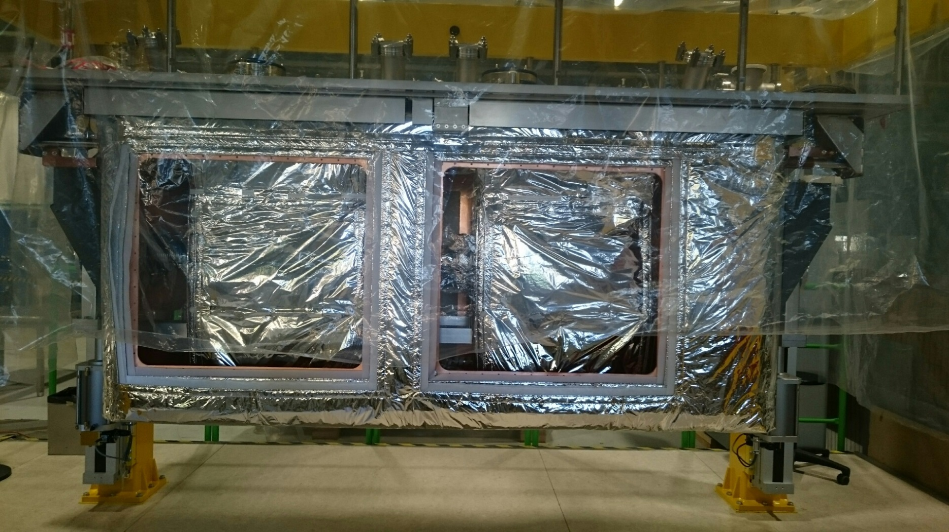
Finished Activities
STEP up to 11 finished
THIS WEEK:
Coax Assy + Meas [RF + MME]
Low Cryostat on Rail
String Insertion on Cryostat
Jumper Preparation

Slide 3
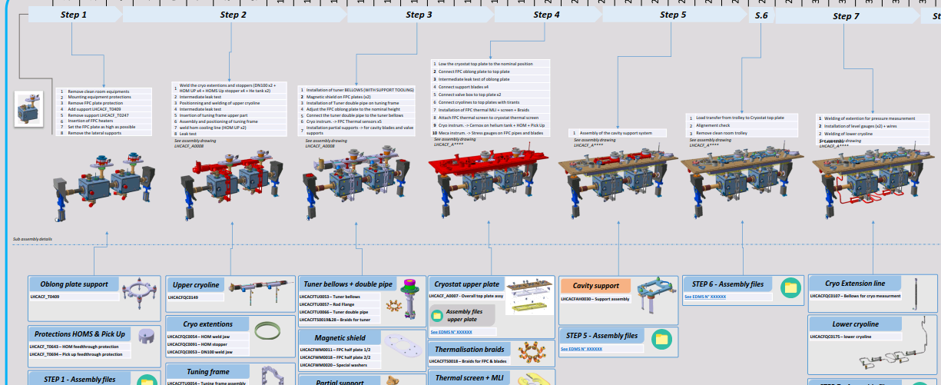

Slide 4
