Slide 1
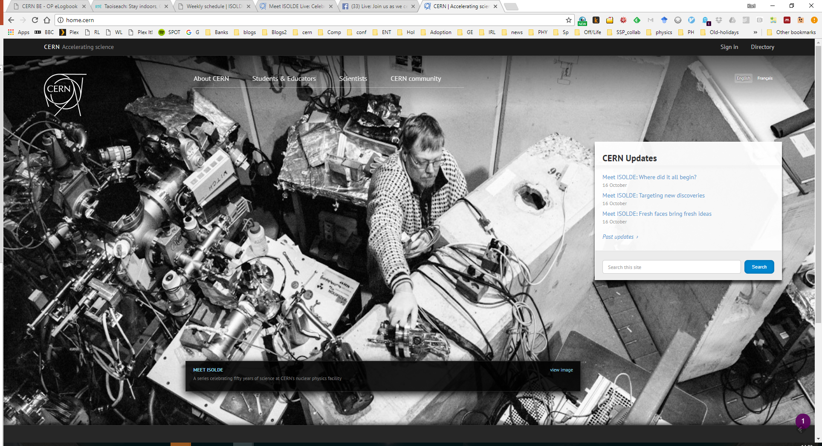
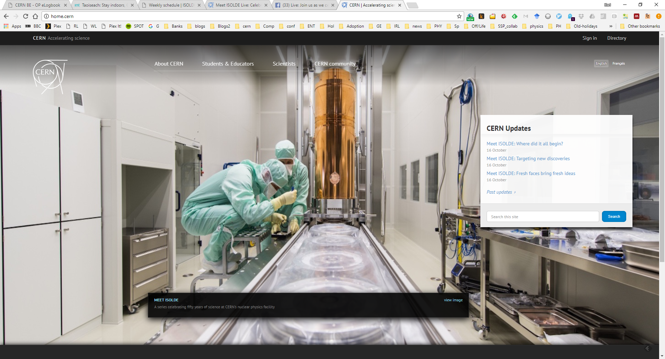
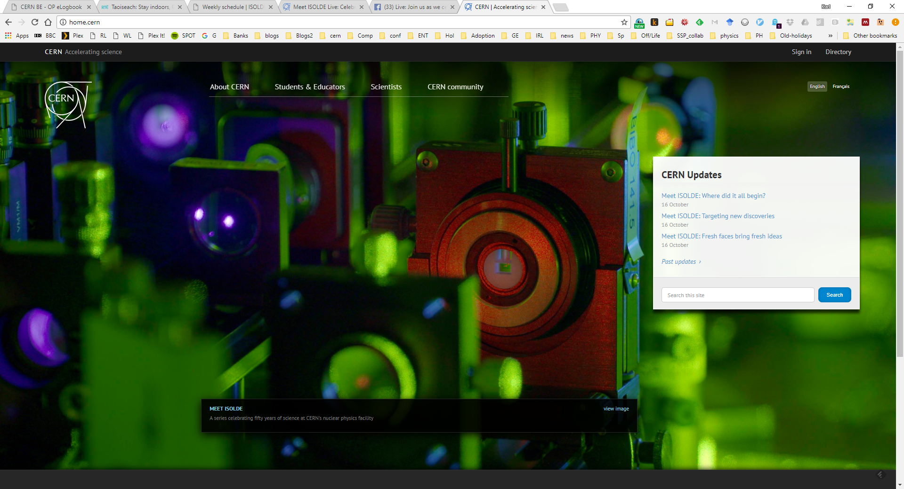
ISOLDE Technical and physics update: INTC 57
Richard Catherall/Karl Johnston

Slide 2
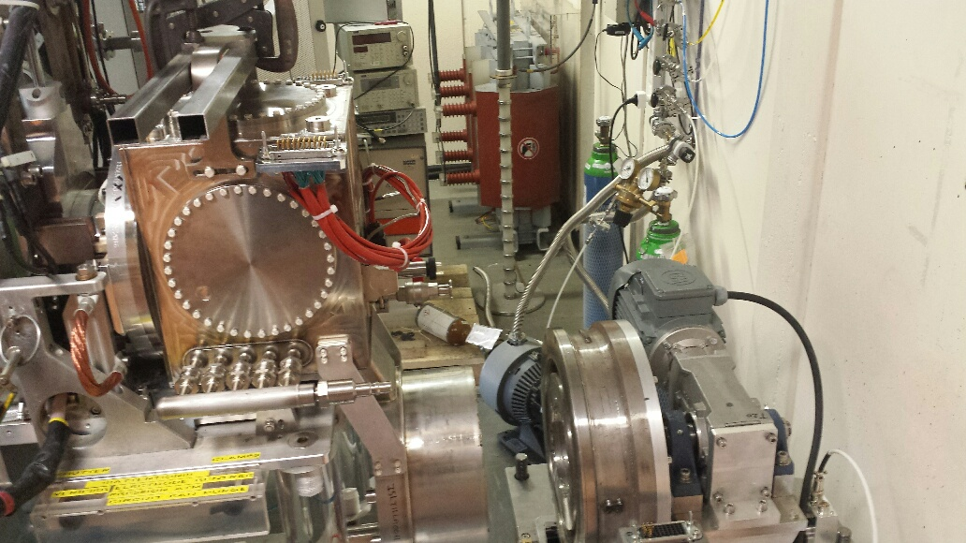
LIEBE
LIEBE target coupled to Off-line separator 1 last Friday
Tests to be done throughout this week
Operation review tentatively planned for 15th November…tbc
Operation on-line scheduled for 29th Nov – 4th Dec on GPS
Pb/Bi loop
Magnetic pump
Target unit
LIEBE target coupled to off-line separator

Slide 3
ISOLDE key activities during YETS
 |  |  |  |  |  |  |  |  |  |  |  |  |  |  |  |  |  |  |  |  |  |  |  |  |  |  |  |  |  |  |  |  | 2018
 |  | Dec |  |  |  |  |  |  |  |  |  |  |  |  |  |  |  |  |  |  |  |  |  |  |  |  |  |  |  |  |  |  | Jan |  |  |  |  |  |  |  |  |  |  |  |  |  |  |  |  |  |  |  |  |  |  |  |  |  |  |  |  |  |  | Feb
 |  |  |  |  | 4 |  |  |  |  |  |  | 11 |  |  |  |  |  |  | 18 |  |  |  |  |  |  | 25 |  |  |  |  |  |  | 1 |  |  |  |  |  |  | 8 |  |  |  |  |  |  | 15 |  |  |  |  |  |  | 22 |  |  |  |  |  |  | 29 |  |  |  |  |  |  | 5
Protons off
Water Off
consignation power supplies
used target preparation
target removal
HT installation
 |  | Feb |  |  |  |  |  |  |  |  |  |  |  |  |  |  |  |  |  |  | Mar |  |  |  |  |  |  |  |  |  |  |  |  |  |  |  |  |  |  |  |  |  |  |  |  |  |  |  |  |  |  | Apr
 |  |  |  | 12 |  |  |  |  |  |  | 19 |  |  |  |  |  |  | 26 |  |  |  |  |  |  | 5 |  |  |  |  |  |  | 12 |  |  |  |  |  |  | 19 |  |  |  |  |  |  | 26 |  |  |  |  |  |  | 2 |  |  |  |  |  |  | 9 |  |  |  |  |  |  | 16
Frontend maintenance
Water on
Deconsignation power supplies
cold check out period
SEM grid tests (HRS)
SEM grid tests (GPS)
HT tests with p-beam (HRS only)
protons on
ISOLDE physics
Class A ventilation maintenance

Slide 4
Main YETS/2018 upgrades
Change power converter for GPS magnet (4 weeks)
Change power supplies for XL9GP.MC.0400 steerer
Change power supplies for separator XSEP.MB.1000
Installation of new HT power supply and modulator
  Second one to be done after LS2
  Possibility to revert back to “old system”
Ventilation tests
Installation of telescopic camera in target area
Due to the upgrade of the 9-gap amplifier, the new equipment is not compatible with existing equipment. Spare equipment thus needs to be purchased.
Divisional request for spare equipment for the 9-gap amplifiers in 2017/18 – 115 kCHF based on offer from Bertronix the original supplier of the amplifiers.

Slide 5
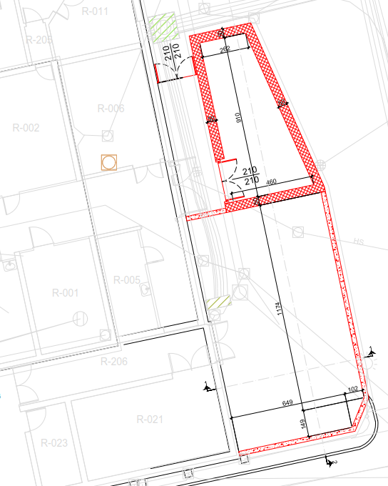
Nano-lab
Studies on-going
Will not combine non-actinide and actinide activities in building 179
Meeting 7th November to discuss specification requests with RP and safety.
Construction likely to start in September 2018.

Slide 6

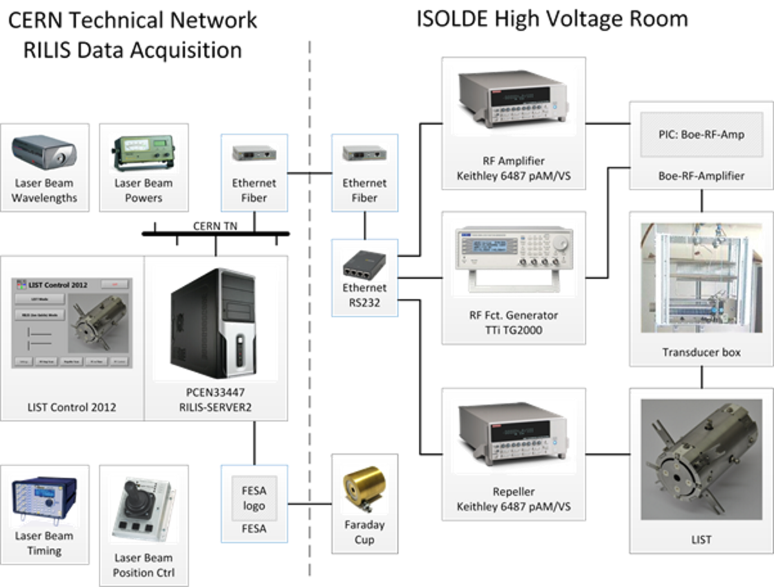
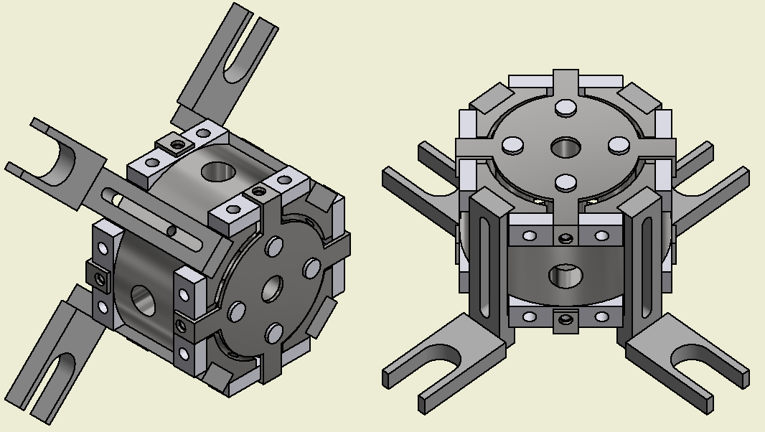
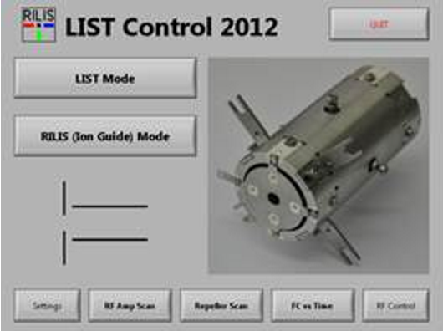
LIST 2018
Obtained technical drawings from Larissa Group Mainz
LIST 2.0 assembly will be provided from Mainz
To be verified: status of RF cable at GPS
LIST control system: replicate 2012 setup
https://edms.cern.ch/document/1400724/1
R.Heinke

Slide 7
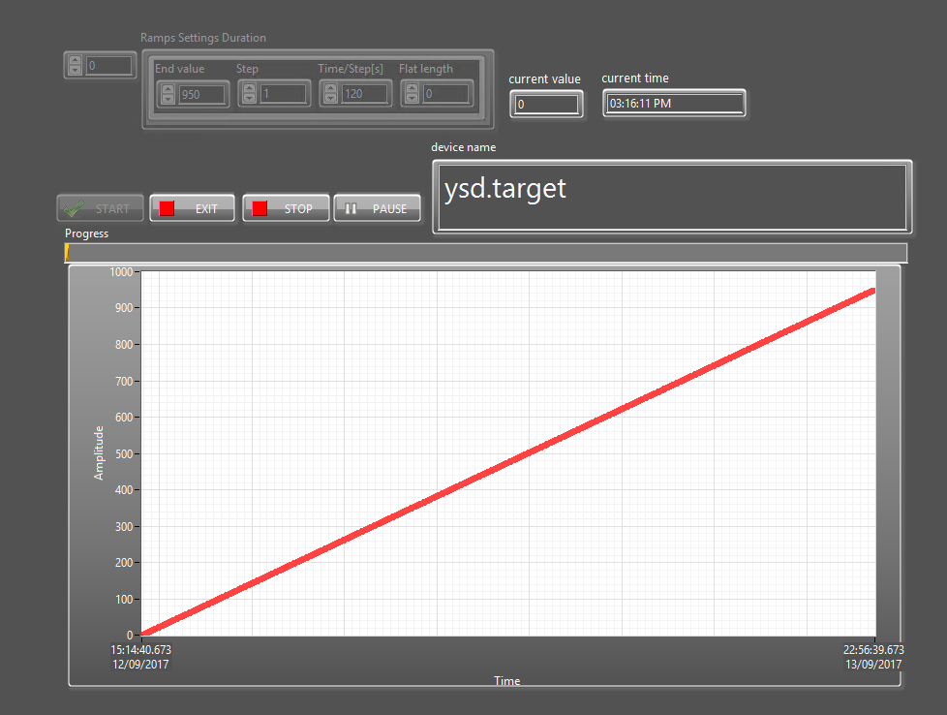
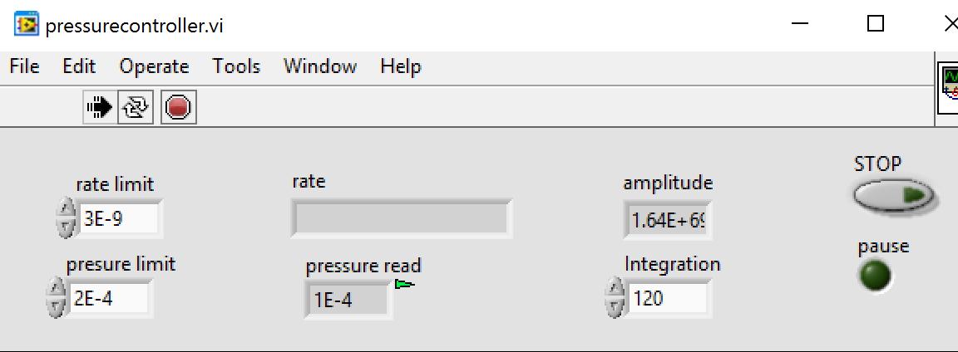
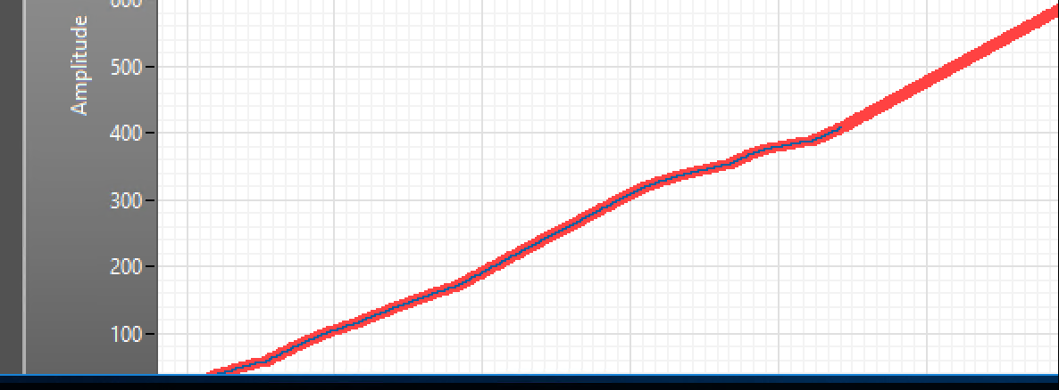
Automatic UCx Production
Setting a ramp
Set thresholds
Start carburization
Heating is regulated automatically
Successfully used for UC611 and UC618
Finished in 4 days without human intervention

Slide 8
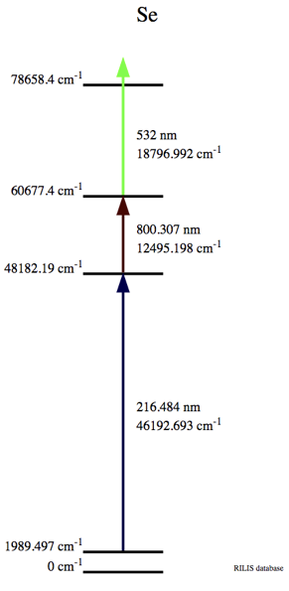
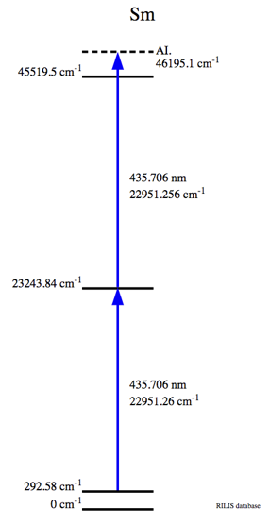
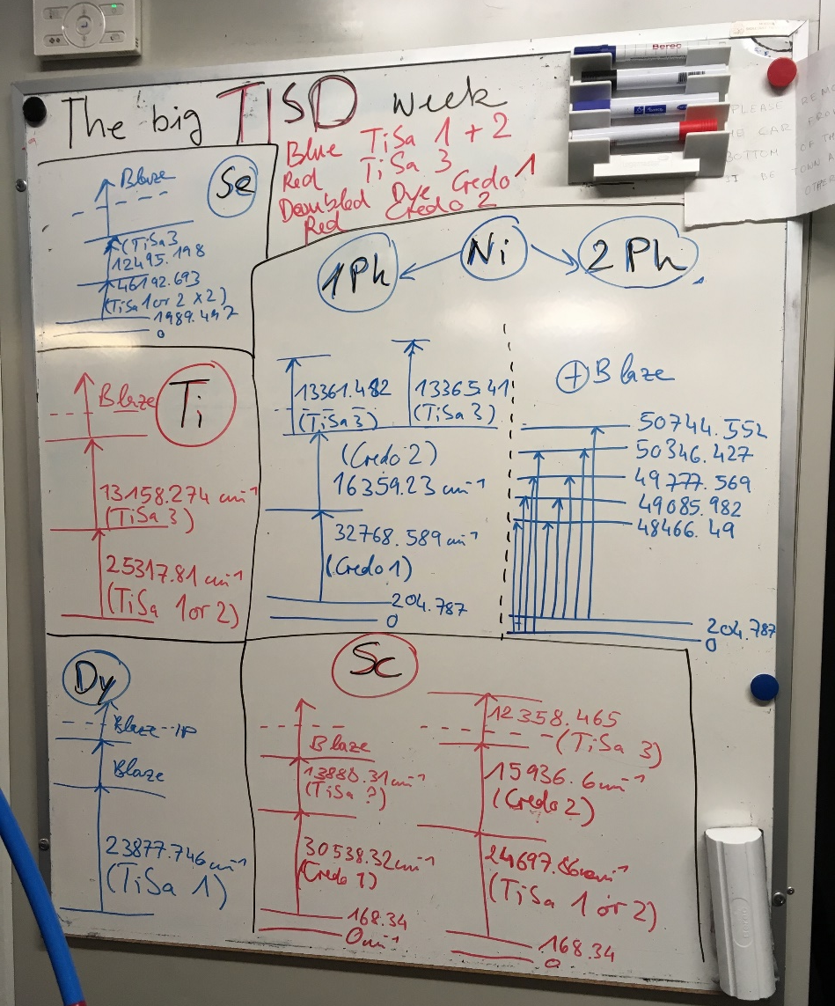
5 RILIS elements in one week: new record!
Titanium
Selenium
Tested
on-line
But further beam development
needed
Scandium
Dysprosium
Scandium
Selenium
Samarium
Convenient
efficient
one-laser
2-step scheme
Dysprosium
Nickel
B.Marsh

Slide 9
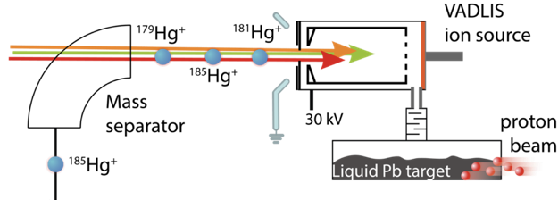
Clean ²⁰⁶Hg beams with VADLIS
3rd on-line application of VADLIS ion source for an experiment
  (full Hg chain for in source laser spectroscopy; Mg + Ne for ISOLTRAP, 206Hg for Miniball)
RILIS–mode achieves similar efficiency to VADIS-mode
Note: RILIS-mode efficiency is expected to improve by at least 2 x if the adjustable-extractor VADIS is used.
B.Marsh

Slide 10
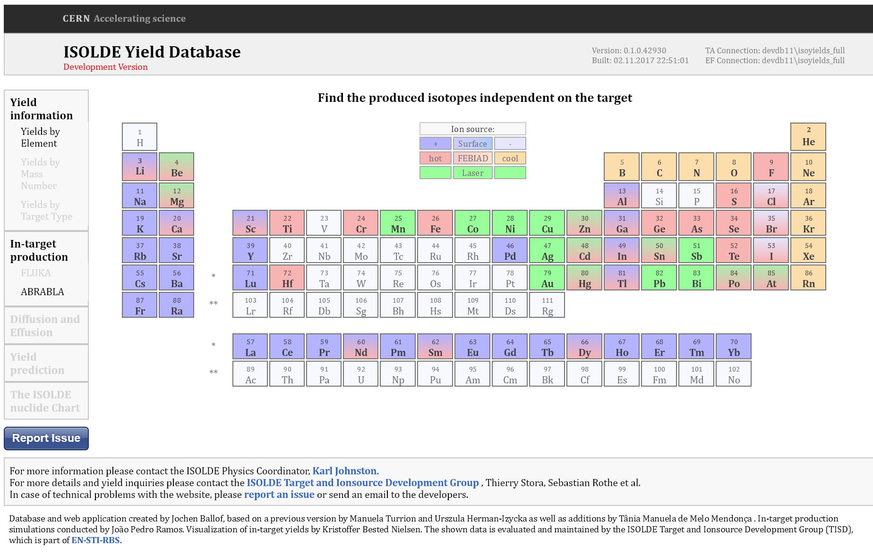
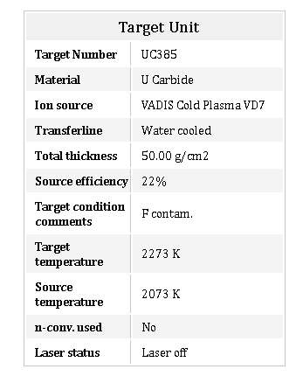
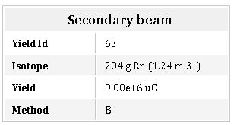
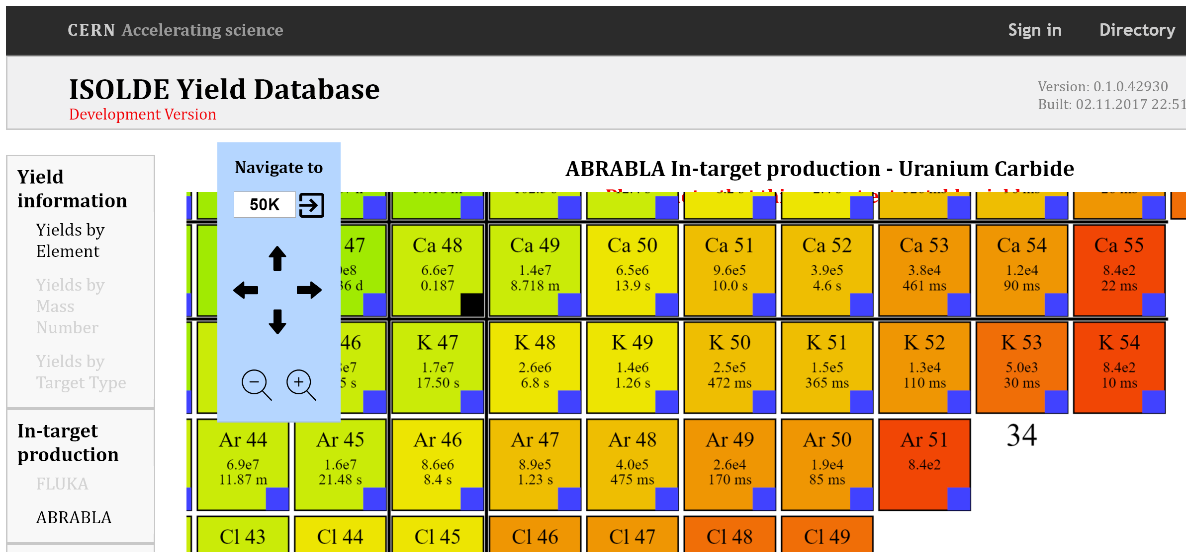
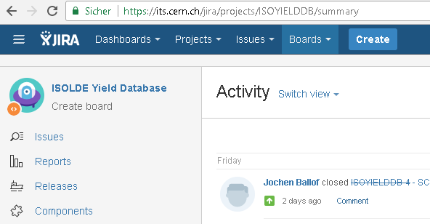
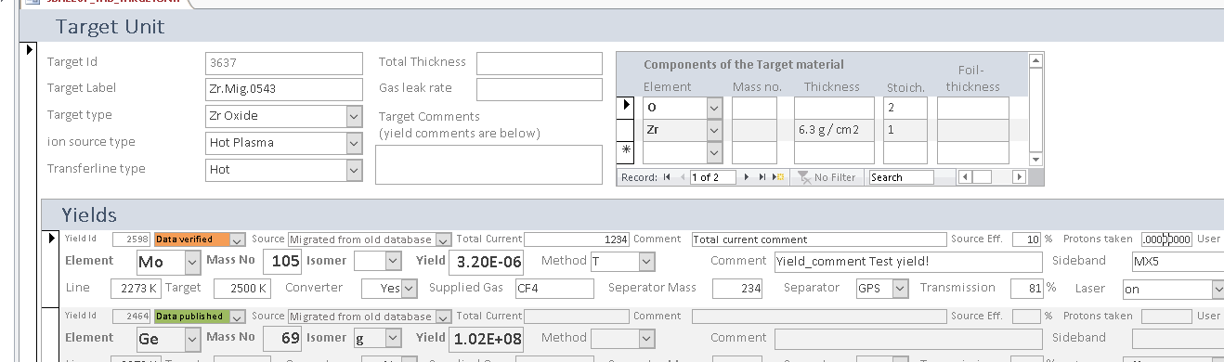
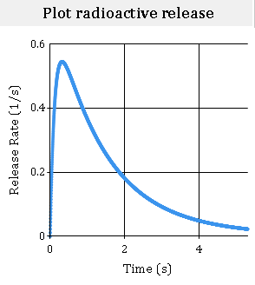
ISOLDE Yield Database YYDB(https://isoyields2.web.cern.ch)
Features
CERN SSO
New Database design
In target production (ABRABLA)
Release curves available
More target details visible
Issue tracking
Philosophy
All measurements (TISD, USERS) get entered into YYDB
Manually change attribute (measured -> validated -> published)
Attribute determines visibility (after login, no login required)
Future
Web based interface allows entering of yields to registered users
Add FLUKA results for in-target production
Add yield prediction
Establish link to CRIBE database
J.Ballof

Slide 11
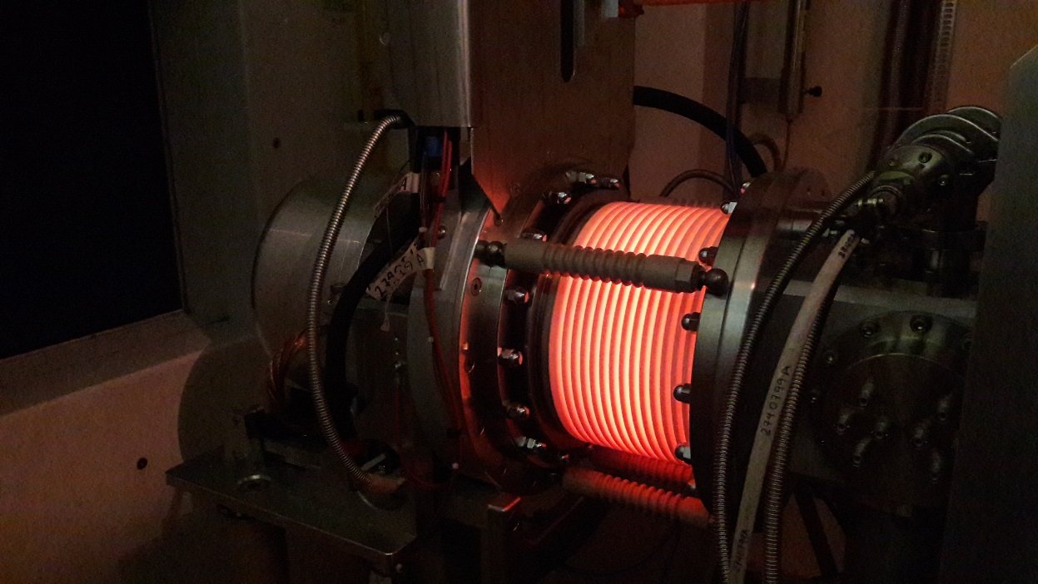
MEDICIS
Gearing up towards stable beam tests
DSO tests done
Removal of physical barrier to the rest of Class A labs and calibration of ventilation system across Class A labs and MEDICIS labs
Access system operational
Image of MEDICIS Frontend insulator while heating target container to ~2000C

Slide 12
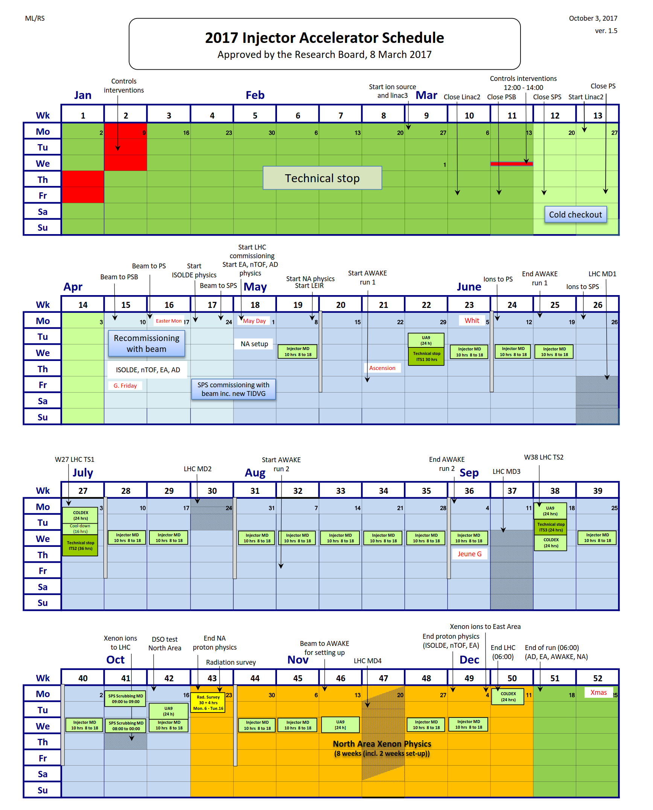
Protons to ISOLDE for physics since week 17
Original end of protons was week 47 (Nov 20th)
Negotiated extension of two extra weeks
224 days of physics: currently on day 198

Slide 13














ISOLDE Schedule 2017: weeks 16 - 48
XT03
XT03
(Windmill)
ISOLTRAP: Cd/Kr/Ar/Cs/development
IDS: In/Bi/B
VITO: Ar/Na
COLLAPS: Al/Ni/Sn
CRIS: In/K/Ga
Miniball
108Sn
IS562
140Nd; 142Sm
IS546
140Sm
IS558
144Ba; 142Ba
IS553
206Hg
IS547
70Se → 66Ge
IS569
72Se
IS597
94Rb
IS572
SSP: Mn/In/Cd/Hg
Biophysics: Tb/Cd/Hg
Medical: Tb
Scattering Chamber
15C beams to XT03
IS619
9Li
IS561
We are here…
Target change
CERN holiday
Setting up/proton scan/yield
Physics GPS
Physics HRS
KJ: 06.10.17

Slide 14
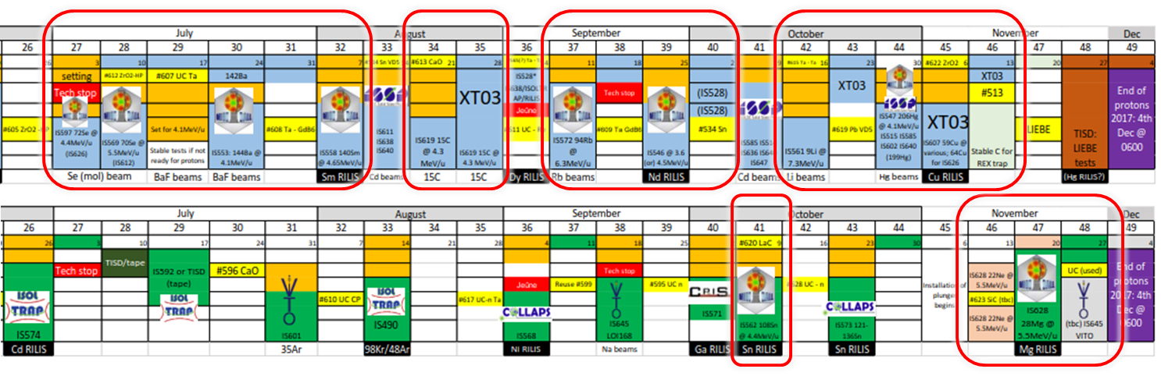
12 HIE ISOLDE experiments
9 at Miniball : 8 Coulomb excitation; 1 multi-nucleon transfer; 3 at XT03
→ Still to come: 59Cu (this week) and 28Mg (plunger)
Experiment # | IS597 | IS659 | IS553 | IS558 | IS619 | IS572 | IS546 | IS562 | IS561 | IS547 | IS607 | IS628
Isotopes | 72Se19+ | 66Ge16+, 70Se17+ | 142Ba33+, 144Ba33+ | 140Sm34+ | 15C5+ | 94Rb23+ | 140Nd33+, 142Sm33+ | 108Sn26+ | 9Li3+ | 206Hg46+ | 59Cu20+ | 28Mg9+
Energies [MeV/u] | 4.4 | 4.4 | 3.4, 4.2 | 4.65 | 4.35 | 6.21 | 4.62 | 4.5 | 8.04 | 4.19 | 3.6, 4.0, 4.3, 4.7, 5.0, 5.3 | 5.5
Target | GPS | GPS | GPS | GPS | GPS | GPS | GPS | HRS | GPS | GPS | GPS | HRS
HEBT | XT01 | XT01 | XT01 | XT01 | XT03 | XT01 | XT01 | XT01 | XT03 | XT01 | XT03 | XT01
Target installation | Fri - AM | Wed - AM | Tue - PM | Mon - AM (-1) | Mon - AM | Mon - AM | Fri - AM | Tue - AM | Mon - AM | Fri - AM | Mon - PM
Ionization | Molecular | Molecular | Molecular | RILIS | Molecular | Surface | RILIS | RILIS | RILIS Tried | RILIS | RILIS | RILIS
RIB ready |  |  |  |  | Thu - 14:30 |  |  |  | Thu - 23:50
RIB first delivery | Fri - 23:00 | Thu - 19:45 | Thu - 18:40 | Tue - 18:00 | Sat - 17:00 | Wed - 17:30 | Wed - 17:15 | Thu - 20:00 | Sat - 00:45 | Thu - 21:40
 | 2017/07/07 | 2017/07/13 | 2017/07/20 | 2017/08/08 | 2017/08/26 | 2017/09/13 | 2017/09/27 | 2017/10/12 | 2017/10/21 | 2017/11/02
(Thanks for Jose Alberto Rodriguez)

Slide 15

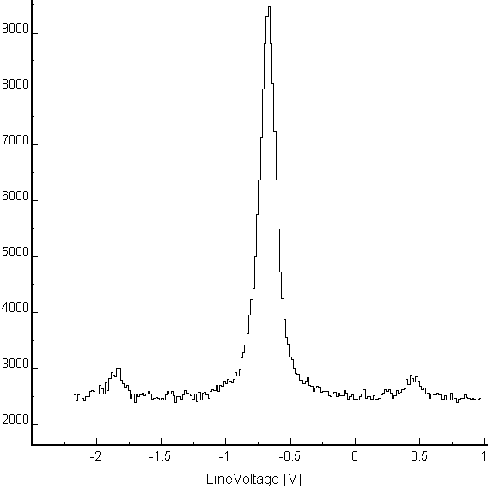
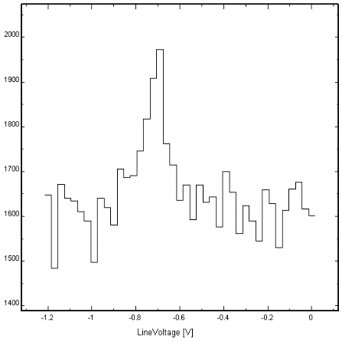
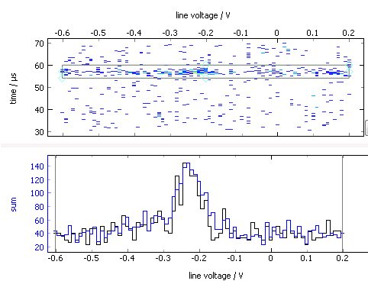
The year 2017 for
Laser spectroscopy of Sn across N = 82
Atomic transition complementary to the one used in 2016:
  Combining both gives firm μ, Q, radii
  Resolve weakly produced isomers
> 20 isotopes in 3 days!
  N = 57 up to N = 84
N = 82
^{128m+g}Sn
¹³⁴Sn
1h30
*
*
1h30
New data acquisition
Photon timing
wrt bunch extraction
Problems ☹
Unexpectedly low Al and Ni yields: key cases out of reach
Long ISOLDE set-up times despite (much appreciated!) efforts of technical teams
⁶⁸Ni
Projection
Line voltage (freq)
Thanks to Hanne Heylen

Slide 16
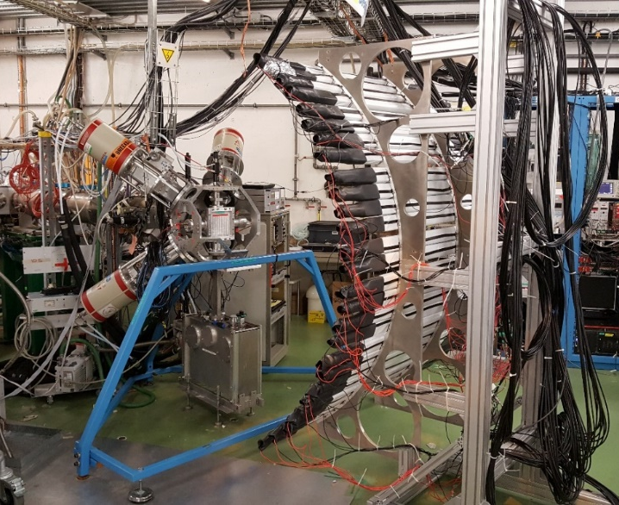
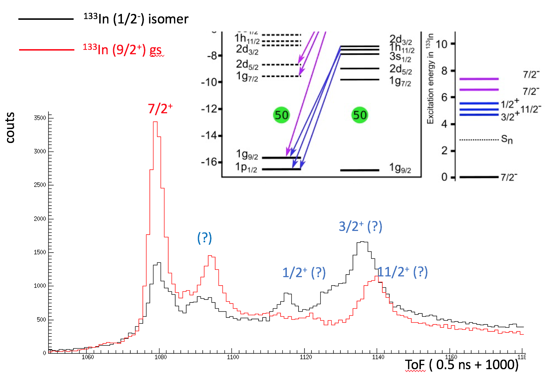
IS632 at IDS: Neutron unbound single particle states in ¹³³Sn from the beta decay of ¹³³In
The IDS Neutron Detector and HPGe Clovers were used
ToF calibrations with ¹⁷N from the HRS CaO target.
Production of ¹³³In ~ 900 ions/uC (~70% transmission from GPS)
Using RILIS, both isomer and gs in ¹³³In were selectively ionized
Clear resonances were observed, to be clarified in the offline analysis using neutron-gamma coincidences
Also excellent runs for B and good for Bi
Thanks to Miguel Madurga

Slide 17
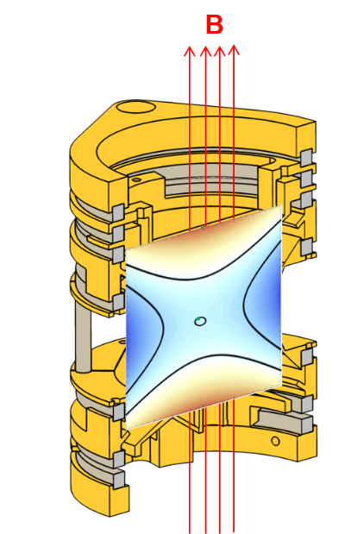
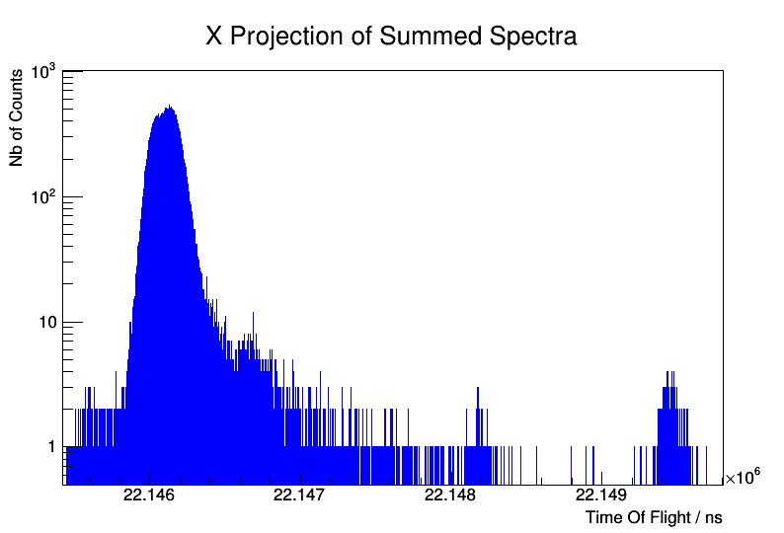
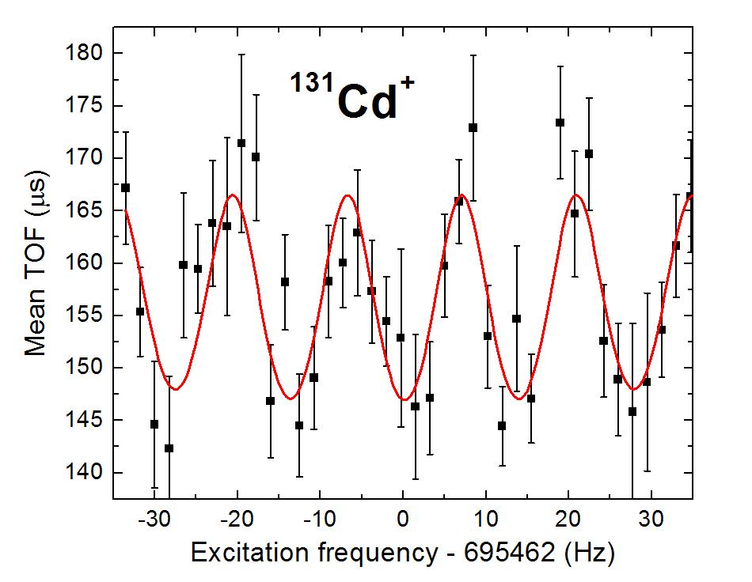
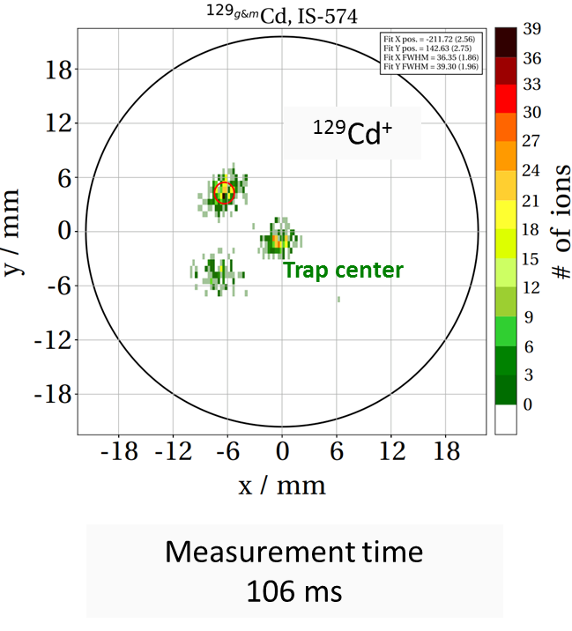
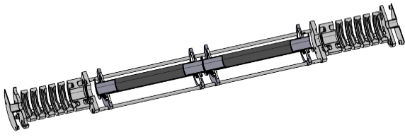
Precision mass spectrometry of ^{131,132}Cd
June 2017 – UC_{x}-converter + quartz + RILIS: high-quality cadmium beams.
The PI-ICR technique allowed fast and optimal separation of the isomeric states in the odd-A cadmium isotopes.
¹³²Ba^{+/132}Cs⁺
¹³²Cd⁺
Precision
Penning trap
MR-TOF MS
Penning trap confirms and improves the MR-TOF mass of ¹³¹Cd from 2014.
c
MR-TOF MS allows first mass measurement of ¹³²Cd.
Thanks to Vladimir Manea

Slide 18
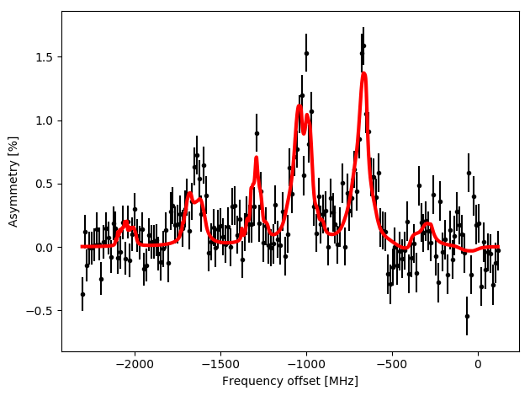
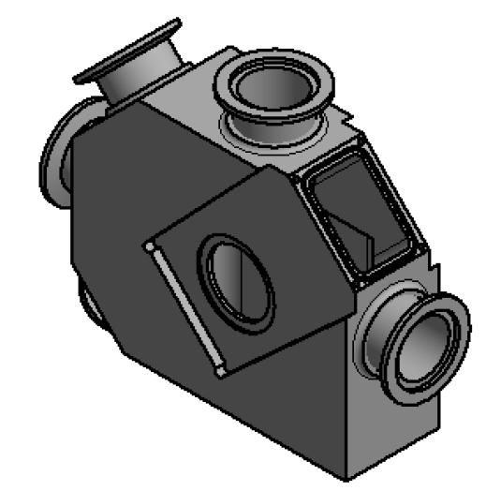
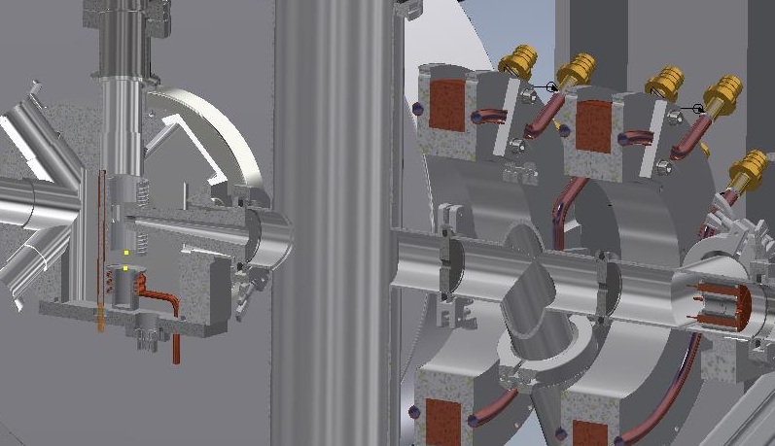
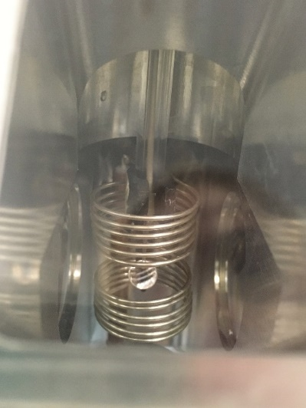
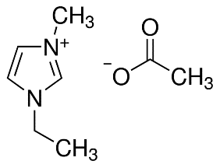
VITO
IS601
Since last meeting:
2 beamtimes with 35Ar – looking for implantation host for β-asymmetry studies:
1st use of multiple laser pumping
1 beamtime on liquid β-NMR (2nd in December):
Compact β-detectors with Si PMTs (U Tennessee)
New liquid b-NMR chamber, differential pumping and transitional field system
Liquid handling system
1st NMR signal at VITO!
IS645
Thanks to Magda Kowalska

Slide 19
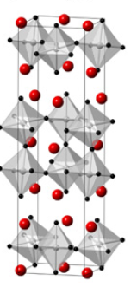
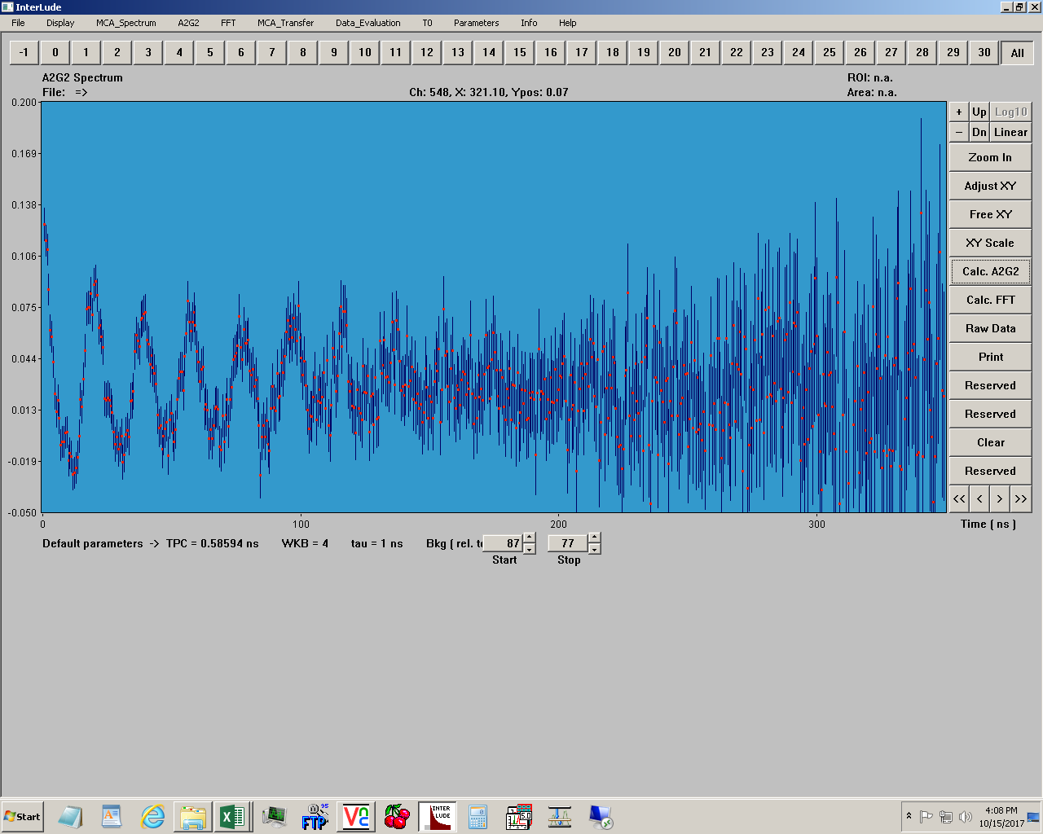
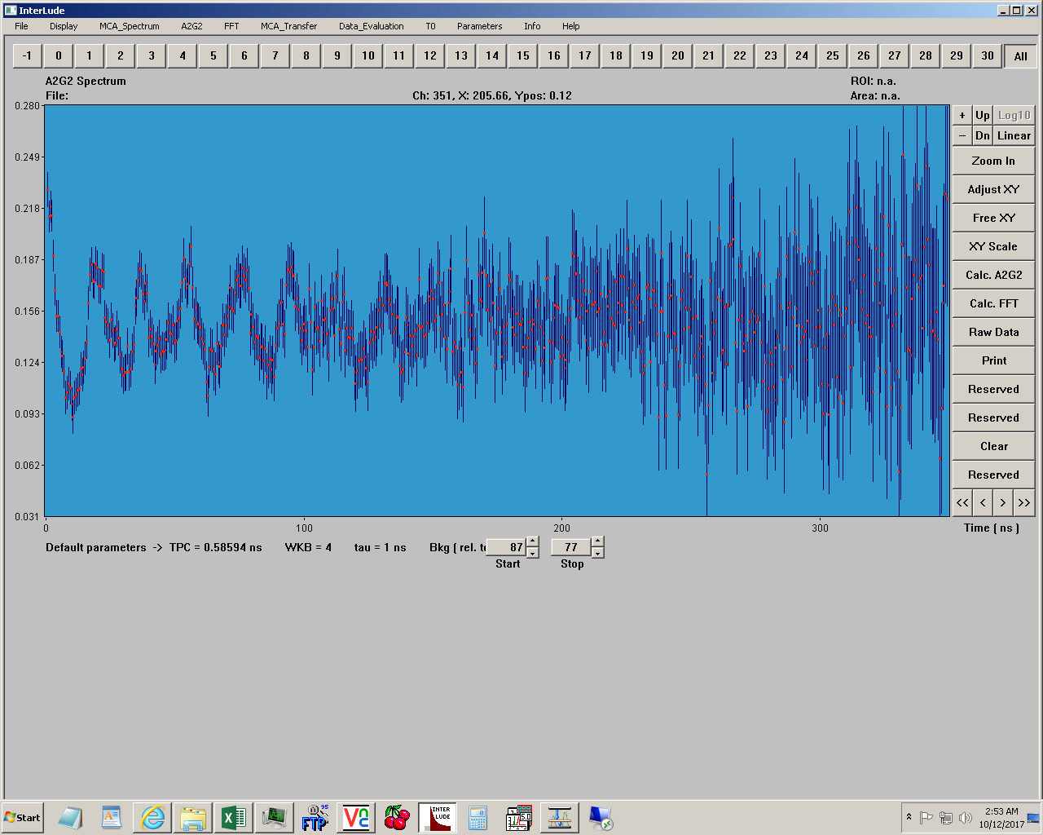
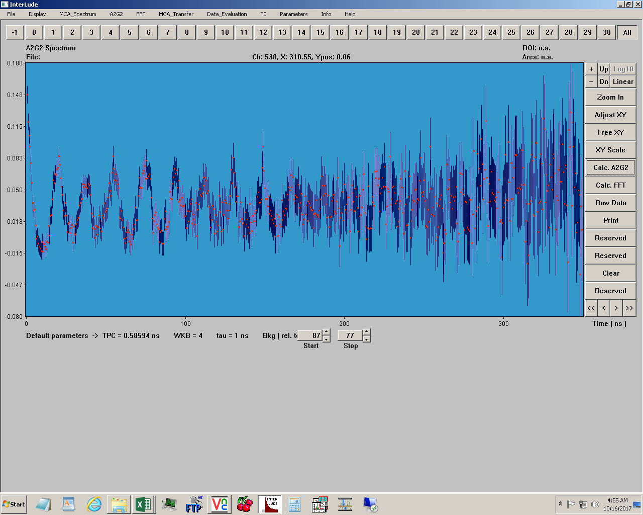
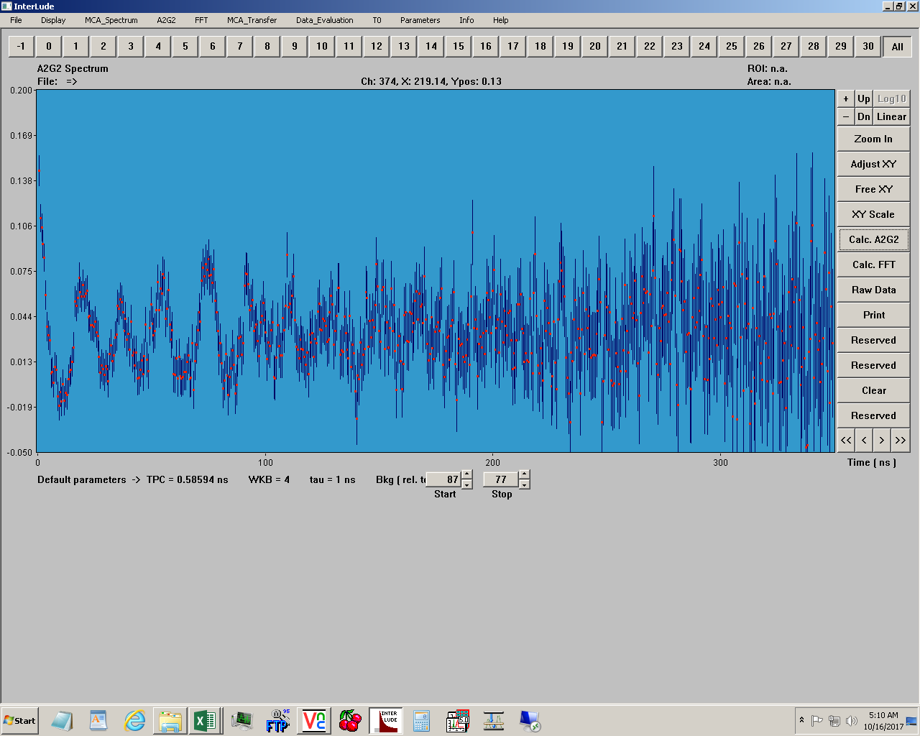
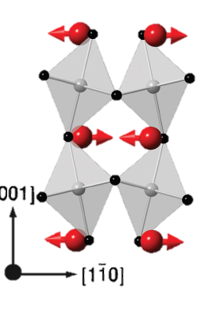
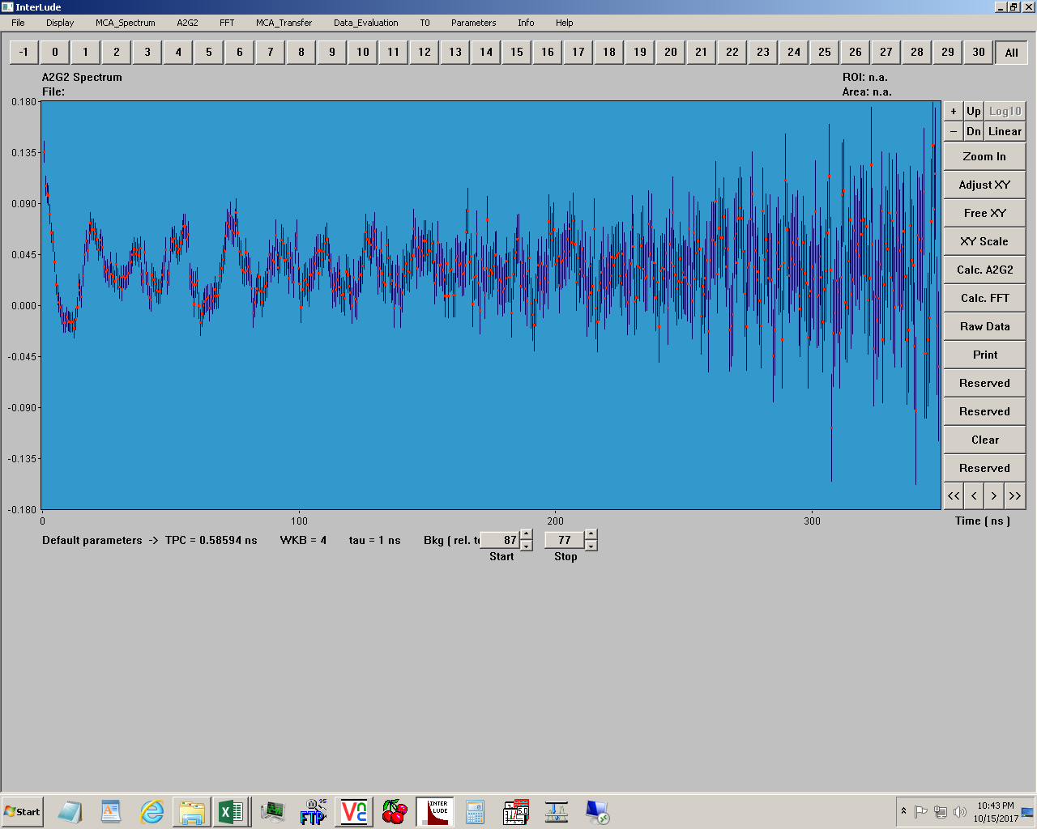
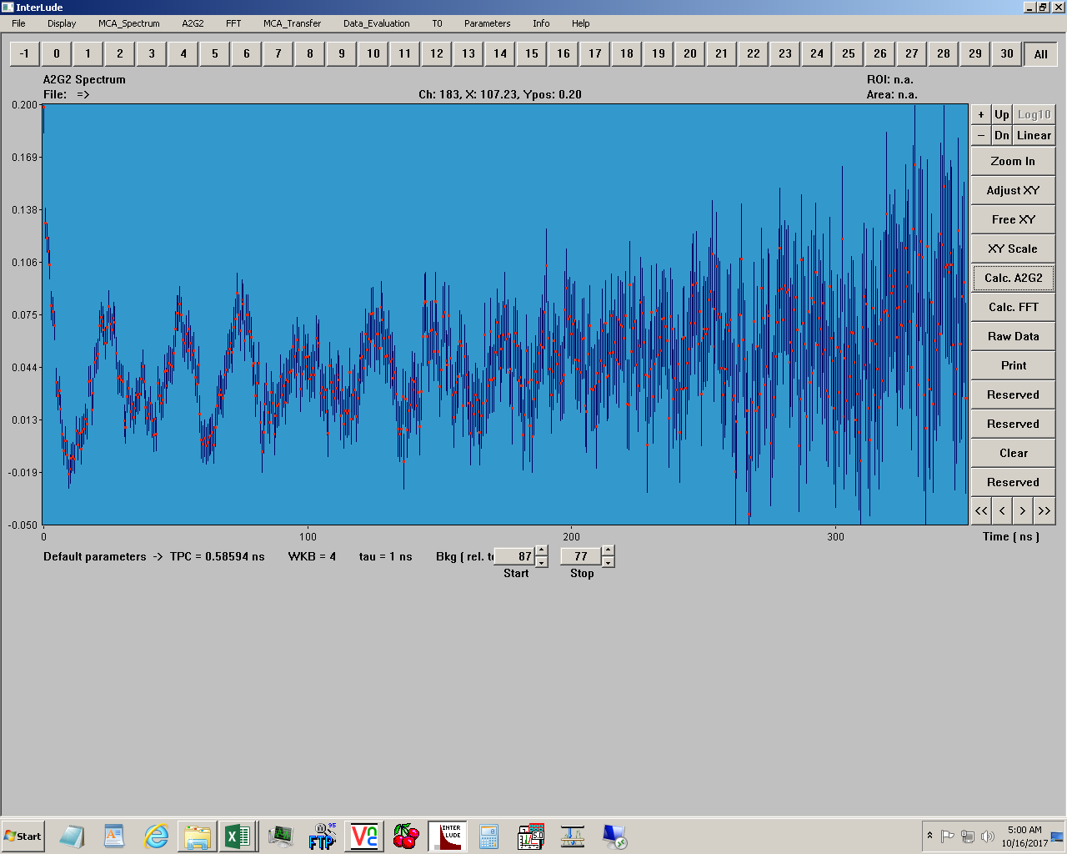
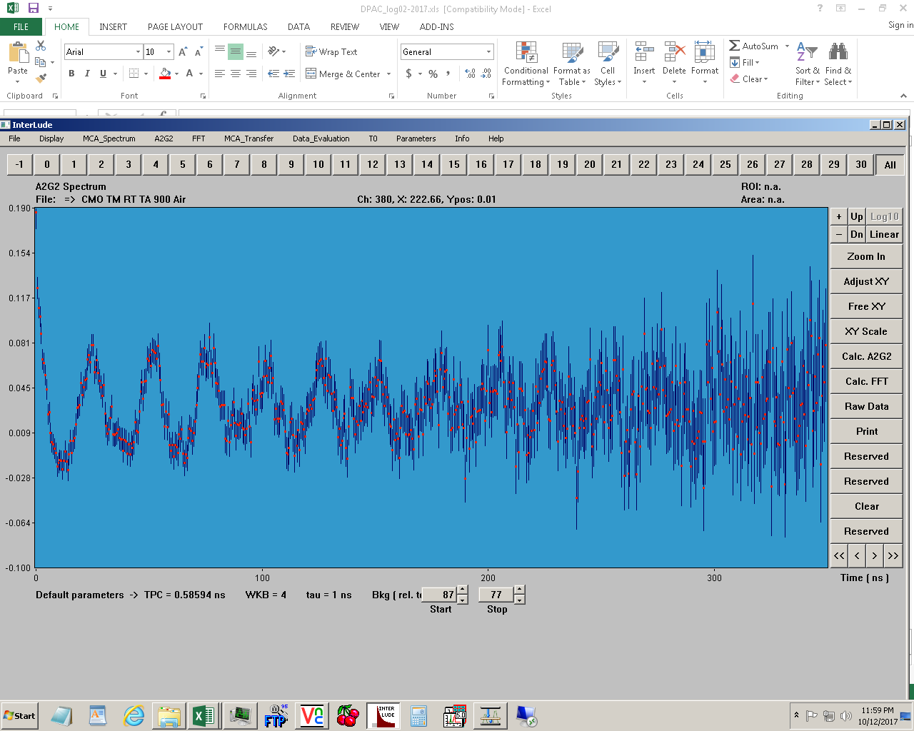
Perturbed Angular Correlation measurements
PAC measurements were performed successfully for the Ca₃Mn₂O₇ in CERN-ISOLDE by beam implantation of ^{111m}Cd run 10/2017.
111Cd beam
424 K
Orthorhombic
Cmca – non polar
400 K
freeezing of the MnO₆ octahedral tilting and
Ca²⁺ displacement phonon modes
380 K
PAC allows us to probe the local atomic environment behind Hybrid Improper Ferroelectricity
- the coupling of the
MnO₆ octahedral rotation
and the
polar displacement of the Ca²⁺ ion’s
368 K
358 K
330 K
300 K
Orthorhombic
Cmc2₁ ₋ polar
Thanks to Dina Lopes

Slide 20
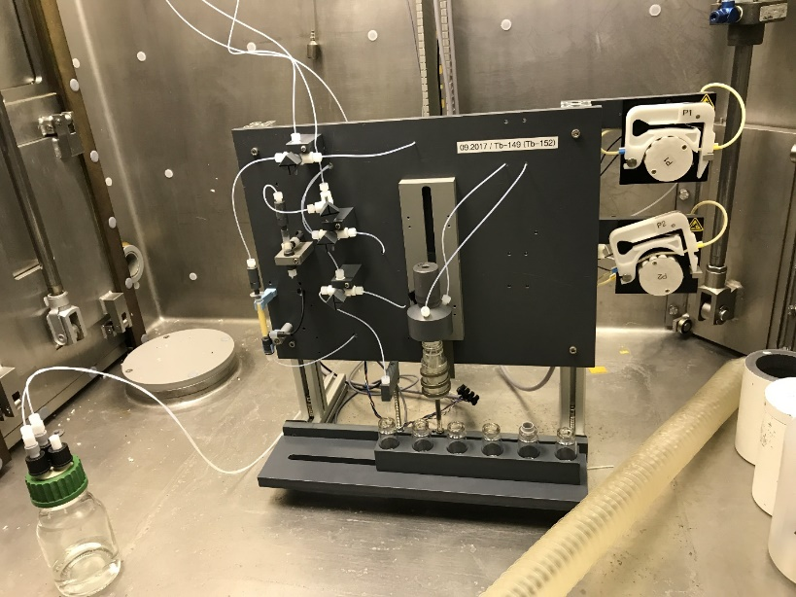


Medical physics
IS638: Medical applications of PAC spectroscopy
IS528: new collection chamber (ISOLDE)and separation system (PSI)
Both DOTA and H₄octapa have been tested with ¹¹¹In and ^{111m}Cd at ambient temperatures and in solution. New chelator shows promising performance over DOTA.
Thanks to Ulli Koester/Nick van der Meulen
Thanks to Monika Stachura

Slide 21




IS572 – Multi Nucleon Transfer Experiment @ MINIBALL
First MNT experiment with RIB.
Beam Intensity required 1.5 10⁷pps
First Exp. @ HIEISOLDE with:
  All cavities used (6.15 MeV/u)
  The RF pulse length of 1.6 ms.
Problems during the run:
Some technical problems after the Tech Stop.
High instantaneous beam intensity.
Radiation problems in ISOHALL. We couldn’t run with high proton beam intensity.
Patrol procedure to be defined at upcoming CSAP
Targets used:
1 mg/cm² for cross-section normalization.
13 mg/cm² for statistic collection.
Since we will beusing high intensity and high cross-section. γ-γ, γ-p, γ-γ-γ, γ-γ-p, etc have been implemented in the DAQ.
⁹⁴Rb
6.15 MeV/u
Target ²⁰⁸Pb
Thanks to Andres Sison

Slide 22




IS572 – Multi Nucleon Transfer Experiment @ MINIBALL
Rb
Gate in 799 keV (²¹⁰Pb :2⁺ → 0⁺)
Rb-like
298 keV (²¹⁰Pb :4⁺ → 2⁺)
Pb
94Rb Coulex
²¹⁰Pb lines
94Sr Coulex
(contamination)
?
?
Thanks to Andres Sison

Slide 23




Slide 24





ISS: tests in week 49
Also, successful re-energising of the WISARD magnet to 9T… beams in 2018

Slide 26
Safety and training etc
Required training for ISOHALL
Online:
Safety at CERN
RP supervised (changed since last year)
Basic electrical awareness
Hands-on:
Electrical awareness
RP hands-on → going to be linked in December
Every Tuesday @ 1300 – 1700), training centre Prevessin.
External trainer: Recent cancellations have been a problem. Meeting soon to ensure courses take place during running period.
2018
Beam requests sent out just after Christmas
Protons from ~ Easter/end of March
HIE ISOLDE from ~ end of June
Continue with interleaving low and high physics

Slide 27







Oct 16th 2017: 50 years of beams at ISOLDE: #meetisolde
http://home.cern/about/updates/series/meet-isolde

