Slide 1
14th IPPOG Meeting – CERN
News from the Coordination
H.P. Beck, IPPOG Chair, Universität Bern
S. Goldfarb, IPPOG Chair, University of Melbourne
B. Gulejova, Scientific Secretary, CERN

Slide 2
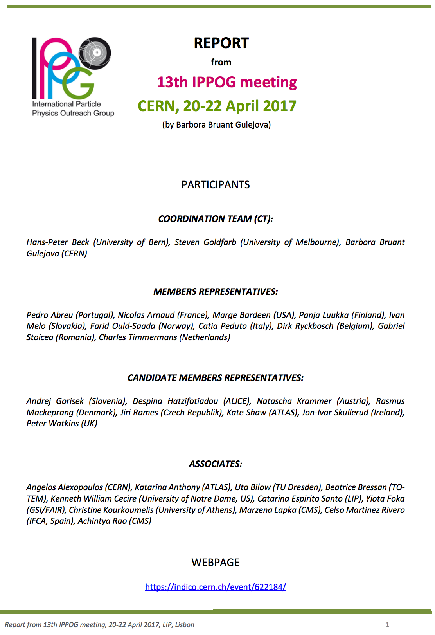
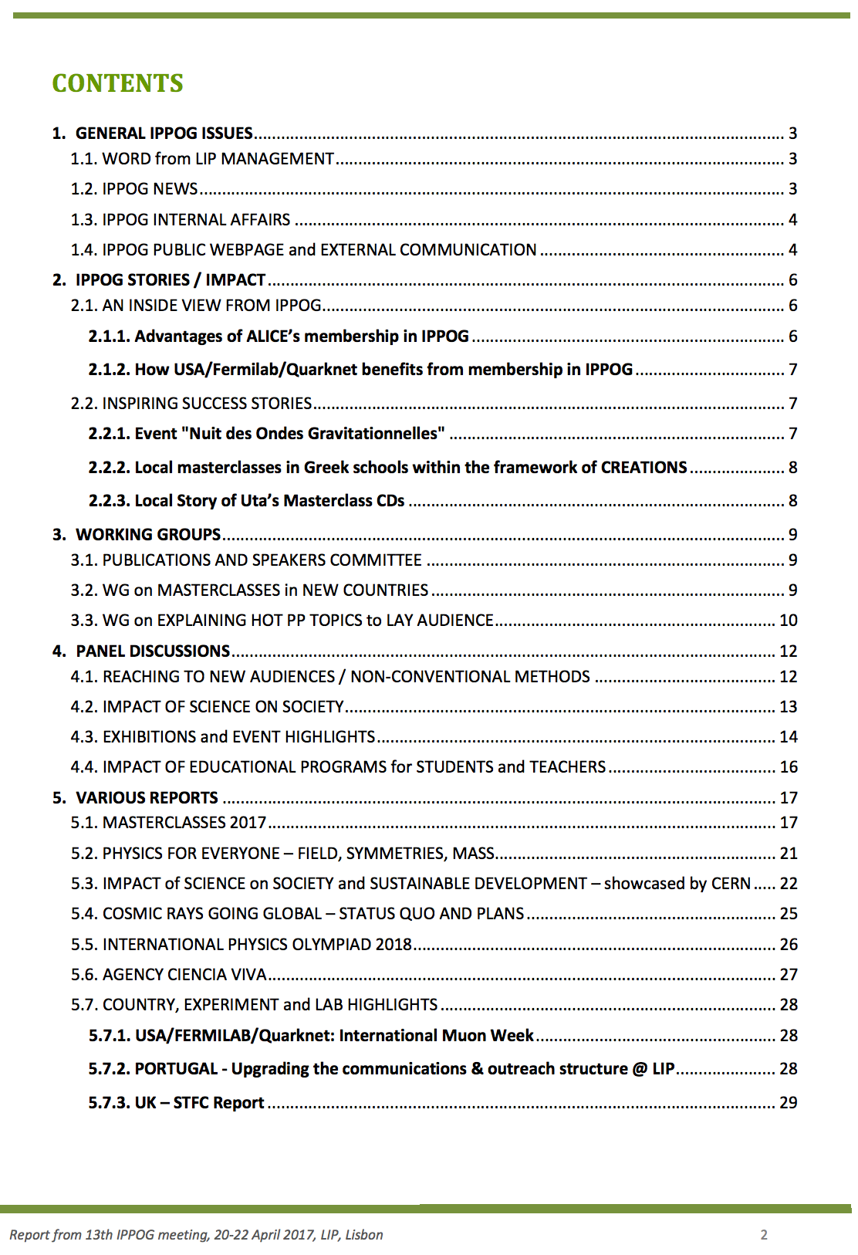
Lisbon (13th IPPOG Meeting)
Complete Report
https://indico.cern.ch/event/622184

Slide 3
Happy 20th Birthday, IPPOG!

Slide 4
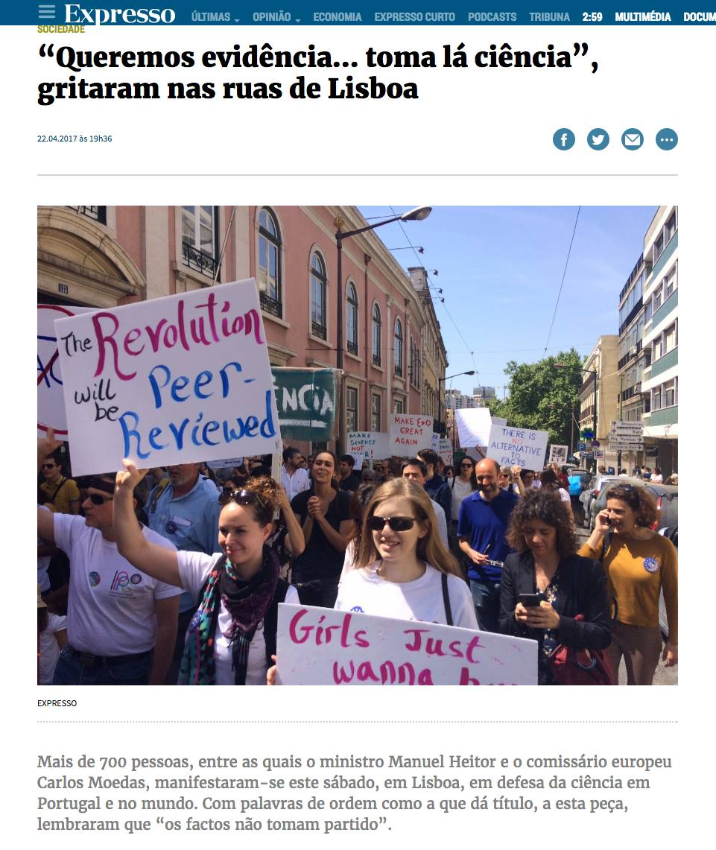
IPPOG In The News
Attain News
2 july 2017
Expresso, Lisbon
22 apr 2017

Slide 5
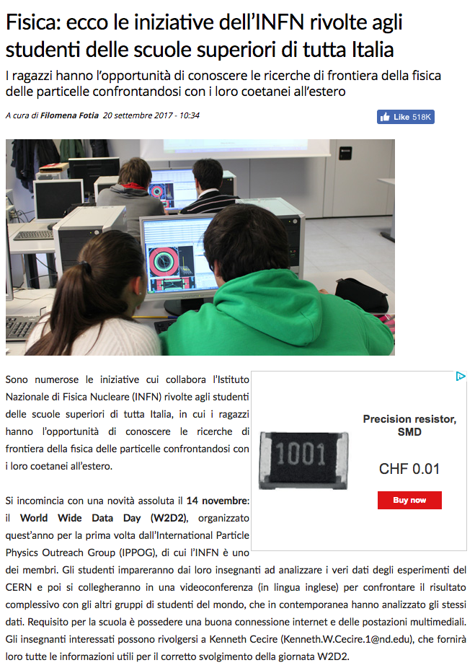
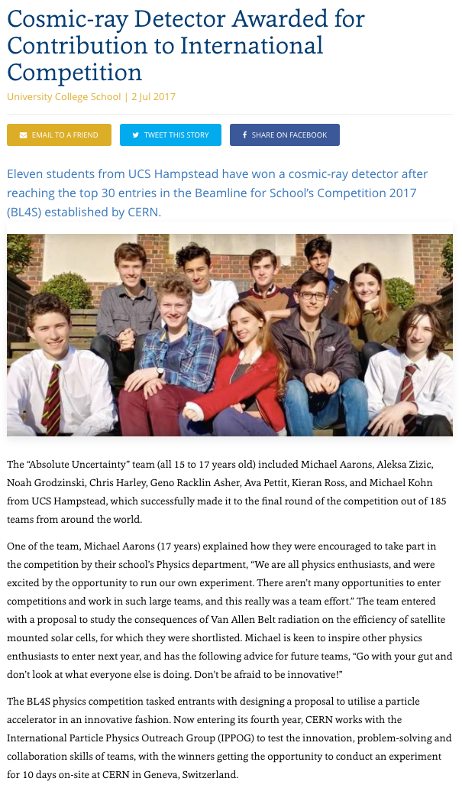
IPPOG In The News
Attain News
2 july 2017
Meteo Web
20 sep 2017

Slide 6
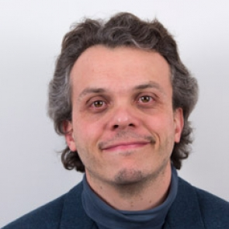
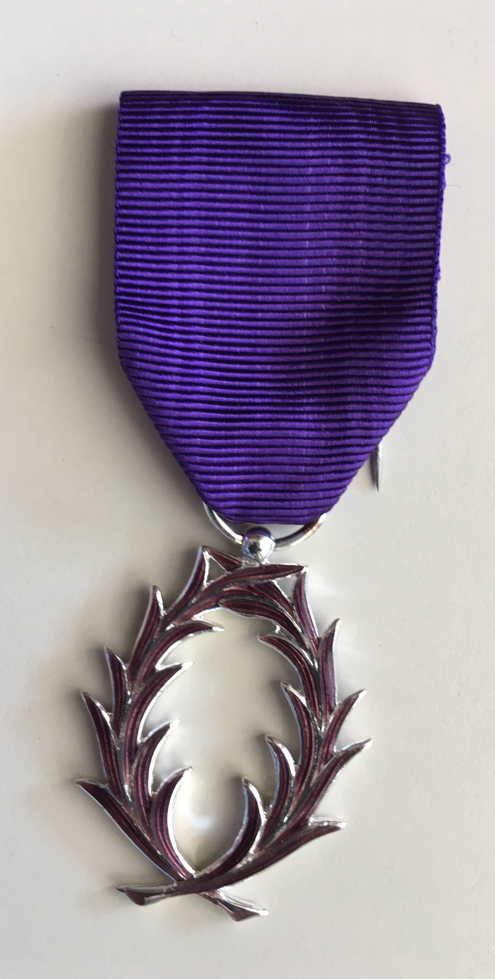
IPPOGers In The News
Nicolas Arnaud Chevalier
The Ordre des Palmes académiques (Order of Academic Palms) is a national order of France for distinguished academics and figures in the world of culture and education. Originally a decoration founded by Emperor Napoléon to honour eminent members of the University of Paris, it was changed into its current form as an Order on 4 October 1955 by President René Coty.^{[1]}

Slide 7
Current Membership
 | Signing Organisation | Country/Lab/Experiment | Date signed
1 | NIKHEF | Netherlands | 22 Sep 2016
2 | DESY for KET | Germany | 23 Sep 2016
3 | Physics Department of University of Oslo | Norway | 21 Oct 2016
4 | LIP | Portugal | 1 Nov 2016
5 | The Section for Elementary Particle and Astroparticle Physics of the Swedish Physical Society through the Swedish LHC Consortium | Sweden | 1 Nov 2016
6 | CHIPP | Switzerland | 4 Nov 2016
7 | Ministry of Education, Science, Research and Sport | Slovak Republic | 15 Nov 2016
8 | Institute of Atomic Physics | Romania | 17 Nov 2016
9 | Helsinki Institute of Physics | Finland | 29 Nov 2016
10 | FWO + F.R.S.-FNRS | Belgium | 30 Nov 2016
11 | CERN | CERN | 19 Dec 2016
12 | INFN | Italy | 21 Dec 2016
13 | CNRS/IN2P3 | France | 23 Dec 2016
14 | The Henryk Niewodniczański Institute of Nuclear Physics Polish Academy of Sciences | Poland | 29 Dec 2016
15 | CoEPP | Australia | 14 Feb 2017
16 | The University of Notre Dame on behalf of QuarkNet | USA | 14 Mar 2017

Slide 8
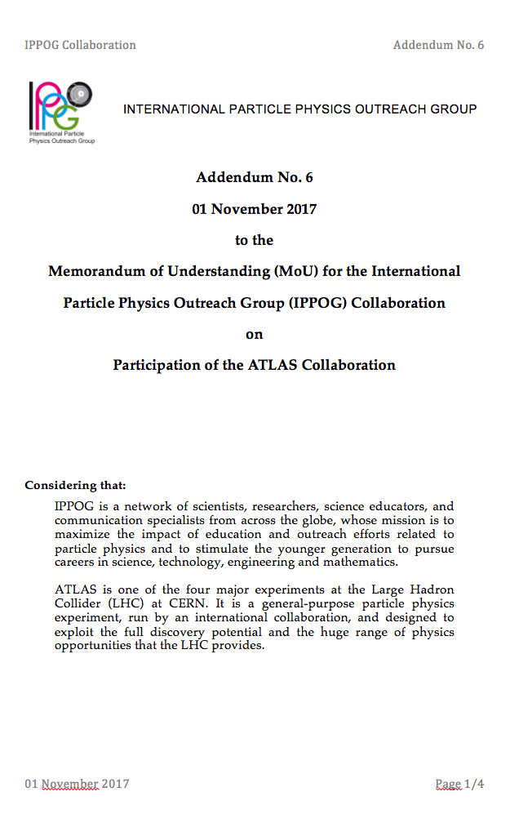
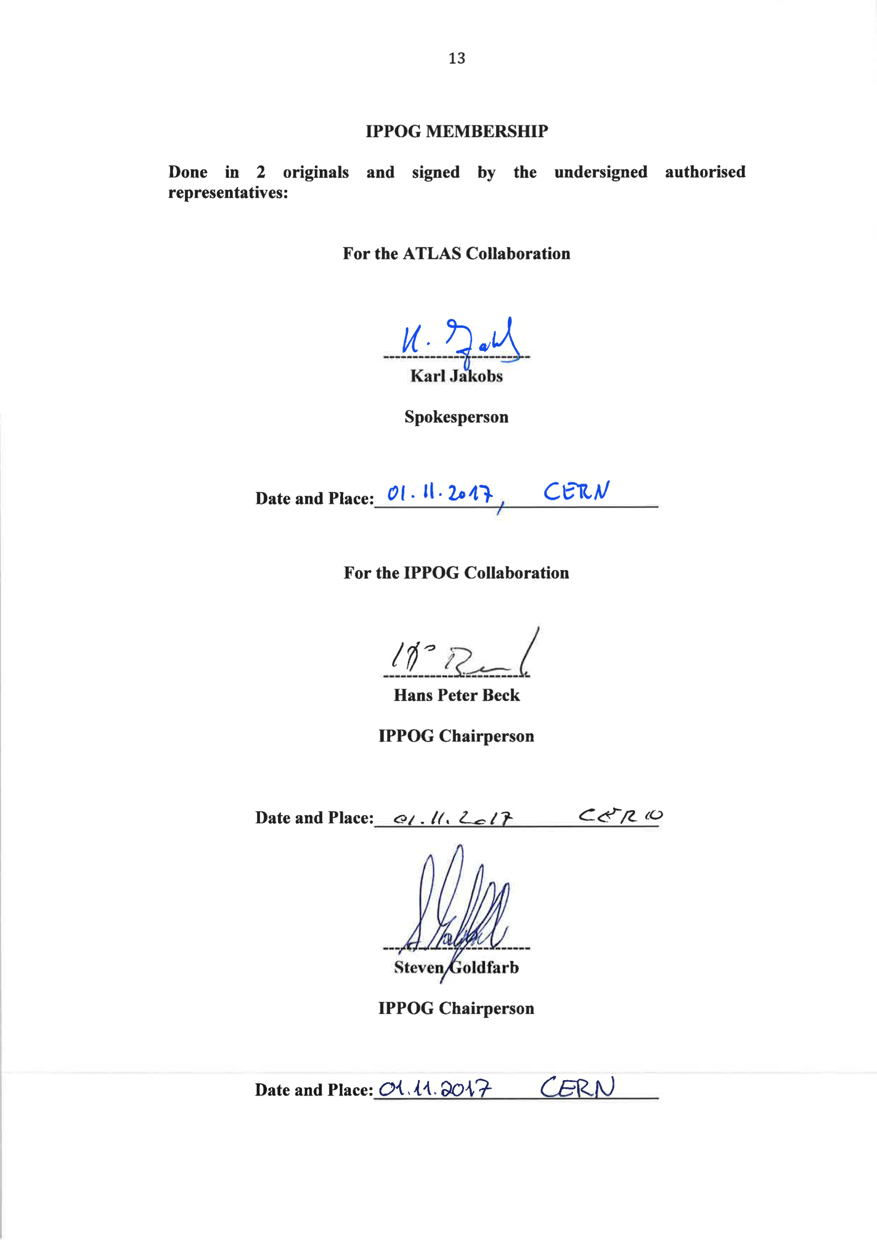
New Membership
First Scientific Collaboration to sign

Slide 9
Candidates
Candidate Membership expires 18 Dec 2018
  Countries
    Austria, Bulgaria, Czech Republic, Denmark, Greece, Ireland, Israel, Spain, South Africa, UK
  Scientific Collaborations
    ALICE, CMS, LHCb, TOTEM
  Labs
    DESY (as a lab)

Slide 10
Expressions of Interest
Brazil
  Marcelo Gameiro Munhoz, Universidade de São Paulo, Brazil, member of ALICE collaboration and member of Education Committee of the Brazilian Physics Society
  Ready to sign MoU and Addendum.
Belle II
  Toru Iijima and Zdenek Dolezal joined IPPOG meeting at CERN in November 2016.
  Ready to sign MoU and Addendum.
Turkey
  Bilge Demirkos is coordinating and running Masterclasses in Turkey, and is interested to make Turkey a Member in IPPOG.
GSI/FAIR
  Yiota Foka active in ALICE Masterclass program, and is interested to have GSI/FAIR join IPPOG.

Slide 11
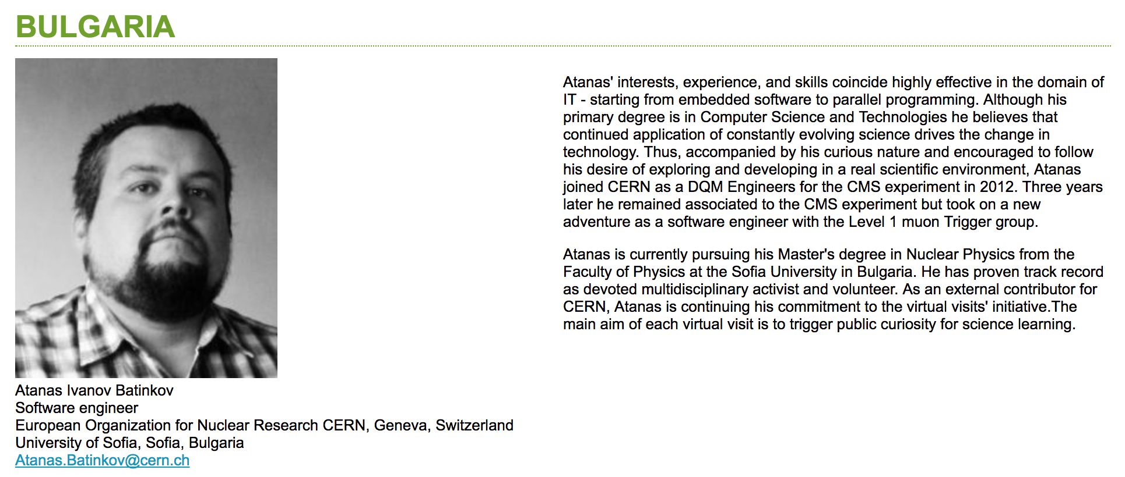
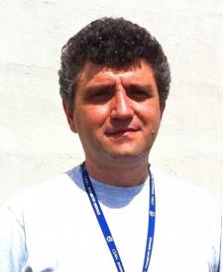
New Representatives
Stefan Piperov

Slide 12
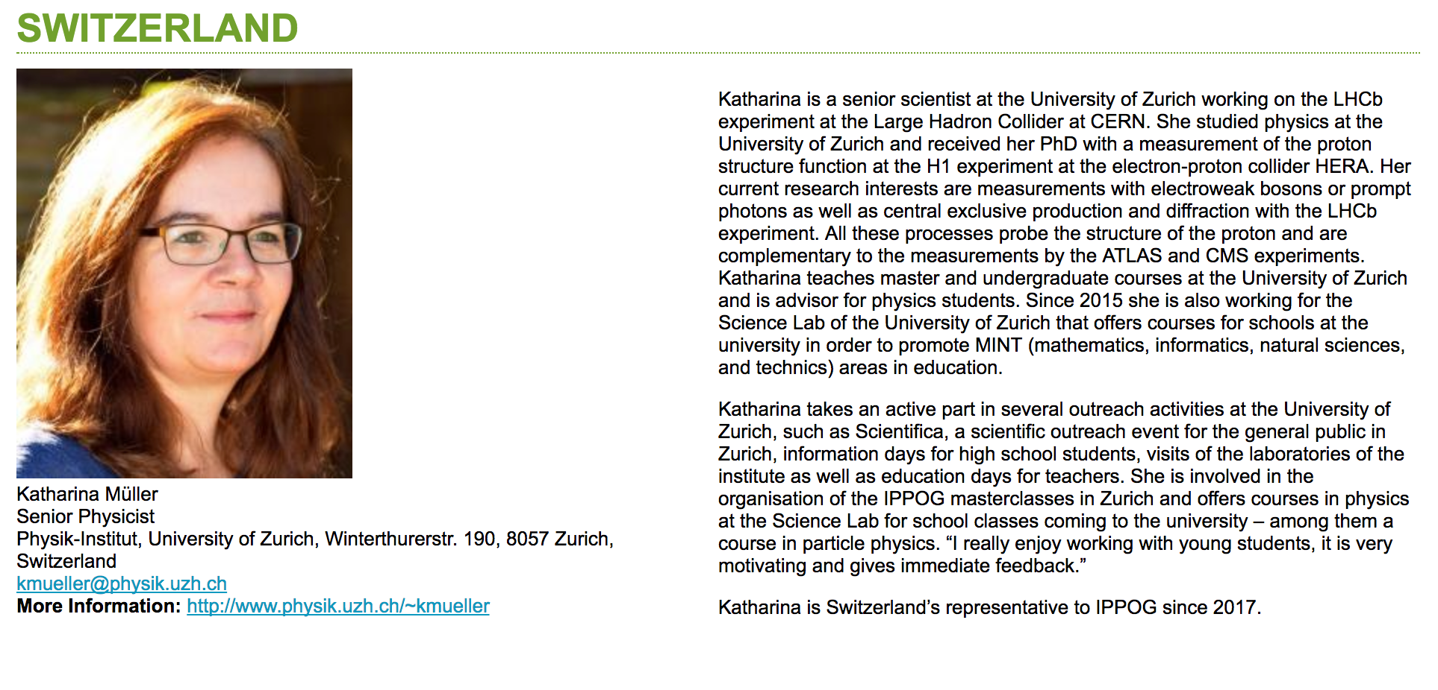
New Representatives

Slide 13
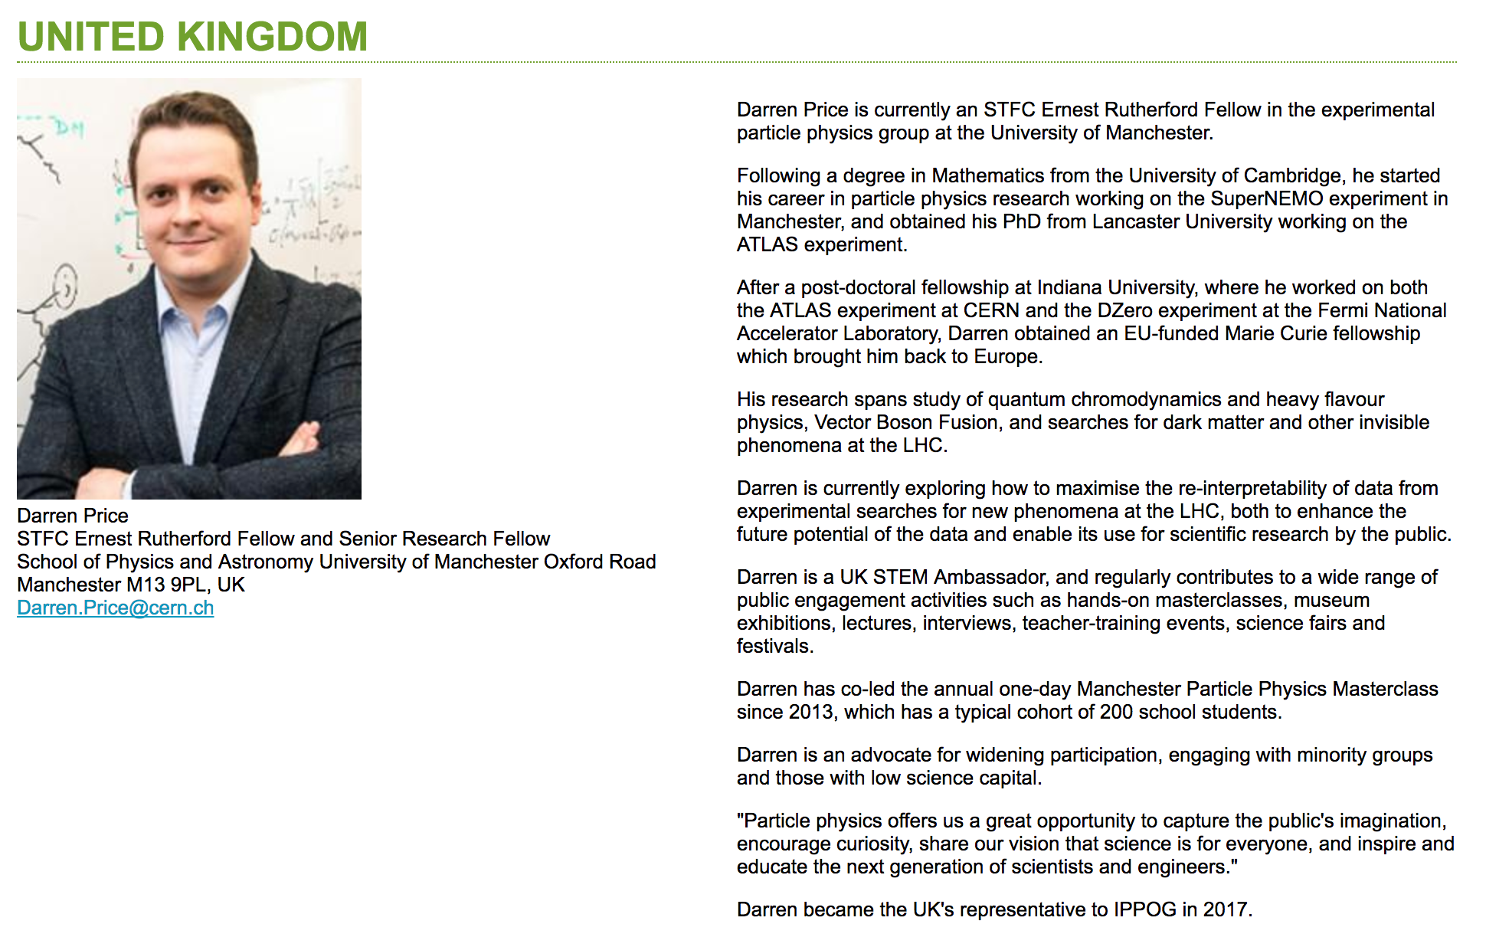
New Representatives

Slide 14
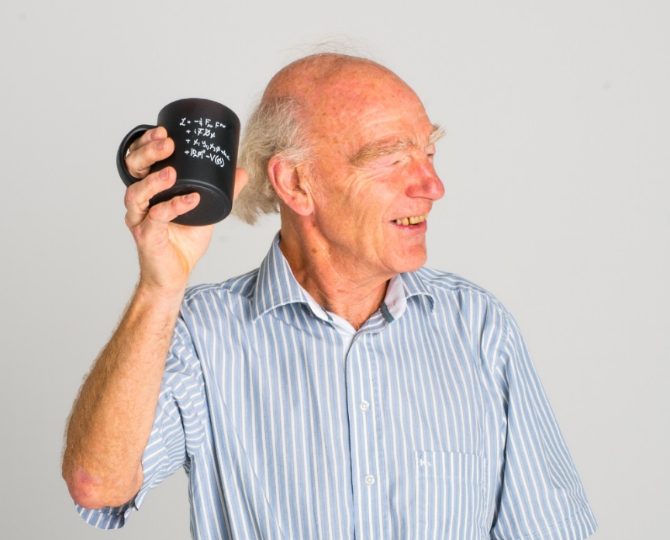
Thank You
Pete Watkins has been a very active member of IPPOG since ???? and continues to participate in several working groups and steering groups. His contributions have been crucial and greatly appreciated!

Slide 15
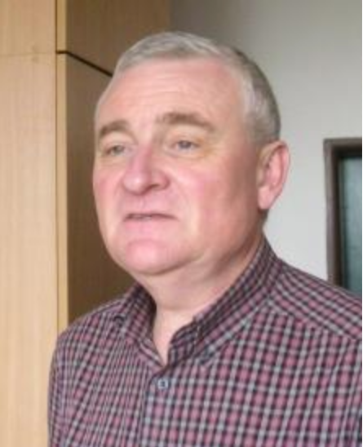
Thank You
Jiri Rames has been representing the Czech Republic since the very beginning of EPPOG and has made many important contributions. He will be replaced by Vladimir Pleskac.

Slide 16
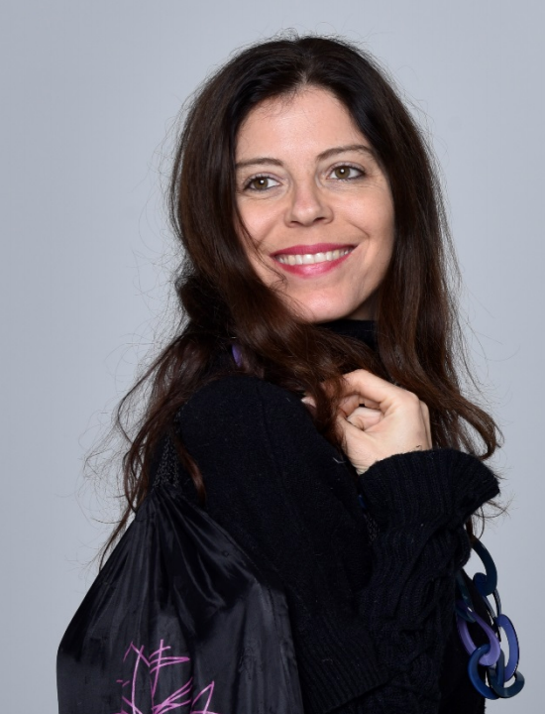
Exhibits Working Group
Chair
  Catia Peduto
Members
  Barbora Gulejova, CERN, Panagiotis Charitos, CERN (FCC), Marge Bardeen, Fermilab, Celso Martinez, Spain, Pedro Abreu, Portugal, Christine Kourkoumelis, Greece, Beatrice Bressan, TOTEM, Natascha Hoermann, Austria, Panja Luukka, Finnland, Angelos Alexopoulos, CMS, Nicolas Tracas, Greece
Mandate
  “Gather best practice of exhibits from the IPPOG countries with all their useful information and put them in the IPPOG resources database.”

Slide 17

Global Cosmics Working Group
globalcosmics.org

Slide 18
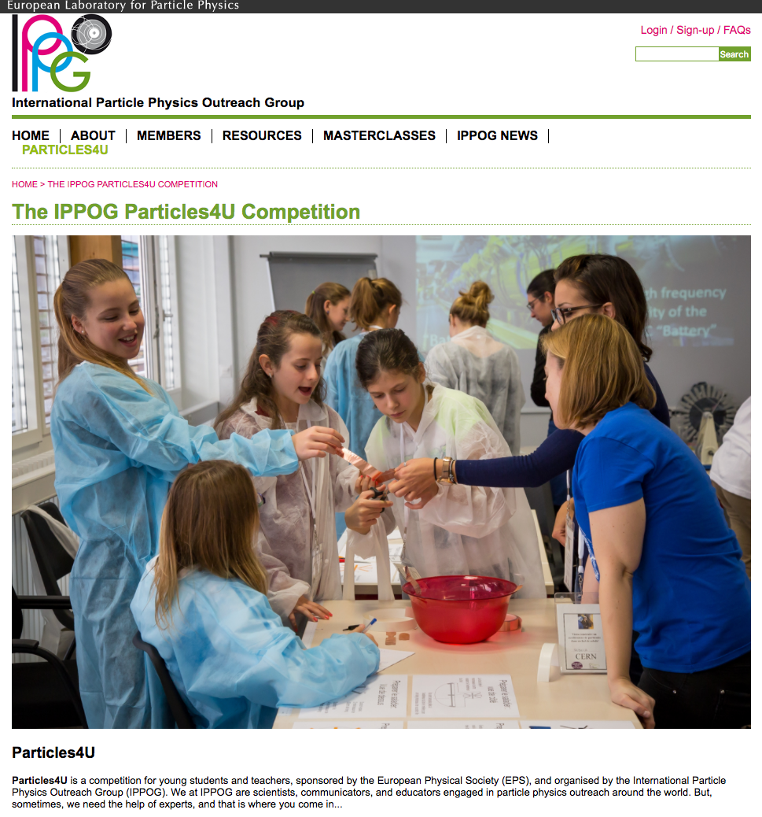
Particles4U Competition
EPS Award of 3 kEUR

Slide 19
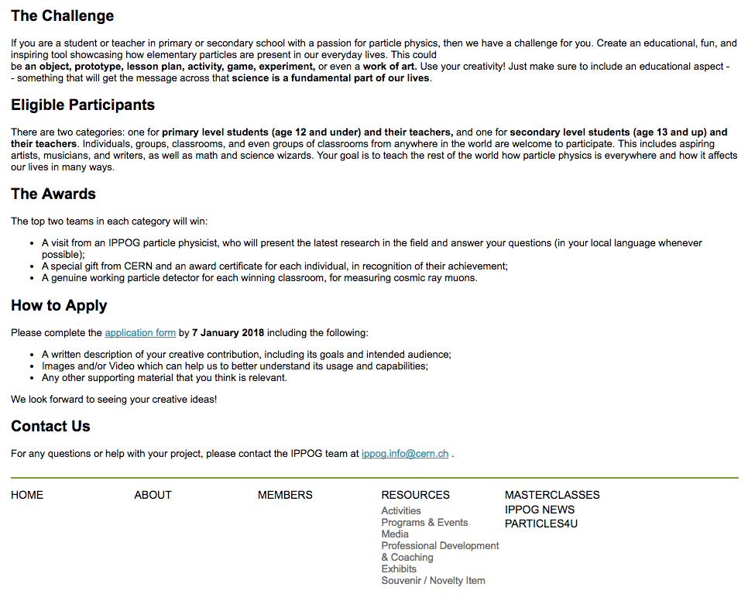
Particles4U Competition
To be officially launched following the meeting

Slide 20
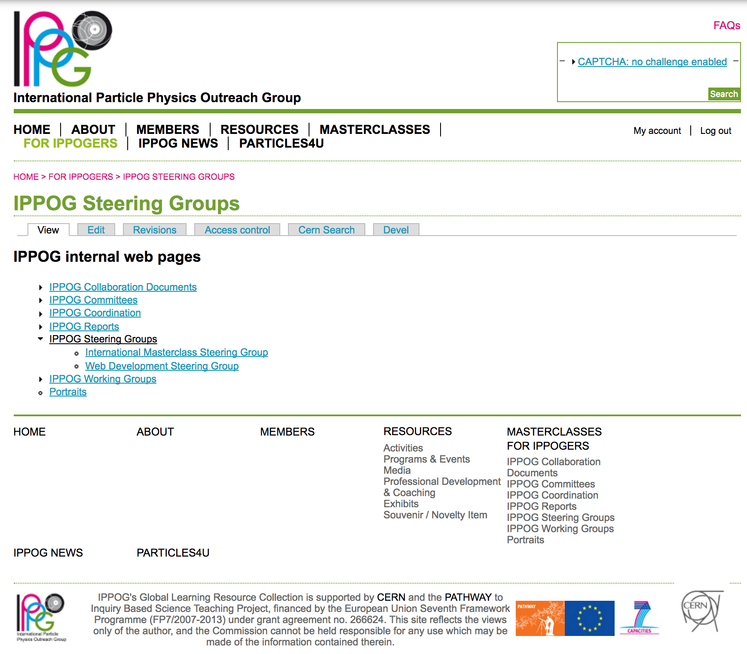
Internal Web Pages
For IPPOGers

Slide 21

Indico Categories
Now under Projects/IPPOG

Slide 22
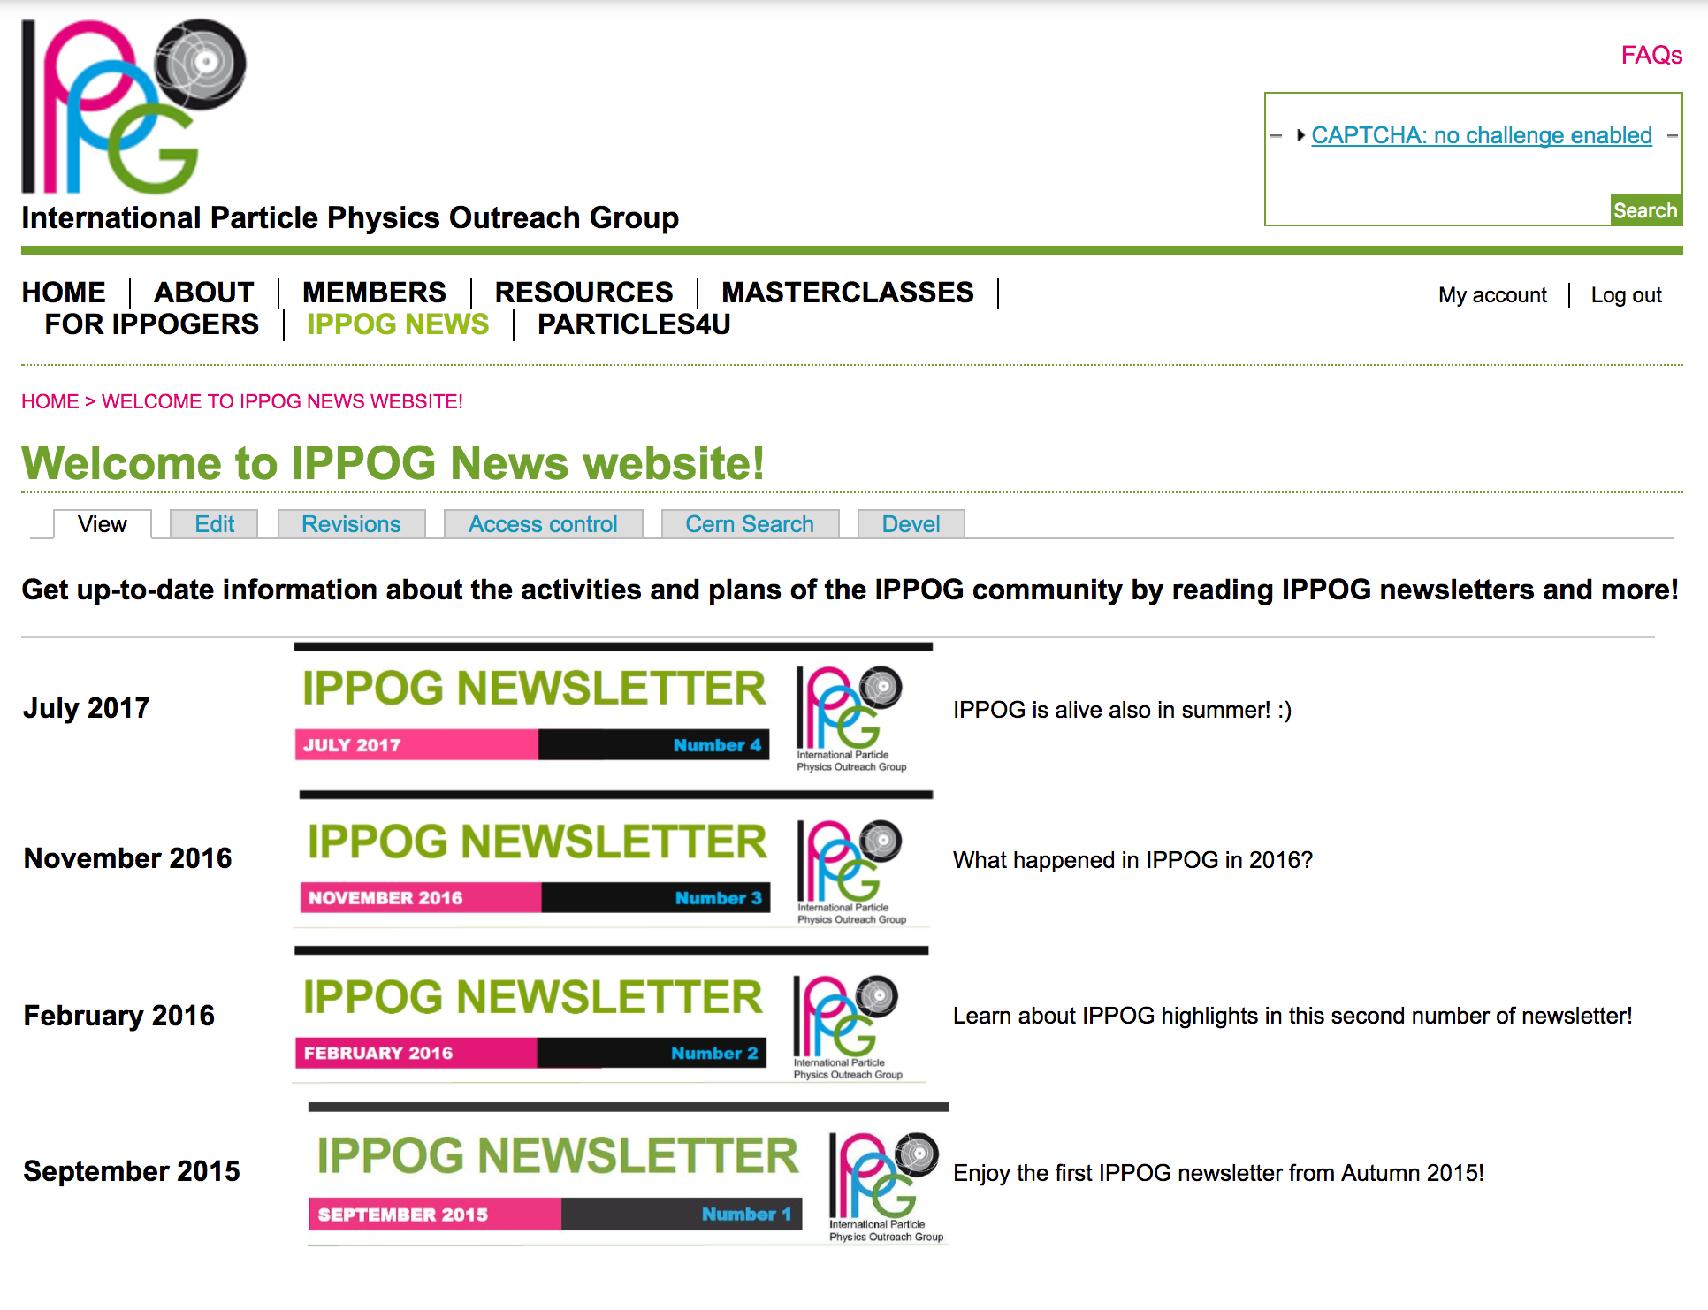
News Letters
IPPOG News

Slide 23
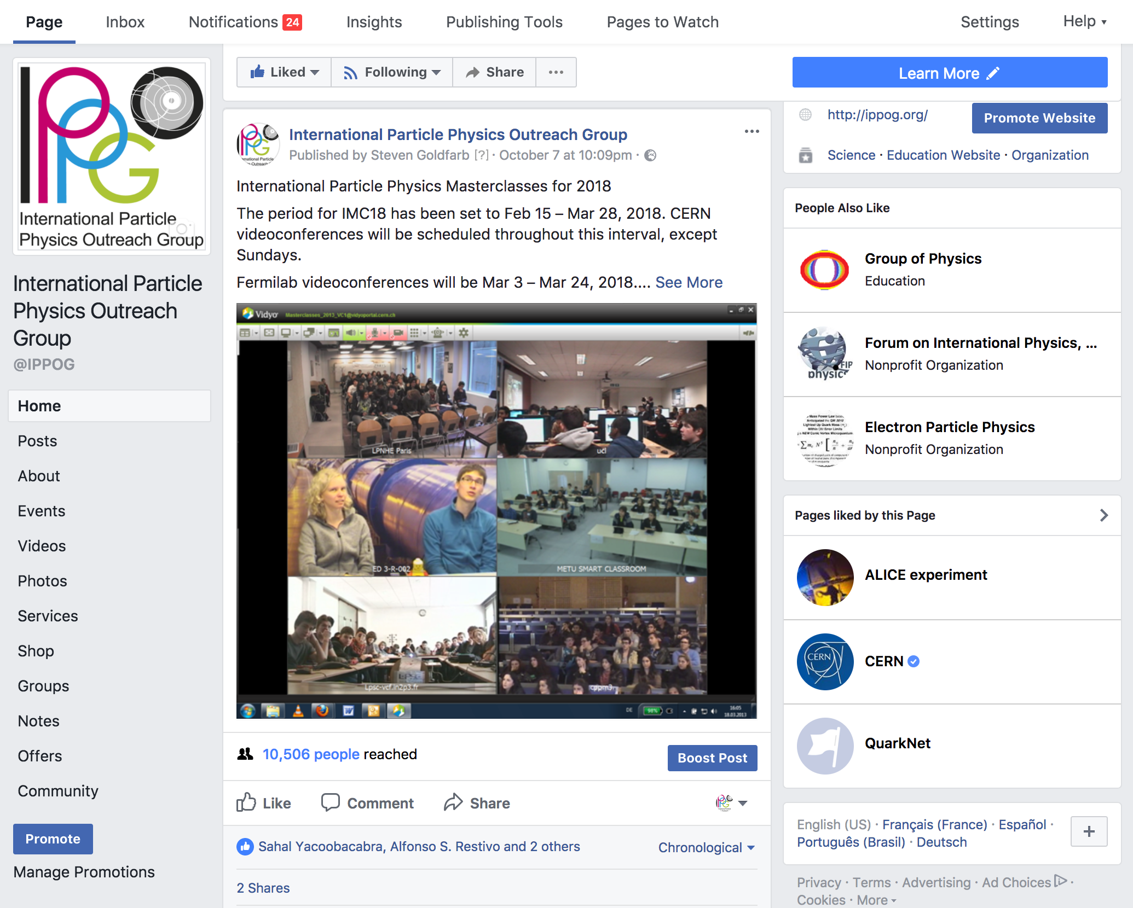
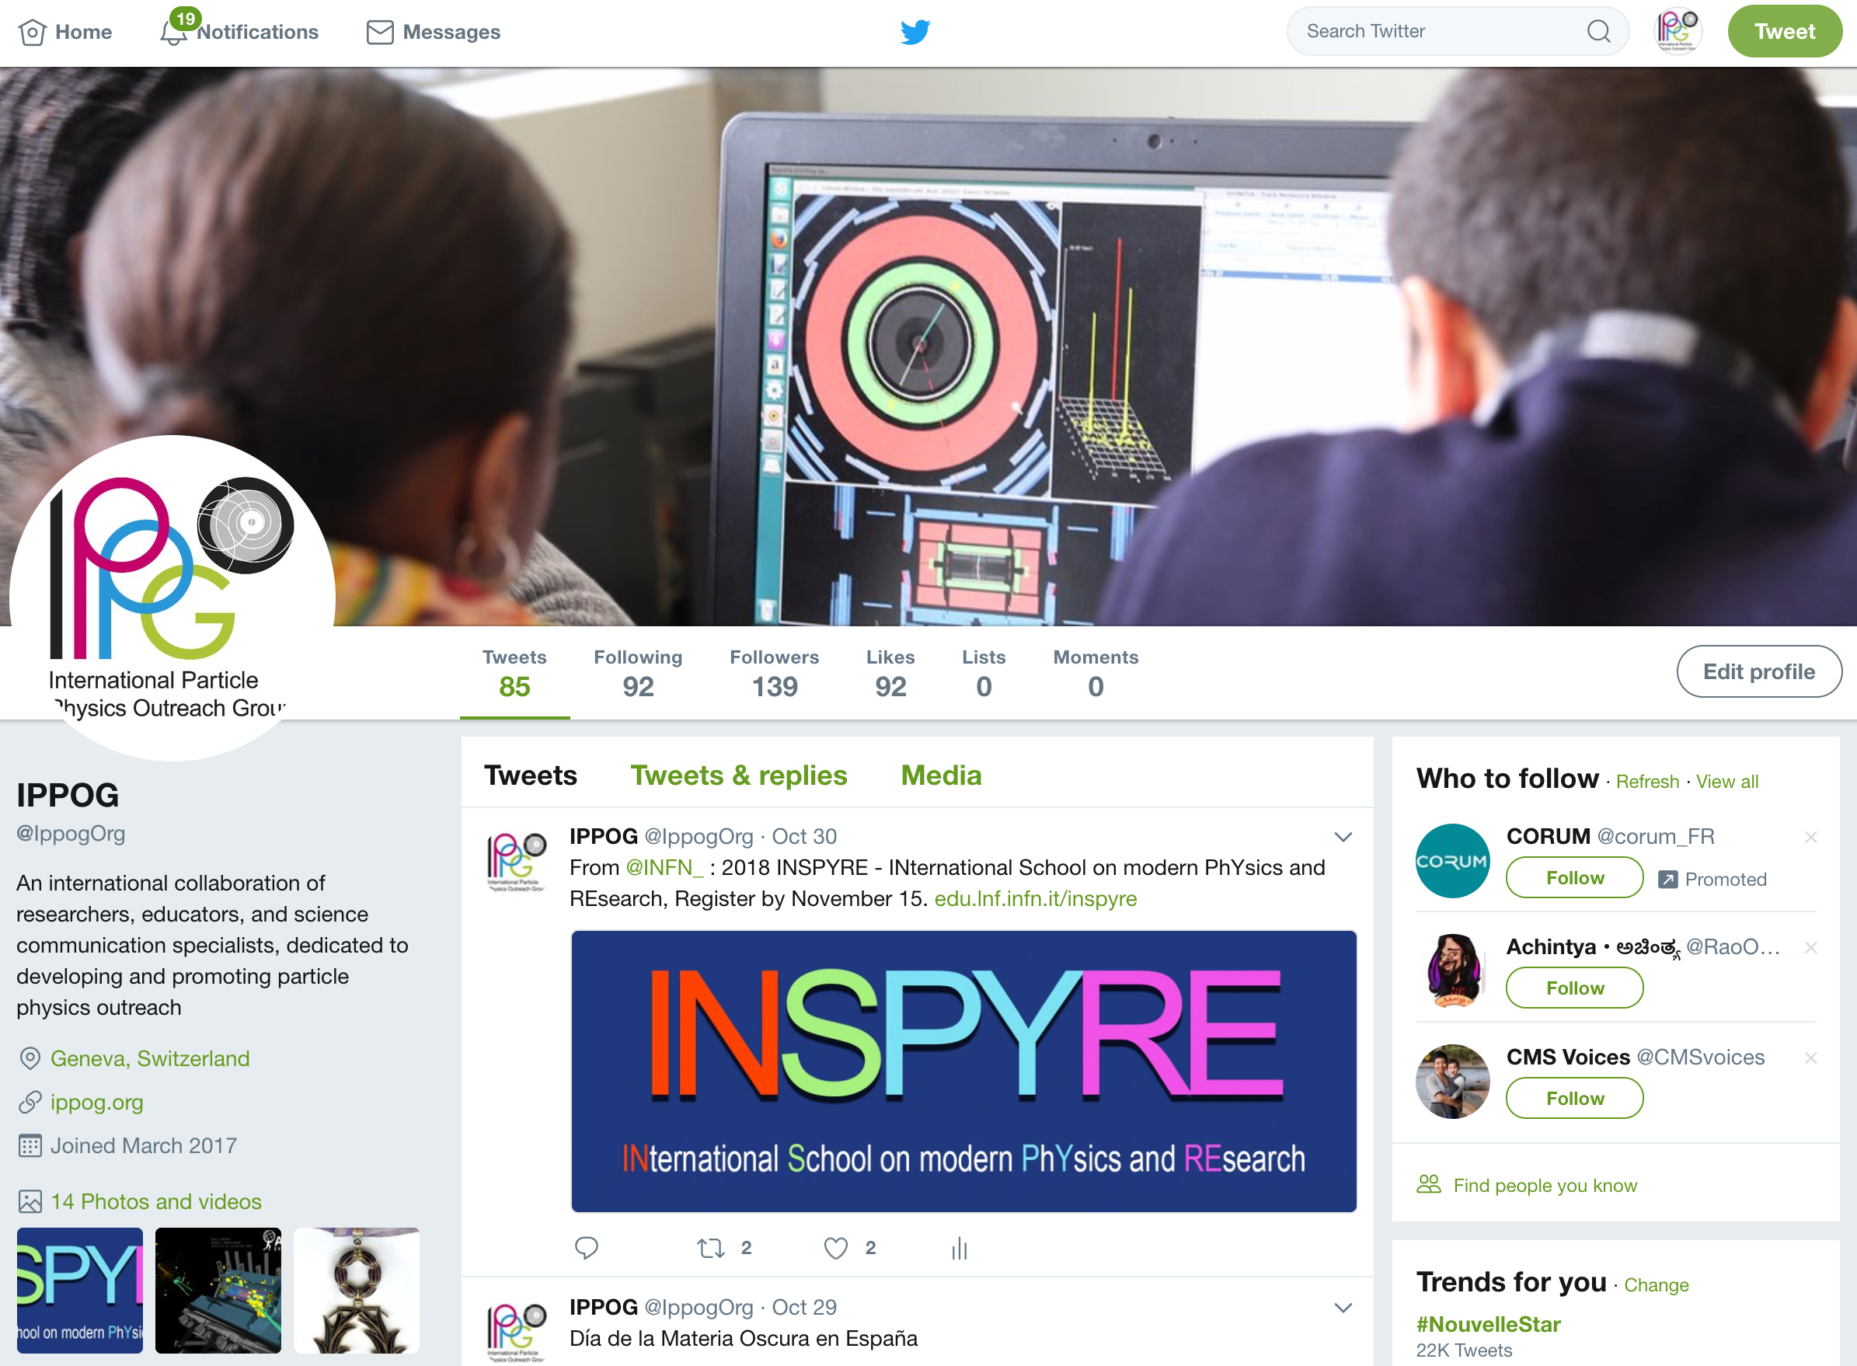
Communication
Needed: Social Media Coordinator
  Communication Strategy
  Policy for Supporting IPPOG Events, Communication
  Planning and Development of Content
  Coordination of announcements, sharing, etc.
Twitter: @ippogOrg
Facebook: @IPPOG

Slide 24
Communication
Public Web Pages and Resource Database
  Assembled Steering Group
    S. Boutas (CERN Webmaster), M. Lapka, P. Watkins, B. Gulejova, H.P. Beck, S. Goldfarb (chair)
  Preparing Specifications
    Drupal 8
    Compliance with CERN Support
    Including Infrastructure for Resource Database, Global Cosmics, International Masterclasses
  Call for Tender Follows Completion of Specifications

Slide 25
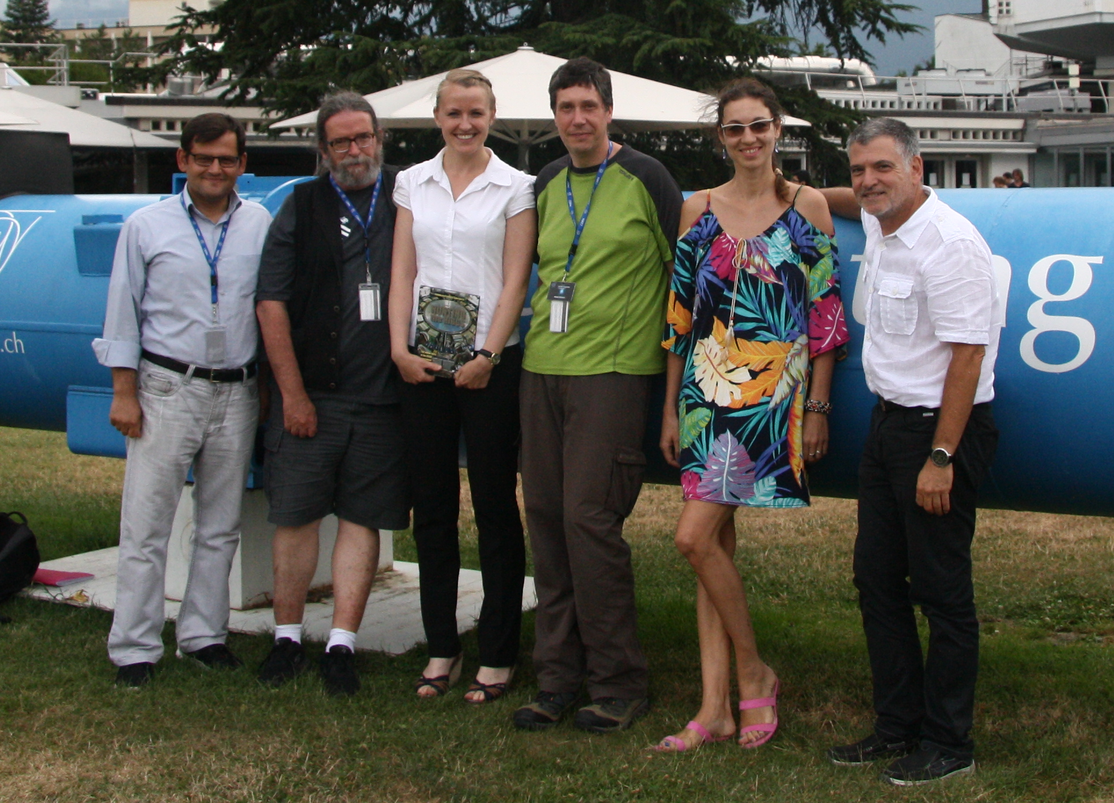
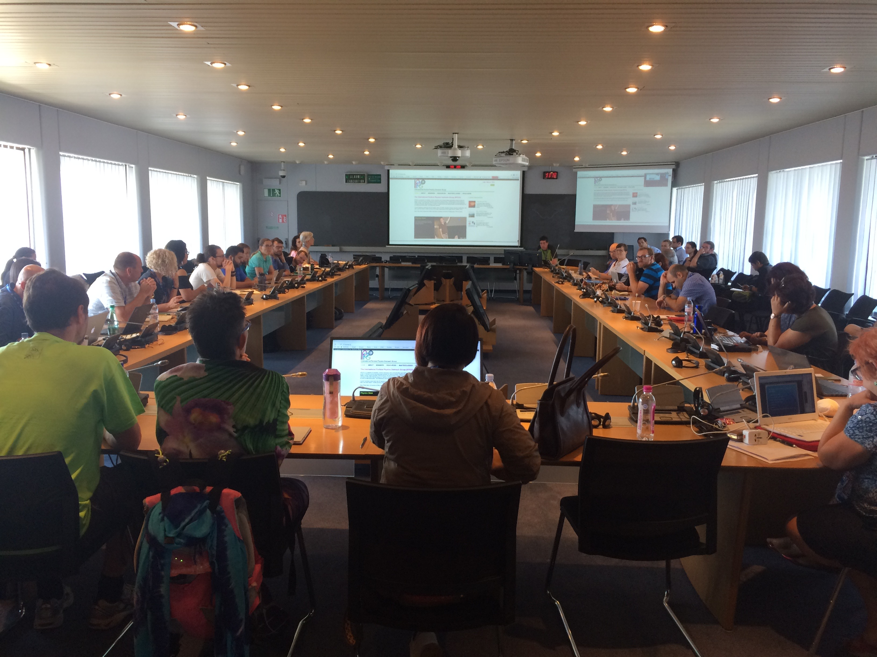
Communication
Public Web Pages and Resource Database
  Unexpected Help from HST Program
    Curation of Resource Database Content (the assignment)
    Proposed structure of pages for teachers / students (extra credit)

Slide 26
Working Group Reports
Explaining Particle Physics Hot Topics to a Lay Audience
  Conveners: Dirk Ryckbosch, Thomas Naumann
Bringing Masterclasses to New Countries
  Conveners: Uta Bilow, Ken Cecire
Global Cosmic Rays
  Conveners: Marge Bardeen, Charles Timmermans

Slide 27
Discussion Panels
Exhibitions and Event Highlights (Sascha Mehlhase)
  This time we propose to focus the discussion on how to handle conferences like ECSITE etc.
Broadening the physics scope of Masterclasses (Rasmus Mackeprang)
  Participants of this panel will be challenged to expand the scope of Masterclasses to cover new physics topics, experiments, and/or laboratories.
IPPOG and gravitational waves (Nicolas Arnaud)
  Gravitational waves are back in the spotlight, thanks to the recent Physics Nobel Prize. Panelists are asked to consider the role of IPPOG in the outreach of gravitational waves physics.
Beauty and Physics (Ivan Melo)
  Thanks to IPPOGer Ivan Melo, there has been an interesting electronic discussion on “Beauty and Physics”, subject of the article Ivan published. Let’s discuss this beautiful topic face to face.

Slide 28
Saturday Discussions & Votes
Full Membership
  Next Meeting Venue
Collaboration Board
  New Members
    Brazil, Belle II
  Budget 2018
  Annual Fees 2018
  Creation of IPPOG Finance Advisory and Auditing Board (IFAAB)

