Slide 1
14th IPPOG Meeting – CERN
IPPOG Public Web Pages
S. Goldfarb, IPPOG Chair, University of Melbourne

Slide 2
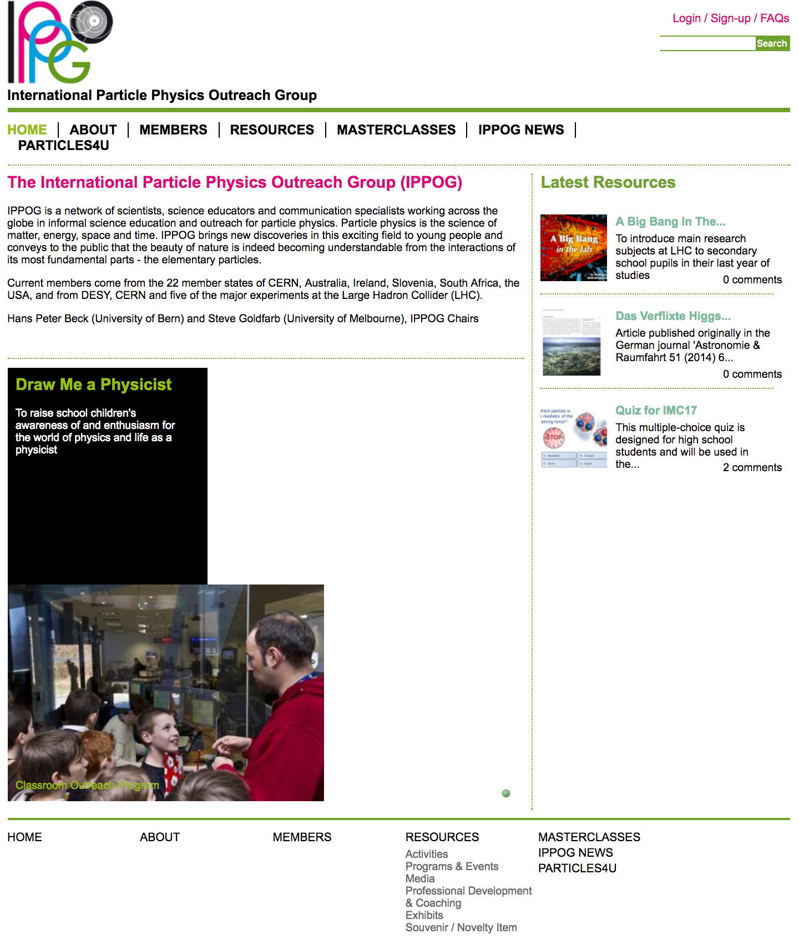
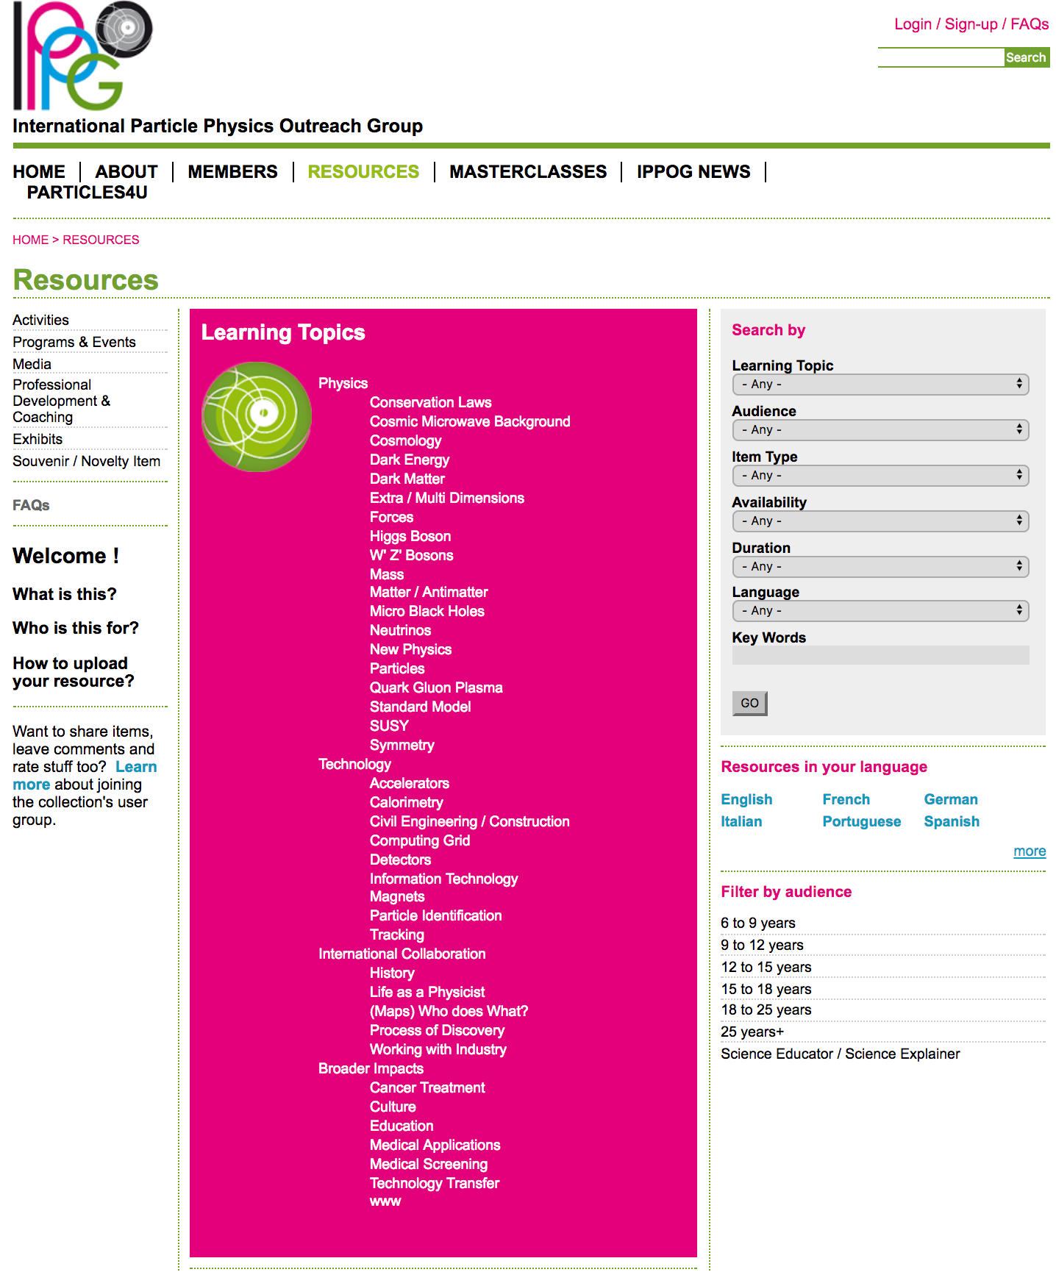
Home Page
Resource DB

Slide 3
Notes to Spark Discussion
Why we decided to re-launch development
  Current web pages meant to be 1st iteration
  Interface has important shortcomings
  Original development not maintainable by CERN
  Need to move to Drupal 8
About integrating Cosmics & Masterclasses
  Needed now for specifications
  Leaders of both efforts will be involved in process
  Will only happen if functionality improved
  Will save resources by developing centrally
  Autonomy will be maintained

Slide 4
Status
Public Web Pages and Resource Database
  Assembled Steering Group
    S. Boutas (CERN Webmaster), M. Lapka, P. Watkins, B. Gulejova, H.P. Beck, S. Goldfarb (chair)
  Preparing Specifications
    Drupal 8
    Compliance with CERN Support
    Including Infrastructure for Resource Database, Global Cosmics, International Masterclasses
  Call for Tender Follows Completion of Specifications

Slide 5
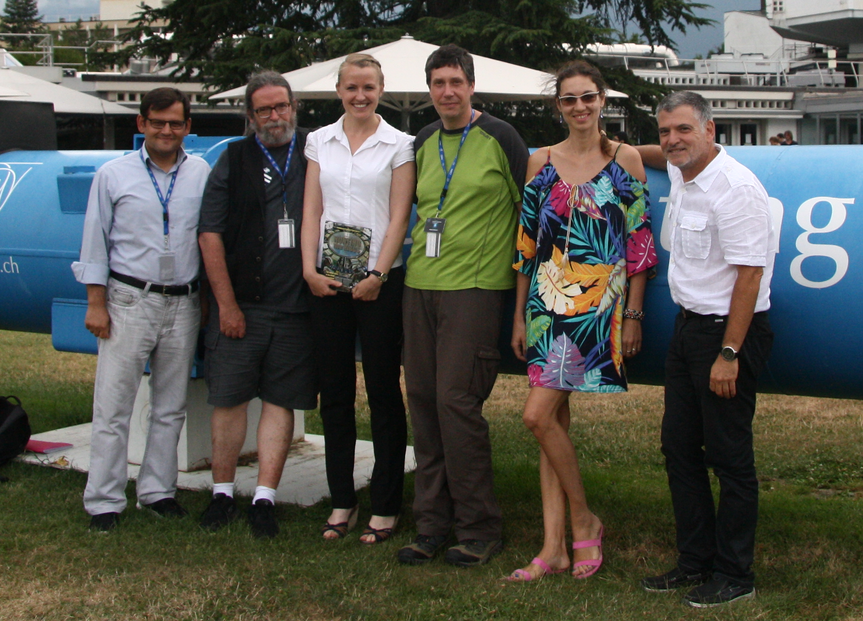
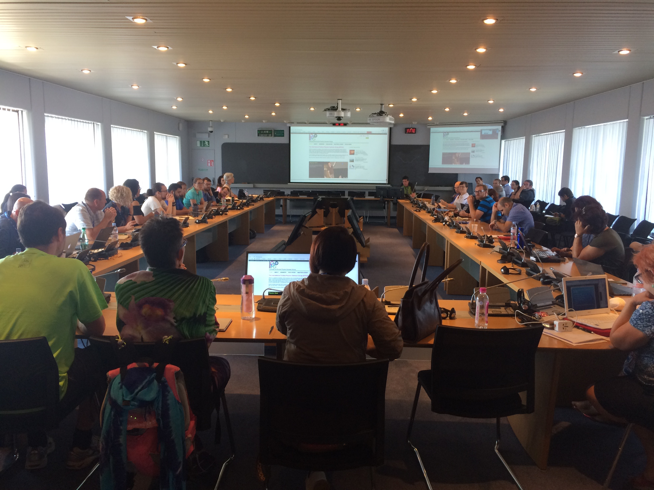
Help from our friends
Unexpected Help from HST Program
  Curation of Resource Database Content (the assignment)
  Proposed structure of pages for teachers / students (extra credit)

