Slide 1
IMC 18 Report
Uta Bilow + Ken Cecire
IPPOG meeting, CERN
02.11.2017

Slide 2
Dates
IMC18: 15.02. – 28.03.
Fermilab VC: 03.03 – 24.03.
UN Int. Day of Women and Girls in Science: 12.02.

Slide 3
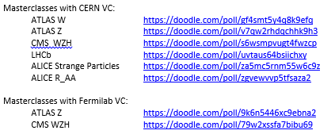
Registration to IMC18
Sept 15: Announcement of dates
Oct 27: Registration opened (Fri last week)
Dates for LHCb and ALICE doodled beforehand
max. 2 VCs in parallel at CERN, always 4-5 pm CET
single VCs at Fermilab, variable times
More slots will open if required
www.physicsmasterclasses.org/downloads/Circular2017_10_27.pdf

Slide 4
Registration – the numbers
 | ATLAS Z | ATLAS W | CMS | LCHb | ALICE S.P. | ALICE R_AA | ATLAS Z | CMS WZH
 | CERN |  |  |  |  |  | Fermilab
Slots offered | 110 | 40 | 60 | 45 | 35 | 5 | many | many
slots taken (in 2017) | 85 (103) | 32 (34) | 56 (52) | 36 (41) | 14 (21) | 4 (4) | 1 | 15
Still available | 25 | 18 | 4 | 9 | 21 | 1 | many | many
Institutes (in 2017) | 68 (78) | 21 (31) | 37 (39) | 30 (31) | 13 (19) | 4 (4) | 1 | 8

Slide 5
New Countries / Institutes / Groups for IMC18
Confirmed:
Bulgaria: Sofia (CMS)
Qatar: Doha (CMS)
Iran: Tehran (CMS)
Strasbourg: ALICE group
Interest expressed:
India
Palestine
Lebanon

Slide 6
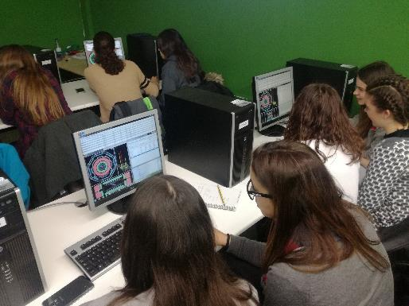
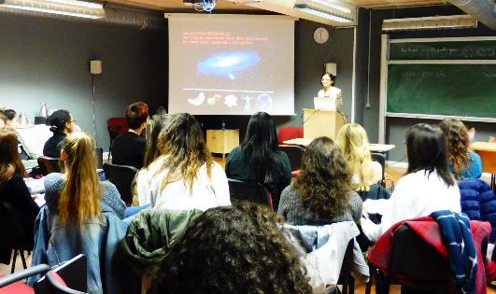
IDWGS
UN International Day of Women and Girls in Science = Feb 11
IMC pilot in 2017 on Feb 10+11
  10 institutes, 3 video conferences
  320 girls, very well received
Talk at LCHP Shanghai (Julia Djuvsland) + proceedings
Poster at EPS-HEP Venice + proceedings
2018: IMC IDWGS on Feb 12
Few requests for celebrating March 8 (Int. Womens Day) in addition
  No special event from our side
  Female moderators
  Diverse groups in the VC

Slide 7
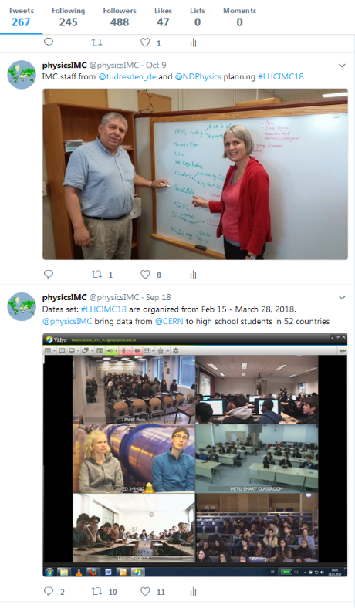
Communication
Circulars
  2017: biweekly on Fridays
  2018: weekly on Fridays
Twitter
  @physicsIMC
  #LHCIMC18
  Team: Nicolas, Ken, Uta, more volunteers?
  Schedule
  Encourage institutes to tweet with specific tips (circular)
Press release
  Template for institutes

Slide 8
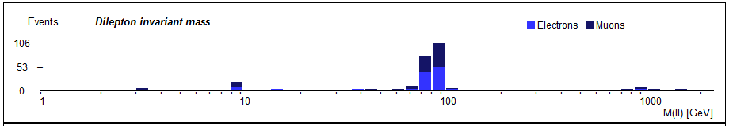
Timeline
Holiday resonance
Start recruiting moderators
Prelim. schedules
Updates instructions
Moderators training
Vidyo tests
Question time
IMC18 start
11
12
01
02

Slide 9
Measurements
ALICE working on improvement of measurement
  Change geometry, do reconstruction
  To ROOT or not to ROOT
  Non-ROOT more accessible to students; ROOT has a measure of authenticity
  Event display should be what physicists use
ATLAS Z exploring new physics but measurement stable
  Add missing Et plot?
CMS, LHCb, ATLAS W stable
  CMS intro Drell-Yan

Slide 10
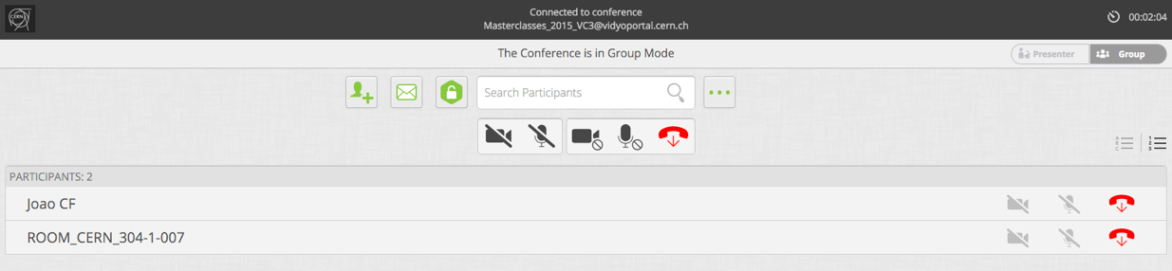
Vidyo
New client with new features and different look
  Moderator rights will change
  → Not before or during IMC18!

Slide 11

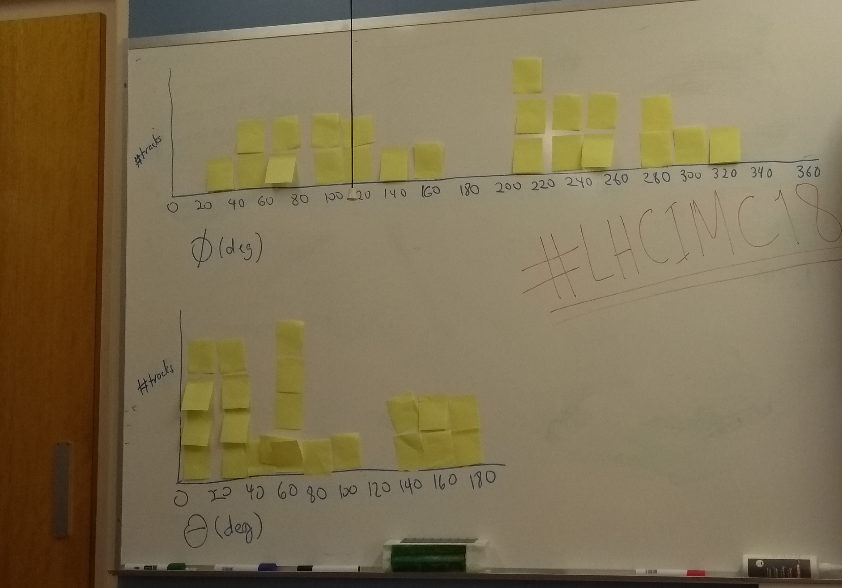
World Wide Data Day
“24-hour shift” for simple but meaningful measurements from ATLAS, CMS
Students measure theta and phi for dimuon events, plot histograms.
School do measurements, have VCs
November 14, 2017 – 36 groups, ~480 students so far
http://tiny.cc/w2d2-17
We need moderators!
Continue
Maybe change focus/topic

Slide 12
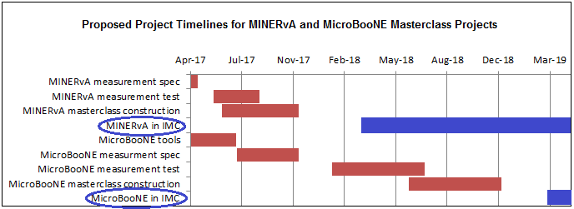
Fermilab Neutrino plan
Still in development
Big goal: DUNE
More neutrino masterclasses welcome – and not just at Fermilab

Slide 13
MINERvA masterclass
First IMC neutrino masterclass
Roll out in March and May (1 week each)
Simple measurement
  reject background; select signal events
  find px, py, pz of neutron in nucleus from ejected proton and muon
pz implies neutrino beam energy
Uncertainty in px and py → diameter of nucleus

Slide 14

Belle II Masterclass
Super KEKB – 40x luminosity of KEK
  Upsilon resonance – B mesons
Target audiences of B2MC: students, high school, primary, public
General intro: VR with Oculus Rift (make Google Cardboard version?
Two versions:
  Web version, simpler, on server
  Virtual appliance for download, more sophisticated analysis
Start with Belle masterclass based on B-Lab
  Analysis based on Blockly
  Create histograms: J/Psi, upsilon, pi
  Can add a fit to curve

Slide 15
Belle II Masterclass
Virtual appliance
  VirtualBox VM: http://belle2.ijs.si/belleIIubuntu16.04.3.7z
  unpack with http://www.7-zip.org/
  run with https://www.virtualbox.org/
  Start the VirtualBox
  Open the browser inside the virtual appliance and navigate
  to http://localhost/masterclass
Ideas, observations
  Look for matter-antimatter asymmetry in Belle/Belle2?
  More analysis, fewer events (students manipulate analysis code but do not examine event-by-event)
  Measurement takes 2 hr

Slide 16
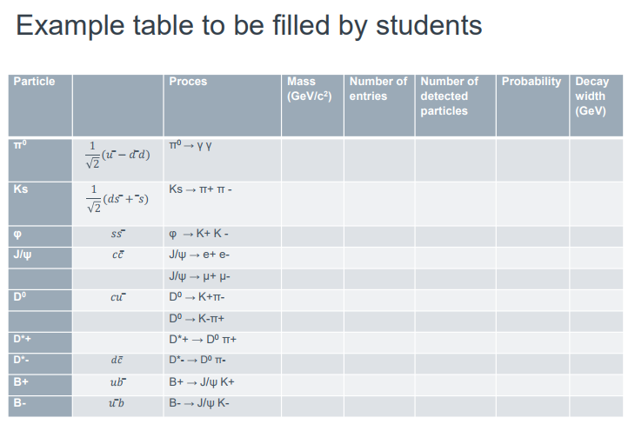

Slide 17
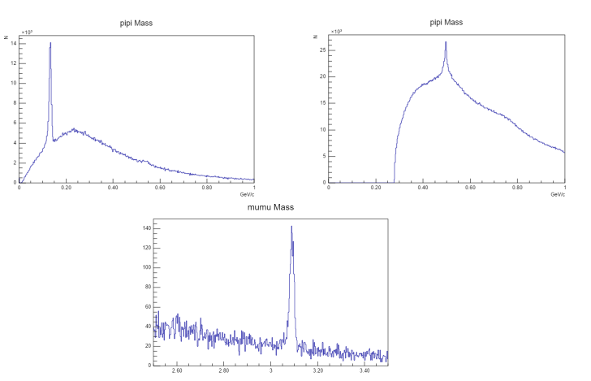

Slide 18
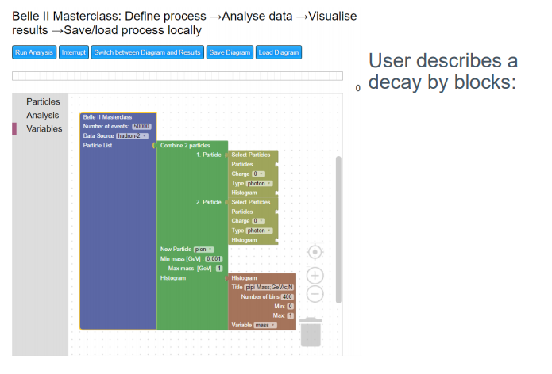

Slide 19
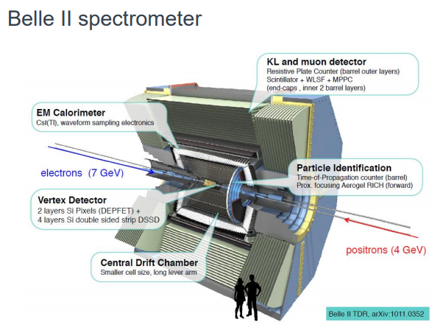

Slide 20
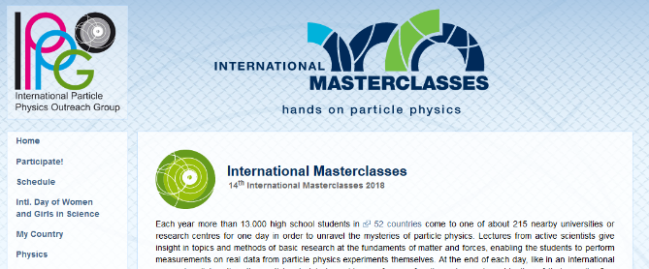
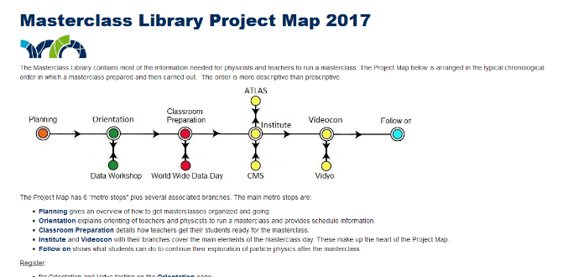
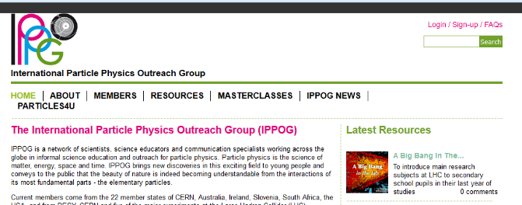
Website
www.physicsmasterclasses.org
  hosted at TU Dresden
  html
https://quarknet.org/page/masterclass-library-project-map-2017
  hosted at Fermilab
  Drupal 7
ippog.org so far only links to physicsmasterclasses.org
content will be integrated in ippog.org
  Only project, not individual measurements

Slide 21
Particle Physics Masterclasses
Existing
LHC-MC = IMC
IceCube MC
Pierre-Auger MC
Neutrino MC (Minerνa)
Nuclear MC (Univ. York)
  Activity demonstrating half-lives and the random nature of radioactive decay
  Computer simulation of the liquid drop model of neutron stars
  Use of advanced gamma detectors to analyse energy spectra and identify unknown sources and materials
Under development
Neutrino MC (MicroBoone)
Belle II MC
More ideas
TOTEM
CLIC
SESAME
…

Slide 22
IMC as a roof?
Is this all a Masterclass?
Can/should IMC be a roof for this?
  Not meant in terms of organisation, coordination
Create a common webpage?
  Short presentation of all MC projects with links to each project
  URL and location of such page
  Enhance visibility
  Support general idea of IPPOG
  URL of this webpage?

Slide 23
IMC Budget
IPPOG supports efforts to develop and improve the programme, including activities to broaden its scope in content, as well as geographical and social reach.
5 k€ budget per year
Draft of policies on spending
Discussion in SG not finished yet, only minor details

