Slide 1

C.Kourkoumelis
University of Athens
EU funded projects on science communication, education and outreach
The example of CREATIONS

Slide 2
The finished EU projects:
1)The Learning with ATLAS@CERN (2009-2011)
http://www.learningwithatlas-portal.eu/
UoA/IASA was the coordinator
2)The PATHWAY IBSE Project (2011-2013)
Focused on teachers
FP7-Science-in-Society-2010-1
http://www.pathway-project.eu/
CERN was a partner
3) Discover the_COSMOS (Sept 2011-Sept 2013)
Focused on teachers +Students
FP7 Coordination action
UoA/IASA was the coordinator
http://portal.discoverthecosmos.eu/
2

Slide 3

DISCOVER_the_COSCMOS
(DtC)
15 Partners across Europe+LBL
(CERN was a partner)
Focused on teachers +Students
Combined educational e-resources from Astronomy and HEP (TUD, LBL, CERN, UoB, UoA/IASA)
A portal where we have combined all the resources from former portals {COSMOS(Astronomy) and Learning with ATLAS @CERN (HEP)} was created
3

Slide 4
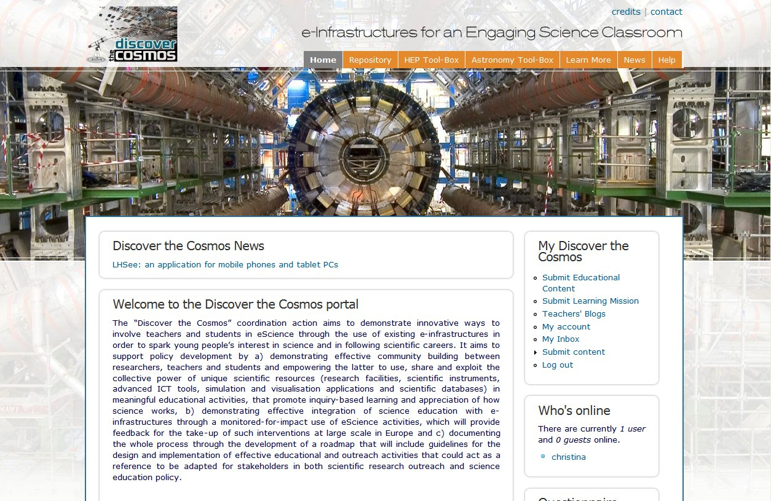
http://portal.discoverthecosmos.eu/

Slide 5
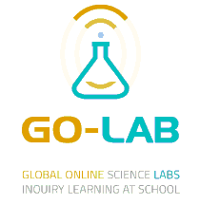
The finished EU projects:
Go-Lab (Nov.2012-Nov.2016, 20 partners)
Built science laboratory based on IBSE
infrastructure for schools
“on line” labs (federation of labs)
http://www.go-lab-project.eu/
143 on-line labs
132 Inquiry Learning Spaces
34 Apps
In all STEM curricula subjects in 10 languages
CERN was a partner

Slide 6

The finished EU projects:
Inspiring Science Education
(April 2013+40mo, 31 partners)
Large pilots for schools ->to reach 5,000 schools in 15 European countries
http://inspiring-science-education.org/
120 Demonstrators (in all STEM curricula subjects)
Harvested existing repositories with 278,000 educational resources (mainly ODS and DtC)

Slide 7

http://creations-project.eu/
A Horizon 2020 European outreach project to
Develop an Engaging Science Classroom
36 months (Oct 15->Oct 18), 1.8 ME, 16 partners
Coordinator: University of Bayreuth
Improve skills of youngsters in STEM subjects
HEP partners are UoA/IASA, UoBirmingham, Art@CMS, STFC
Some partners focus on combining science and art and boost creativity in schools
ex. Global Science Opera, Cultural Collisions , science using theater

Slide 8
Any EU outreach project should include:
A pedagogical framework
Creation of educational resources/scenaria
Workshops for teachers->community support (three stage: before/during/final)
Pilots+Large scale Implementation
Dissemination and exploitation plan
Ways of measurement the impact, assessment

Slide 9
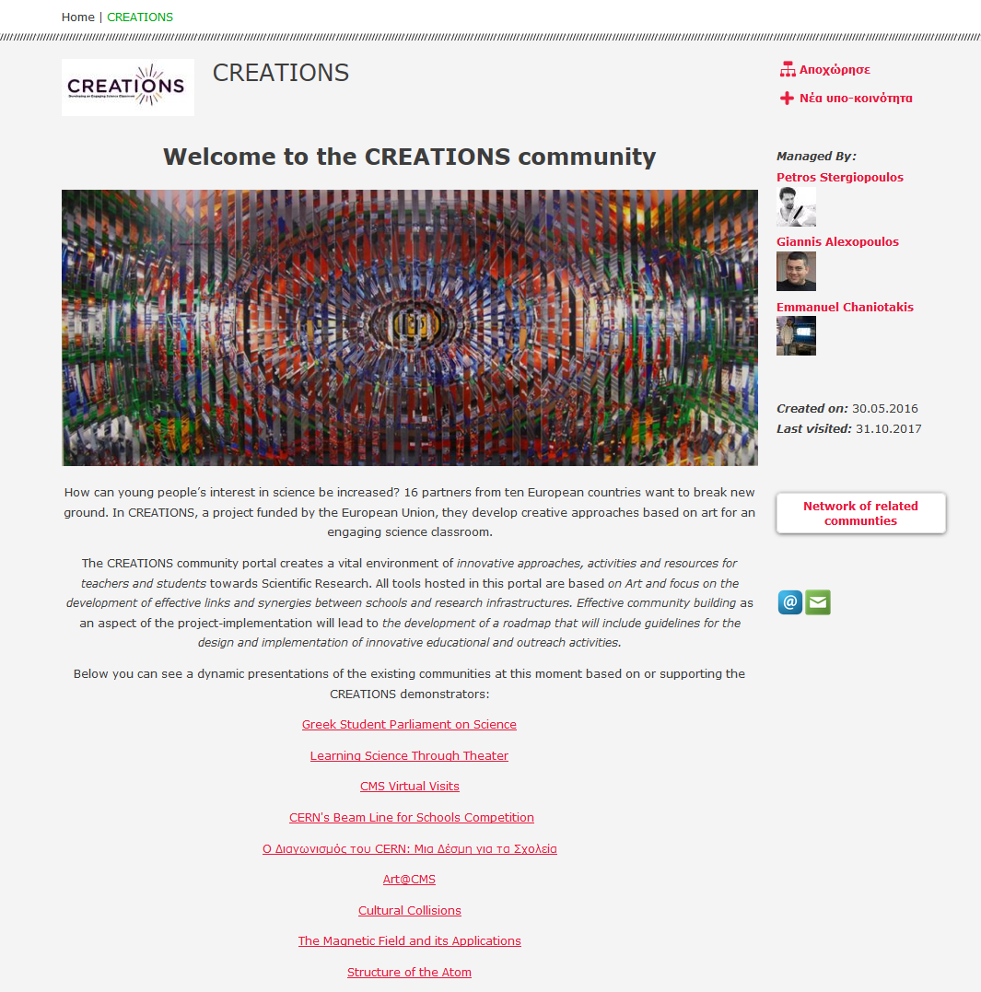
Open Discovery Space portal
CREATIONS Community hosts educational material and links to all the CREATIONS subcommunities supporting the CREATIONS Demonstrators
List of educational scenaria
50 now->100 end of project

Slide 10
Some numbers for the first two years
Community support
  Teachers’ workshops (visionary+practice/reflection) : 62
  Teachers trained:~900
Implementation
  Teachers ~1,400
    Local 850, national 450, international 100
  Students ~15,300
    Local 9100, national 9800, international 1400

Slide 11
Assessment
In CREATIONS the impact is evaluated with:
  “Pisa like” assessment questions at each phase of the demonstrator/scenario
  Use indicators on the success of the event analysis HYPATIA (# of Z’s found, # of Higgs found, e-pair/μ-pair)
  Pre and post creativity questionnaires (already collected 7500 questionnaires!!)
  CREATIONS has about one more year to go…
  New projects should start soon!!

