Slide 1
Initiatives to reach new audiences
Connie Potter
CERN and ATLAS

Slide 2
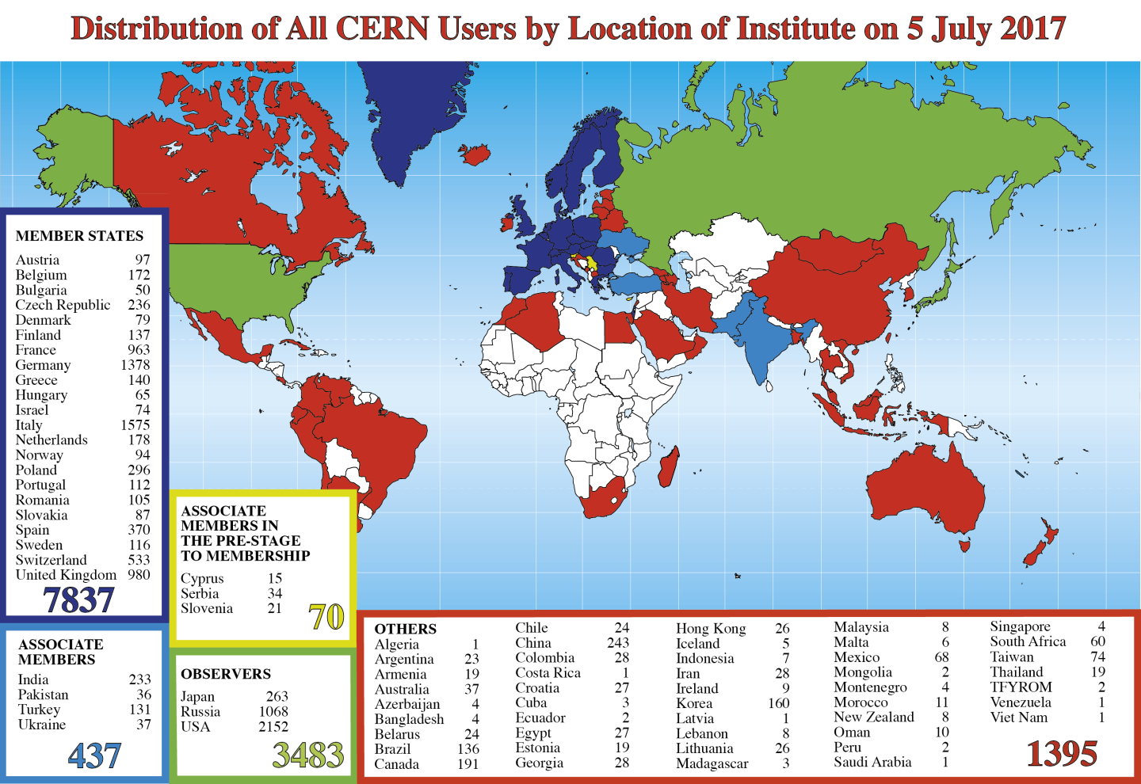

Slide 3
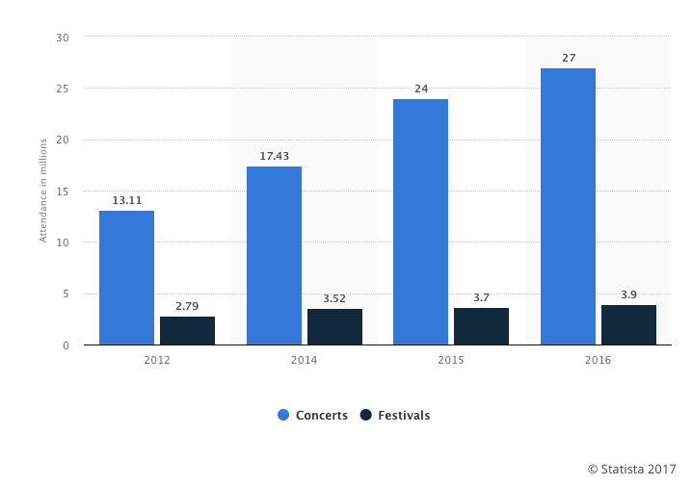
More (mind-boggling) numbers
U.K.
ABOUT THIS STATISTIC
This statistic displays information on the attendance at music concerts and festivals in the United Kingdom (UK) from 2012 to 2016. The data refers to both local attendants and music tourists from abroad. Over the period of consideration, attendance at UK live music events increased. The number of festival visitors grew by over one million in the three years between 2012 and 2016, from 2.79 million to 3.9 million.
U.S.A.
In a survey carried out by Billboard in 2016, average thirty two million people go to at least one U.S. music festival every year.
NORWAY
300’000 people go to a music festival every year!

Slide 4
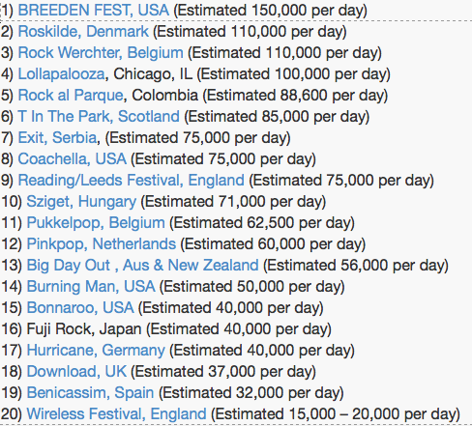
Festivals : a Worldwide Phenomenon

Slide 5
Faced with stiff competition from an ever growing number of festivals, organisers are looking to add areas and activities that are a bit different, something unexpected
And that’s where we come in…

Slide 6
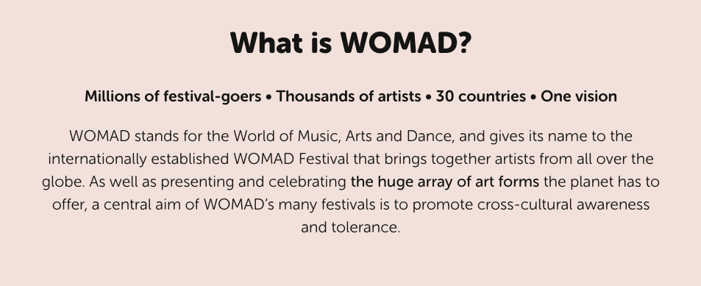
People camping for three days - are going for the music,
the literature, the culture
but not for any science.. At least not until…..

Slide 7



WOMAD2016
Charlton Park, Wiltshire, UK
At the invitation of the director of the Festival (after a special visit to CERN)
“Why don’t we have a World of Physics?”
Partners:
with the Lancaster University ATLAS group and the UK Institute of Physics
with support from the STFC
Team camped in basic tents provided by the festival
Physics Pavilion ran for the full 3 days
offering talks … workshops … ATLAS virtual visit
It was a first for WOMAD and a first for CERN

Slide 8
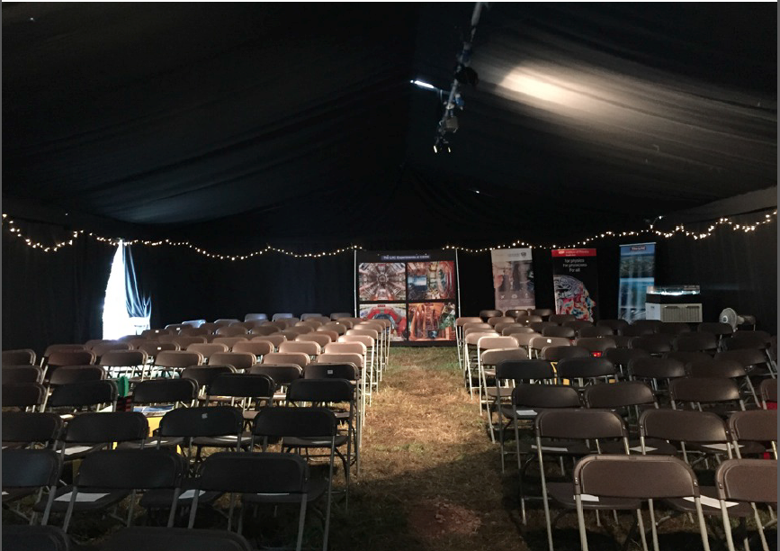

Slide 9
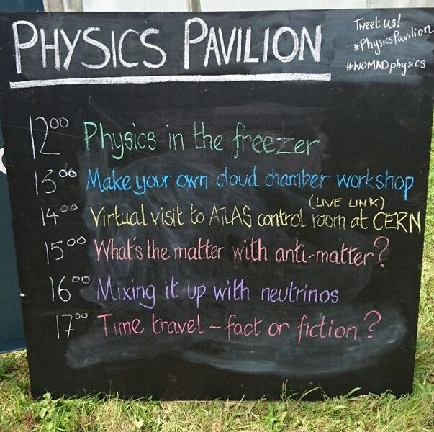
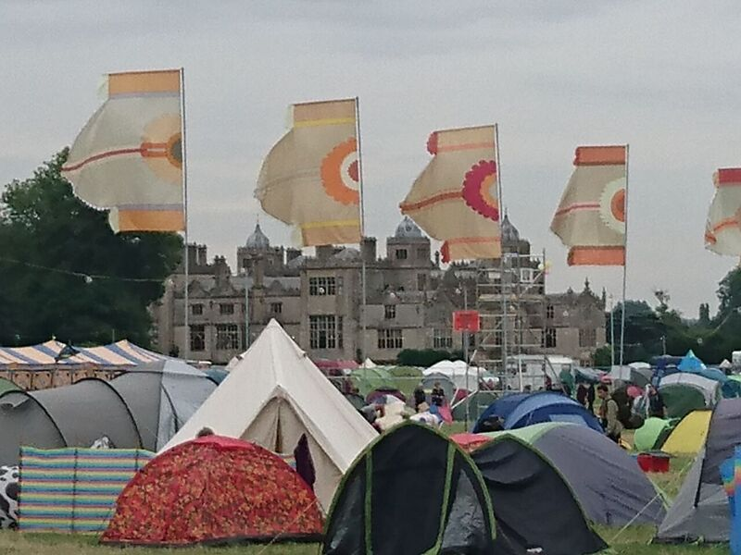
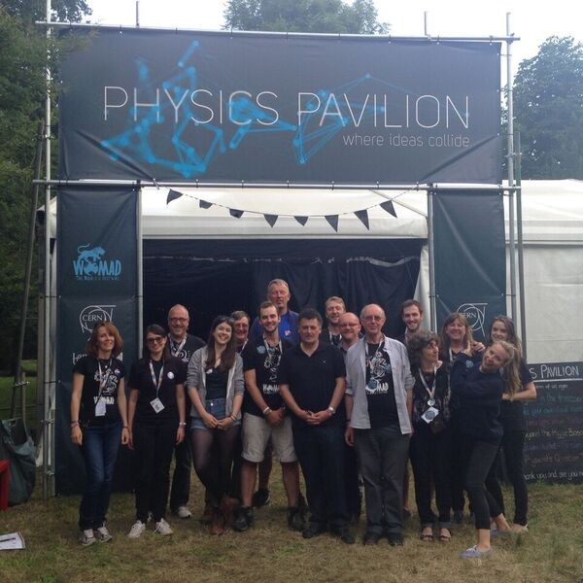
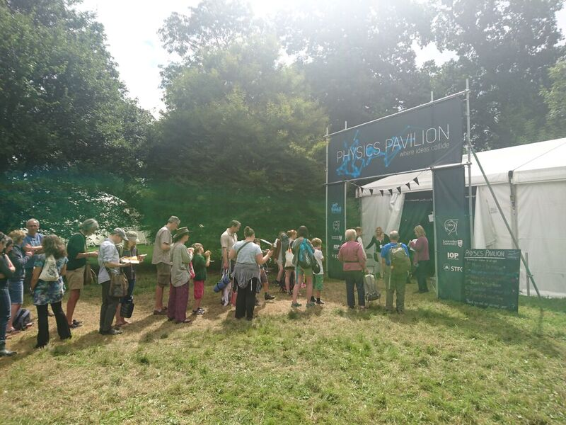

Slide 10
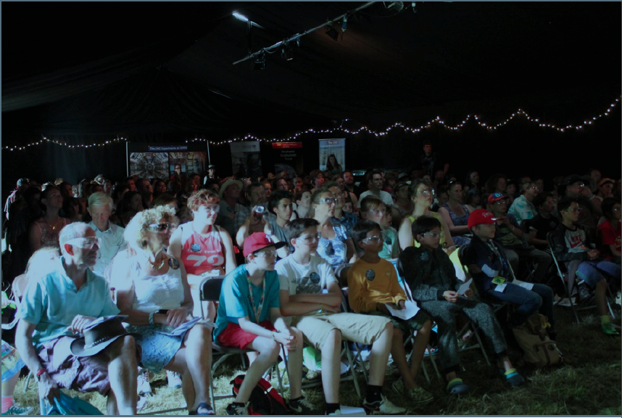

Slide 11
WOMAD 2017
Immediately after 2016 festival ended,
invited by WOMAD to return
two new additional spaces
One for workshops
One for drop-in physics demos
Also NEW
After the success of the first year,
we were approached by other groups to come join us
The Dyson Foundation

Slide 12
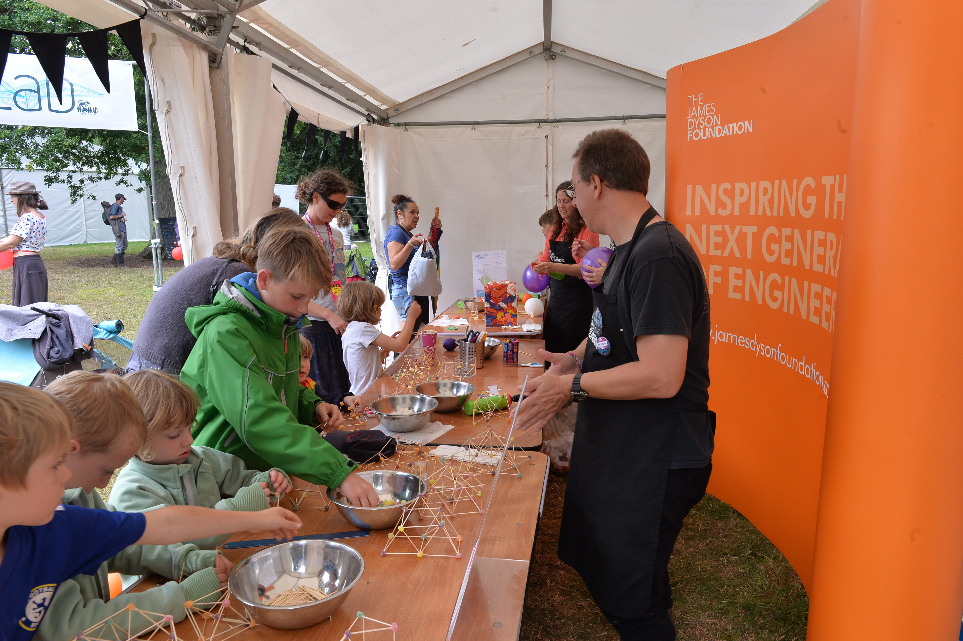
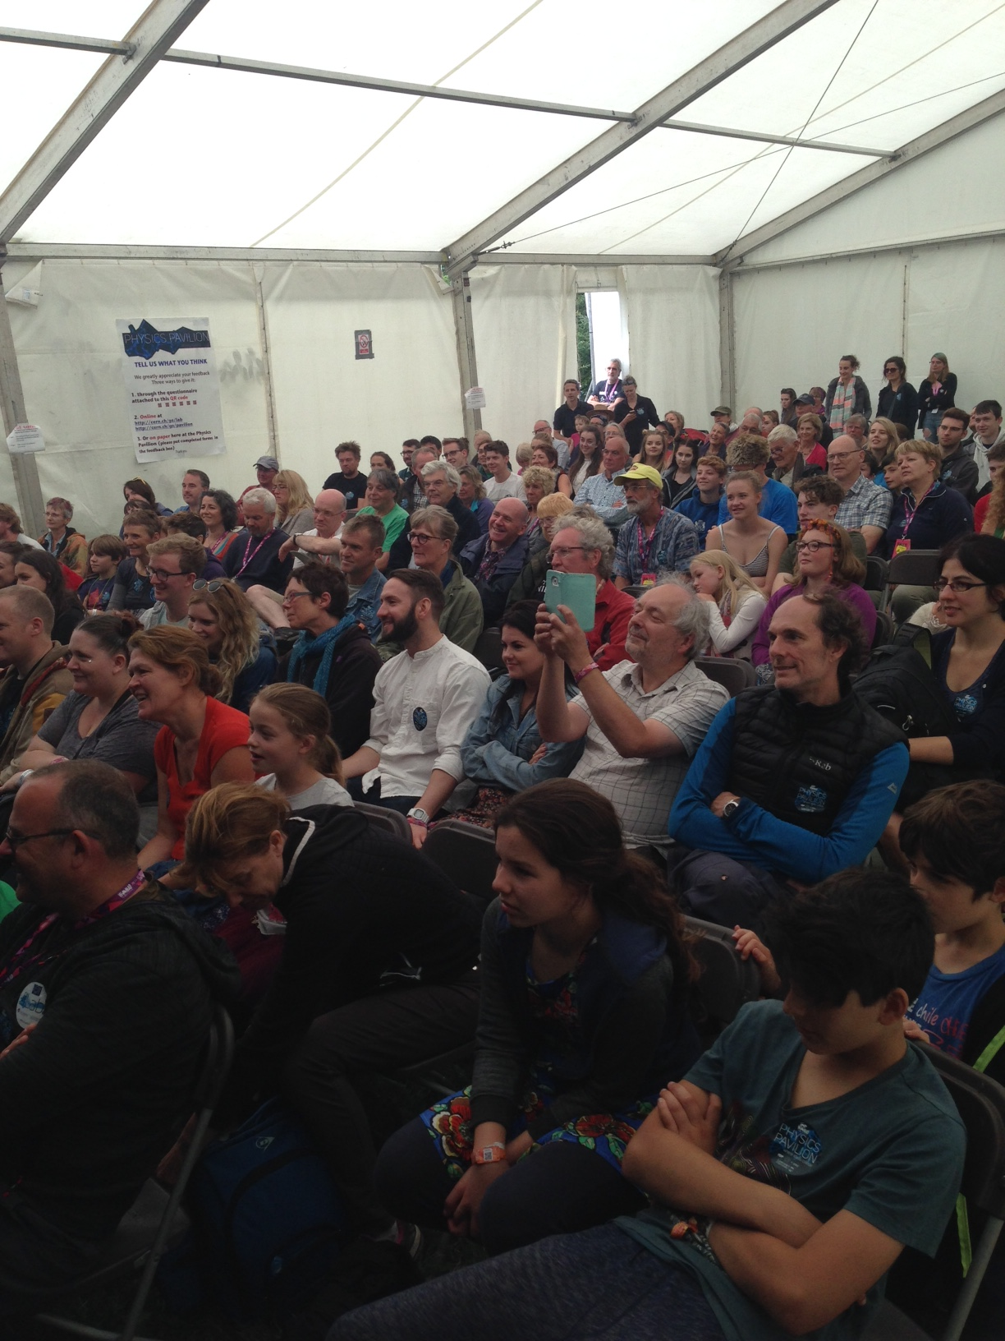
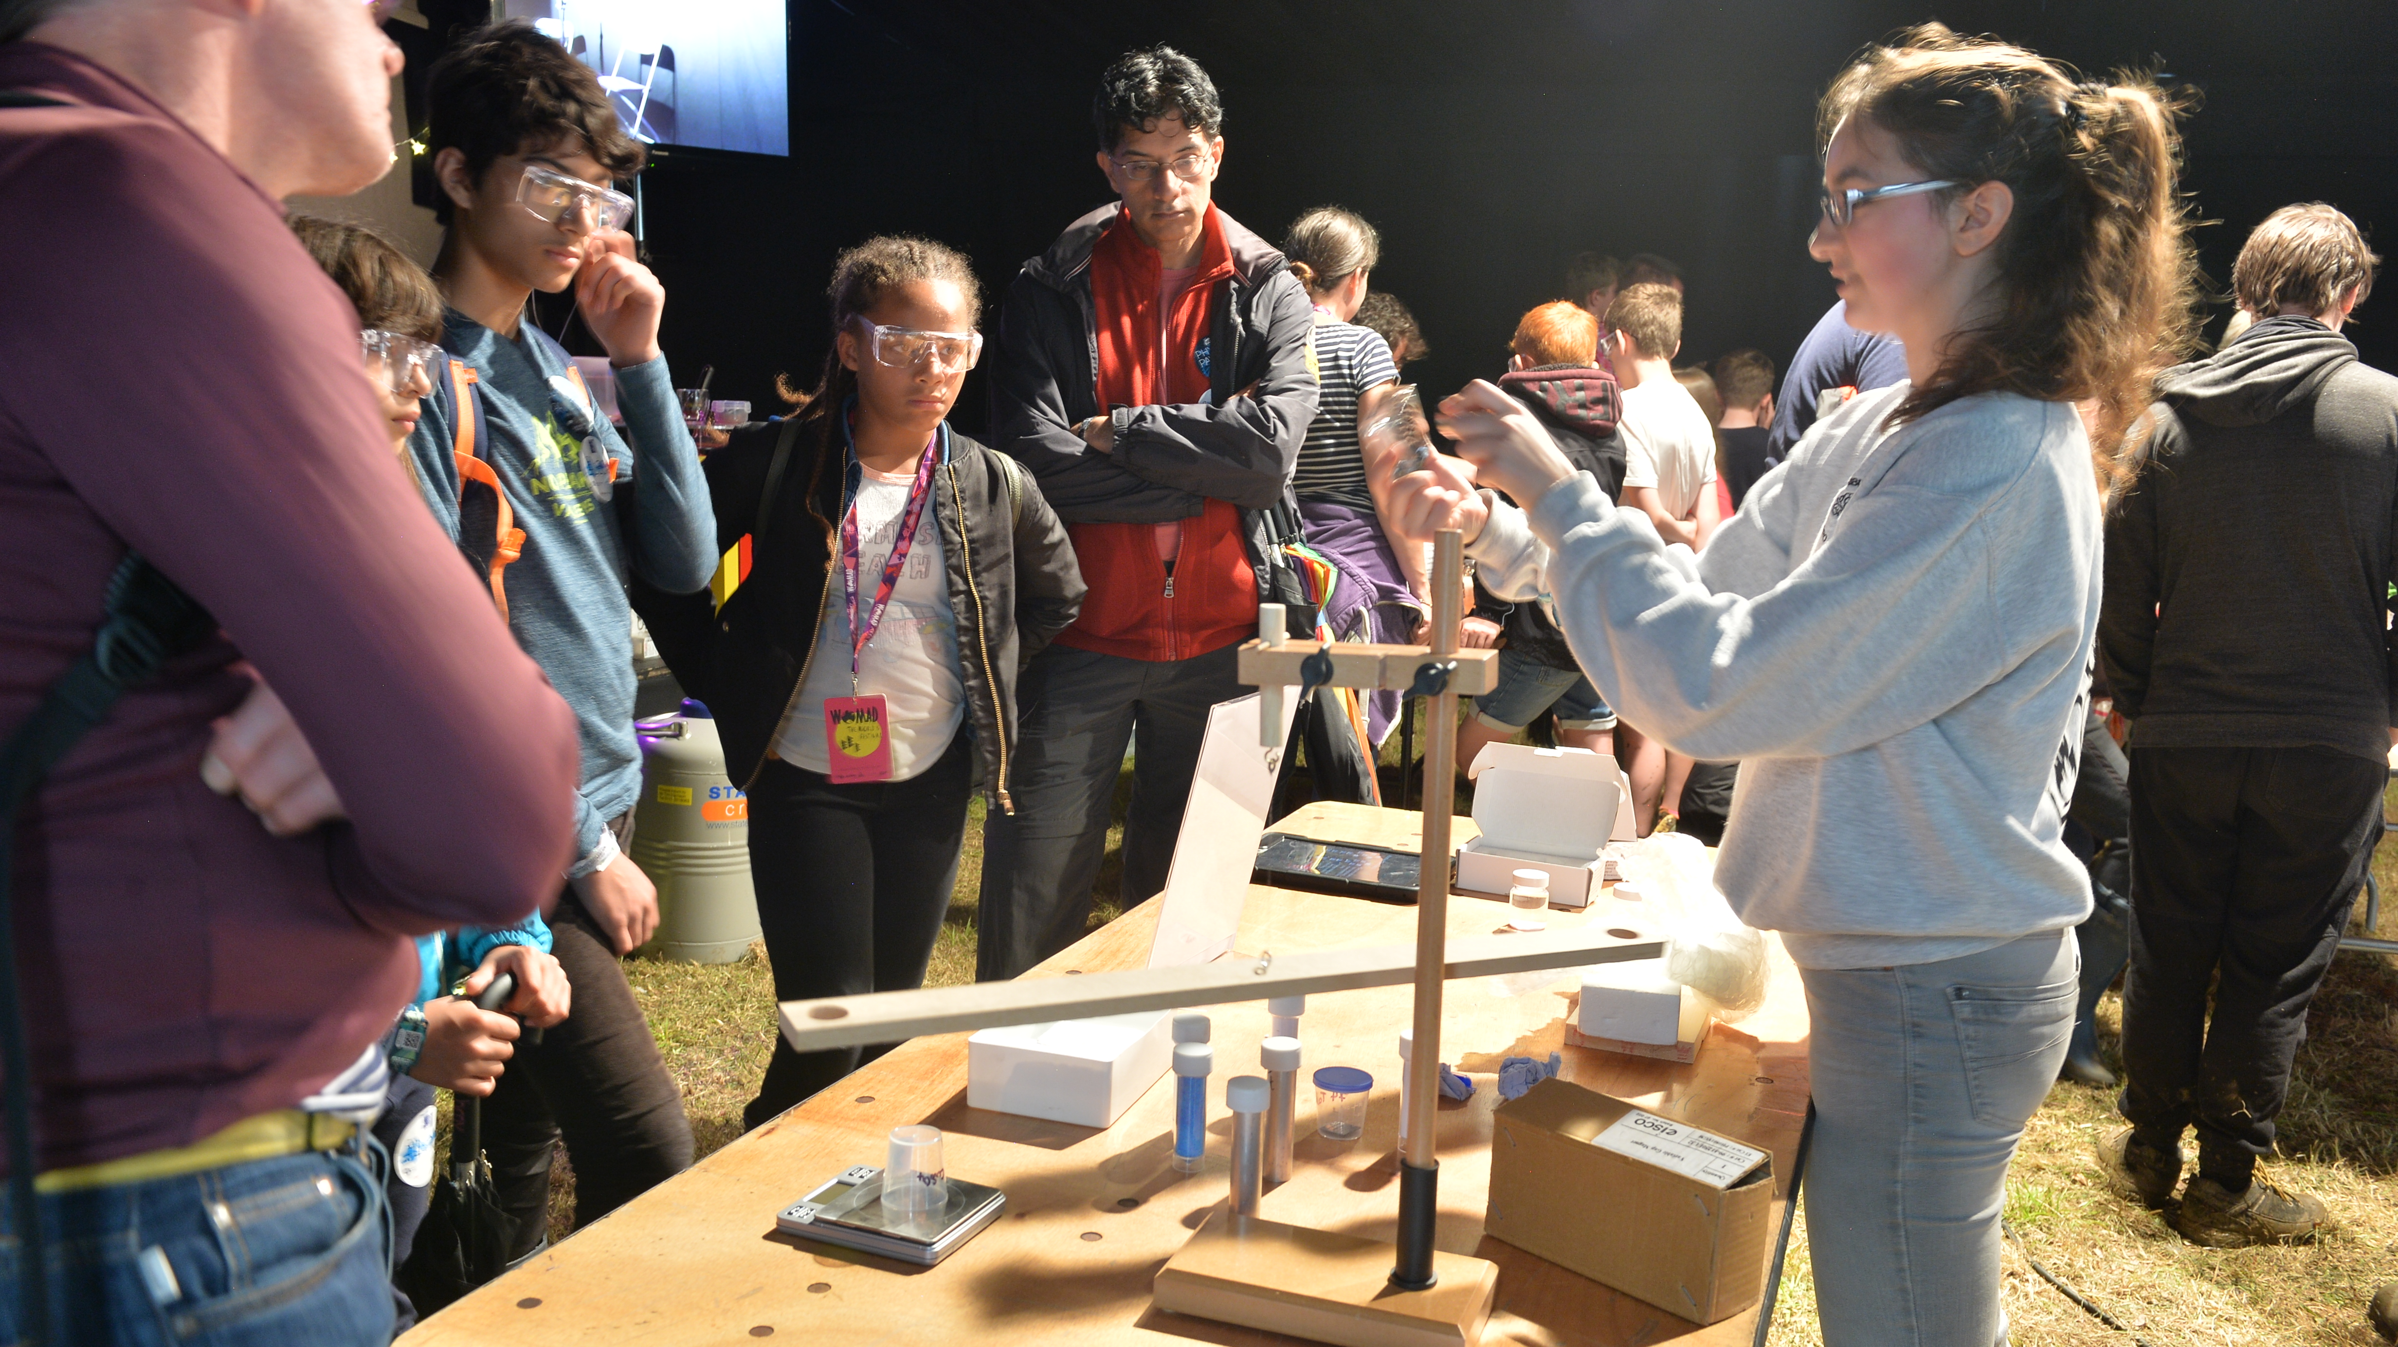
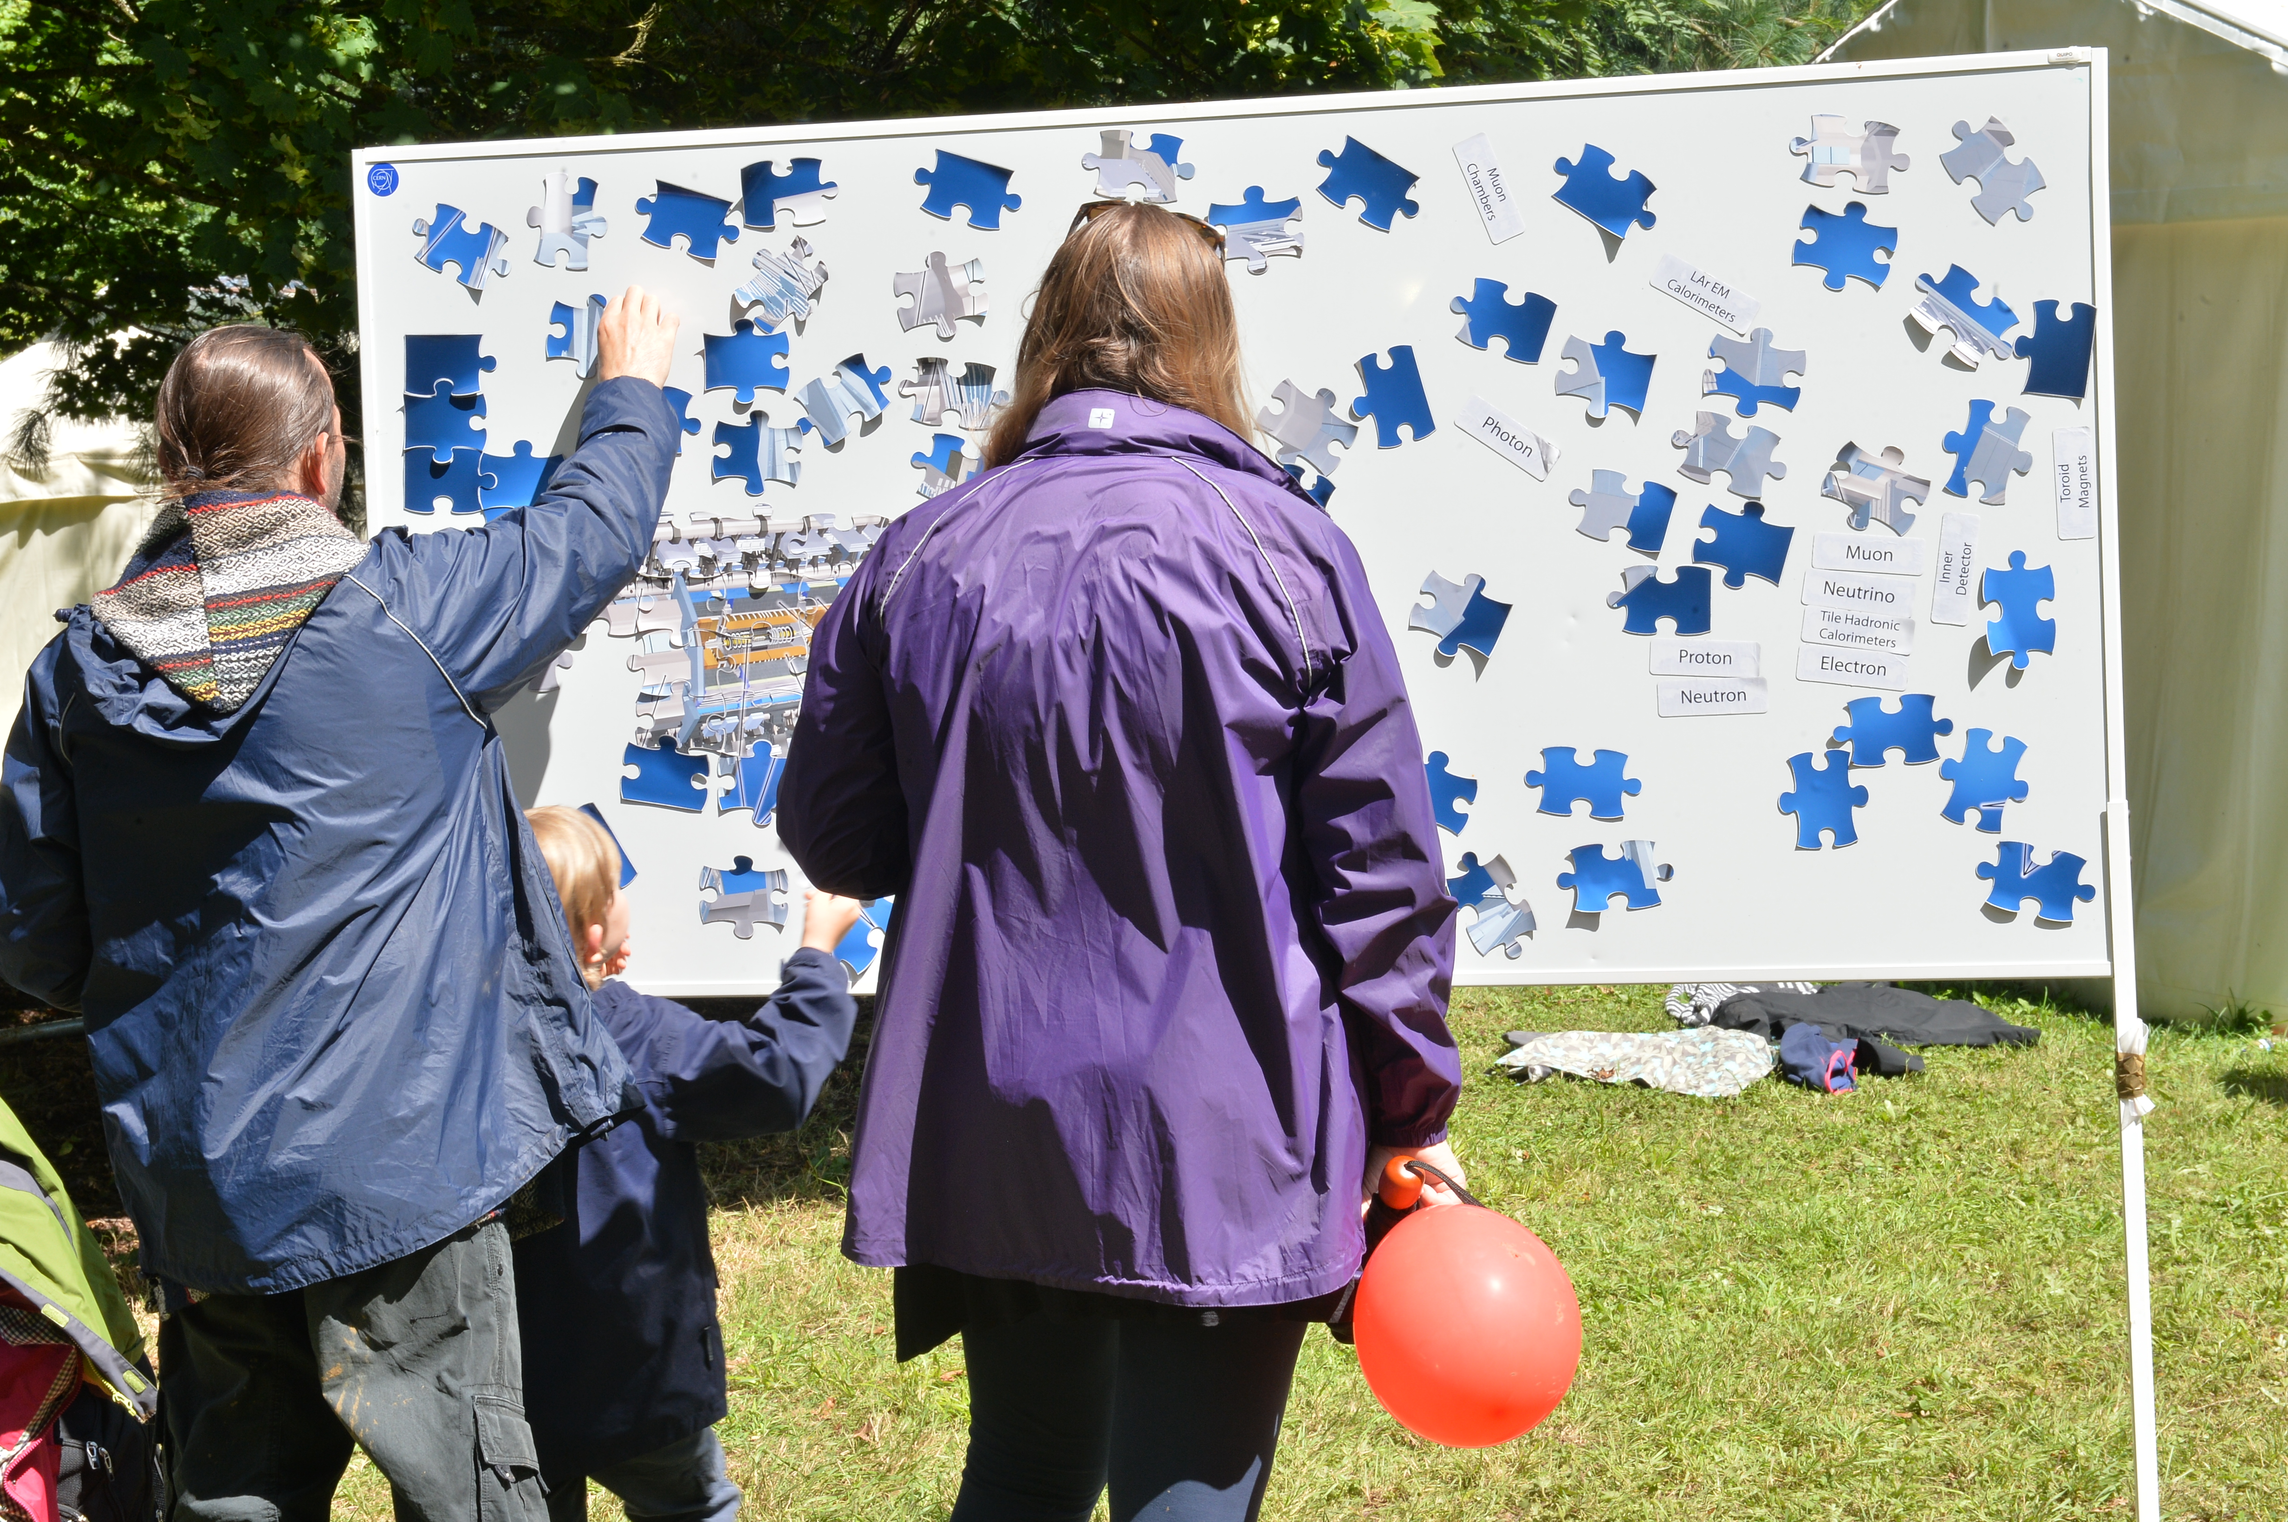
WOMAD2017
https://www.youtube.com/watch?v=nR7YHfKotbs = WOMAD2016 film

Slide 13
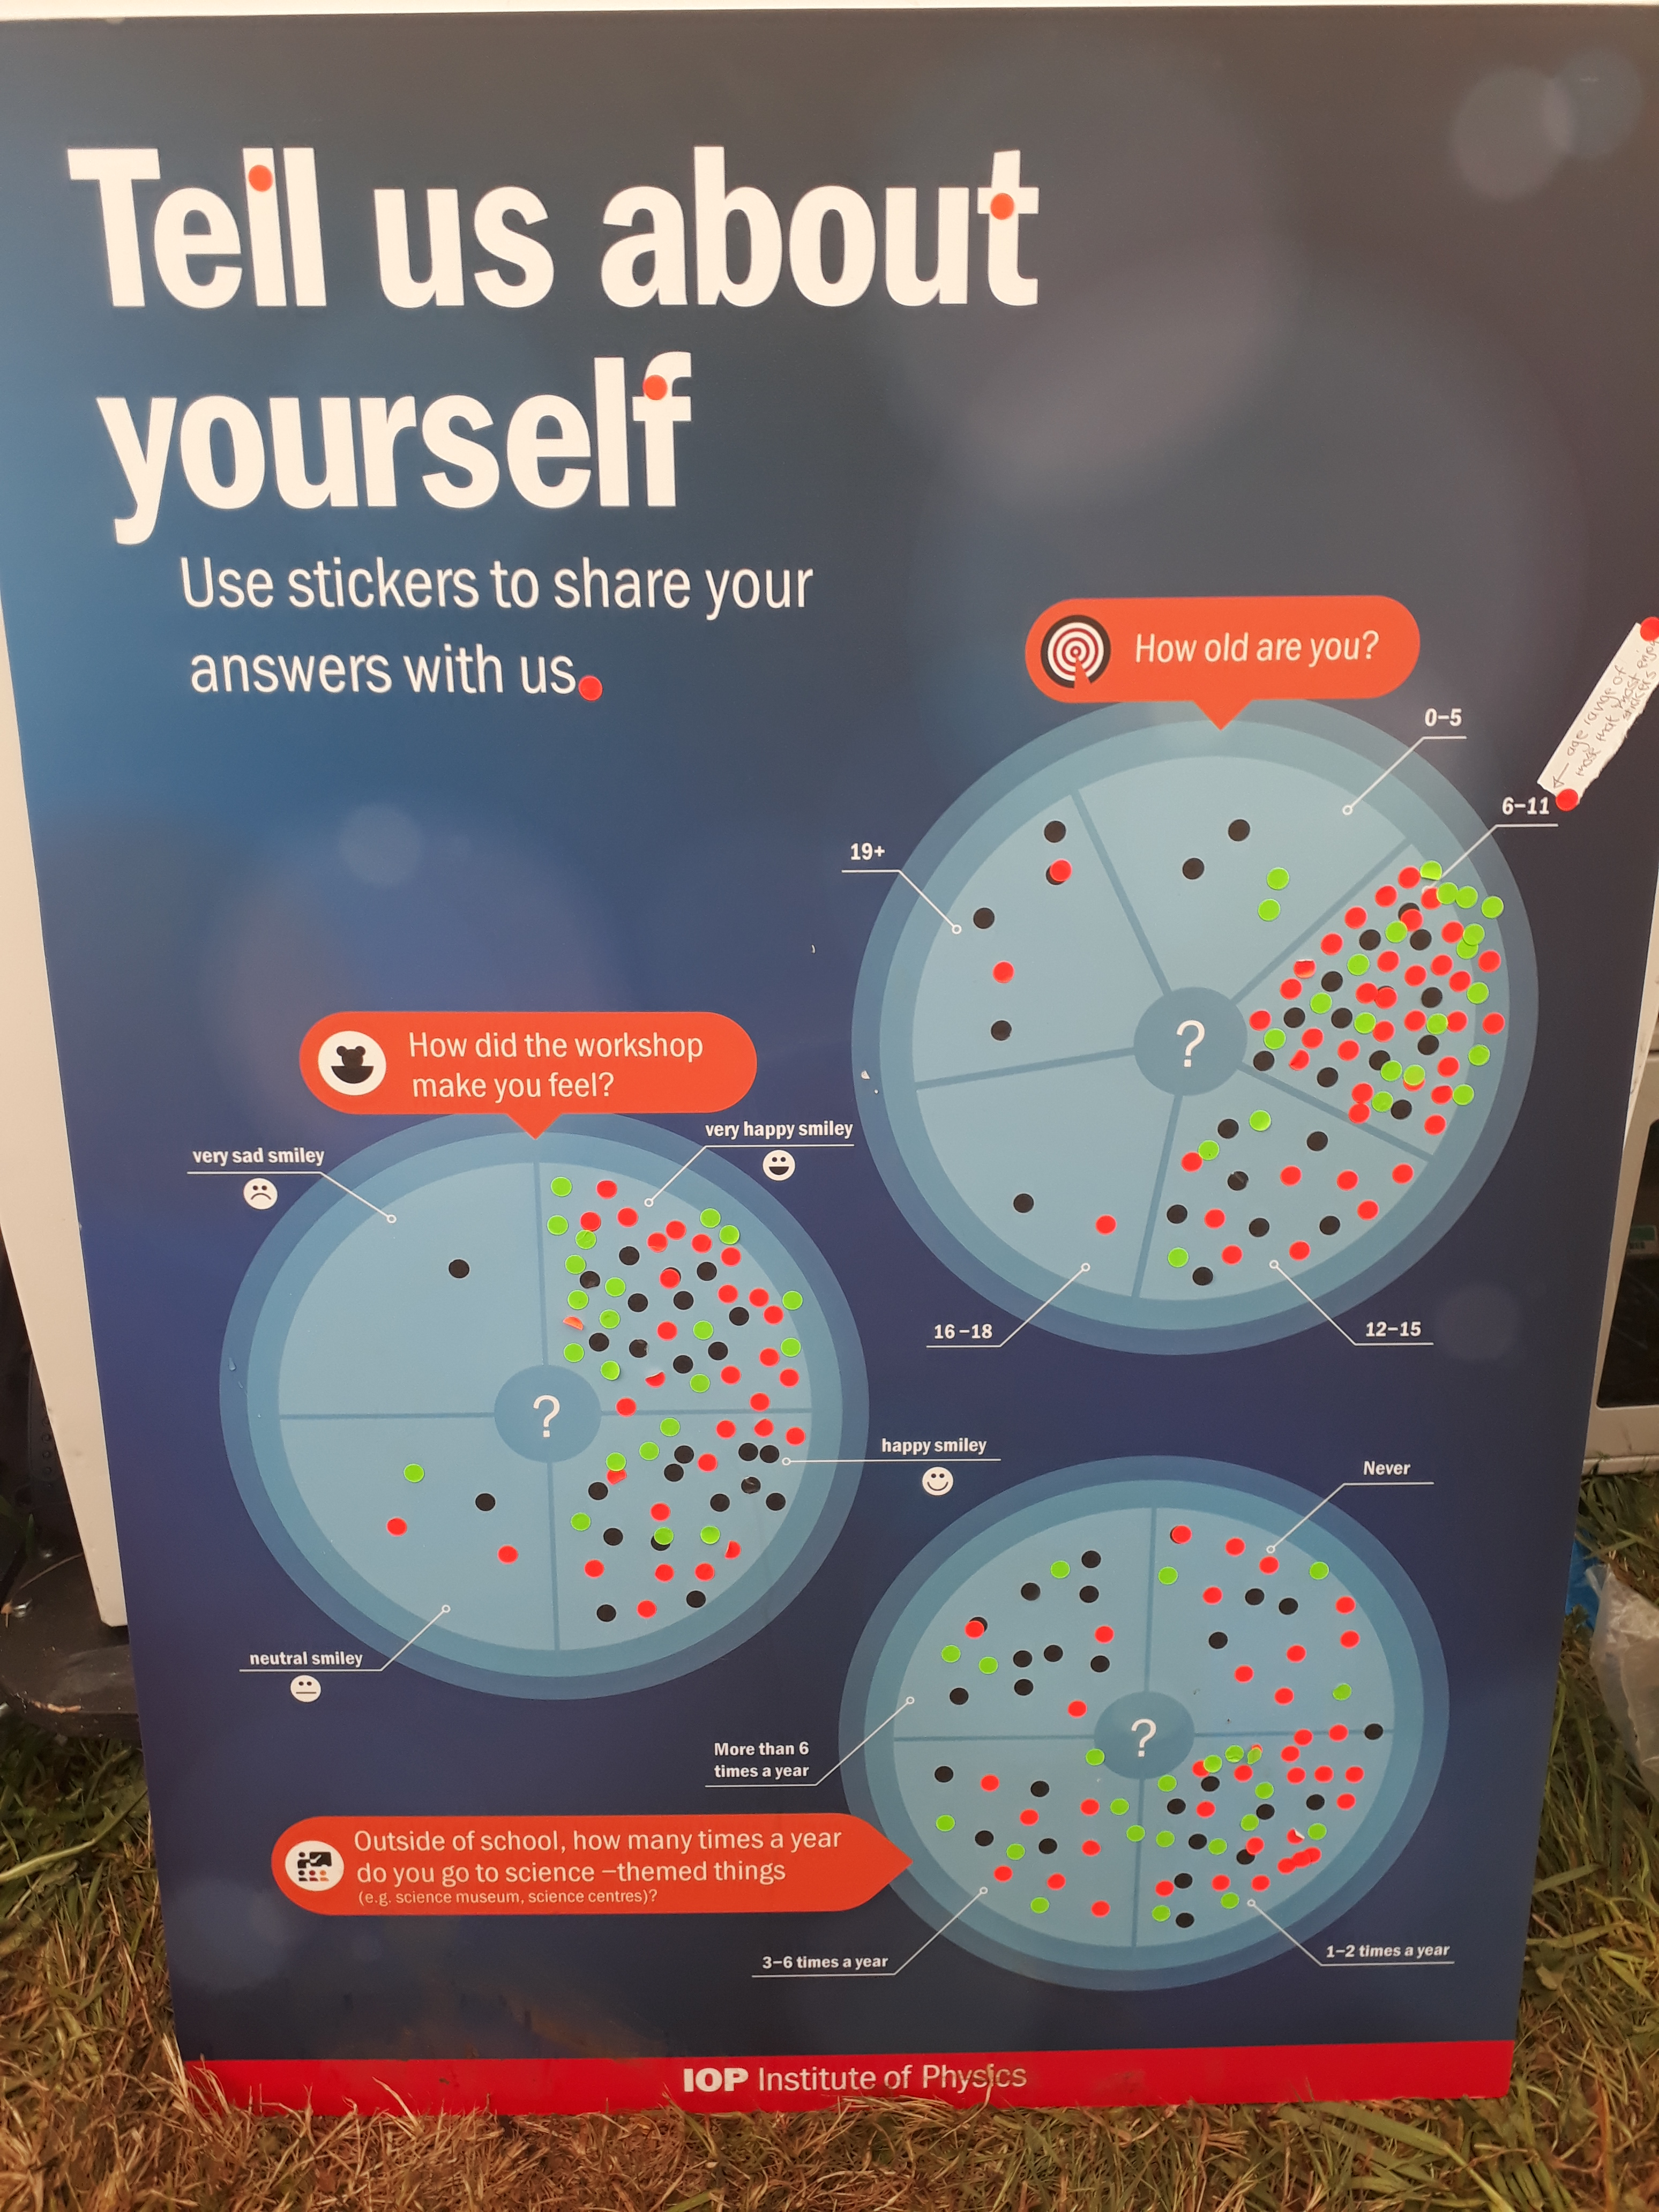
Amazingly successful
4500 people in 2016 !
5400 people in 2017 !
WOMAD2018
26 to 29 July

Slide 14
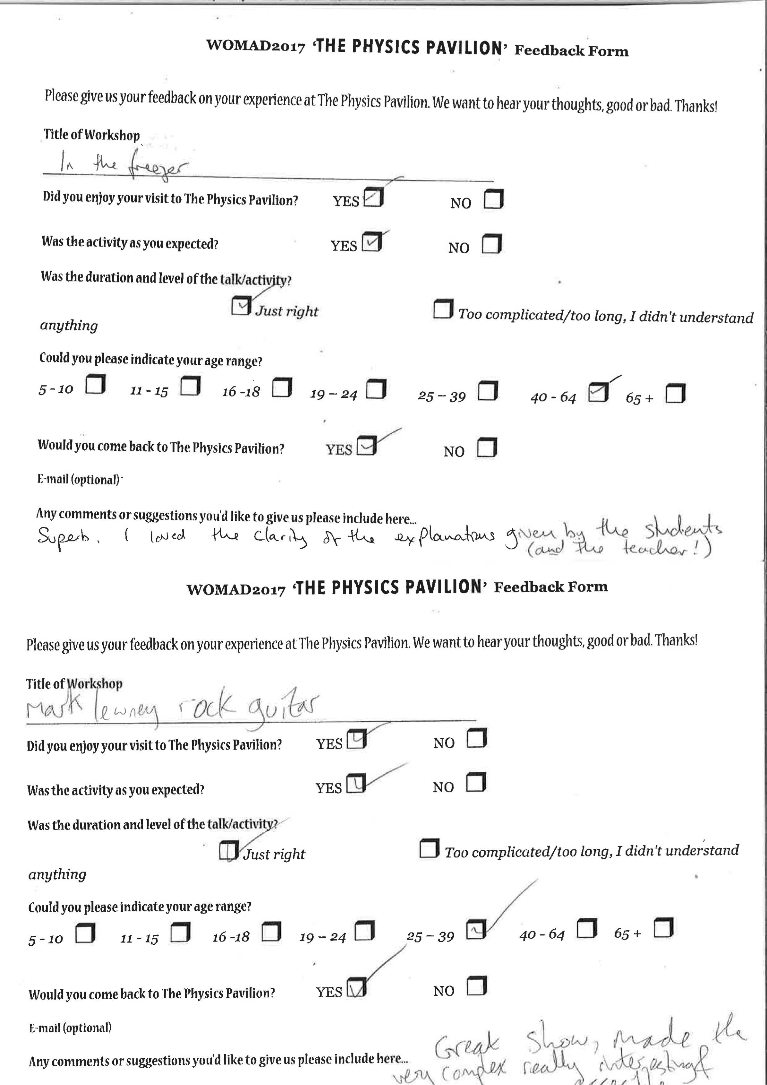
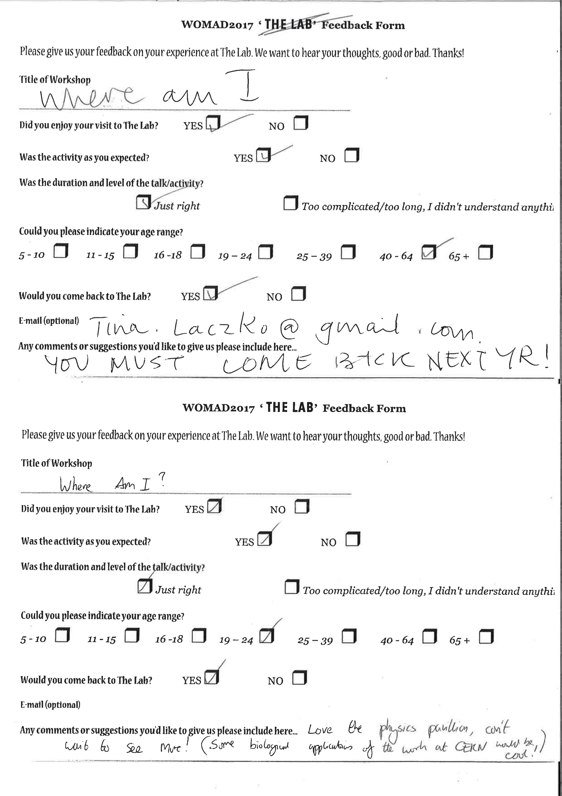
Fascinating feedback wide variety of ages
You must come back next year!
Superb. I loved the clarity of the explanations given by the school and the teacher
Loved the physics pavilion, can’t wait to see more! Some biological applications of the work at CERN would be cool!
Great show, made very complex really interesting and accessible

Slide 15
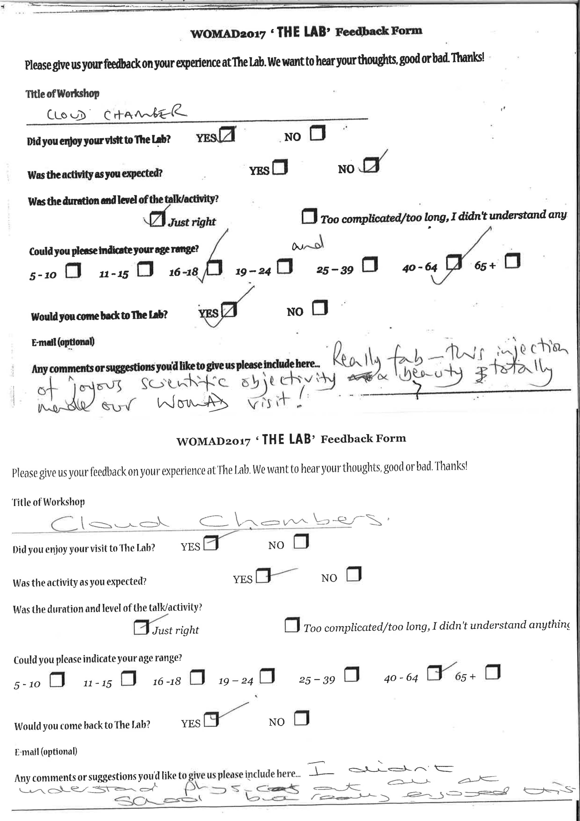
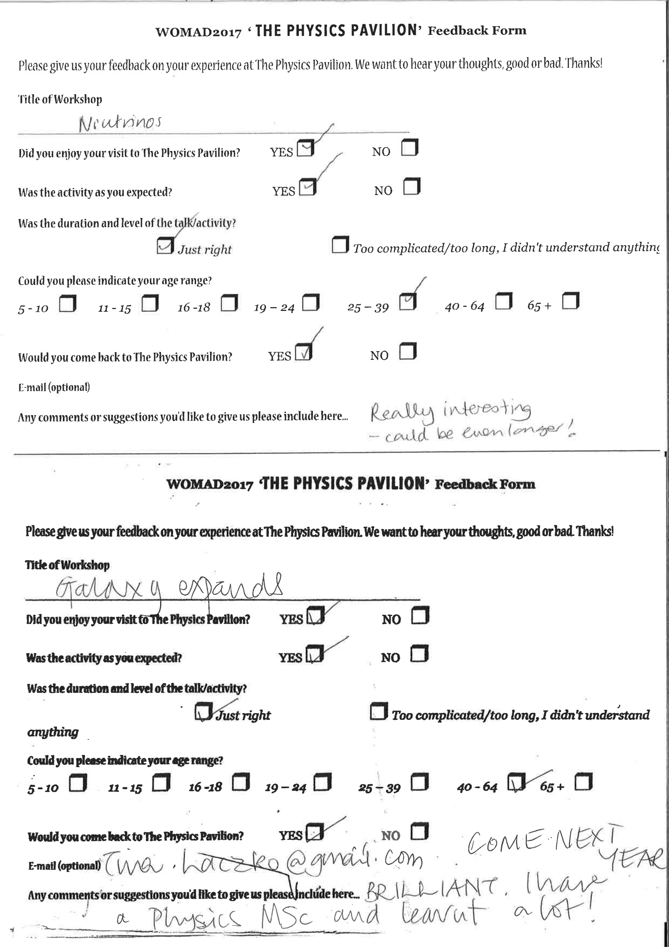
Fascinating feedback
Really interesting – could be even longer!
Really fab – this injection of joyous scientific objectivity and beauty totally made our WOMAD visit!
I didn’t understand physics at all at school but really enjoyed it
Brilliant. I have a Physics MSc and learnt a lot. COME NEXT YEAR

Slide 16
MOOGFEST 2017
North Carolina, United States
What is MOOGFEST?
Moogfest is the synthesis of music, art and technology.
Its Mission: Grow a global community of futurists who explore emerging sound technologies and design radical instruments for change.
Band that came for a “Special Visit” to CERN, with links to the Moogfest festival
asked if we’d be interested in having a presence there.
In collaboration with US ATLAS Outreach Coordinator Mark Kruse
we offered:
A key note talk by Kate Shaw, Steve Goldfarb and Mark Kruse
A public Masterclass
(I believe first time ever for a non-scientific audience)
A Virtual Visit to ATLAS
A Pub talk

Slide 17
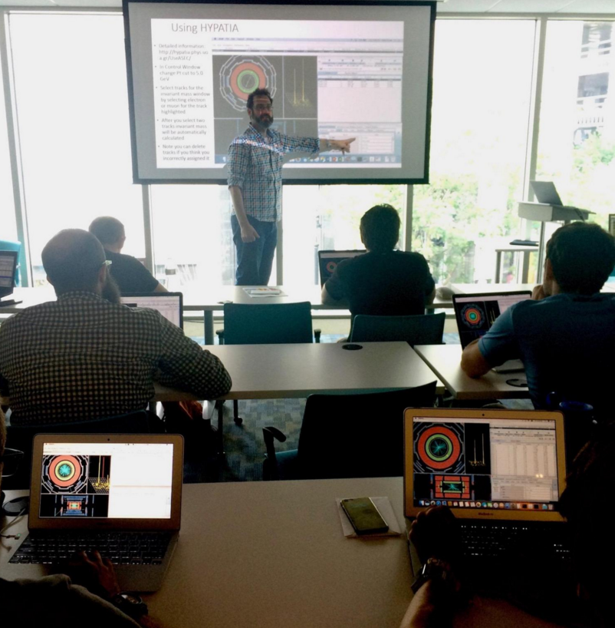
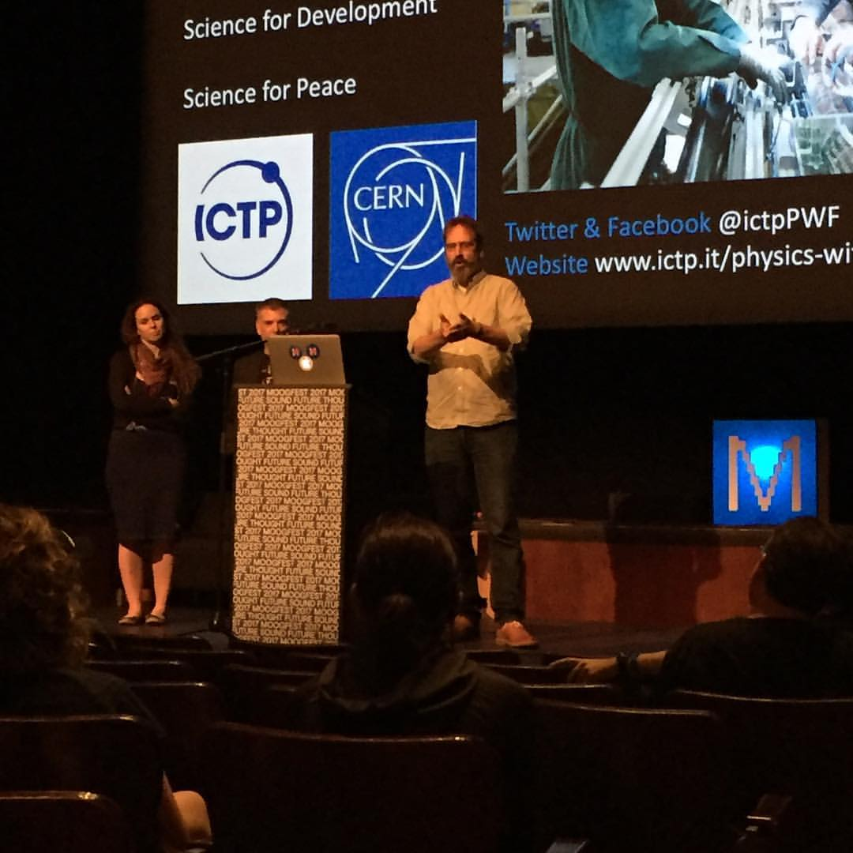
First-ever public Masterclass @
MOOGFEST2017
Keynote talk @
MOOGFEST2017

Slide 18
MOOGFEST 2017
Great success
Masterclass was heavily oversubscribed (hundreds)
Keynote talk went way over scheduled end time because of non-stop questions from a tremendously curious audience
Pub talk and virtual visits very popular and Mark asked many times since to give more in other towns
So successful asked to return in 2018

Slide 19
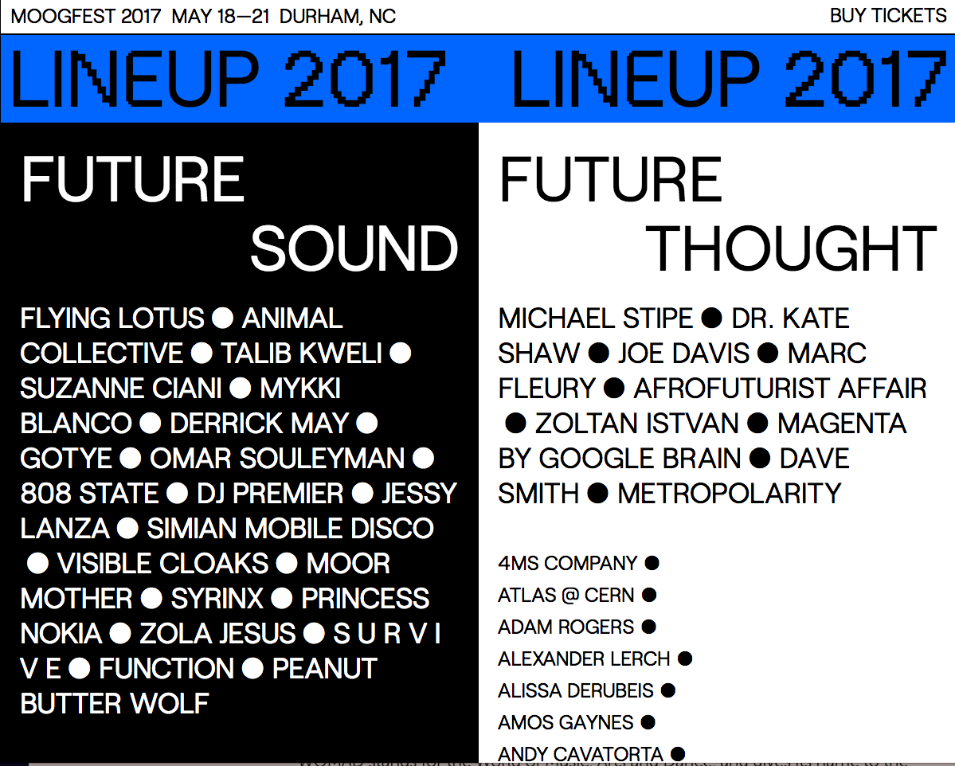
MOOGFest 2017 film https://www.youtube.com/watch?v=nIYC4yfDqk0&list=PL5G8dePRoap13IaiM6lHhgKUCt5pT3F0Y&index=3

Slide 20

This is a COLLABORATION between
CERN and/or the CERN experiments,
local Institute Teams, national Physics outreach bodies
&
the Festivals
This allows all partners to minimize their costs and at
the same time build and strengthen relationships between
CERN/Experiments and outreach teams of
Member / non-Member States
These environments can be re-created almost anywhere
Many countries have huge music and/or arts festivals

Slide 21
What does this offer us?
A different way of communicating and experiencing science, and the chance for scientists to take their experience, knowledge and passion to a completely new environment
Taking science to where the people are
Offers an opportunity to engage with people who are normally indifferent to
science by ‘popping up in the last place they expect to find it’

Slide 22

In the words of a legendary adventurer, our goal can be summarised by
To explore strange new worlds...
To seek out new life; new civilisations...
To boldly go where no one has gone before

