Slide 1
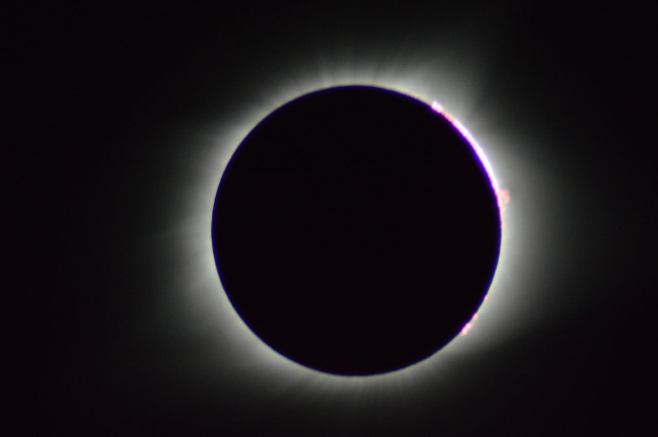

Special Cosmic Ray Projects
Solar Eclipse Project
Cosmics at Fermilab’s 50th Open House
An Inspiring Story

Slide 2
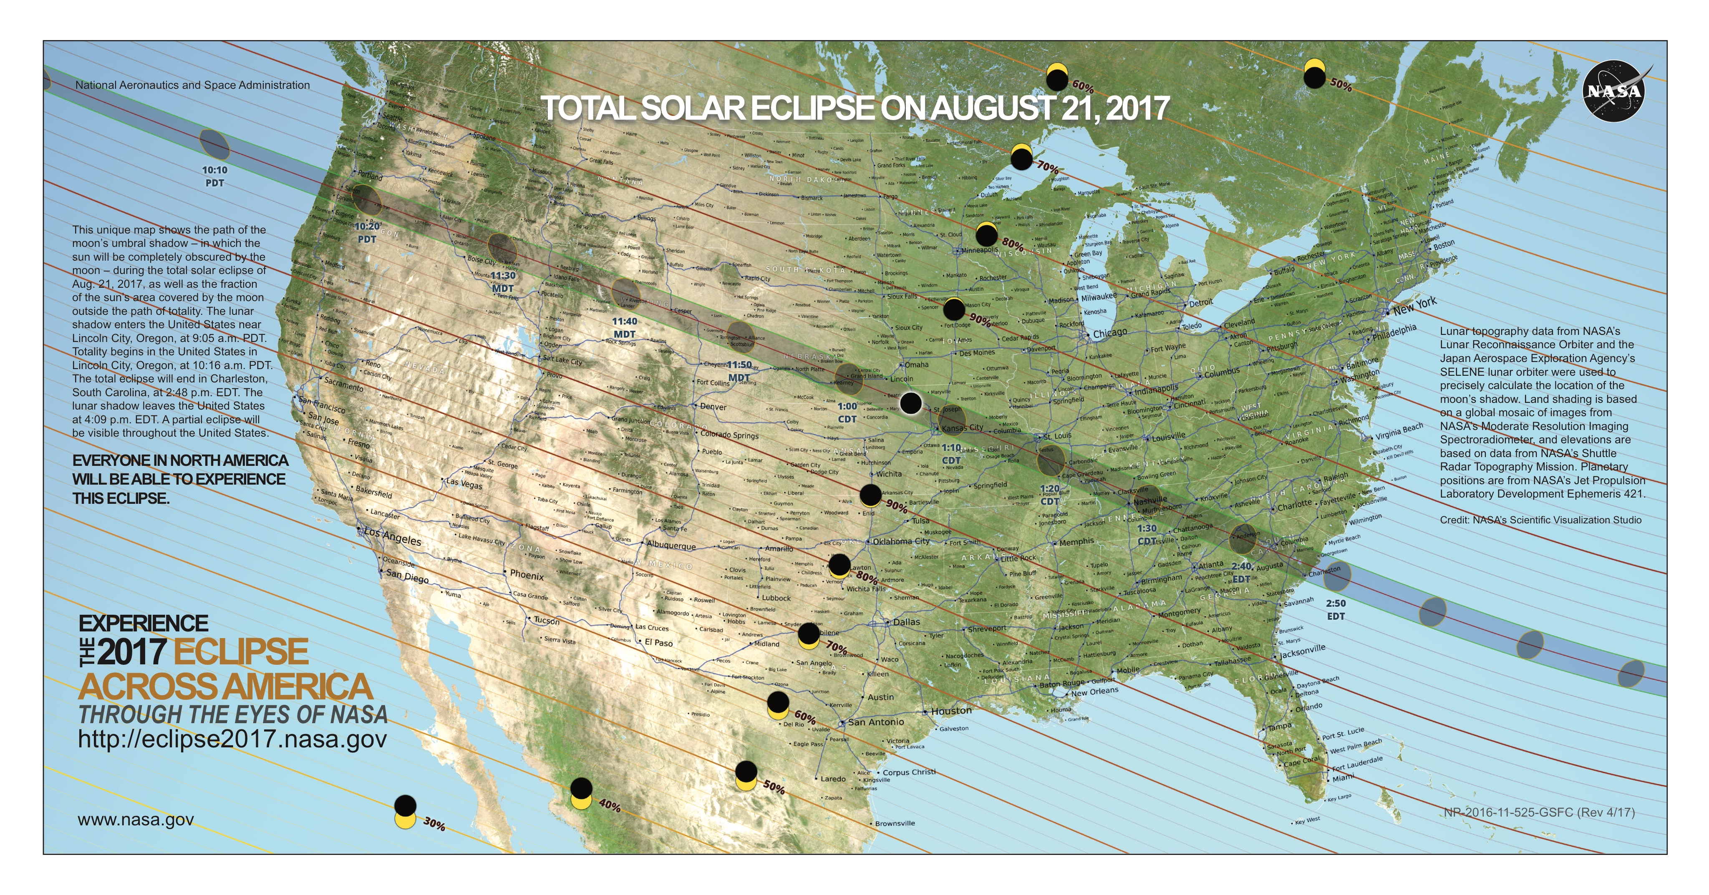
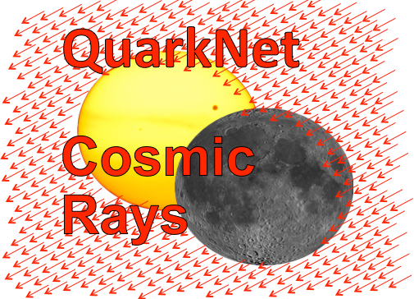
Eclipse Path and
Telescope Locations

Slide 3
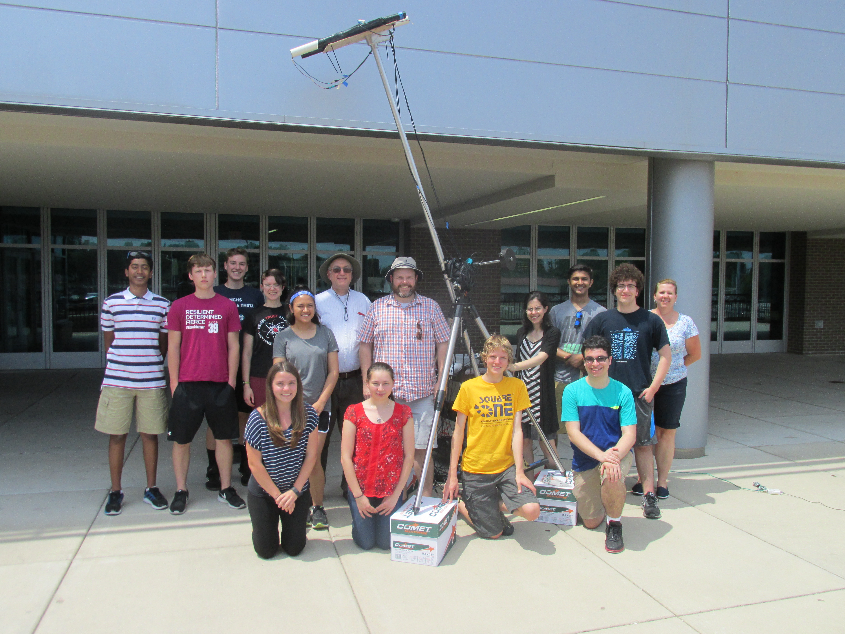
Solar Eclipse Goals
Measure cosmic ray rates near the sun during the August 21st solar eclipse. Never done before!
Compare eclipse muon rates to rates for an empty sky, moon only and sun only.
Show sun is not a major source of cosmic rays.
Search for global changes in muon rates.
Over 45 groups participate.
Build telescope from QuarkNet cosmic ray detectors

Slide 4
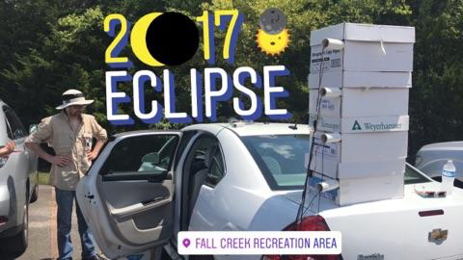
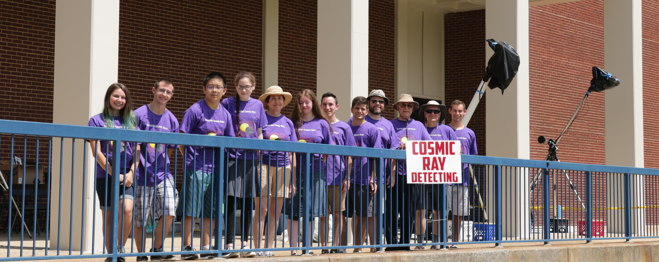
Eclipse Project Stats
Solar Cosmic Ray experiment was an idea from teachers.
Muons at surface never measured before during eclipse.
Designed and prototyped by students.
Data from 55 detectors
48 QuarkNet centers
4 tracking telescopes
Over 20 fixed angle telescopes
Remaining detectors were vertically stacked.
Missouri
Mississippi

Slide 5
Timeline
Feb. - Idea originated with a teacher at an APS conference. Brand new research question! No previous publications on surface muons during an eclipse exist!
Feb.-Aug. - 6 months to design experiment & assemble collaboration of teachers & students
Spring – Teachers & students design measurement goals & techniques.
Invite QuarkNet participants.
Create website to host instructions, logbook, collaborator comments.
Summer - Assemble prototypes during workshops.
Aug. 21 - ECLIPSE
Sept.-Dec. – Analyze independent site results; combine results.
Jan. 2018 - Announce results.

Slide 6
Central Logbook
Communication Required!
Eclipse Website:
Goals
Instructions
Collaborator information
Eclipse maps & info
Analysis tools & examples
Logbook for datasets
https://sites.google.com/view/quarknet2017eclipse/

Slide 7
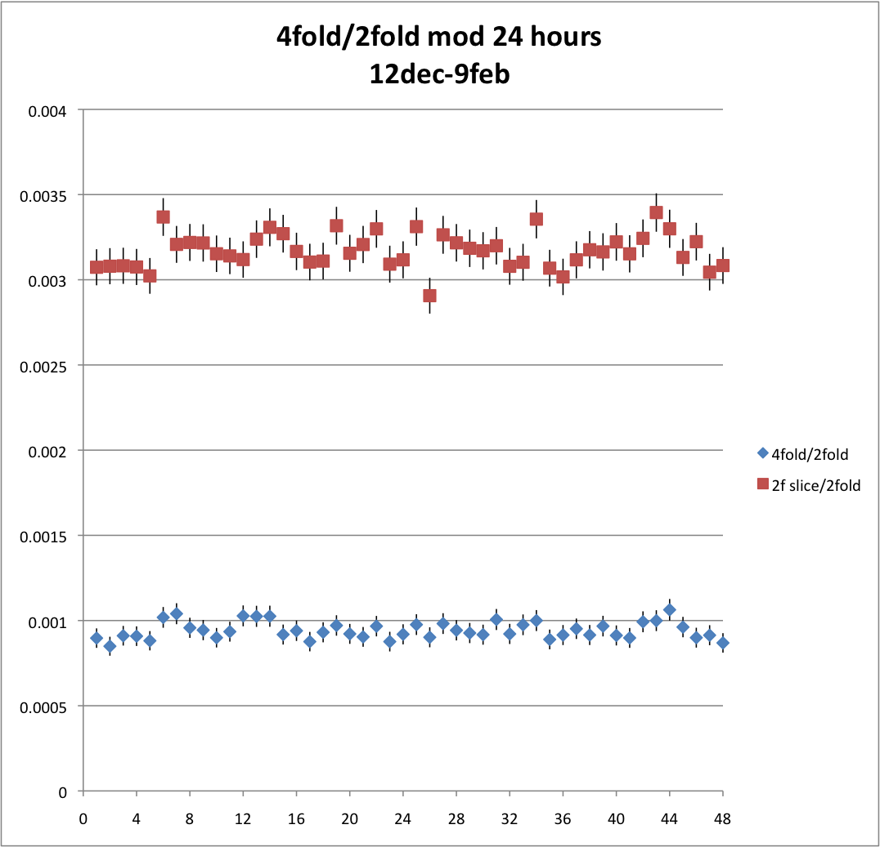
Design and Prototypes
Build on ICD, IMW & previous
attempts to measure muon
shadow caused by sun.
Muons in direction of sun vs. 30-minute bins, 30 days overlapped (2016)
Will any effect be 0.5 degrees (moon size) or wider due to earth’s magnetic field?
All high school groups can contribute: use existing detectors & design telescope frames.
Three telescope designs: tracking to follow sun; fixed angle to let sun move across acceptance; normal stack
Telescope frame: cheap; light; parts available at local hardware stores; support with telescope mount
Students improved design with three stages of prototype.
Loss around noon?

Slide 8
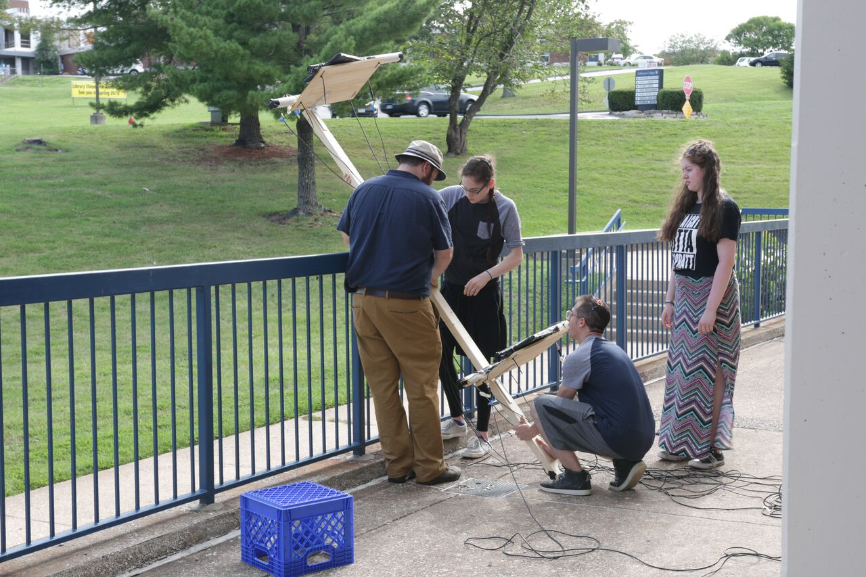
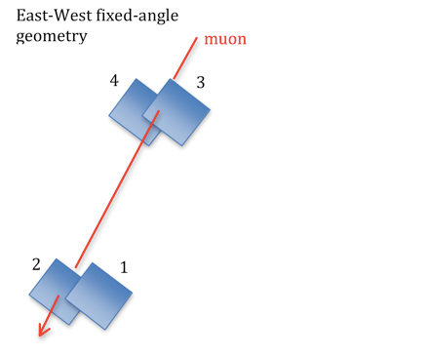
Student-designed Prototypes
Design Challenges:
Muon rates vs. pointing resolution
Overlap of counter pairs
Separation of counters
Normalization with pairs
Constructed telescope
frames for Tracking &
Fixed Telescopes.
Measured muon rates to identify optimum separation.
(10 feet for tracking; 6 feet for fixed telescopes)
muon not from sun

Slide 9
Tracking Telescope
Using a shadow of a target on the frame, adjust the the telescope to follow the position of the sun. Monitor the region around the sun continuously.
Muons traversing all 4 counters come from the blue region.
Muons traversing one counter from each end come from the gray region.
Compare muon rates during eclipse above
to rates under conditions below.
Empty Sky
Sun only in Sky
Moon only in Sky

Slide 10
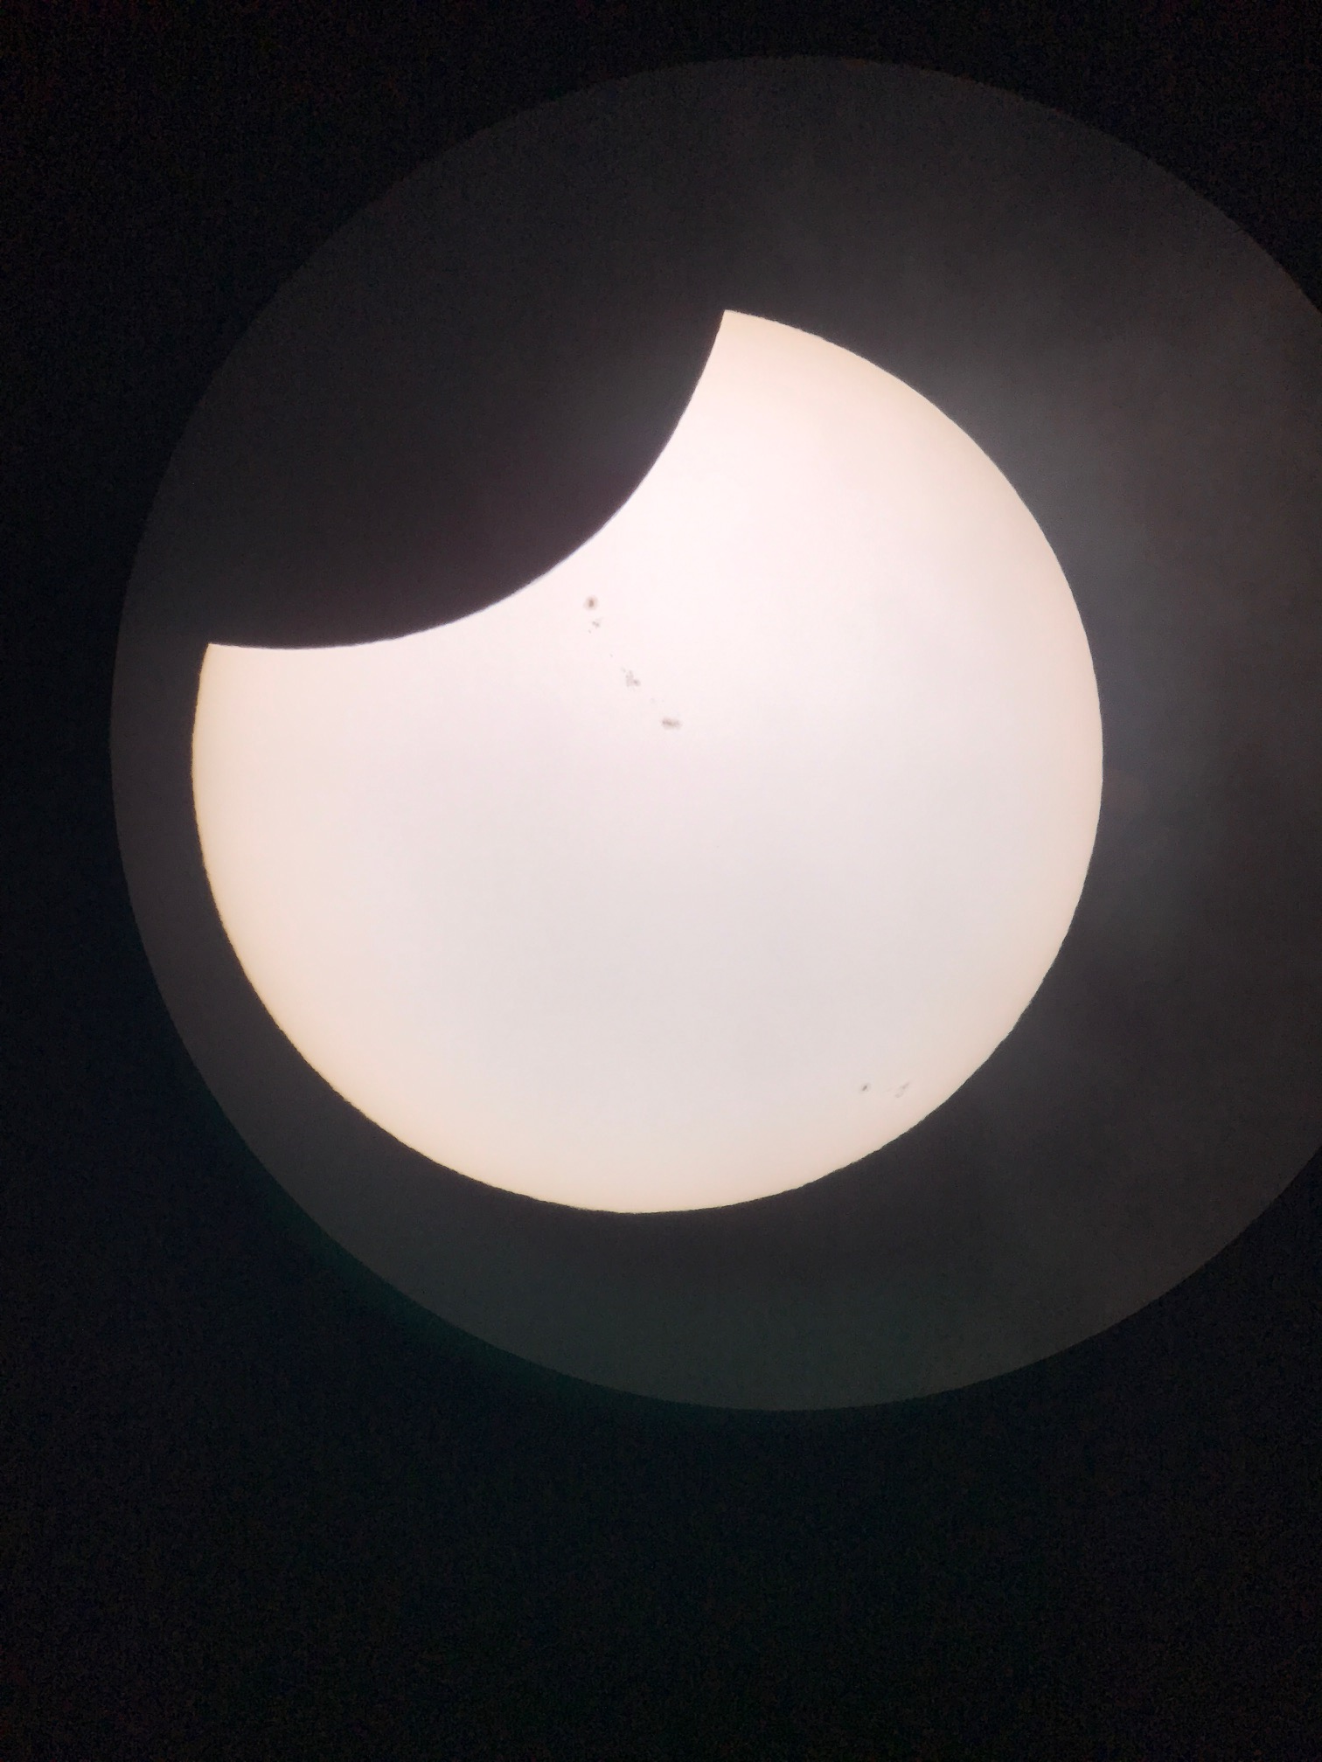
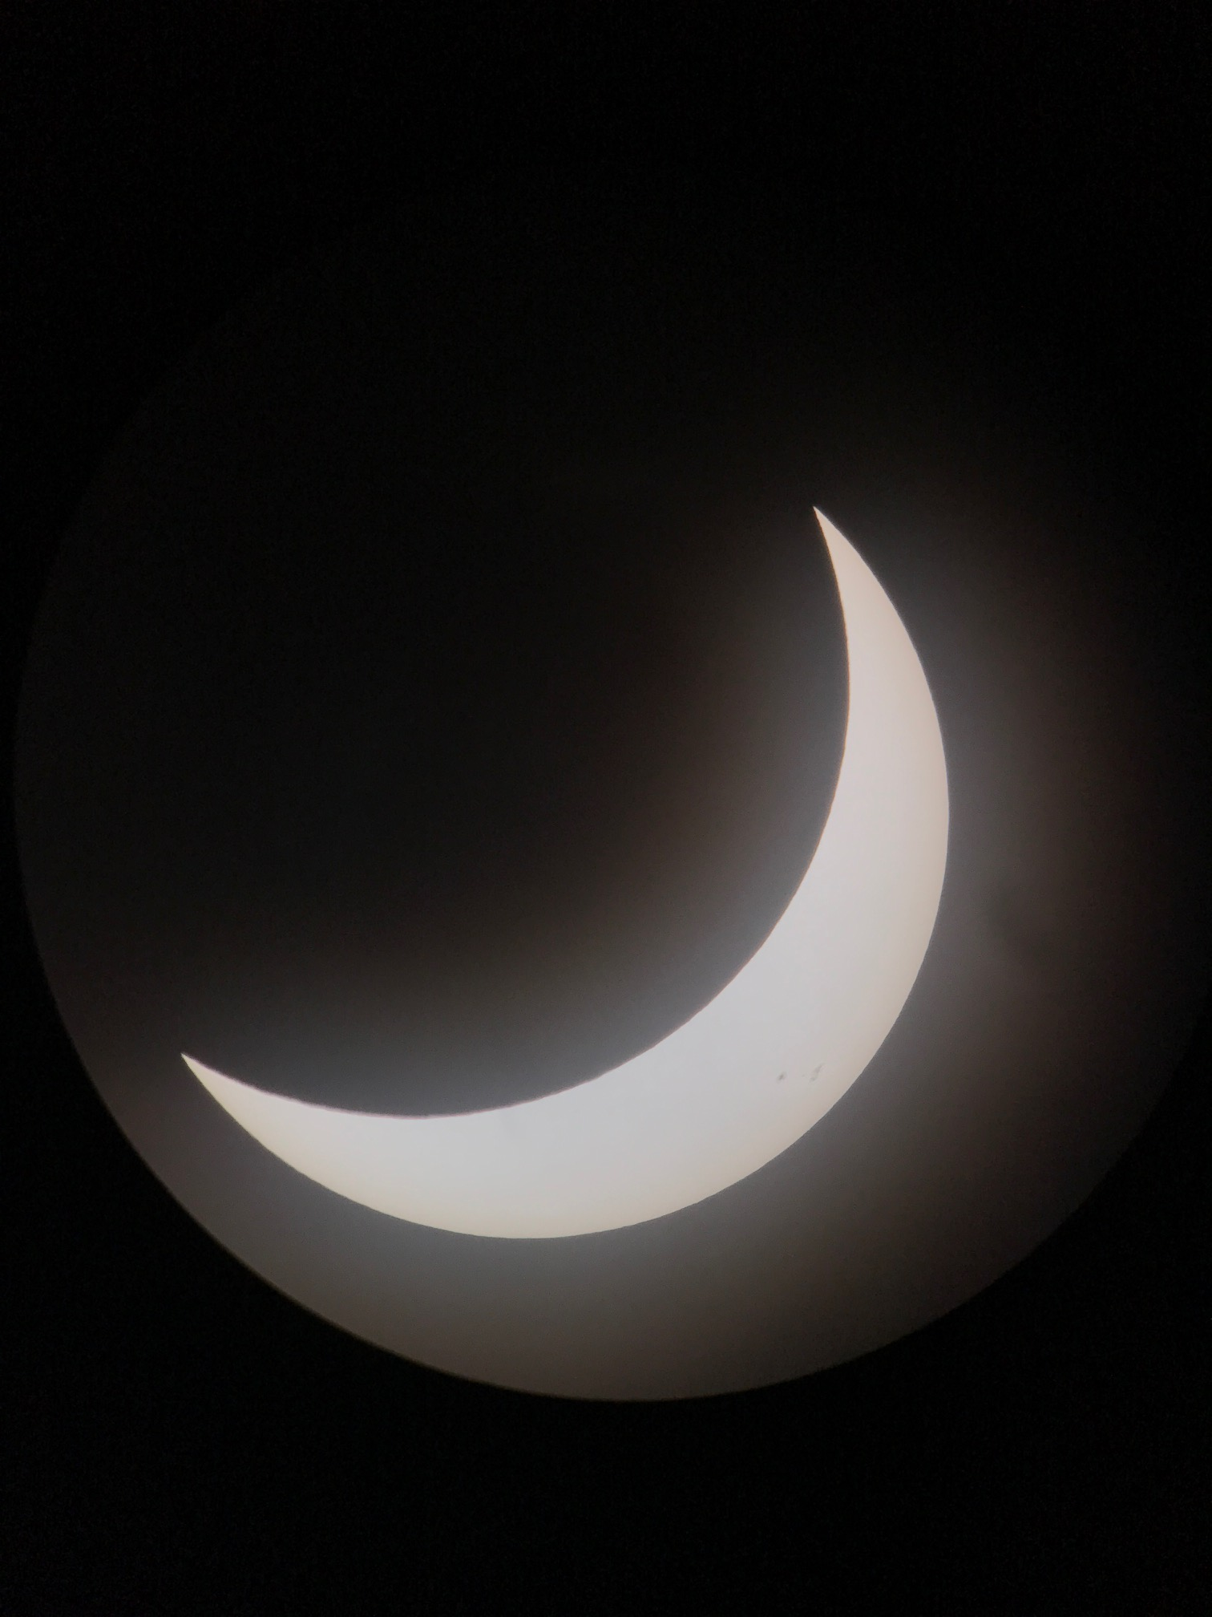
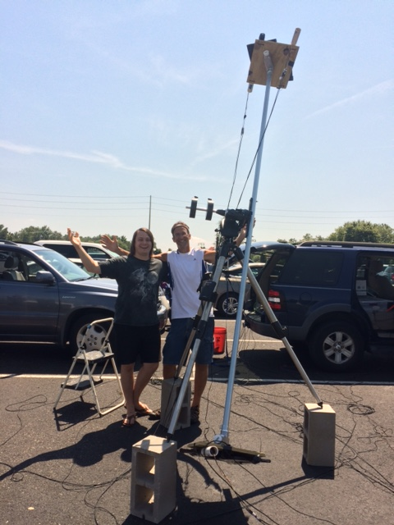
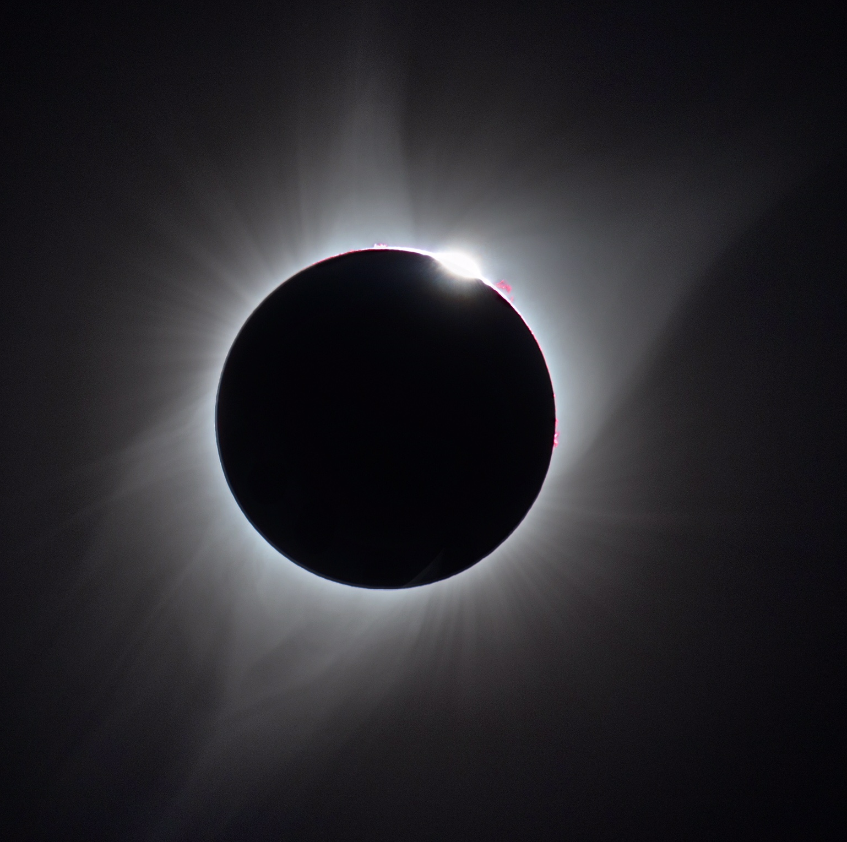
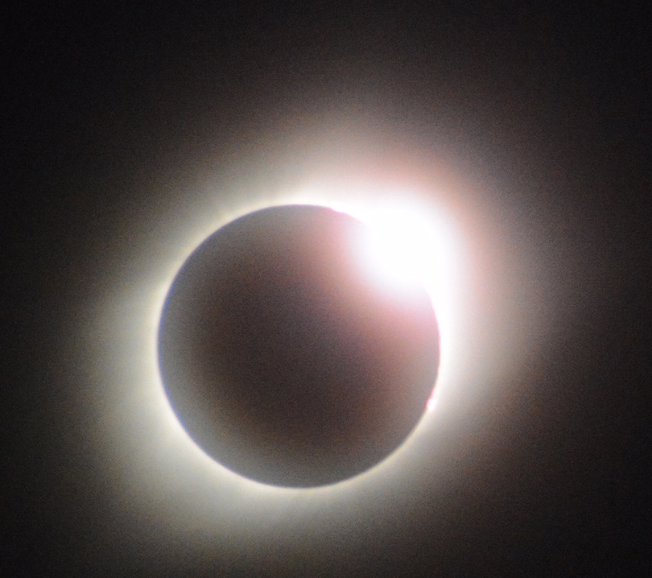
Tracking Telescope
Ohio

Slide 11
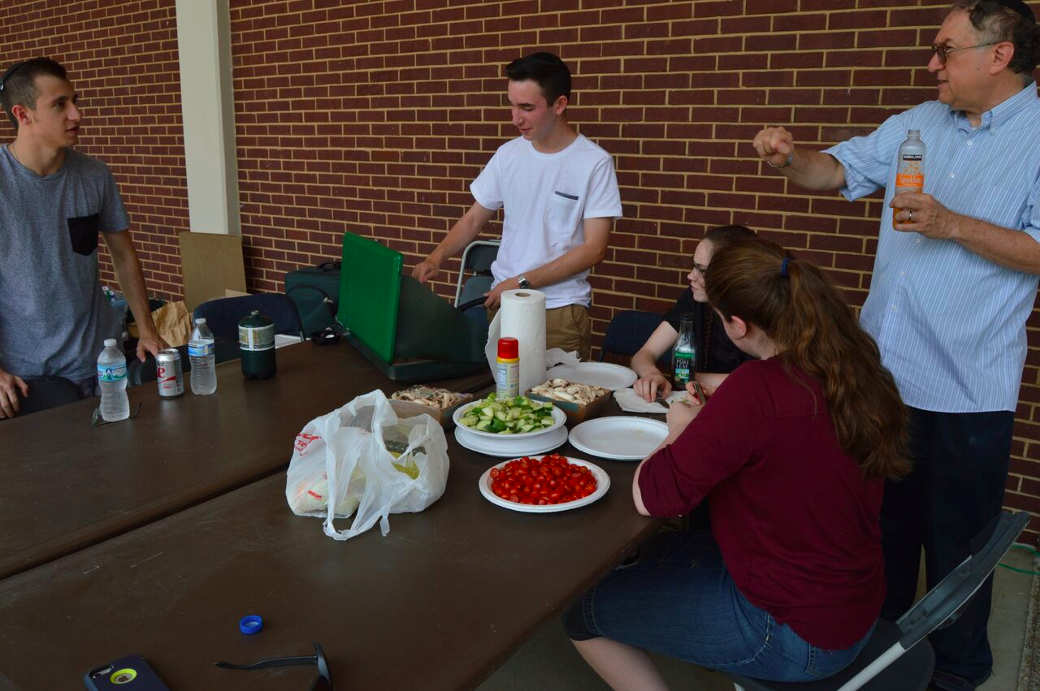
Student Preparation
Provided directions for building telescopes.
Measured muon rates during empty sky, sky with moon & sky with sun.
Developed tracking procedures—align with telescope’s shadow; laser to transfer position vs. time to ground; use laser to reproduce during eclipse if cloudy.
Measured 2-muon backgrounds to be
< 3% of muons reconstructed in direction of the sun.
4-day trip to total eclipse location, so baselines could be measured ahead of the eclipse.
QuarkNet staff helped by developing an e-Lab analysis tool the students requested to measure rates vs. time for various combinations of counters.

Slide 12
Eclipse Analysis
Students measured initial muon rates vs. time using normalization techniques to reduce effects due to changes in atmospheric pressure.
Learned that normalization counter pairs could identify periods when counters were working stably and help correct counter efficiencies when problems occurred.
Identified & solved new problems—due to intense heat buildup in sun during eclipse, counters were wrapped in dark bags—led to disconnected counters & flakey connections.
Future—combine results from sites around the U. S.

Slide 13
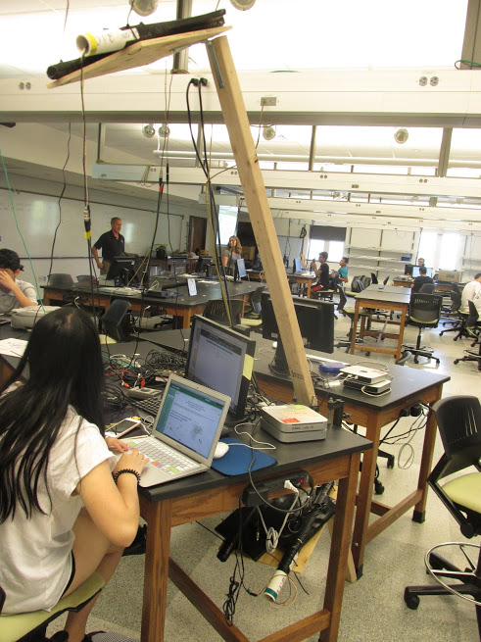
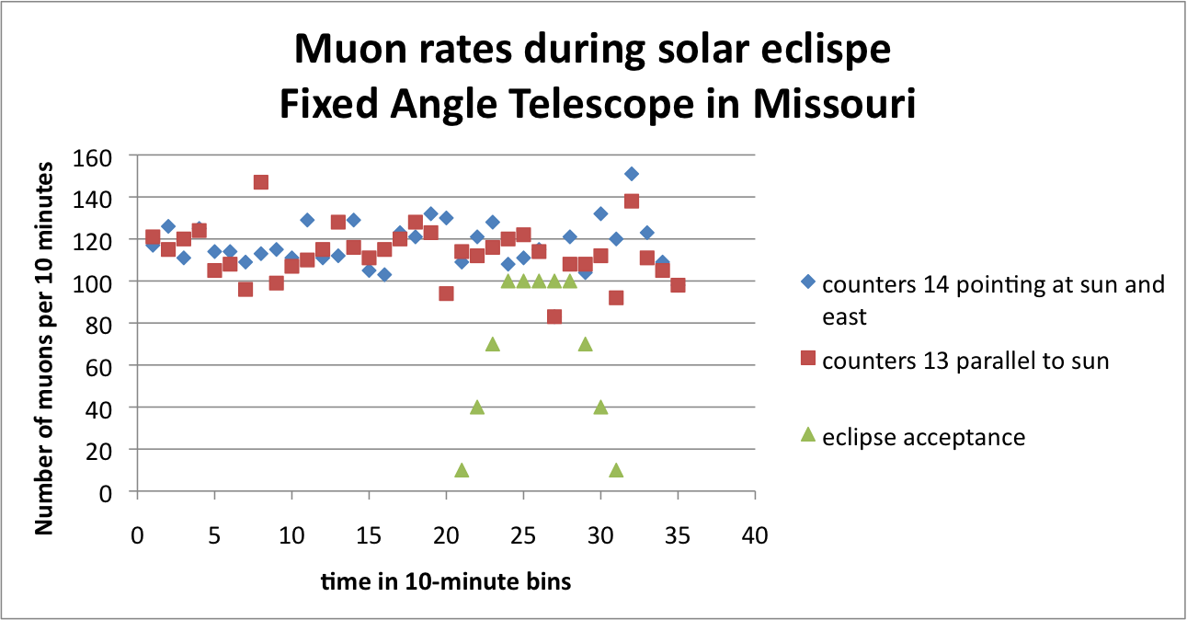
Fixed-Angle Telescopes
Rates of muons from the direction of the sun during the eclipse
Compare with empty sky, moon or sun
Muons every 10 minutes
Parallel to the sun
5 degrees east of the sun
Indiana

Slide 14
Solar Project Summary
Teachers and students around the U. S. collaborated to carry out original research with QuarkNet cosmic ray detectors during the 2017 total solar eclipse.
Developed analysis tools and detectors.
Constructed prototypes.
Collected data - during summer break!
Observed the total solar eclipse.
Analysis taking place during fall, results in Jan. 2018
If that is not enough—groups have telescopes and are currently trying to observe the muon deficit around sun and rate changes due to solar activity.

Slide 15
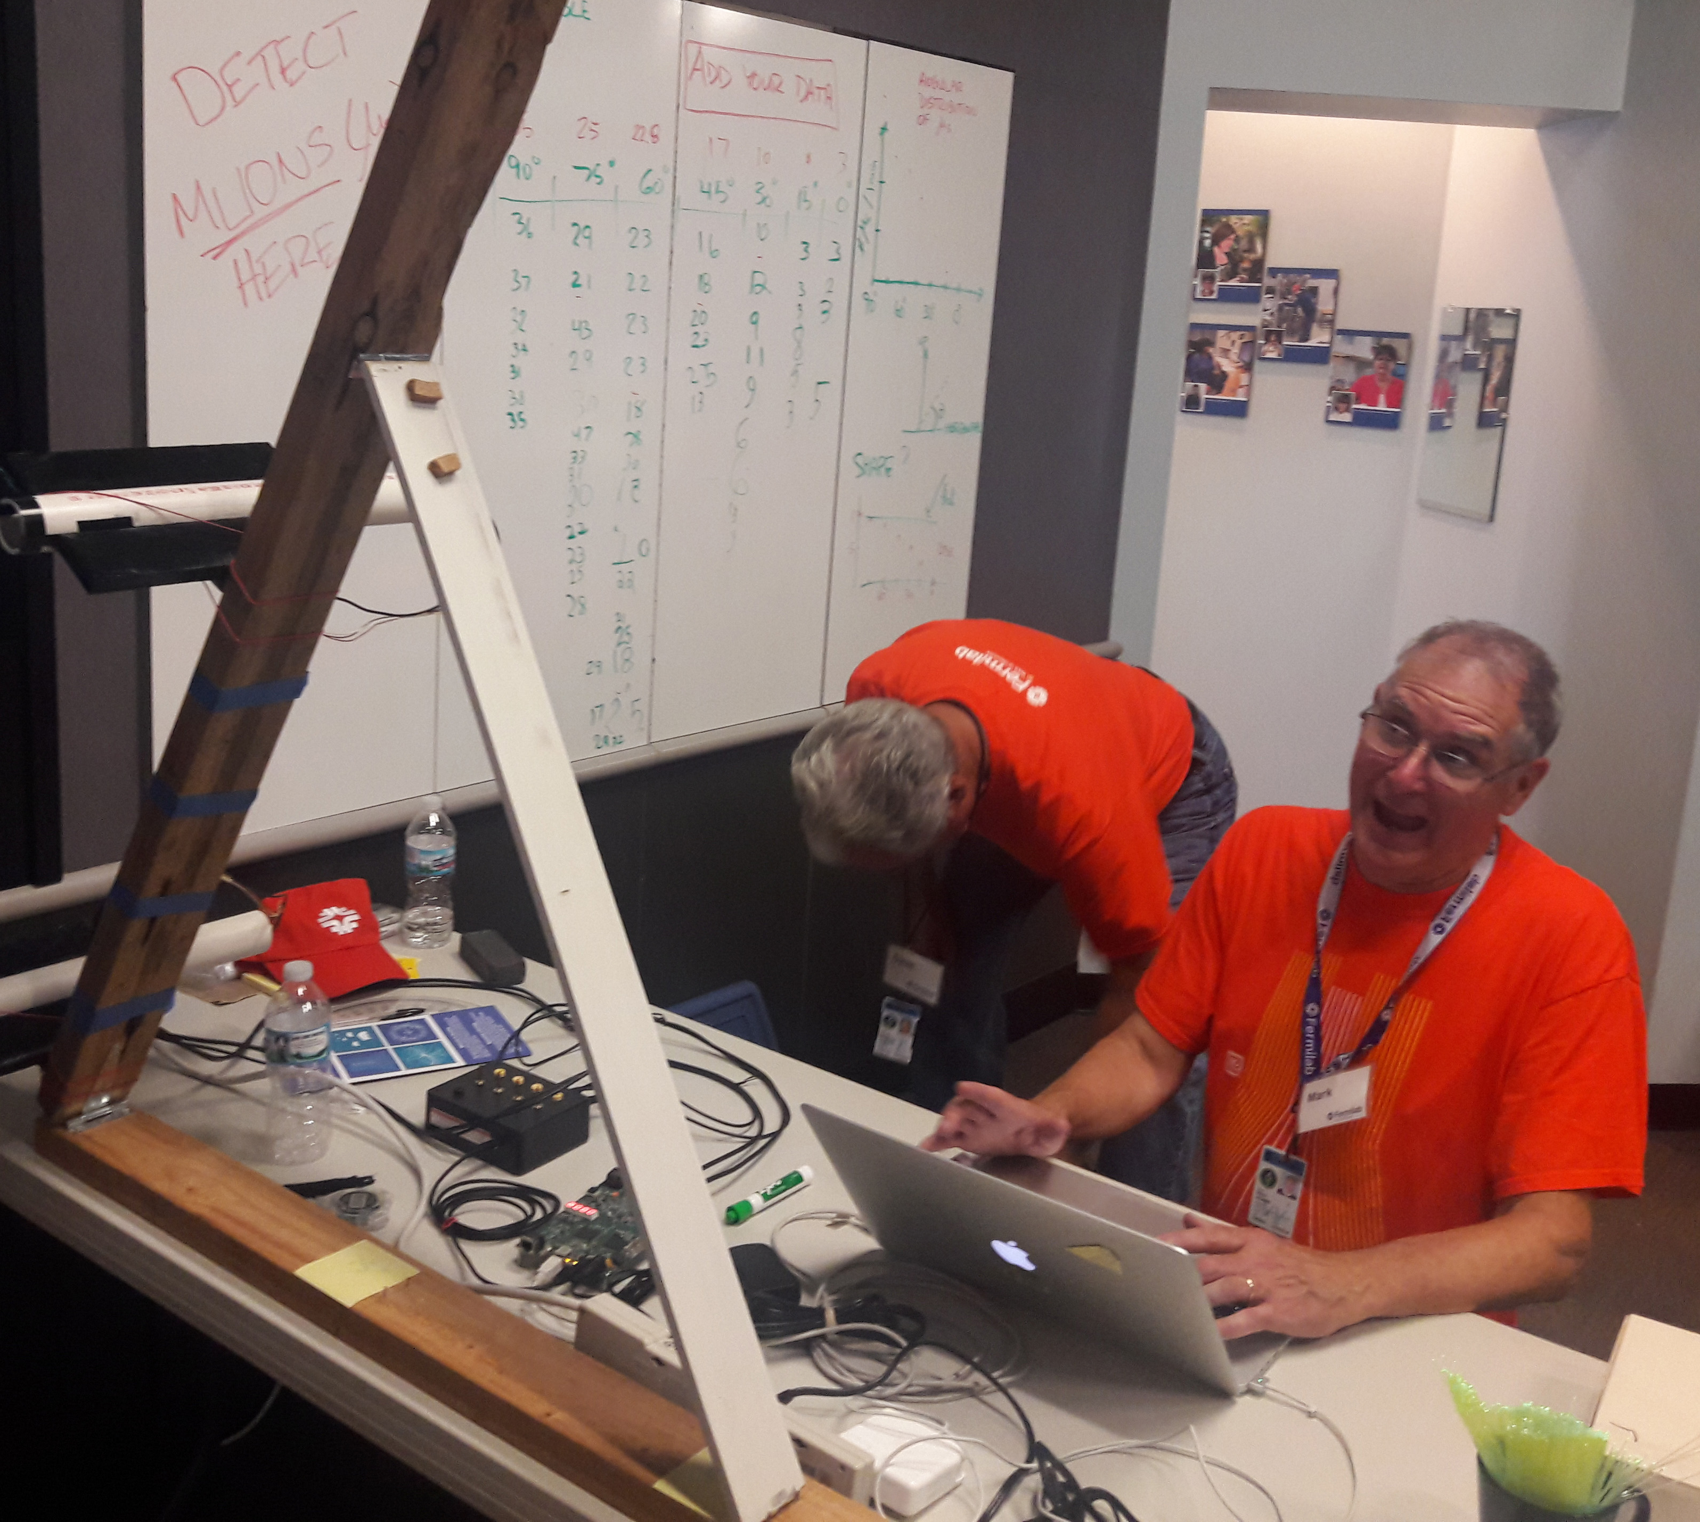
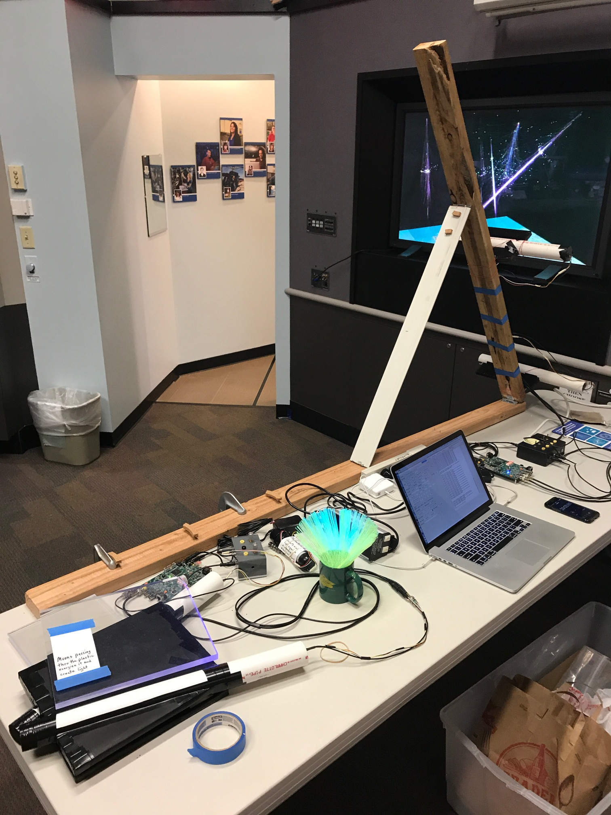
Cosmics at Open House
Families used scintillators to prove muons come form the sun.
The average of children measuring muon rates vs. zenith angle was 8 (OK maybe 9). They recorded their data too.

Slide 16
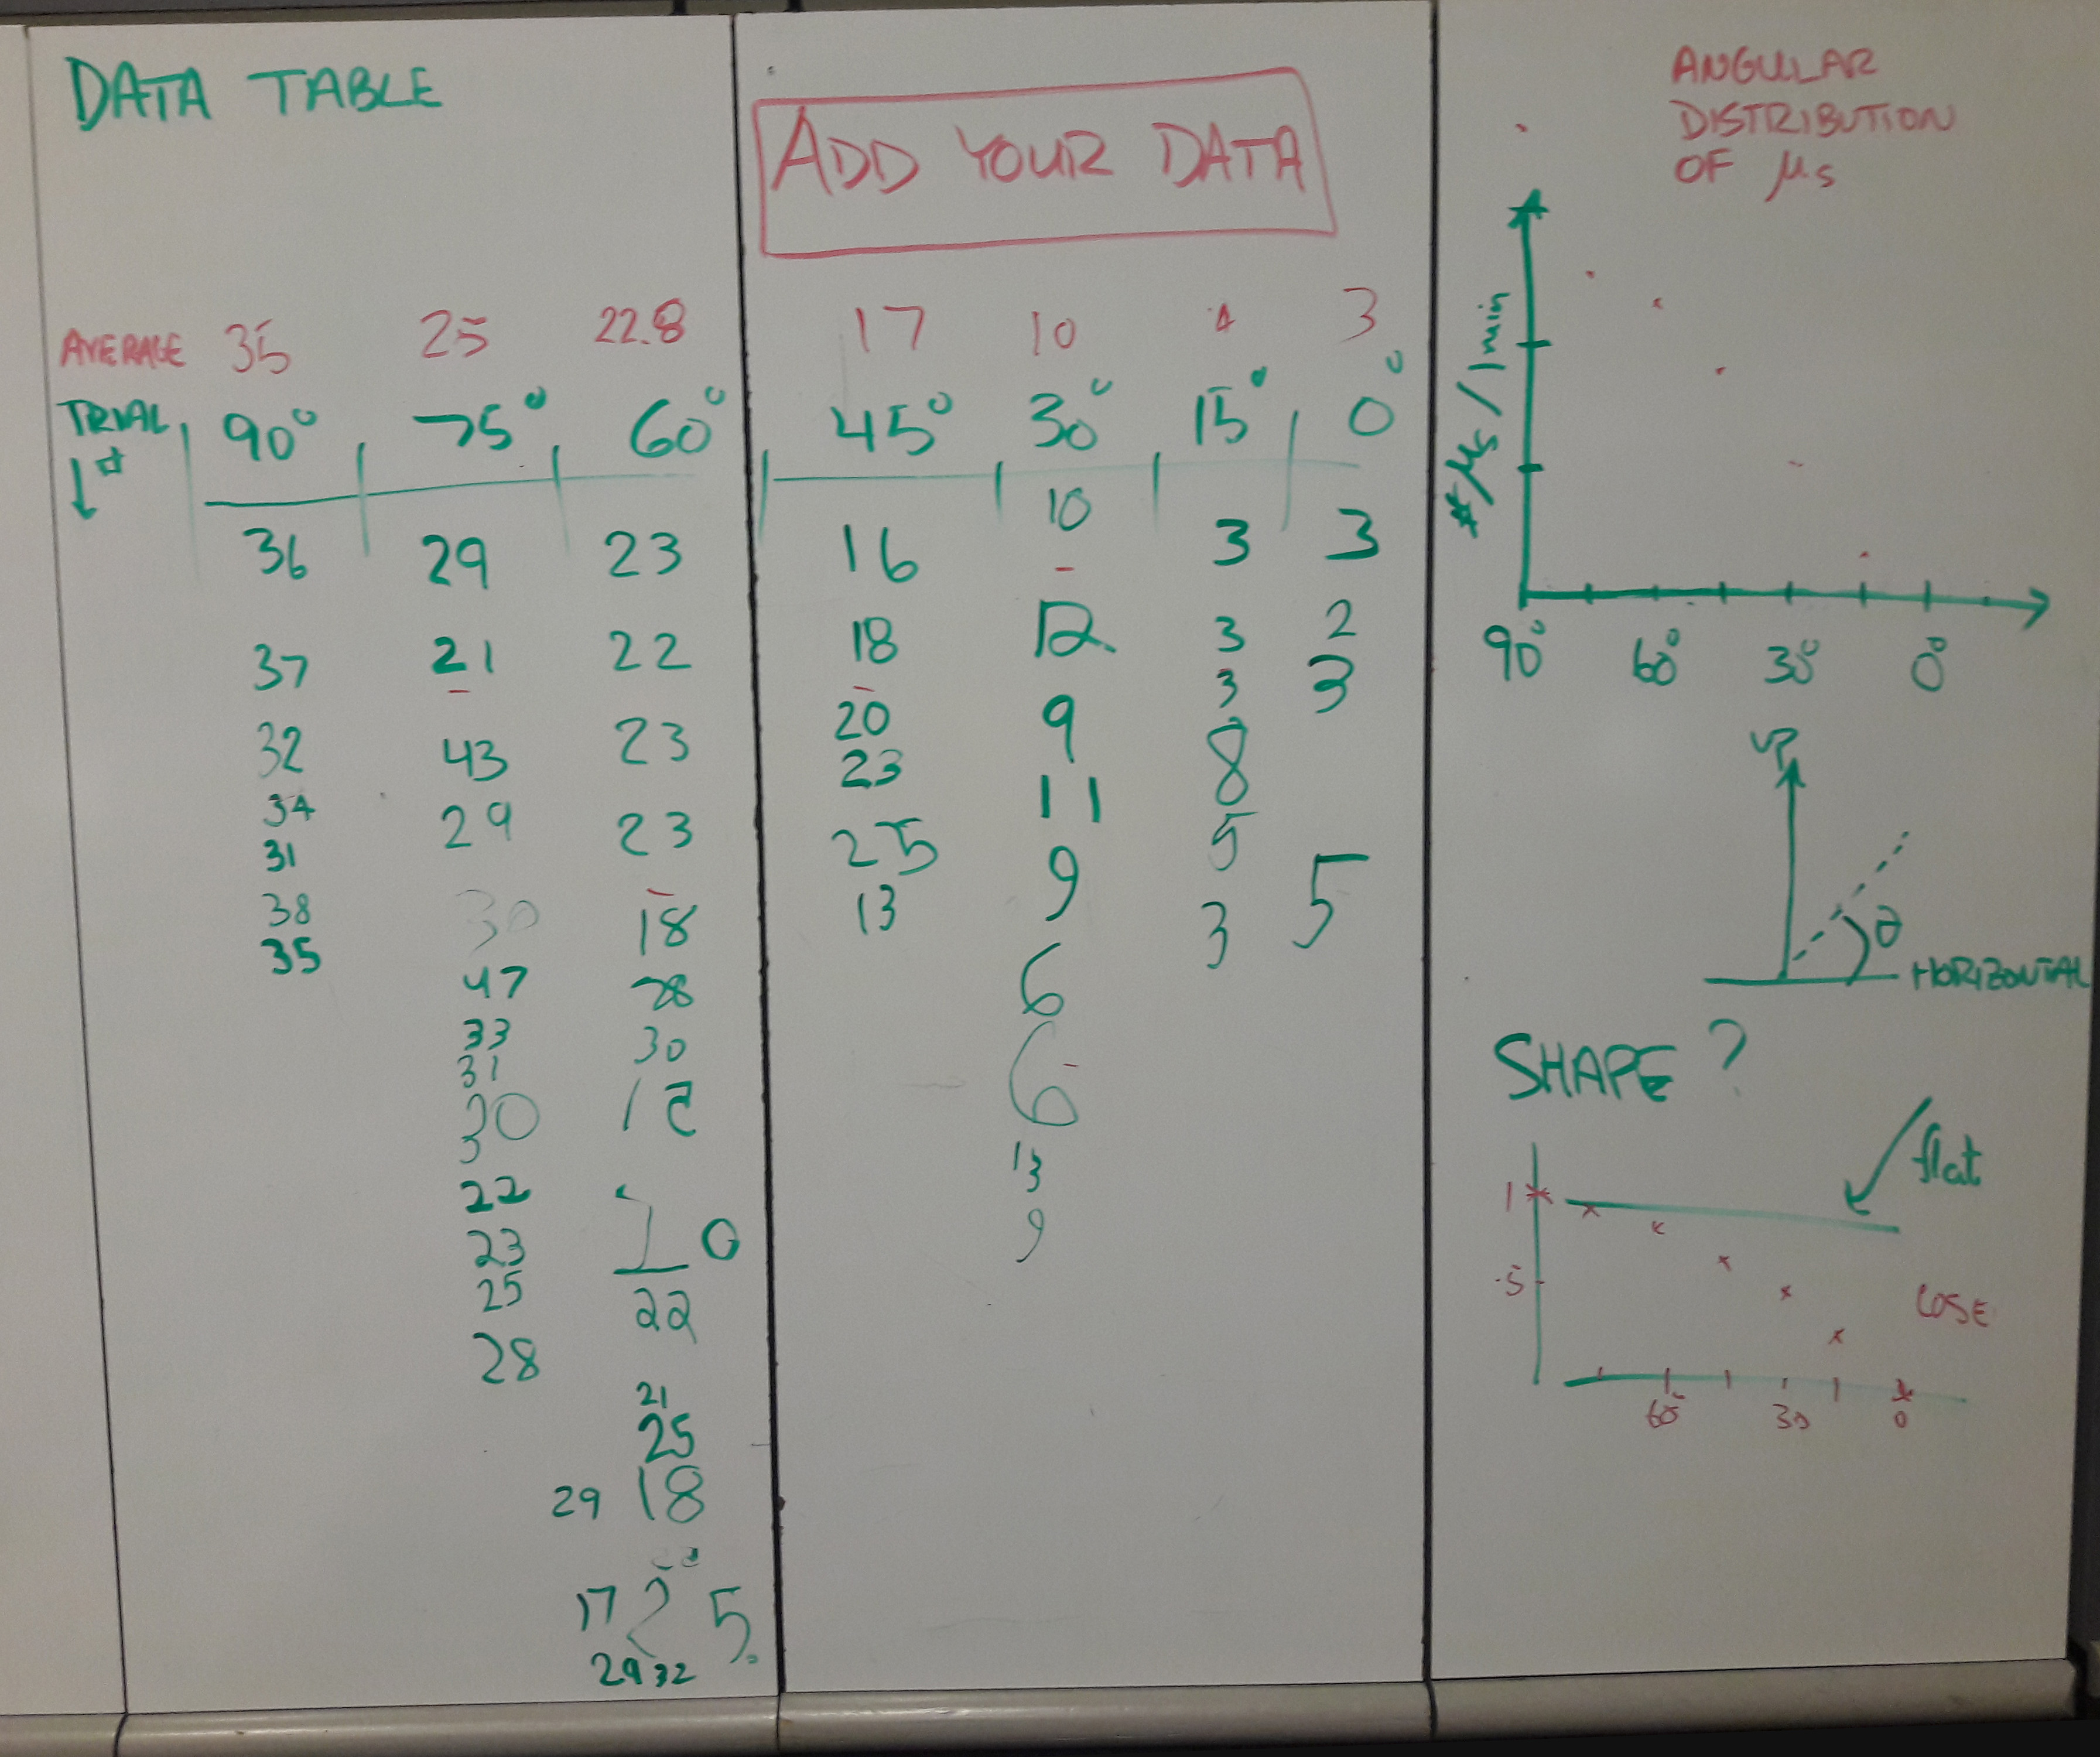
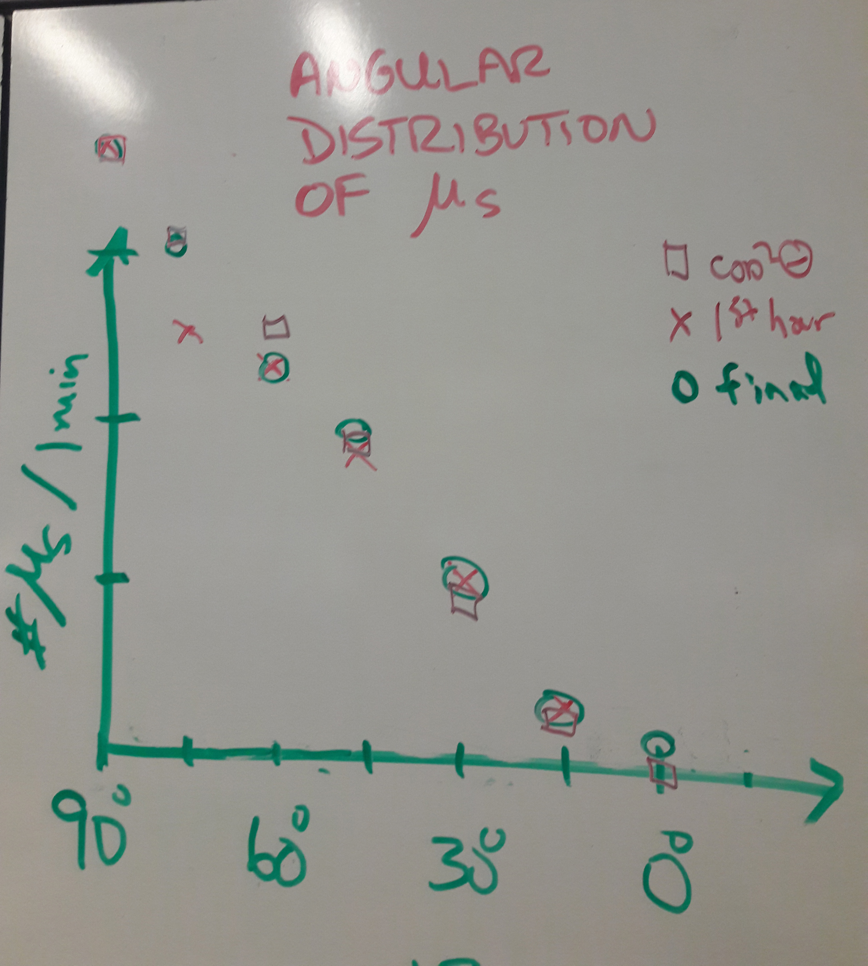
CR Data at Open House

