Slide 1
14th IPPOG Meeting – CERN
Particles 4 U
H.P. Beck, S. Goldfarb, B. Gulejova

Slide 2
EPS Call in February 2017
Dear Council Delegates,
As we discussed at Council 2016, the Executive Committee would like to use the ideas and experience from EPS Council members to propose and develop new activity projects with high impact. Indeed the review group on EPS strategy submitted at Council an Action Plan with various recommendations in relation to communication, internal and external cooperation, presence in Brussels, membership and funding. It requested also to regularly measure the success of EPS activities. Much has been undertaken by the Executive Committee in the past year, but now it is also the responsibility of the delegates to pick up the challenge.
For the first time, 60 to 90 minutes will be set aside in the 2017 EPS Council agenda to allow delegates (EPS Divisions and Groups, Member Societies, IM and AM Delegates, and Action Committees) to present original ideas for new projects.
Scope
Projects in any field of EPS main stream can be submitted, including (but not limited to) scientific excellence, education, communication and outreach, publication, diversity, etc. Projects to enhance current EPS programmes such as Physics for Development, Young Minds, etc. are also welcome. They should start in the first half of 2017 and are limited in time, with possibility of extension if very successful.
Budget
Euro 30,000 will be allocated in the 2017 budget to finance these projects. Up to Euro 5,000 per project will be allocated.
Application for funding
The application should be no longer than 2 A4 pages.
It should include: - a concise description of the project/activity
- the expected outcome
- the partners and their roles
- the target audience for the activity
The projects will be reviewed by the Executive Committee
Duration and reporting
Accepted projects will be implemented during 2017, with a report to Council in 2018.
The deadline for applications is 15 March 2017. Please send applications directly to David Lee (d.lee@eps.org).
Thank you. Best regards
David LEE
EPS Secretary General

Slide 3
Proposal submitted on 5th March 2017

Slide 4
Proposal accepted on 28th April 2017
Dear Hans Peter,
I am pleased to inform the project Creating tools showcasing particle physics in every day life has been retained for funding. The EPS has agreed to provide Euro 3000.
By accepting the grant, you undertake to provide a publishable summary of the project no later than 31 January 2018.
In the attached form, we request that you provide us with the bank coordinates of the institution that is responsible for implementing the project.
Best regards David

Slide 5
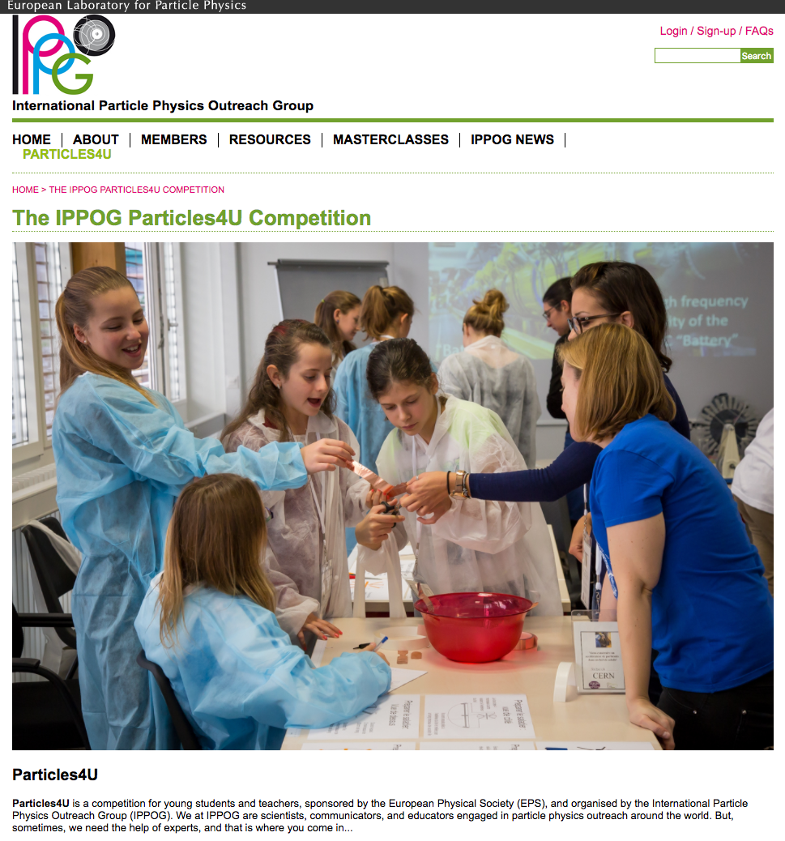
Particles4U Competition

Slide 6
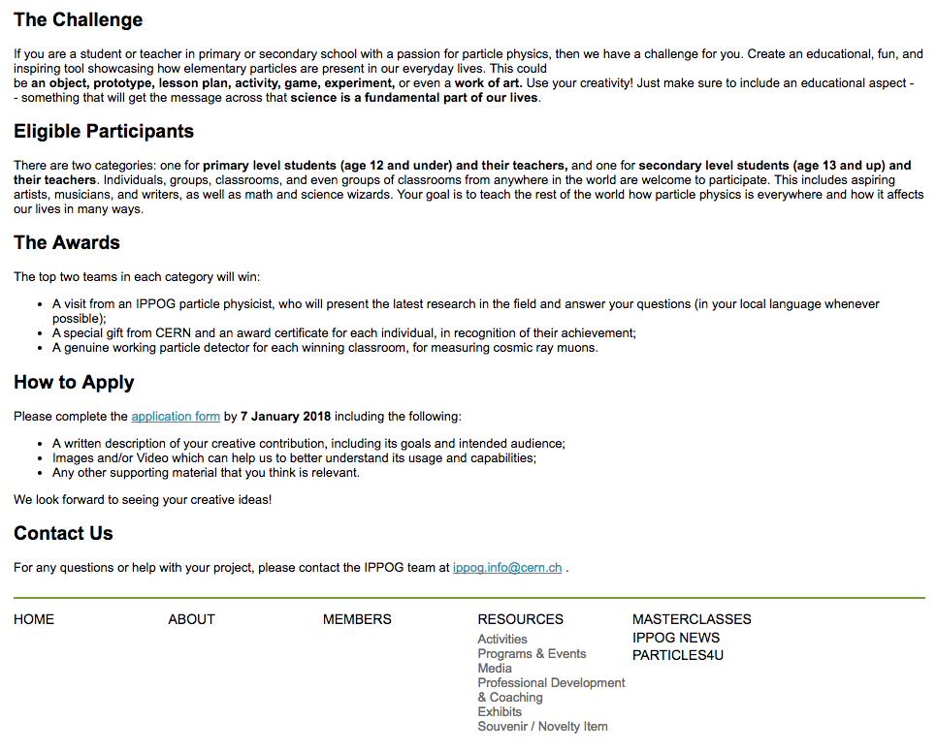
Particles4U Competition
To be officially launched following the meeting

