Slide 1
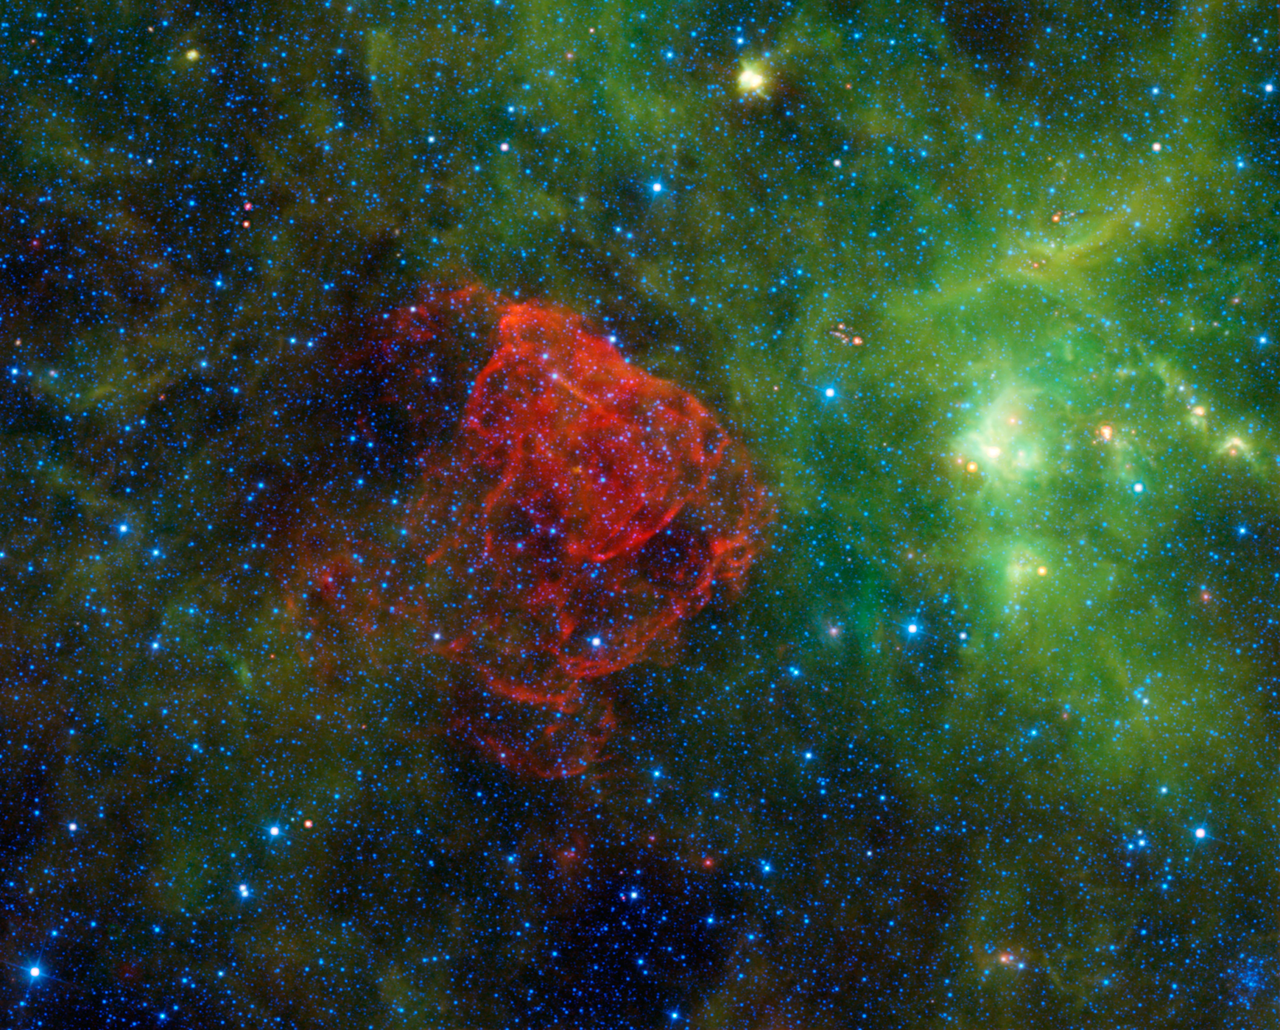

Cosmic Pi
an open source detector for cosmic rays

Slide 2
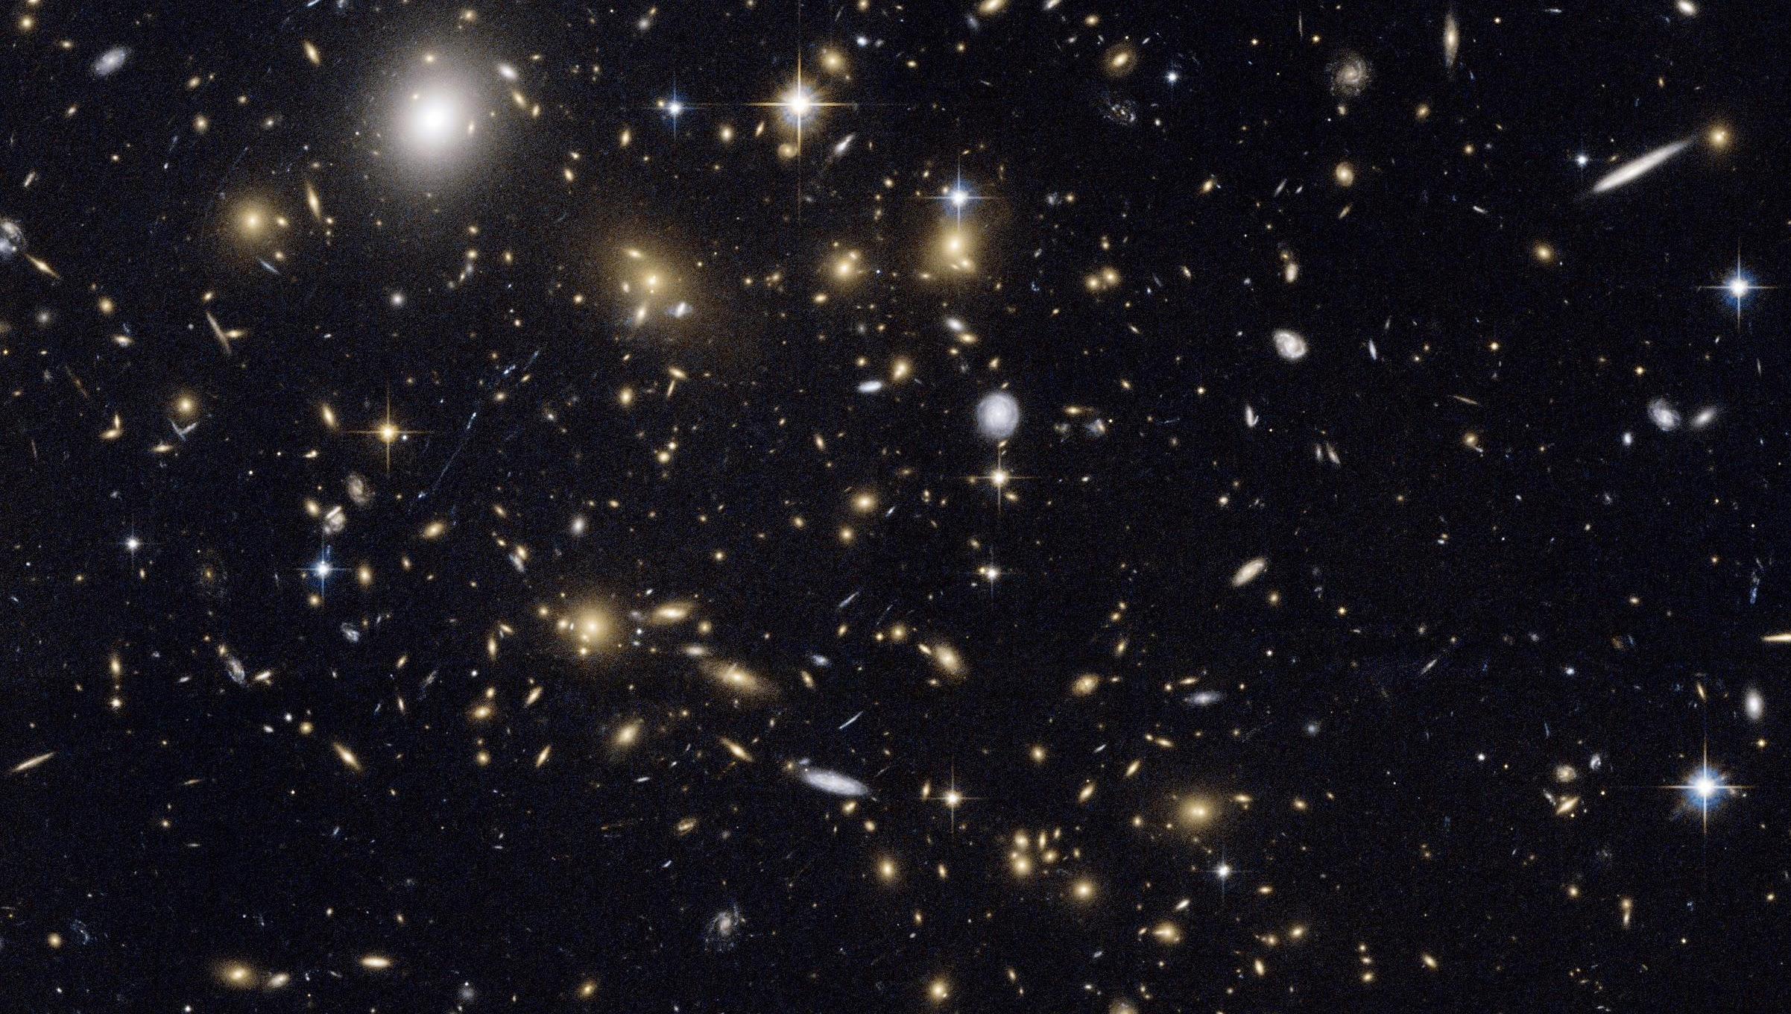

Slide 3
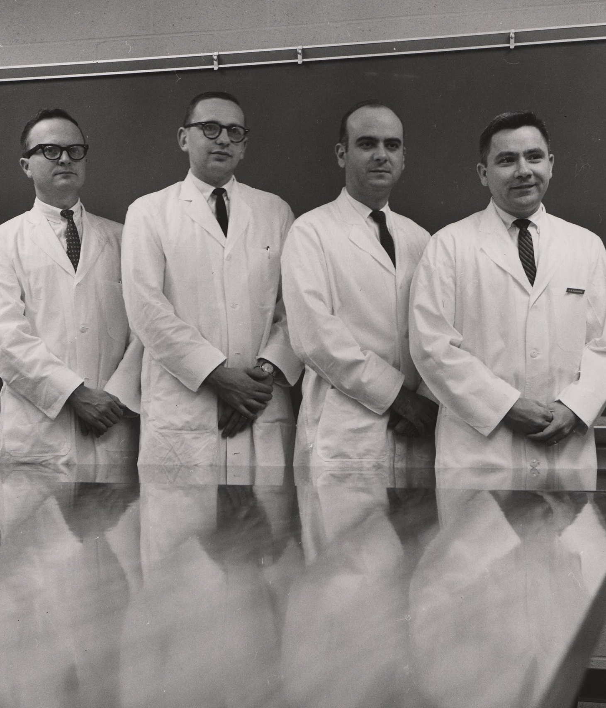

Scientists
Professionals
Citizens

Slide 4
The mysteries of the universe
wouldn‘t it be great to see the invisible?
aren’t far away galaxies at the edge of the universe exciting?
why not use the internet to network these detectors?
what can we do if we all work together on a distributed system?
CERN is a very exciting place, let’s replicate some of it in your pocket…

Slide 5

Notes:
Telescopes are great for looking at things far away.
Cosmic rays from far away.
Discovered in 1912 by Victor Hess, they come from outside the earth’s atmosphere.
They hit the atmosphere.
The atmosphere protects us from radiation in space.
Like a raindrop hitting an umbrella, they make smaller drops.
These fall to earth,
passing through our bodies right now.
We just can’t feel them.
Study because the origins aren’t known!

Slide 6
What do we need to do?
accelerate particles
convert a particle into something we can detect
time the arrival of each particle as precisely as possible
store & share the data
analyse the results

Slide 7
A way of looking at High Energy Physics
Electricity
Accelerators
Detectors
Computing Power
Analysis
Money
Results
Knowledge
People

Slide 8
a distributed system
How Cosmic Pi compares
Cosmic Rays
Detector
Detector
Detector
Detector
Detector
Detector
Detector
Detector
Detector
Detector
Detector
Detector
Detector
Detector
Detector
Detector
Detector
Detector
Detector
Detector
Detector
Detector
Detector
Raspberry Pi
Raspberry Pi
Raspberry Pi
Raspberry Pi
Raspberry Pi
Raspberry Pi
Raspberry Pi
Raspberry Pi
Raspberry Pi
Raspberry Pi
Raspberry Pi
Raspberry Pi
Raspberry Pi
Raspberry Pi
Raspberry Pi
Raspberry Pi
Raspberry Pi
Raspberry Pi
Raspberry Pi
Raspberry Pi
Raspberry Pi
Raspberry Pi
Raspberry Pi
Analysis Framework
Electricity
Money
Time
?
Electricity
Money
Time
Electricity
Money
Time
Results
Knowledge
Electricity
Money
Time
Electricity
Money
Time

Slide 9
What is important for distributed detection?
what is happening
where is it happening
when did it happen
what is the detector status
If we know all these things, we can collect useful data.

Slide 10
How to collect this information?
we need a cosmic ray (muon) detector
we need to locate the detector in space (GPS)
we need to mark events in time (GPS + high precision timer)
we need to monitor the detector status
additional sensors are probably a good idea:
  temperature
  altitude
  humidity
  acceleration
  magnetic field

Slide 11

How do you catch a cosmic ray?
High energy cosmic ray (particle)
Scintillator
Photons
Photons
Atmosphere + Magnetosphere
Photons
Cosmic ray shower, Muons
Muons, typically 1 event/cm2/minute at sea level
We collect the photons with a photon detector, based on the photoelectric effect (A. Einstein)
Our photon detector is called a Silicon Photomultiplier, a highly complex type of diode.
Other methods are possible, this is simply the one we chose!

Slide 12
Hardware
Timing system (GPS)
Extra sensors:
Temperature, Pressure, Humidity, Acceleration, Magnetic field…
Scintillator
HV PSU
Trigger
Shaper
Analogue to Digital Converter
Microprocessor control
& communications
Raspberry Pi
Silicon Photomultipler (SiPM)
Amplifier

Slide 13
Software
Communication scripts
Arduino Firmware
Communication scripts
Data Analysis
Communications scripts
Data Analysis
Server 2
SA
Main webserver
Client (Cosmic Pi)
Server 1
Local webserver
Main webserver
Main database
Local database
Main database
Debian Linux
Raspbian Linux
Debian Linux

Slide 14
Firmware
Arduino DUE
Arduino Bootloader
Altimeter readout
Analogue to Digital Conversion
Event timing
Temperature & Humidity readout
HV Power Supply Control
GPS input (date + timestamp)
Accelerometer & Magnetometer readout
Detection Threshold Control
Serial Output Routines

Slide 15

Assembly
Metal enclosure
Cosmic Pi PCB
Arduino DUE
Wrapped Scintillator
GPS Antenna
SIPM
SIPM
USB

Slide 16

Why is Cosmic Pi different?
open source (hardware and software)
distributed system
scintillator detector
Cheap (<500 EUR)
something anyone can build
Cosmicpi.org

